Slide 1
Complex network geometry and navigation
Dmitri Krioukov CAIDA/UCSD F. Papadopoulos, M. Kitsak, kc claffy, A. Vahdat M. Á. Serrano, M. Boguñá UCSD, December 2010

Slide 2
Notes:
In maze without the MAP
Learning its MAP
Dynamic
More complex

Slide 3
Notes:
Direction would be good
Efficiency
Optimality
Robustness
Geometry!!! (no geometry on the previous slide!)
BEST POSSIBLE if all these conditions satisfied

Slide 4
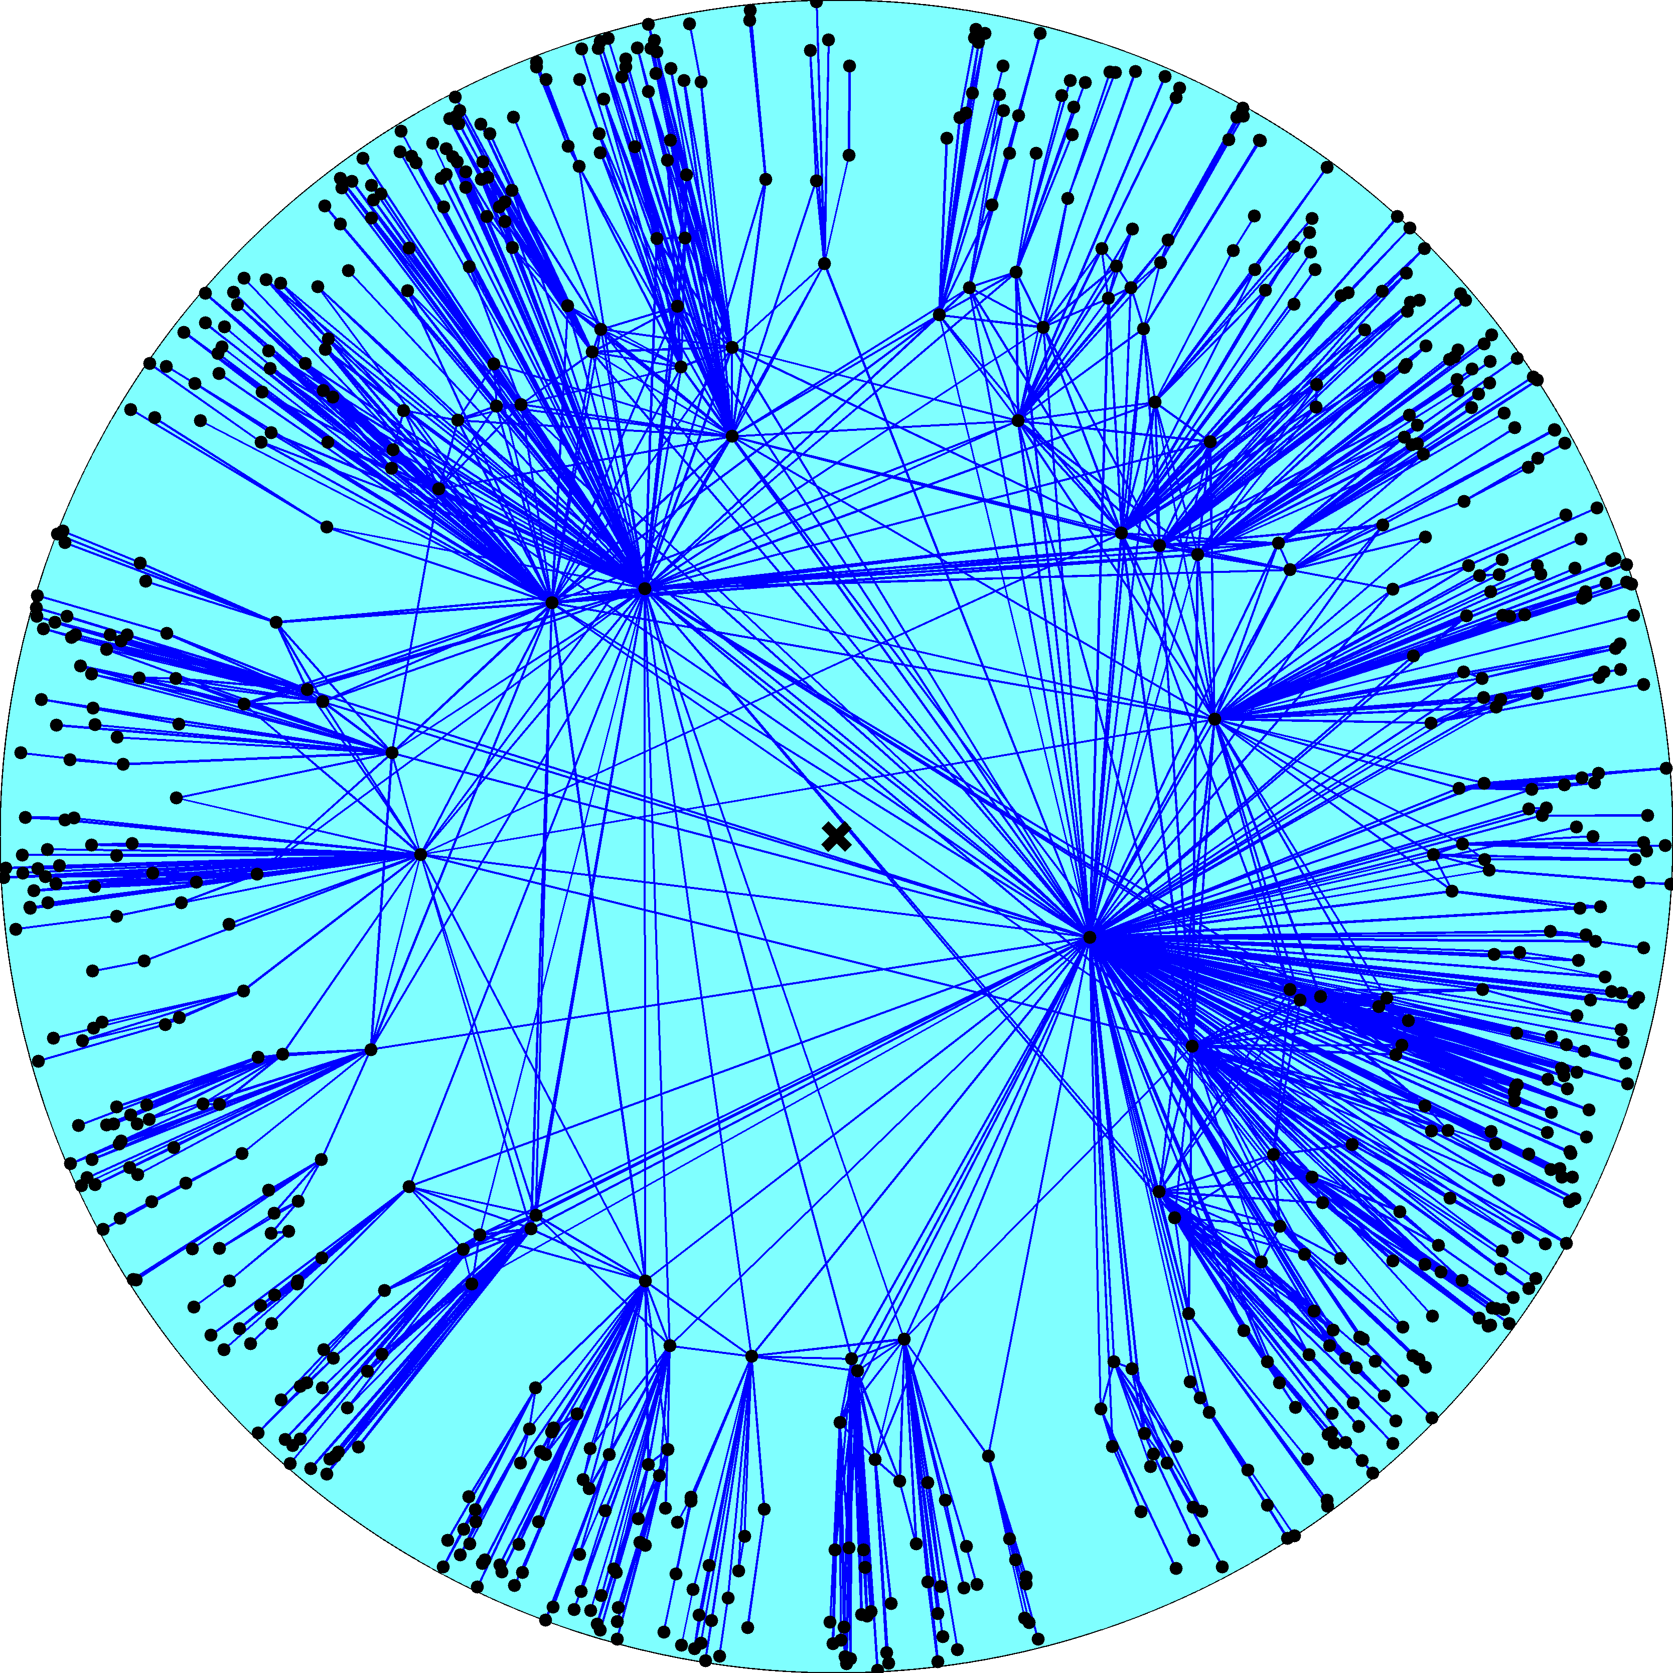
Notes:
Nodes are intersections, links are maze sections between intersections
Complex network: hubs and clustering (not all intersections have just 3-4 roads coming in)
Many real networks are like that
Navigation in real networks
Internet
Brain
Regulatory
Milgram
No global knowledge
Except in the Internet
Routers
Distributed topology learning
Shortest path computations
Topology changes, update, recomputations
Black holes
Major scalability problem
It would be great to route in the direction
To have a direction we need a geometric map

Slide 5
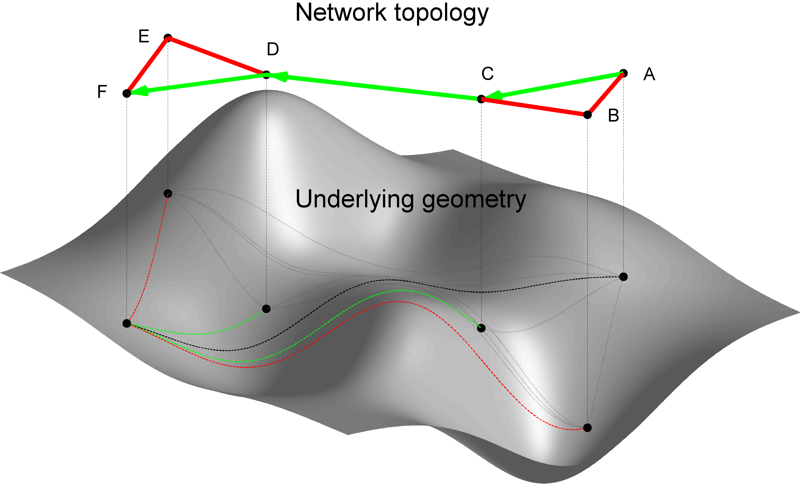
Notes:
No node has any global knowledge
Congruency is needed (for efficiency, optimality, and robustness)
If congruency is there, shortest paths in network are discrete reflections of smooth shortest (geodesic) paths in the space

Slide 6
Notes:
Exactly the picture from the previous slide
Blue disc = grey surface
Blue disc is HYPERBOLIC

Slide 7
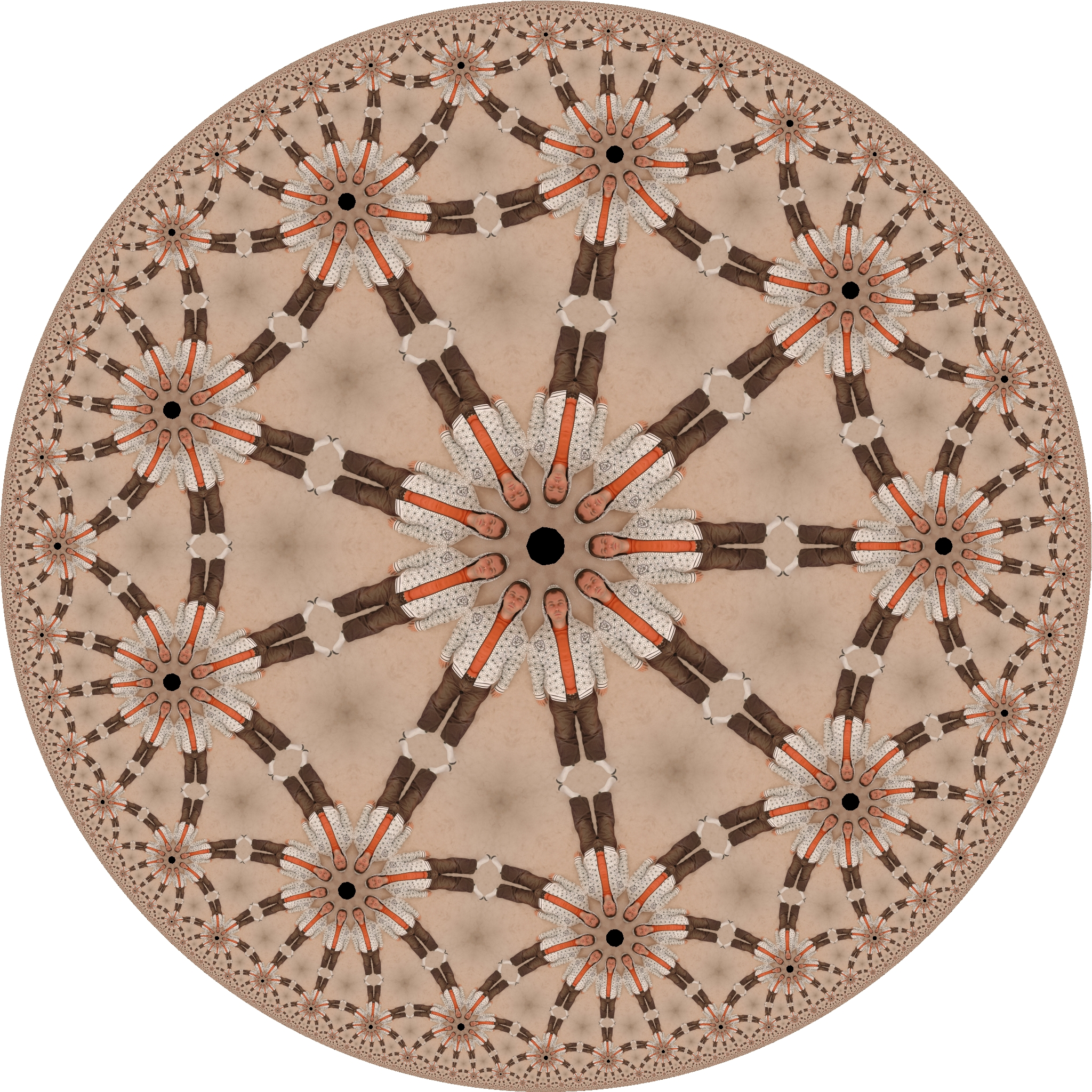
Notes:
Exponential expansion
Geodesics are not straight lines

Slide 8
Notes:
How constructed
Why nodes are not connected at the periphery

Slide 10
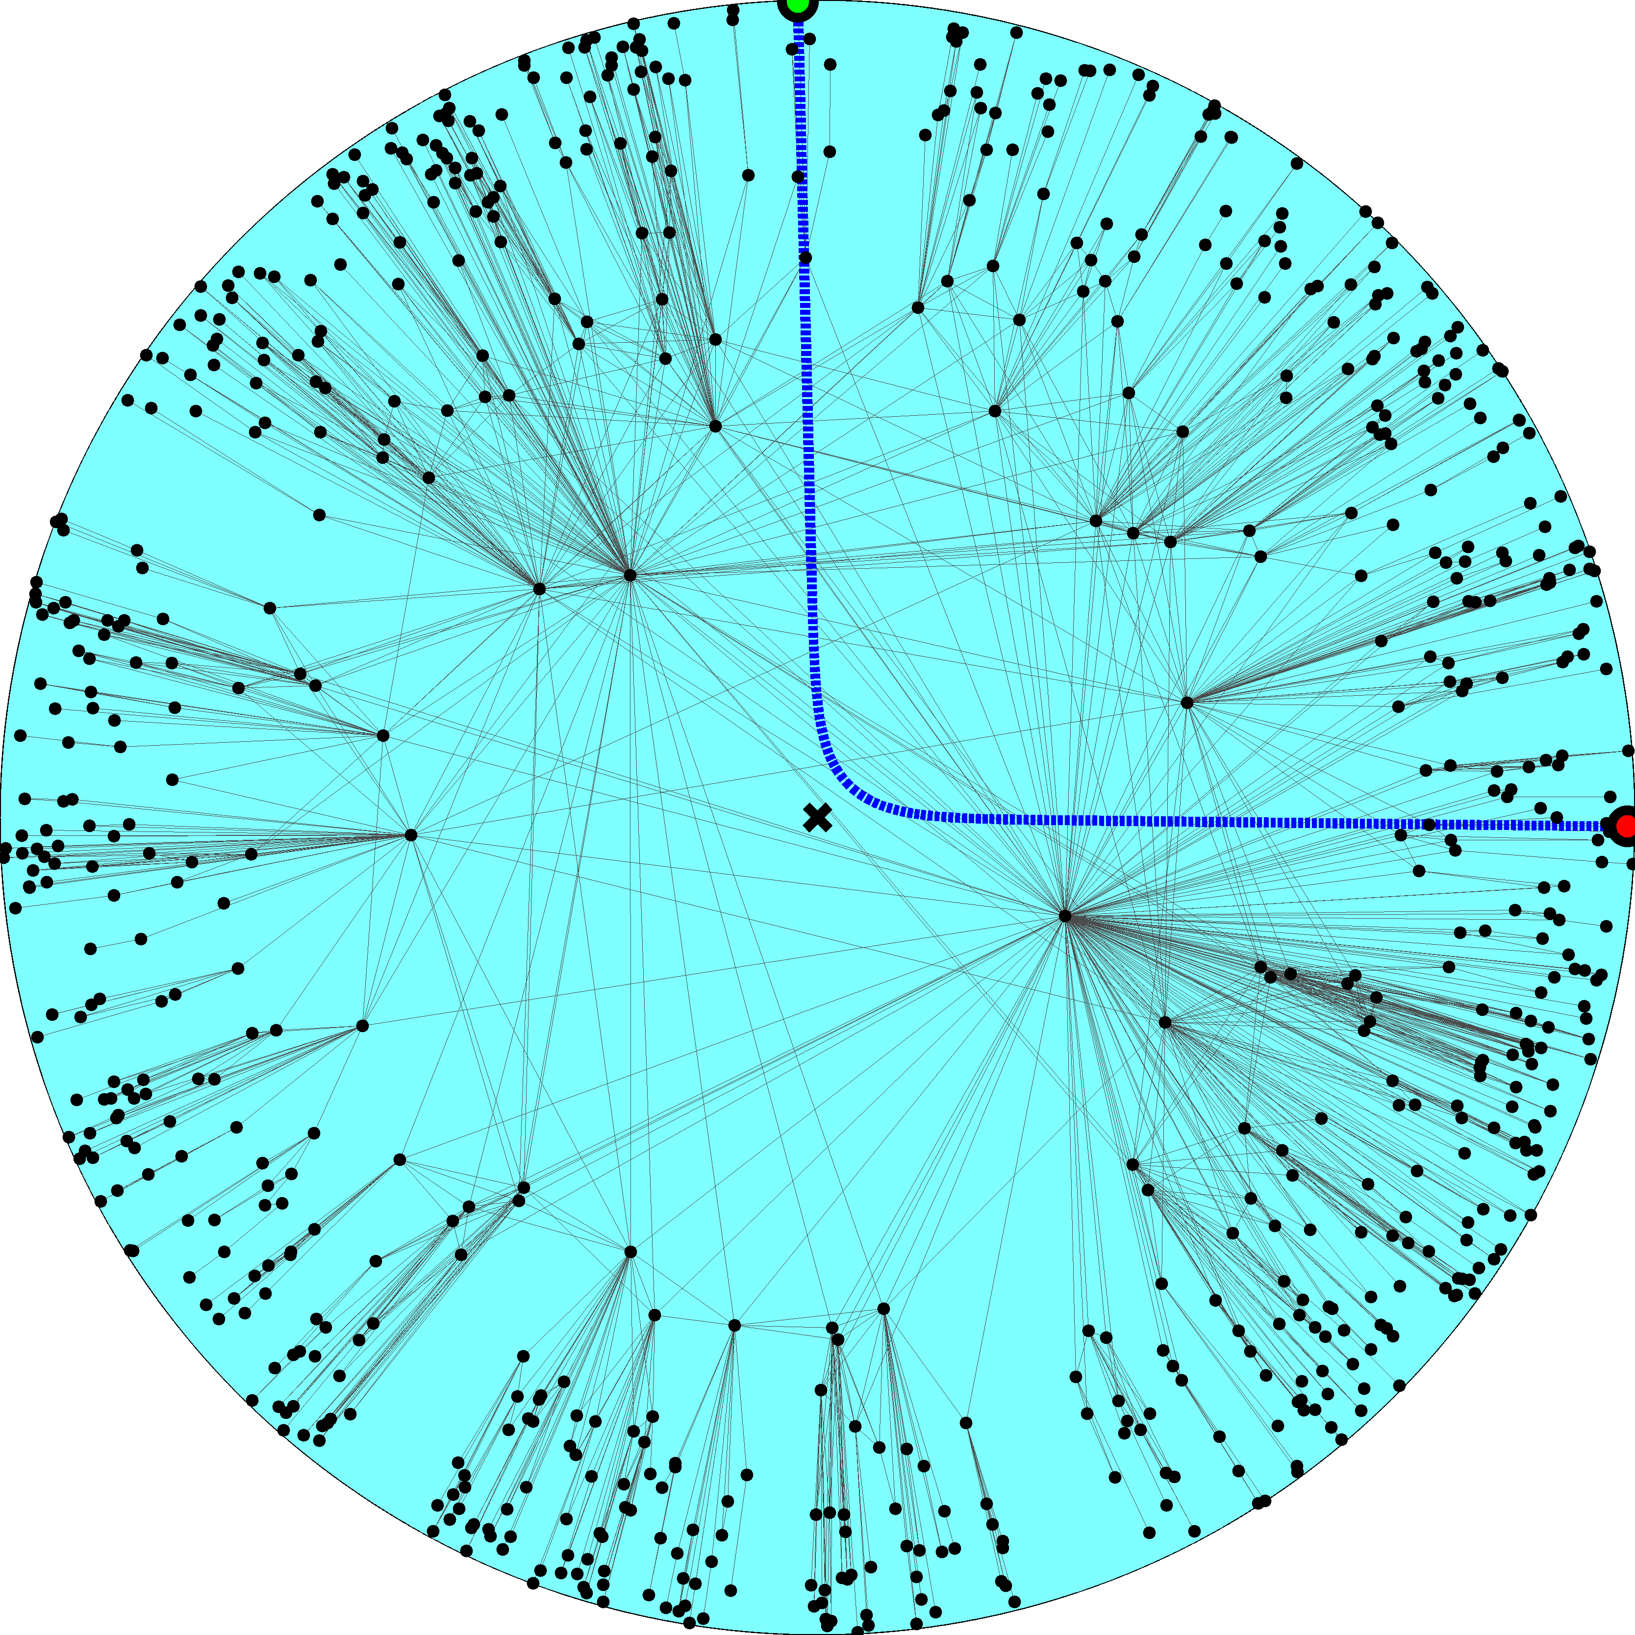

Slide 11
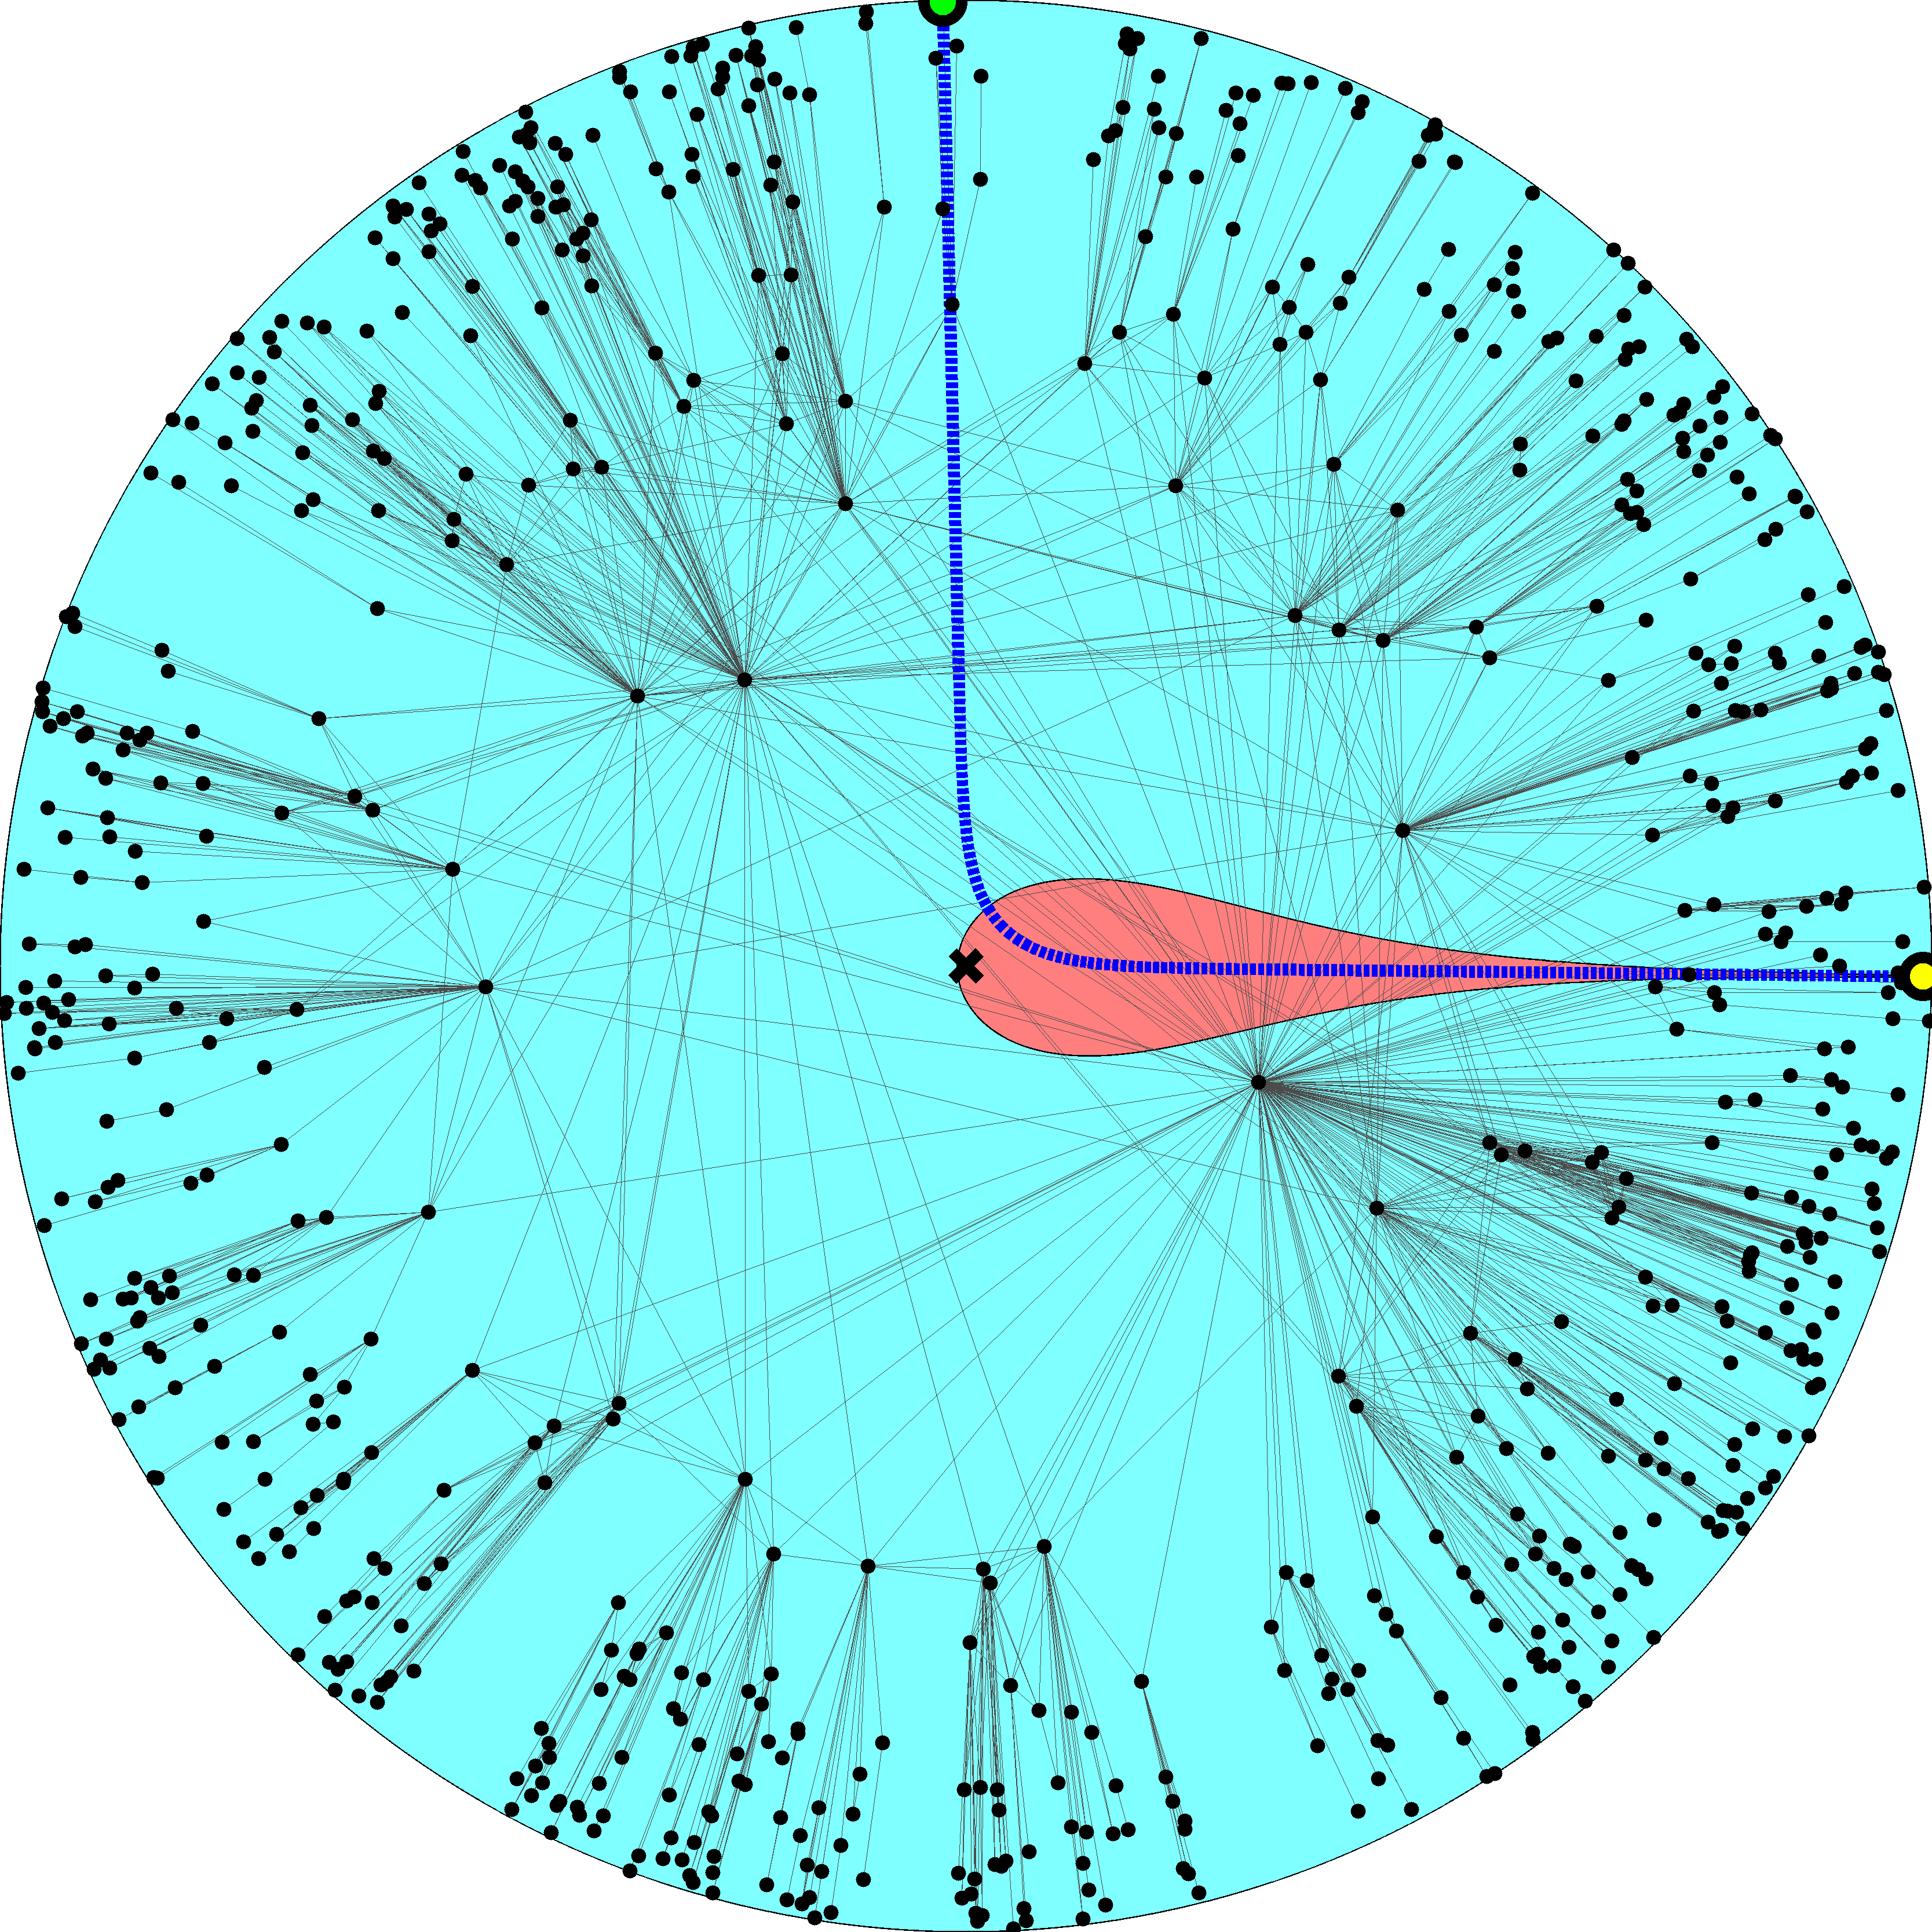

Slide 13
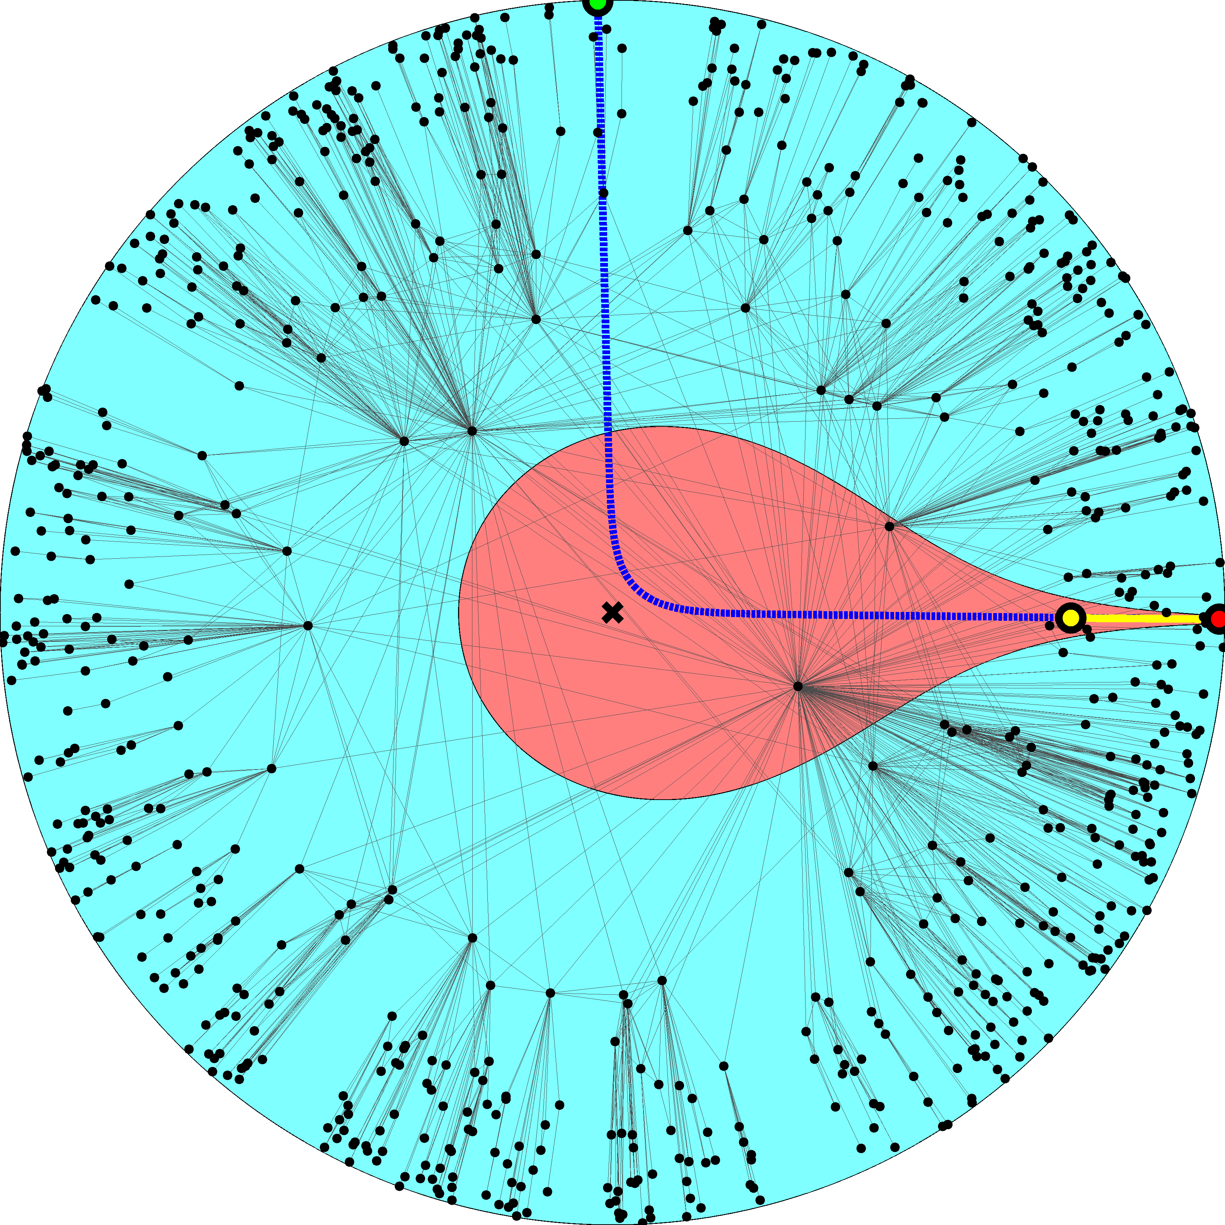

Slide 16
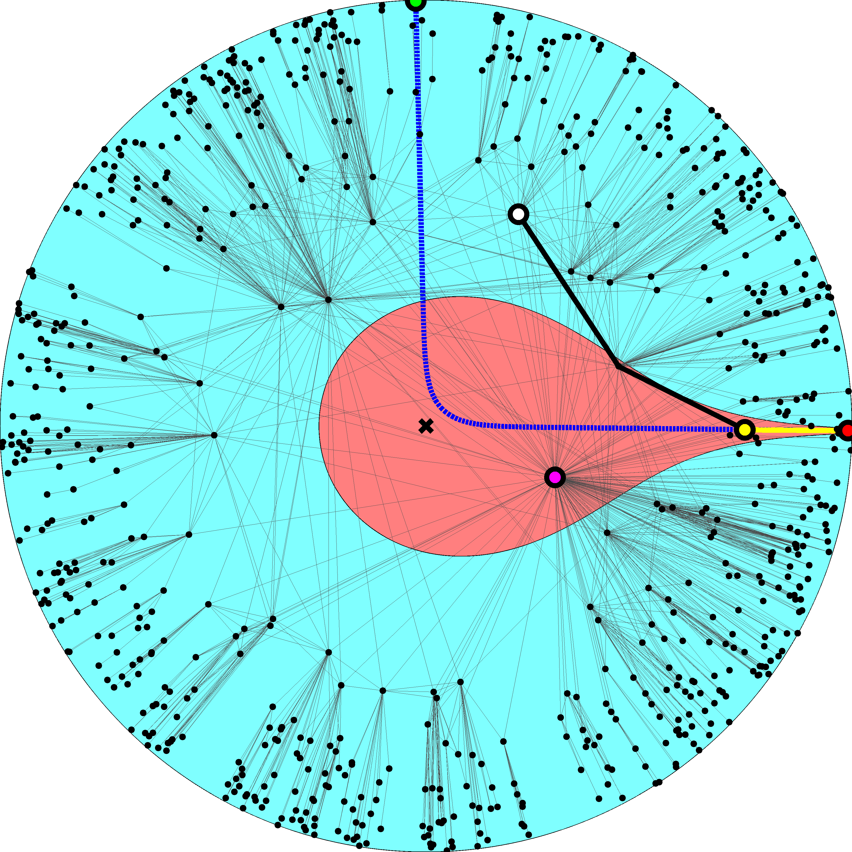

Slide 17
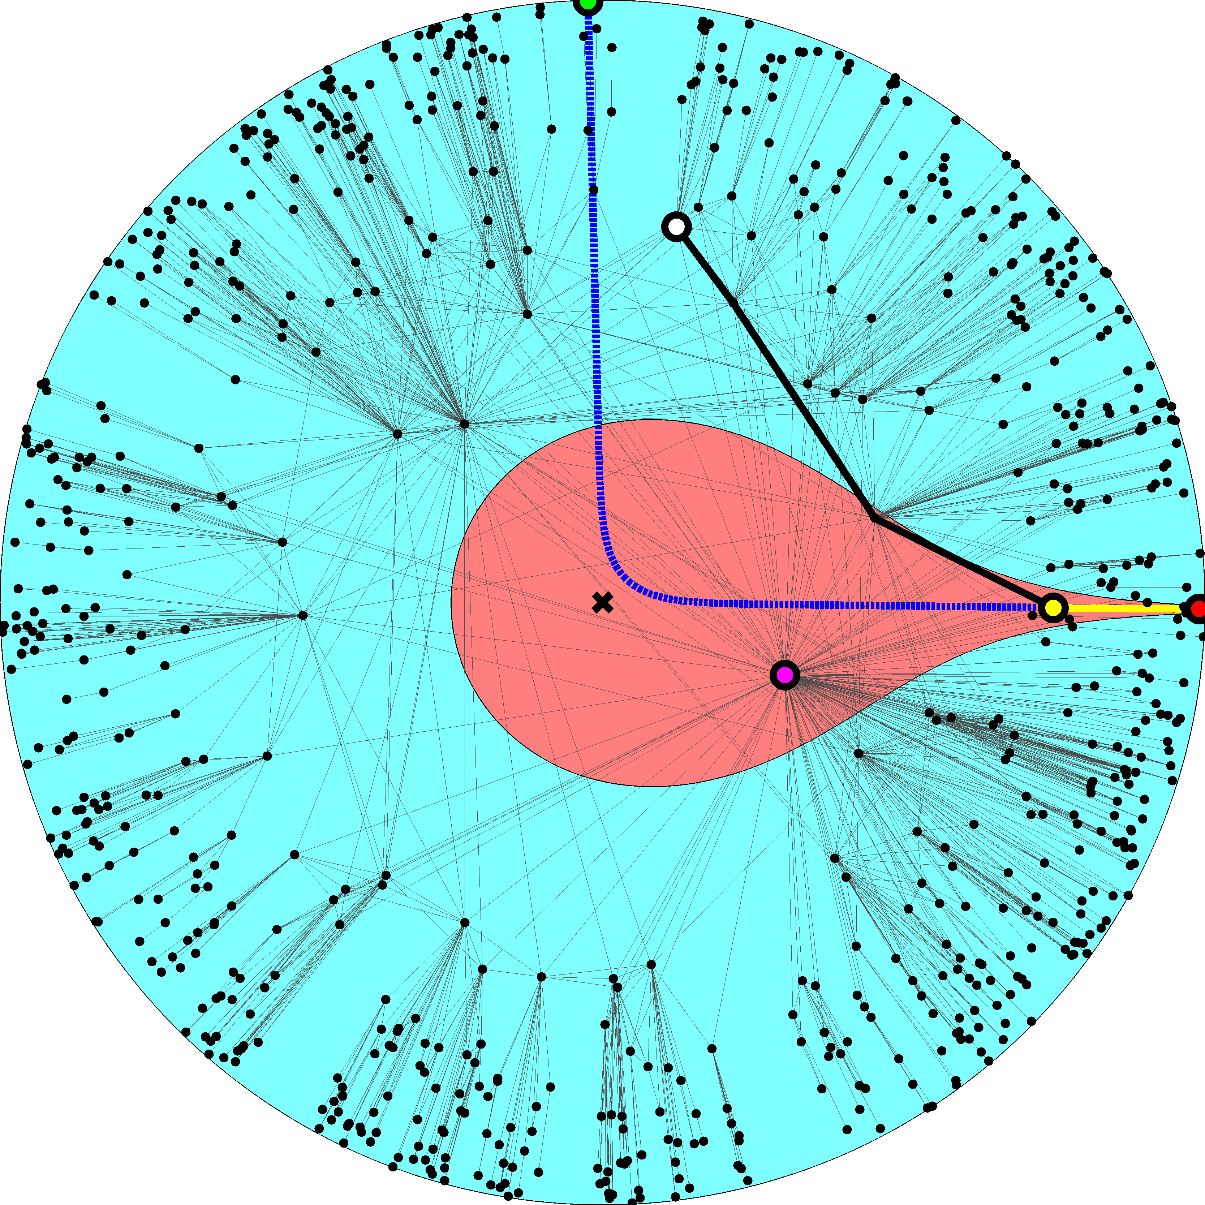

Slide 18
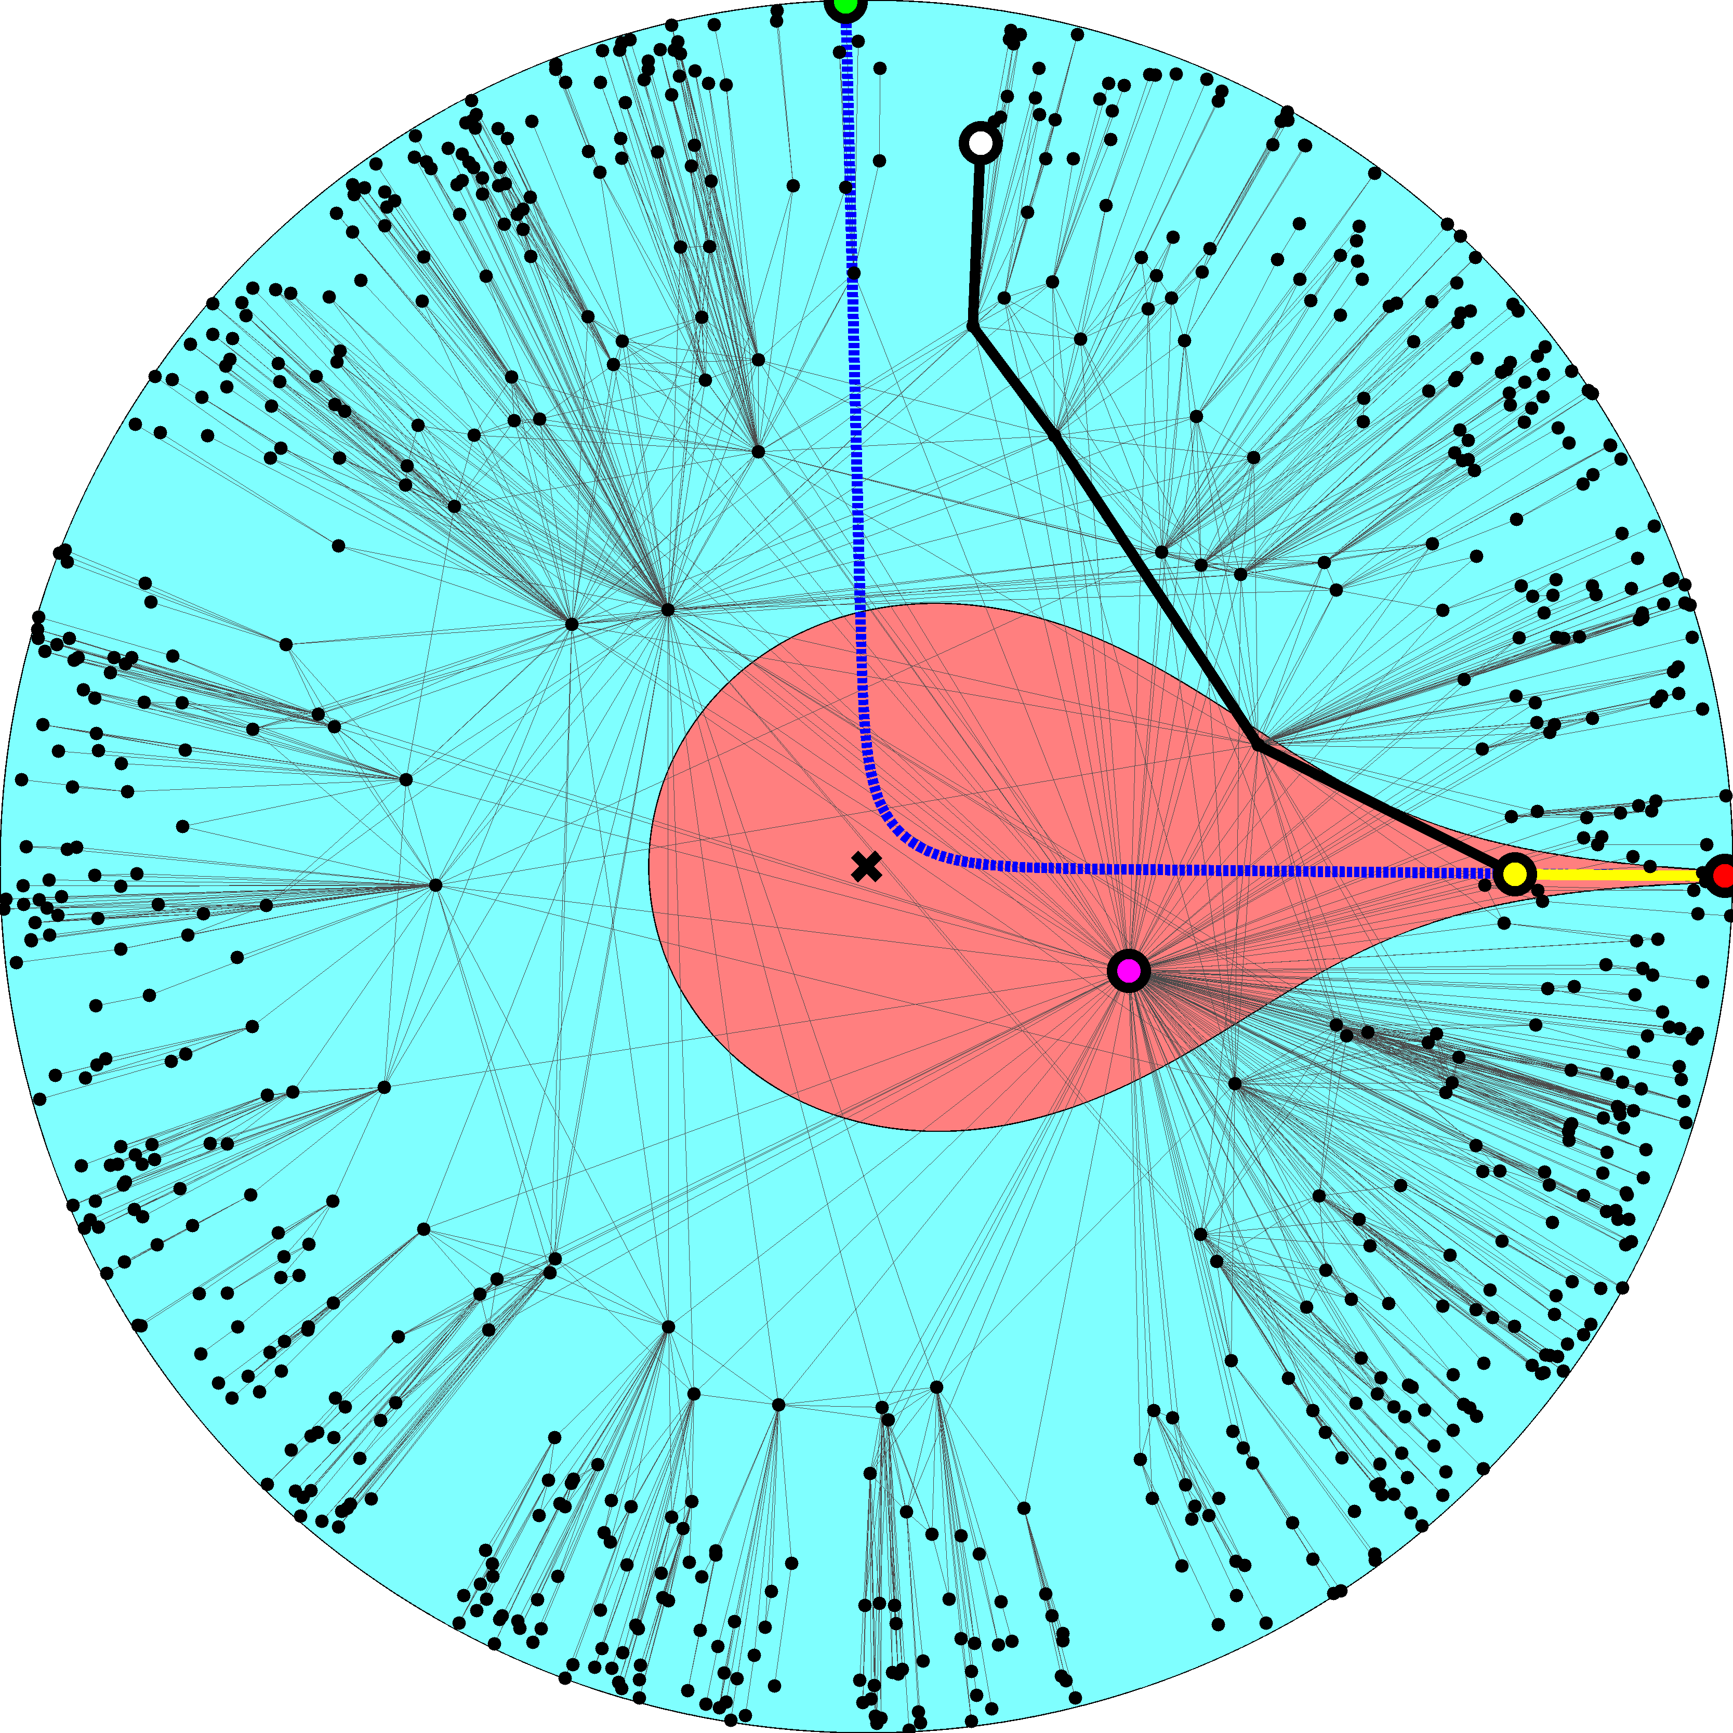

Slide 19
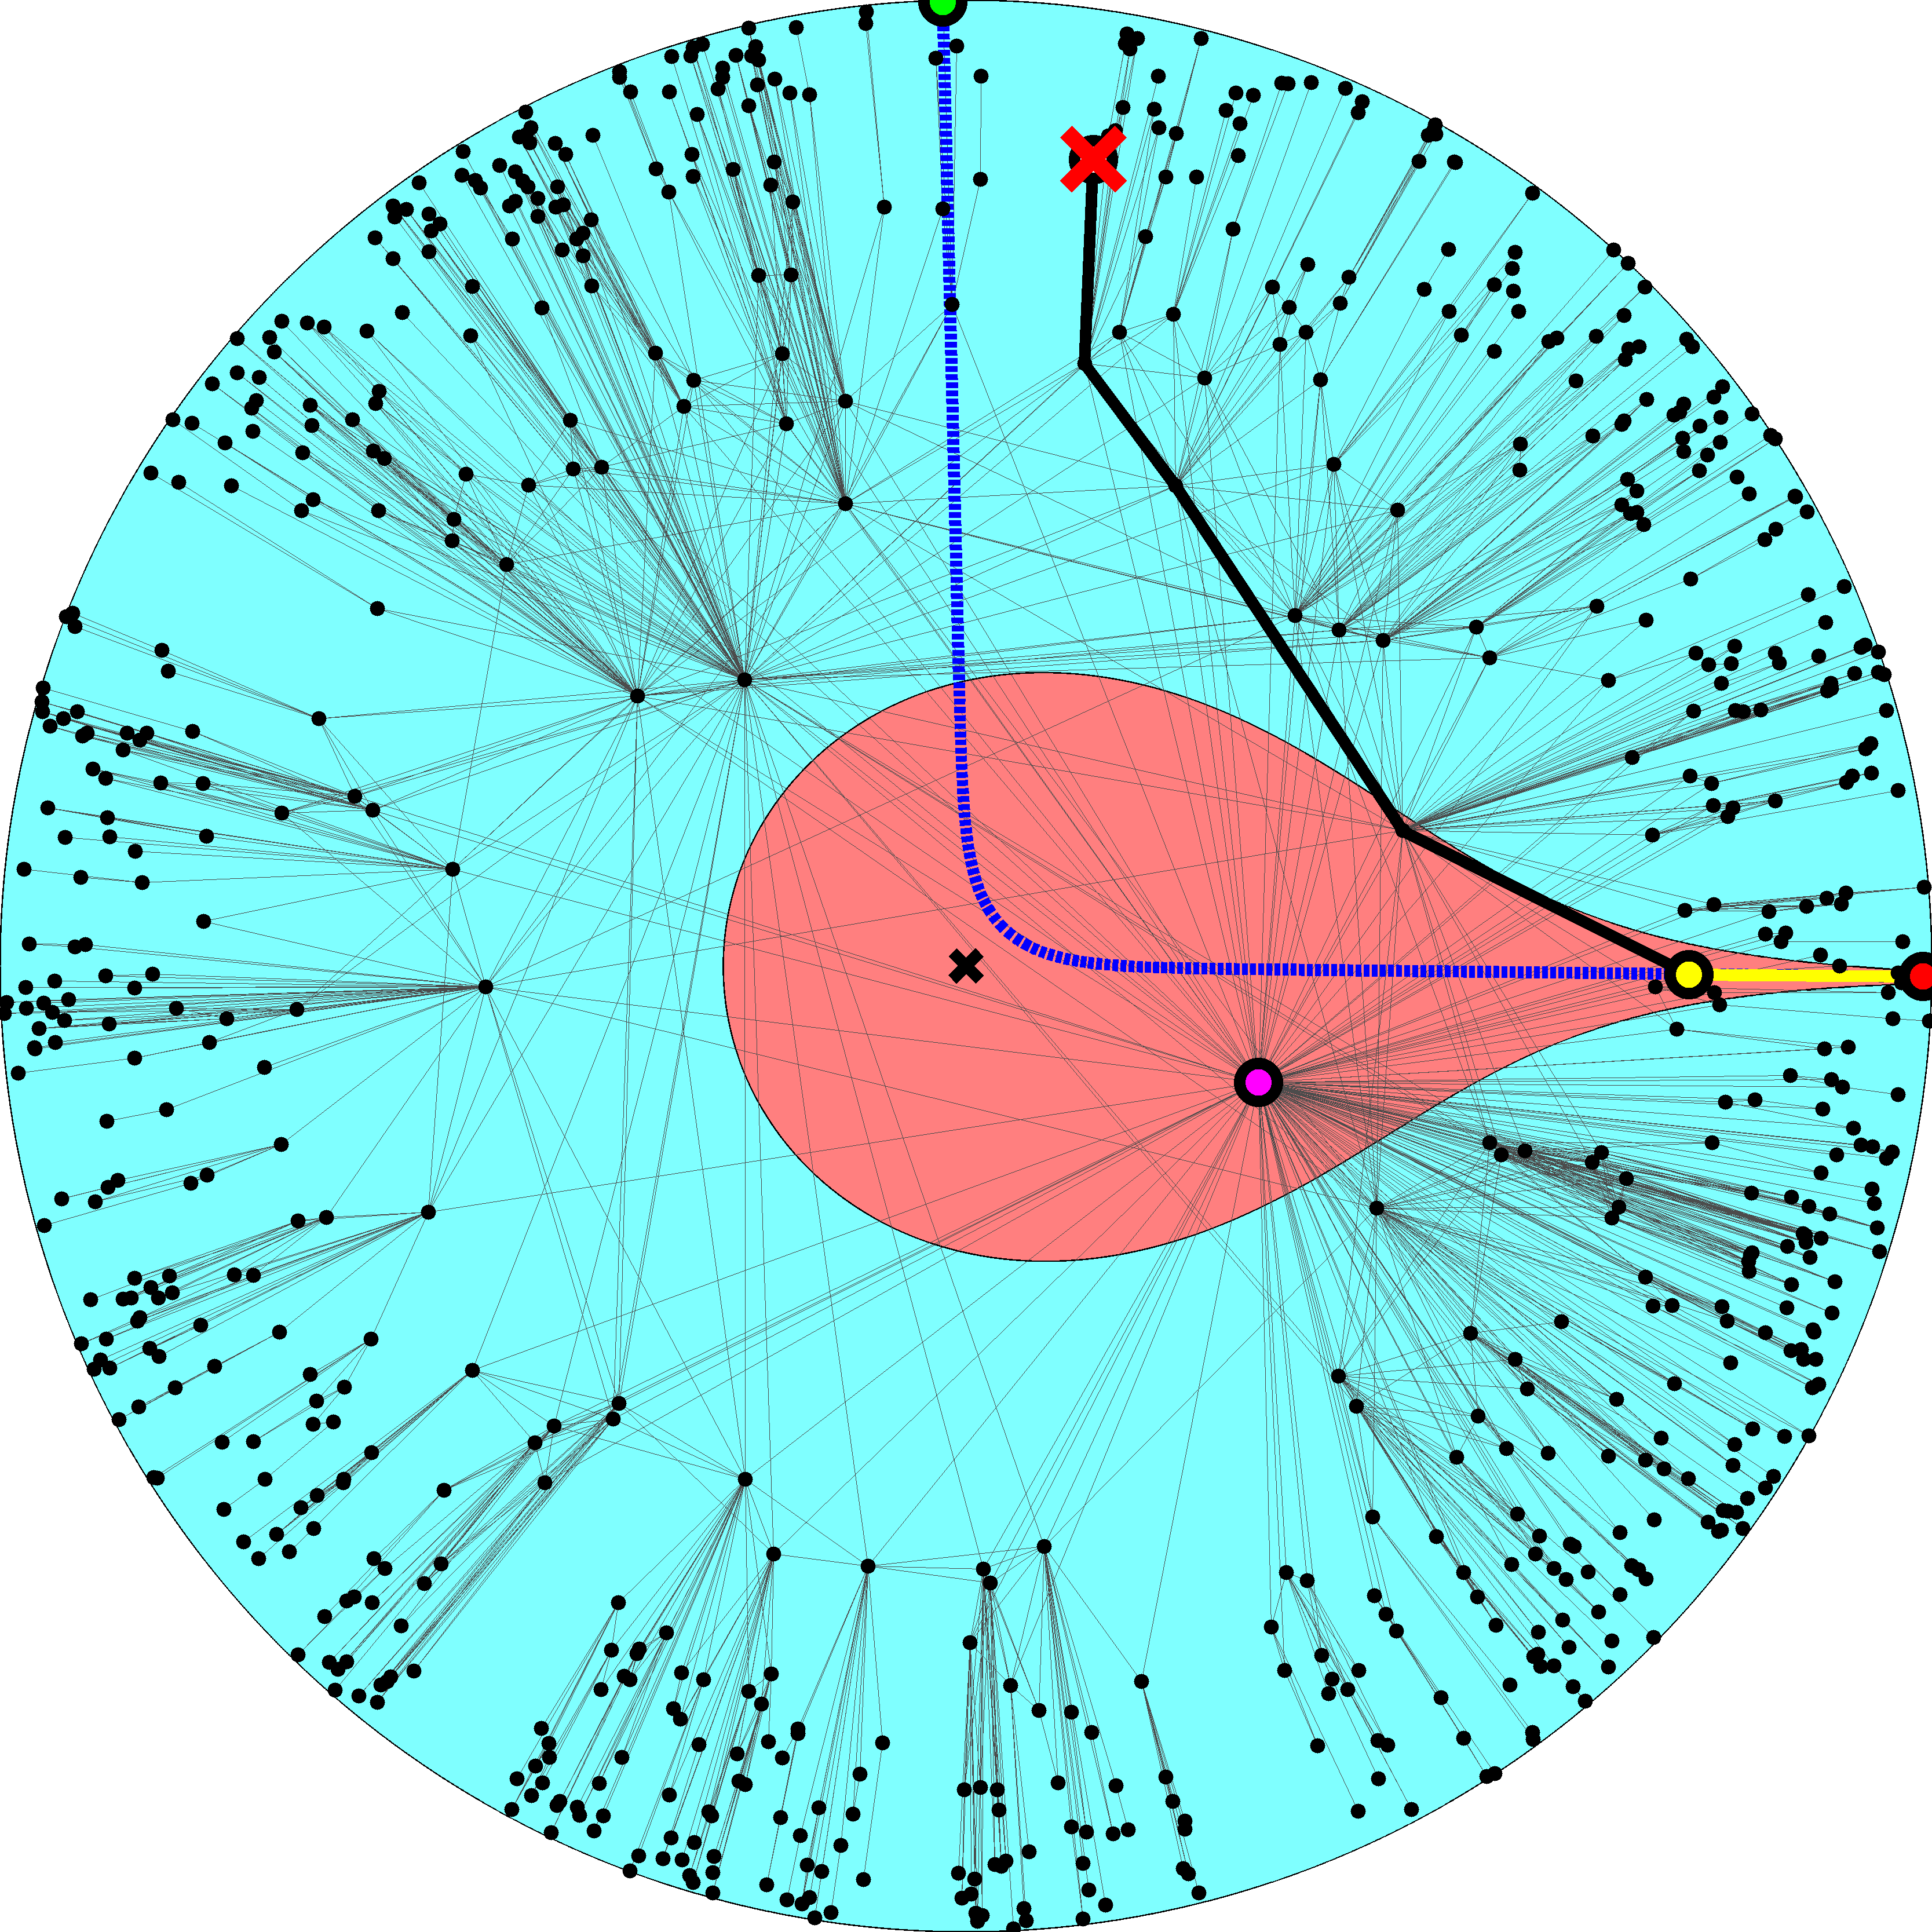

Slide 21
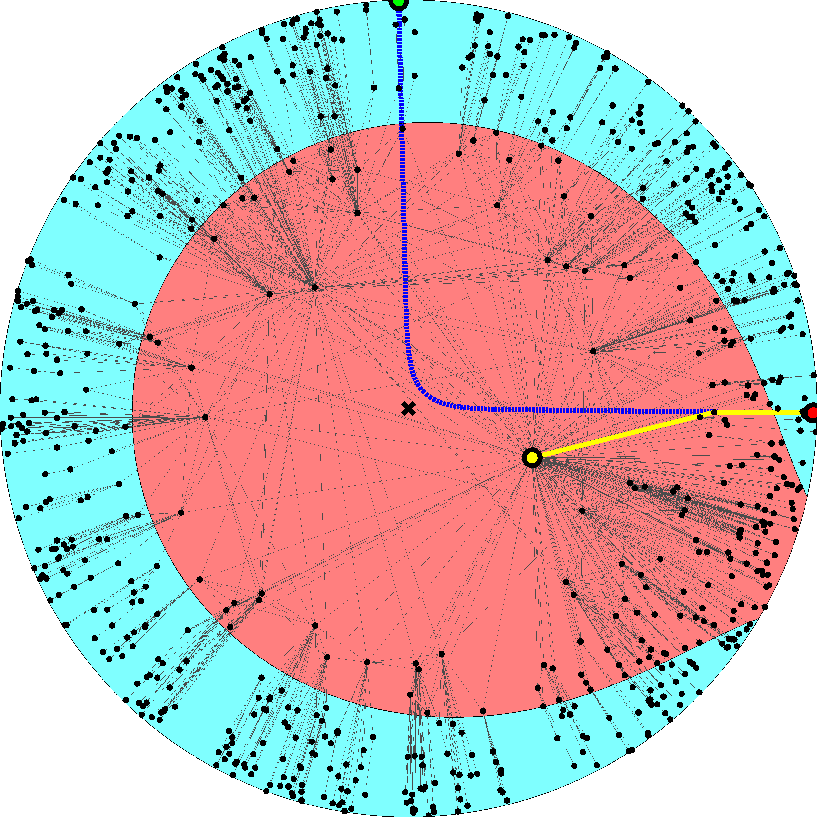

Slide 23
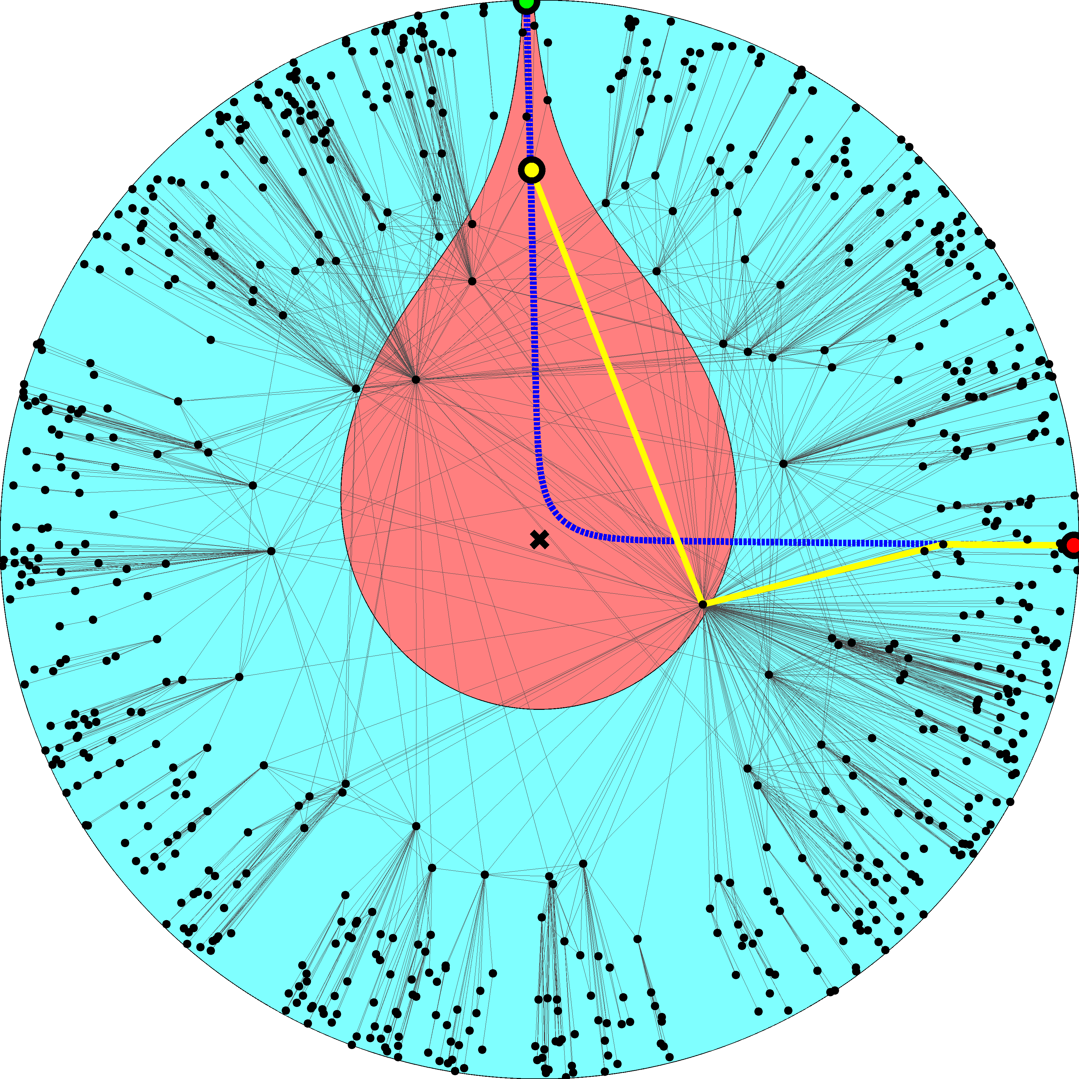

Slide 25
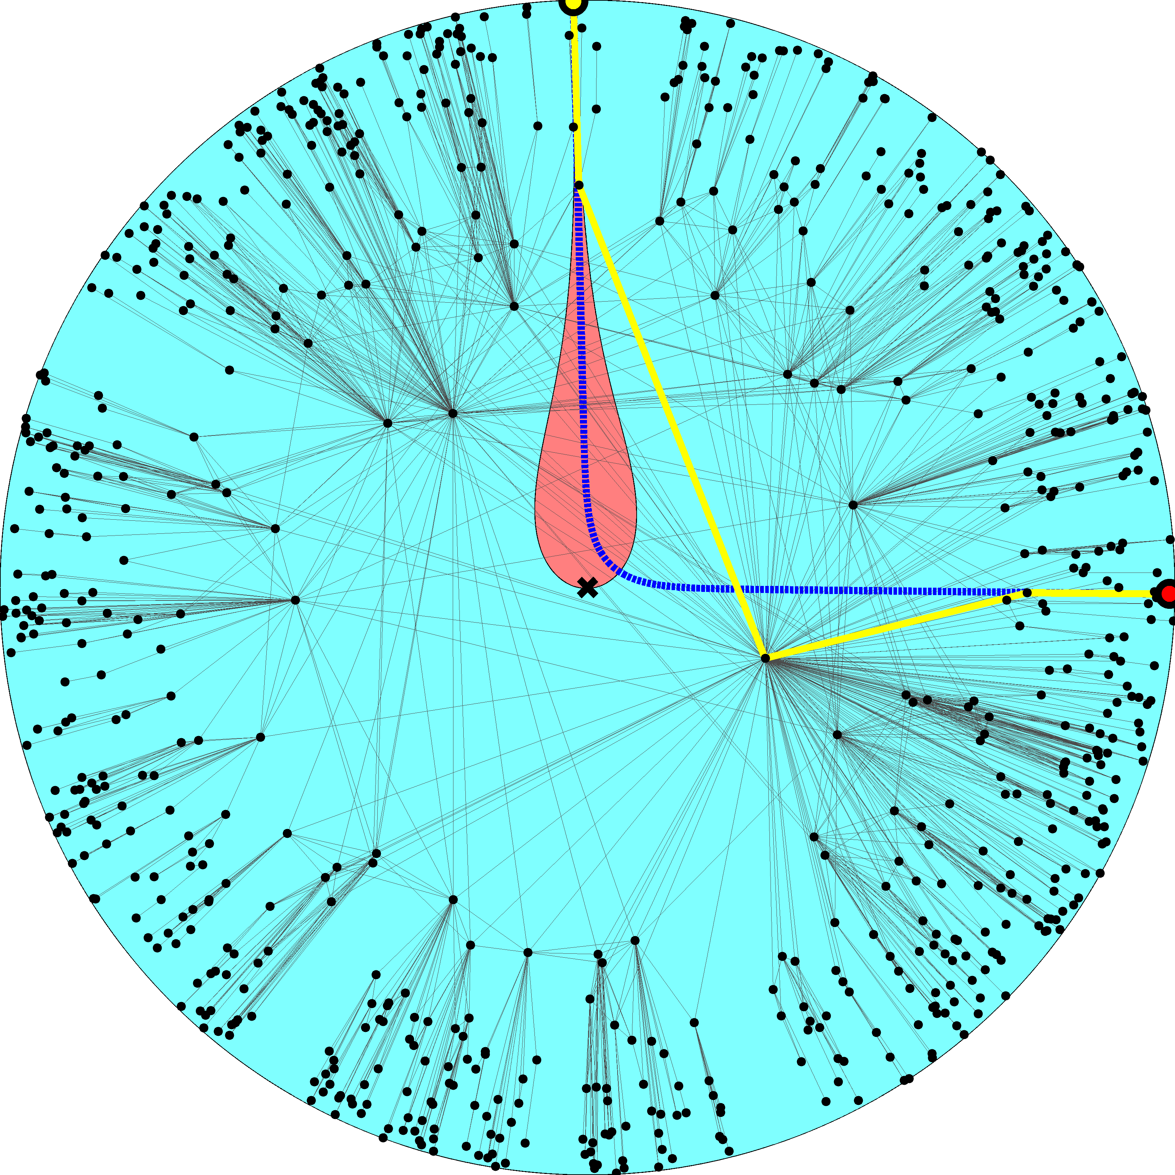

Slide 34
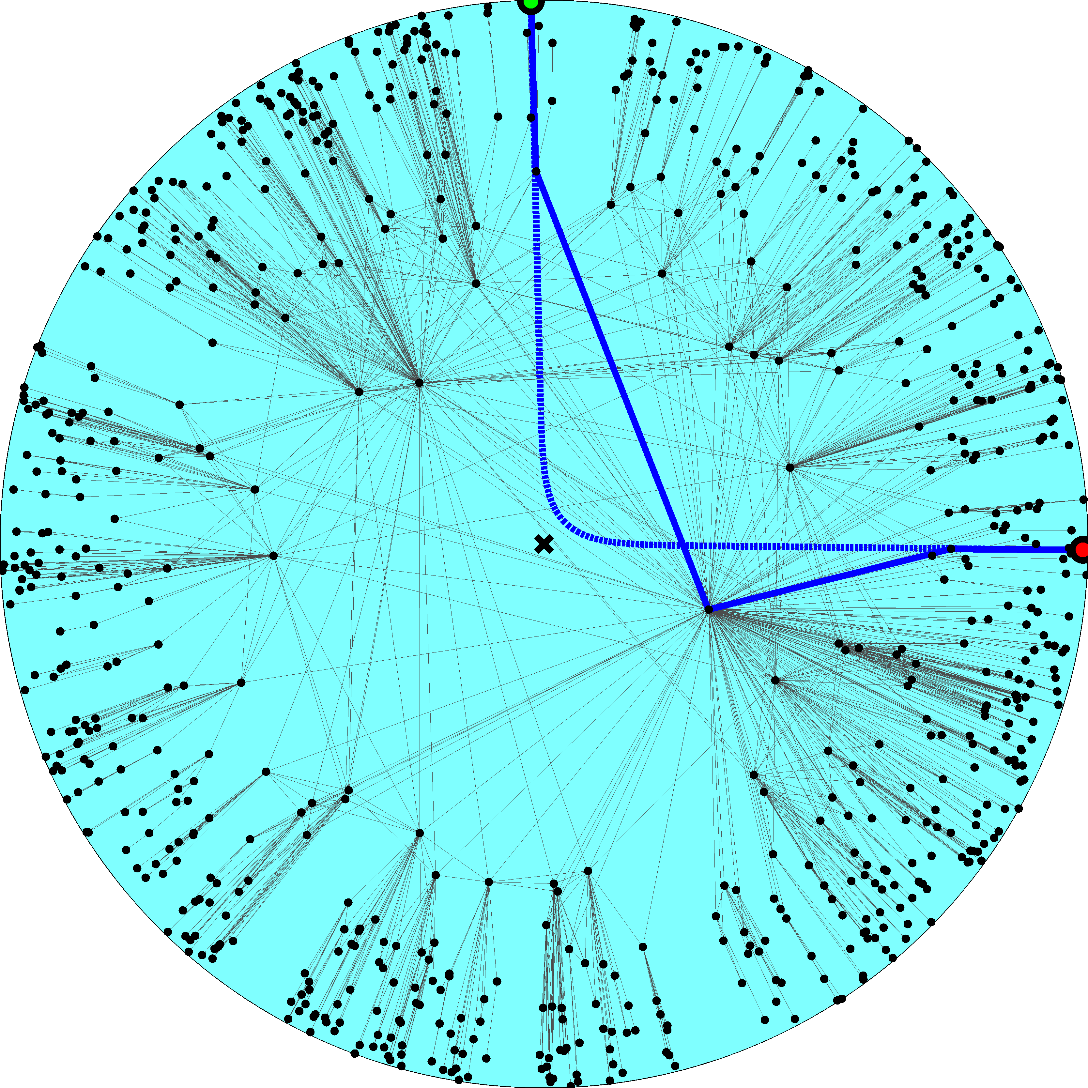

Slide 35
Navigation efficiency and robustness (synthetic networks)
Percentage of successful greedy paths 99.99%
Percentage of shortest greedy paths 100%
Percentage of successful greedy paths after removal of x% of links or nodes
x10%  99%
x30%  95%

Slide 36
Success ratio in random graphs
Configuration model (the same degree distribution) 30%
Classical random graphs (the same average degree) 0.17%

Slide 37
Mapping the real Internet using statistical inference methods
Measure the Internet topology properties
Map them to model parameters
Place nodes at random hyperbolic coordinates
Apply the Metropolis-Hastings algorithm to find the coordinates maximizing the likelihood that Internet is produced by the model

Slide 38
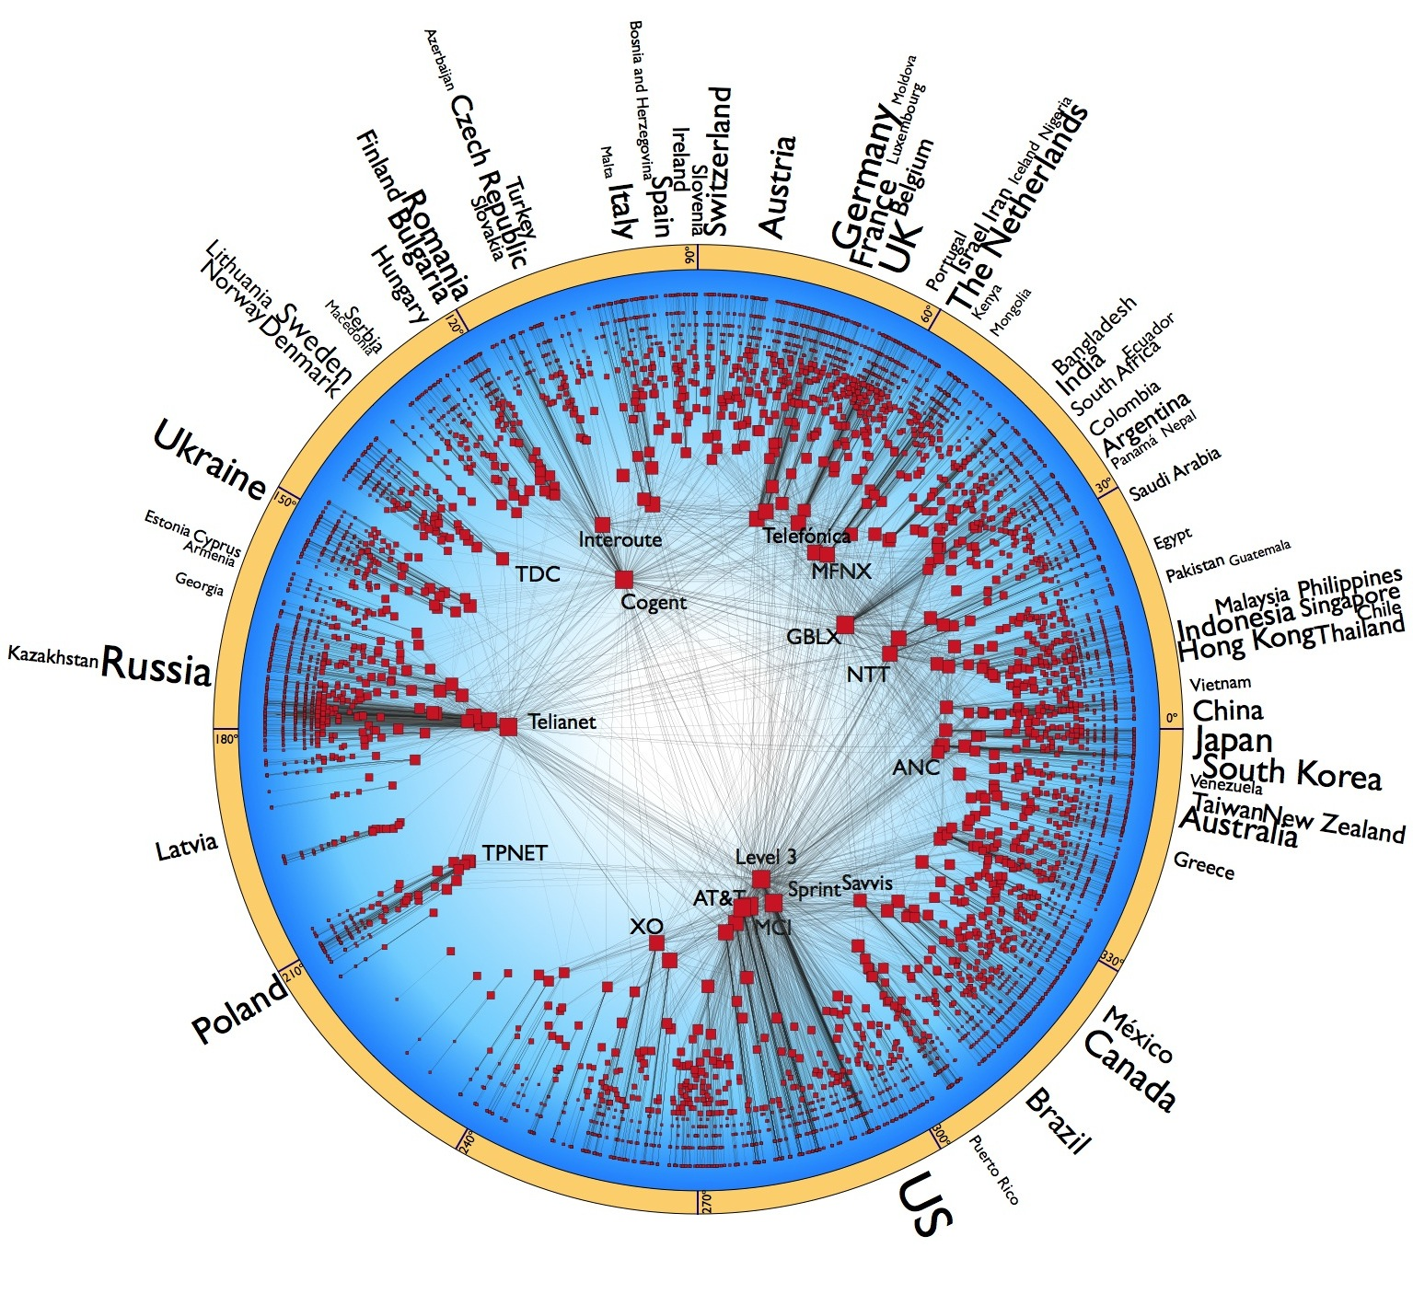
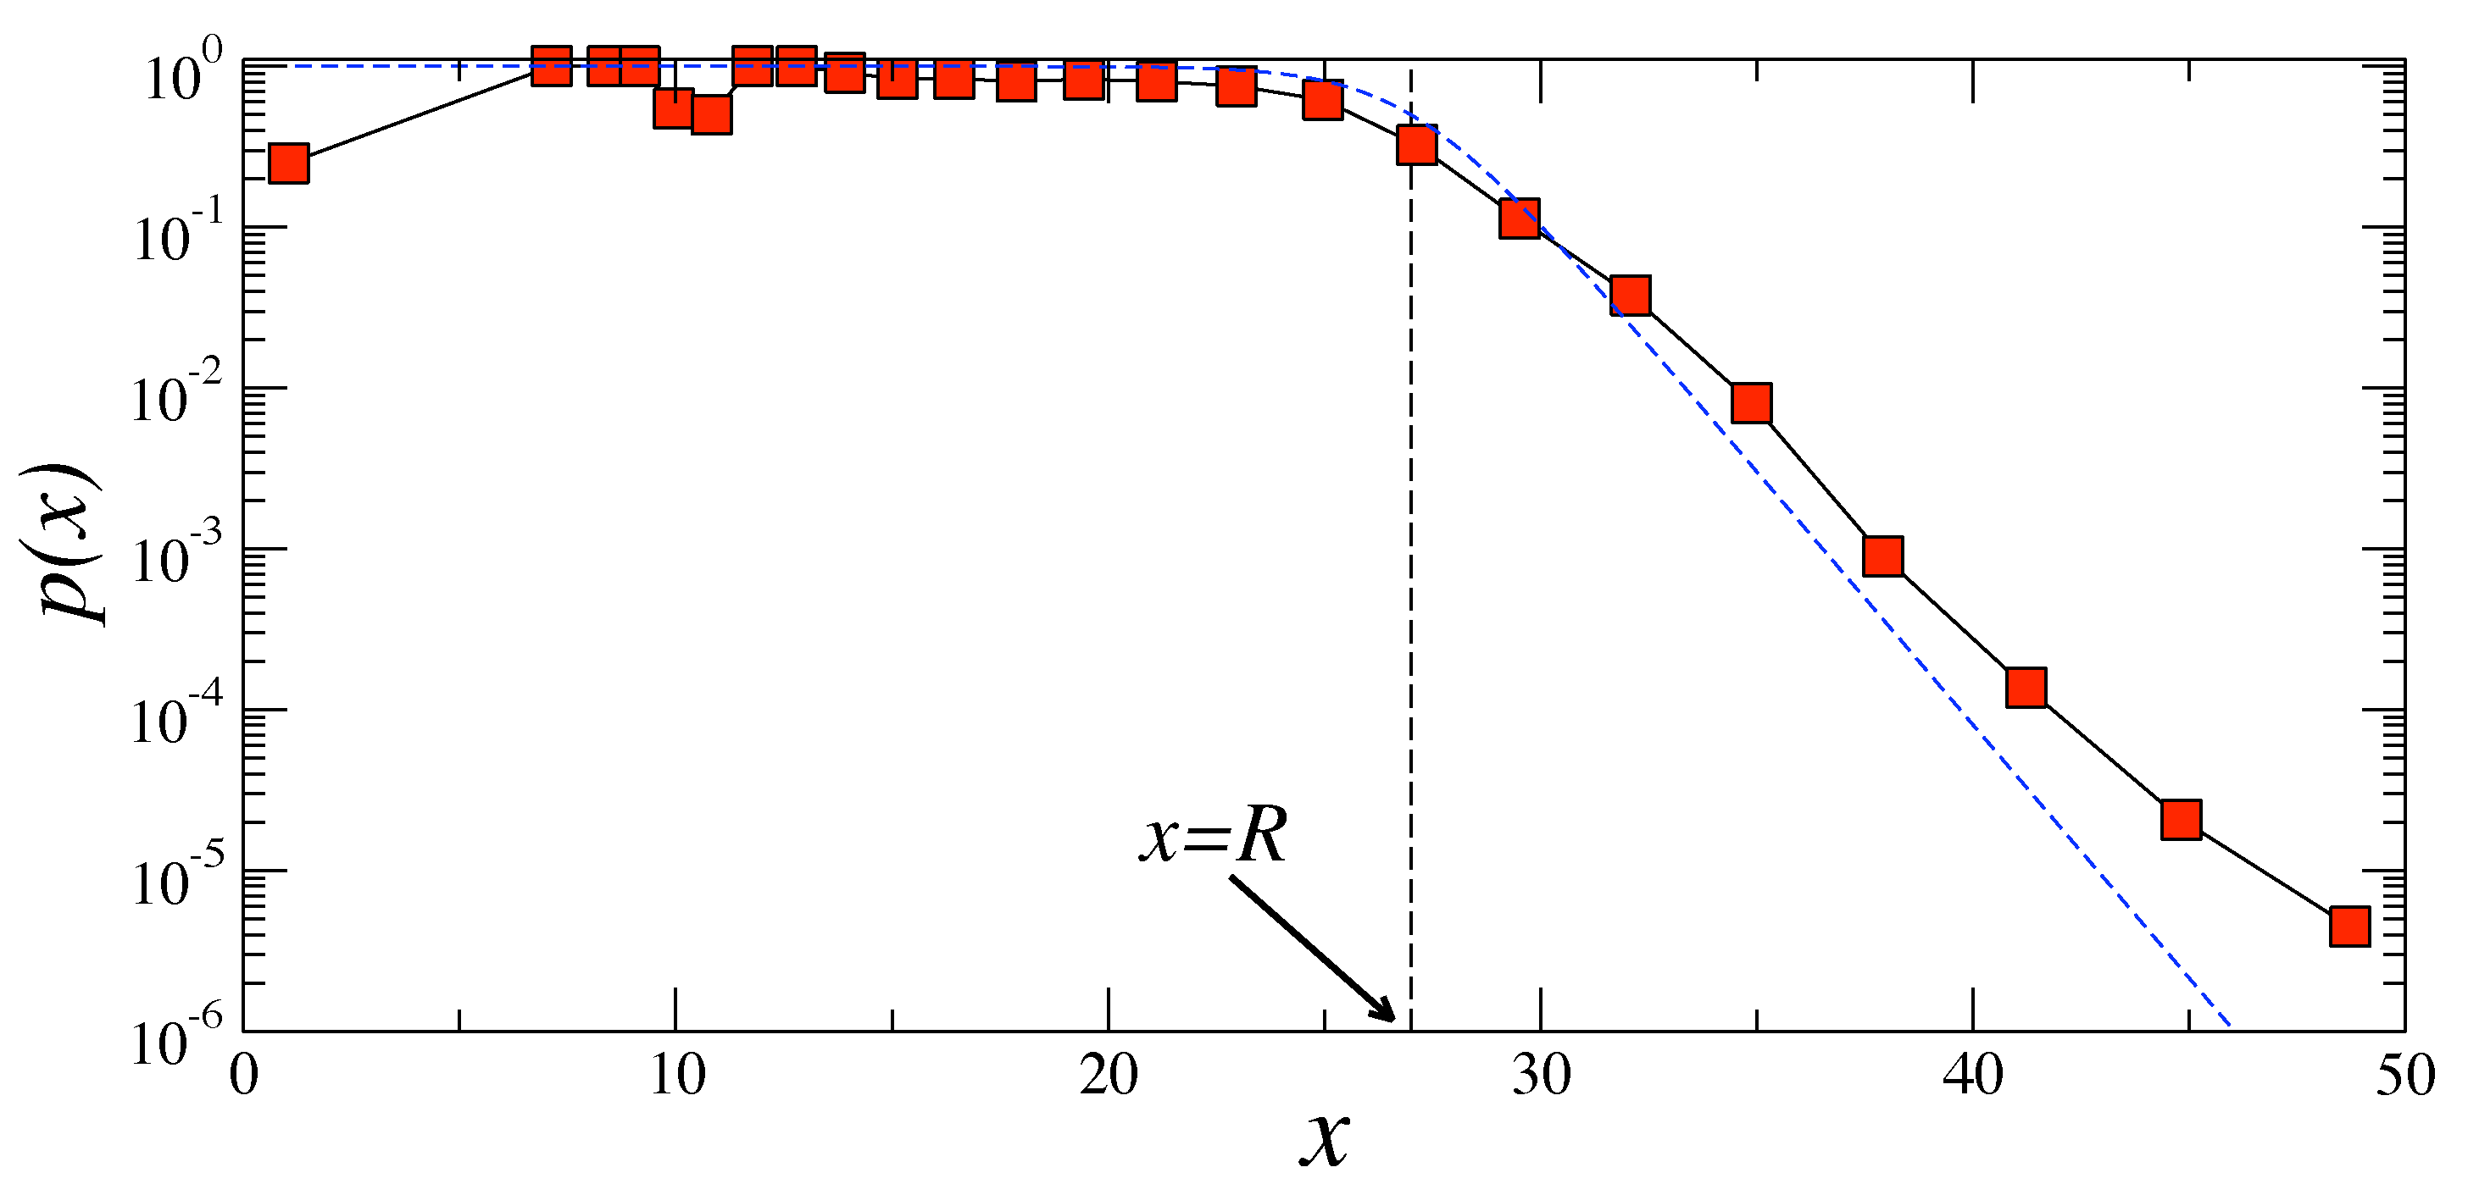

Slide 39
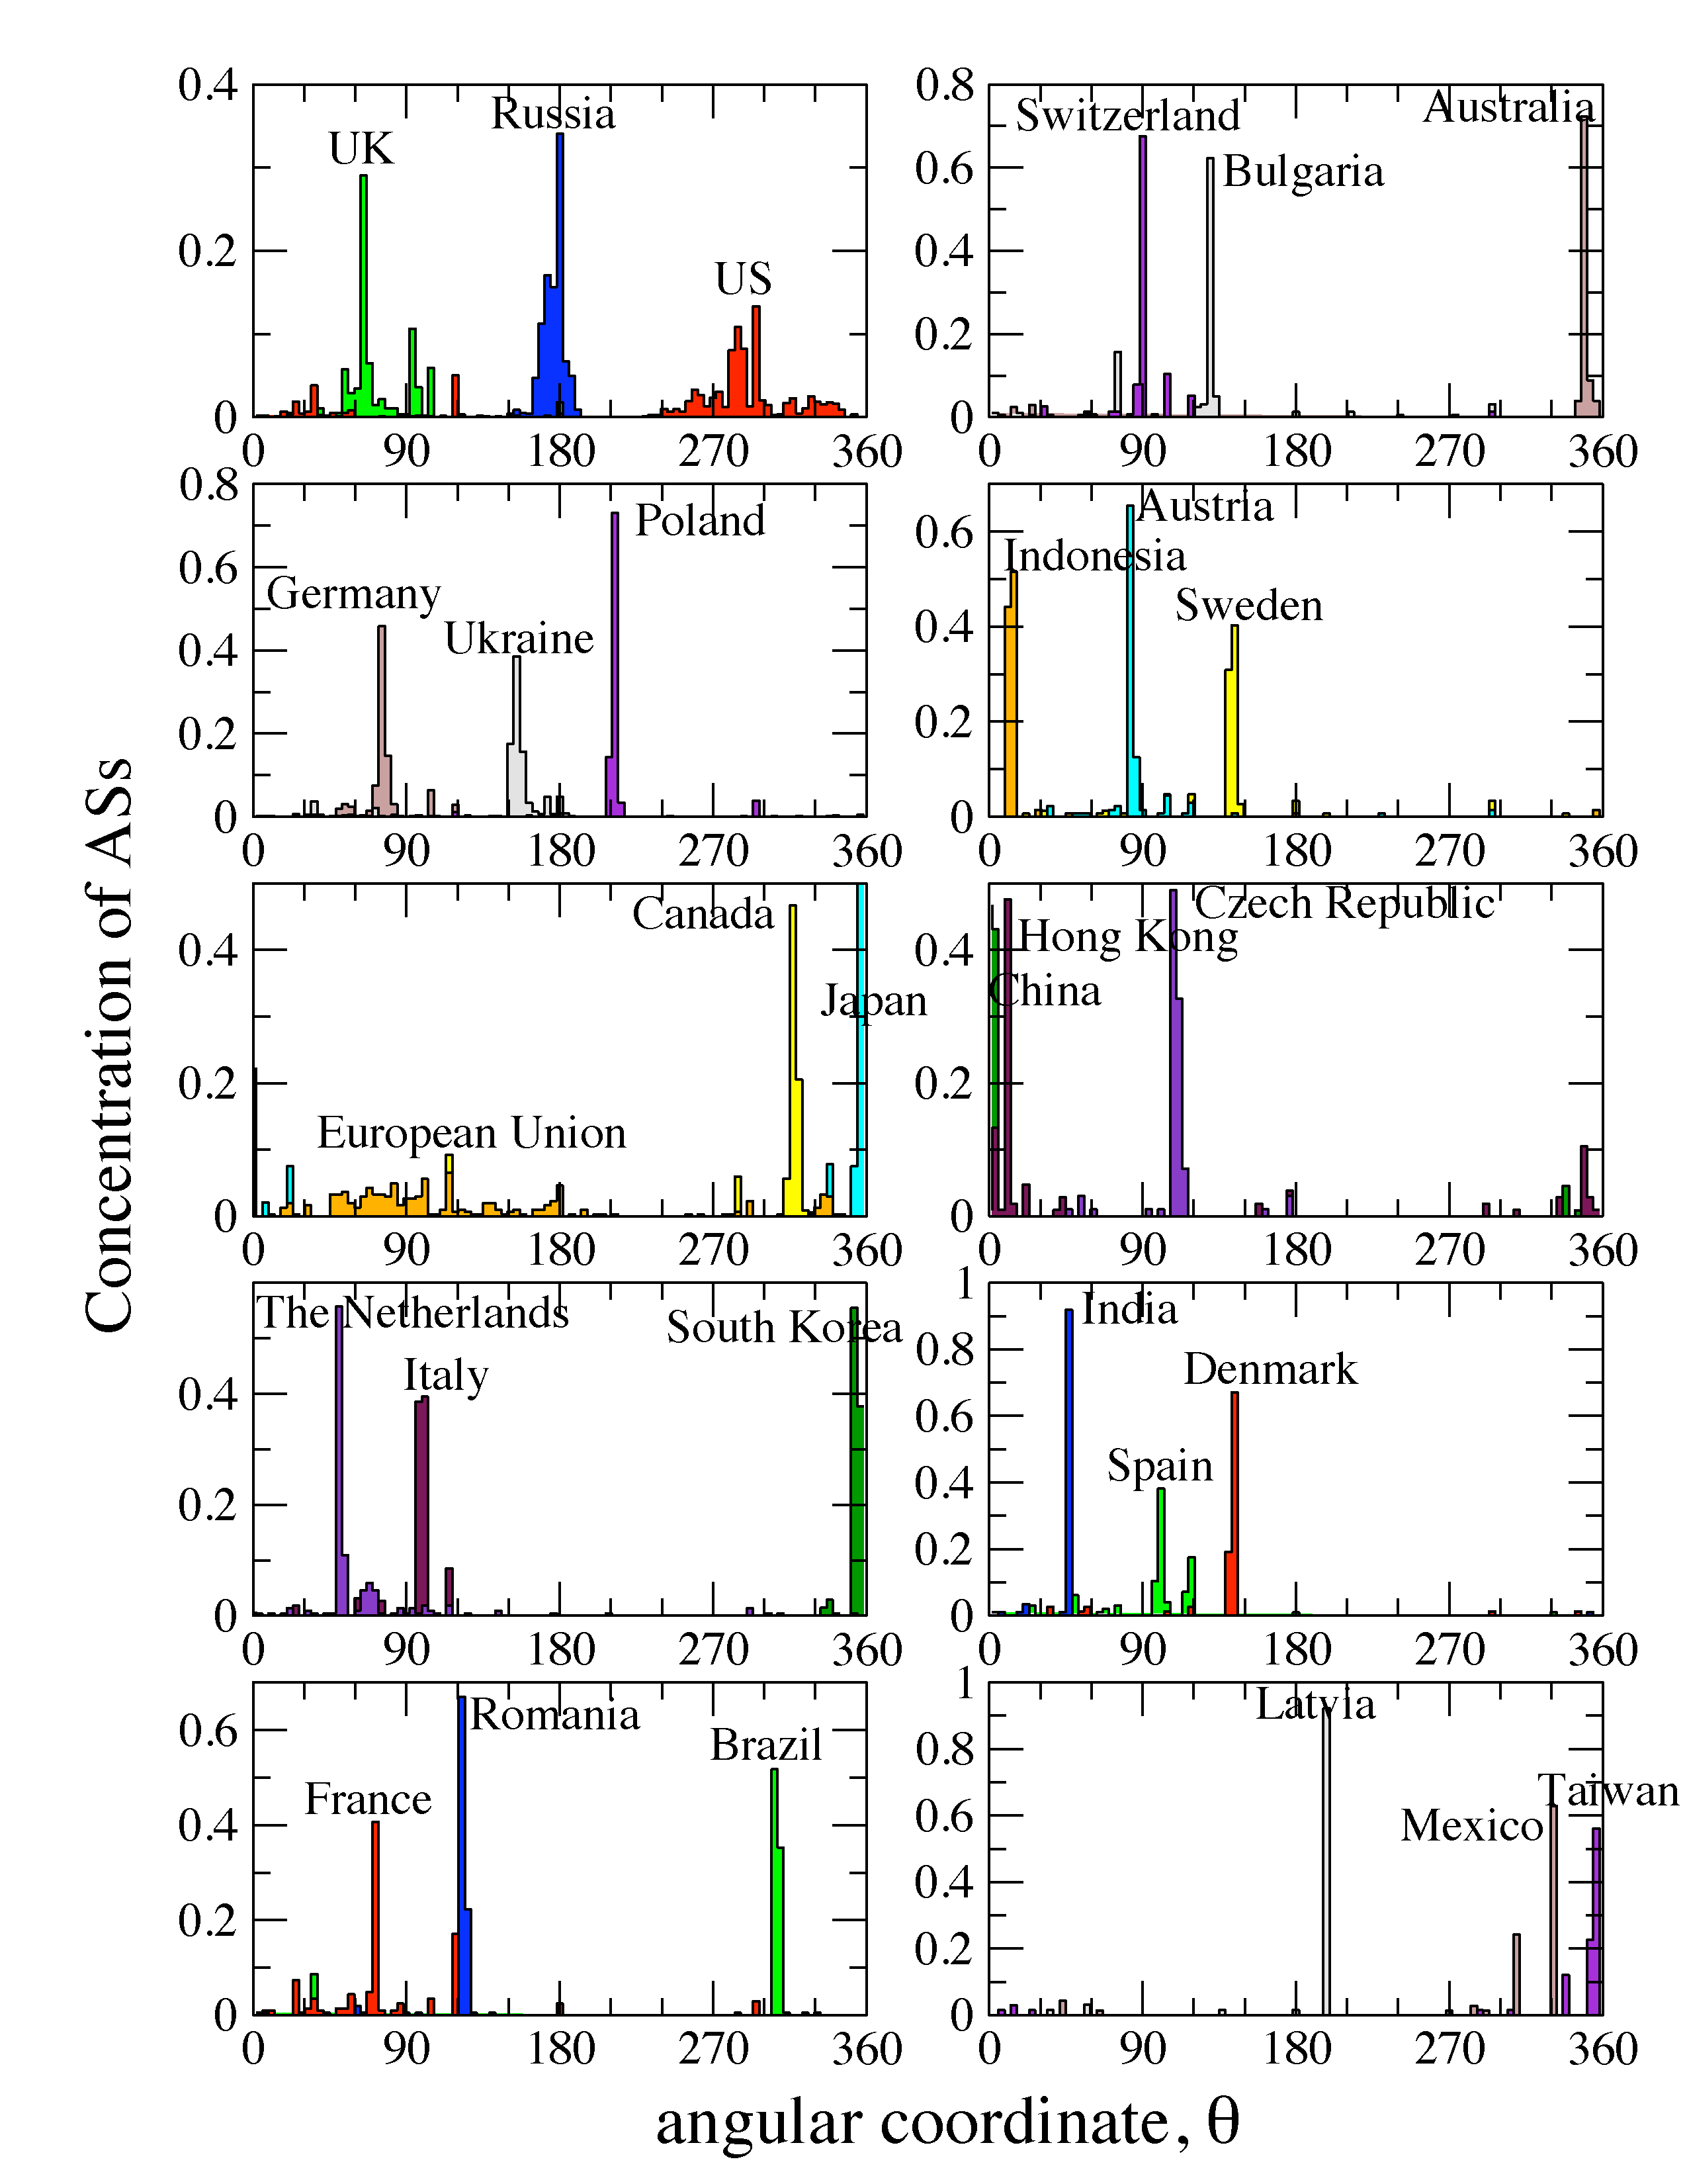

Slide 40
Navigation efficiency and robustness (Internet)
Percentage of successful greedy paths 97%
Average stretch 1.1
Percentage of successful greedy paths after removal of x% of links or nodes:

Slide 41
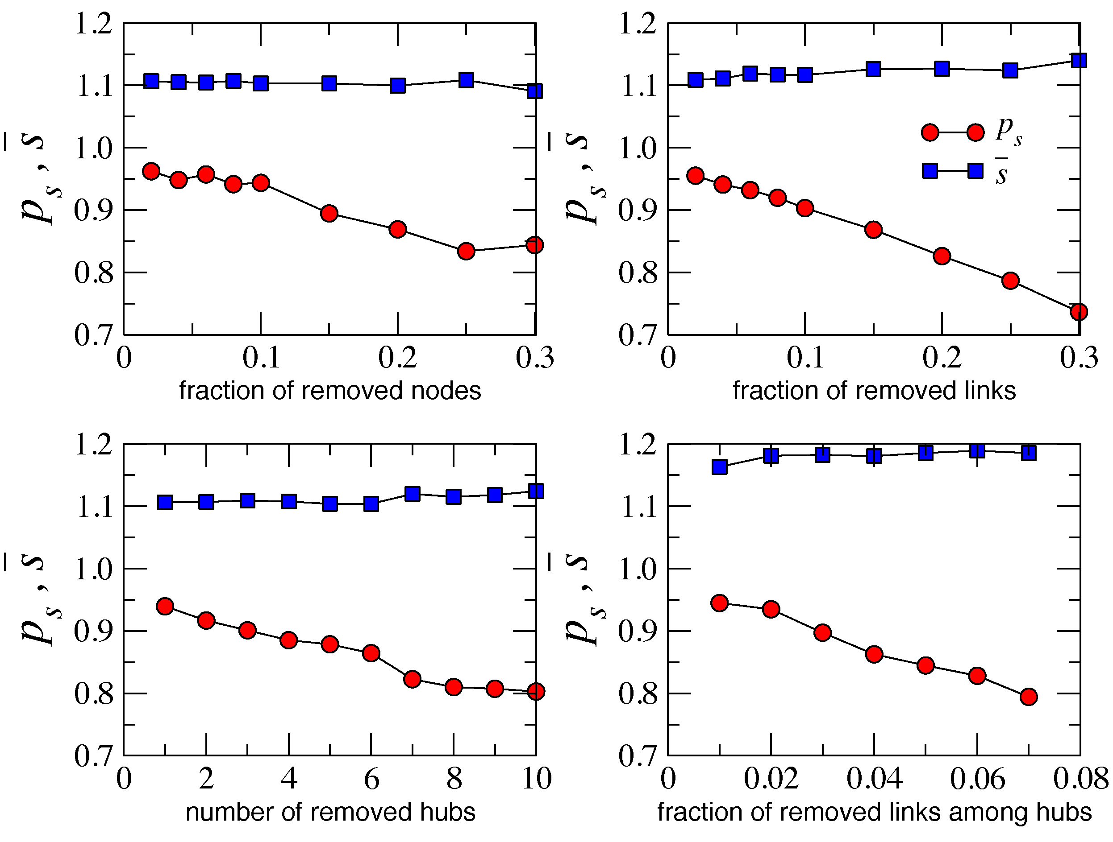
Why?
Congruency between hyperbolic space geometry and scale-free network topology
Hierarchical/heterogeneous organization of the two (zooming-out/zooming-in pattern)
Strong clustering/metric structure
How?
Strong clustering yields high path diversity
All paths are congruent to their corresponding hyperbolic geodesics
If some paths are damaged, many others remain, and can still be found since they all congruent

Slide 42
No routing information exchange upon topology changes
if the minor degradation of routing efficiency is tolerable
Slightly more intelligent variations of greedy forwarding, using small amount of non-local information, sustain 100% routing efficiency

Slide 43
Take-home message

?
←

Slide 44
Open question
Does any optimization of efficiency and robustness of targeted transport drive network evolution explicitly?
Or is it just a natural but implicit by-product of other (standard) network evolution mechanisms?

Slide 45
Summary (of other results)
We have discovered a new geometric framework to study the structure and function of complex networks
The framework provides a natural (no “enforcement” on our side) explanation of two basic structural properties of complex networks (scale-free degree distribution and strong clustering) as consequences of underlying hyperbolic geometry
The framework admits a standard statistical physics approach (exponential random graphs), interpreting auxiliary fields as linear function of hyperbolic distances/energies
The framework subsumes the configuration model, classical random graphs, and random geometric graphs as three limiting cases with degenerate geometric structures
The framework explains how the hierarchical structure of complex networks ensures the maximum efficiency of their navigation function – optimal routing without global topology knowledge
The framework provides a basis for mapping real complex networks to their hidden/underlying hyperbolic spaces

Slide 46
Applications of network mapping
Internet
optimal (maximally efficient/most scalable) routing
routing table sizes, stretch, and communication overhead approach their theoretical lower bounds
Other networks
discover hidden distances between nodes (e.g., similarity distances between people in social networks)
“soft” communities become areas in the underlying space with higher node densities
tell what drives signaling in networks, and what network perturbations drive it to failures (e.g., in the brain, regulatory, or metabolic networks)

Slide 47
M. Boguñá, F. Papadopoulos, and D. Krioukov, Sustaining the Internet with Hyperbolic Mapping, Nature Communications, v.1, 62, 2010
D. Krioukov, F. Papadopoulos, A. Vahdat, and M. Boguñá, Hyperbolic Geometry of Complex Networks, Physical Review E, v.82, 036106, 2010, Physical Review E, v.80, 035101(R), 2009
F. Papadopoulos, D. Krioukov, M. Boguñá, and A. Vahdat, Greedy Forwarding in (Dynamic) Scale-Free Networks Embedded in Hyperbolic Metric Spaces, INFOCOM 2010, SIGMETRICS MAMA 2009
M. Boguñá, D. Krioukov, and kc claffy, Navigability of Complex Networks, Nature Physics, v.5, p.74-80, 2009

