Slide 1
Robustness of Targeted Transport in Complex Networks
Dmitri Krioukov CAIDA/UCSD F. Papadopoulos, M. Kitsak, kc claffy, A. Vahdat M. Á. Serrano, M. Boguñá Robustness of Complex Networks TU Delft, November 2010

Slide 3
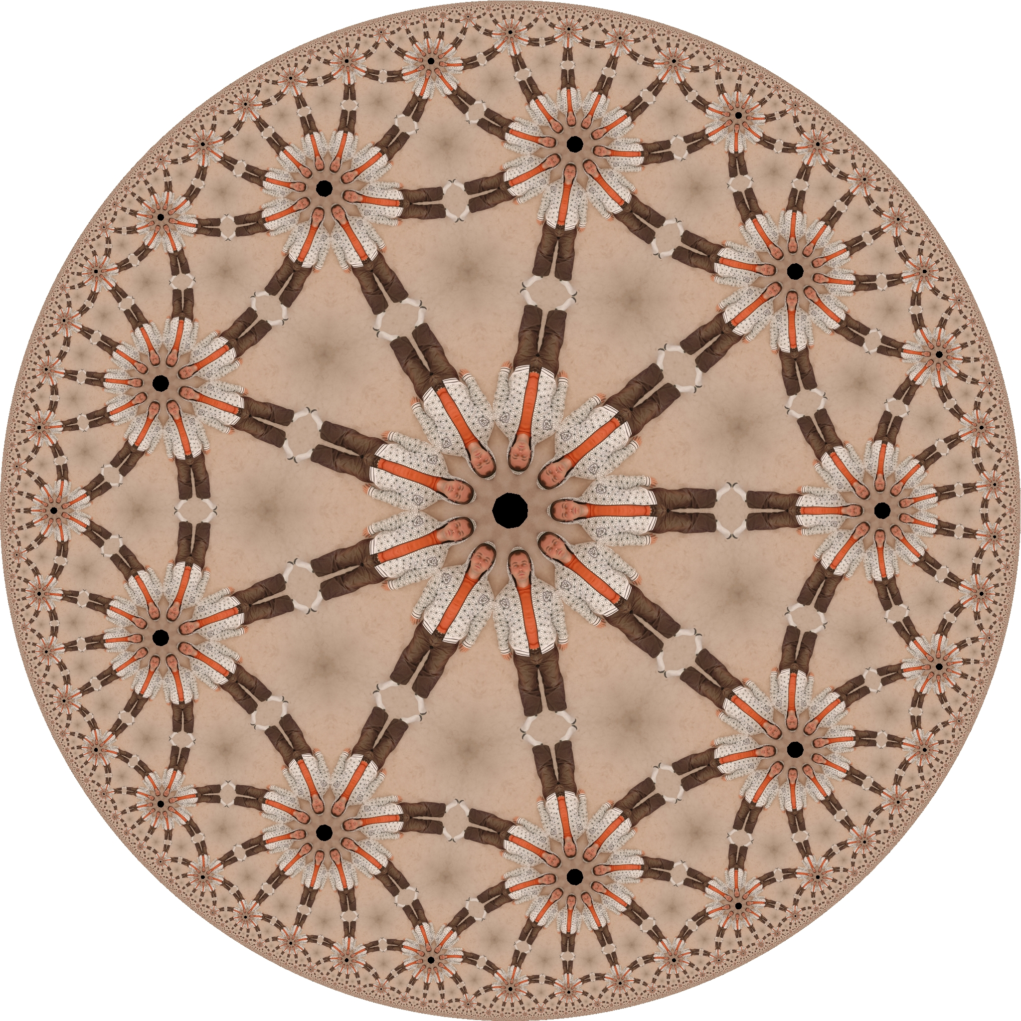

Slide 6
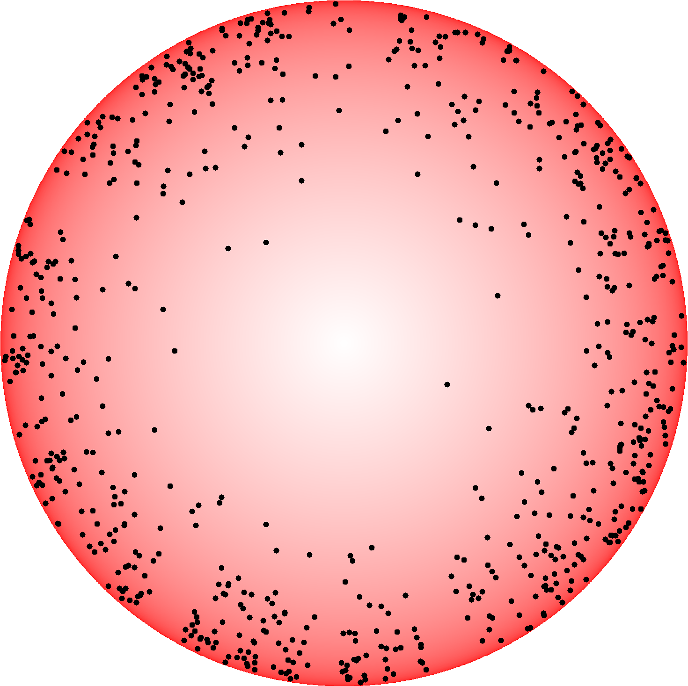

Slide 9
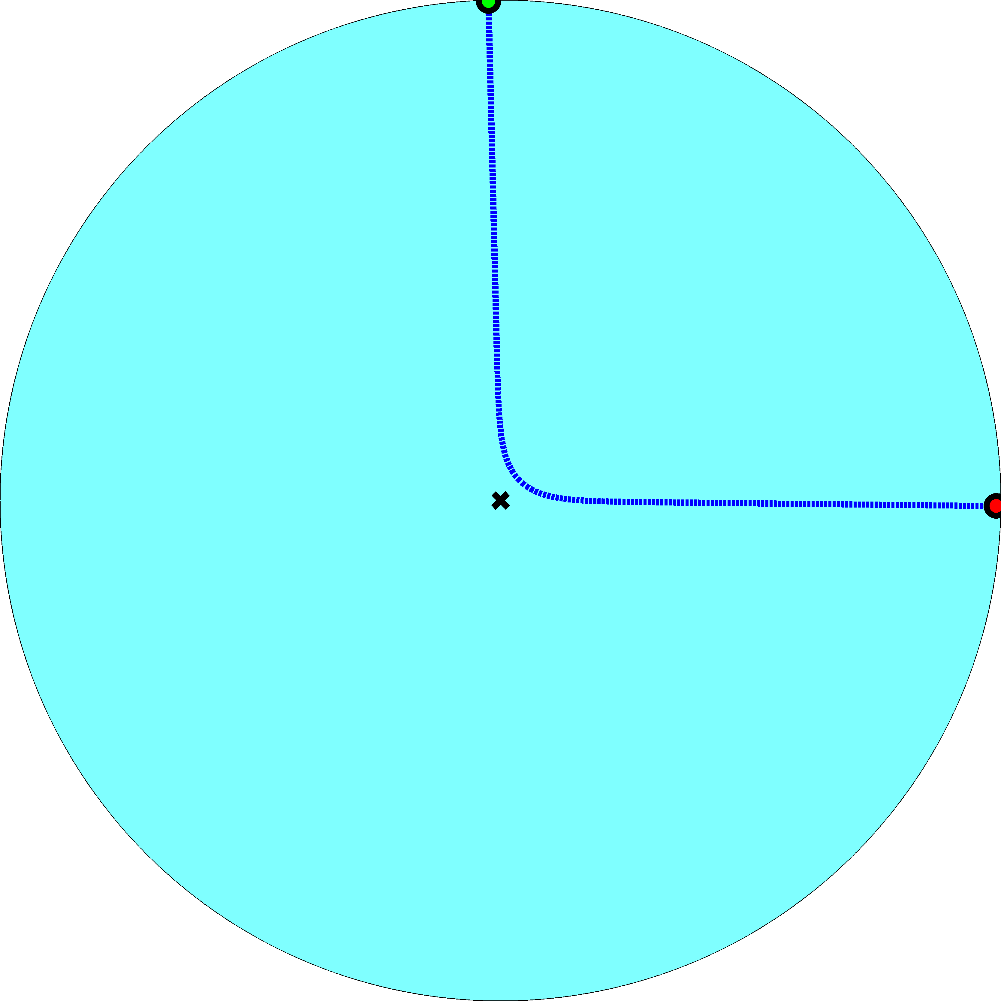
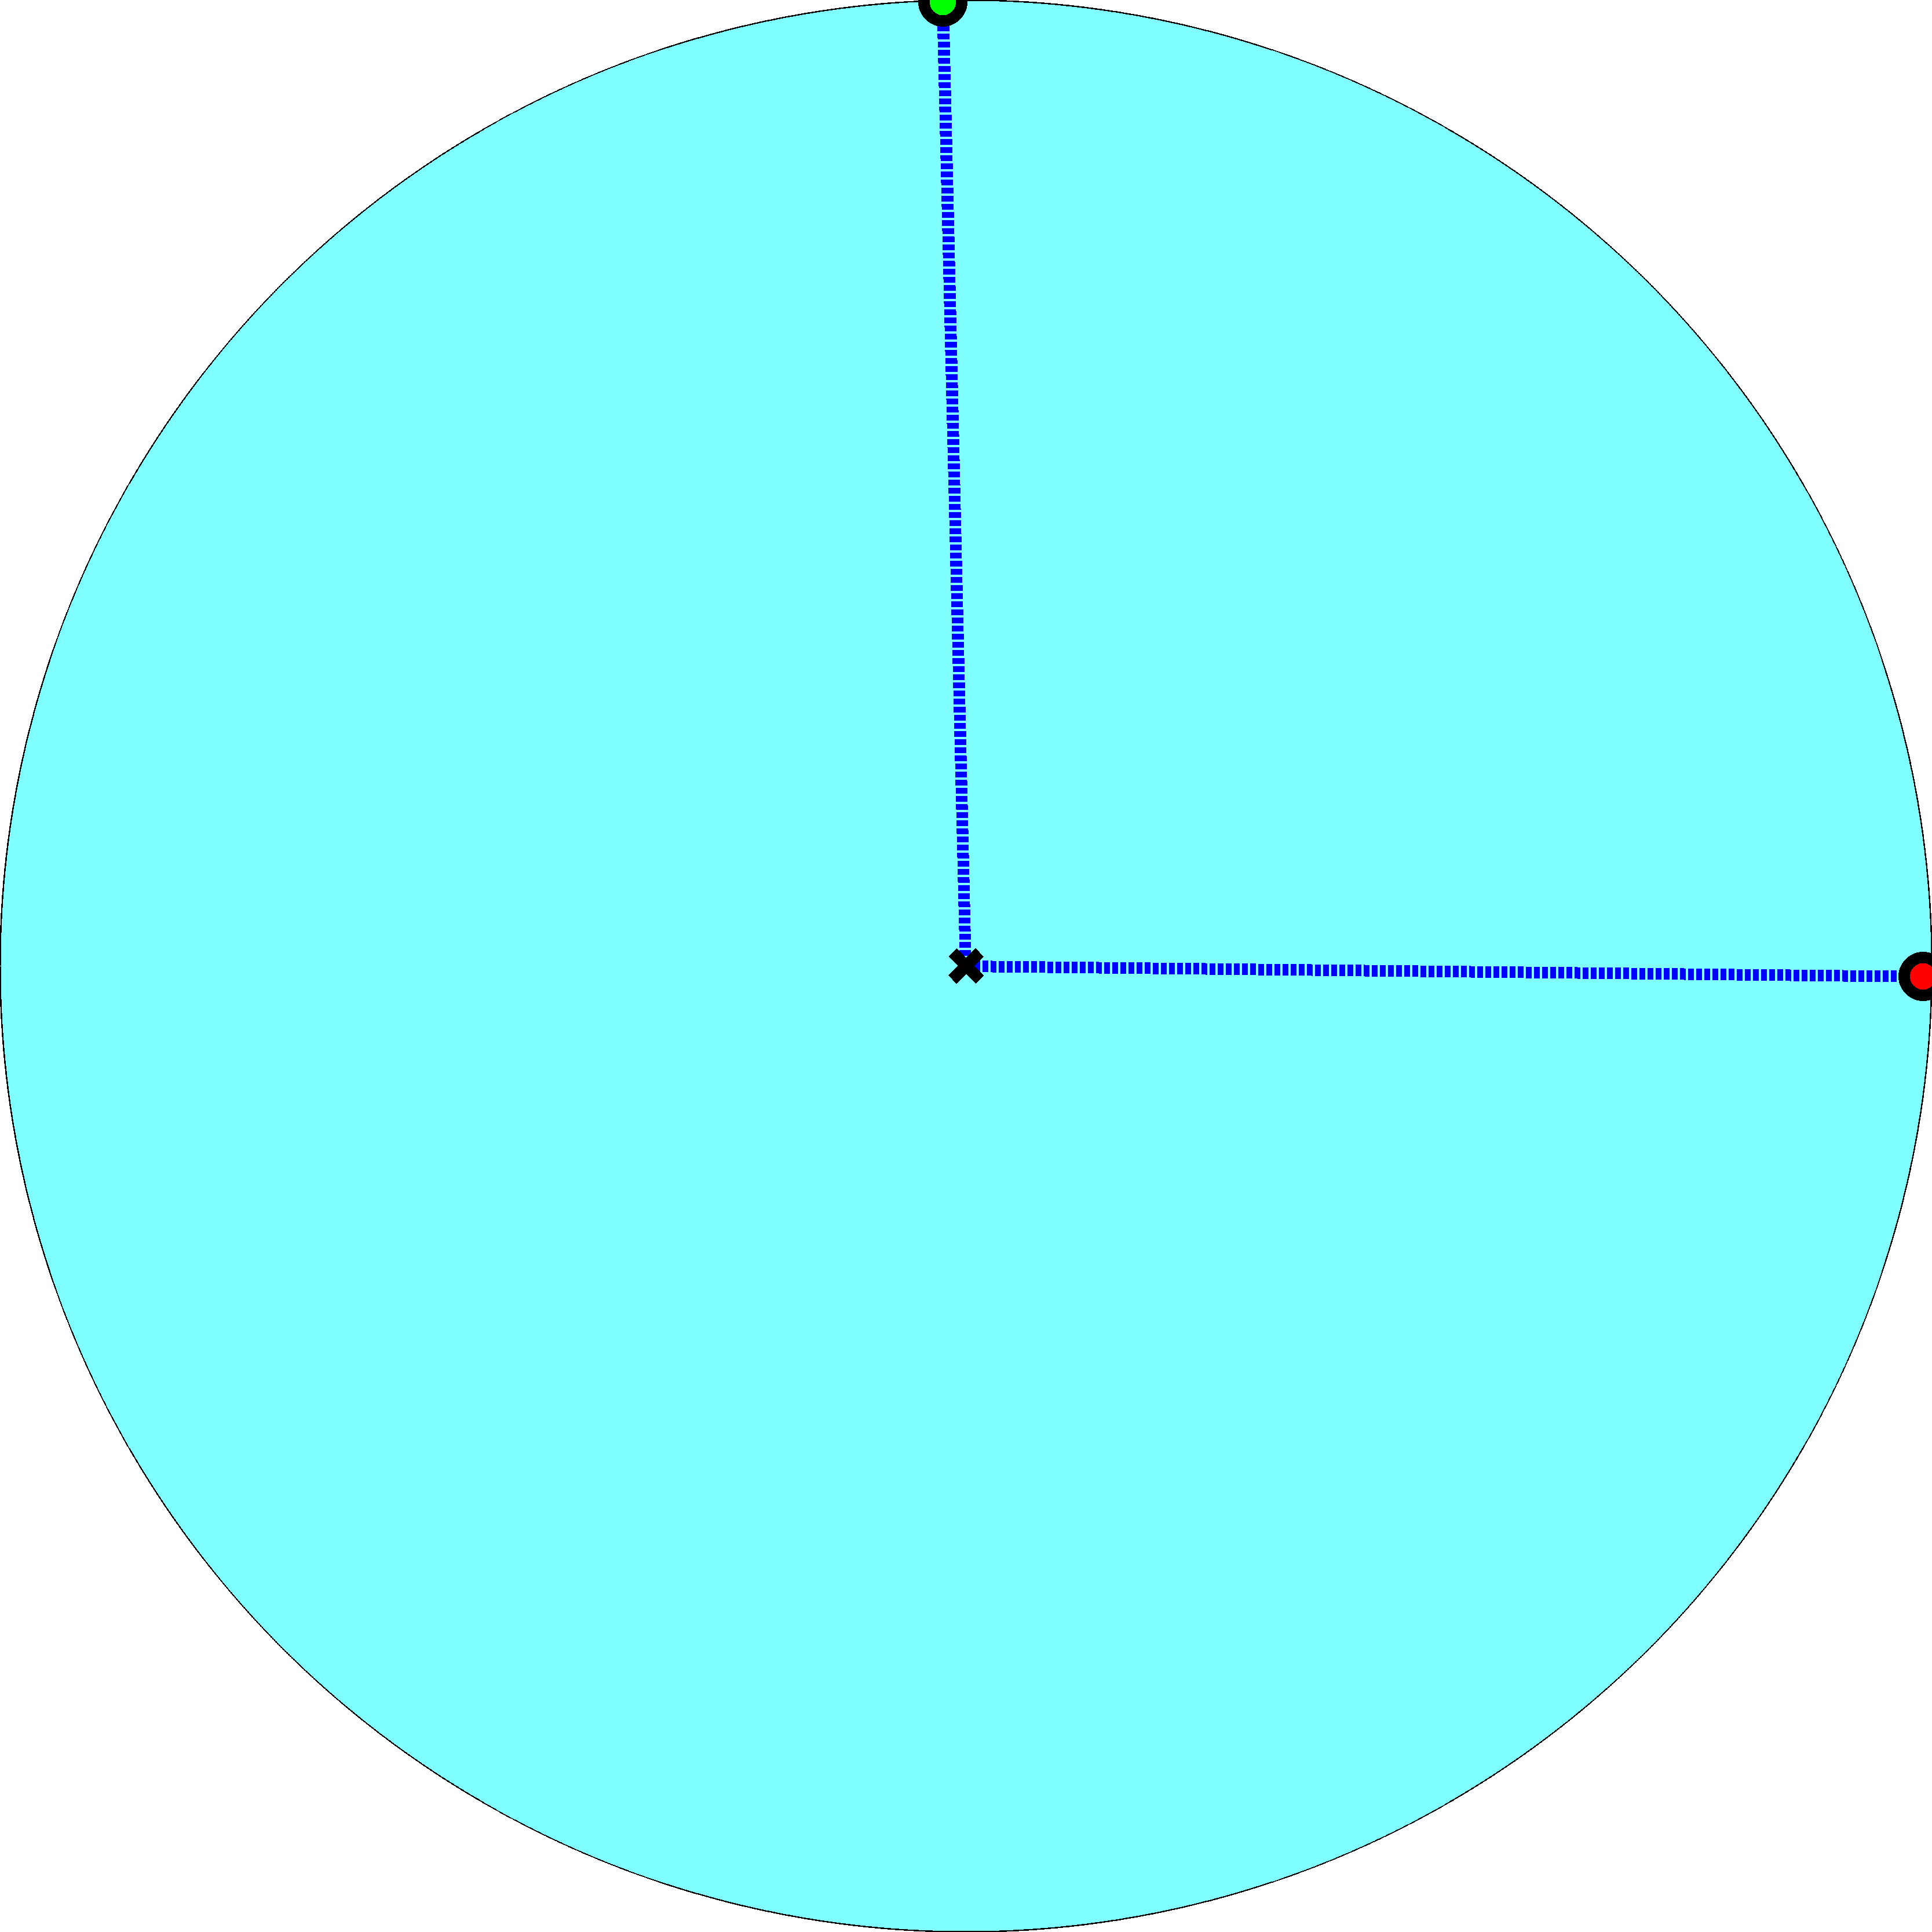
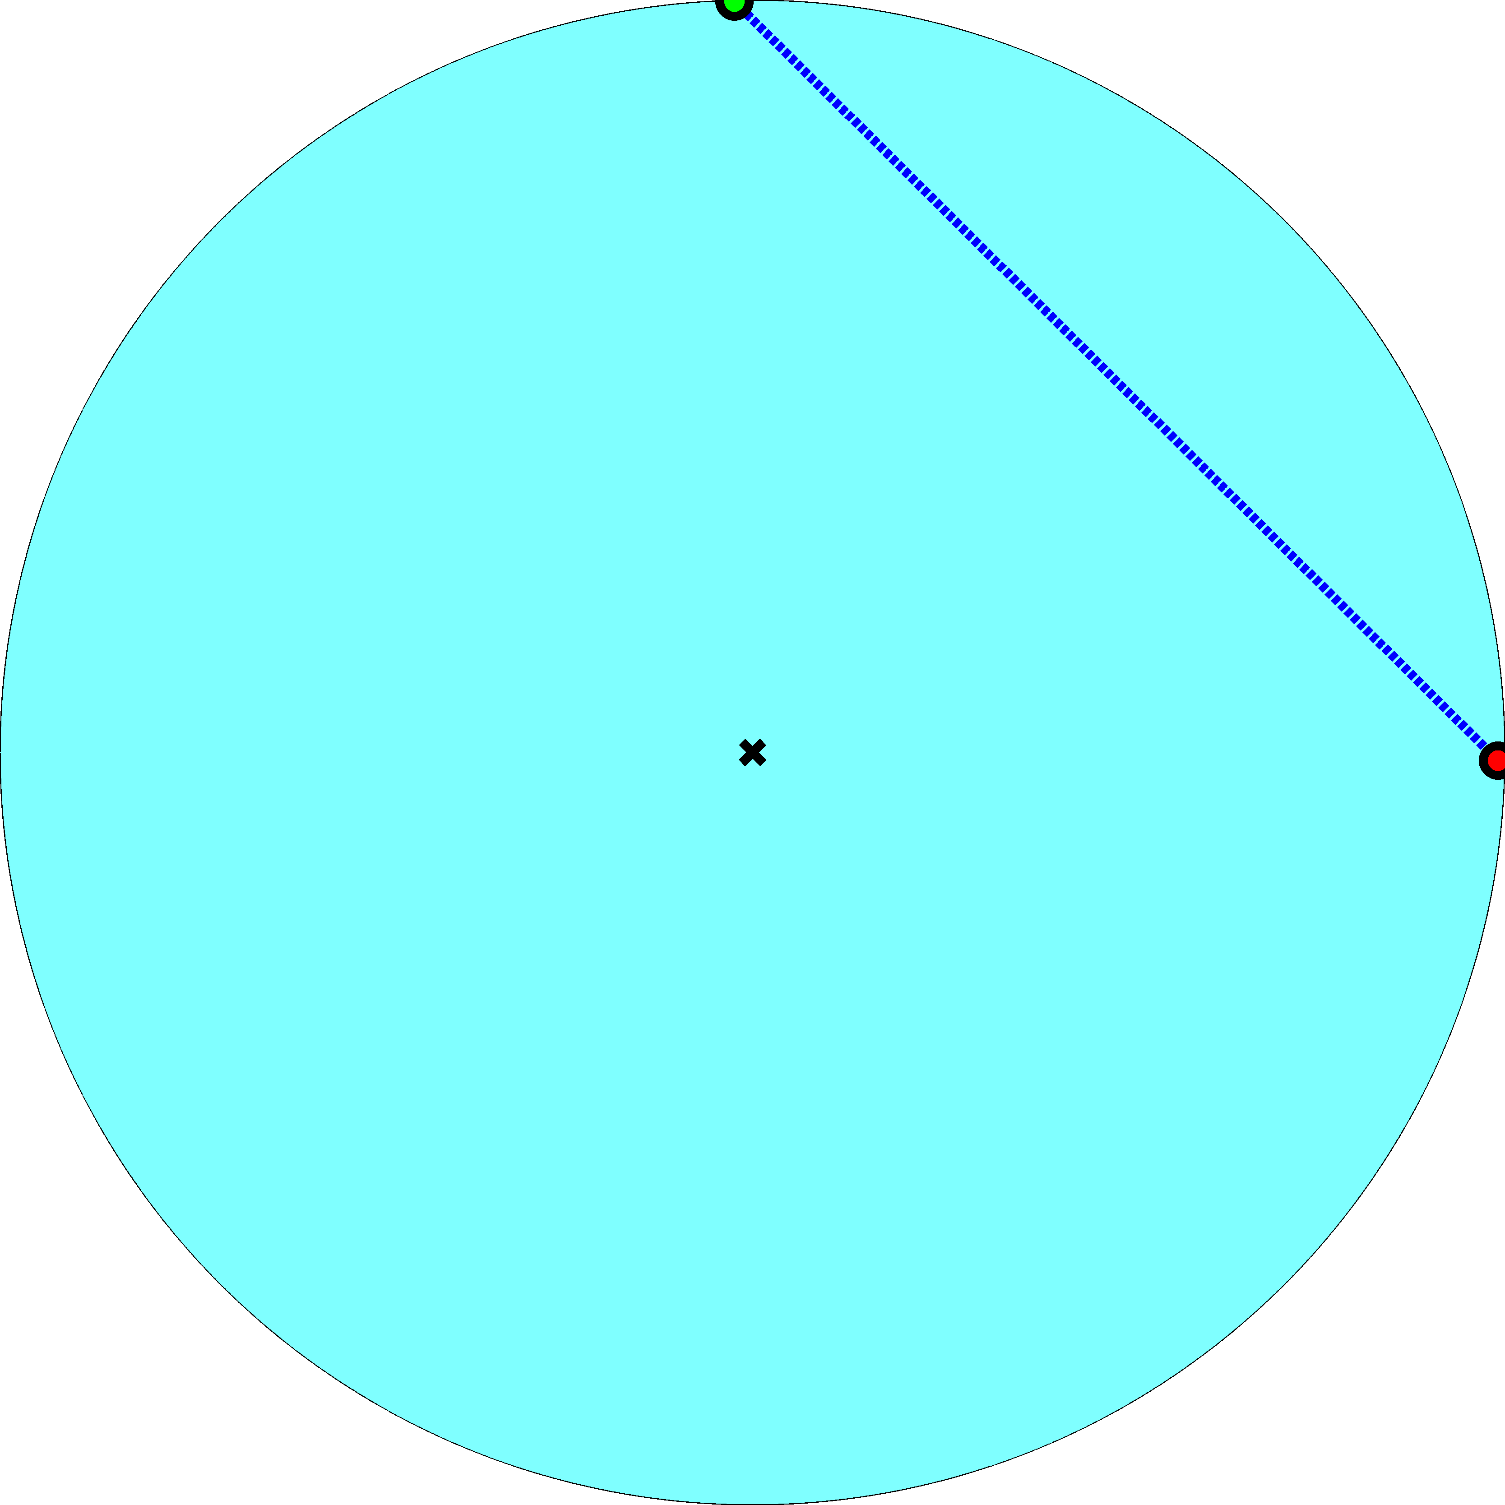
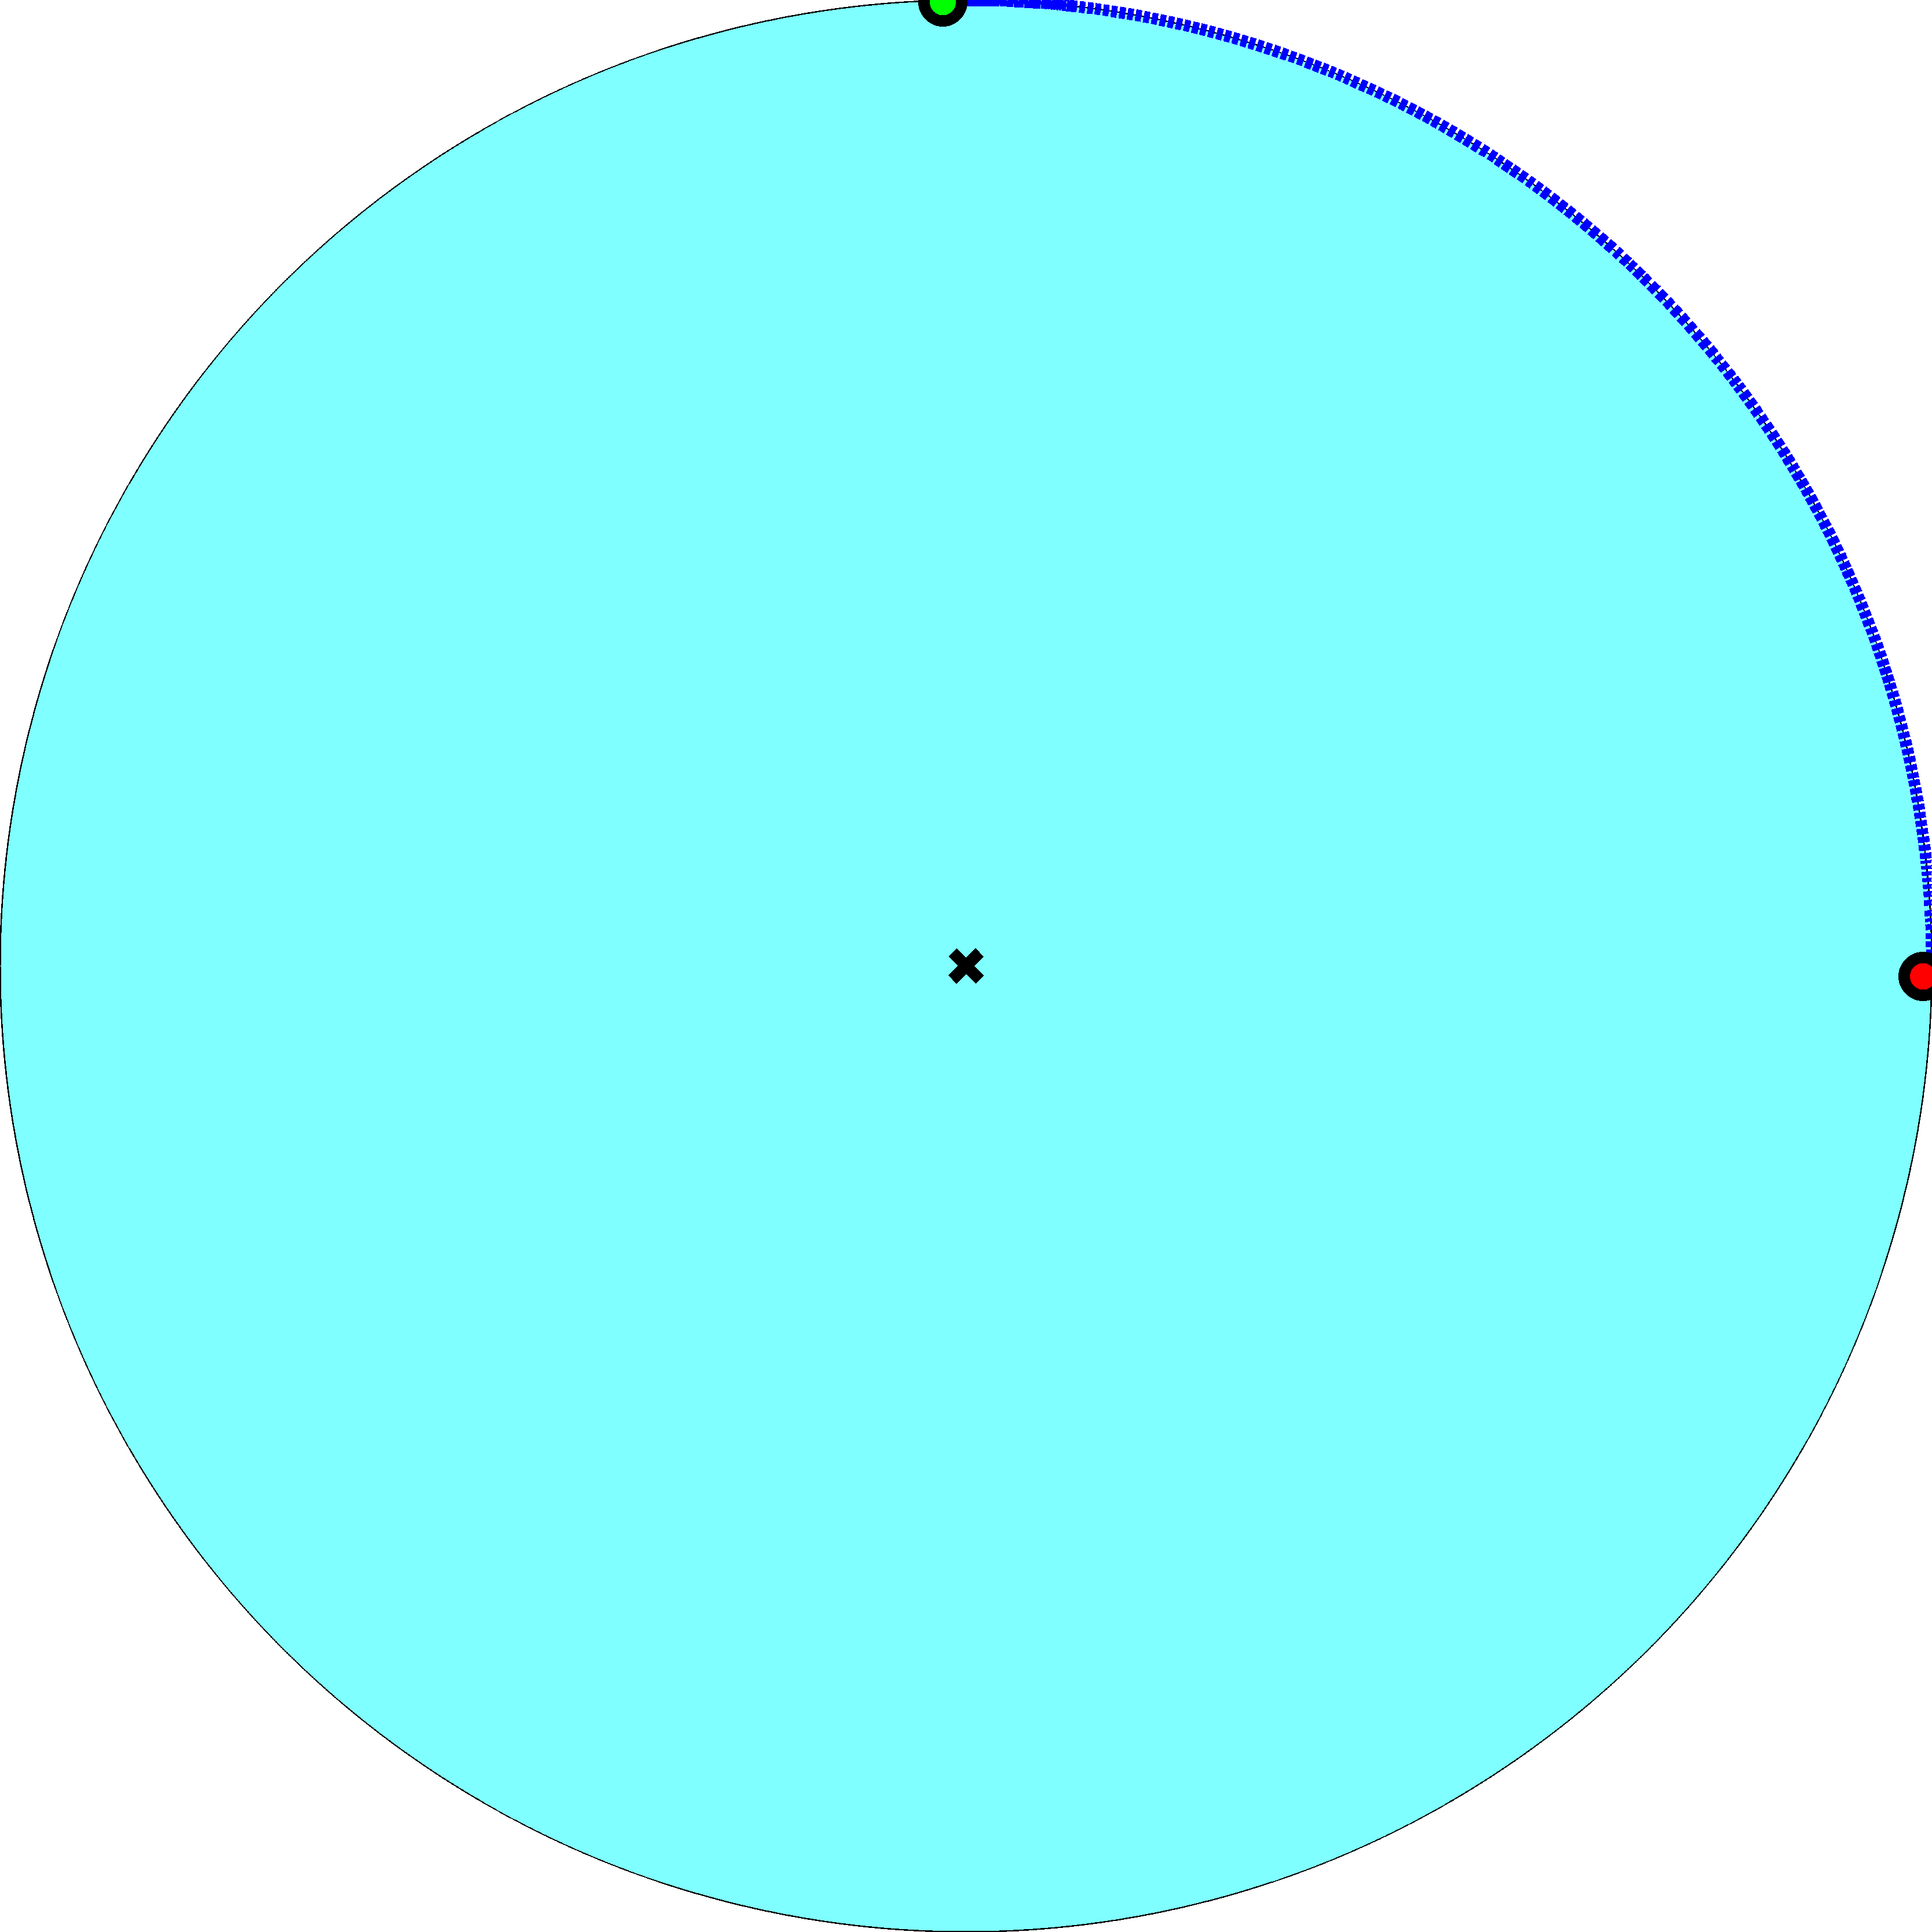
Hyperbolic (K   ²)
Tree (K  )
i
j
Euclidean (K  0)
Sphere (K  )

Slide 10
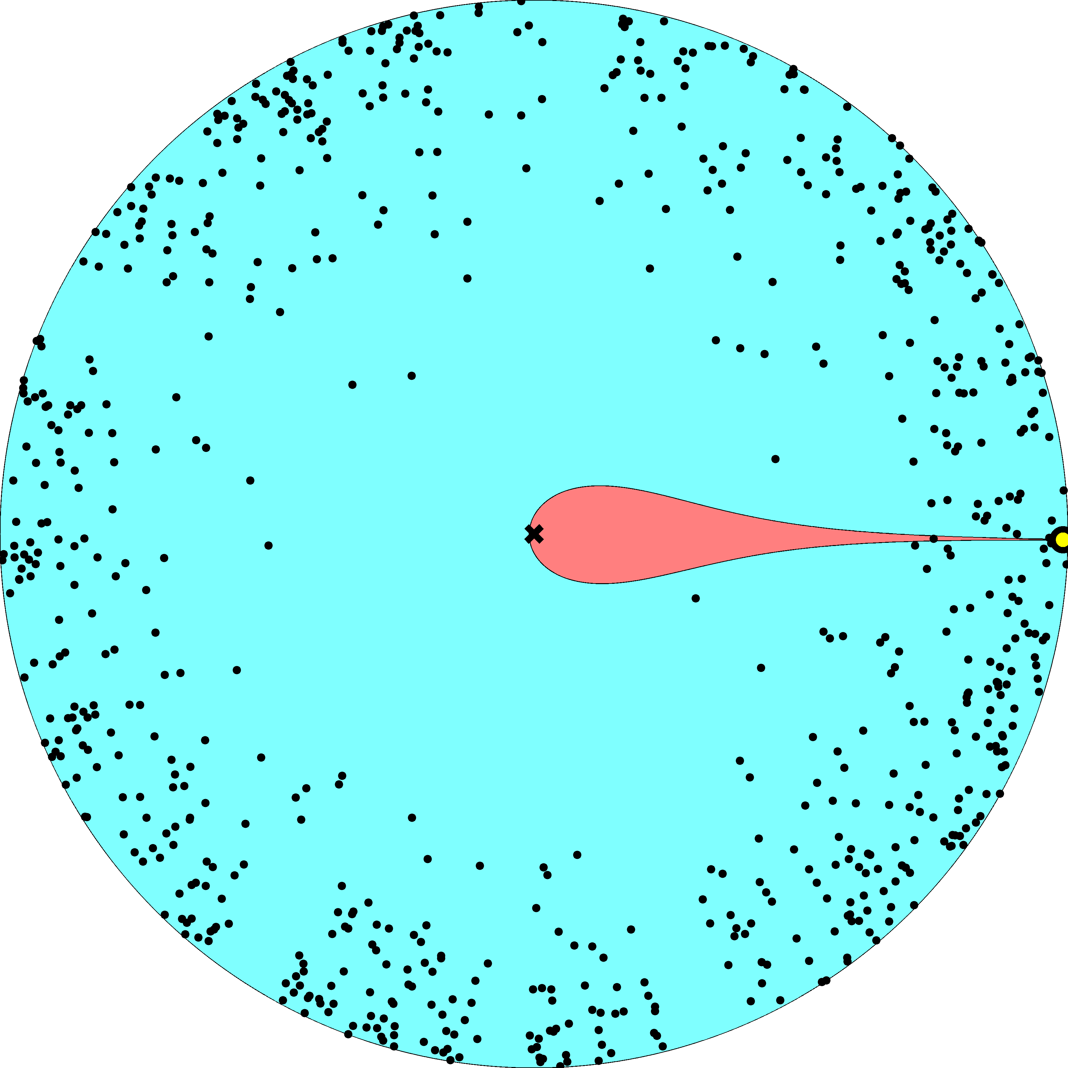

Slide 11
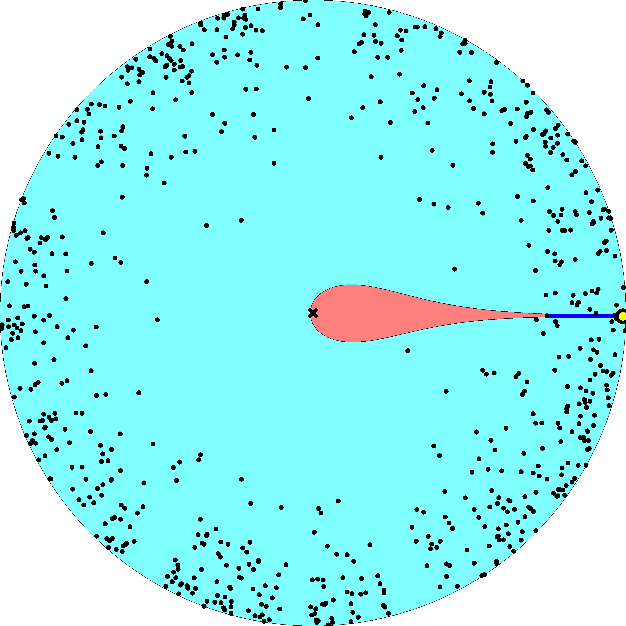

Slide 12
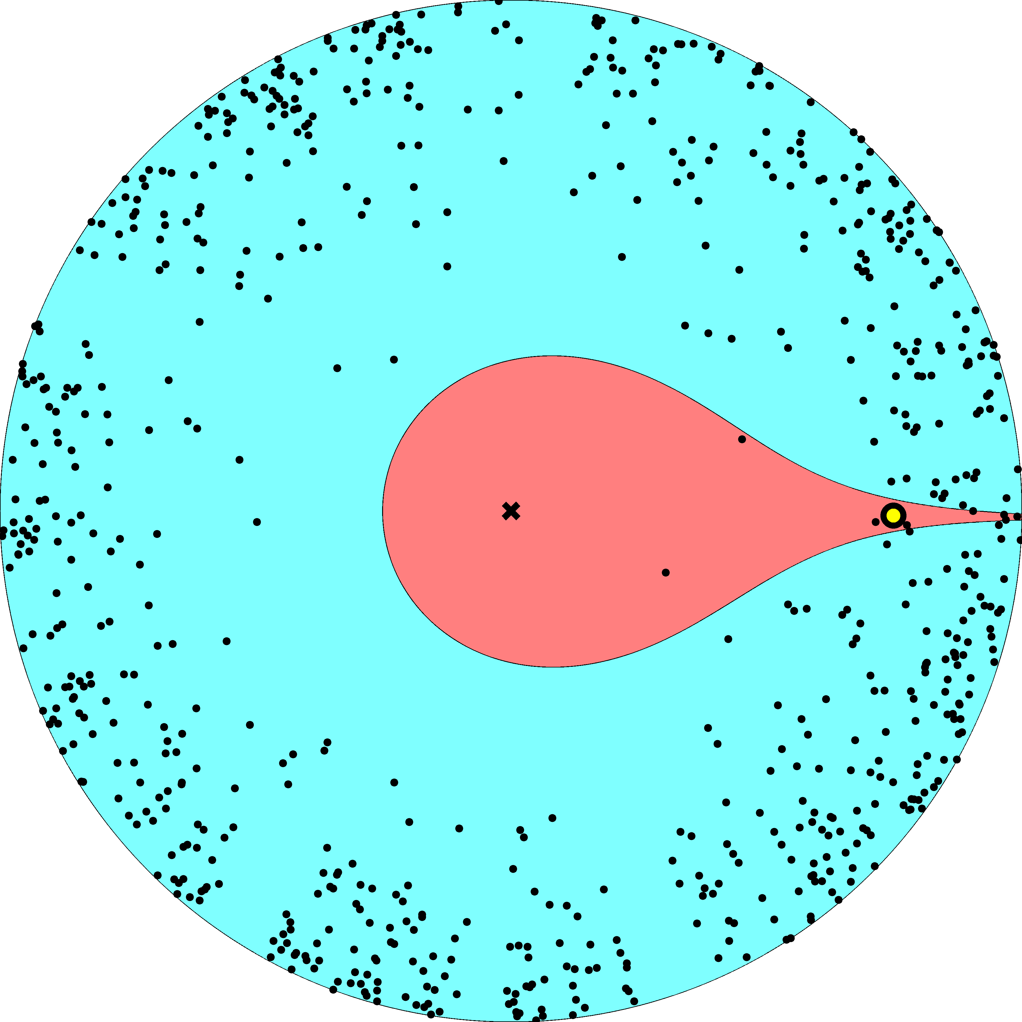

Slide 13
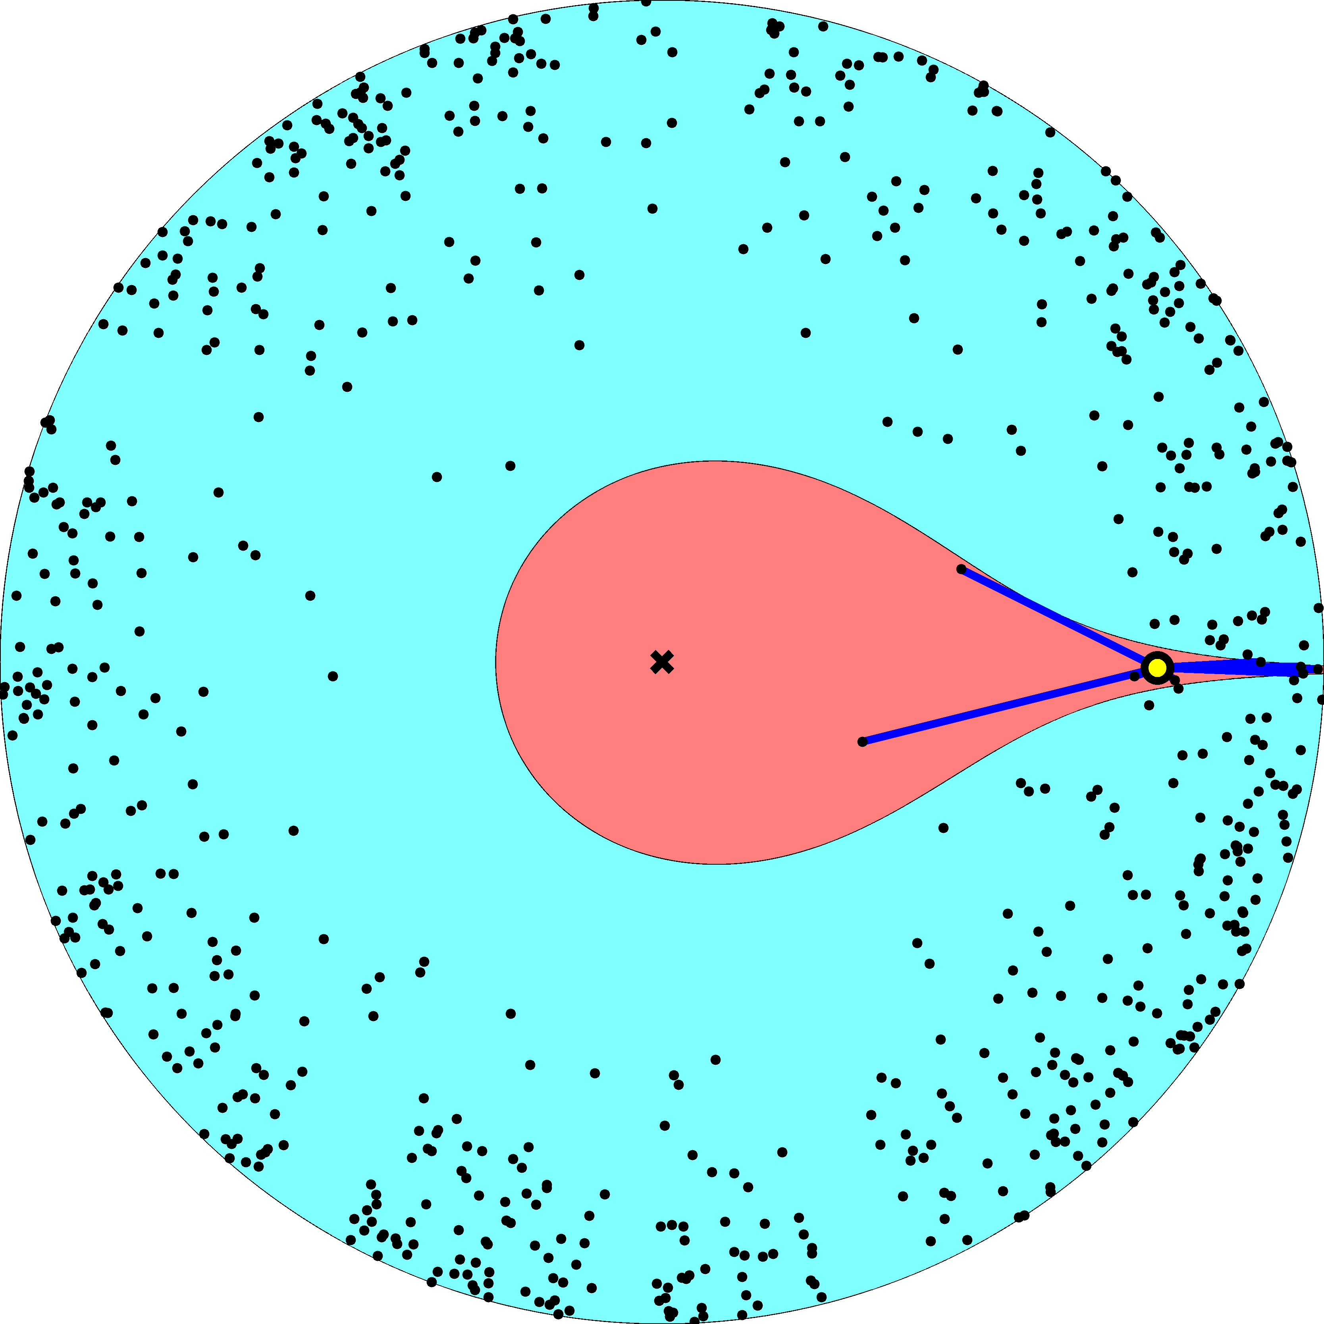

Slide 14
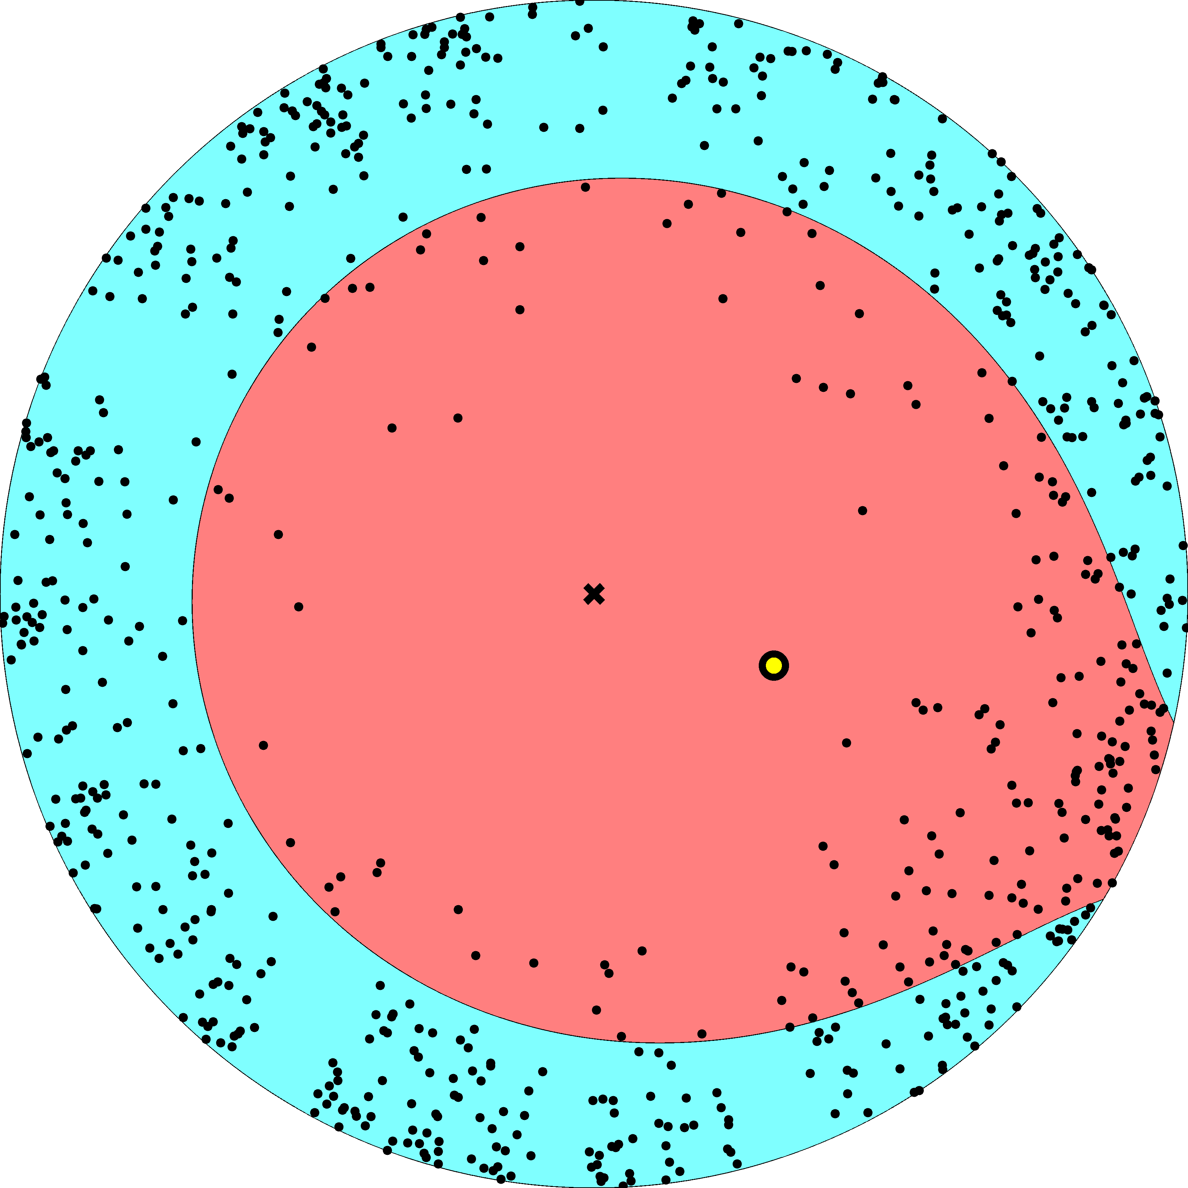

Slide 15
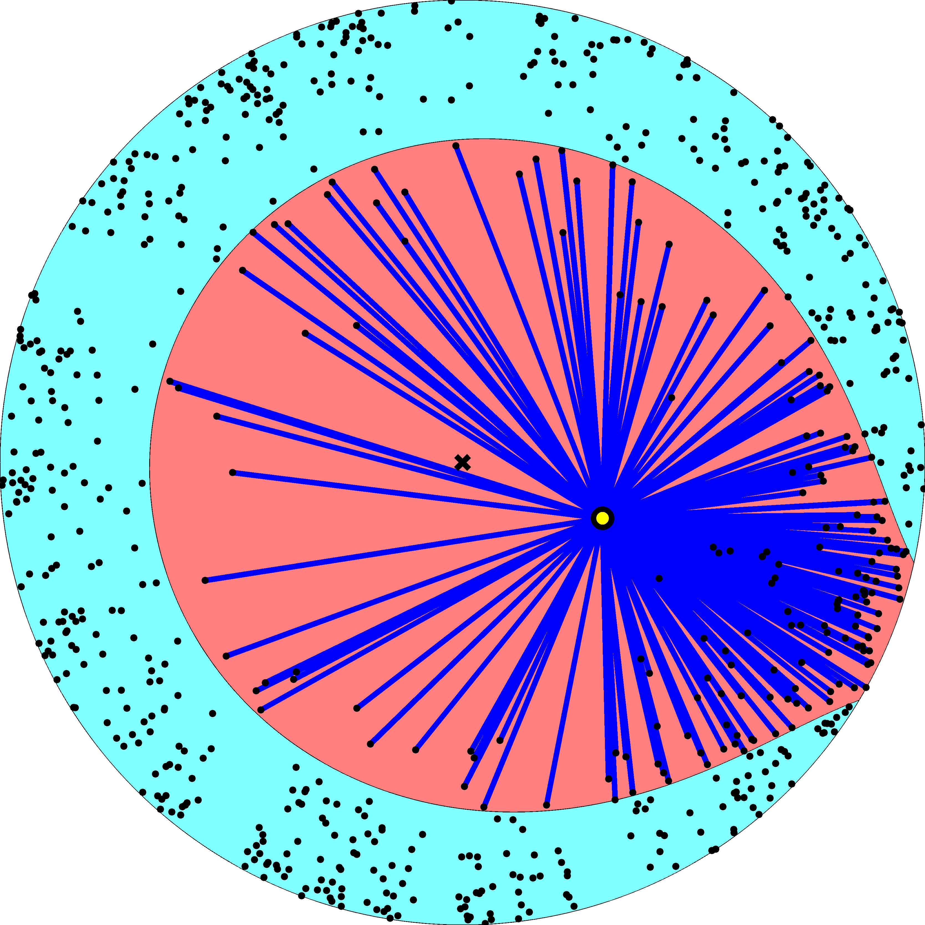

Slide 16
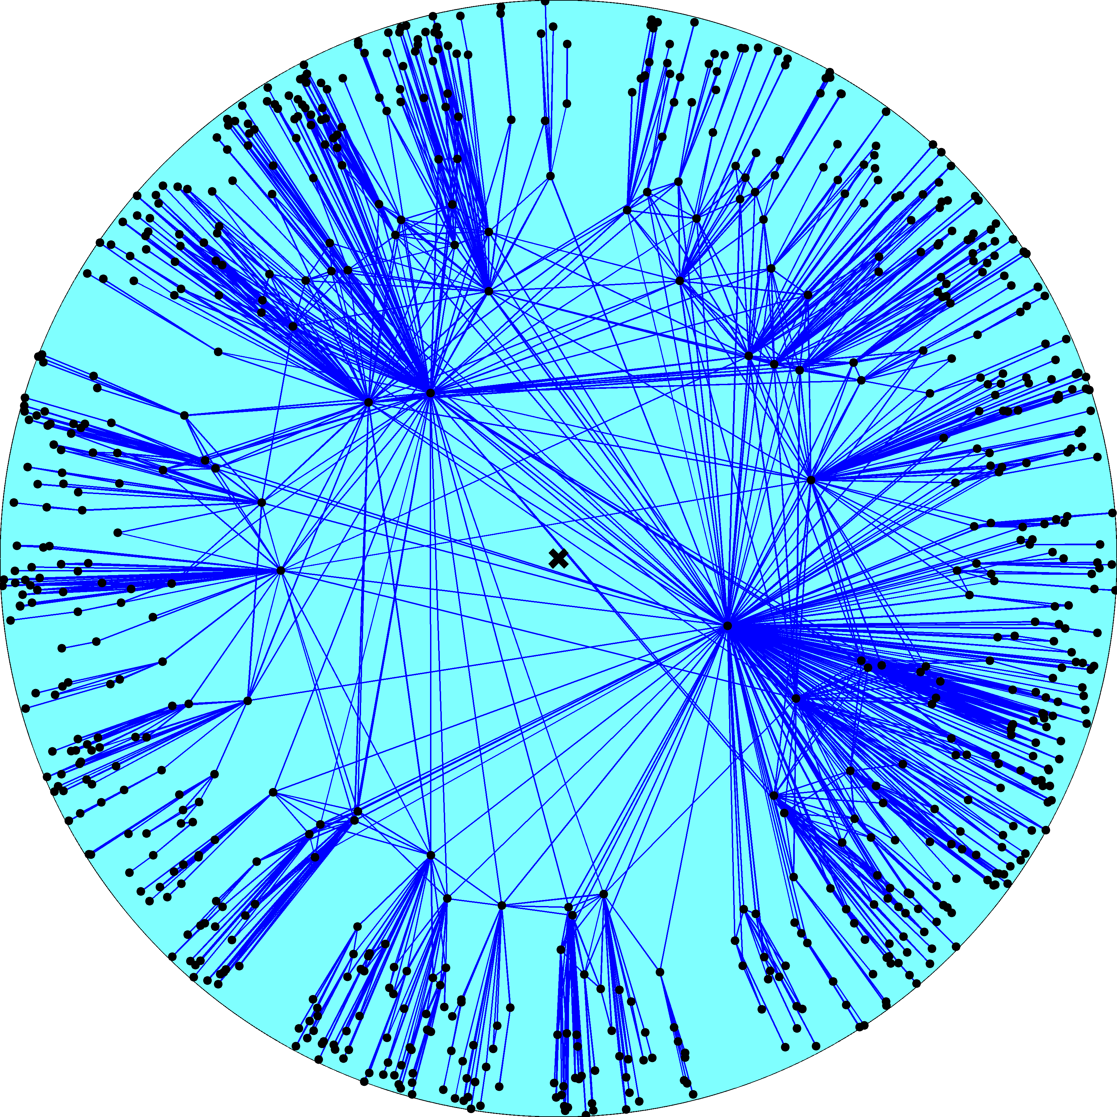
Node density
Node degree
R – disk radius
K – disk curvature
maximized
Degree distribution
Clustering

Slide 17
Fermi-Dirac connection probability
connection probability p(x) – Fermi-Dirac distribution
hyperbolic distance x – energy of links/fermions
disk radius R – chemical potential
two times inverse sqrt of curvature 2/ – Boltzmann constant
parameter T – temperature

Slide 18
Chemical potential R is a solution of
number of links M – number of particles
number of node pairs N(N1)/2 – number of energy states
distance distribution g(x) – degeneracy of state x
connection probability p(x) – Fermi-Dirac distribution

Slide 19
Cold regime 0T1
Chemical potential R(2/)ln(N/)
Constant  controls the average node degree
Clustering decreases from its maximum at T0 to zero at T1
Power law exponent  does not depend on T, (2/)1

Slide 20
Phase transition T1
Chemical potential R diverges as ln(|T1|)

Slide 21
Hot regime T1
Chemical potential RT(2/)ln(N/)
Clustering is zero
Power law exponent  does depend on T, T(2/)1

Slide 23
Classical random graphs T;  fixed
R  T(2/)ln(N/)  
(r) = e^{rR}  (rR)
x_{ij} = r_{i} + r_{j} + (2/)ln[sin(_{ij}/2)]
g(x)  (x2R)
→ 2R

Slide 24
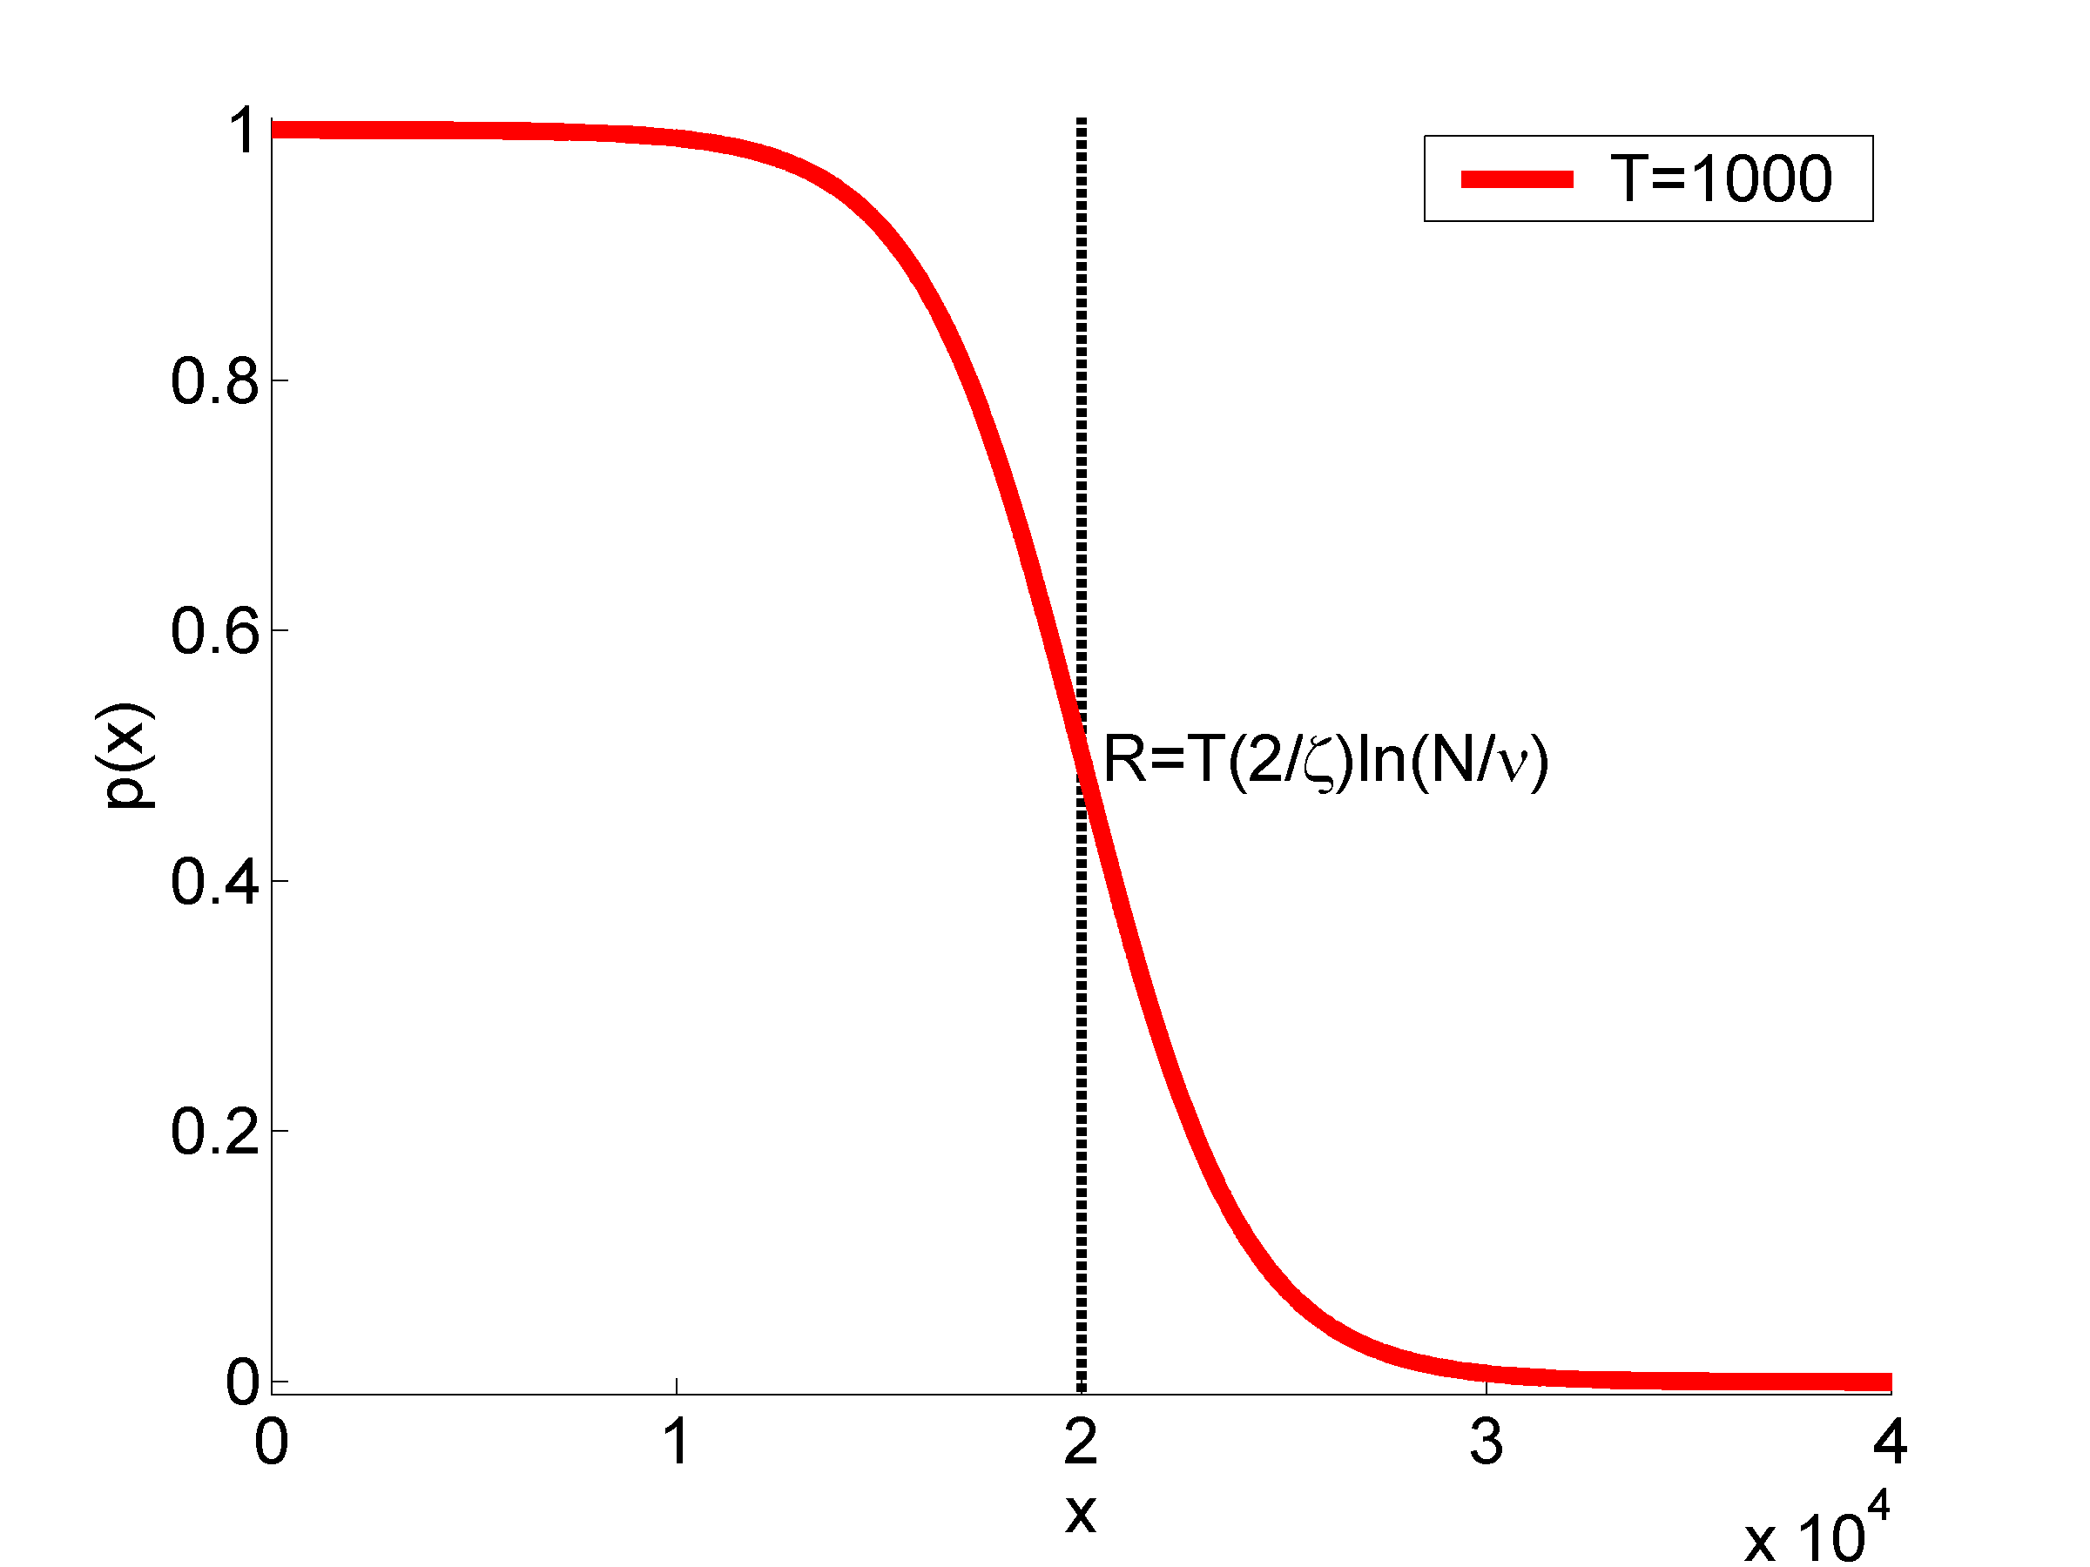
p  ↑k/N

Slide 25
Classical random graphs T;  fixed
R  T(2/)ln(N/)  
(r) = e^{rR}  (rR)
x_{ij} = r_{i} + r_{j} + (2/)ln[sin(_{ij}/2)]  2R
g(x)  (x2R)
p(x)  p = ↑k/N
Classical random graphs G_{N,p}
random graph with a given average degree ↑k = pN
Redefine x_{ij} = sin(_{ij}/2) (K = )

Slide 26
Configuration model T;  ; T/ fixed
R  T(2/)ln(N/); fixed
(r) = e^{rR}; fixed
x_{ij} = r_{i} + r_{j} + (2/)ln[sin(_{ij}/2)]
p(x_{ij})  p_{ij} = k_{i}k_{j}/(↑kN)
Configuration model
random graph with given expected degrees k_{i}
x_{ij} = r_{i} + r_{j} (K = )
→ r_{i} + r_{j}

Slide 27
2
100
2
1
1000

Slide 28
H²
S¹

Slide 29
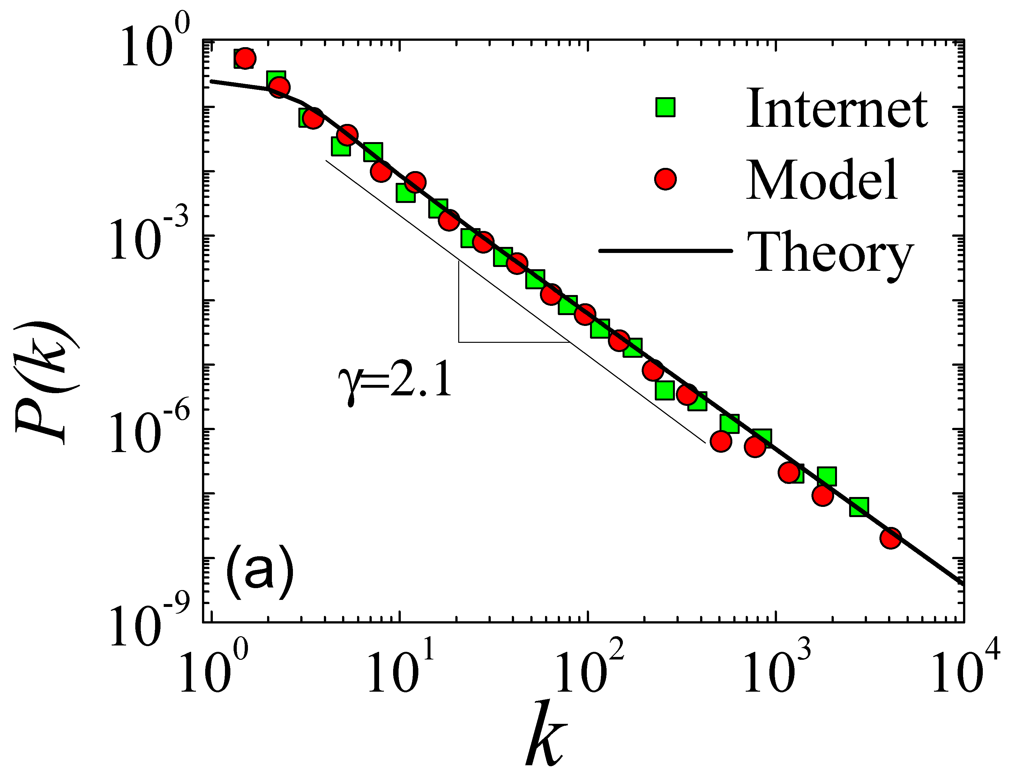

Slide 30
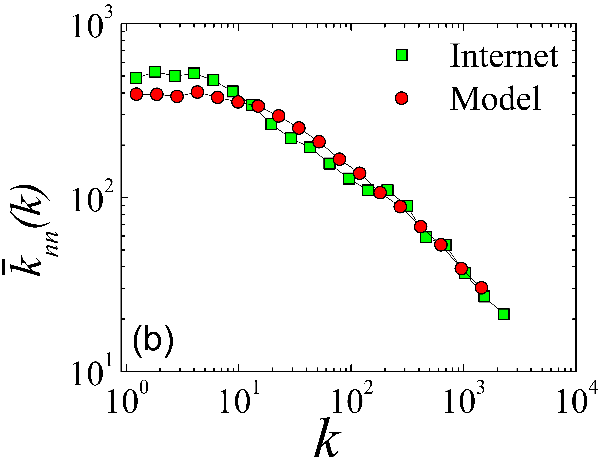

Slide 31
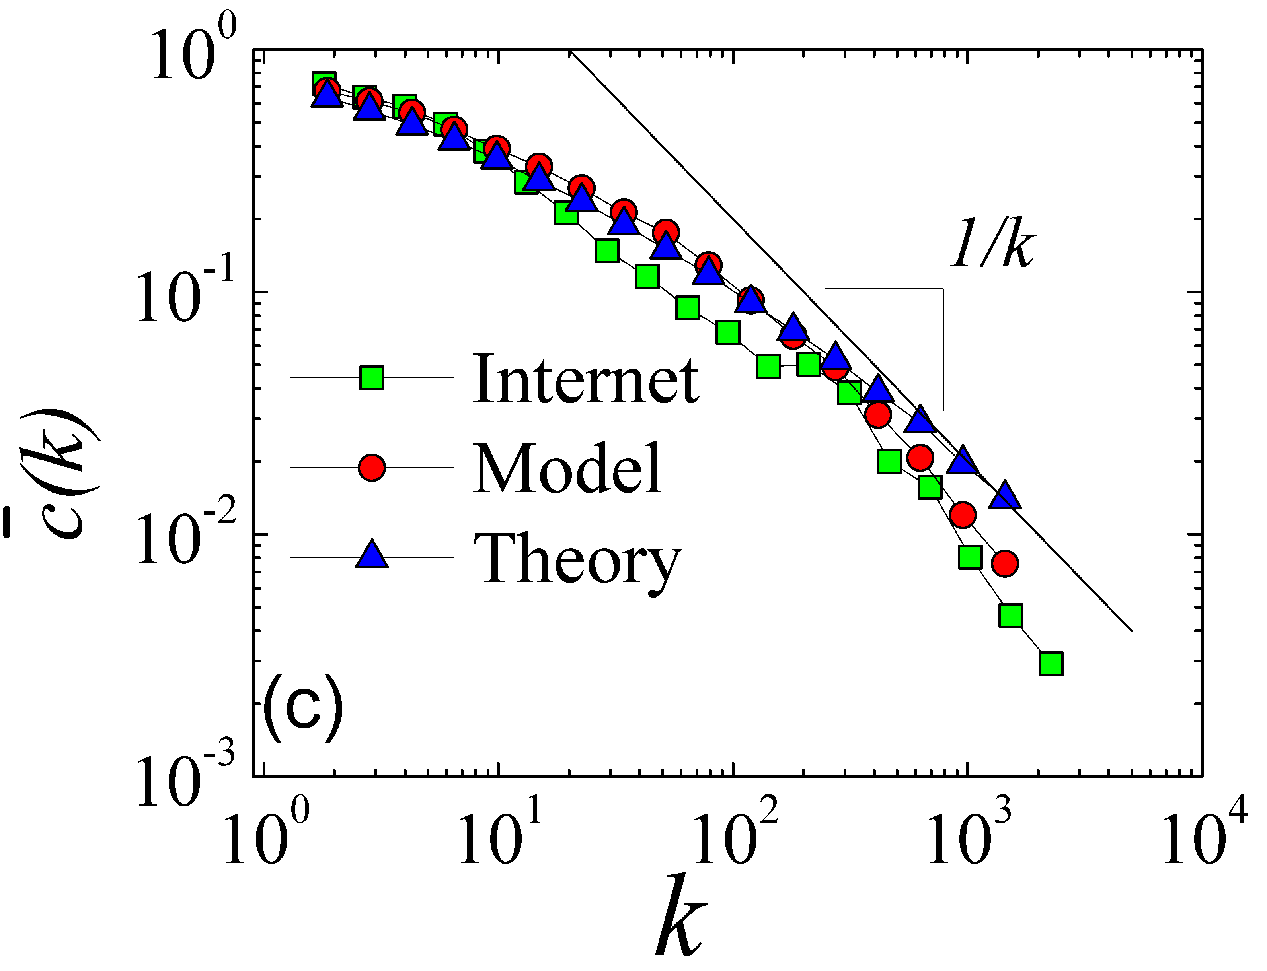

Slide 32
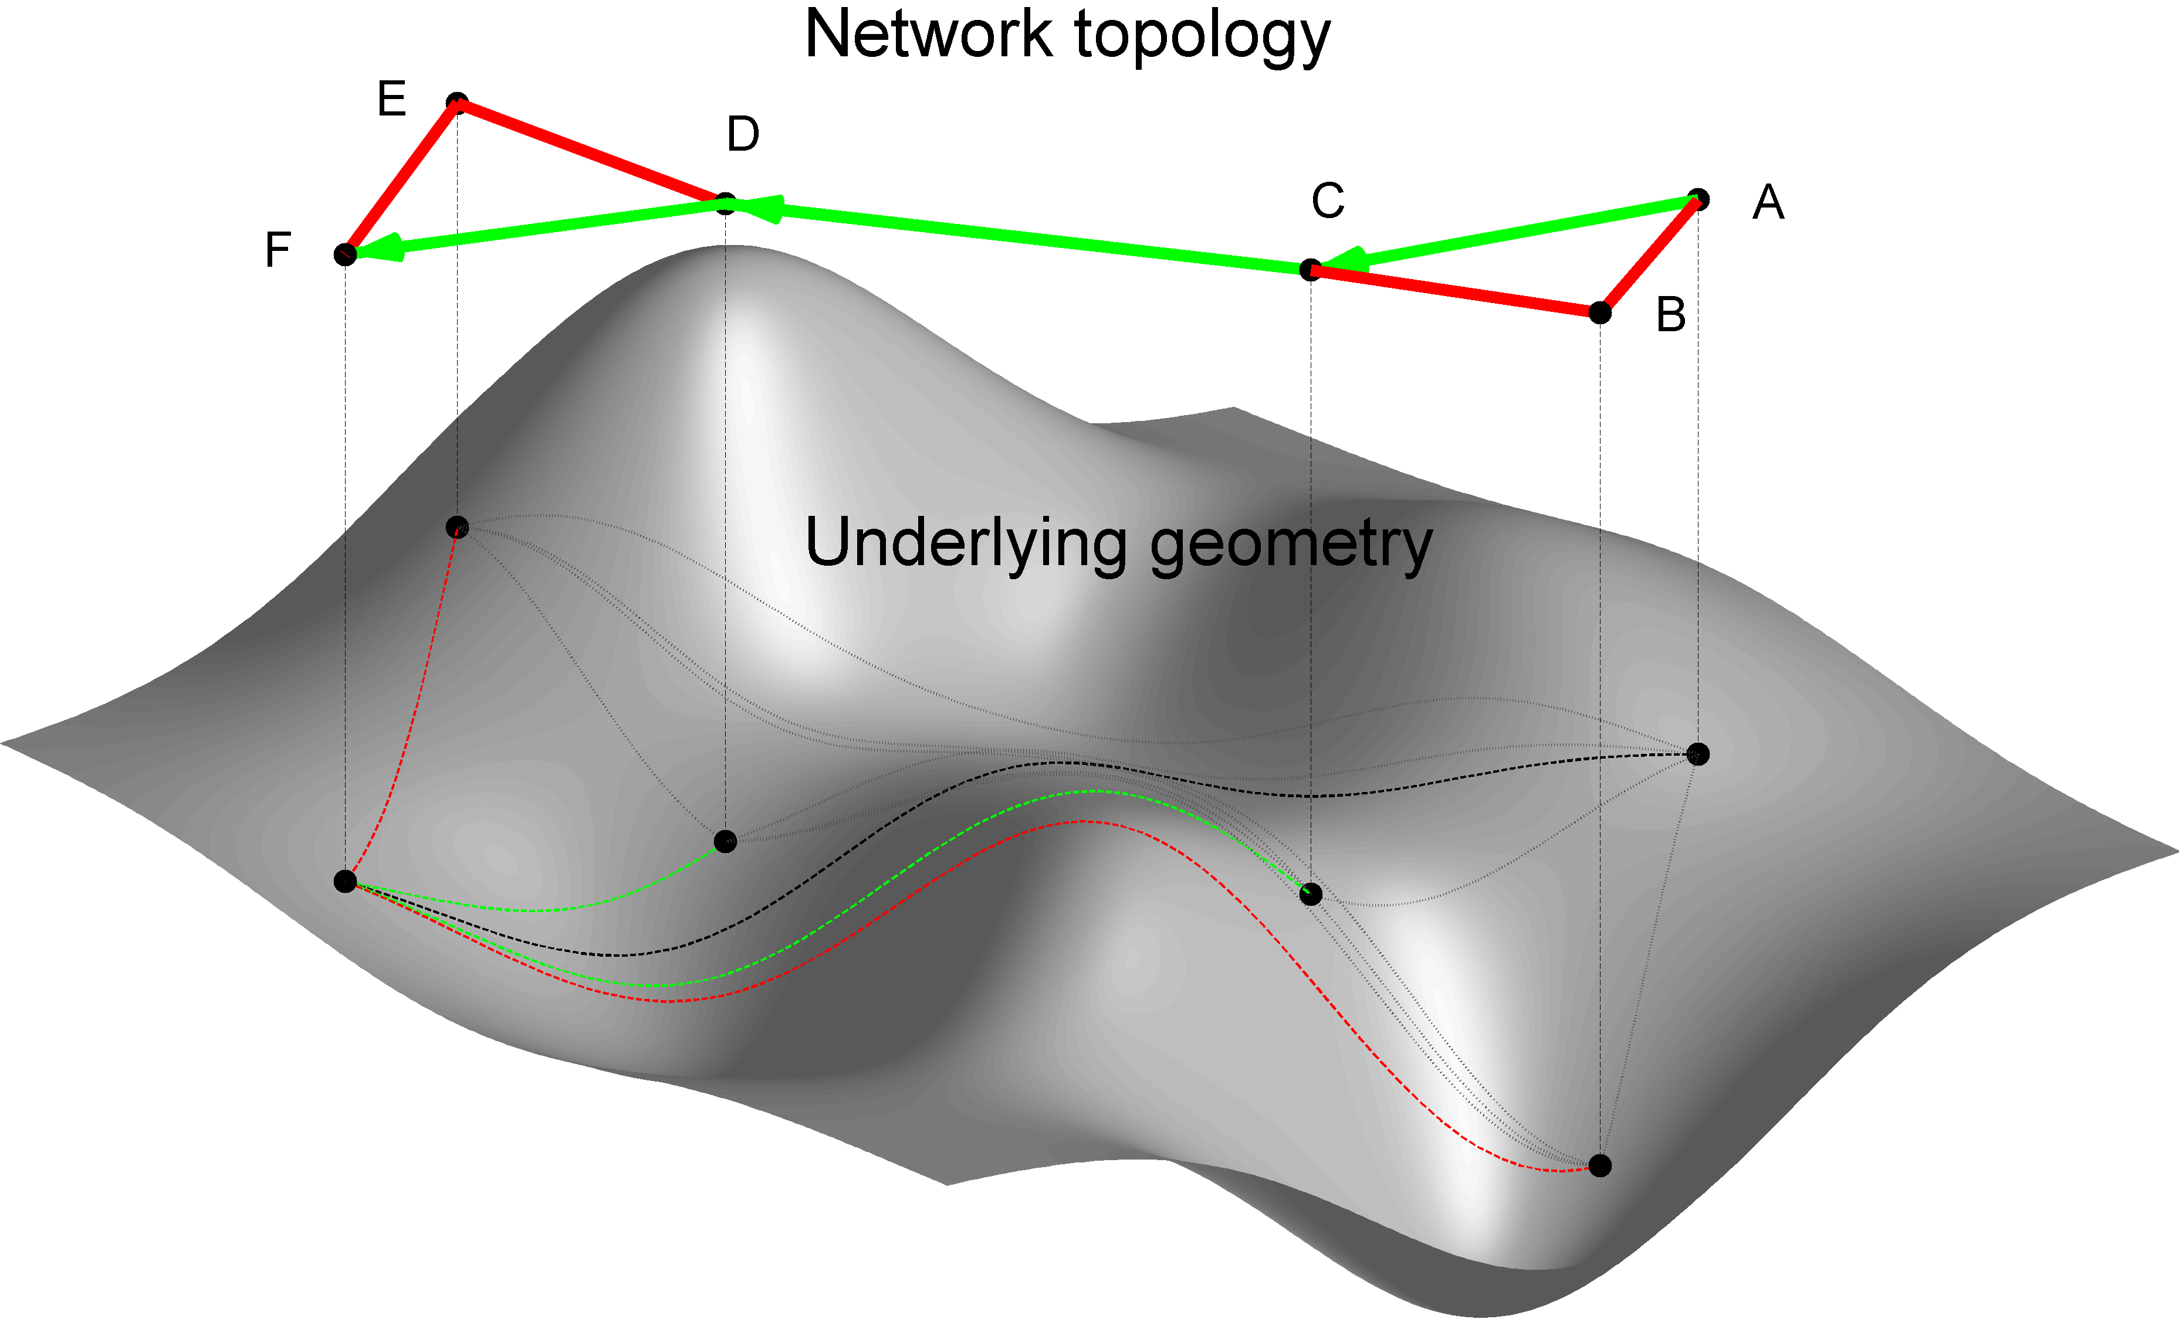
From structure
To function

Slide 35
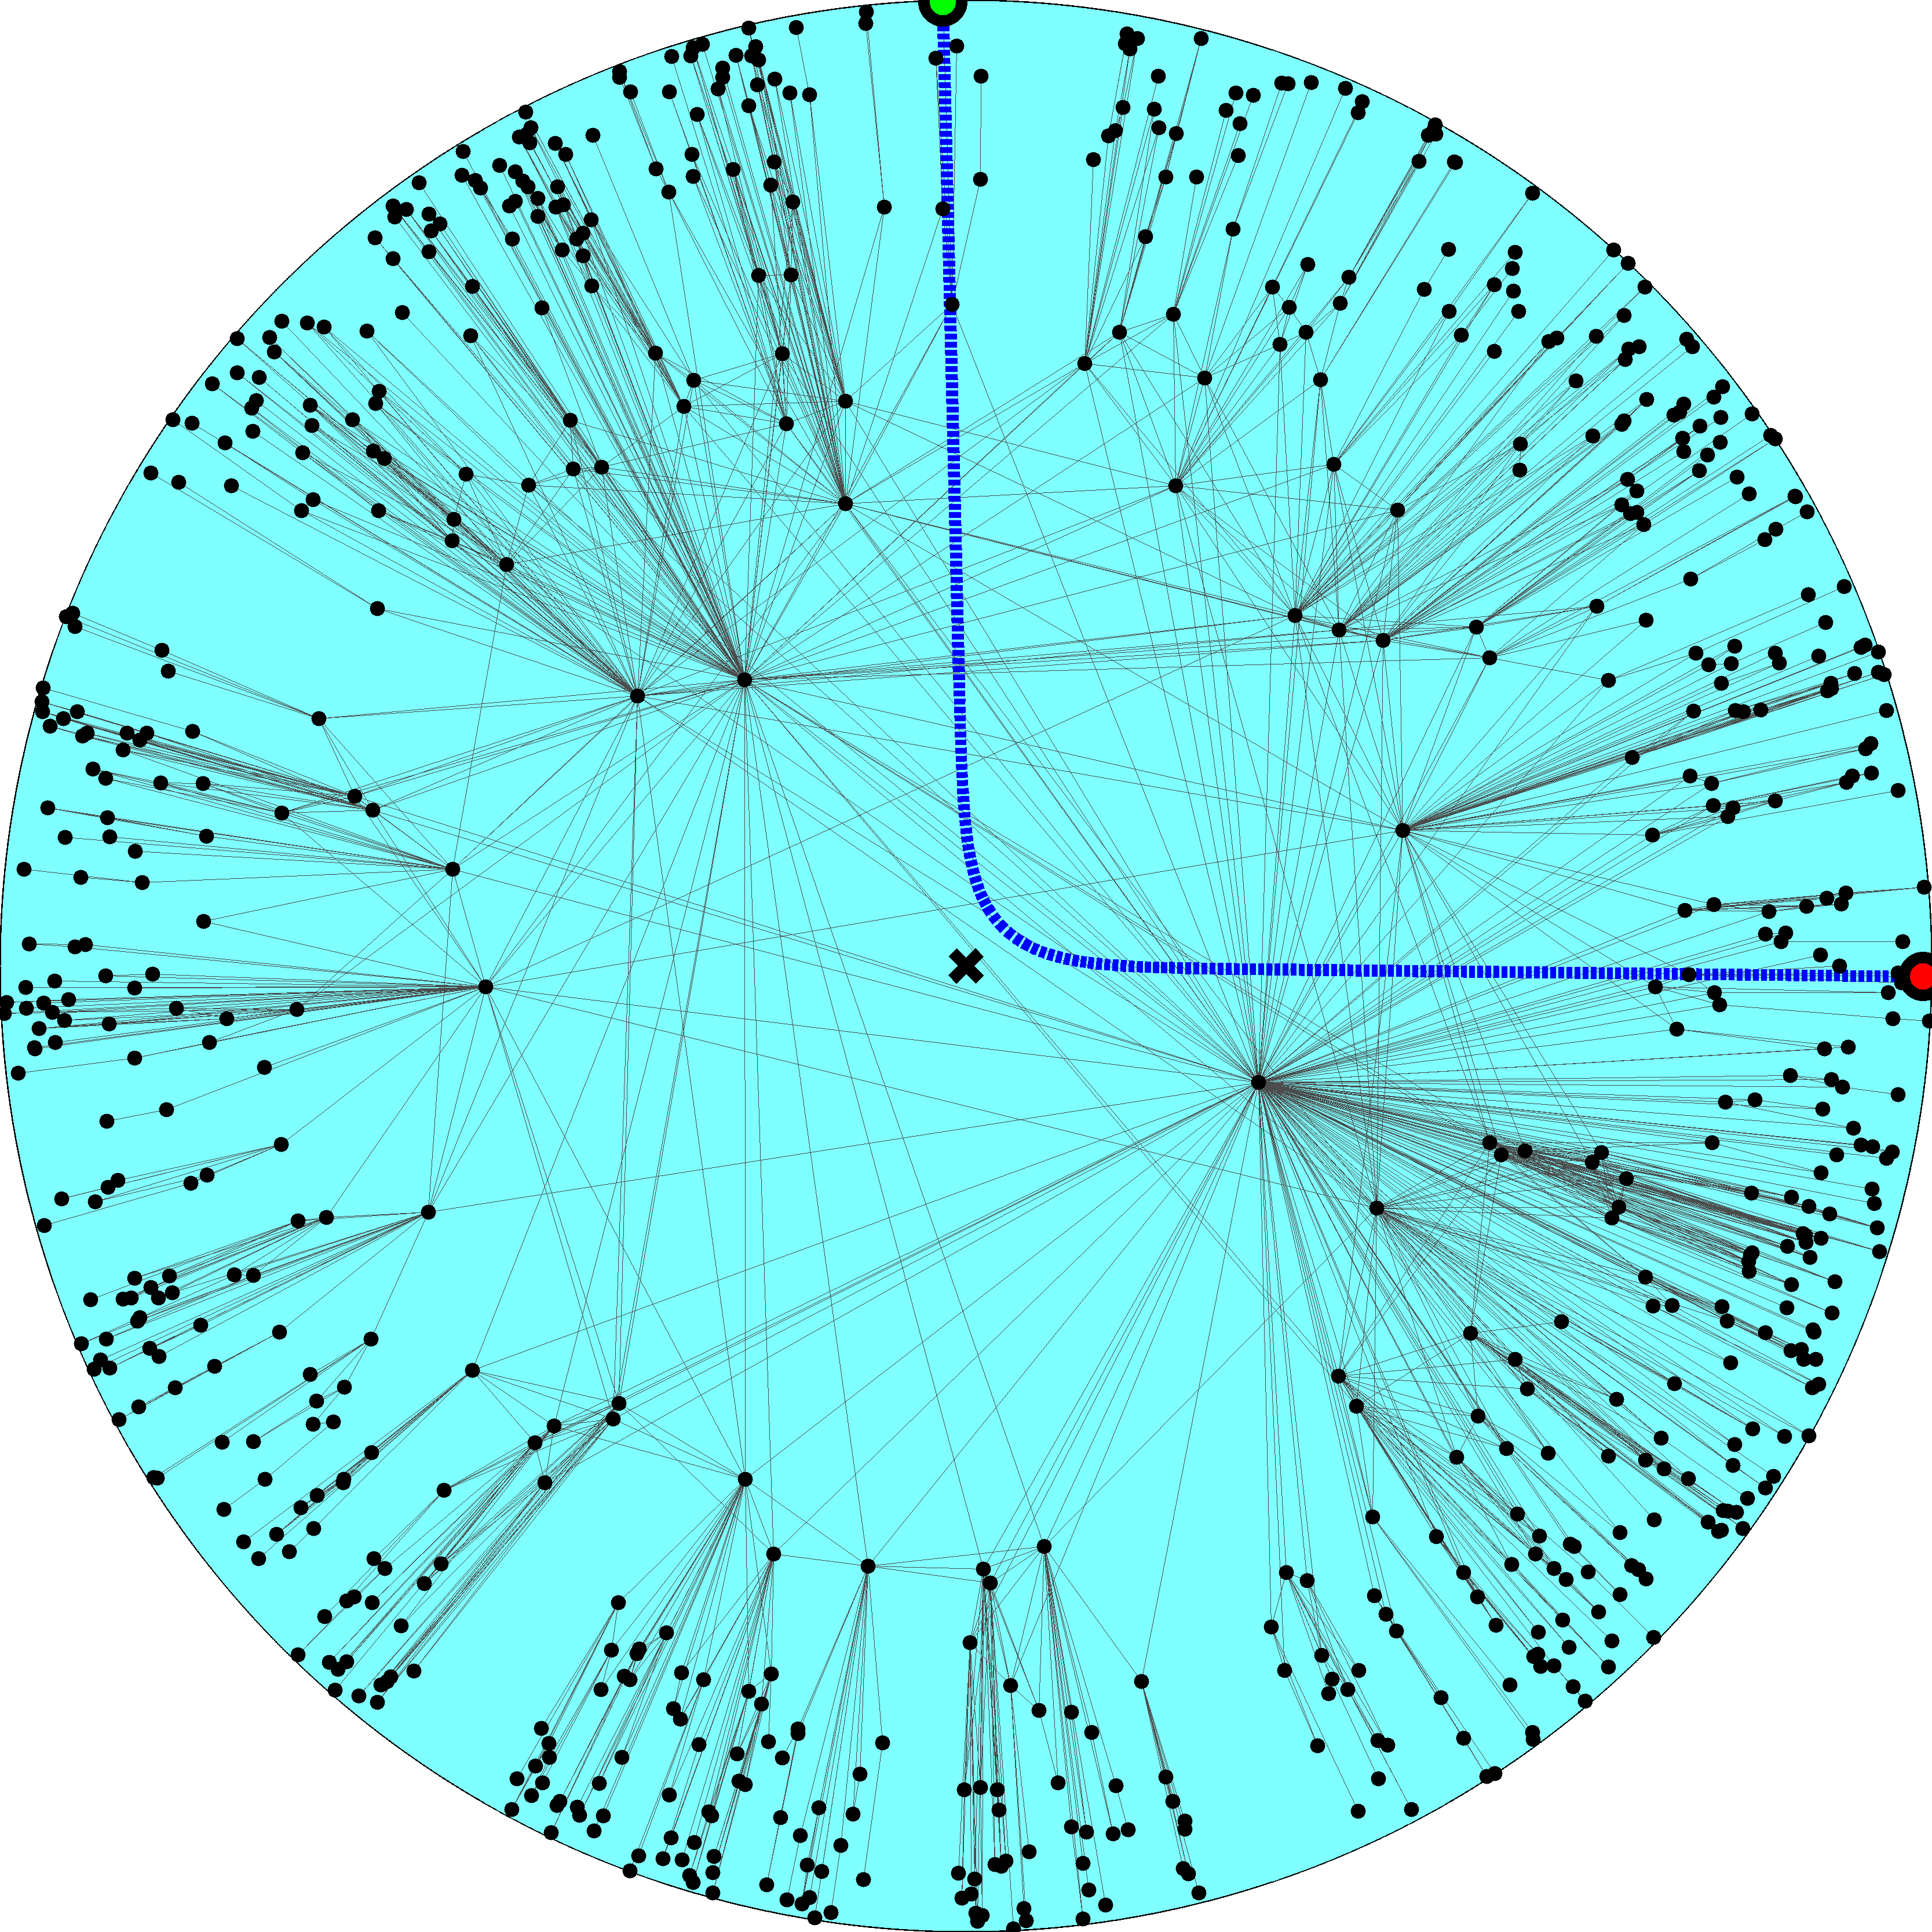

Slide 36
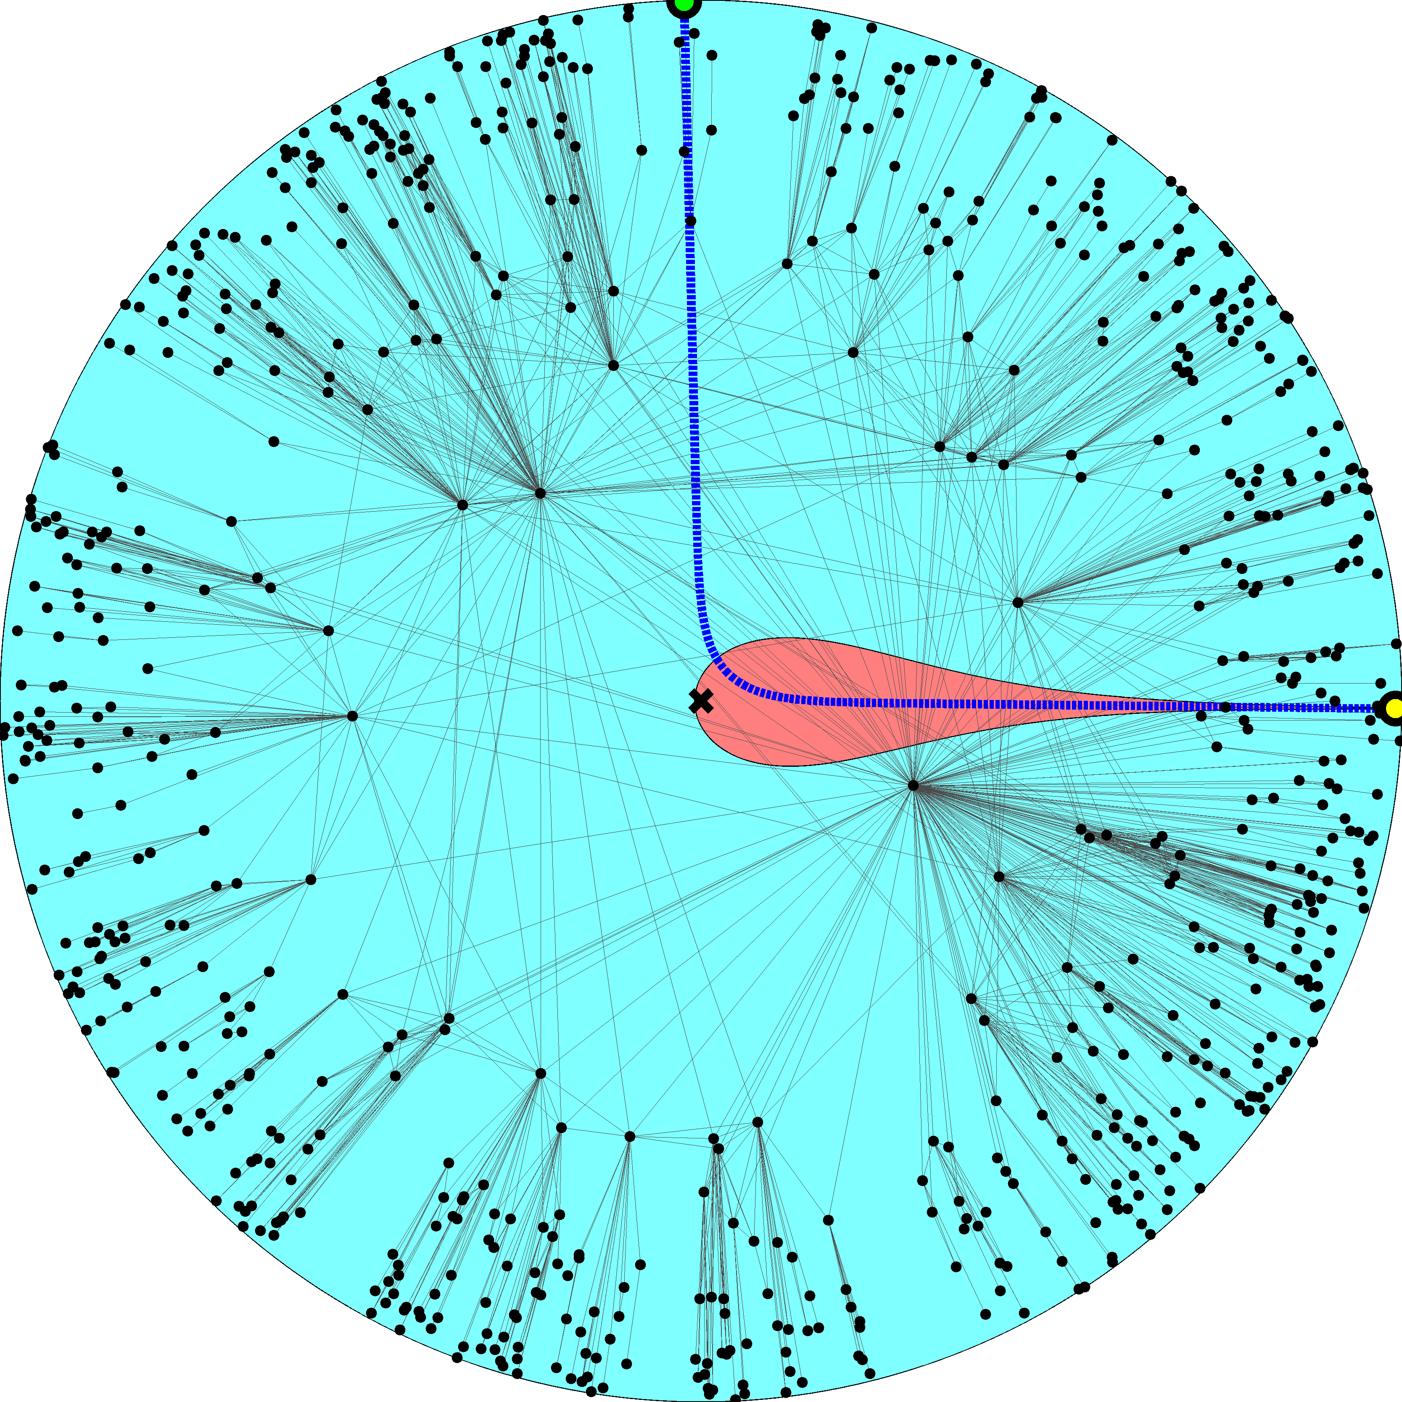

Slide 38
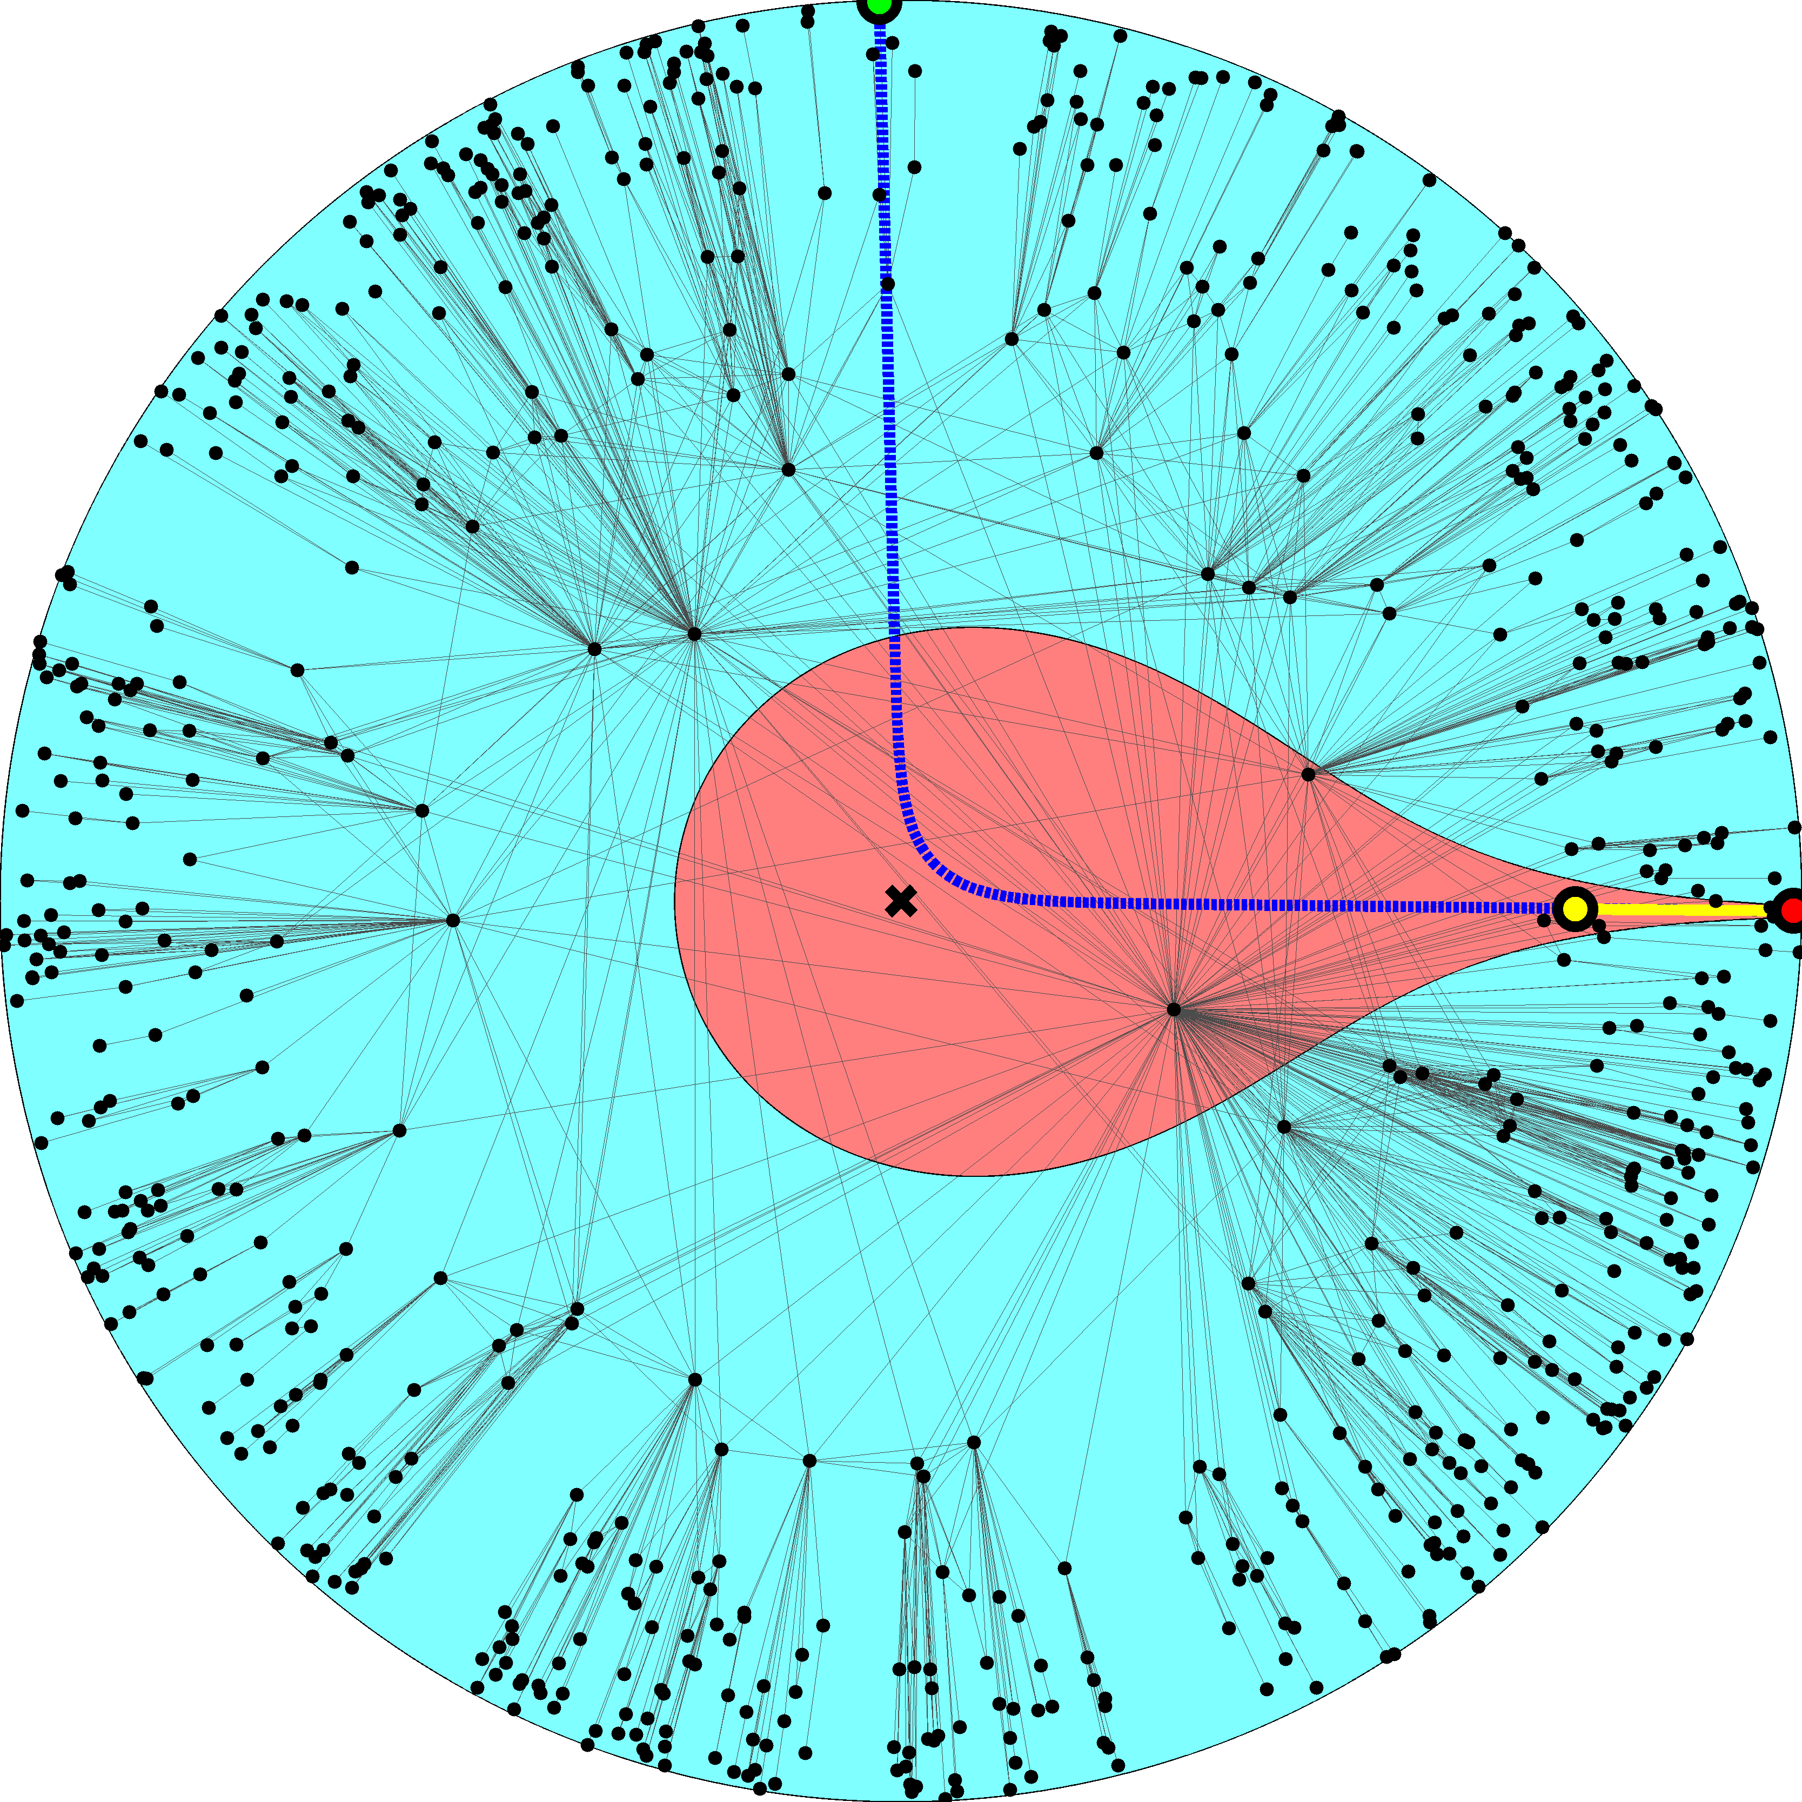

Slide 41
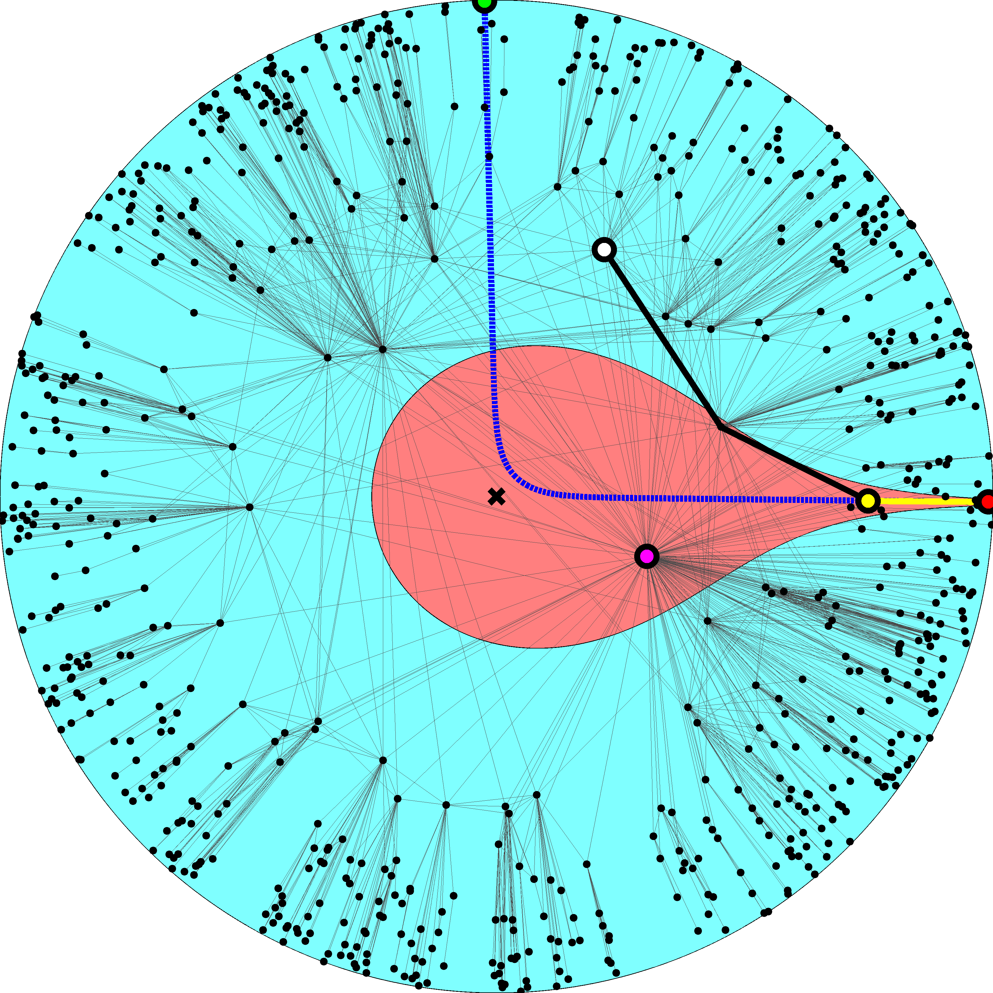

Slide 42
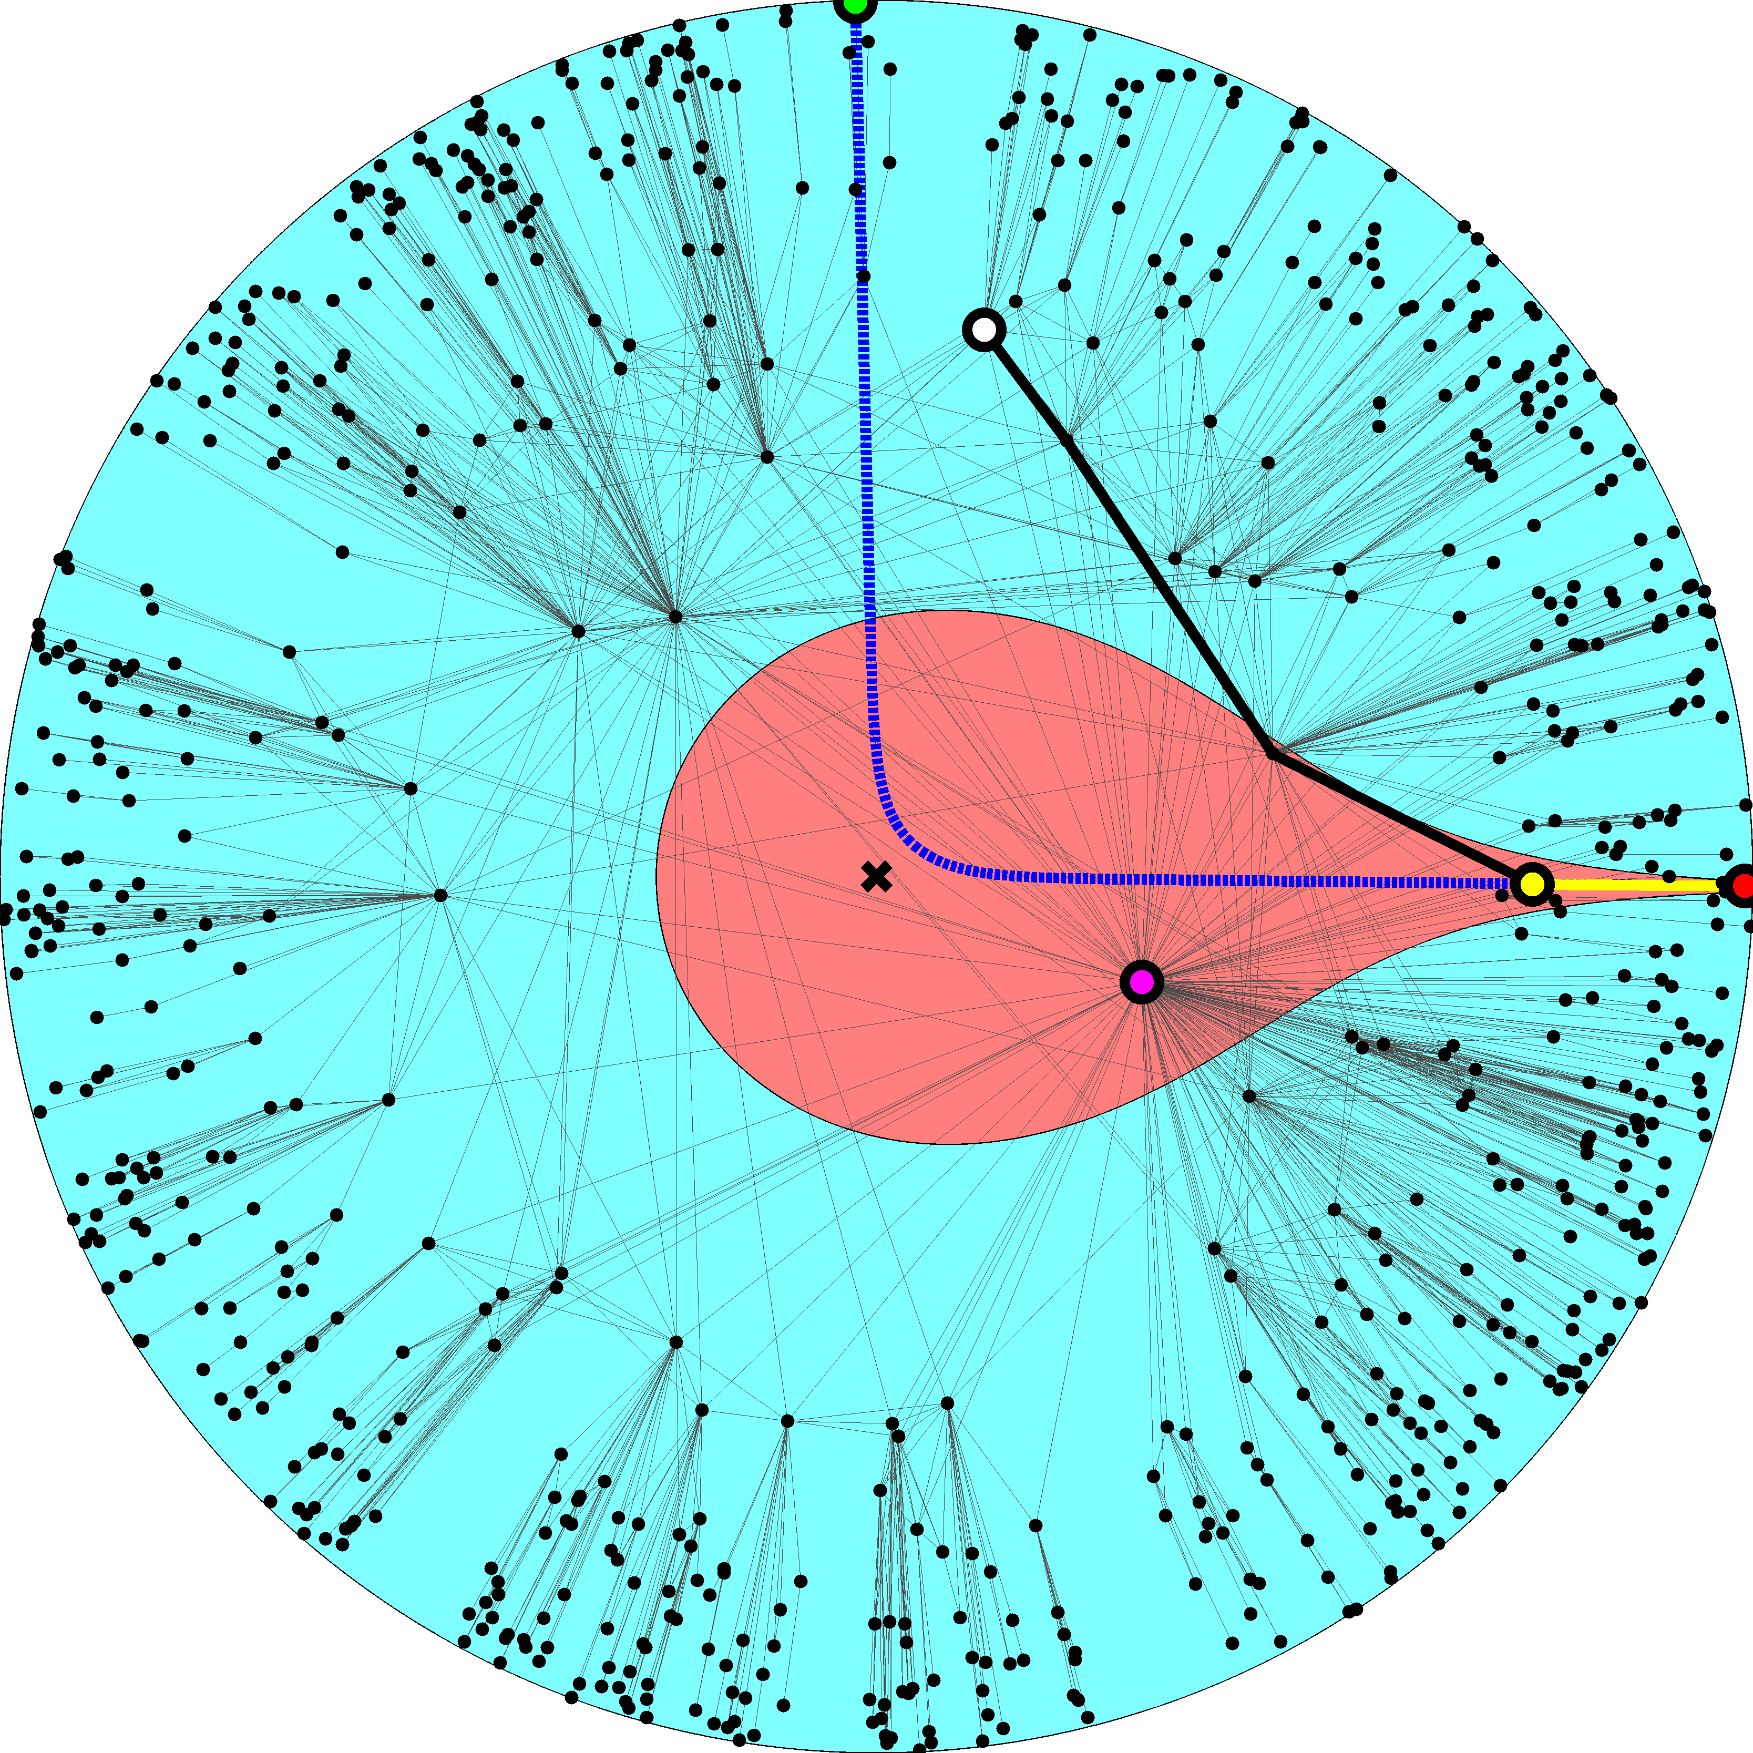

Slide 43
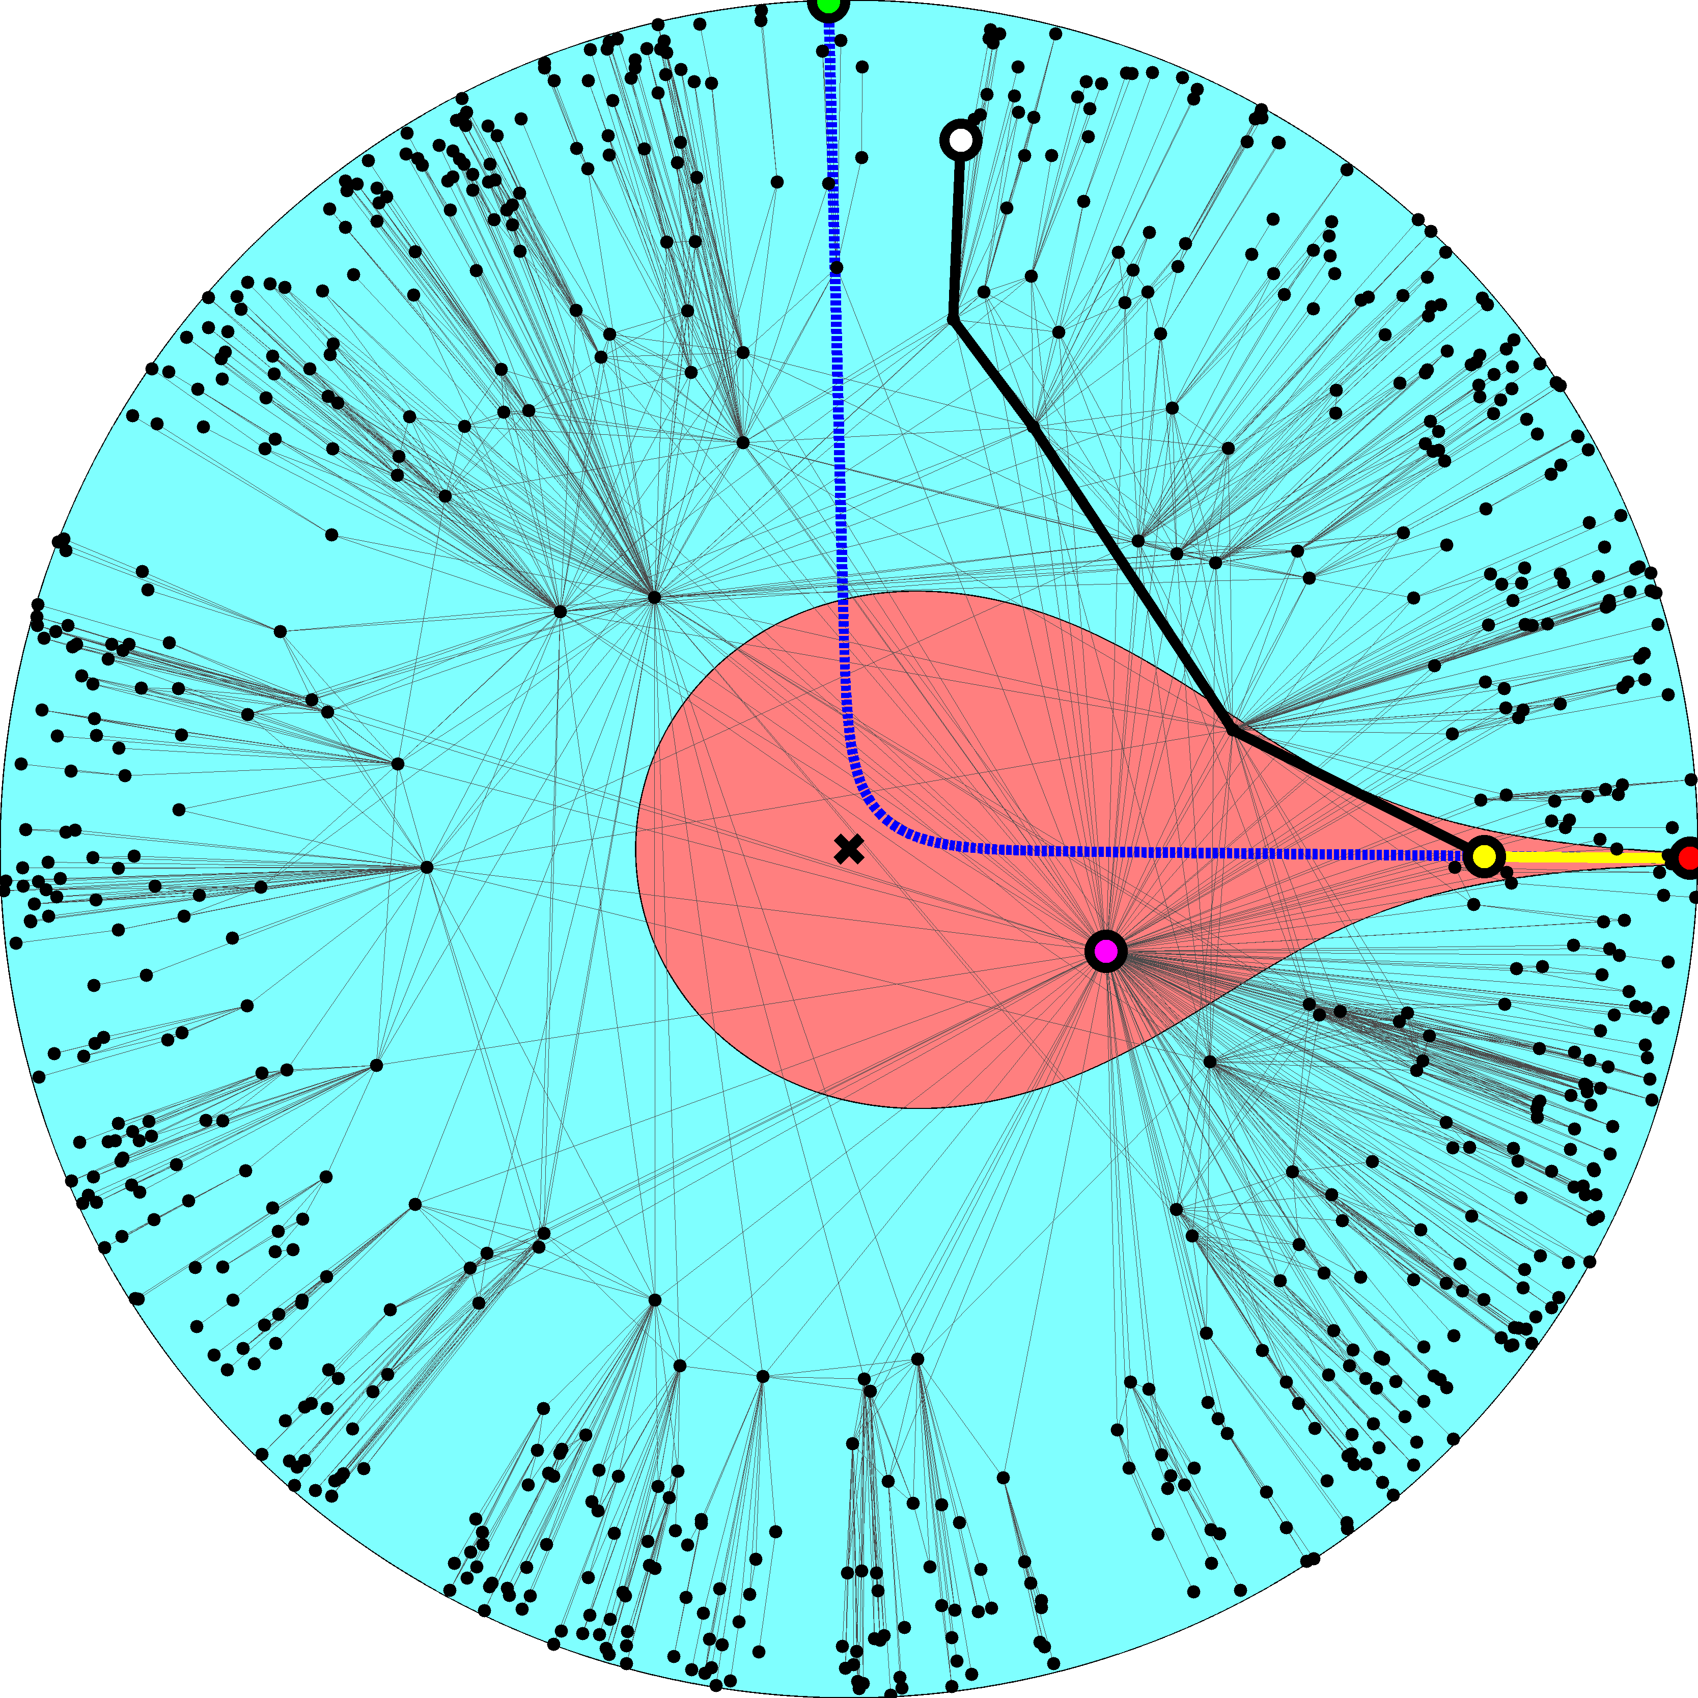

Slide 44
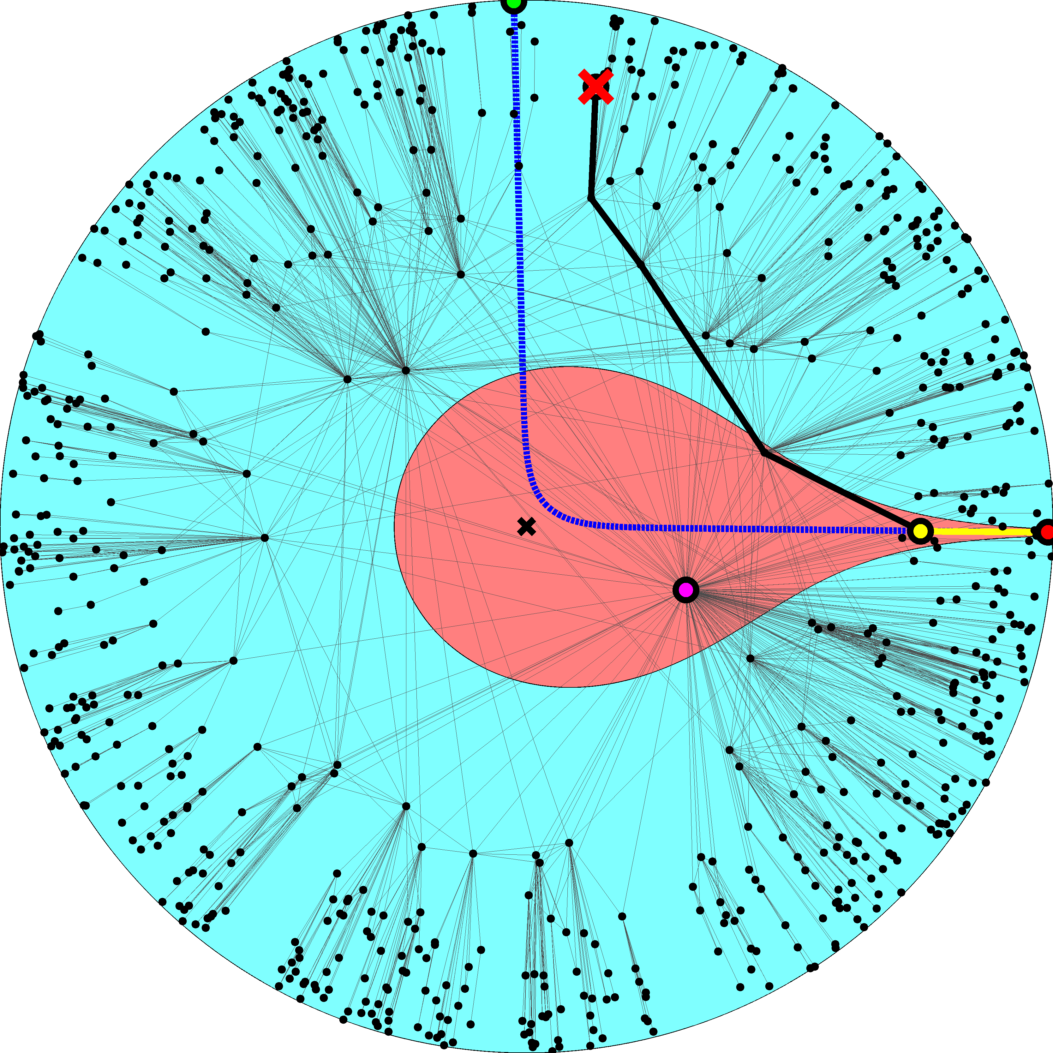

Slide 46
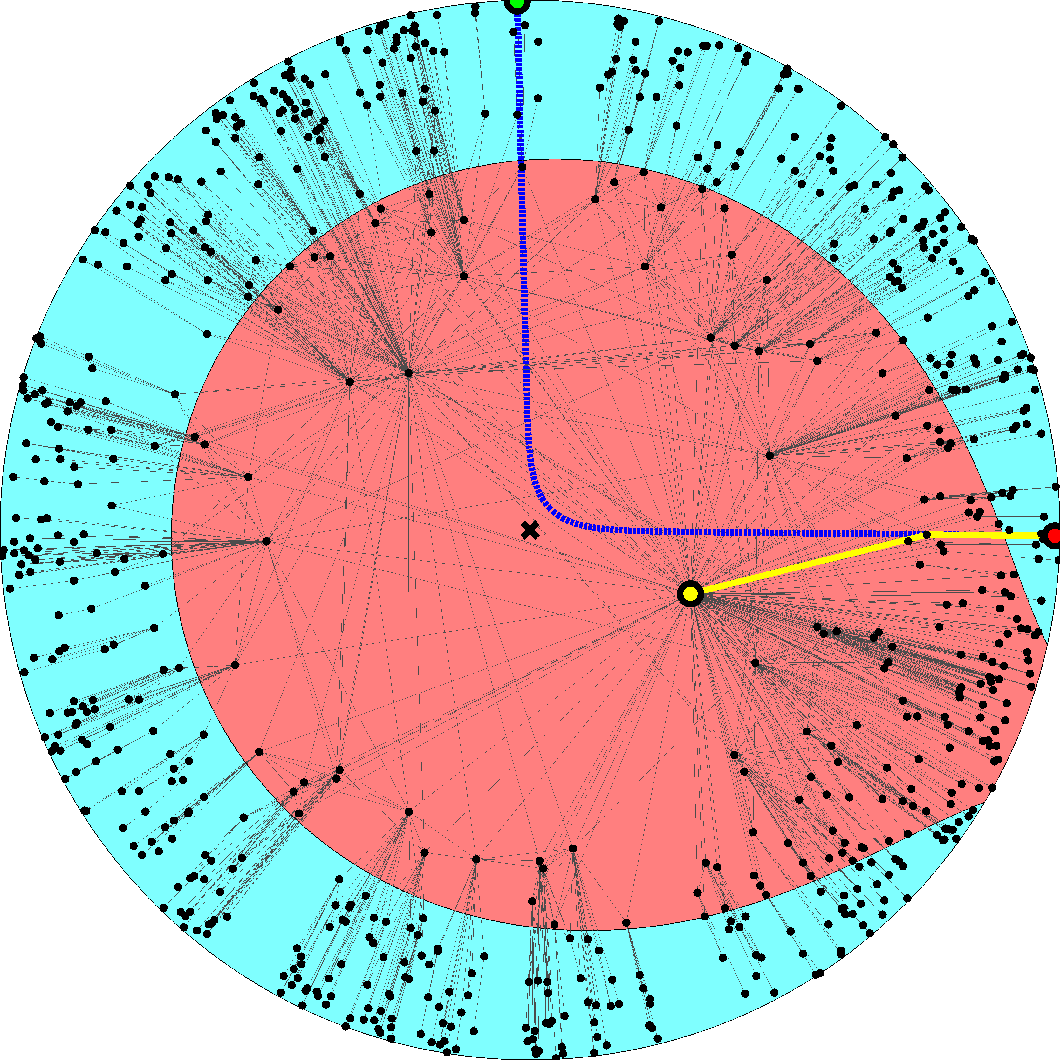

Slide 48
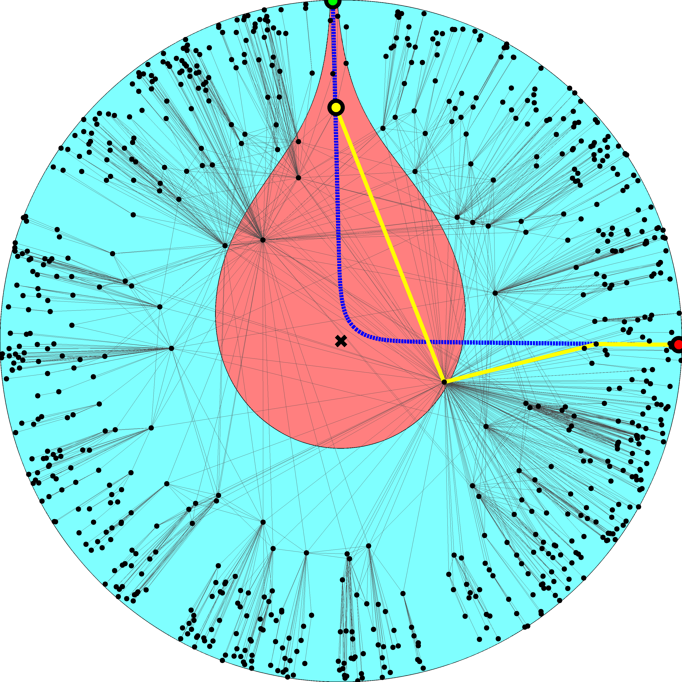

Slide 50
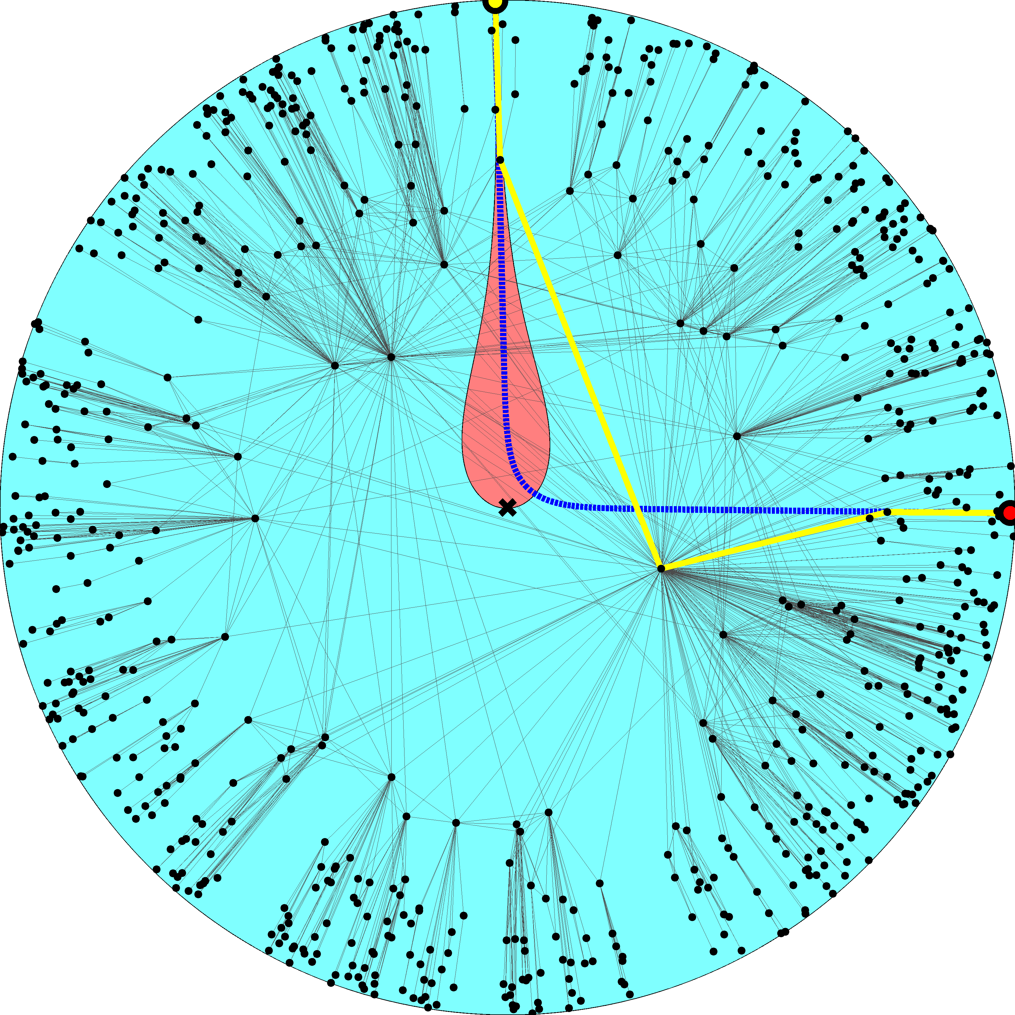

Slide 59
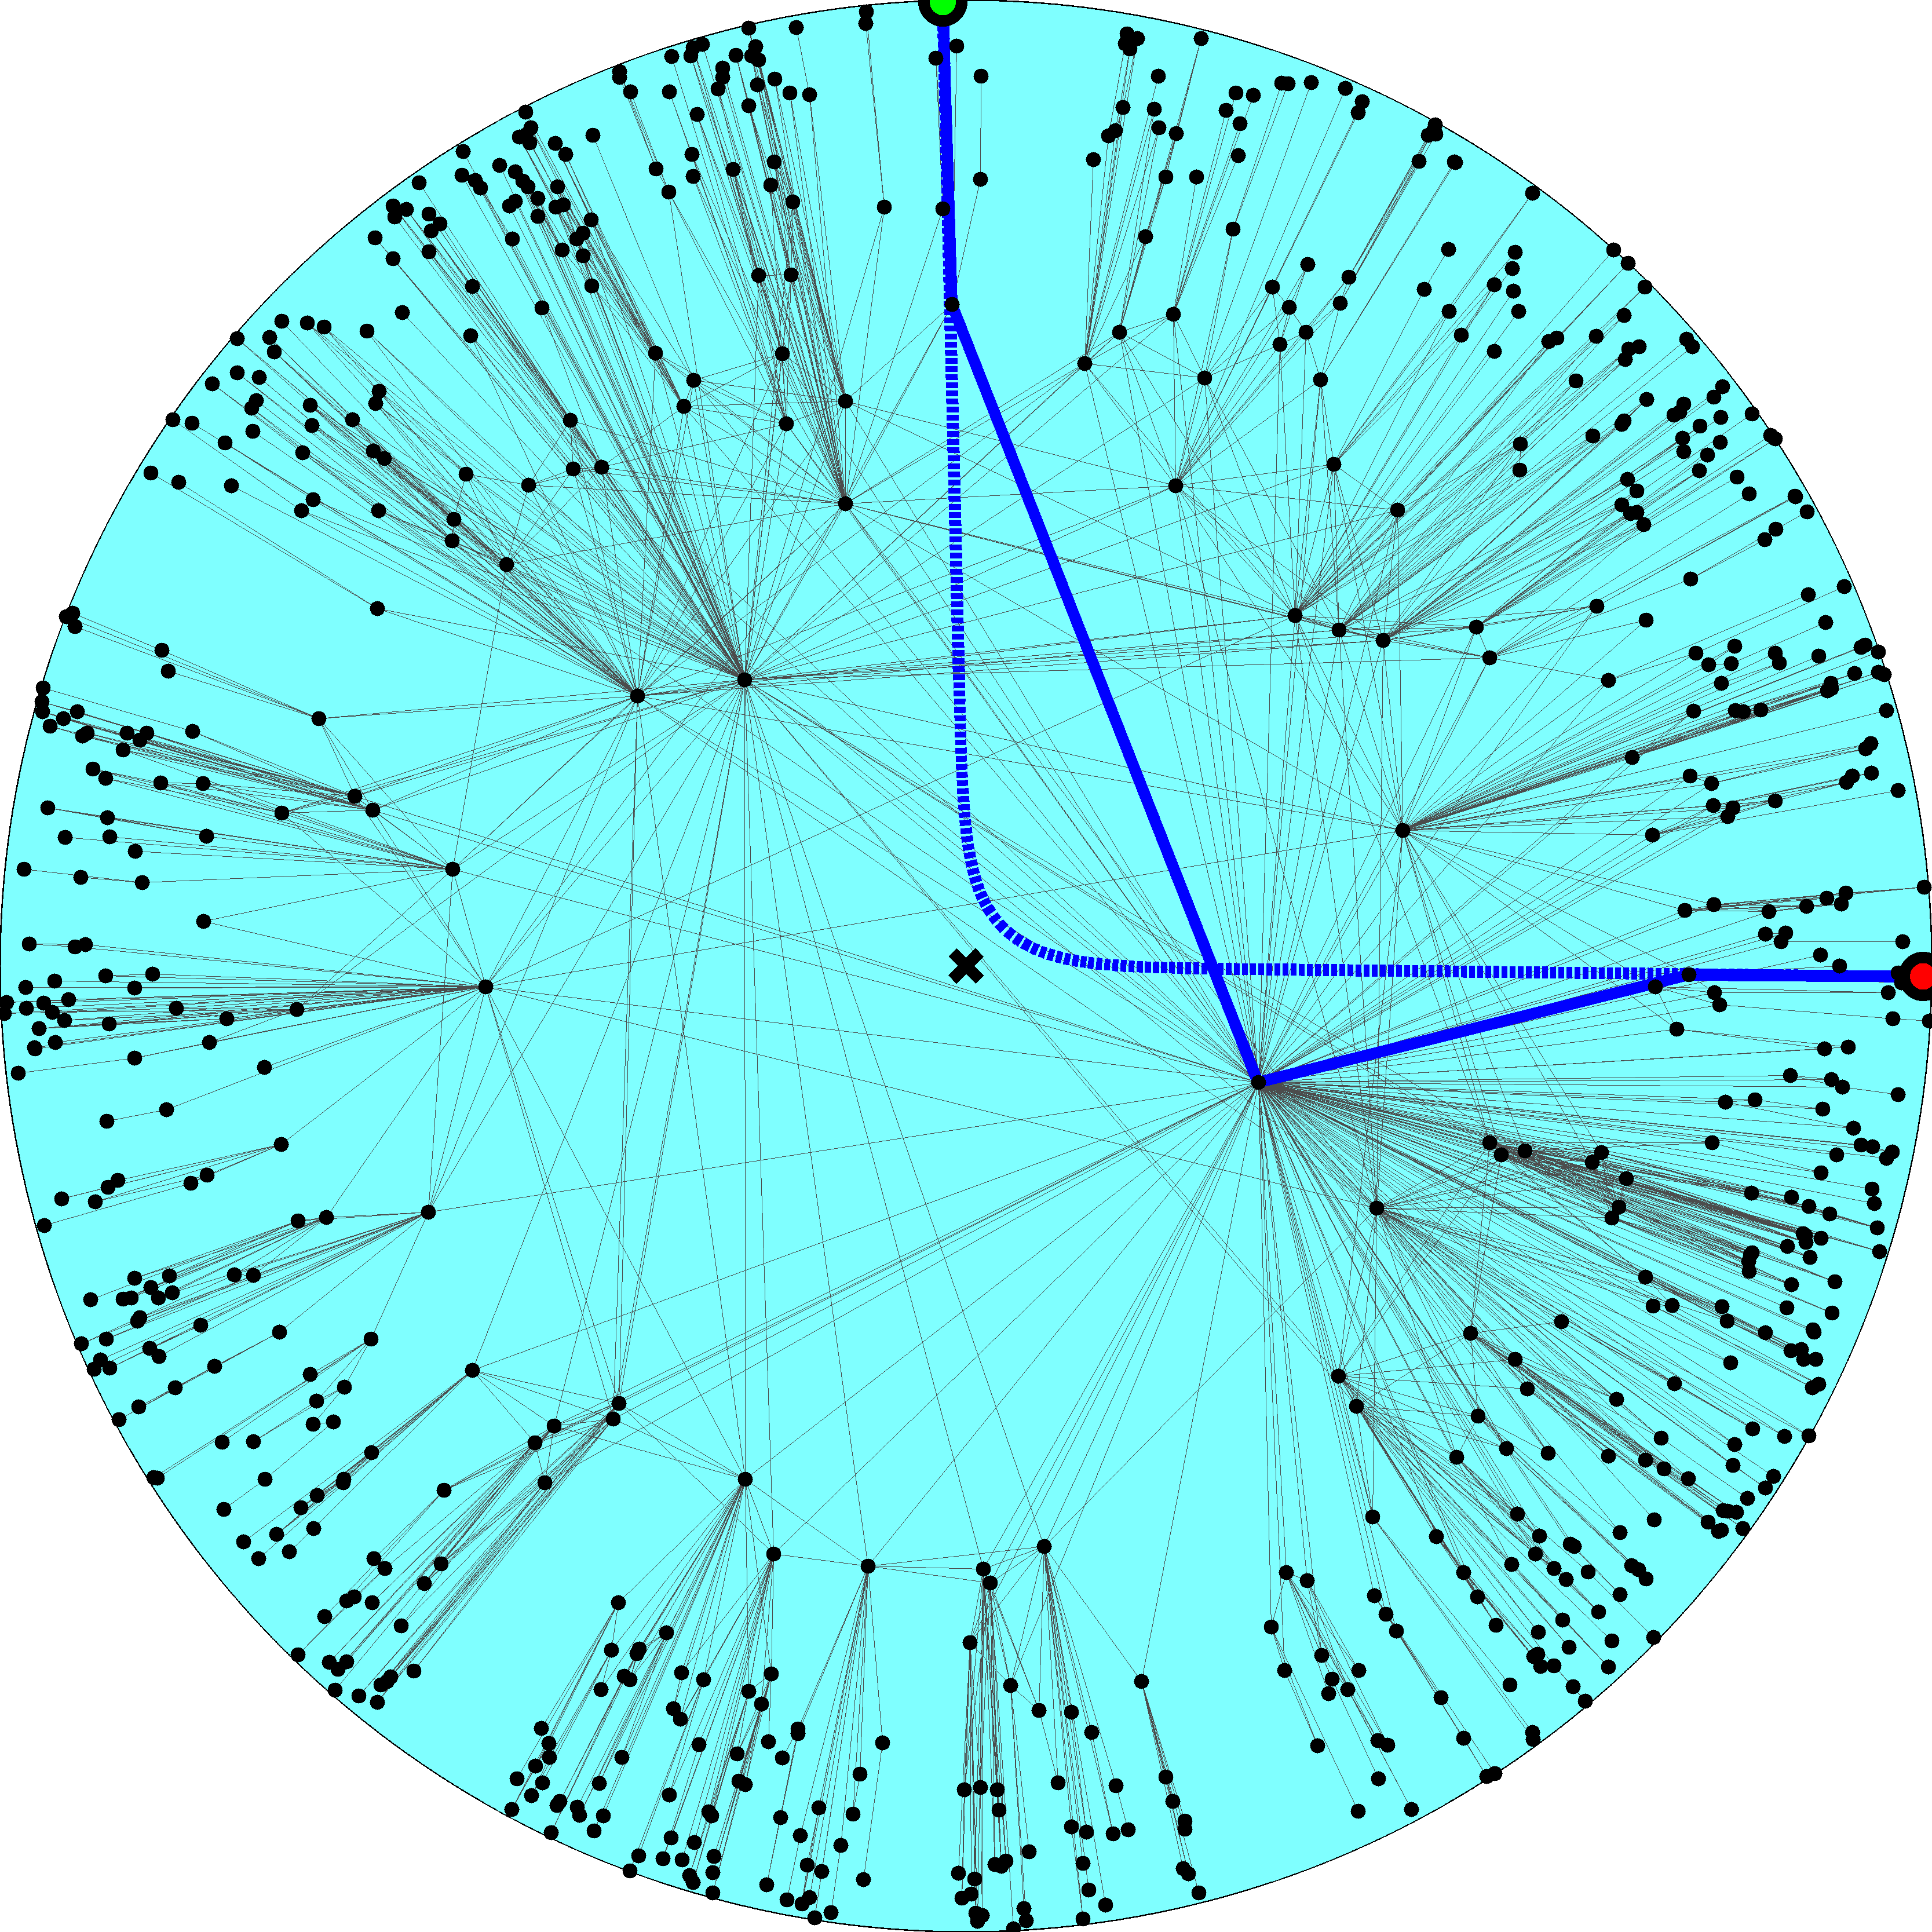

Slide 60
Navigation efficiency and robustness (2.1)
Percentage of successful greedy paths 99.99%
Percentage of shortest greedy paths 100%
Percentage of successful greedy paths after removal of x% of links or nodes
x10%  99%
x30%  95%

Slide 61
Success ratio in random graphs
Configuration model (2.1) 30%
No angular coordinates; node degree gradient only
Classical random graphs 0.17%
No radial coordinates; the connection probability does not depend on any distances at all

Slide 62
Mapping the real Internet using statistical inference methods
Measure the Internet topology properties
N, ↑k, , c
Map them to model parameters
R, , , T
Place nodes at hyperbolic coordinates (r,)
k ~ e^{(Rr)/2}
’s are uniformly distributed on [0,2]
Apply the Metropolis-Hastings algorithm to find ’s maximizing the likelihood that Internet is produced by the model

Slide 63
Metropolis-Hastings
Compute current likelihood L_{c}
Select a random node
Move it to a new random angular coordinate
Compute new likelihood L_{n}
If L_{n} > L_{c}, accept the move
If not, accept it with probability L_{n} / L_{c}
Repeat

Slide 64
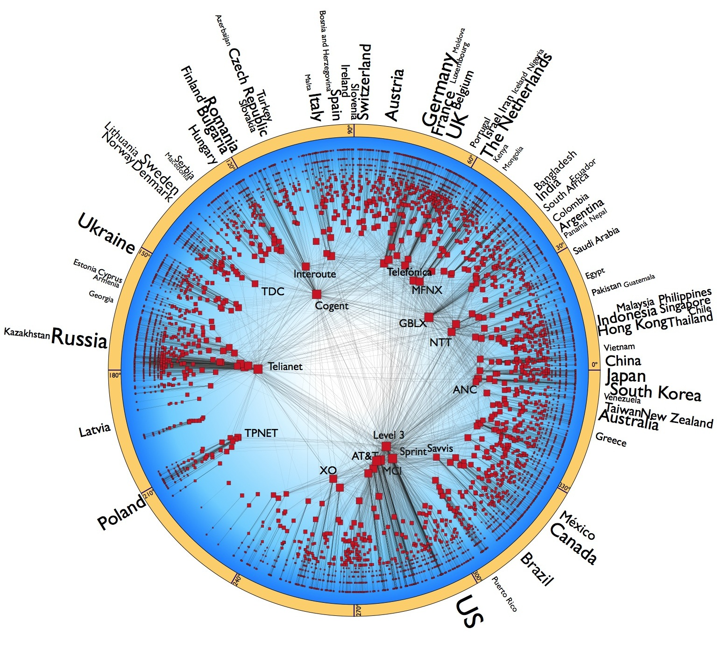
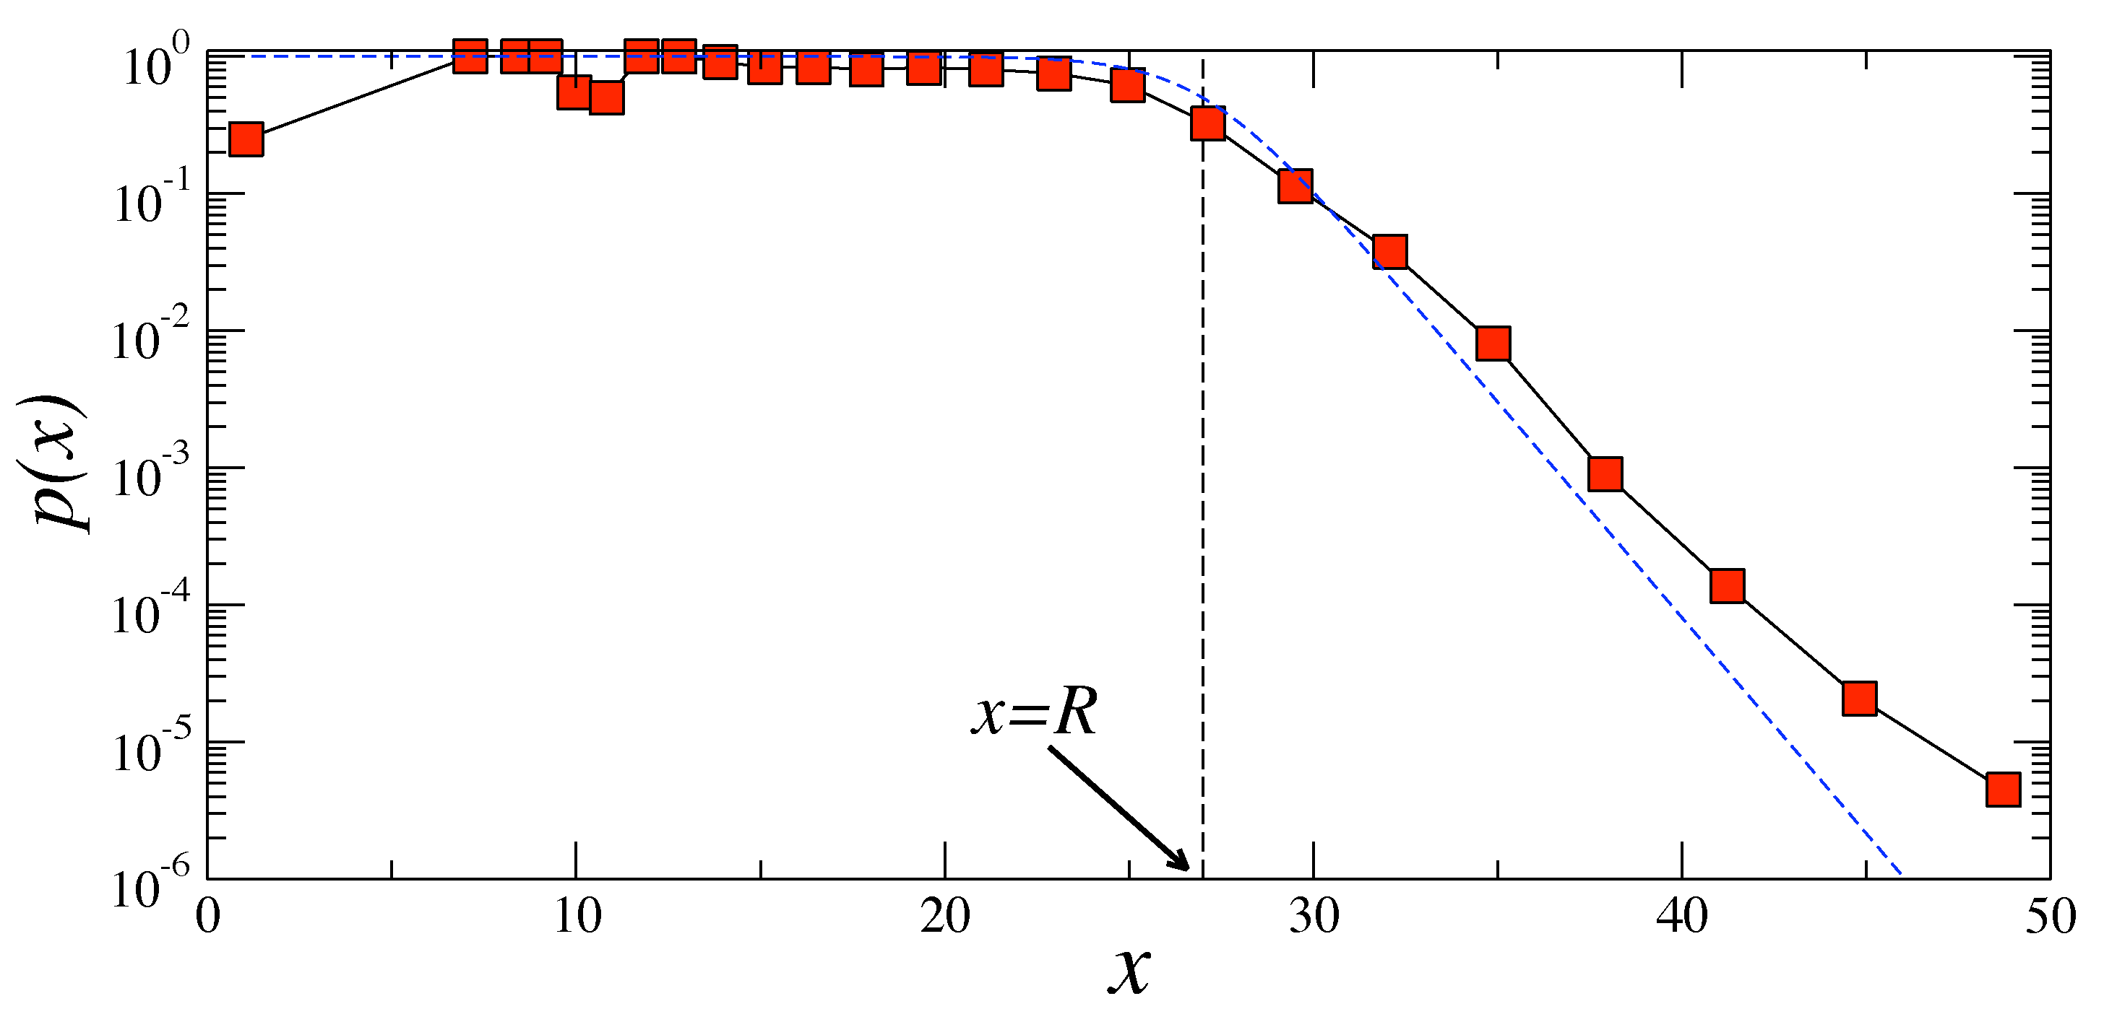

Slide 65
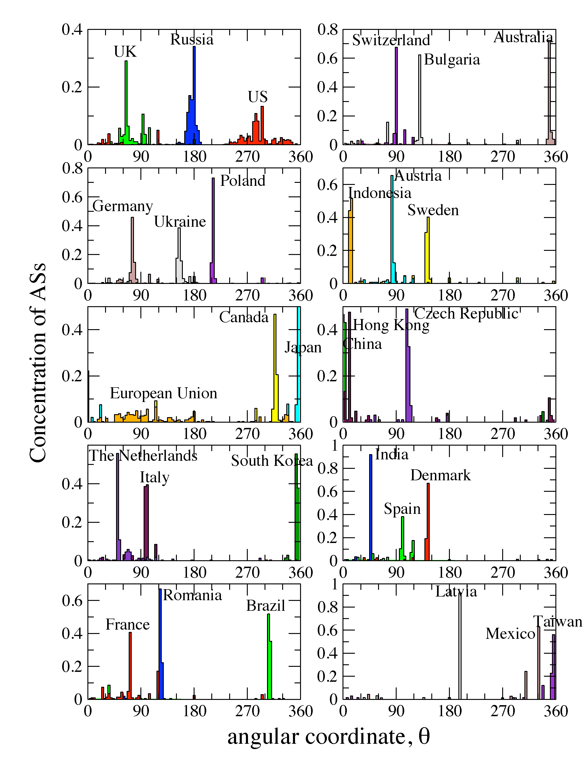

Slide 66
Navigation efficiency and robustness (Internet)
Percentage of successful greedy paths 97%
Average stretch 1.1
Percentage of successful greedy paths after removal of x% of links or nodes:

Slide 67
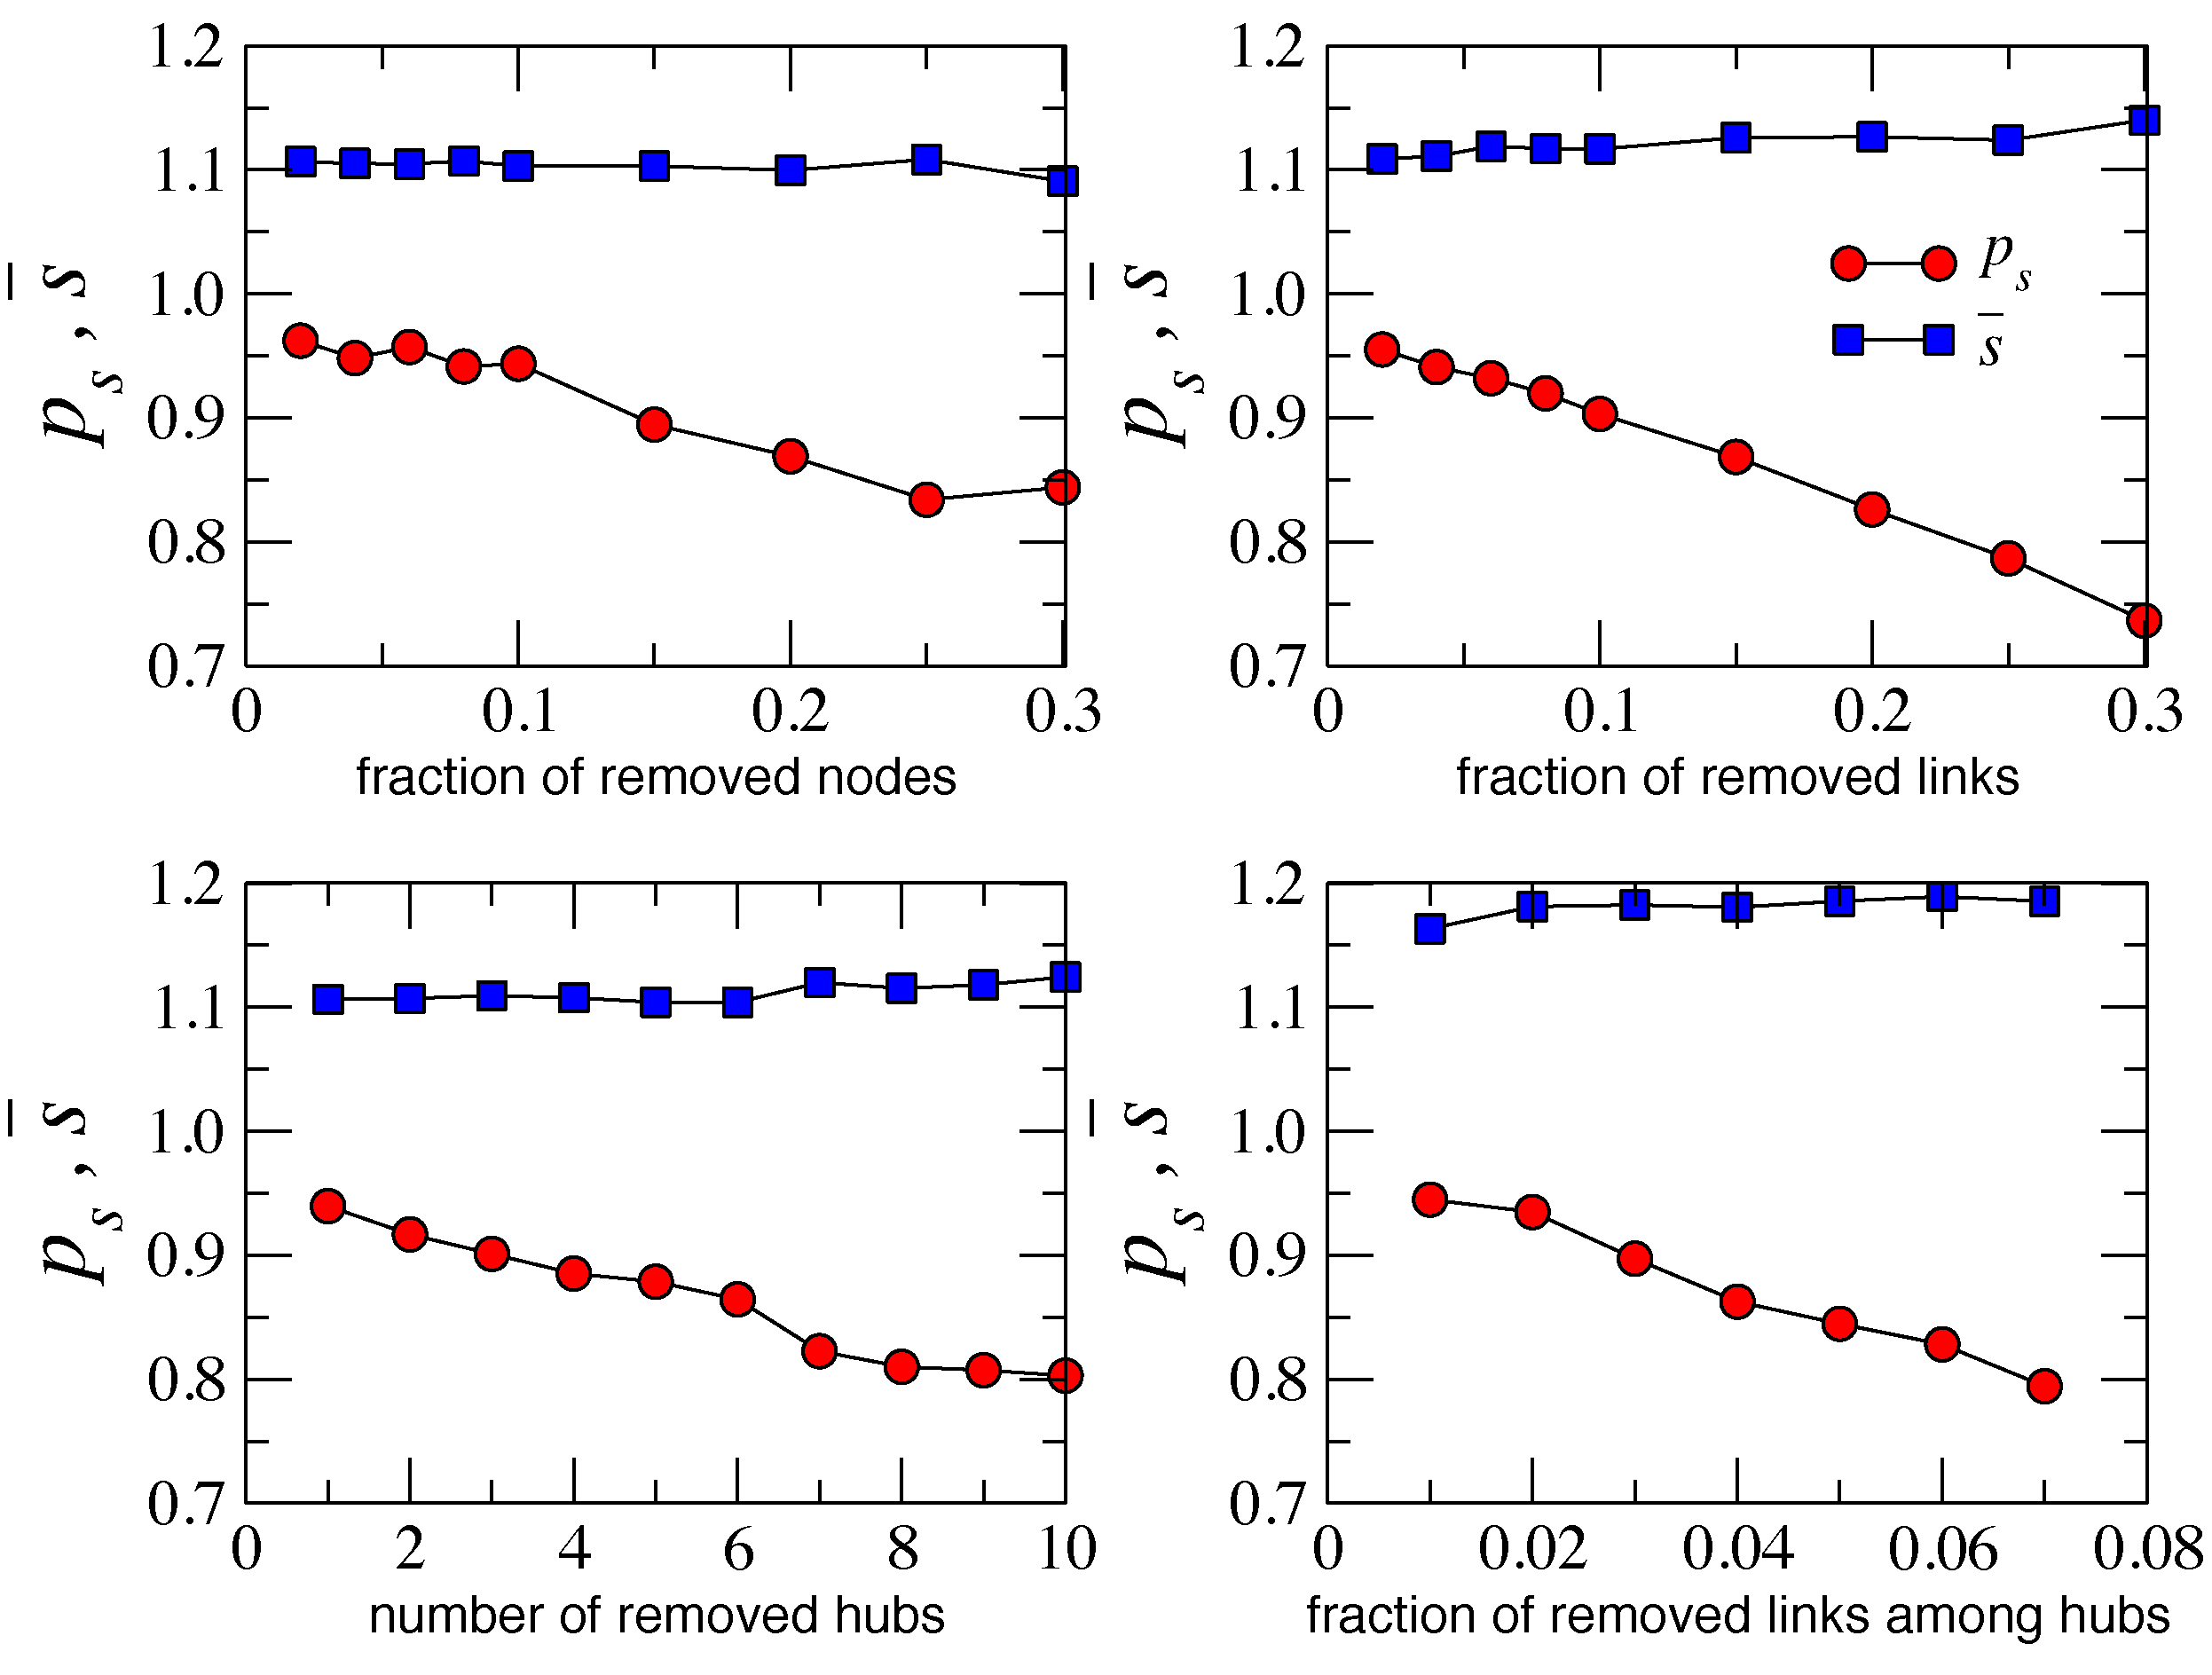
Why?
Congruency between hyperbolic space geometry and scale-free network topology
Hierarchical/heterogeneous organization of the two (zooming-out/zooming-in pattern)
Strong clustering/metric structure
How?
Strong clustering yields high path diversity
All paths are congruent to their corresponding hyperbolic geodesics
If some paths are damaged, many others remain, and can still be found since they all congruent

Slide 74
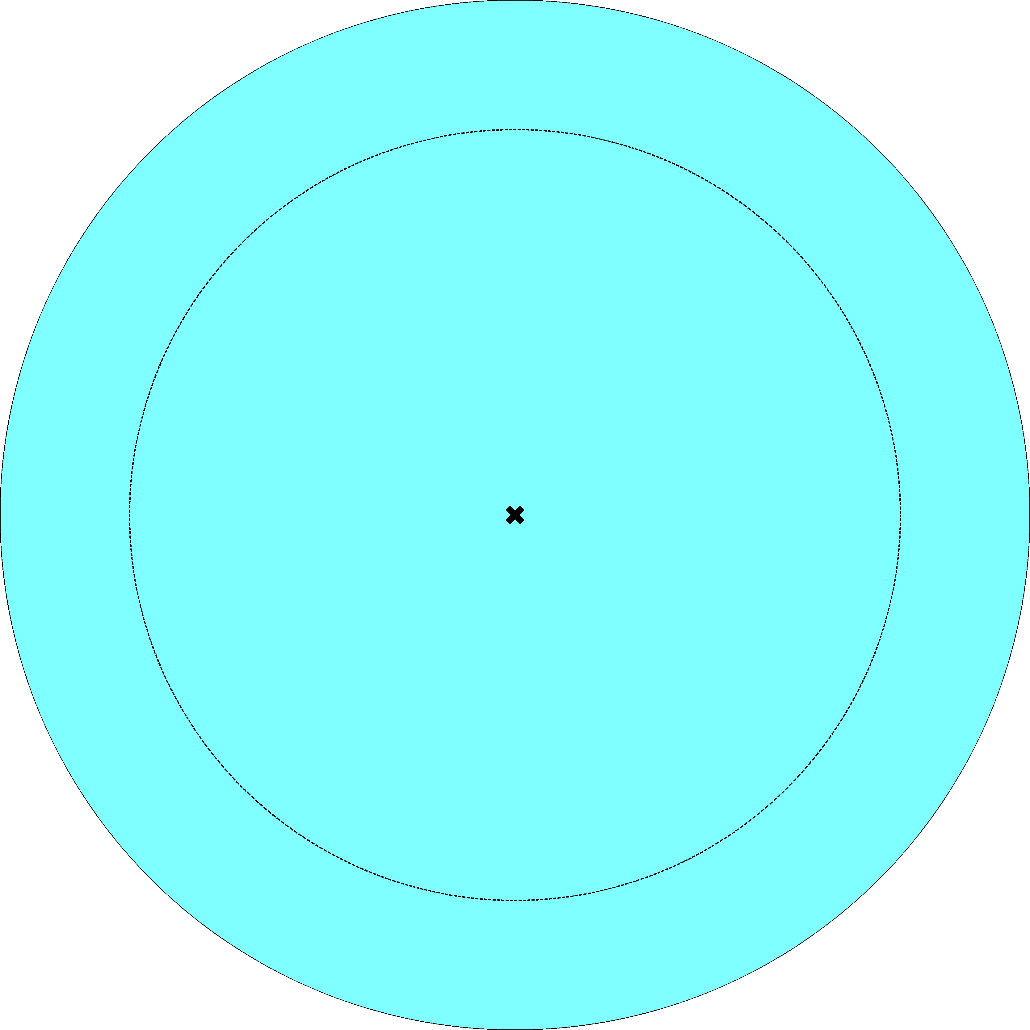
k

Slide 75
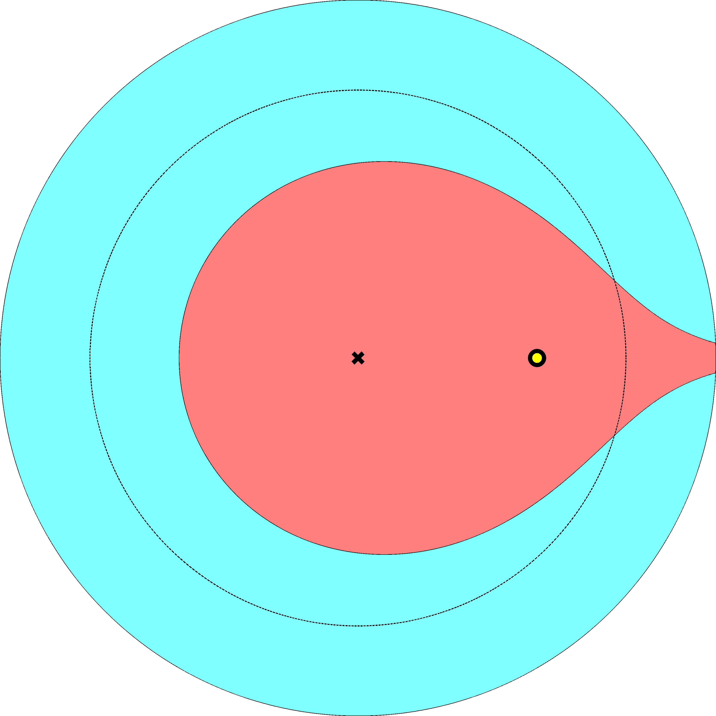
k
k

Slide 76
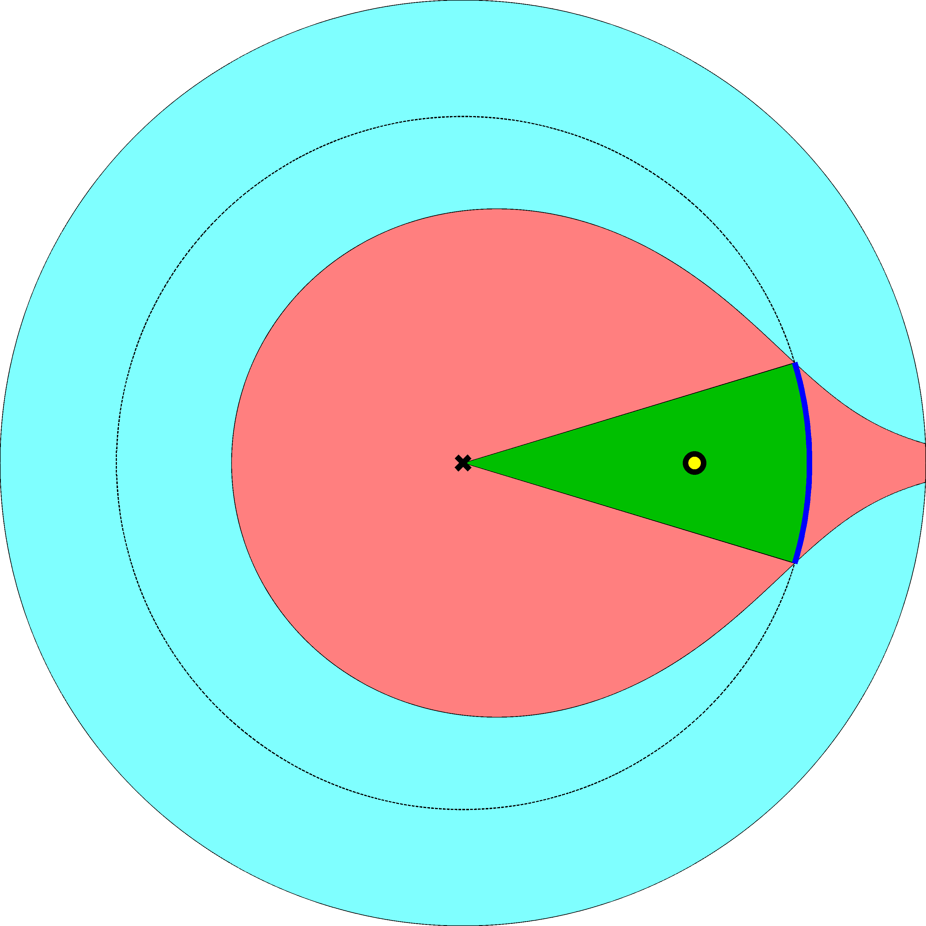
k
k

Slide 79
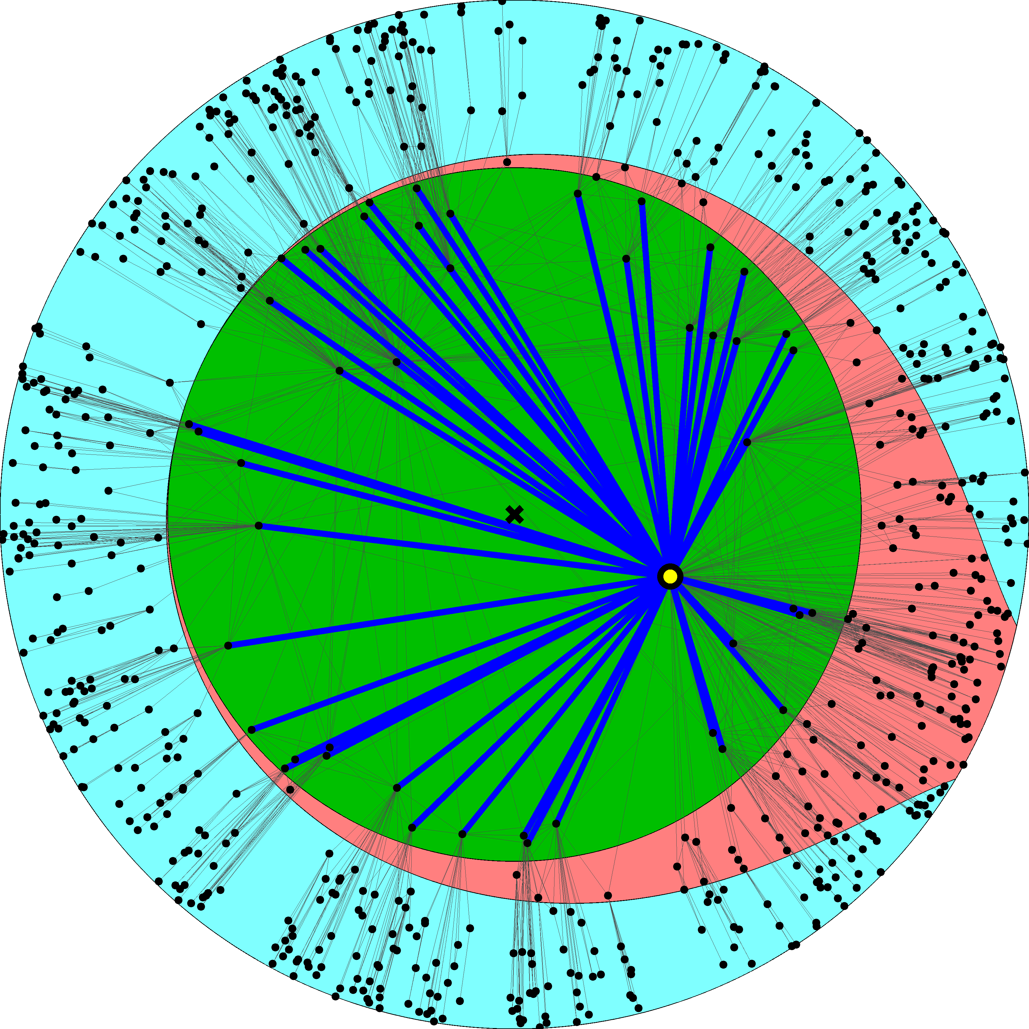
Nodes of degree k cover  ~ kk/N of space by links to nodes of degree k
Nodes of degree k connect to all nodes of degree k↑kN/k
❑
k
k
k  N^{1/(1)}  k  ↑kN^{(2)/(1)}
k  N^{1/(1)}  ↑kN^{(3)/(1)} 1

Slide 80
Take-home message

?
←

Slide 81
Conclusions
We have discovered a new geometric framework to study the structure and function of complex networks
The framework provides a natural (no “enforcement” on our side) explanation of two basic structural properties of complex networks (scale-free degree distribution and strong clustering) as consequences of underlying hyperbolic geometry
The framework admits a standard statistical physics approach (exponential random graphs), interpreting auxiliary fields as linear function of hyperbolic distances/energies
The framework subsumes the configuration model, classical random graphs, and random geometric graphs as three limiting cases with degenerate geometric structures
The framework explains how the hierarchical structure of complex networks ensures the maximum efficiency of their navigation function – optimal routing without global topology knowledge
The framework provides a basis for mapping real complex networks to their hidden/underlying hyperbolic spaces

Slide 82
Open question
Does any optimization of efficiency and robustness of targeted transport drive network evolution explicitly?
Or is it just a natural but implicit by-product of other (standard) network evolution mechanisms?

Slide 83
Applications of network mapping
Internet
optimal (maximally efficient/most scalable) routing
routing table sizes, stretch, and communication overhead approach their theoretical lower bounds
Other networks
discover hidden distances between nodes (e.g., similarity distances between people in social networks)
“soft” communities become areas in the underlying space with higher node densities
tell what drives signaling in networks, and what network perturbations drive it to failures (e.g., in the brain, regulatory, or metabolic networks)

Slide 84
M. Boguñá, F. Papadopoulos, and D. Krioukov, Sustaining the Internet with Hyperbolic Mapping, Nature Communications, v.1, 62, 2010
D. Krioukov, F. Papadopoulos, A. Vahdat, and M. Boguñá, Hyperbolic Geometry of Complex Networks, Physical Review E, v.82, 036106, 2010, Physical Review E, v.80, 035101(R), 2009
F. Papadopoulos, D. Krioukov, M. Boguñá, and A. Vahdat, Greedy Forwarding in (Dynamic) Scale-Free Networks Embedded in Hyperbolic Metric Spaces, INFOCOM 2010, SIGMETRICS MAMA 2009
M. Boguñá, D. Krioukov, and kc claffy, Navigability of Complex Networks, Nature Physics, v.5, p.74-80, 2009

