Slide 1



The Internet is Flat: Modeling the Transition from a Transit Hierarchy to a Peering Mesh
Amogh Dhamdhere (CAIDA/UCSD)
Constantine Dovrolis (Georgia Tech)

Slide 2
The Internet Ecosystem
More than 30,000 autonomous networks independently operated and managed
The “Internet Ecosystem”
  Different types of networks
  Interact with each other and with “environment”
Network interactions
  Localized, in the form of bilateral contracts
  Customer-provider or settlement-free peering
Distributed optimizations by each network

Slide 3
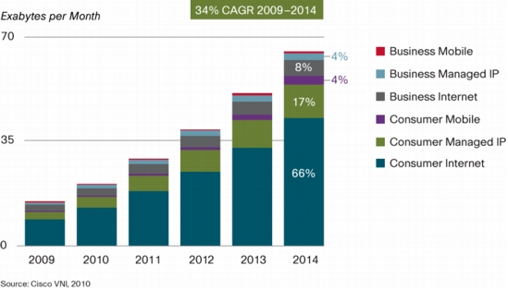
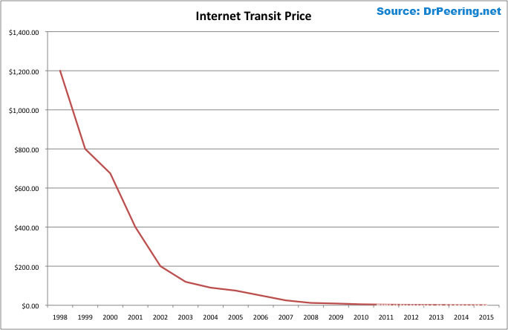
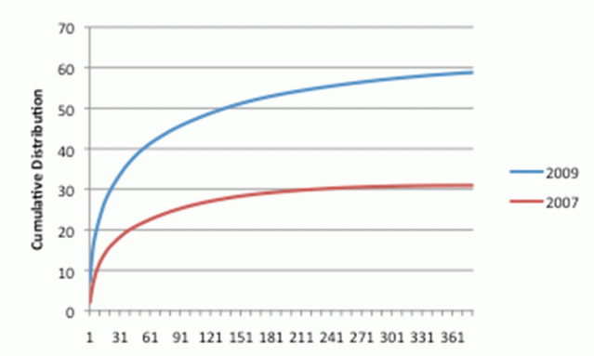
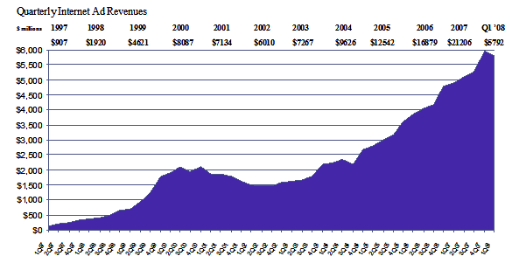
Economics of the Internet Ecosystem
Traffic growth
Source: Cisco
Transit price decline
Source: William Norton
Ad revenue increase
Source: IAB
Content Consolidation
Source: Arbor Networks

Slide 4
Recent Trends: Arbor Networks Study
The Old Internet (late 90s – 2007)
Top content providers generated small fraction of total traffic
Content providers were mostly local
Peering was restrictive
  The New Internet (2007 onwards)
Top content providers generate large fraction of total traffic
Content providers are present everywhere
Peering is more open
How do the “old” and “new” Internet differ in terms of topology, traffic flow, and economics?
“Internet Interdomain Traffic”, Labovitz et al., Sigcomm 2010

Slide 5
Previous Work
“Descriptive”
  Match graph properties e.g. degree distribution
Homogeneity
  Nodes and links all the same
Game theoretic, analytical
  Restrictive assumptions
Little relation to real-world data
“Bottom-up”
  Model the actions of individual networks
Heterogeneity
  Networks with different incentives, link types
Computational
  As much realism as possible
Parameterize/validate using real data

Slide 6
The ITER Model
Agent-based computational model to answer “what-if” questions about Internet evolution
Inputs
  Network types based on business function
  Pricing/cost parameters
  Interdomain traffic matrix
  Geographical constraints
  Peer/provider selection methods
Output: Equilibrium internetwork topology, traffic flow, per-network fitness

Slide 7
ITER: Model Components
Enterprise Customers (EC) e.g., Georgia Tech Small (regional) Transit Providers (STP) e.g., France Telecom
Large (tier-1) Transit Providers (LTP) e.g., AT&T Content Providers (CP) e.g., Google
Transit, peering and operational costs based on data from NANOG and network operators
Traffic matrix based on studies of content popularity, Arbor study, measurements at GT
Geographical presence modeled as presence at IXPs

Slide 8
ITER: Provider and Peer Selection
Provider selection
  Choose providers based on customer cone size
  Measure of the “size” of a provider
  Used by commercial products, e.g., Renesys
Peer selection
  Peer if ratio of total traffic handled is less than α
  Approximates the “equality” of two ISPs

Slide 9
The ITER approach
Interdomain
TM
Routing
Cost/price
parameters
Interdomain
topology
Traffic
flow
Per-AS economic fitness
AS Optimizations
Provider
selection
Peer
selection
Analytically intractable! Find equilibrium computationally, using agent-based simulations
Equilibrium: no network has the incentive to change its providers/peers

Slide 10
Properties of the equilibrium
Is an equilibrium reached?
  Yes, in most cases
Is the equilibrium unique?
  No, can depend on playing sequence
Multiple runs with different playing sequence
  Per-network properties vary widely across runs
  Macroscopic properties show low variability

Slide 11
ITER: Simulating the “old” and “new” Internet
Same initial topology: constructed with a full-mesh of LTP peering links, preferential attachment to connect ECs and CPs
Change three parameters
  Fraction of traffic sourced by CPs (10% vs. 60%)
  Geographical spread of CPs (one region vs. all regions)
  Peering traffic threshold (α=1 vs. α=10)
50 simulation runs for each instance, average results across runs

Slide 12
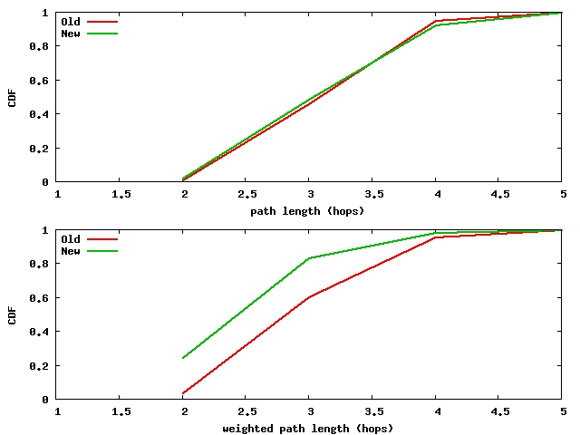
ITER Sims: End-to-end Paths
End-to-end paths weighted by traffic are shorter in the “new” Internet
Paths carrying the most traffic are shorter
AS path lengths
Weighted AS path lengths

Slide 13
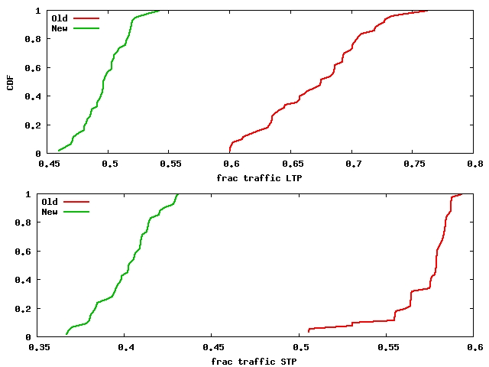
ITER Sims: Traffic Transiting Transit Providers
Traffic bypasses transit providers
More traffic flows directly on peering links
Implication: Transit providers lose money!
Content providers get richer
Traffic transiting LTPs
Traffic transiting STPs

Slide 14
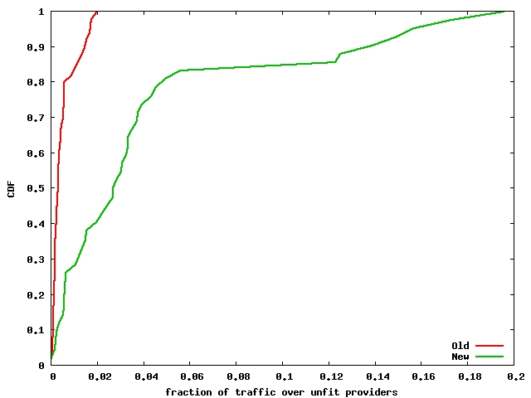
ITER Sims: Traffic Over Unprofitable Providers
More transit providers are unprofitable in the new Internet
These unprofitable providers still have to carry traffic!
Possibility of mergers, bankruptcies or acquisitions
Traffic transiting unprofitable providers

Slide 15
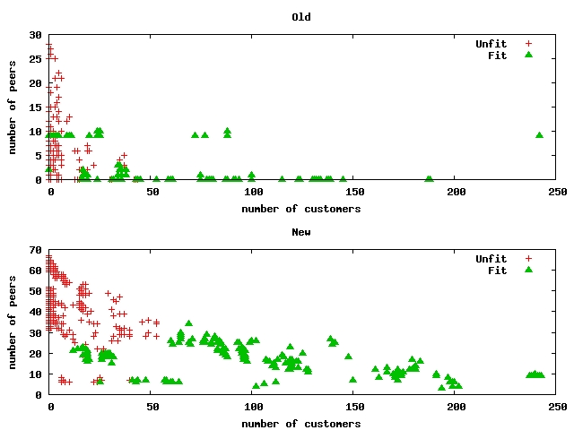
ITER Sims: Peering in the New Internet
Transit providers need to peer strategically in the “new” Internet
STPs peering with CPs: saves transit costs
LTPs peering with CPs: attracts traffic that would have bypassed them

Slide 16
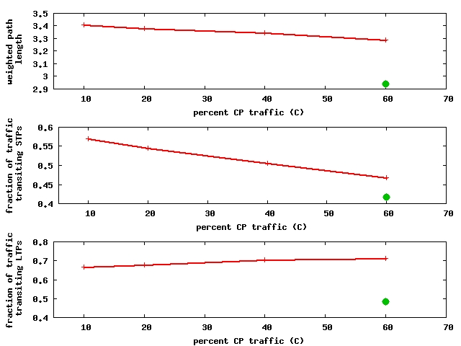
Three Factors
Vary only one of the three factors (fraction of CP traffic)
One factor by itself cannot change output metrics to the values in the “new” Internet
All three factors need to change to see the differences between the “old” and “new” Internet
Weighted path length
Values in the “new” Internet when all three parameters are changed
Traffic transiting STPs
Traffic transiting LTPs

Slide 17
Summary
ITER: A computational, agent-based model of interdomain network formation
Captures the interactions between topology, routing, economics and interdomain traffic flow
Compared “old” and “new” Internet in terms of topology, traffic flow, per-network profitability

Slide 18


Thanks! Questions? amogh@caida.org www.caida.org/~amogh
We gratefully acknowledge funding from the NSF and Cisco Systems

Slide 19
Backup slides

Slide 20
Dependence on Initial Conditions
LTPs that are profitable eventually are also profitable initially in both old and new Internet
Old Internet: 75% of the eventually fit STPs are fit in the initial topology
New Internet: 50% of the eventually fit STPs are fit in the initial topology
STPs that transition from unprofitable to profitable in the new Internet: peer strategically with large CPs

Slide 21
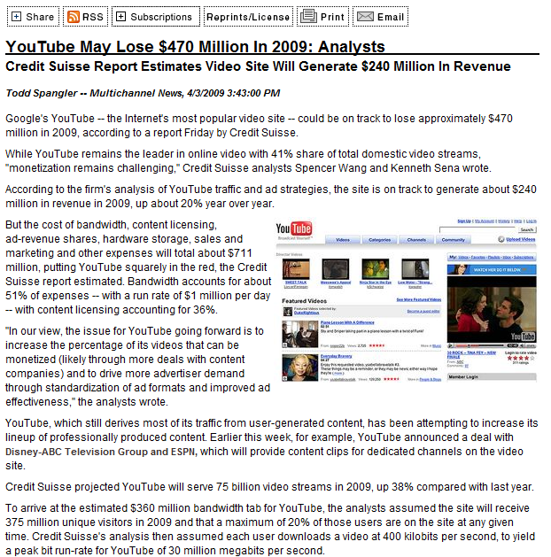
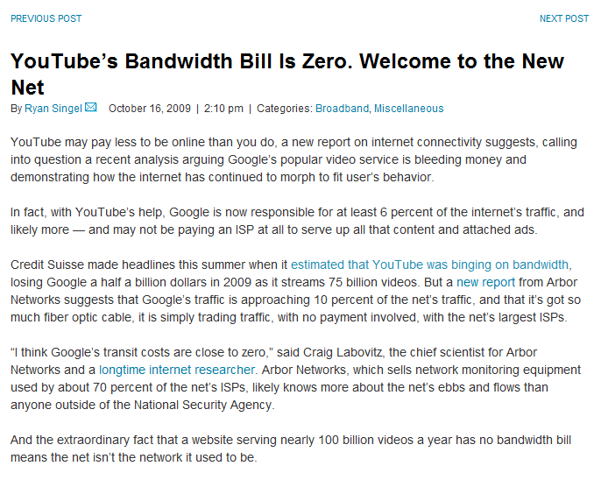
Economics of the Internet Ecosystem
How do we make sense of all this?

Slide 22
Economically-principled models
Objective: Understand the structure and dynamics of the Internet ecosystem from an economic perspective
Capture interactions between interdomain topology, routing, economics, and resulting interdomain traffic flow
Create a scientific basis for modeling Internet interconnection and dynamics based on empirical data

Slide 23
High Level Questions
How does the Internet ecosystem evolve?
What is the Internet heading towards?
  Topology
  Economics
  Performance
Which interconnection strategies of networks optimize their profits, costs and performance?
How do these strategies affect the global Internet?

Slide 24
Why Study Equilibria?
The Internet is never at equilibrium, right?
  Networks come and go, traffic patterns change, pricing/cost structures change, etc….
Studying equilibria tells us what’s the best that networks could do under certain traffic/economic conditions, and what that means for the Internet as a whole
If those conditions change, we need to re-compute equilibria

Slide 25
ITER: Network Types
Enterprise Customers (EC)
  Stub networks at the edge, e.g. Georgia Tech
Transit Providers
  Provide Internet transit
  Regional in scope (STP), e.g. Comcast
  “Tier-1” or global (LTP), e.g., AT&T
Content Providers (CP)
  Major sources of content, e.g. Google

Slide 26
Network actions
Networks perform their actions sequentially
Can observe the actions of previous networks
  And the effects of those actions on traffic flow and economics
Network actions in each move
  Pick set of preferred providers
  Evaluate each existing peering link
  Try to create new peering links

Slide 27
Computing Equilibrium
Situation where no network has the incentive to change its connectivity
Too complex to find analytically: Solve computationally
Computation
  Proceeds iteratively, networks “play” in sequence
  Compute routing, traffic flow, AS fitness
  Repeat until no player has incentive to move

Slide 28
Validation
Validation of a model that involves traffic, topology, economics and network actions is hard!
“Best-effort” parameterization and validation
Parameterized transit, peering and operational costs, traffic matrix properties, geographical spread using best available data

Slide 29
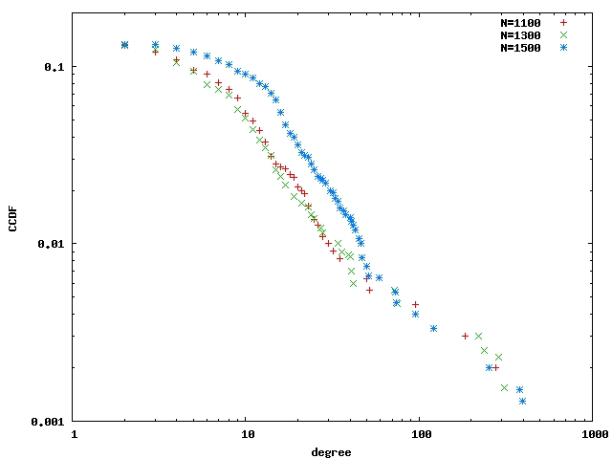
Validation
ITER produces networks with heavy-tailed degree distribution

Slide 30
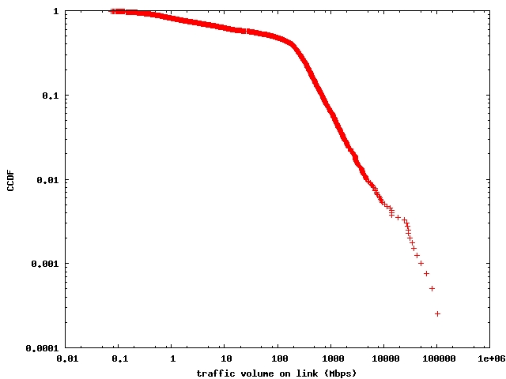
Validation
ITER produces networks with a heavy-tailed distribution of link loads

Slide 31
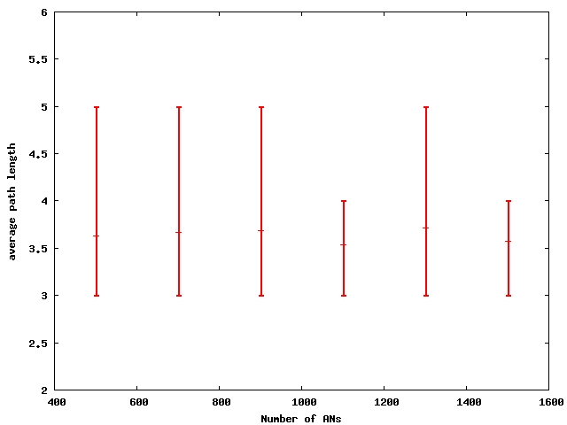
Validation
Average path lengths stay almost constant as the network size is increased

Slide 32
STPs Peering with CPs
LTP
$$
$$
CP
STP
Peering with CPs saves transit costs for STPs

Slide 33
LTPs Peering with CPs
CP
LTP
$$
CP
STP
Peering with CPs attracts traffic (revenue) for LTPs

Slide 34
“What-if” scenario: A super-CP
What if a single CP sources a large fraction of the total traffic?
ITER sims: STPs see higher fitness, LTPs see lower fitness
For STPs: lower peering costs, larger transit savings by peering with a single CP
For LTPs: lower peering costs, but more traffic bypasses them

Slide 35
Peering Policies
What peering policies do networks use? How does this depend on network type?
Do they peer at IXPs? How many IXPs are they present at?
PeeringDB: Public database where ISPs volunteer information about business type, traffic volumes, peering policies
Collecting peeringDB snapshots periodically
Goal is to study how peering policies evolve

Slide 36
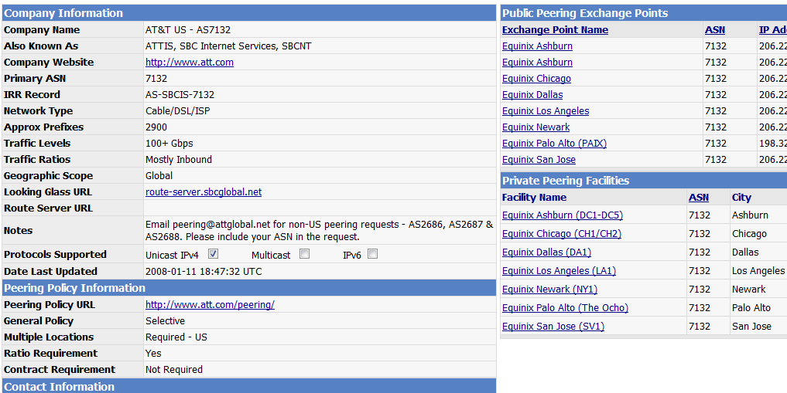
peeringDB

