Slide 1


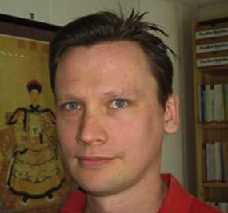



Epidemics in Social Networks
Maksim Kitsak
Cooperative Association for Internet Data Analysis (CAIDA)
University of California, San Diego
Q1: How to model epidemics?
Q2: How to immunize a social network?
Q3: Who are the most influential spreaders?`
University of Nevada, Reno December 2nd, 2010

Slide 2
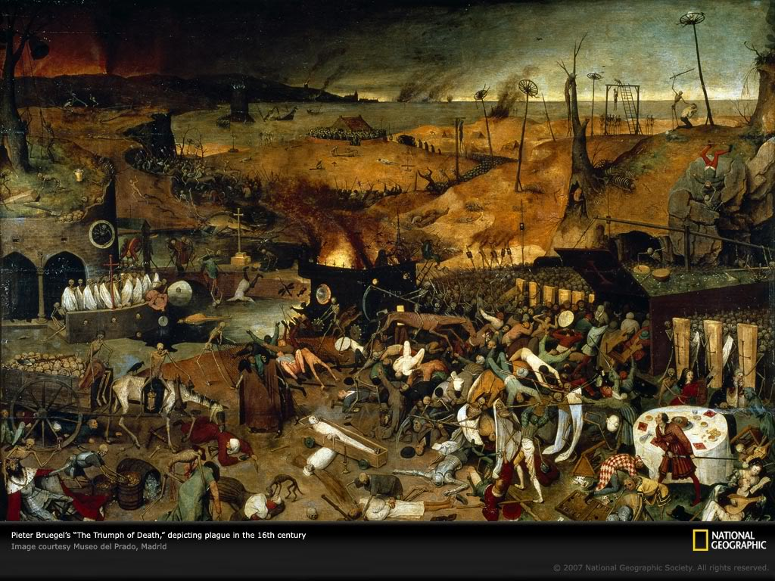

Slide 3
Plague of Athens
25% population
430 B.C.
1300-
1700
Plague
~75-200 million died
1816-
1923
Cholera (7 outbreaks)
~38 million died
1918-
1920
Spanish Flu
20-100 million died
2003
S.A.R.S.
775 deaths
2009
H1N1 (Swine) Flu
18000 deaths
time

Slide 4



Other examples of epidemics
Rumor.
Ideas
Email Virus
MMS Virus

Slide 5
How can we model epidemics? Compartmental models!
β
SI
Susceptible
Infected
β
μ
SIS
Susceptible
Infected
Susceptible
SIR
β
μ
Susceptible
Infected
Recovered
(immune)
Assumption: Random Homogeneous Mixing!

Slide 6
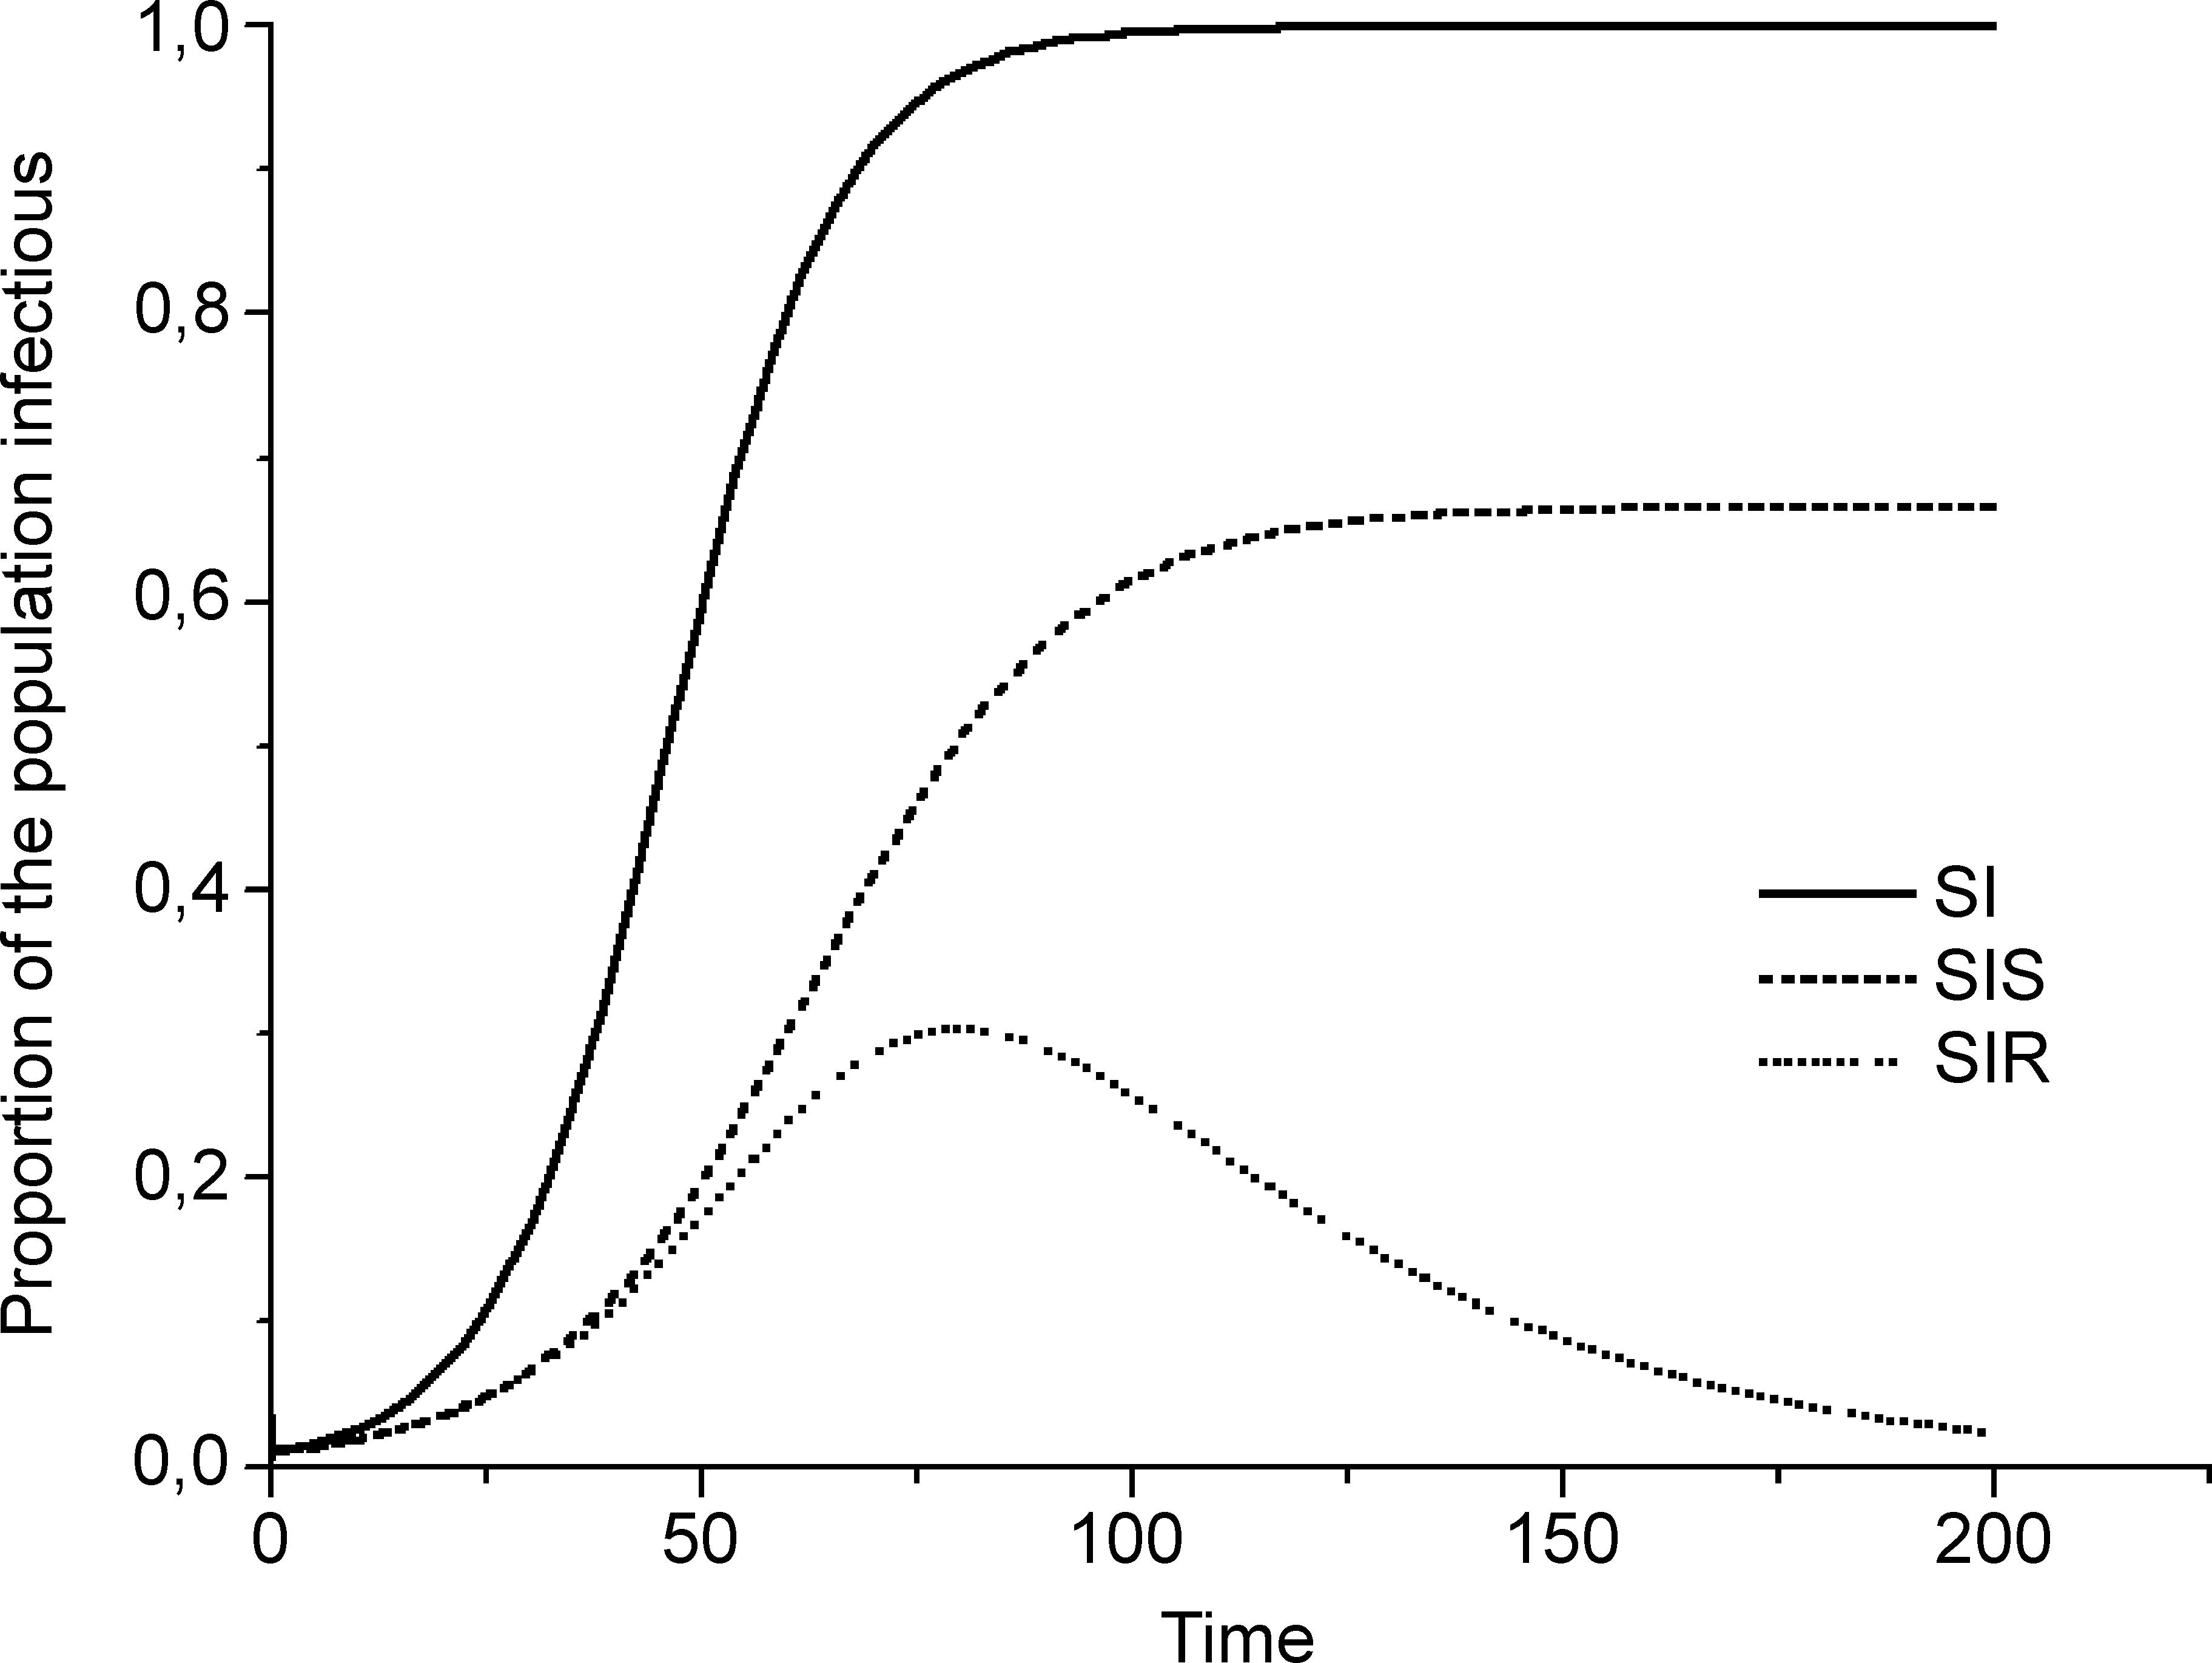
How can we model epidemics? Compartmental models!
S I
Everyone Infected
S I S
Endemic (equilibrium)
Recovery rate = infectious rate
S I R
Everyone Recovers
Critical threshold: β_{c}=μ/<k>
Disease extinct
β_{c}
Disease prevails
β
Compartmental models surprisingly well
reproduce highly contagious diseases.

Slide 7

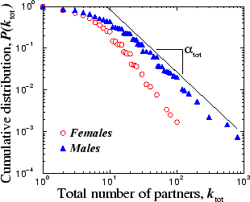
Human sexual contacts
Nodes: people (Females; Males)
Links: sexual relationships
4781 Swedes; 18-74;
59% response rate.
Liljeros et al. Nature 2001

Slide 8
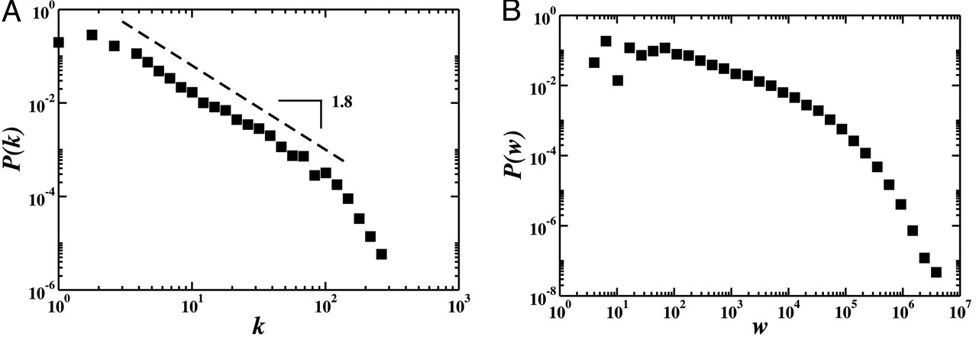
Worldwide Airport Network
3100 airports
17182 flights
99% worldwide traffic
Frequency
# flights per airport
passenger flow
Colizza et al. PNAS 2005

Slide 9
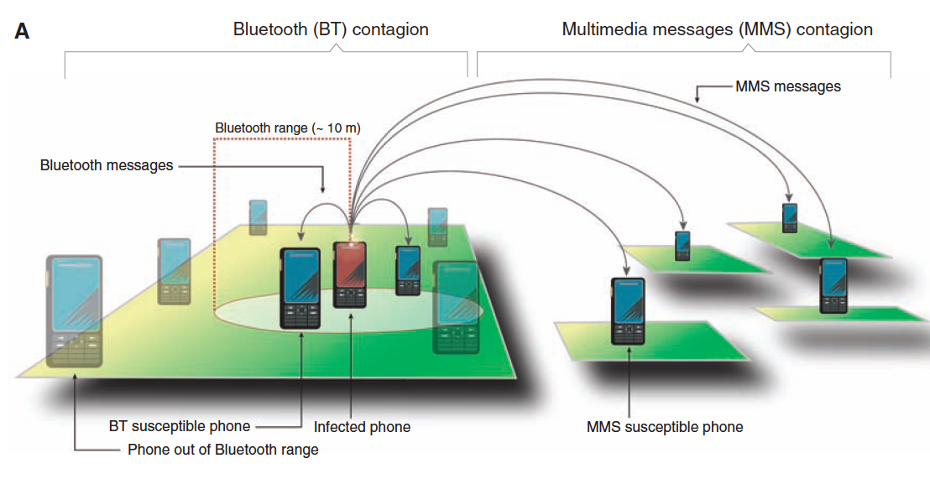
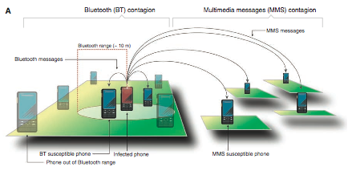
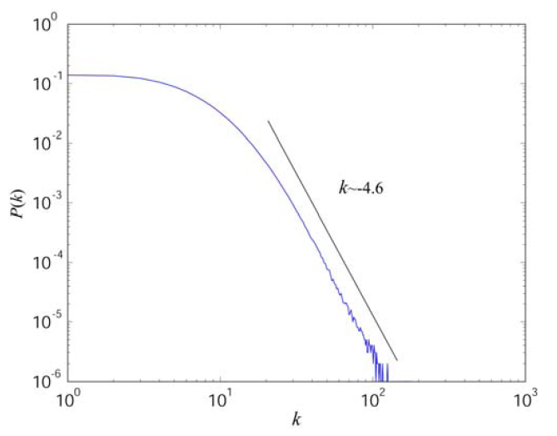
Mobile Phone Contact Network
6.8 million users
1 month observation
Frequency
Contacts per user (1 month)
Wang et al. Science 2009

Slide 10
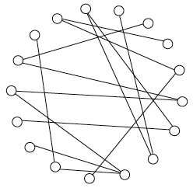
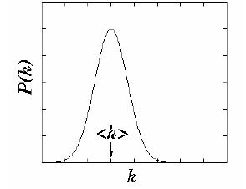
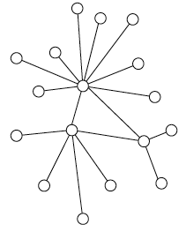
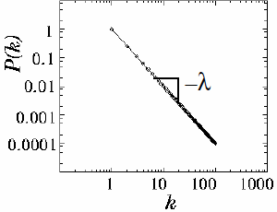
Random vs. scale-free networks
(a) Erdös Rényi
Poisson distribution
(Exponential tail)
(b) Scale-Free
Power-law distribution
Social networks are scale-free! Need stochastic epidemic models.

Slide 11
Stochastic SIR model
β
μ
Susceptible
Infected
Recovered
Transmission rate:
Recovery rate:
Quantities of interest:
Total Recovered: M=14
Survivors: S=3
Total time: T=5

Slide 12
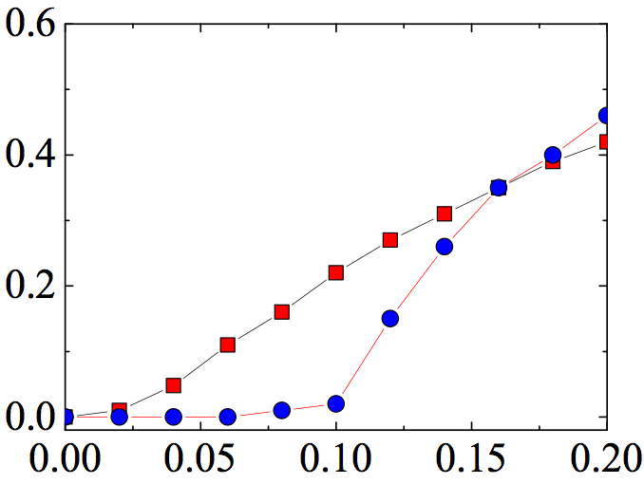
Epidemics in scale-free networks
Power-law distribution
Anderson, May (1991)
Epidemic threshold:
SF, λ=2.1, <k>=10
Random, <k>=10
Infected fraction
β_{c}=0
β/μ
No epidemic threshold in Scale-free networks!

Slide 13
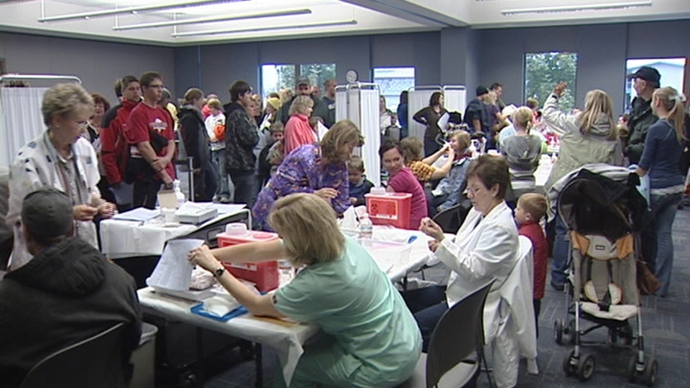
Notes:
.

Slide 14
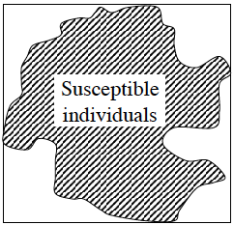
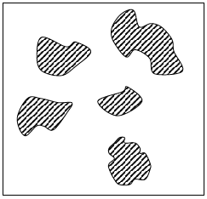
Network Immunization Strategies
Goal of efficient immunization strategy:
Immunize at least critical fraction f_{c} of nodes
so that only isolated clusters of susceptible individuals remain .
If possible, without detailed knowledge of the network.
Large global cluster of susceptible individuals
Small (local) clusters of susceptible individuals
f=0
f_{c}
f=1

Slide 15
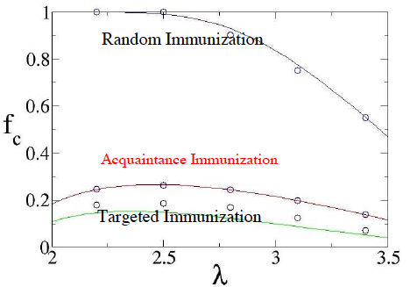
Network Immunization Strategies
Random:
Targeted:
Acquaintance:
Random:
High threshold, no topology knowledge required.
Targeted:
Low threshold, knowledge of
Connected nodes required.
Acquaintance:
Low threshold, no topology knowledge required.
Required fraction
R. Cohen et al, Phys. Rev. Lett. (2003)

Slide 16
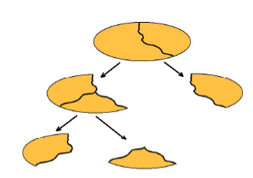
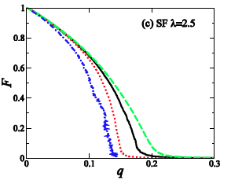
Graph Partitioning Immunization Strategy
Partition network into arbitrary number of same size clusters
Based on the Nested Dissection Algorithm
R.J. Lipton, SIAM J. Numer. Anal.(1979)
Nested Dissection
Largest cluster
Targeted
Fraction immunized
5% to 50% fewer immunization doses required
Y. Chen et al, Phys. Rev. Lett. (2008)

Slide 17
Who are the most influential spreaders?
SIR:
Who infects/influences the largest fraction of population?
SIS:
Who is the most persistent spreader? Who stays the most in the Infected state?
Not necessarily the most connected people!
Not the most central people!
M. Kitsak et al. Nature Physics 2010

Slide 18
Spreading efficiency determined by node placement!
Hospital Network: Inpatients in the same quarters connected with links
Probability to be infected
node A
k=96
node B
k=96
Probability
Fraction of Infected Inpatients

Slide 19
k-cores and k-shells determine node placement
K-core: sub-graph with nodes of degree at least k inside the sub-graph.
Pruning Rule:
Remove all nodes with k=1.
Some remaining nodes may now have k = 1.
2) Repeat until there is no nodes with k = 1.
3) The remaining network forms the 2-core.
4) Repeat the process for higher k to extract other cores
2
3
1
S. B. Seidman, Social Networks, 5, 269 (1983).
K-shell is a set of nodes that belongs to the K-core
but NOT to the K+1-core

Slide 20
Identifying efficient spreaders in the hospital network (SIR)
For every individual i measure the average fraction of individuals M_{i}
he or she would infect (spreading efficiency).
(2) Group individuals based on the number of connections and the k-shell value.
M
A. Most efficient spreaders occupy high k-shells.
B. For fixed k-shell <M>
is independent of k.
Degree
C. A lot of hubs are inefficient spreaders.
k-shell
Three candidates:
Degree, k-shell, betweenness centrality

Slide 21
Imprecision functions test the merits of degree, k-shell and centrality
For given percentage p
Find Np the most efficient spreaders (as measured by M)
Calculate the average infected mass M_{EFF}.
Find Np the nodes with highest k-shell indices.
Calculate the average infected mass M_{kshell.}
Imprecision function:
betweenness centrality
degree
Imprecision
k-shell
Measure the imprecision for
K-shell, degree and centrality.
Percentage
k-shell is the most robust spreading efficiency indicatior.
(followed by degree and betweenness centrality)

Slide 22
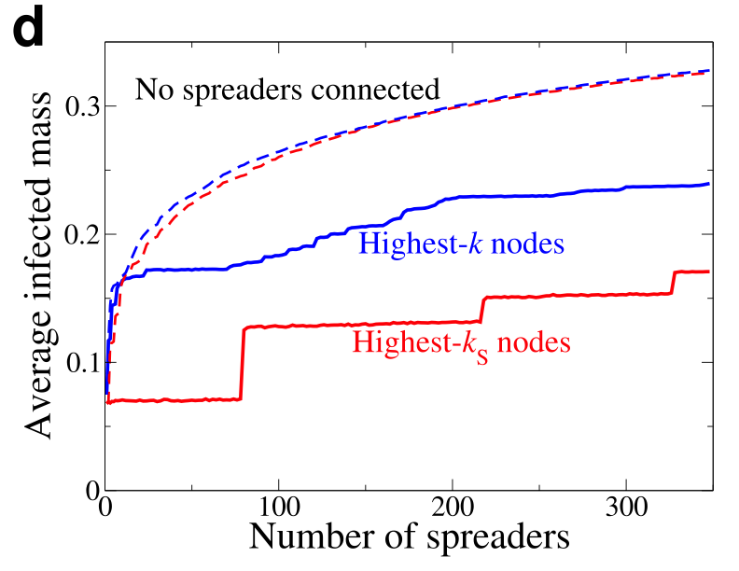
Multiple Source Spreading
What happens if virus starts from several origins simultaneously?
Multiple source spreading is enhanced when one “repels” sources.

Slide 23
Identifying efficient spreaders in the hospital network (SIS)
SIS: Number of infected nodes reaches endemic state (equilibrium)
Persistence ρ_{i}(t) (probability node i is infected at time t)
Degree
k-shell
k-shell
High k-shells form a reservoir where virus can exist locally.
Consistent with core groups (H. Hethcote et al 1984)

Slide 24
Take home messages
1) (Almost) No epidemic threshold in Scale-free networks!
2) Efficient immunization strategy:
Immunize at least critical fraction f_{c} of nodes so that only isolated clusters of susceptible individuals remain
3) Immunization strategy is not reciprocal to spreading strategy!
4) Influential spreaders (not necessarily hubs) occupy the innermost
k-cores.

Slide 25
Collaborators
Lazaros K. Gallos
CCNY, New York, NY
Lev Muchnik
NYU, New York, NY
Fredrik Liljeros
Stockholm University
Sweden
Shlomo Havlin
Bar-Ilan University
Israel
H. Eugene Stanley
Boston University,
Boston, MA
Hernán A. Makse
CCNY,
New York, NY

