Slide 1
Hyperbolic geometry of complex networks
Dmitri Krioukov CAIDA/UCSD
dima@caida.org
F. Papadopoulos, M. Kitsak, M. Boguñá, M. Á. Serrano, A. Vahdat, and kc claffy Bell-Labs, April 2011

Slide 2
Complex networks
Technological
Internet
Transportation
Power grid
Social
Collaboration
Trust
Friendship
Biological
Gene regulation
Protein interaction
Metabolic
Brain
Strong heterogeneity and clustering of complex networks exhaust all their commonalities
the networks are quite different and unique in all other respects (e.g., modularity, etc.)
Is there any geometric explanation for these two universal features?

Slide 3
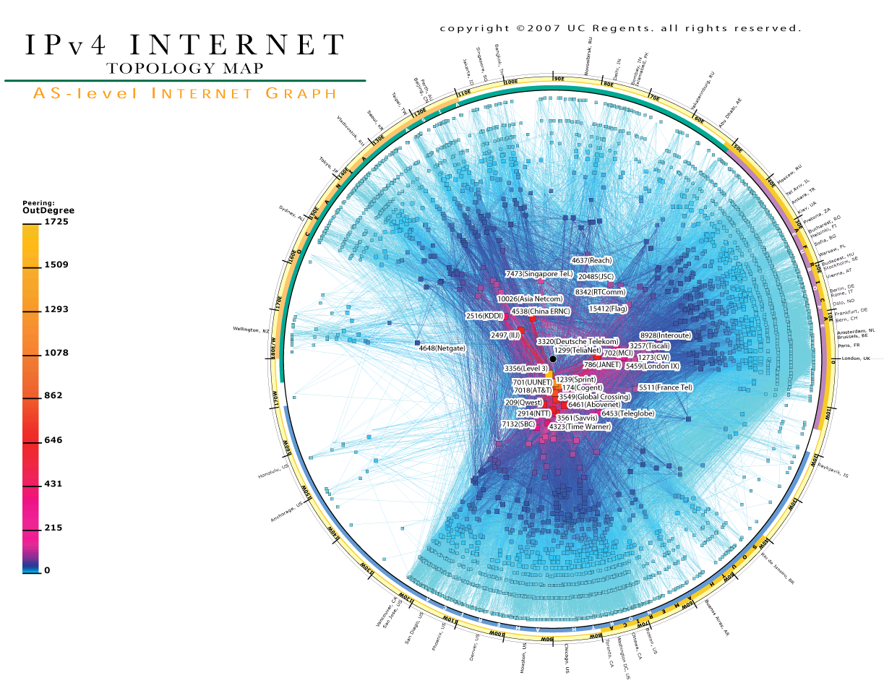

Slide 4
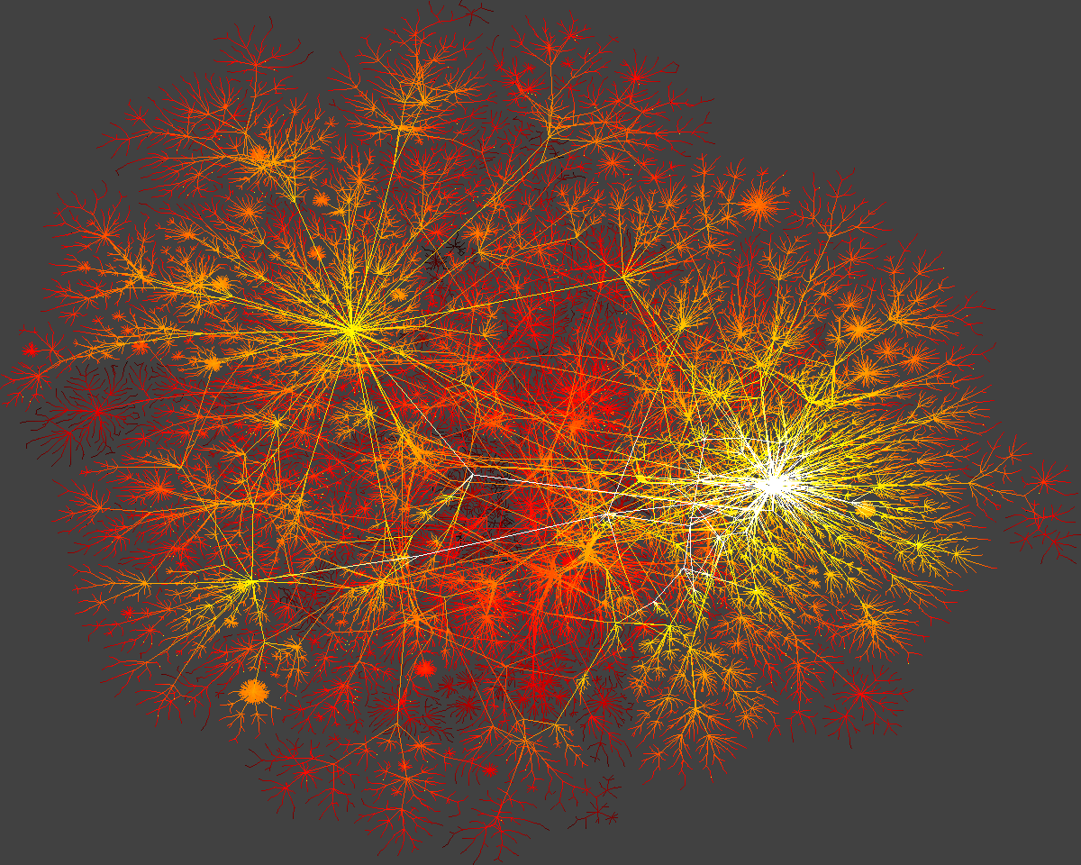

Slide 5
Internet
Heterogeneity: distribution P(k) of node degrees k:
Real: P(k) ~ k
Random: P(k) ~ ^{k}e/k!
Clustering: average probability that node neighbors are connected:
Real: 0.46
Random: 6.810^{4}

Slide 6
Internet vs. protein interaction

Slide 7
Strong heterogeneity and clustering as common features of complex networks
Network | Exponent of the degree distribution | Average clustering
Internet | 2.1 | 0.46
Air transportation | 2.0 | 0.62
Actor collaboration | 2.3 | 0.78
Protein interaction S. cerevisiae | 2.4 | 0.09
Metabolic E. coli and S. cerevisiae | 2.0 | 0.67
Gene regulation E. coli and S. cerevisiae | 2.1 | 0.09

Slide 8
Common features
Strong heterogeneity and clustering of complex networks exhaust all their commonalities
the networks are quite different and unique in all other respects (e.g., modularity, etc.)
Is there any geometric explanation for these two universal features?

Slide 10
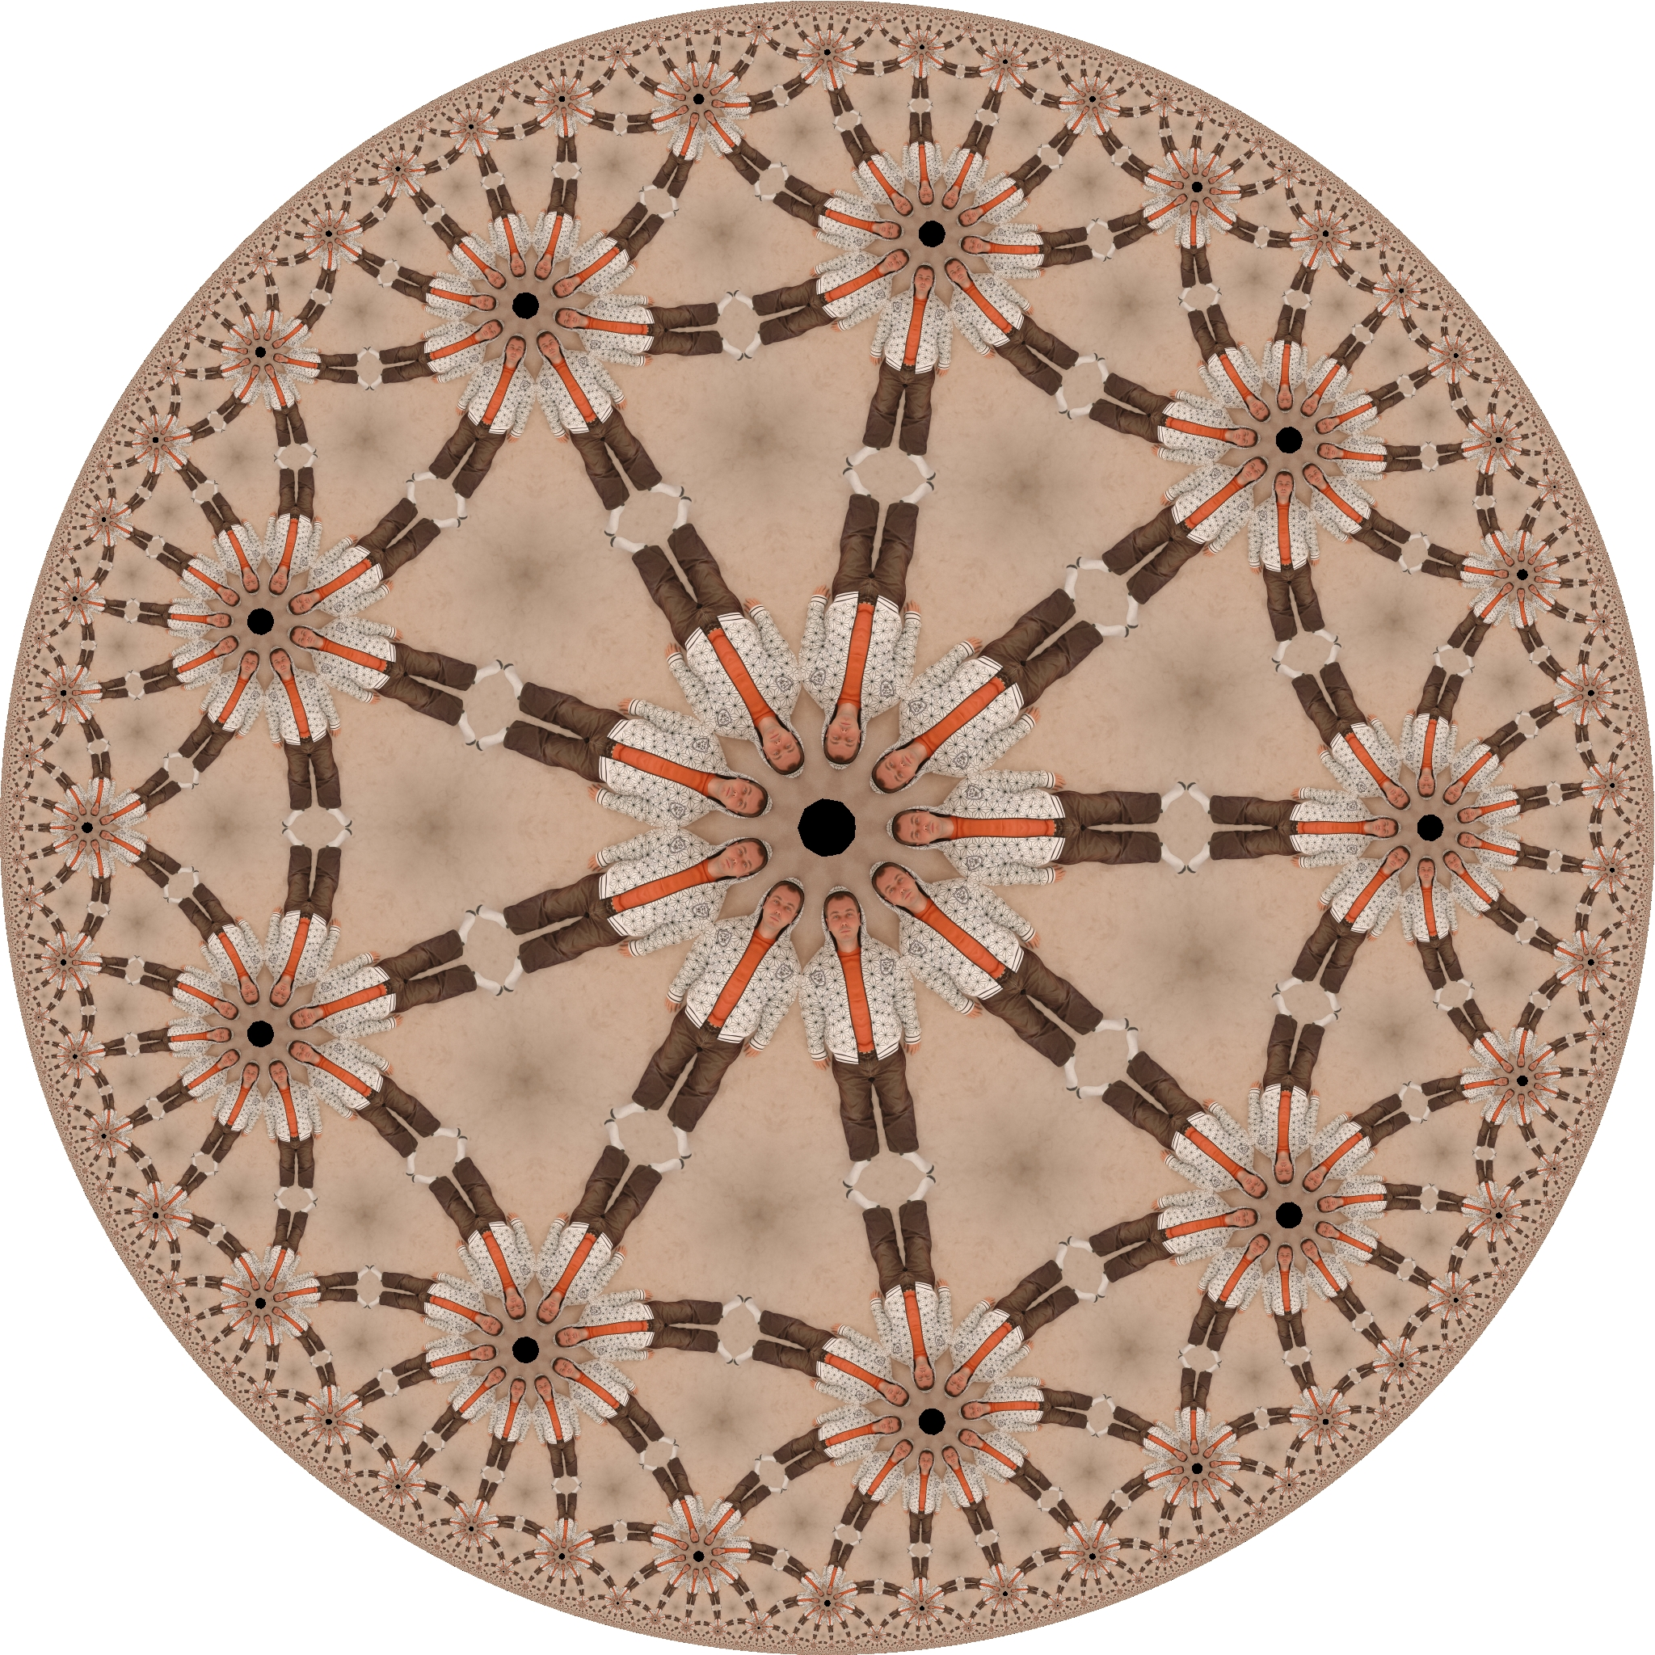

Slide 13
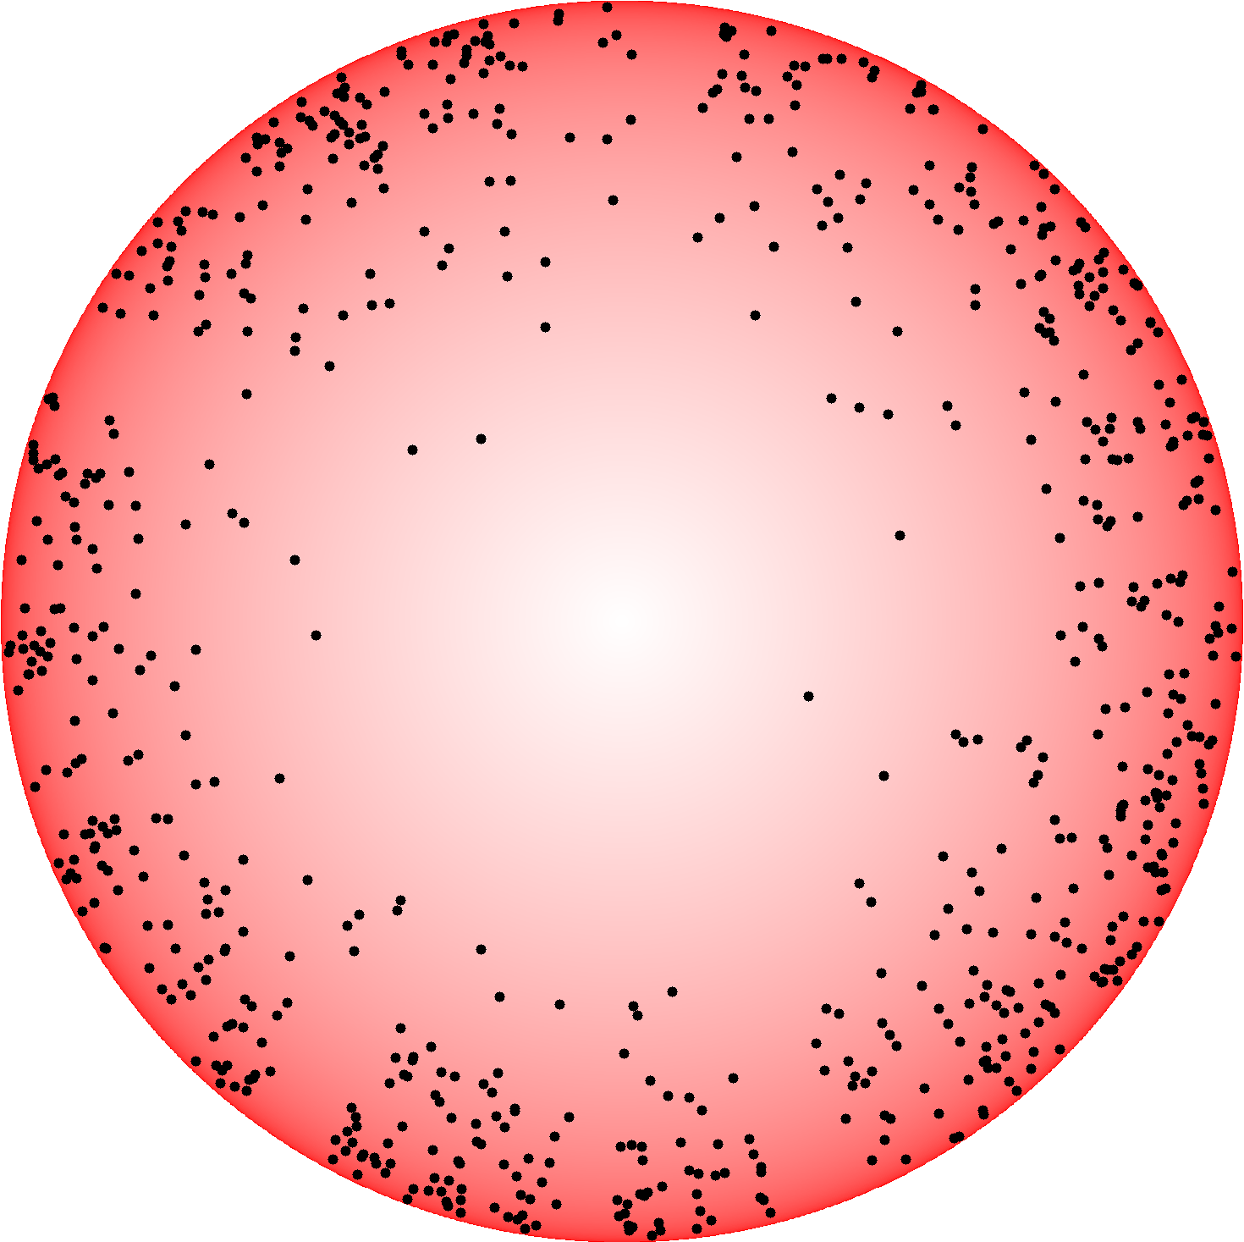

Slide 15
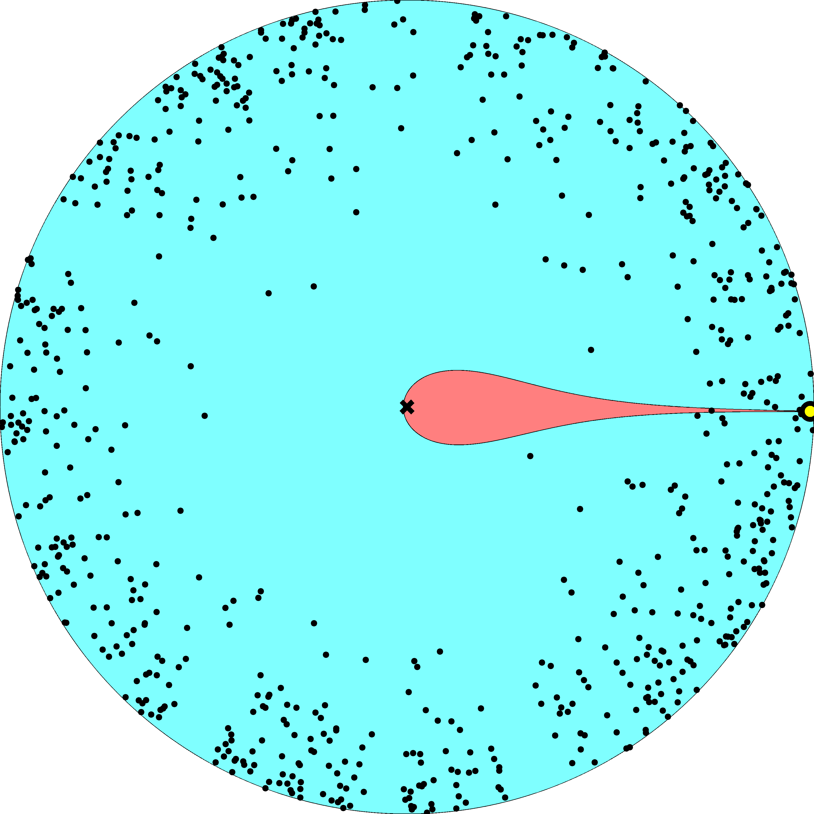

Slide 16
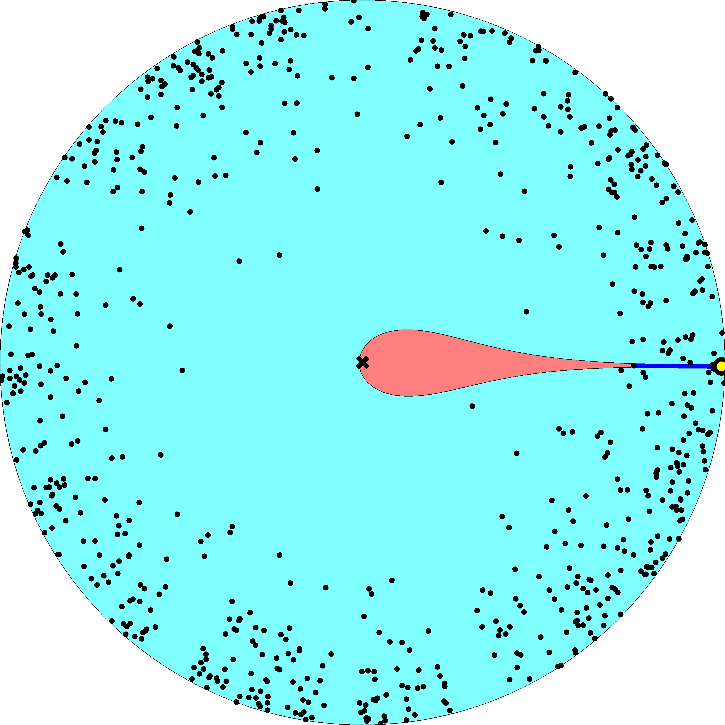

Slide 17
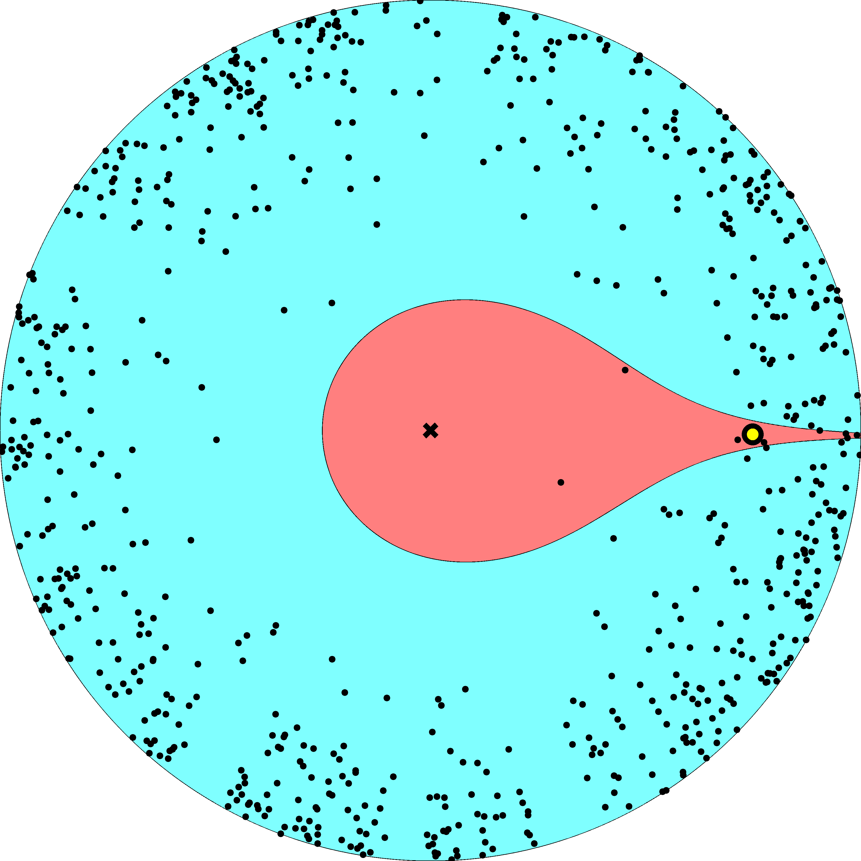

Slide 18
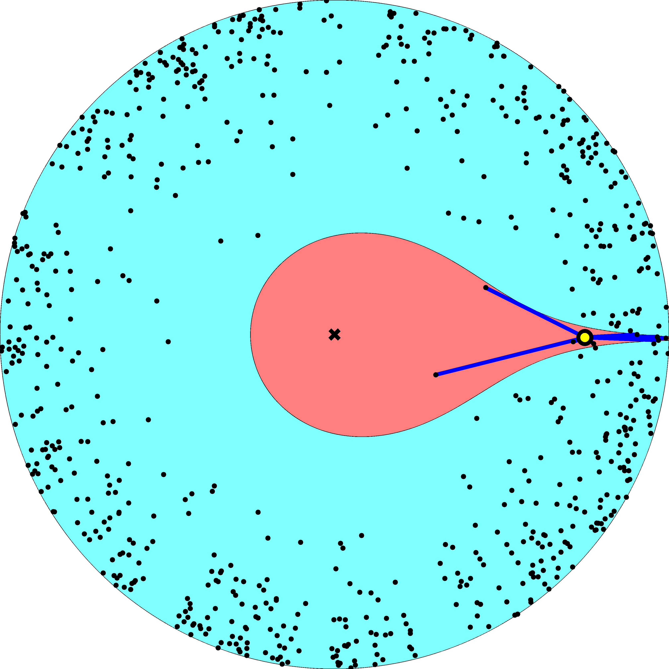

Slide 19
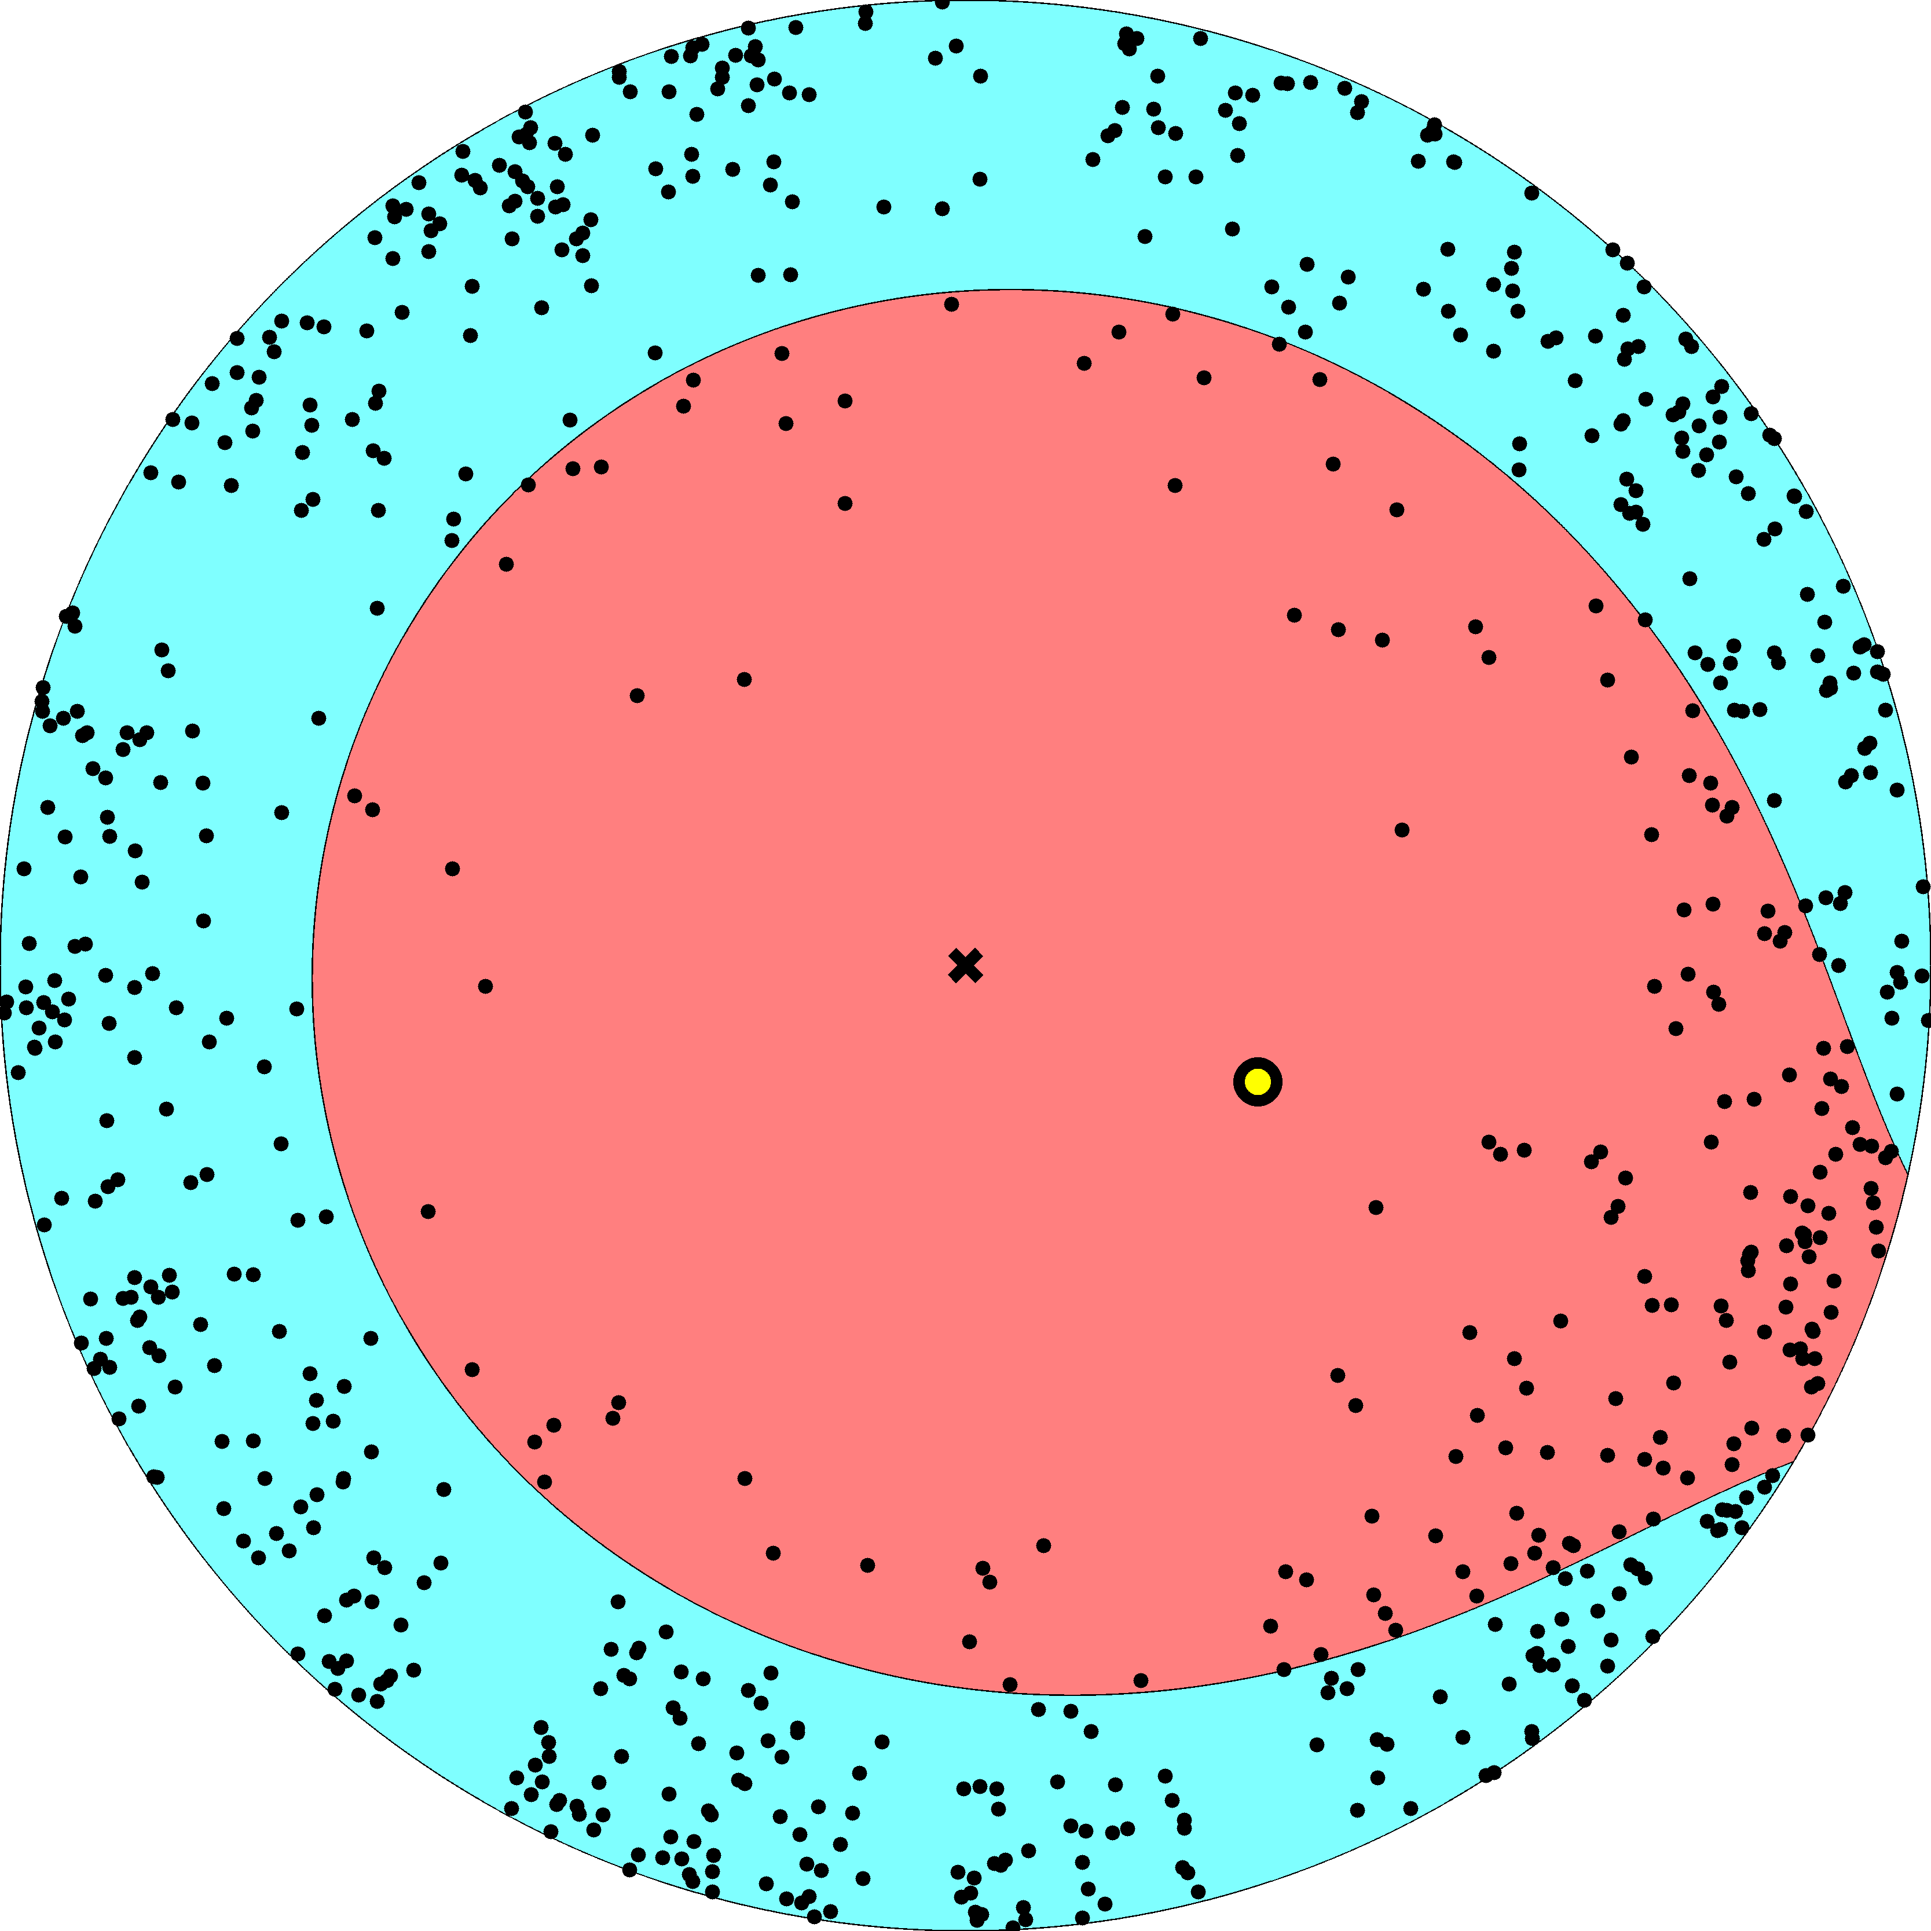

Slide 20
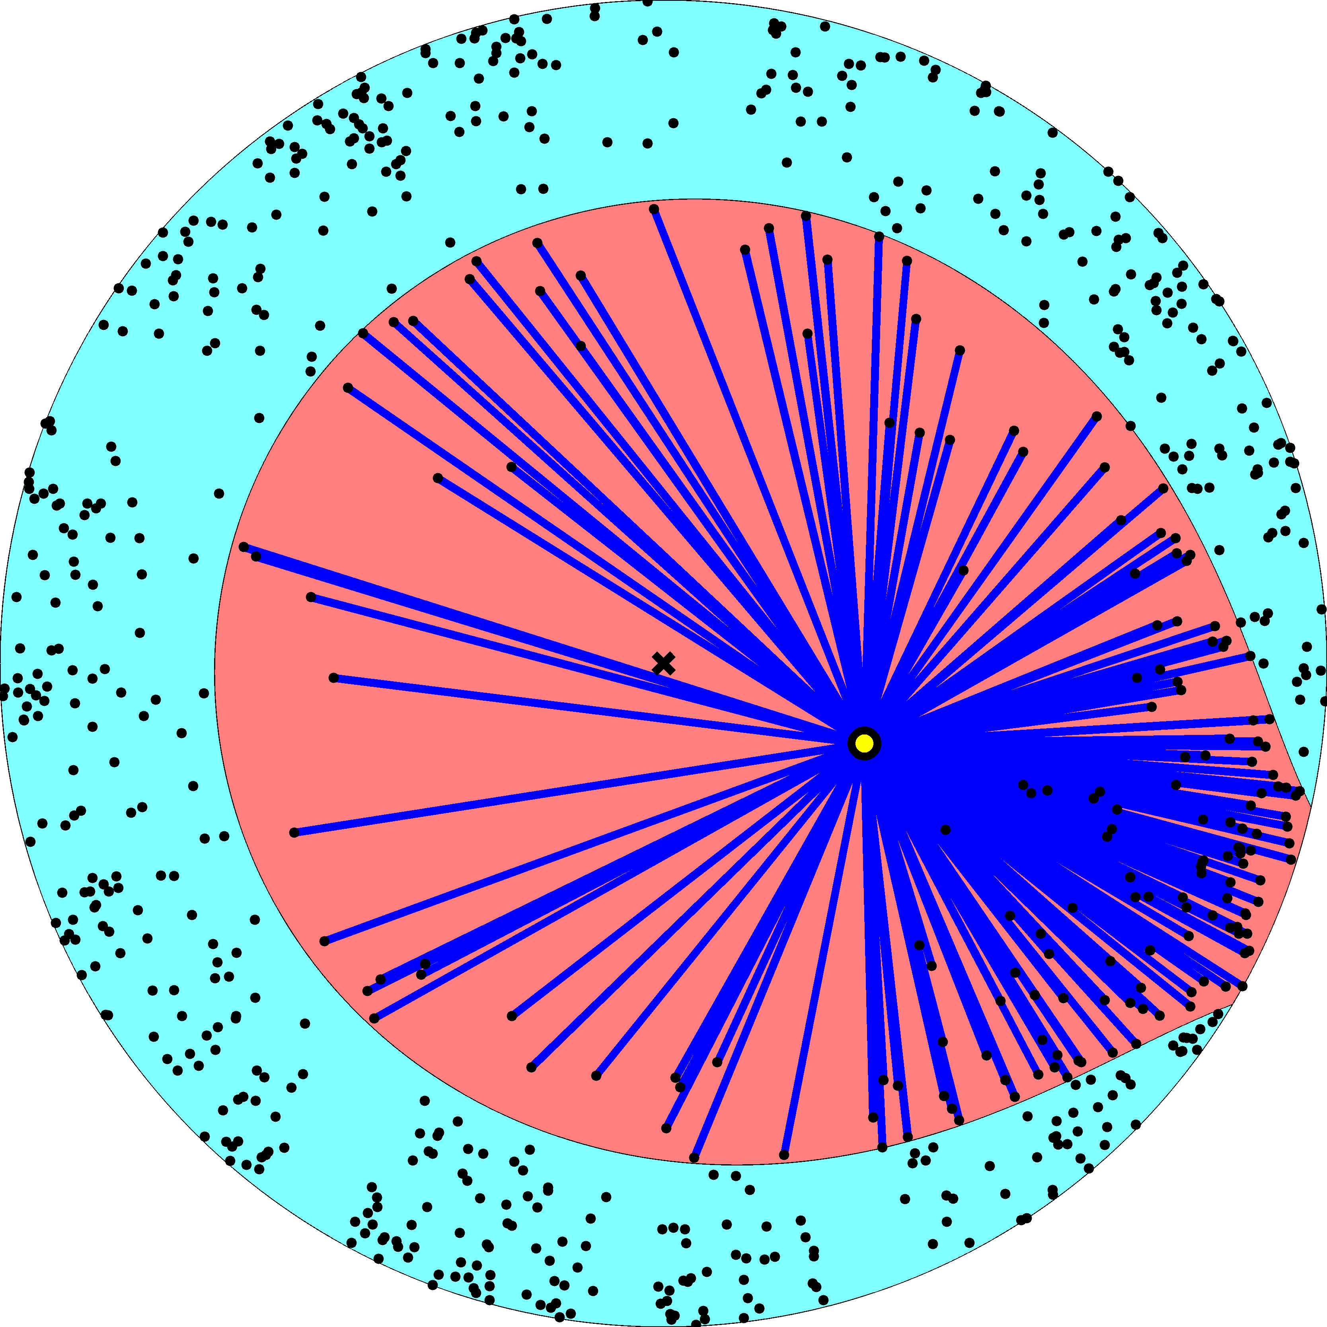

Slide 21
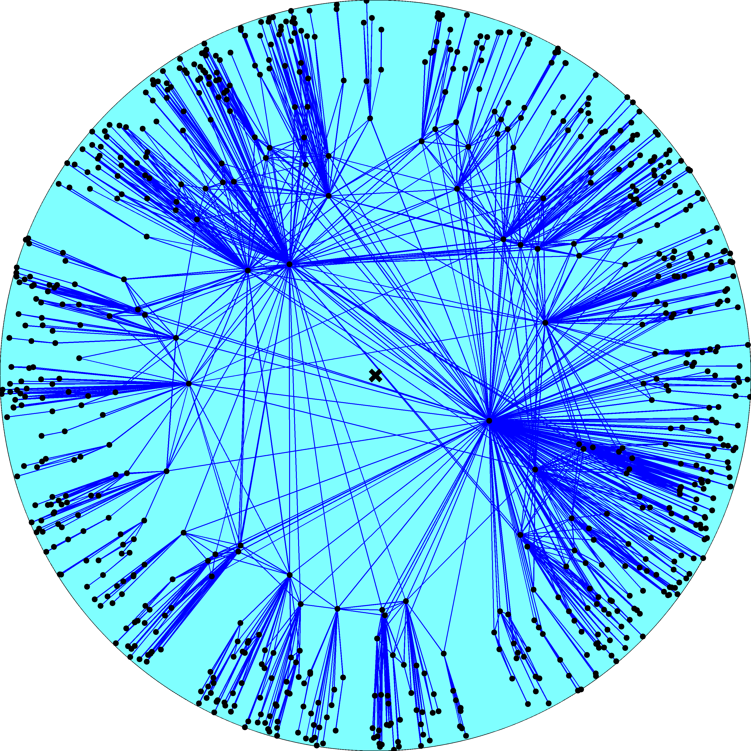
Node density
Node degree
R – disk radius
K – disk curvature
maximized
Degree distribution
Clustering

Slide 22
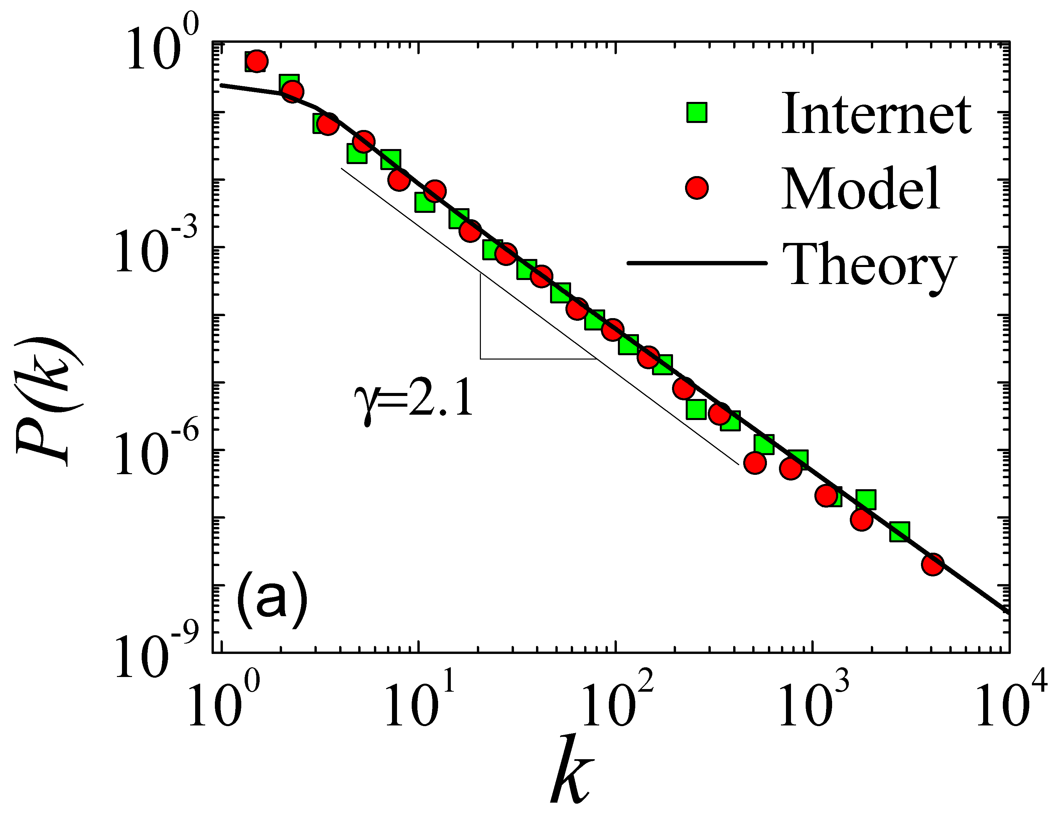

Slide 23
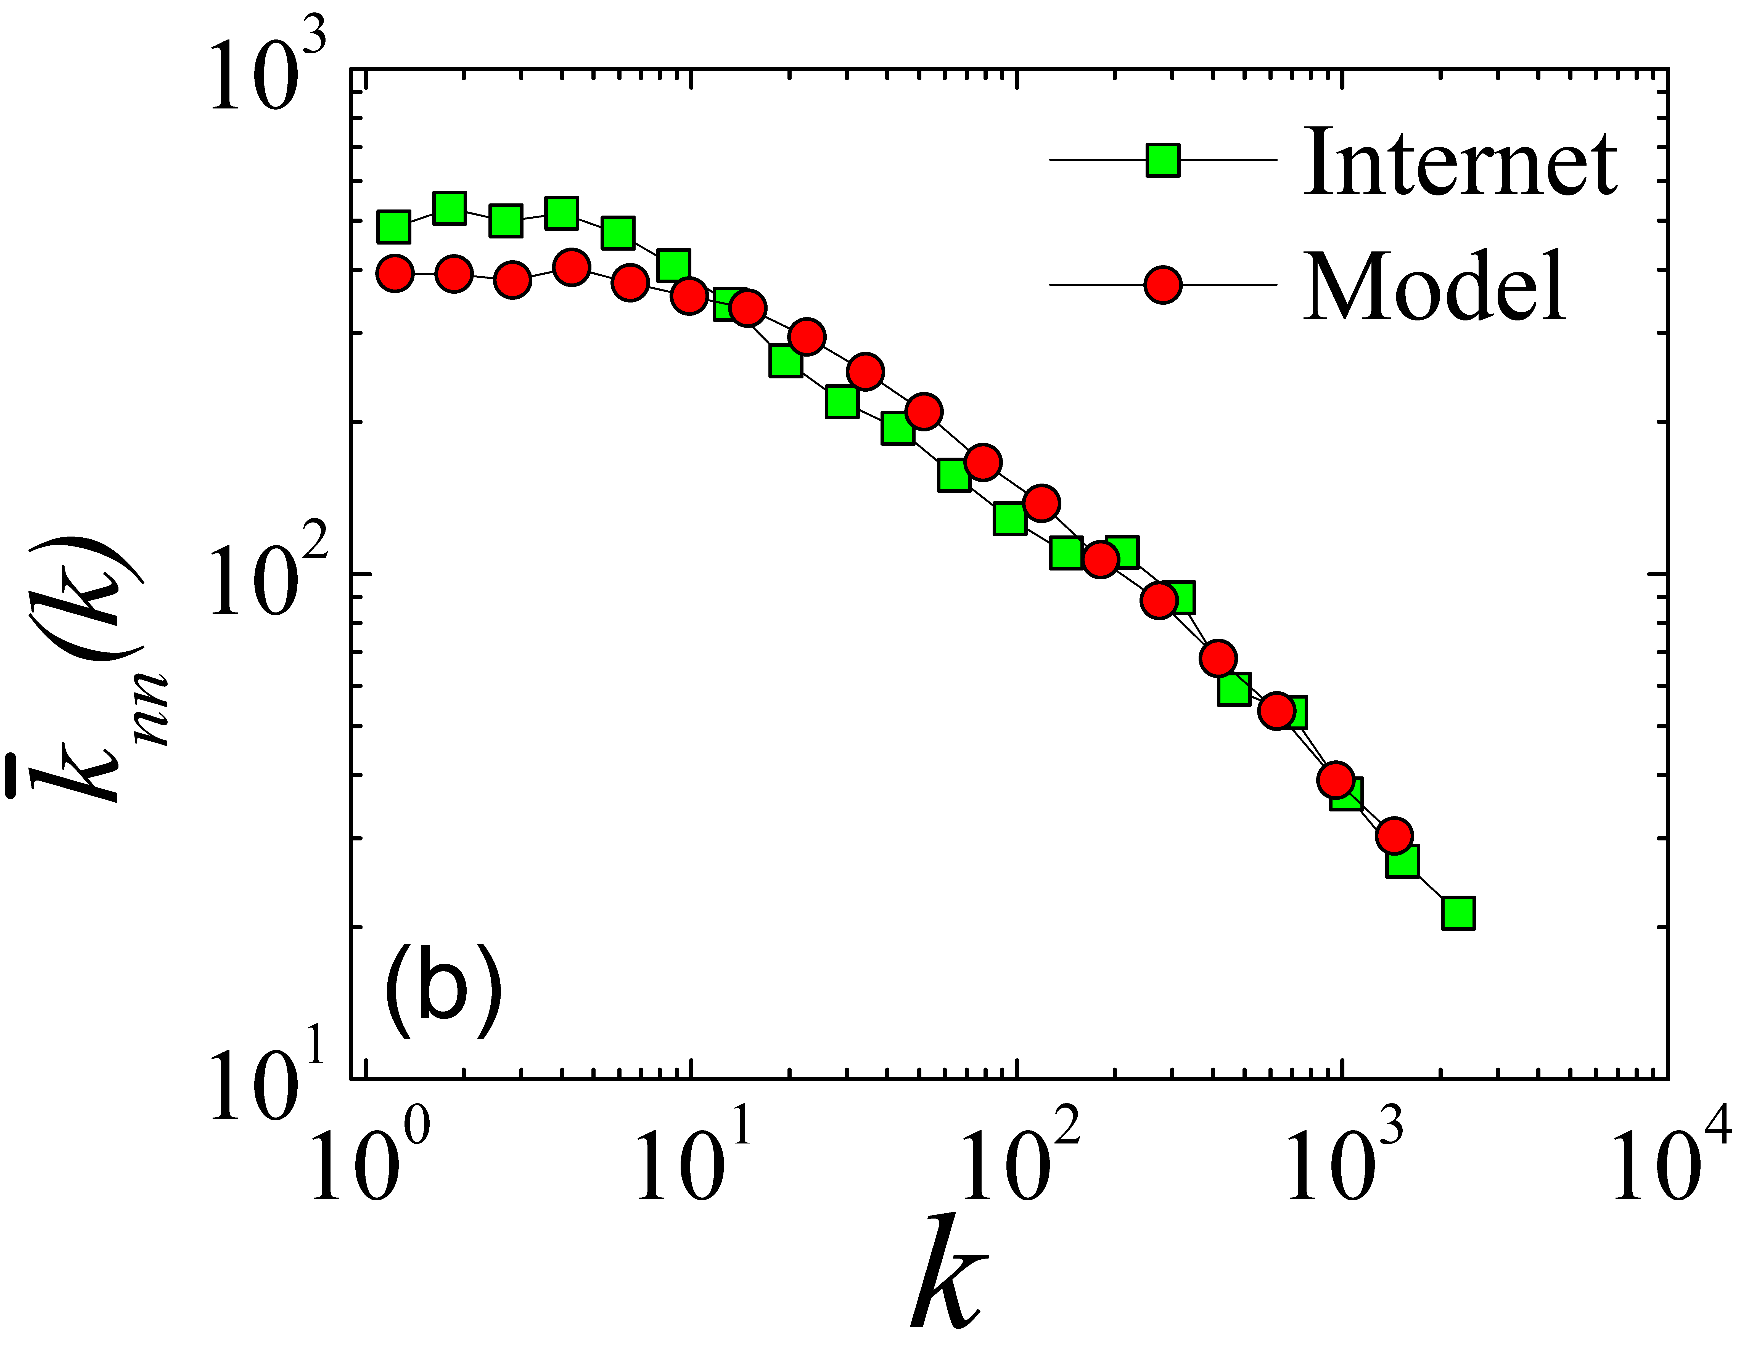

Slide 24
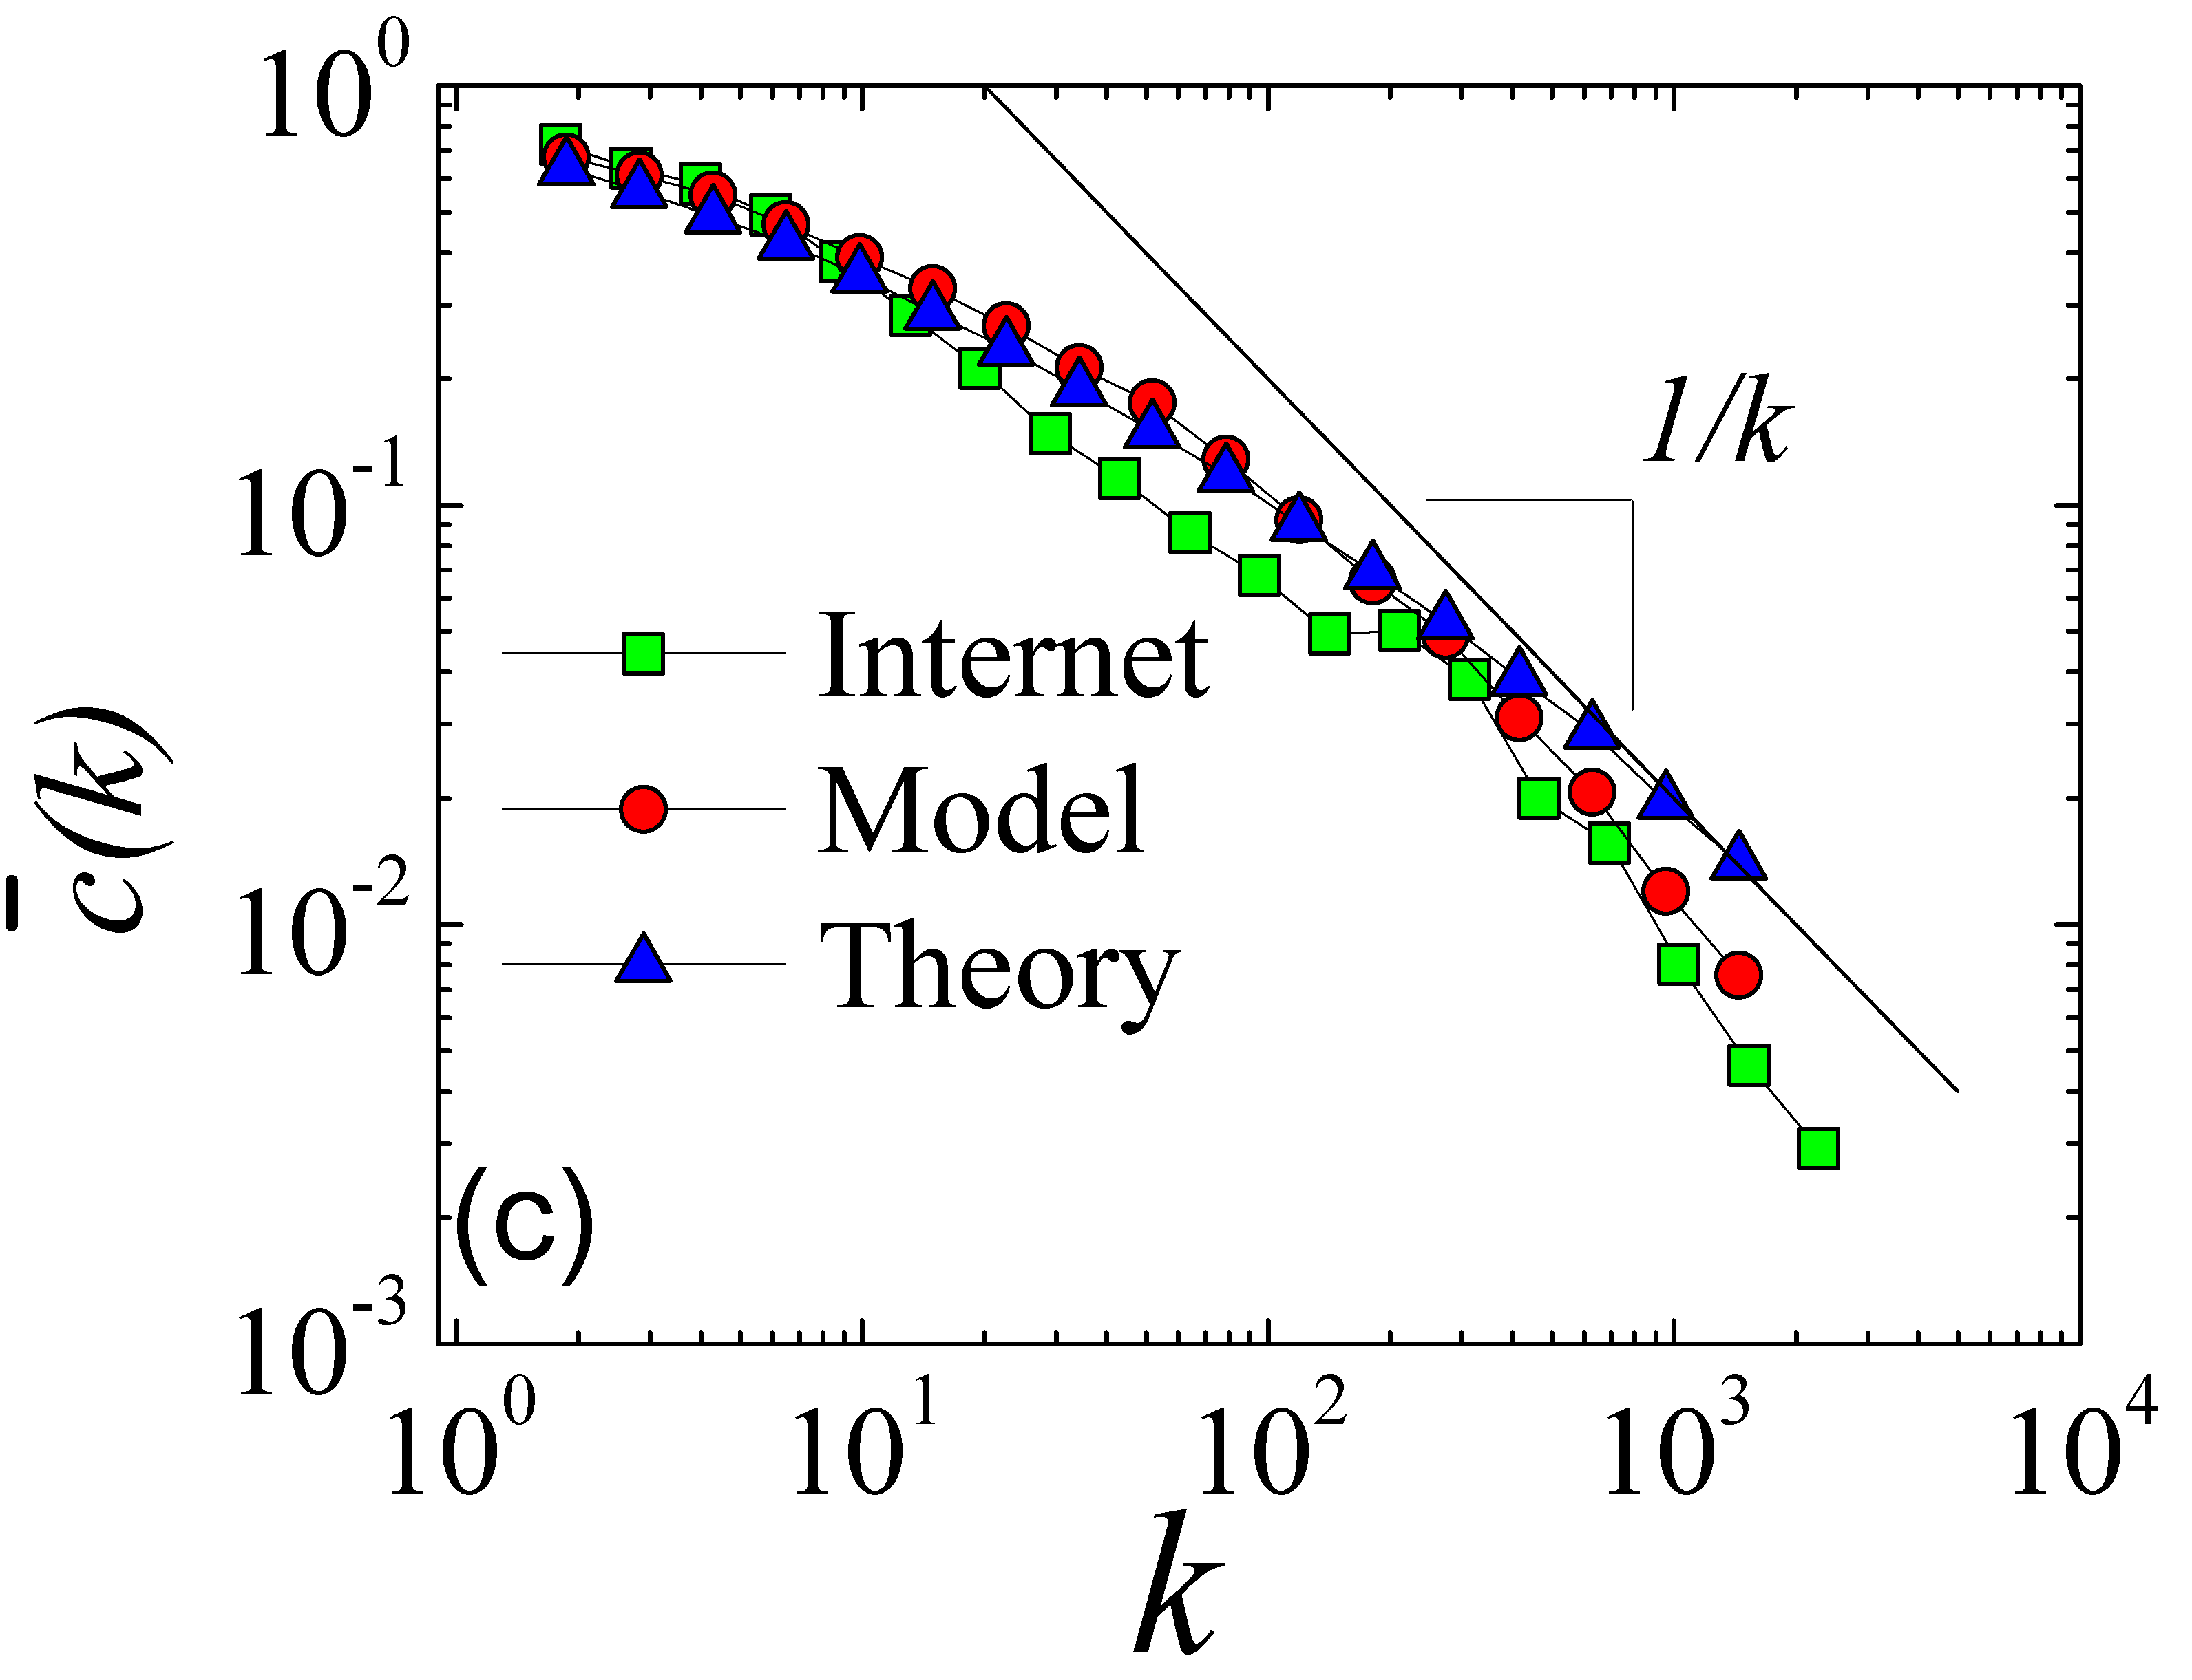

Slide 25
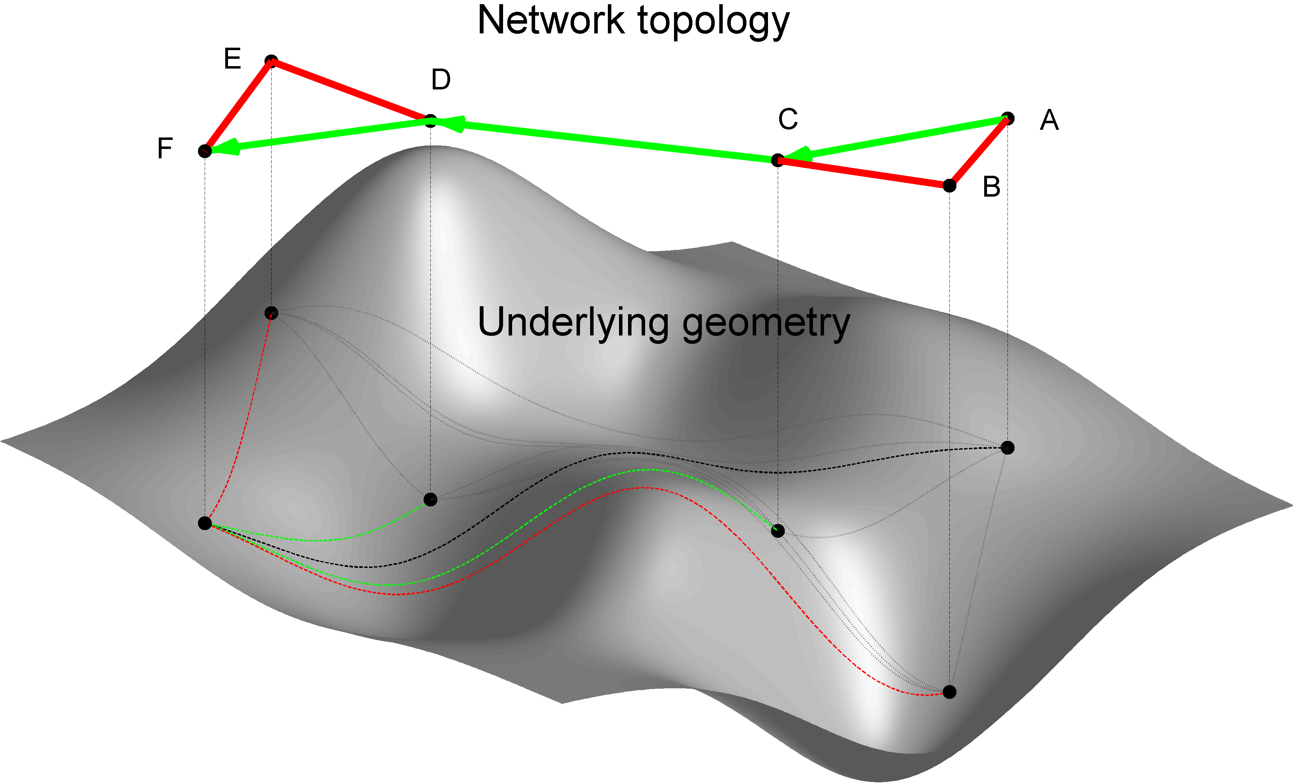
From structure
To function

Slide 28
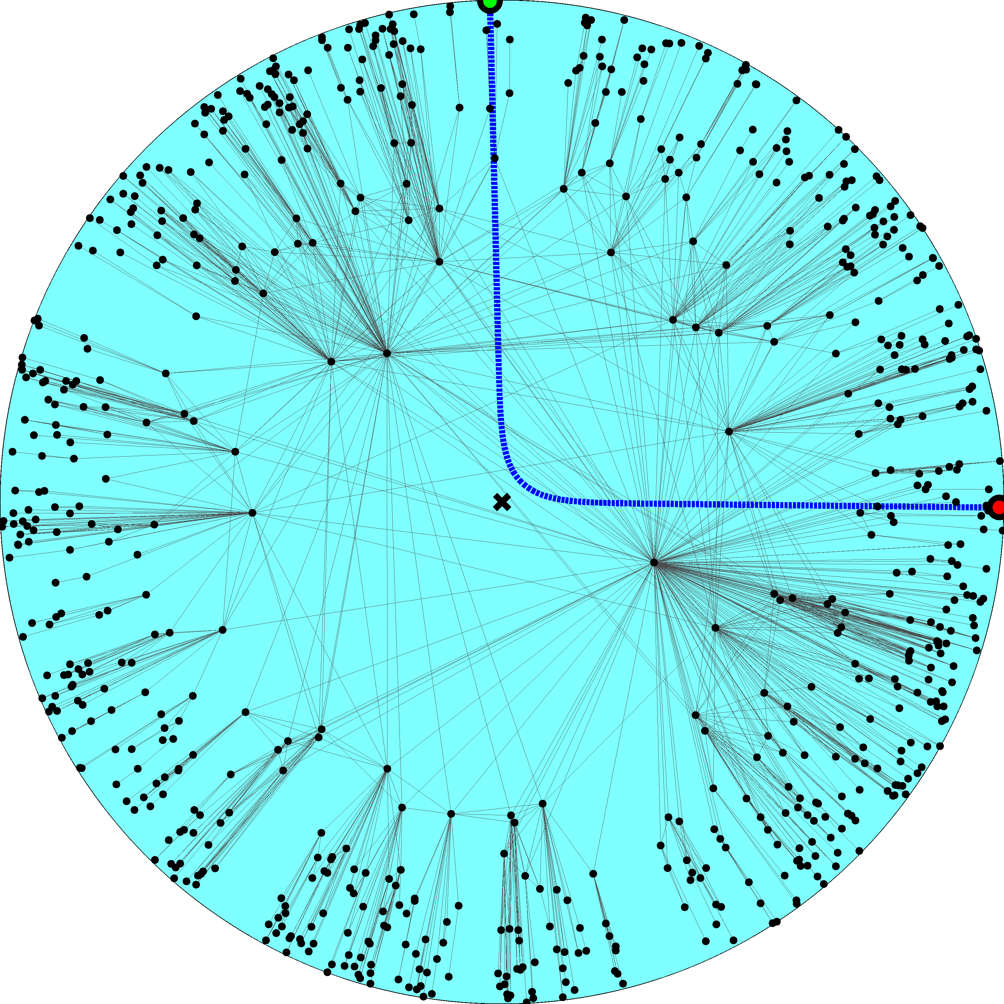

Slide 29
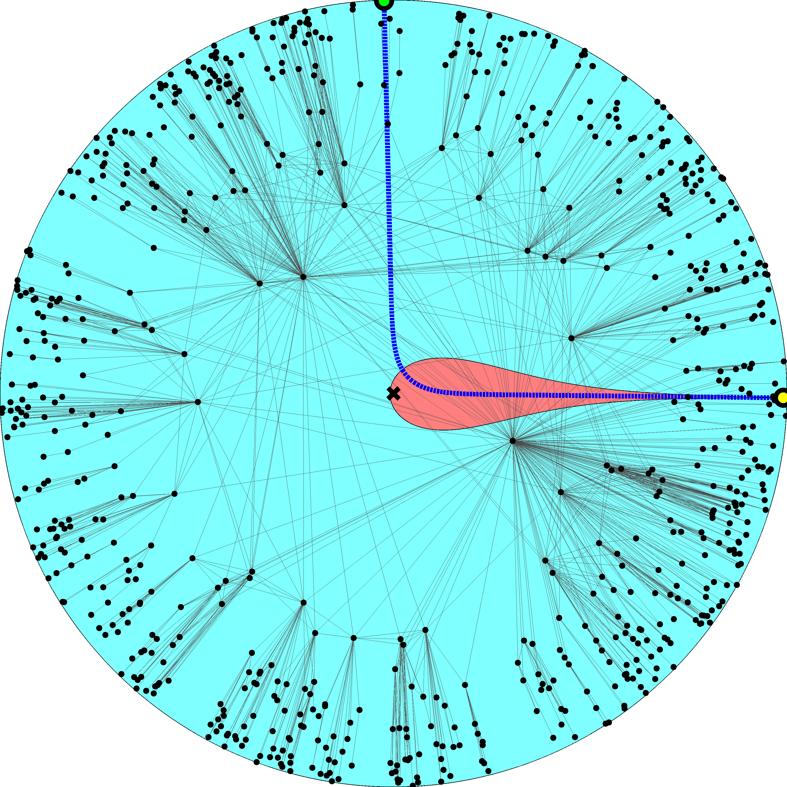

Slide 31
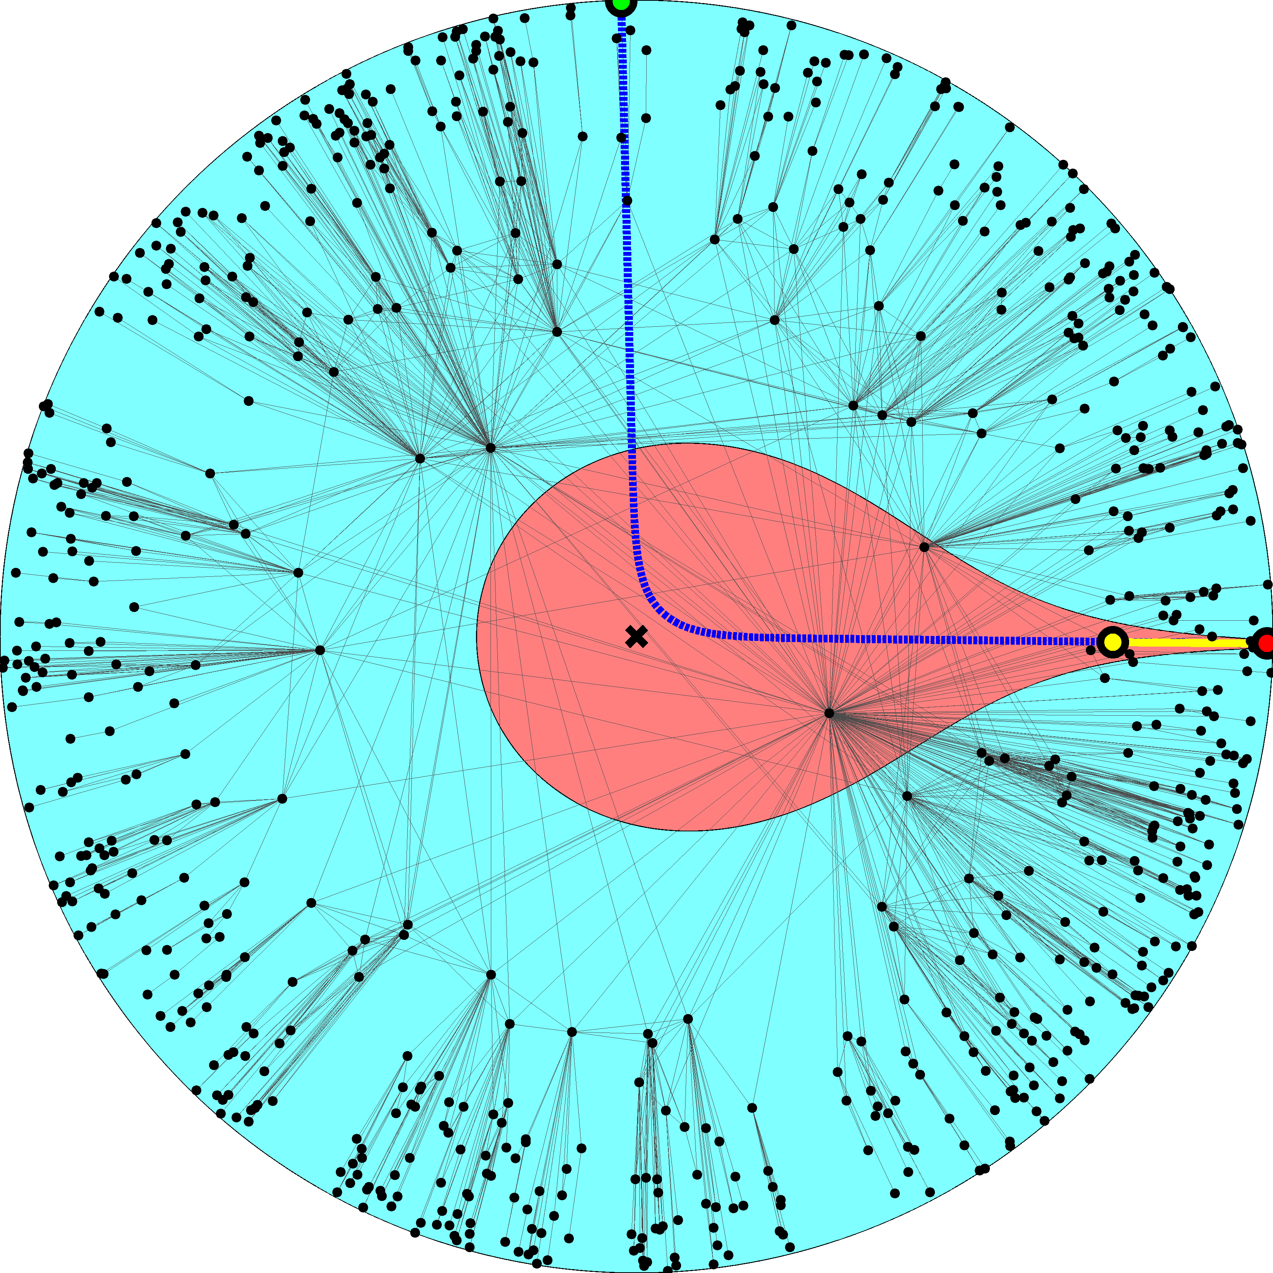

Slide 33
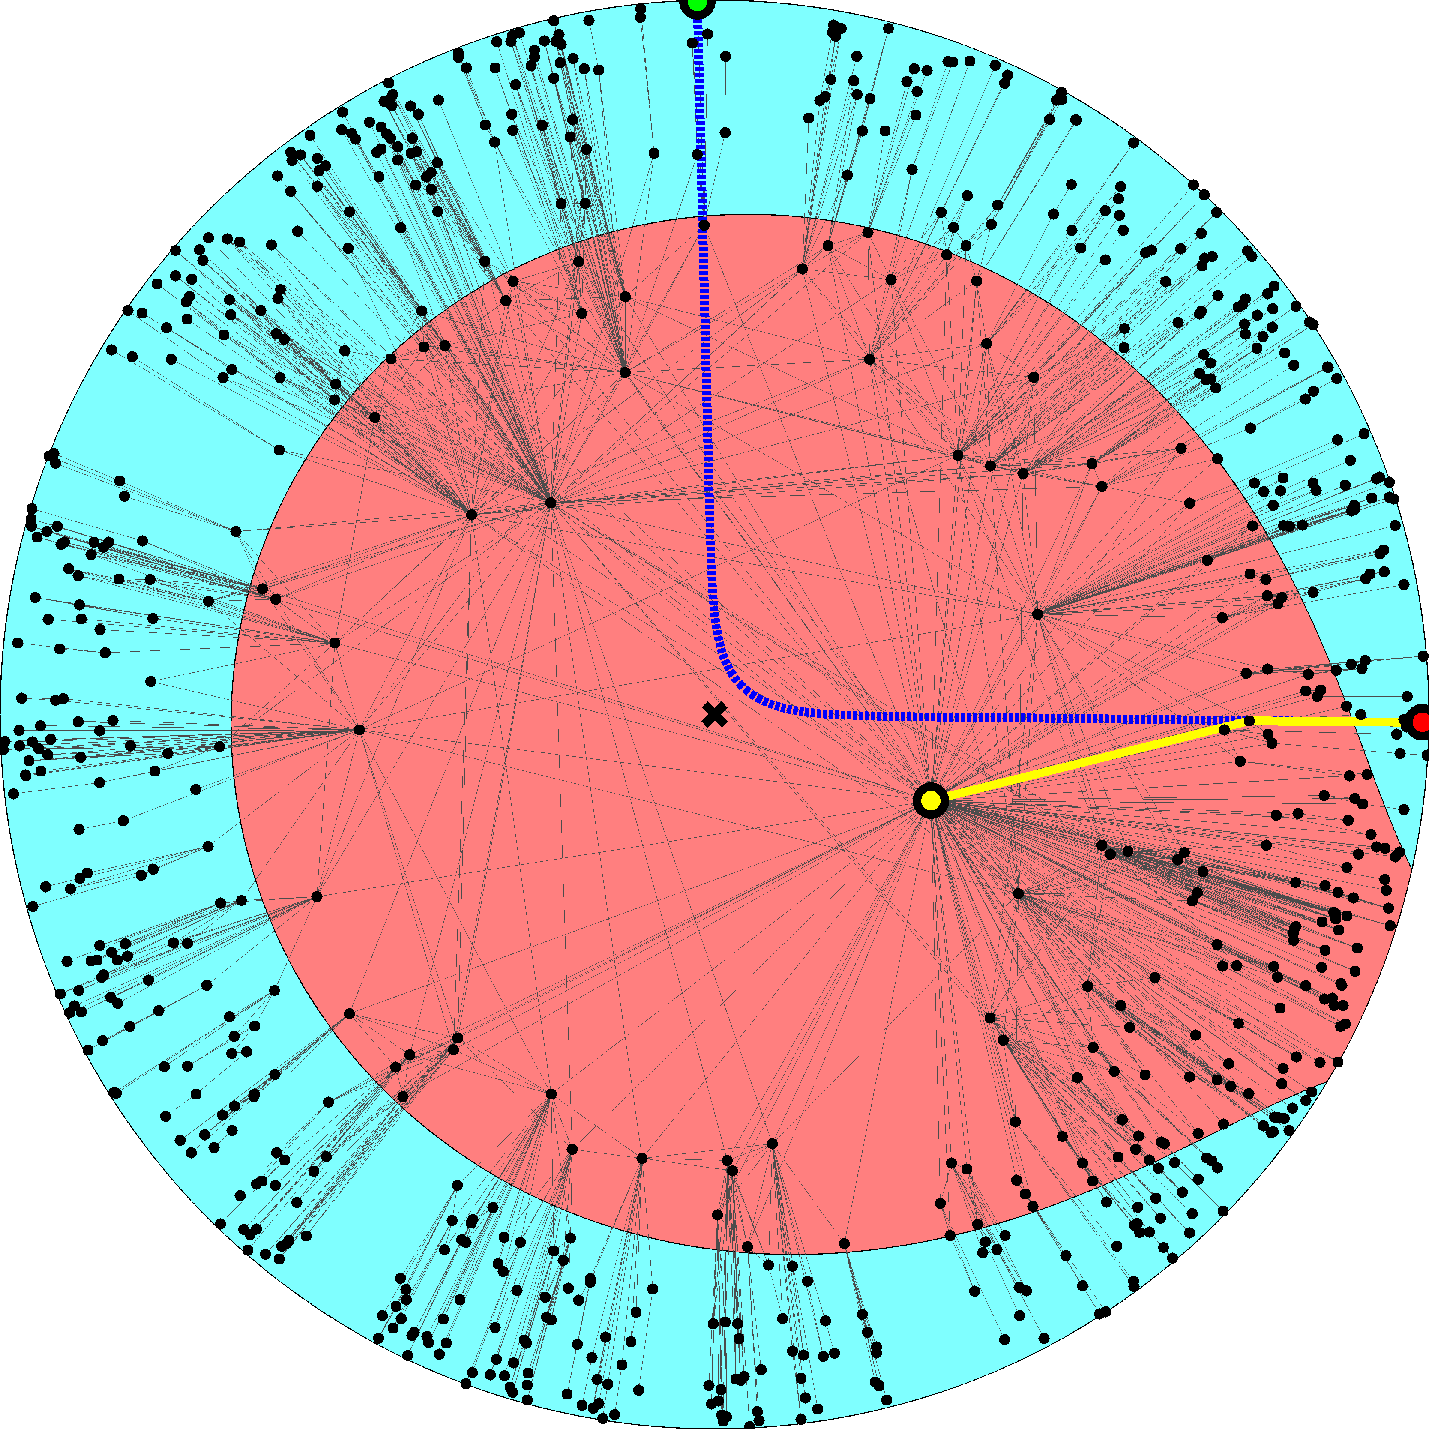

Slide 35
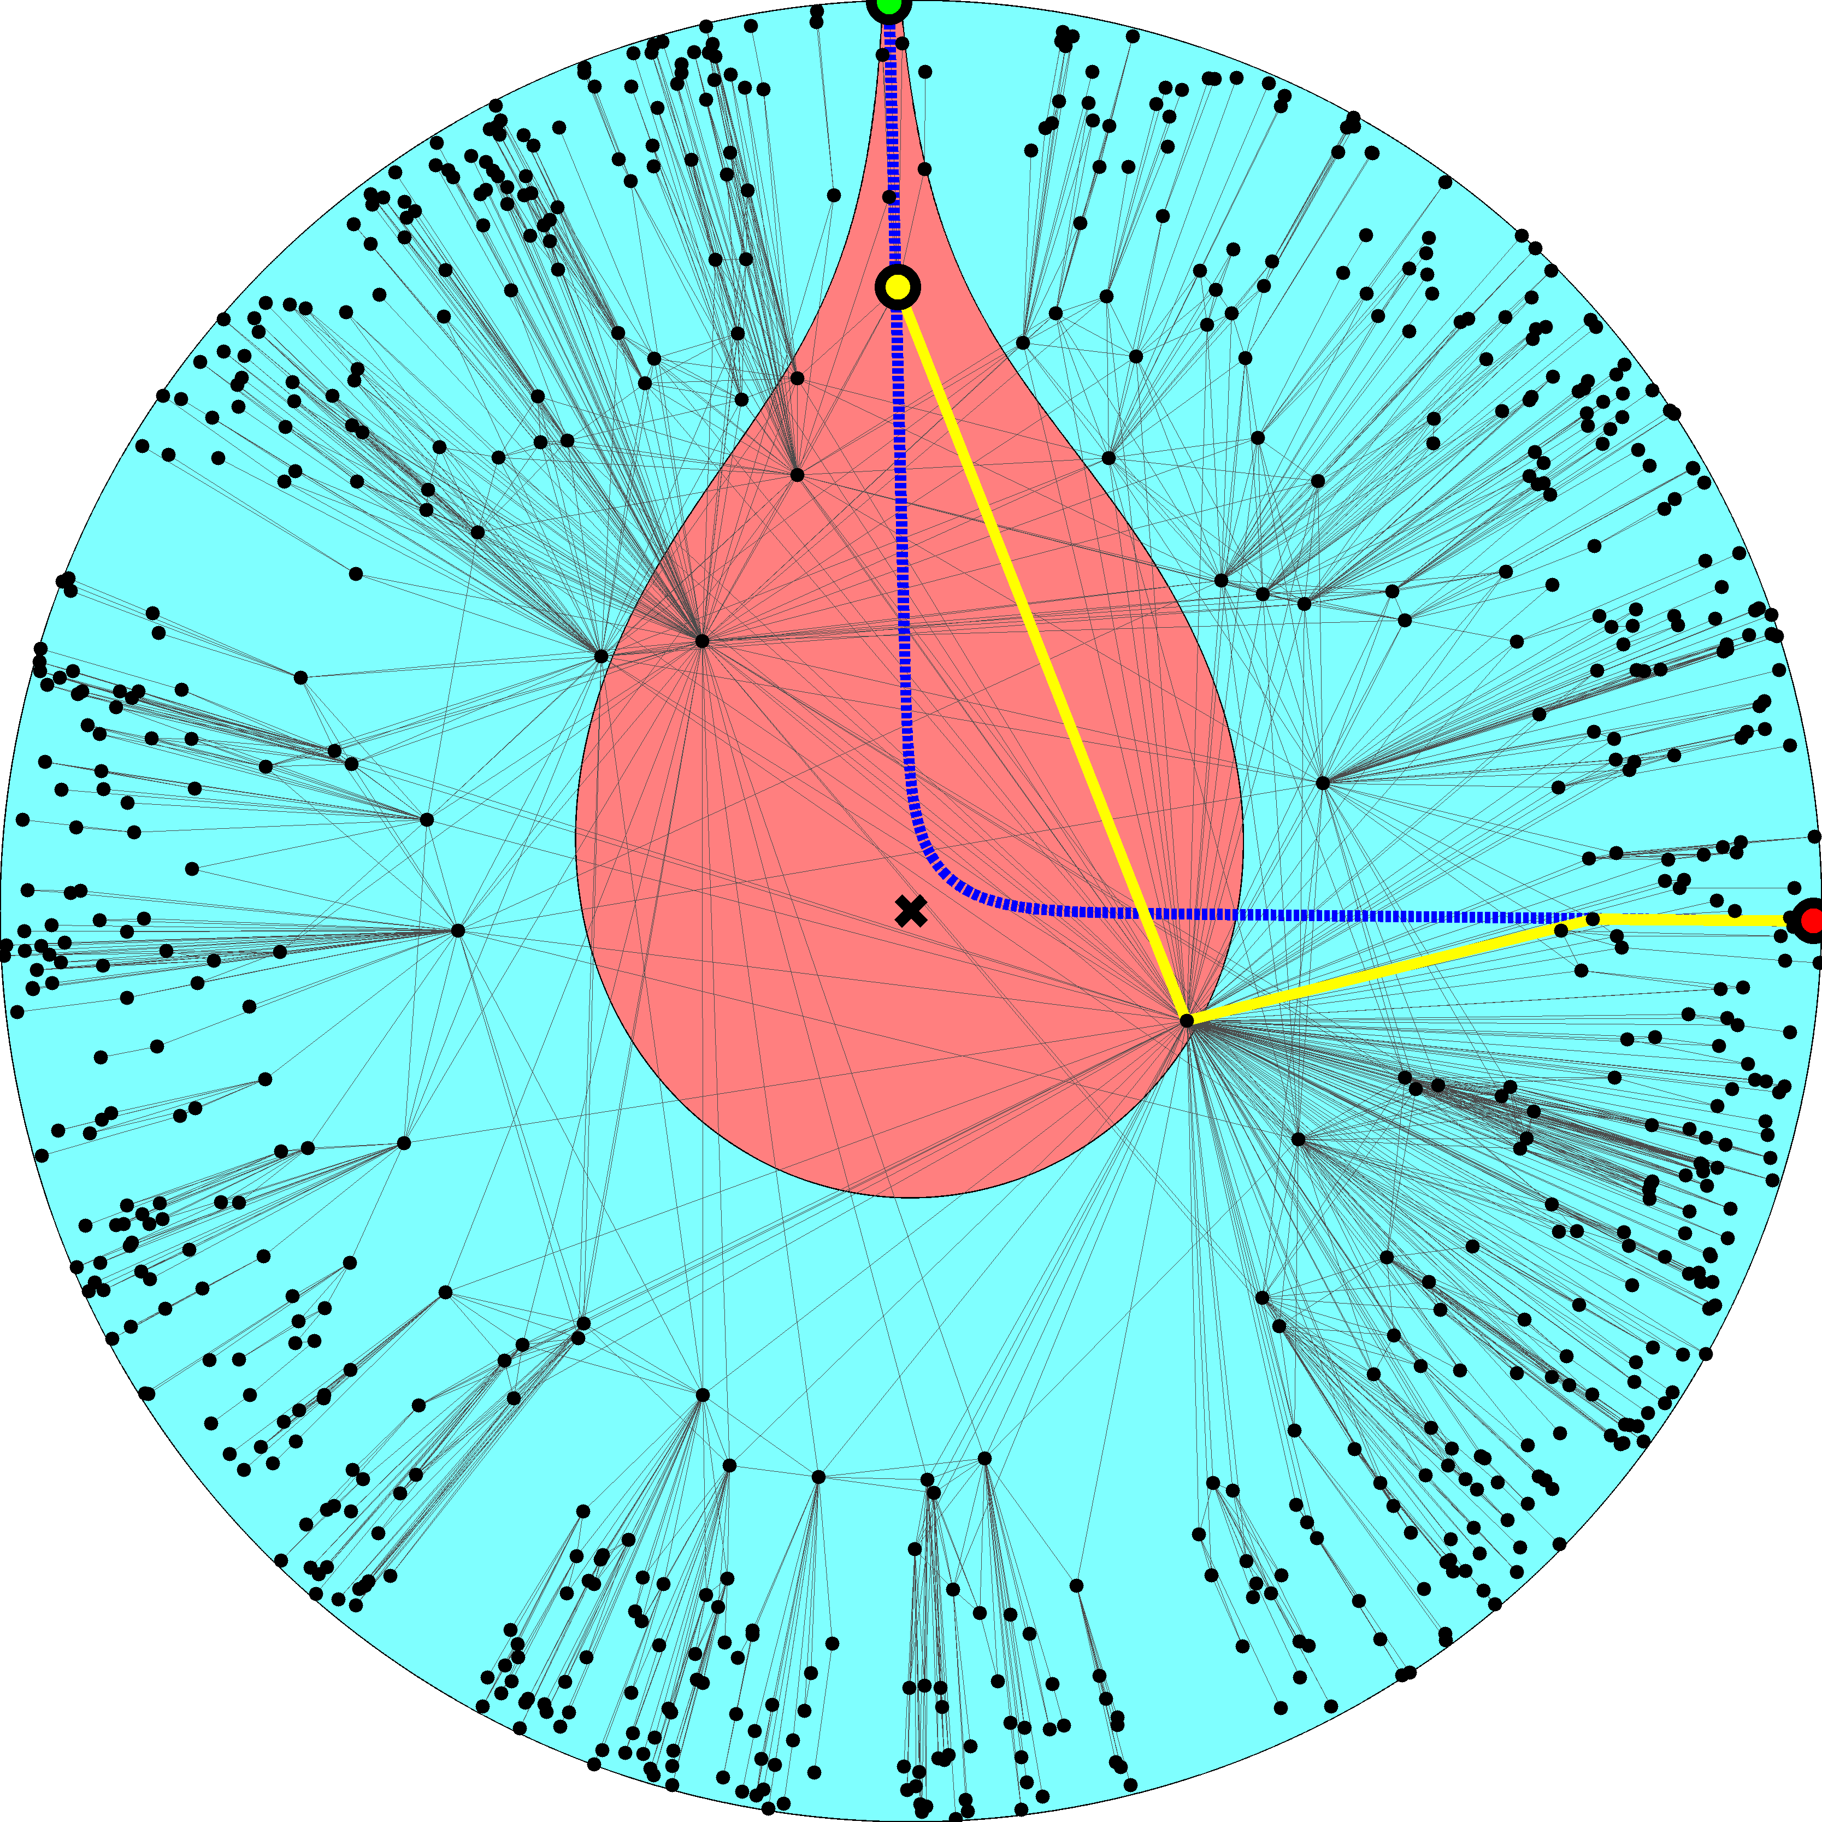

Slide 37
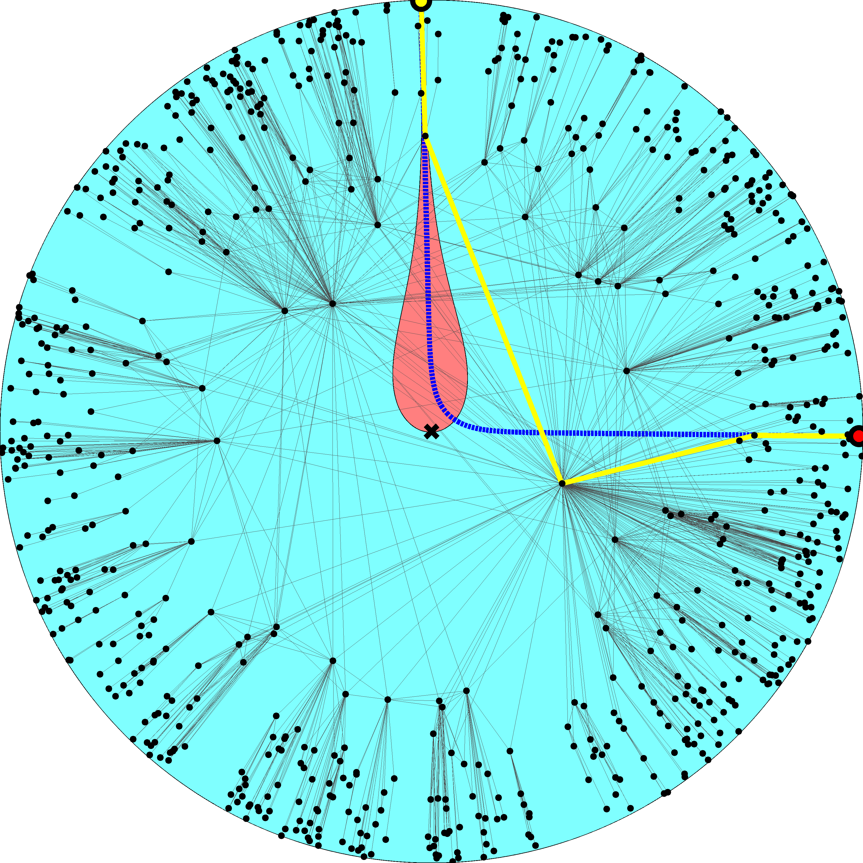

Slide 38
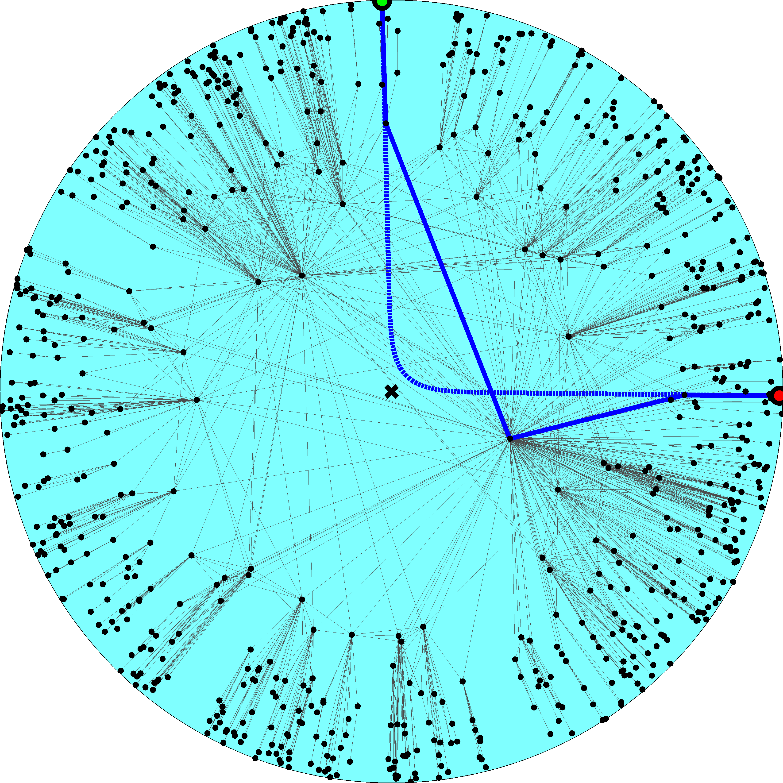

Slide 39
Navigation efficiency and robustness (2.1)
Percentage of successful greedy paths 99.99%
Percentage of shortest greedy paths 100%
Percentage of successful greedy paths after removal of x% of links or nodes
x10%  99%
x30%  95%

Slide 40
Success ratio in random graphs
Configuration model (2.1) 30%
No angular coordinates; node degree gradient only
Classical random graphs 0.17%
No radial coordinates; the connection probability does not depend on any distances at all

Slide 41
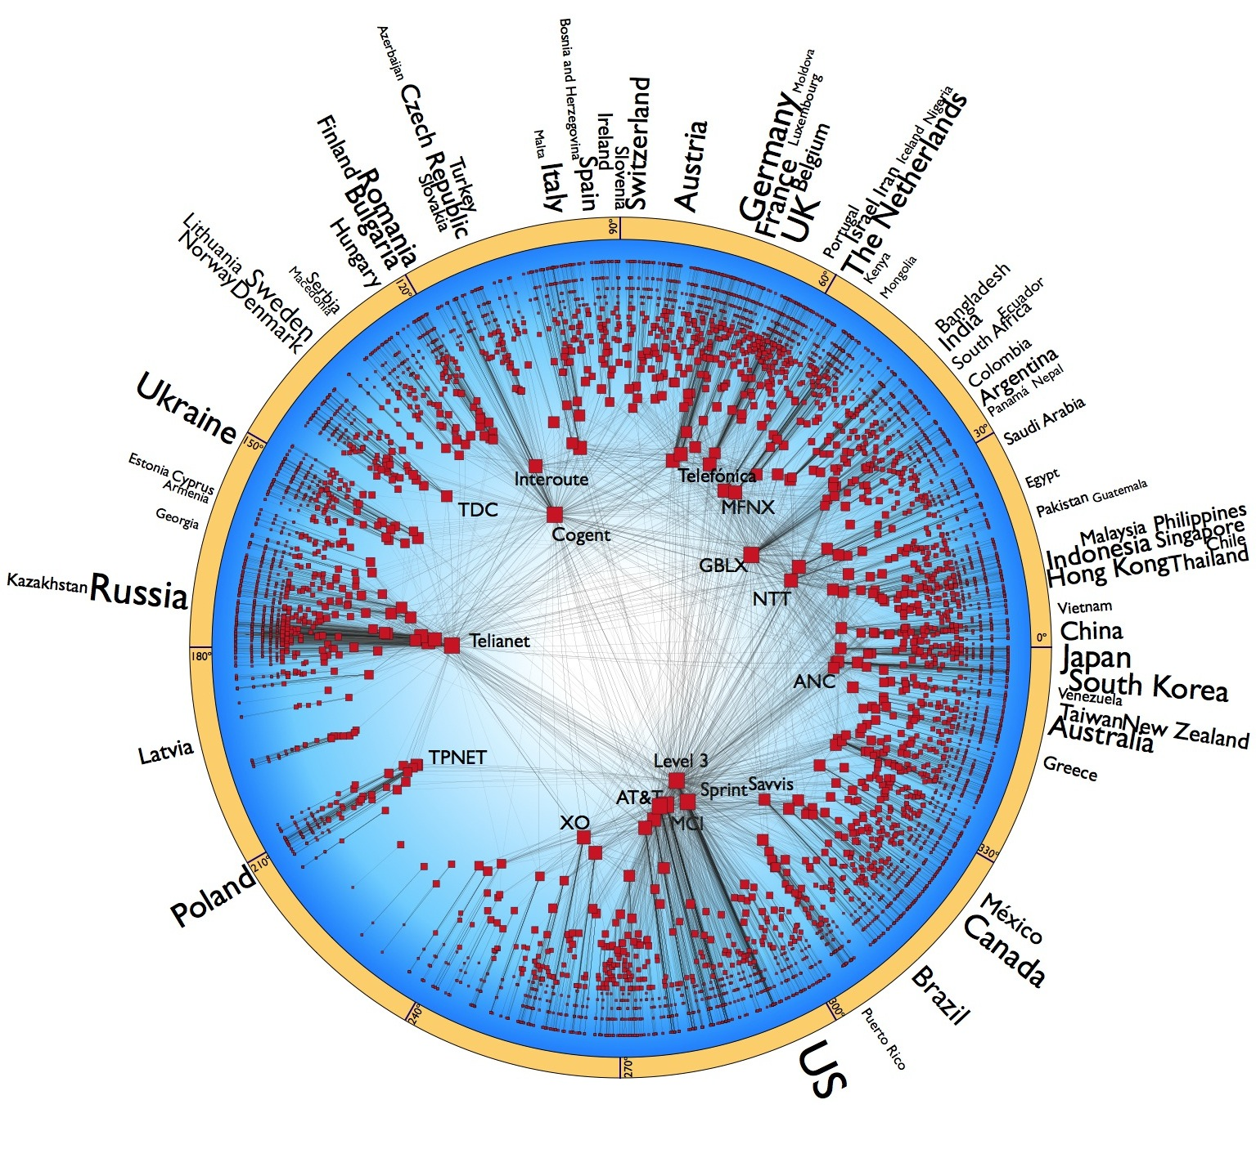

Slide 42
Navigation efficiency and robustness (Internet)
Percentage of successful greedy paths 97%
Average stretch 1.1
Percentage of successful greedy paths after removal of x% of links:
x10%  90%
x30%  75%

Slide 43
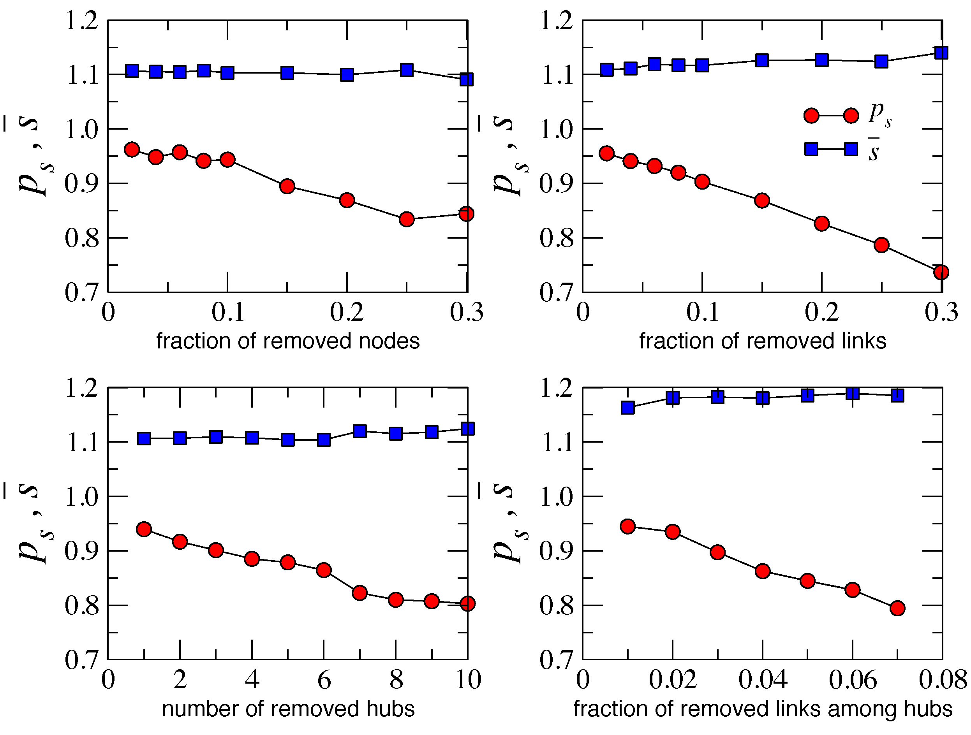
Why?
Congruency between hyperbolic space geometry and scale-free network topology
Hierarchical/heterogeneous organization of the two (zooming-out/zooming-in pattern)
Strong clustering/metric structure
How?
Strong clustering yields high path diversity
All paths are congruent to their corresponding hyperbolic geodesics
If some paths are damaged, many others remain, and can still be found since they all congruent

Slide 44
Take-home message

?
←

Slide 45
Conclusions
We have discovered a new geometric framework to study the structure and function of complex networks
The framework provides a natural (no “enforcement” on our side) explanation of two basic structural properties of complex networks (scale-free degree distribution and strong clustering) as consequences of underlying hyperbolic geometry
The framework admits a standard statistical physics approach (exponential random graphs), interpreting auxiliary fields as linear function of hyperbolic distances/energies
The framework subsumes the configuration model, classical random graphs, and random geometric graphs as three limiting cases with degenerate geometric structures
The framework explains how the hierarchical structure of complex networks ensures the maximum efficiency of their navigation function – optimal routing without global topology knowledge
The framework provides a basis for mapping real complex networks to their hidden/underlying hyperbolic spaces

Slide 46
Open question
Does any optimization of efficiency and robustness of targeted transport drive network evolution explicitly?
Or is it just a natural but implicit by-product of other (standard) network evolution mechanisms?

Slide 47
Applications of network mapping
Internet
optimal (maximally efficient/most scalable) routing
routing table sizes, stretch, and communication overhead approach their theoretical lower bounds
Other networks
discover hidden distances between nodes (e.g., similarity distances between people in social networks)
“soft” communities become areas in the underlying space with higher node densities
tell what drives signaling in networks, and what network perturbations drive it to failures (e.g., in the brain, regulatory, or metabolic networks)

Slide 48
M. Boguñá, F. Papadopoulos, and D. Krioukov, Sustaining the Internet with Hyperbolic Mapping, Nature Communications, v.1, 62, 2010
D. Krioukov, F. Papadopoulos, A. Vahdat, and M. Boguñá, Hyperbolic Geometry of Complex Networks, Physical Review E, v.82, 036106, 2010, Physical Review E, v.80, 035101(R), 2009
F. Papadopoulos, D. Krioukov, M. Boguñá, and A. Vahdat, Greedy Forwarding in (Dynamic) Scale-Free Networks Embedded in Hyperbolic Metric Spaces, INFOCOM 2010, SIGMETRICS MAMA 2009
M. Boguñá, D. Krioukov, and kc claffy, Navigability of Complex Networks, Nature Physics, v.5, p.74-80, 2009

