Slide 1
Percolation in self-similar networks
Dmitri Krioukov
CAIDA/UCSD
M. Á. Serrano, M. Boguñá
UNT, March 2011

Slide 2
Percolation
Percolation is one of the most fundamental and best-studied critical phenomena in nature
In networks: the critical parameter is often average degree ↑k, and there is ↑k_{c} such that:
  If ↑k < ↑k_{c}: many small connected components
  If ↑k > ↑k_{c}: a giant connected component emerges
  ↑k_{c} can be zero
The smaller the ↑k_{c}, the more robust is the network with respect to random damage

Slide 3
Analytic approaches
Usually based on tree-like approximations
  Employing generating functions for branching processes
Ok, for zero-clustering networks
  Configuration model
  Preferential attachment
Not ok for strongly clustered networks
  Real networks
Newman-Gleeson:
  Any target concentration of subgraphs, but
  The network is tree-like at the subgraph level
Real networks:
  The distribution of the number of triangles overlapping over an edge is scale-free

Slide 4
Identification of percolation universality classes of networks
Problem is seemingly difficult
Details seem to prevail
Few results are available for some networks

Slide 5
Conformal invariance and percolation

Slide 6
Conformal invariance and percolation
z₁
z₂
z₄
z₃
J. Cardy’s crossing formula:
, where
Proved by S. Smirnov (Fields Medal)

Slide 7
Scale invariance and self-similarity

Slide 8
Self-similarity of network ensembles
Let ({}) be a network ensemble in the thermodynamic (continuum) limit, where {} is a set of its parameters (in ER, {} = ↑k)
Let  be a rescaling transformation
  For each graph G  ({}),  selects G’s subgraph G according to some rule
Definition: ensemble ({}) is self-similar if
({}) = ({})
where {} is some parameter transformation

Slide 9
2
100
2
1
1000

Slide 10
Hyperbolic distance

Slide 11
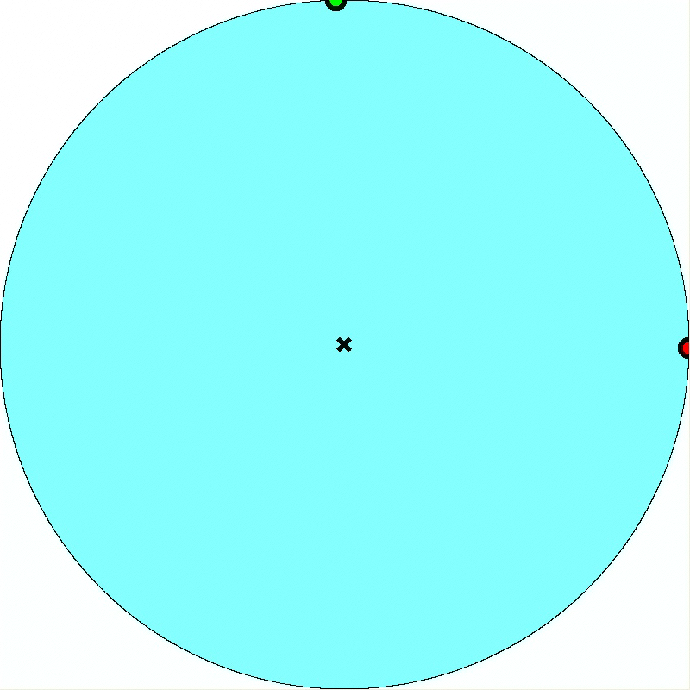

Slide 13
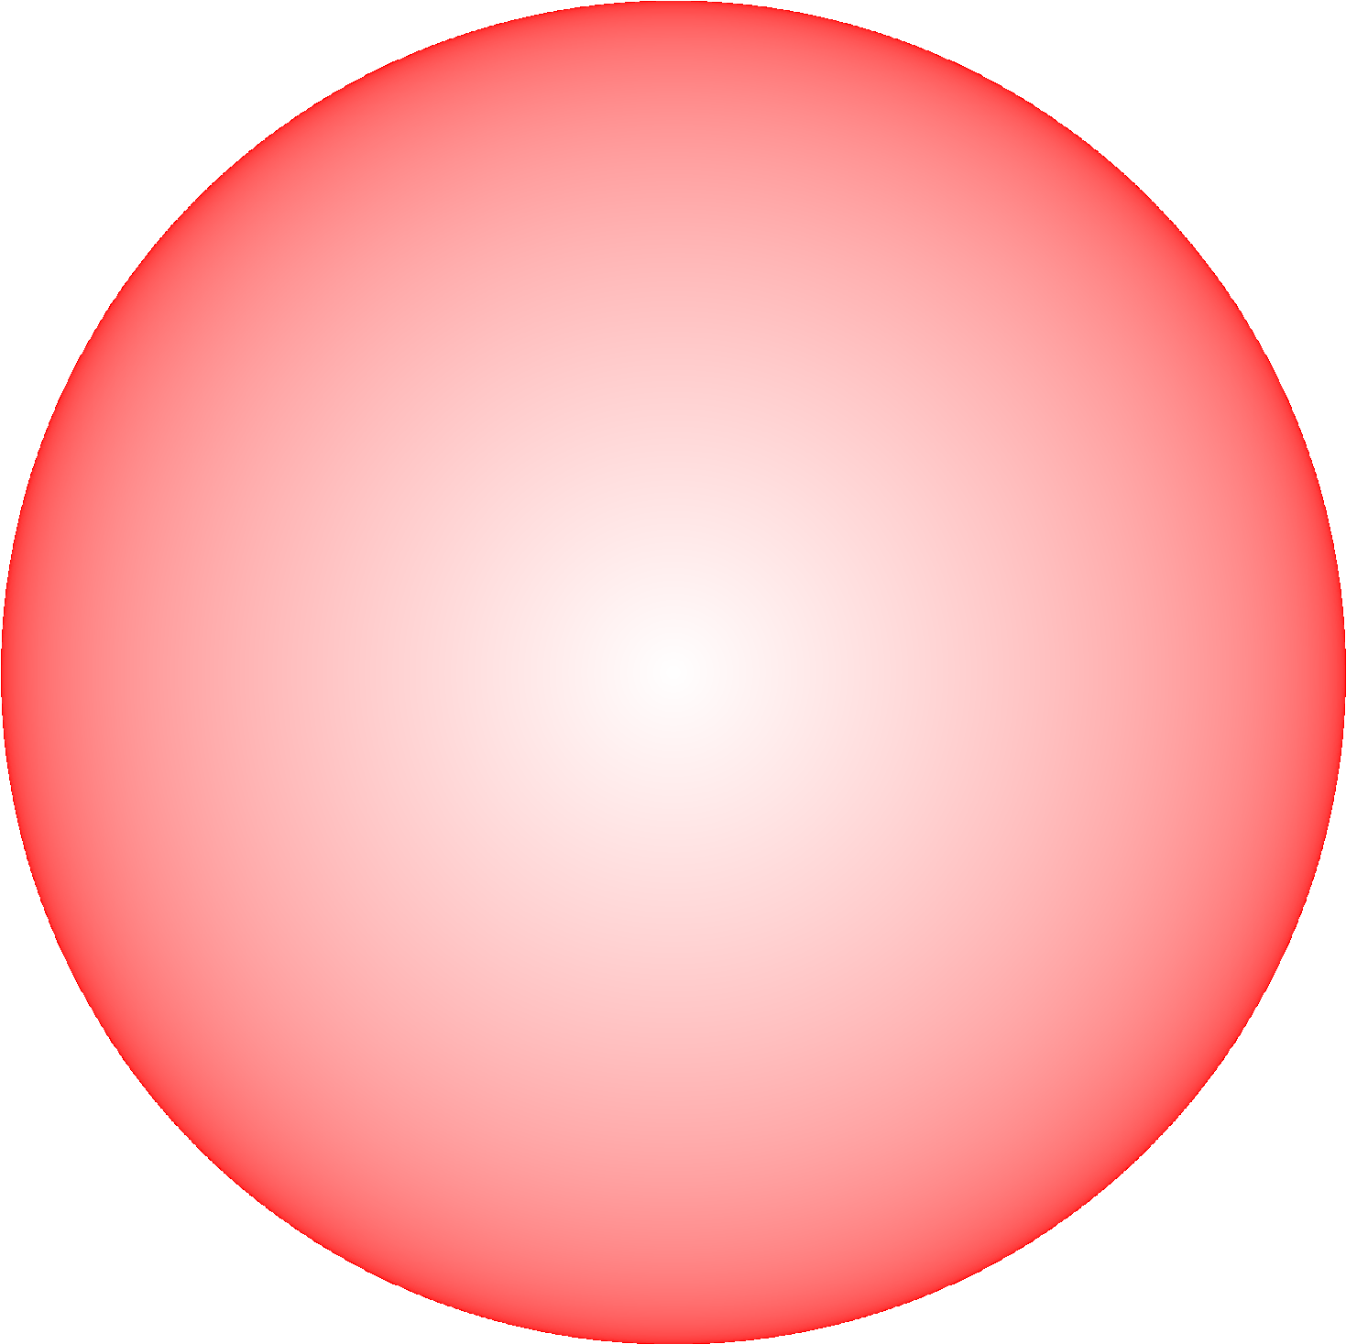

Slide 14
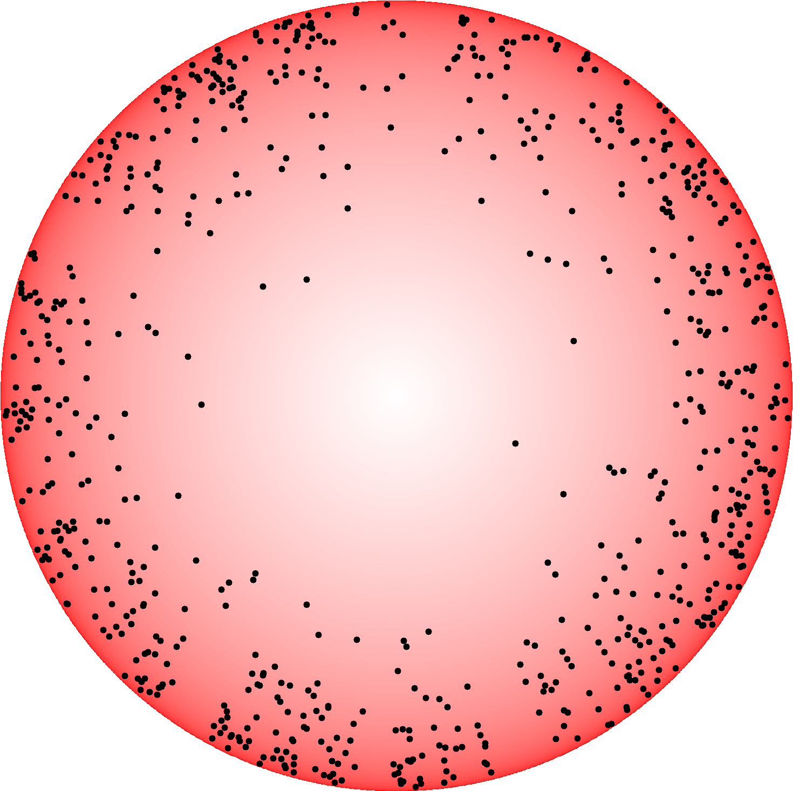

Slide 15
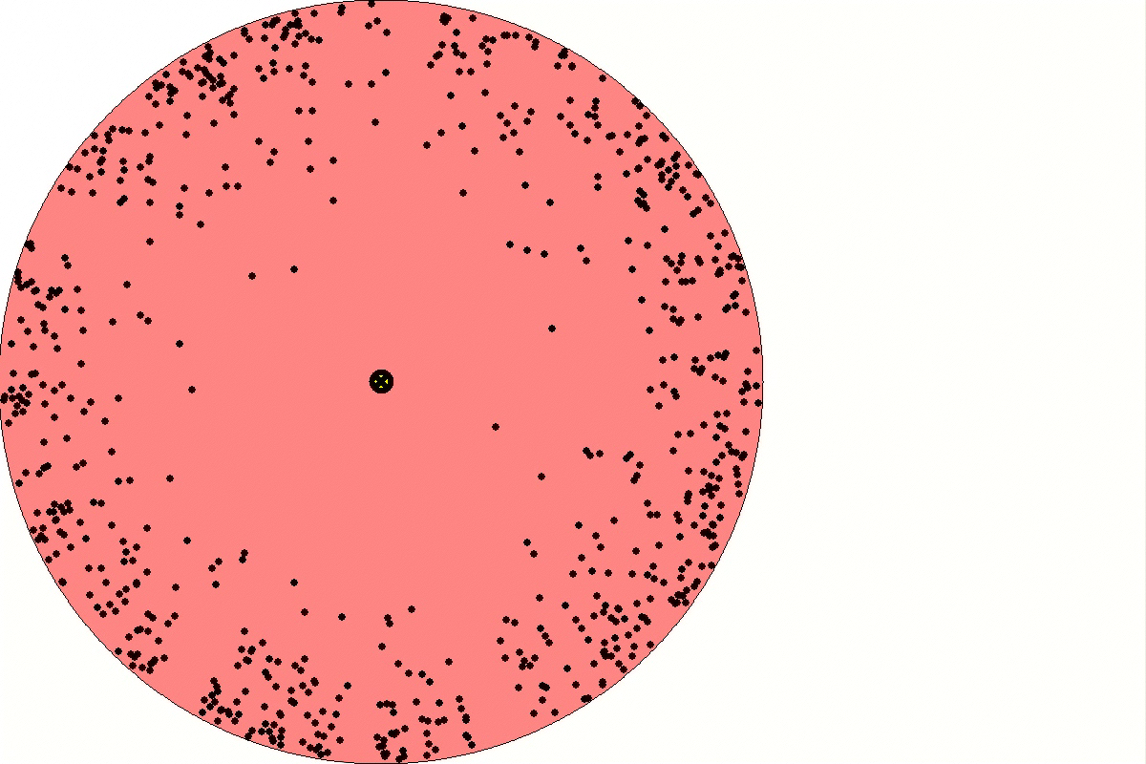

Slide 16
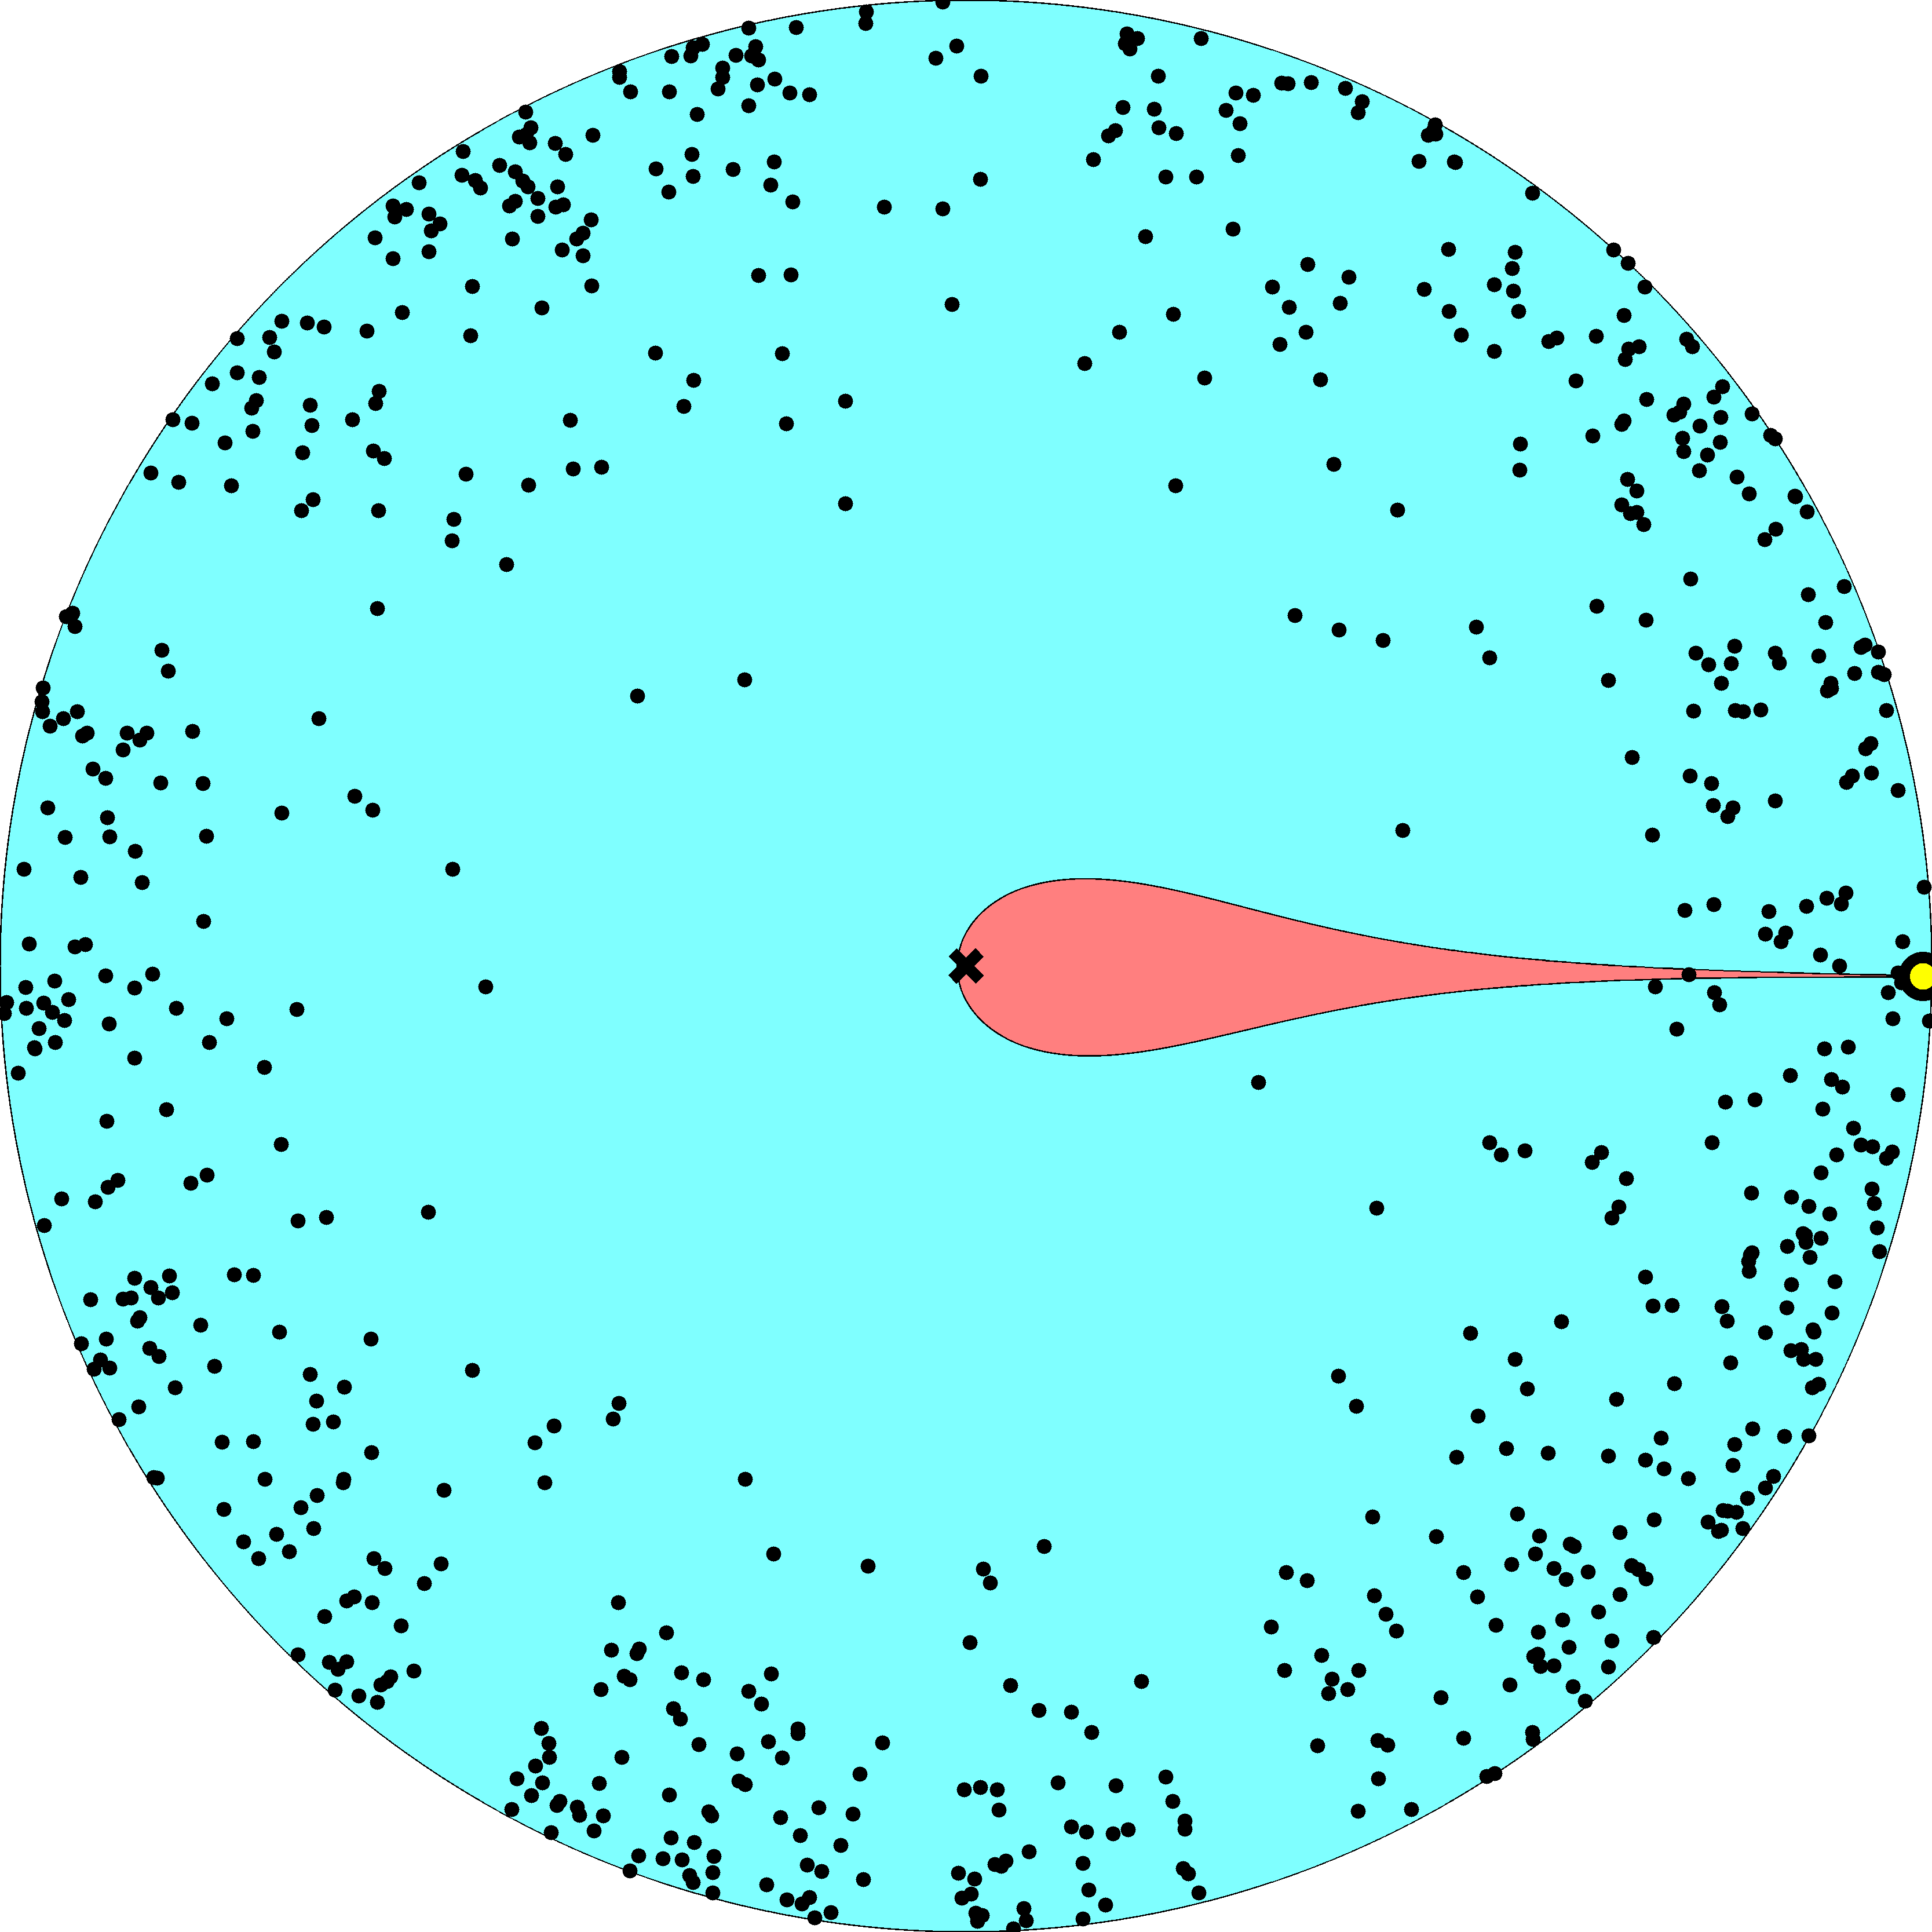

Slide 17
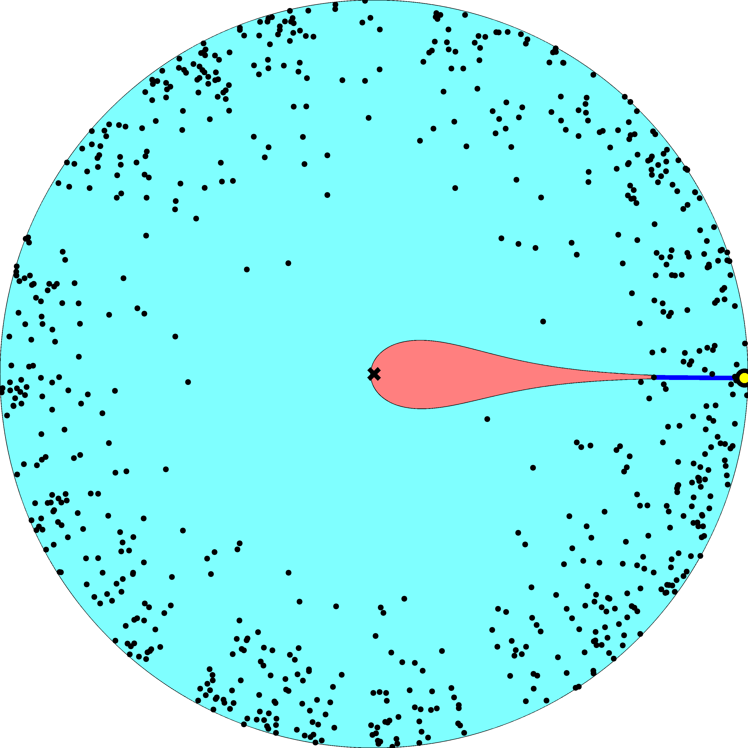

Slide 18
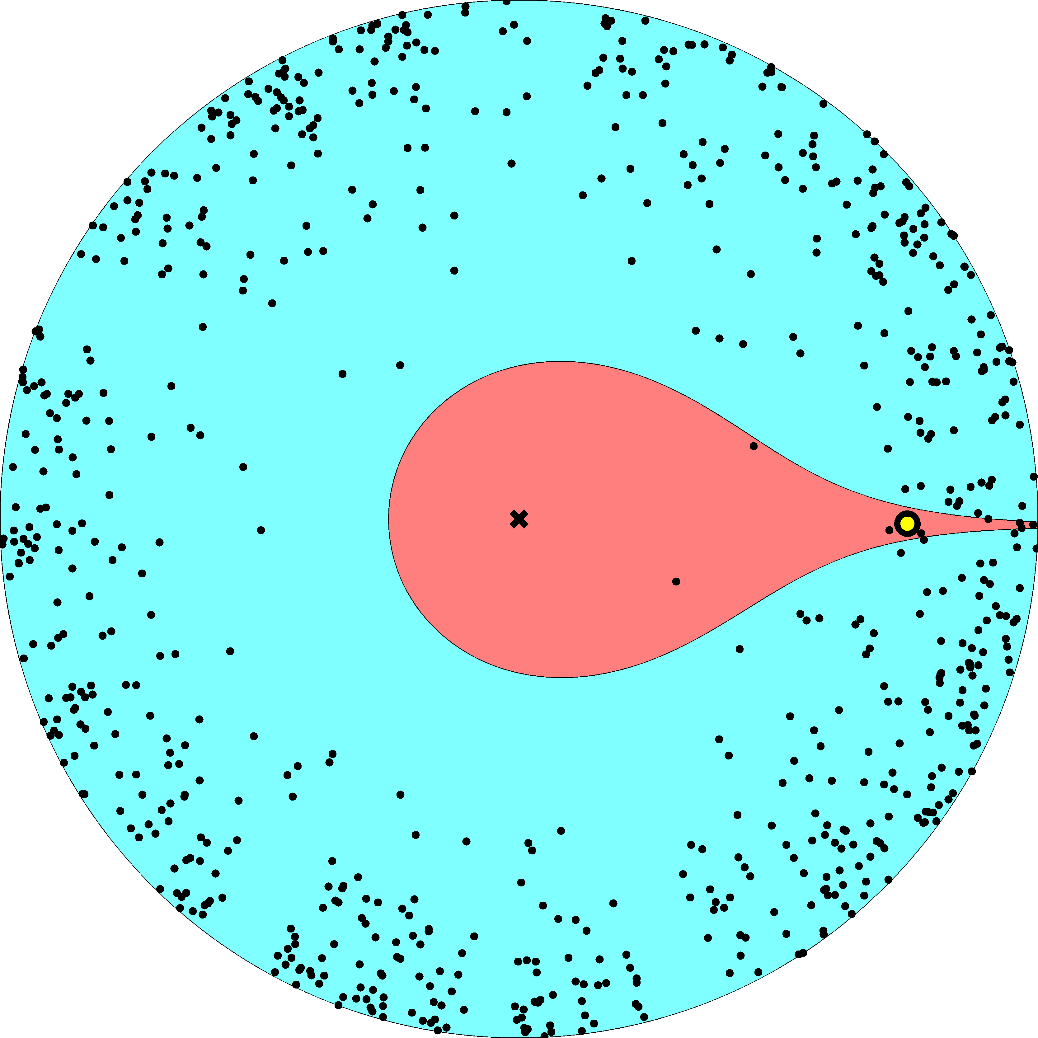

Slide 19
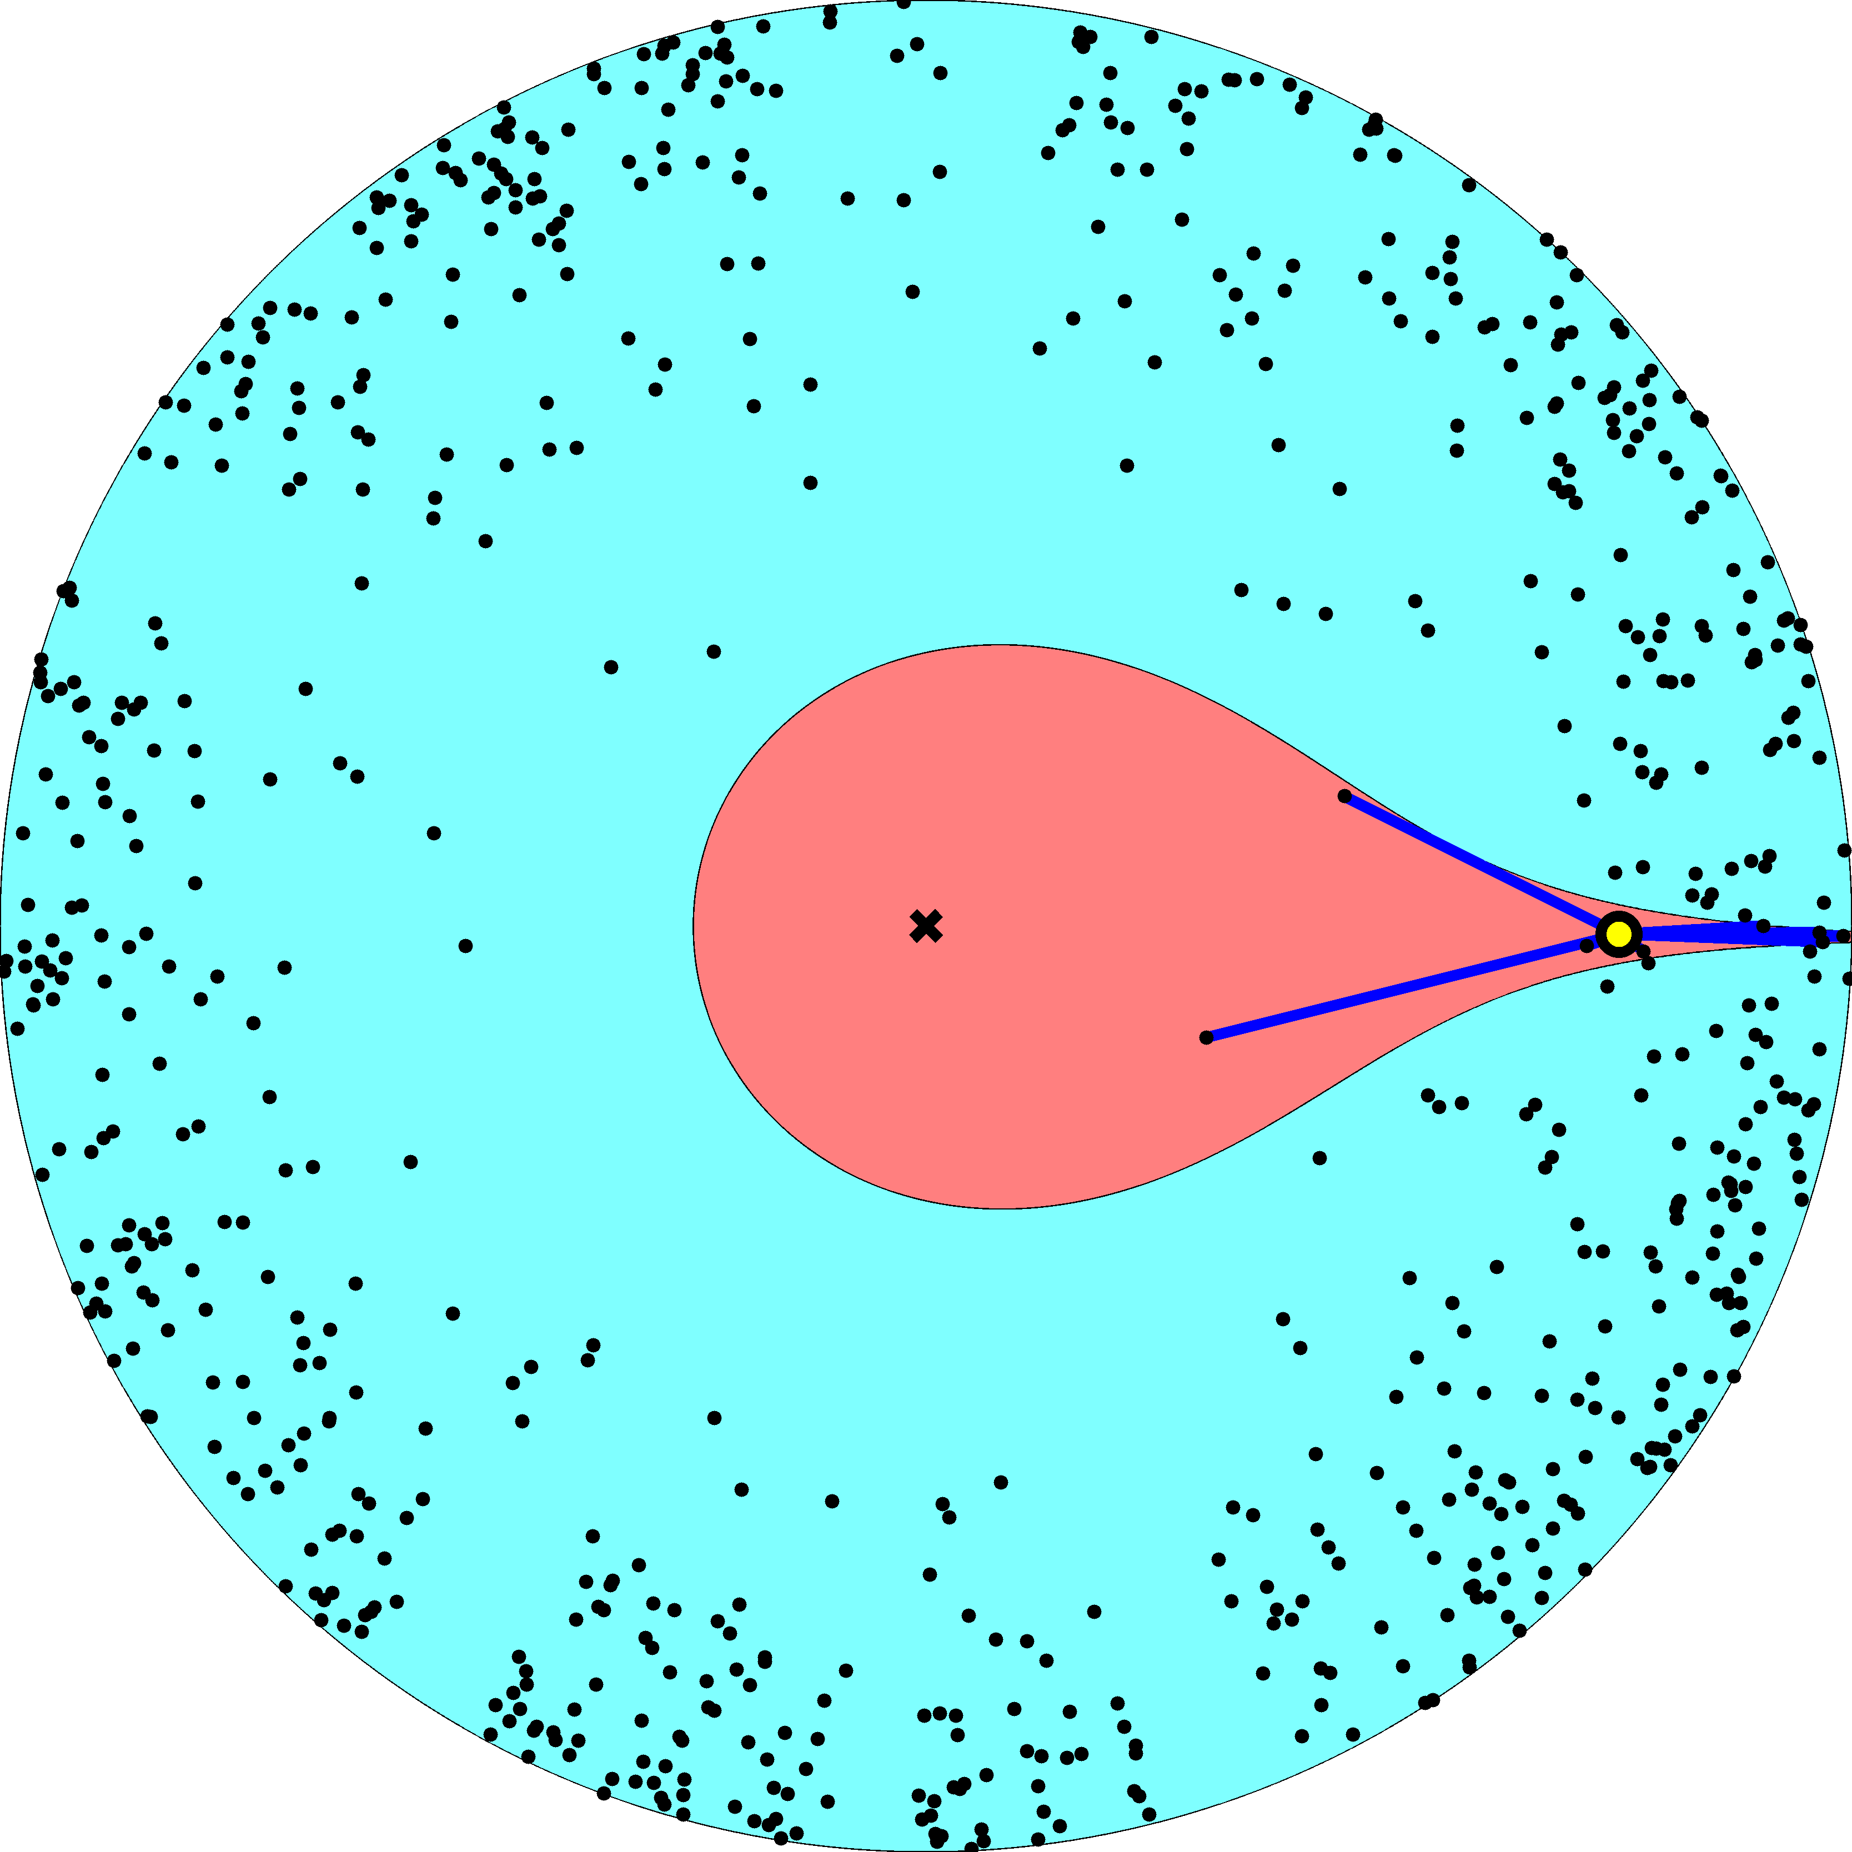

Slide 20
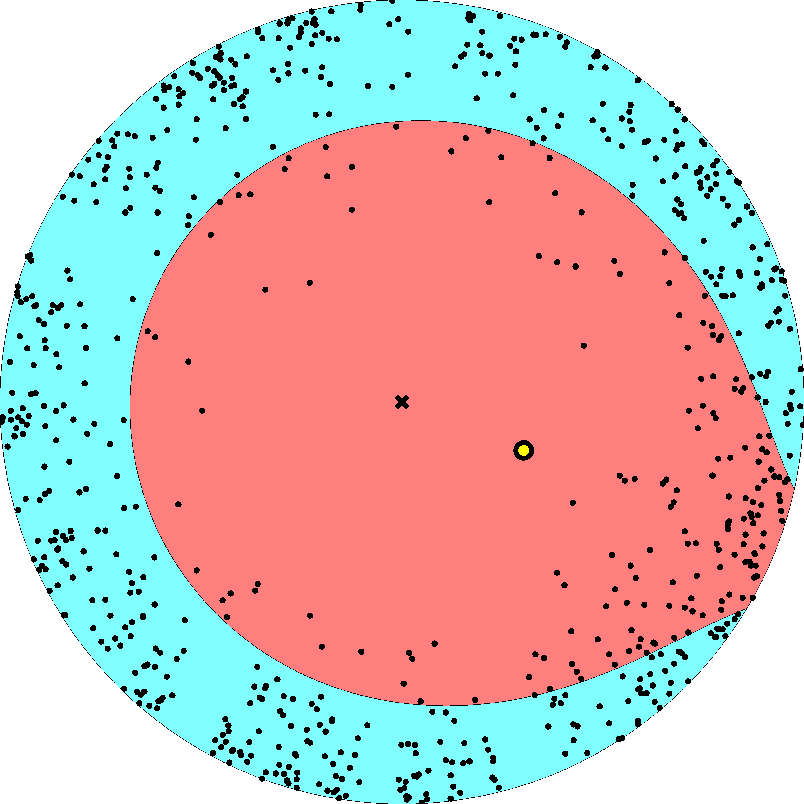

Slide 21
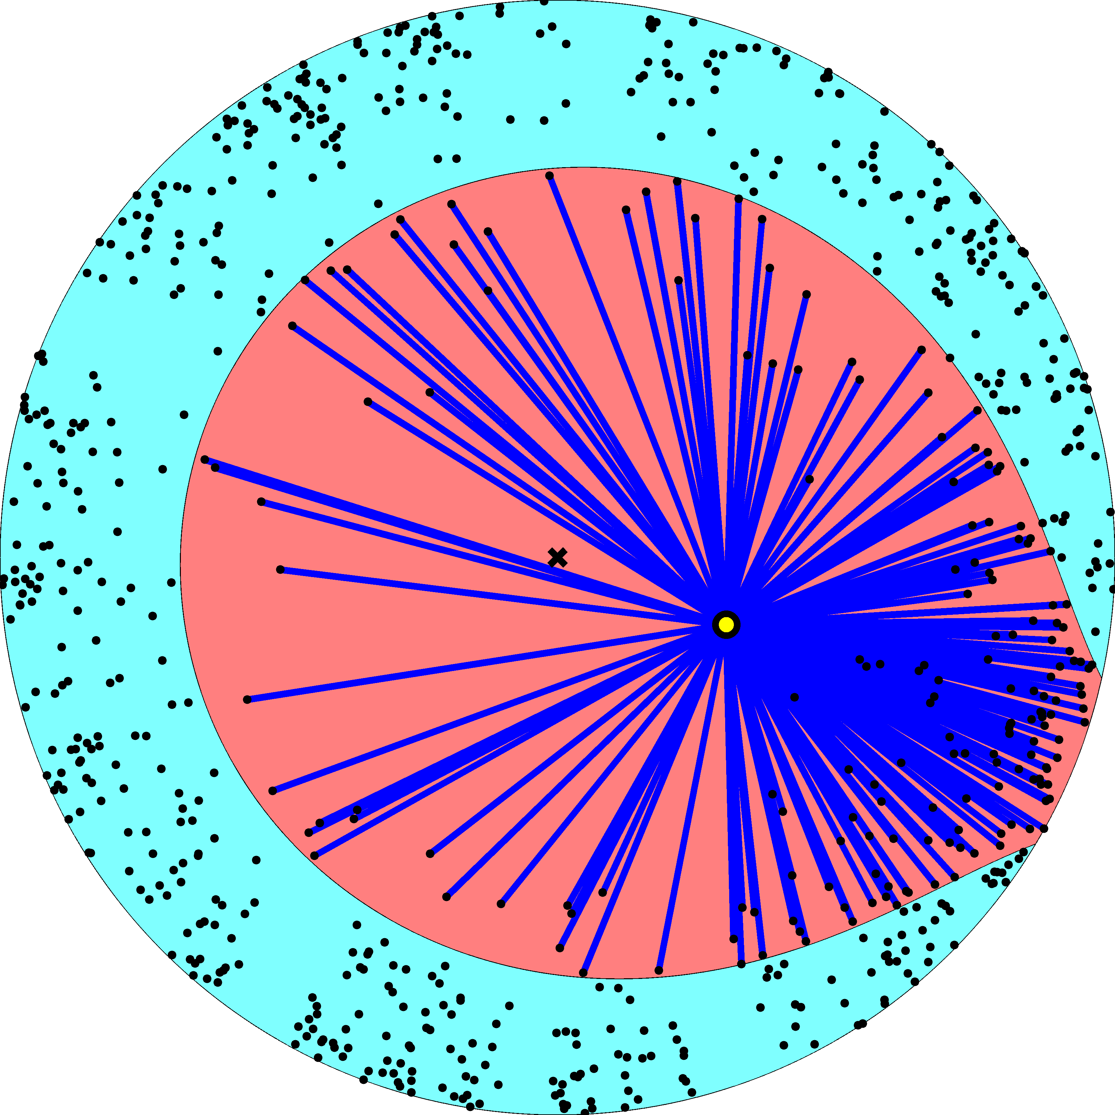

Slide 22
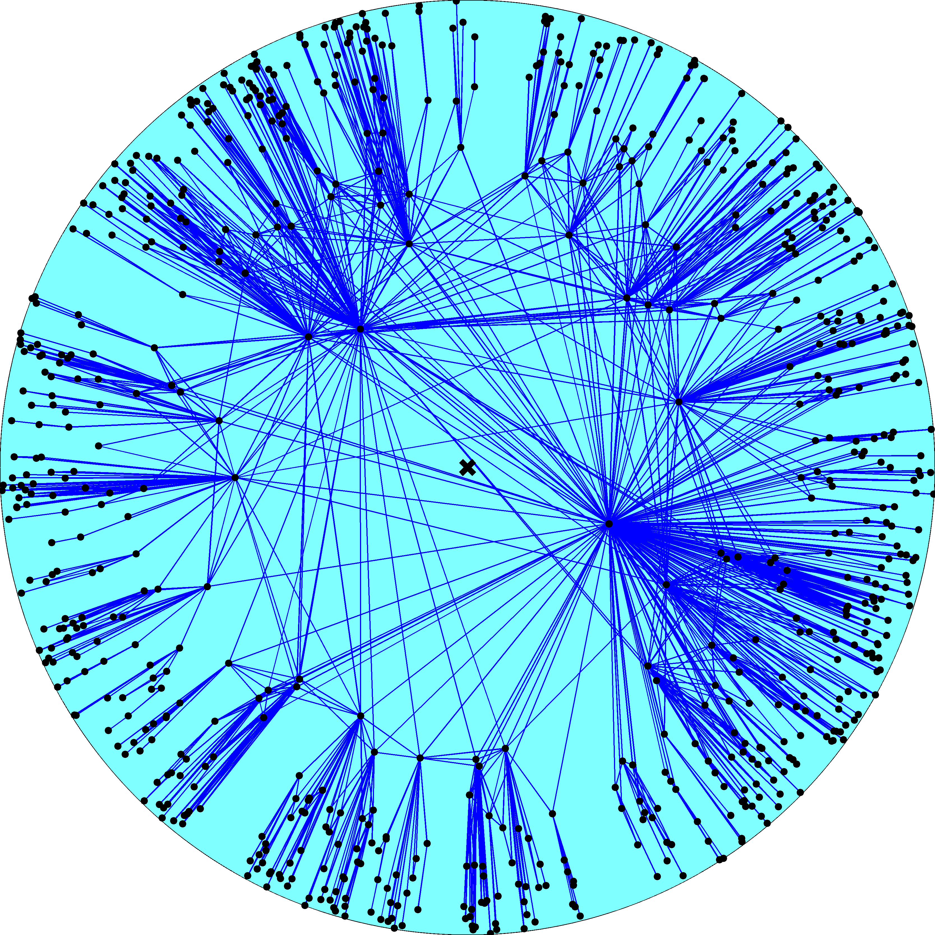
Node density
Node degree
R – disk radius
K – disk curvature
maximized
Degree distribution
Clustering

Slide 23
Fermi-Dirac connection probability
connection probability p(x) – Fermi-Dirac distribution
hyperbolic distance x – energy of links/fermions
disk radius R – chemical potential
two times inverse sqrt of curvature 2/ – Boltzmann constant
parameter T – temperature

Slide 24
Chemical potential R is a solution of
number of links M – number of particles
number of node pairs N(N1)/2 – number of energy states
distance distribution g(x) – degeneracy of state x
connection probability p(x) – Fermi-Dirac distribution

Slide 25
Cold regime 0T1
Chemical potential R(2/)ln(N/)
  Constant  controls the average node degree
Clustering decreases from its maximum at T0 to zero at T1
Power law exponent  does not depend on T, (2/)1

Slide 26
Phase transition T1
Chemical potential R diverges as ln(|T1|)

Slide 27
Hot regime T1
Chemical potential RT(2/)ln(N/)
Clustering is zero
Power law exponent  does depend on T, T(2/)1

Slide 28
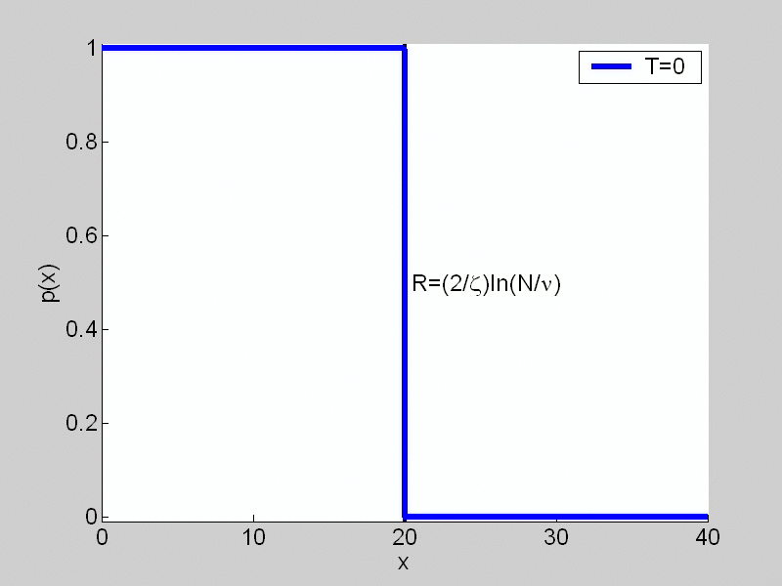

Slide 29
Classical random graphs
T;  fixed
R  T(2/)ln(N/)  
(r) = e^{rR}  (rR)
x_{ij} = r_{i} + r_{j} + (2/)ln[sin(_{ij}/2)]
g(x)  (x2R)
→ 2R

Slide 30
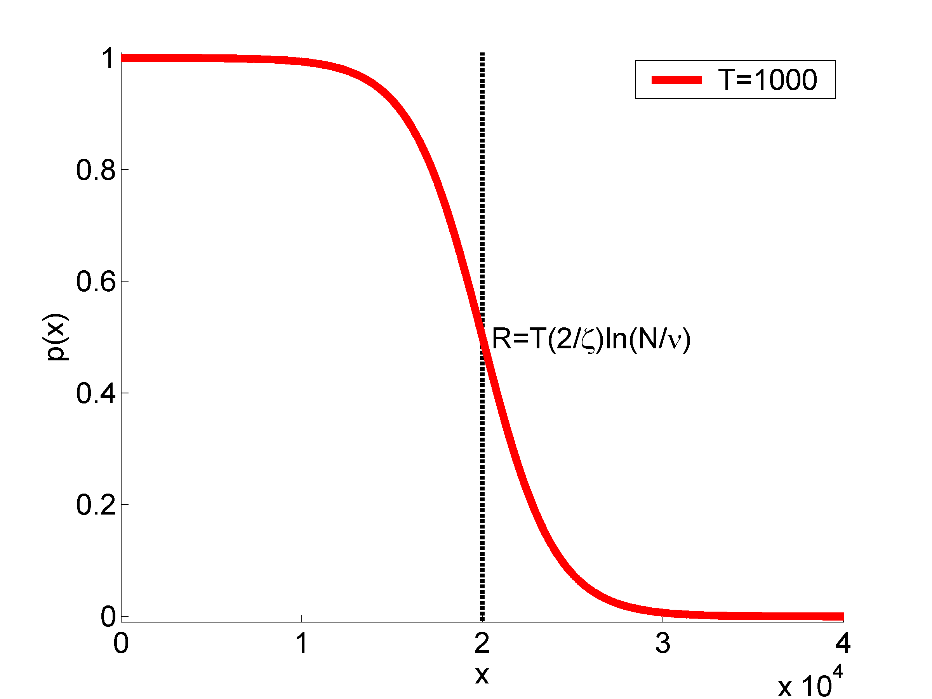
p  ↑k/N

Slide 31
Classical random graphs
T;  fixed
R  T(2/)ln(N/)  
(r) = e^{rR}  (rR)
x_{ij} = r_{i} + r_{j} + (2/)ln[sin(_{ij}/2)]  2R
g(x)  (x2R)
p(x)  p = ↑k/N
Classical random graphs G_{N,p}
  random graph with a given average degree
  ↑k = pN
Redefine x_{ij} = sin(_{ij}/2) (K = )

Slide 32
Configuration model
T;  ; T/ fixed
R  T(2/)ln(N/); fixed
(r) = e^{rR}; fixed
x_{ij} = r_{i} + r_{j} + (2/)ln[sin(_{ij}/2)]
p(x_{ij})  p_{ij} = k_{i}k_{j}/(↑kN)
Configuration model
  random graph with given expected degrees k_{i}
x_{ij} = r_{i} + r_{j} (K = )
→ r_{i} + r_{j}

Slide 33
Model summary
Very general geometric network model
Can model networks with any
  Average degree
  Power-law degree distribution exponent
  Clustering
Subsumes many popular random graph models as limiting regimes with degenerate geometries
Has a well-defined thermodynamic limit
  Nodes cover all the hyperbolic plane
What about rescaling?

Slide 34
Rescaling transformation 
Very simple: just throw out nodes of degrees
 > 

Slide 35
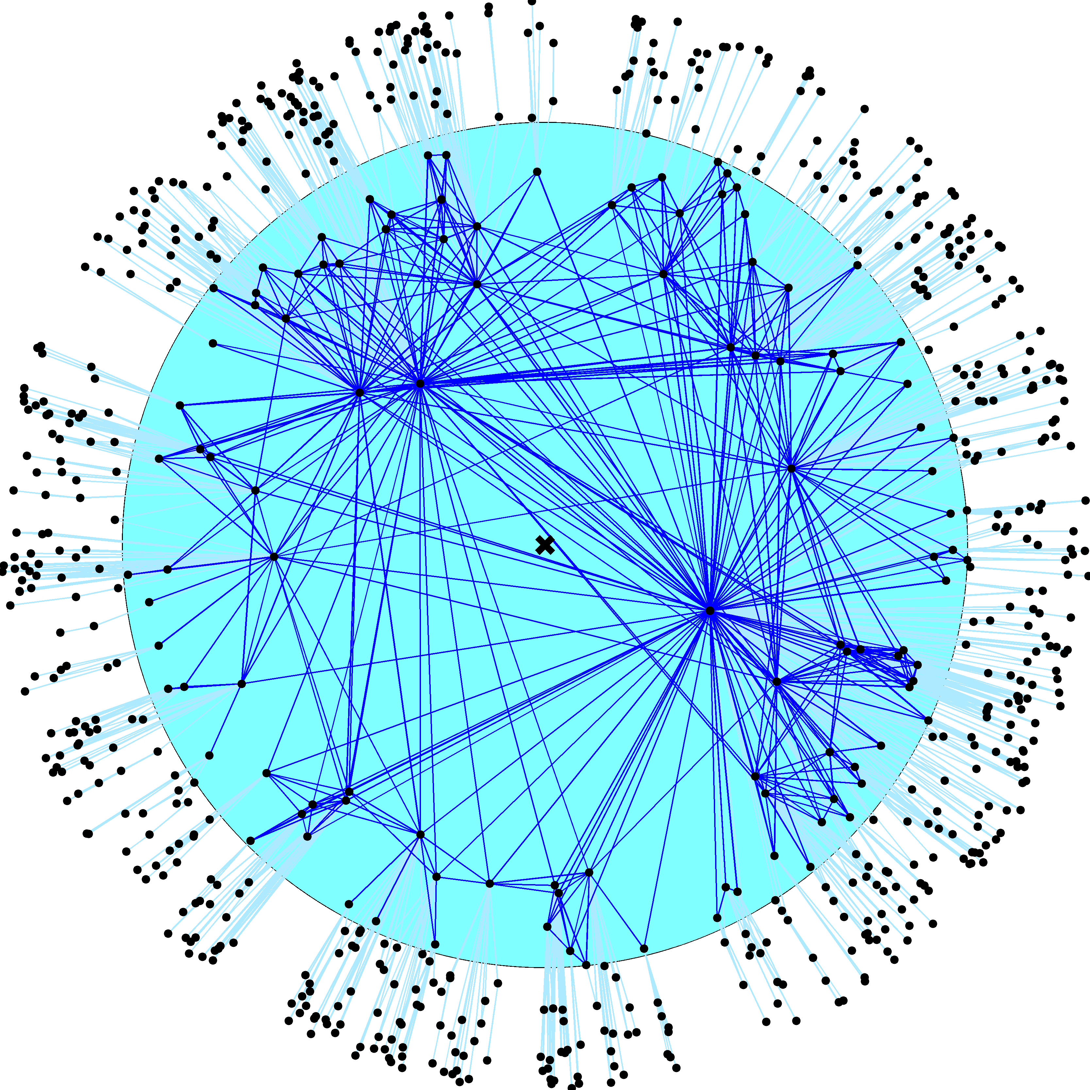
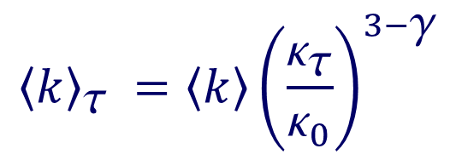


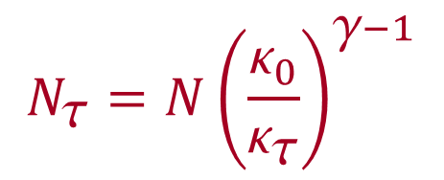
$$N_{τ}=N{\left(\frac{κ_{0}}{κ_{τ}}\right)}^{γ−1}$$
$$_{}=$$
$${\left\langle c\right\rangle }_{τ}=\left\langle c\right\rangle$$
$${\left\langle k\right\rangle }_{τ} ={\left\langle k\right\rangle \left(\frac{κ_{τ}}{κ_{0}}\right)}^{3−γ}$$

Slide 37


Slide 38
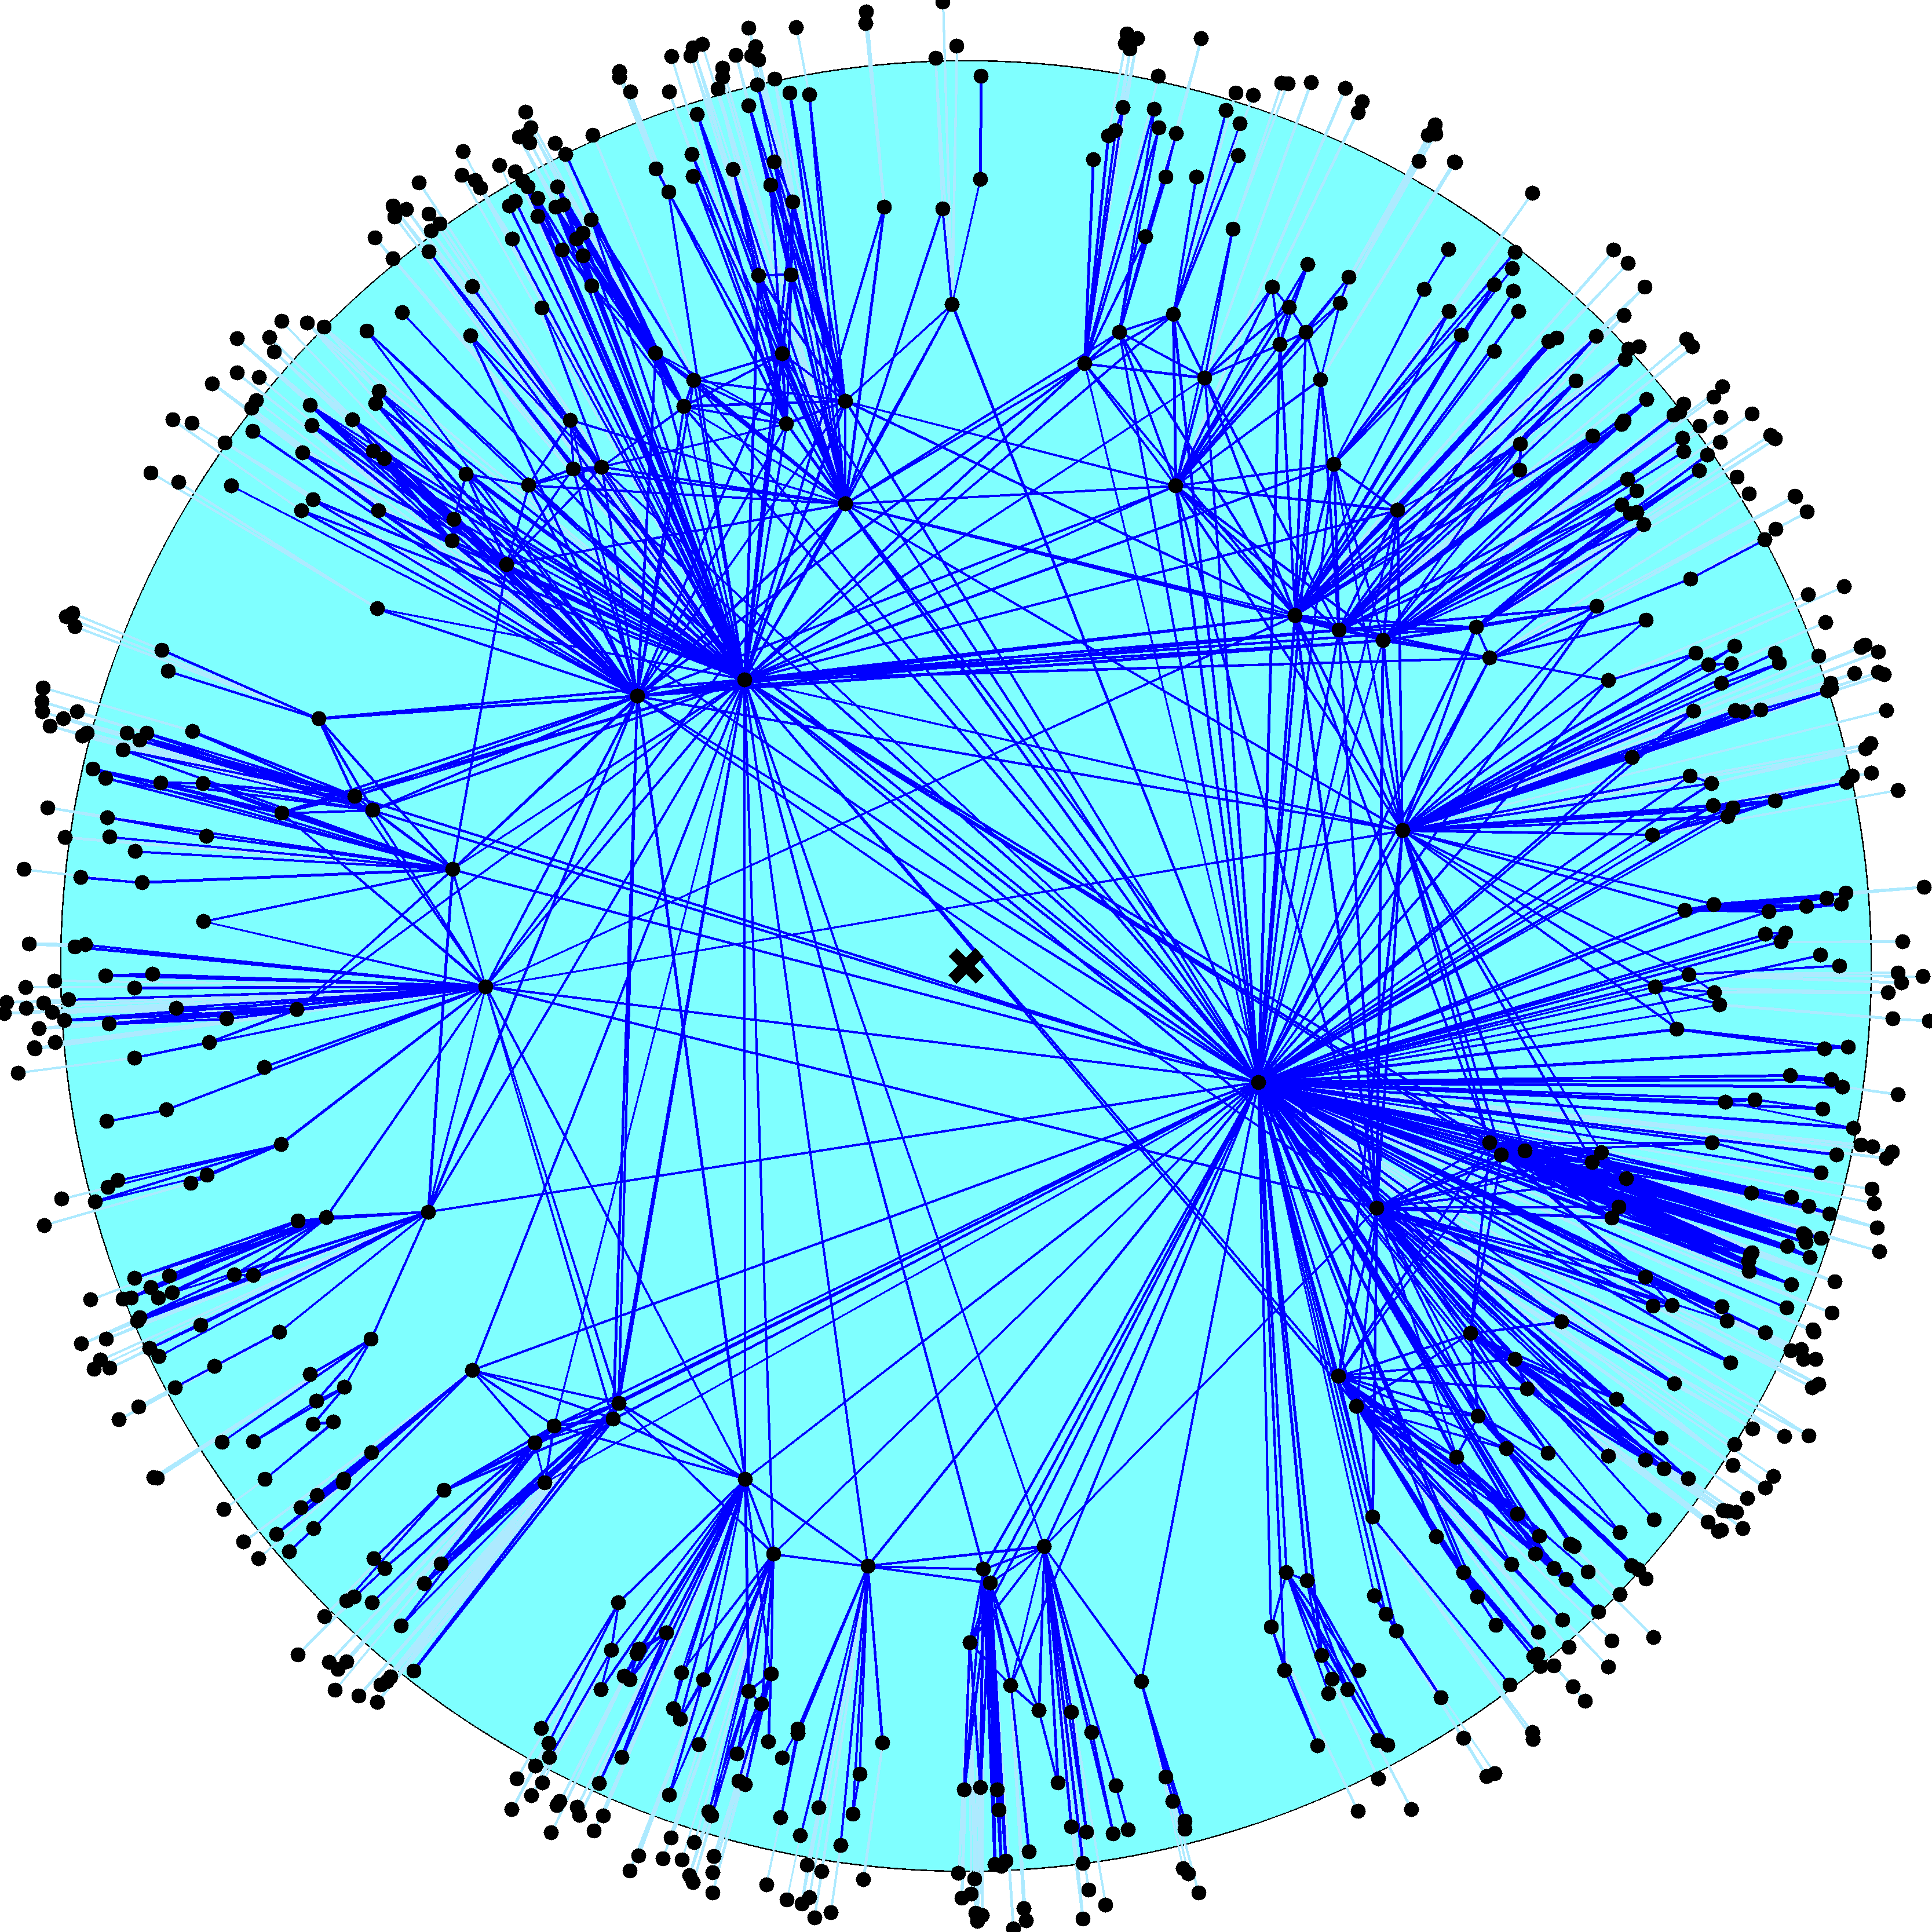

Slide 39
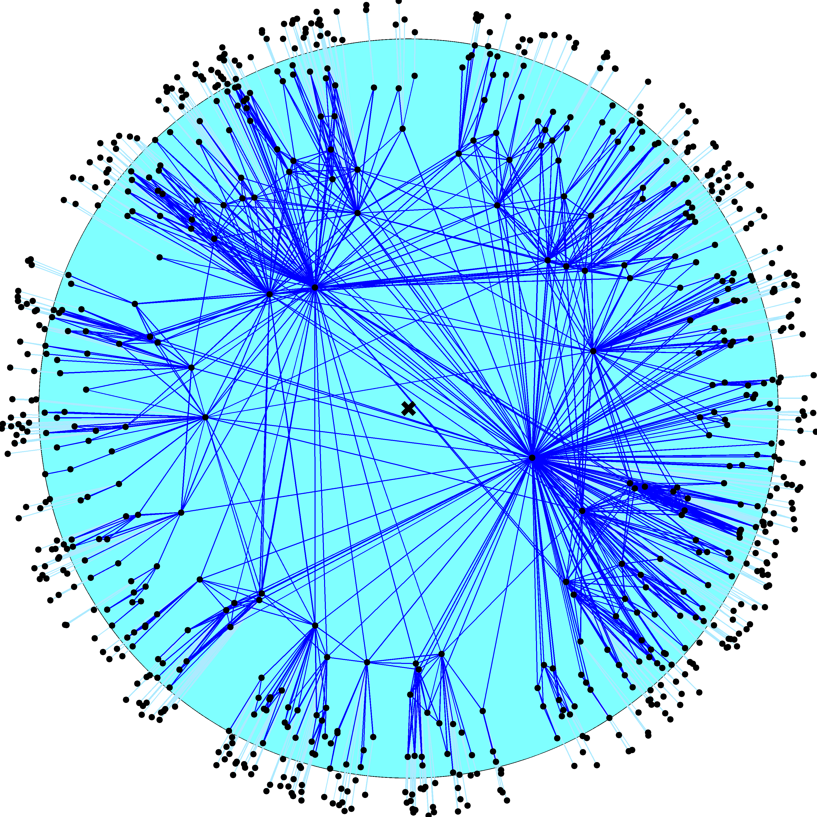

Slide 40
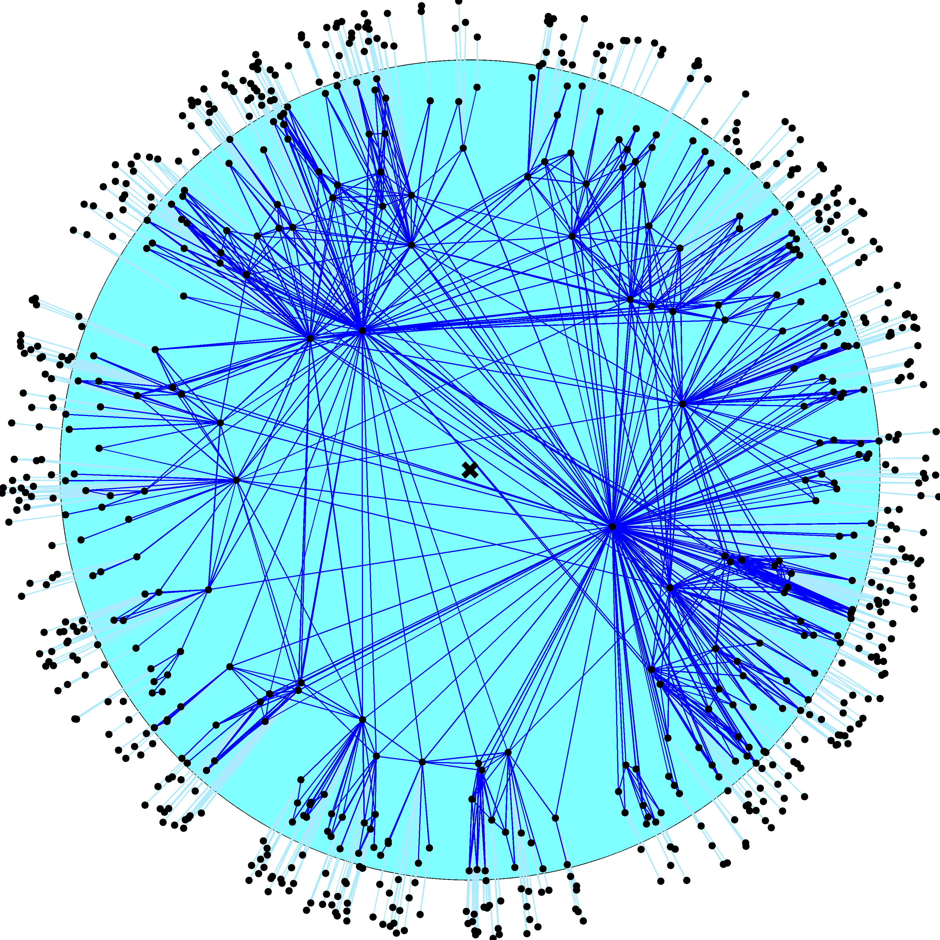

Slide 41
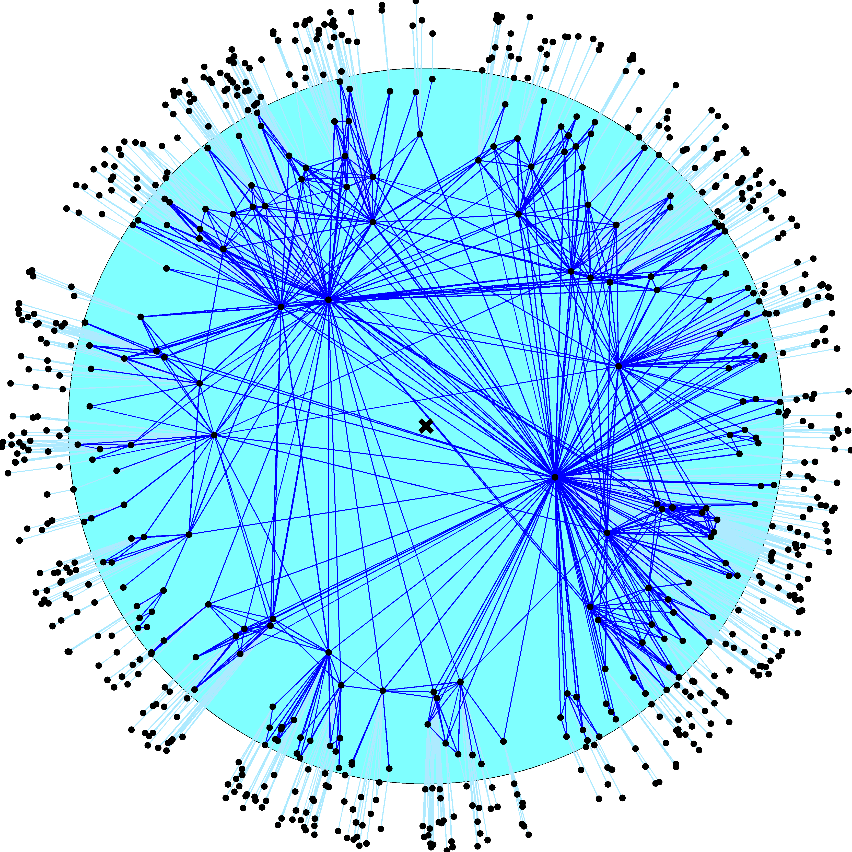

Slide 42
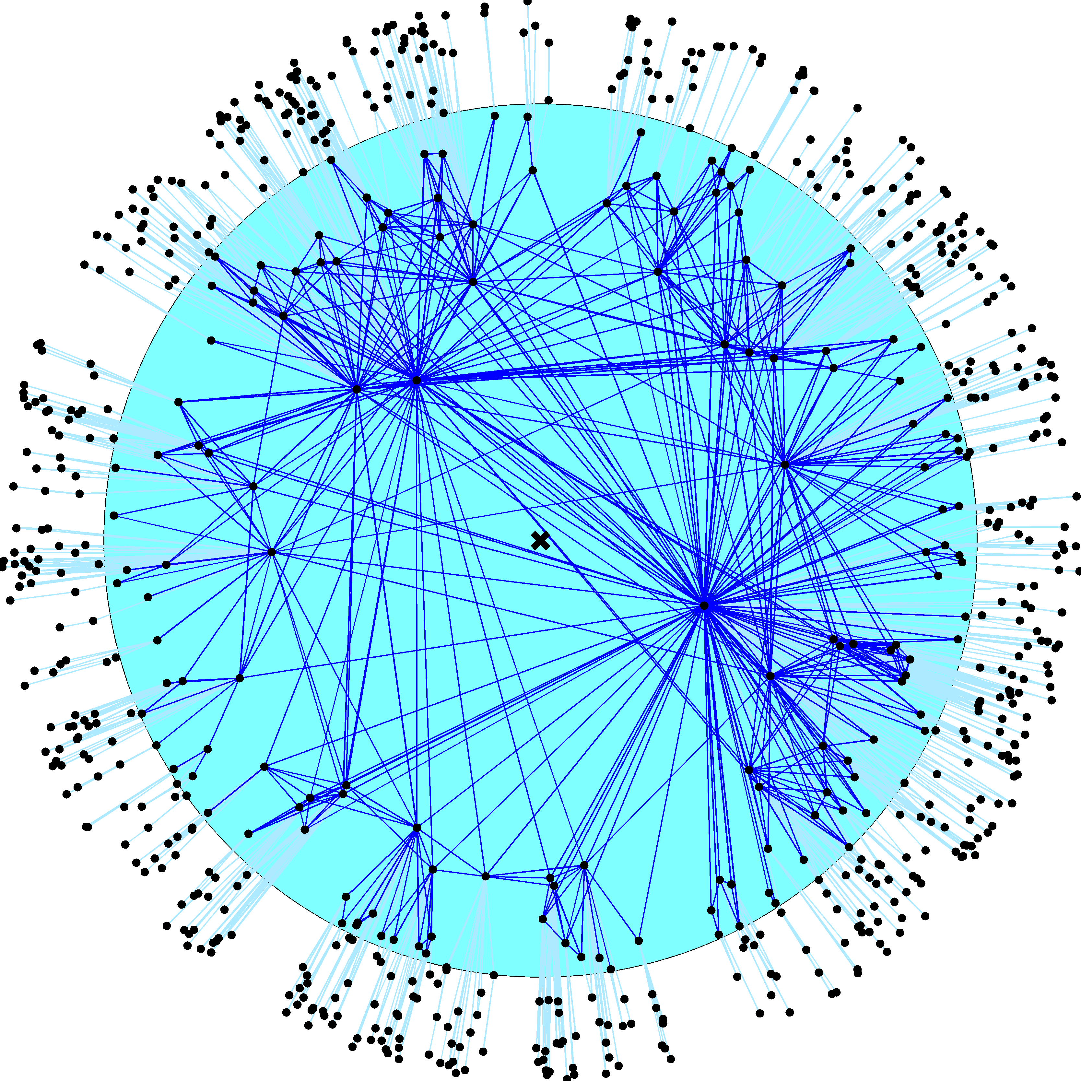

Slide 44
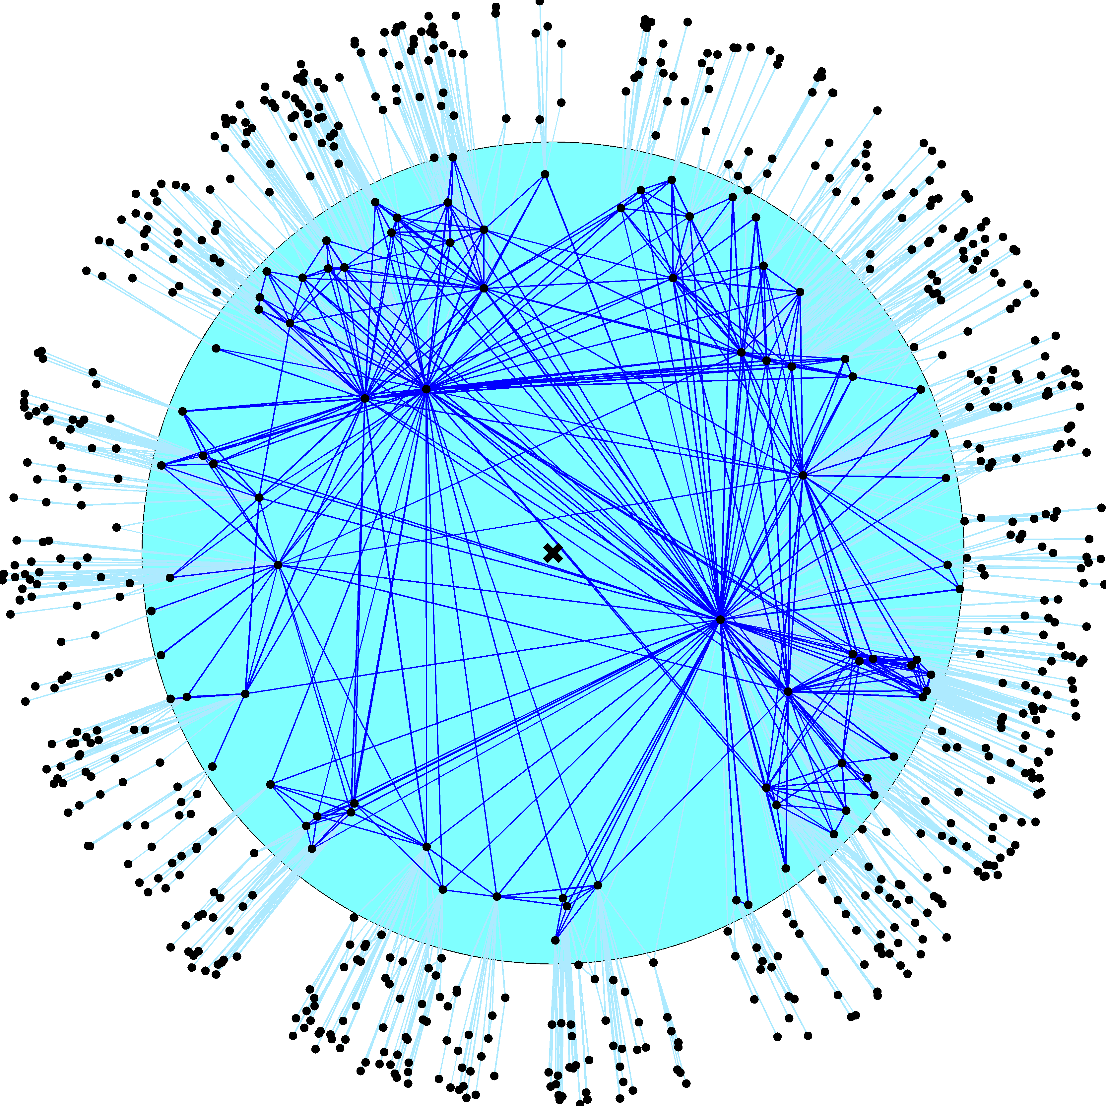

Slide 45
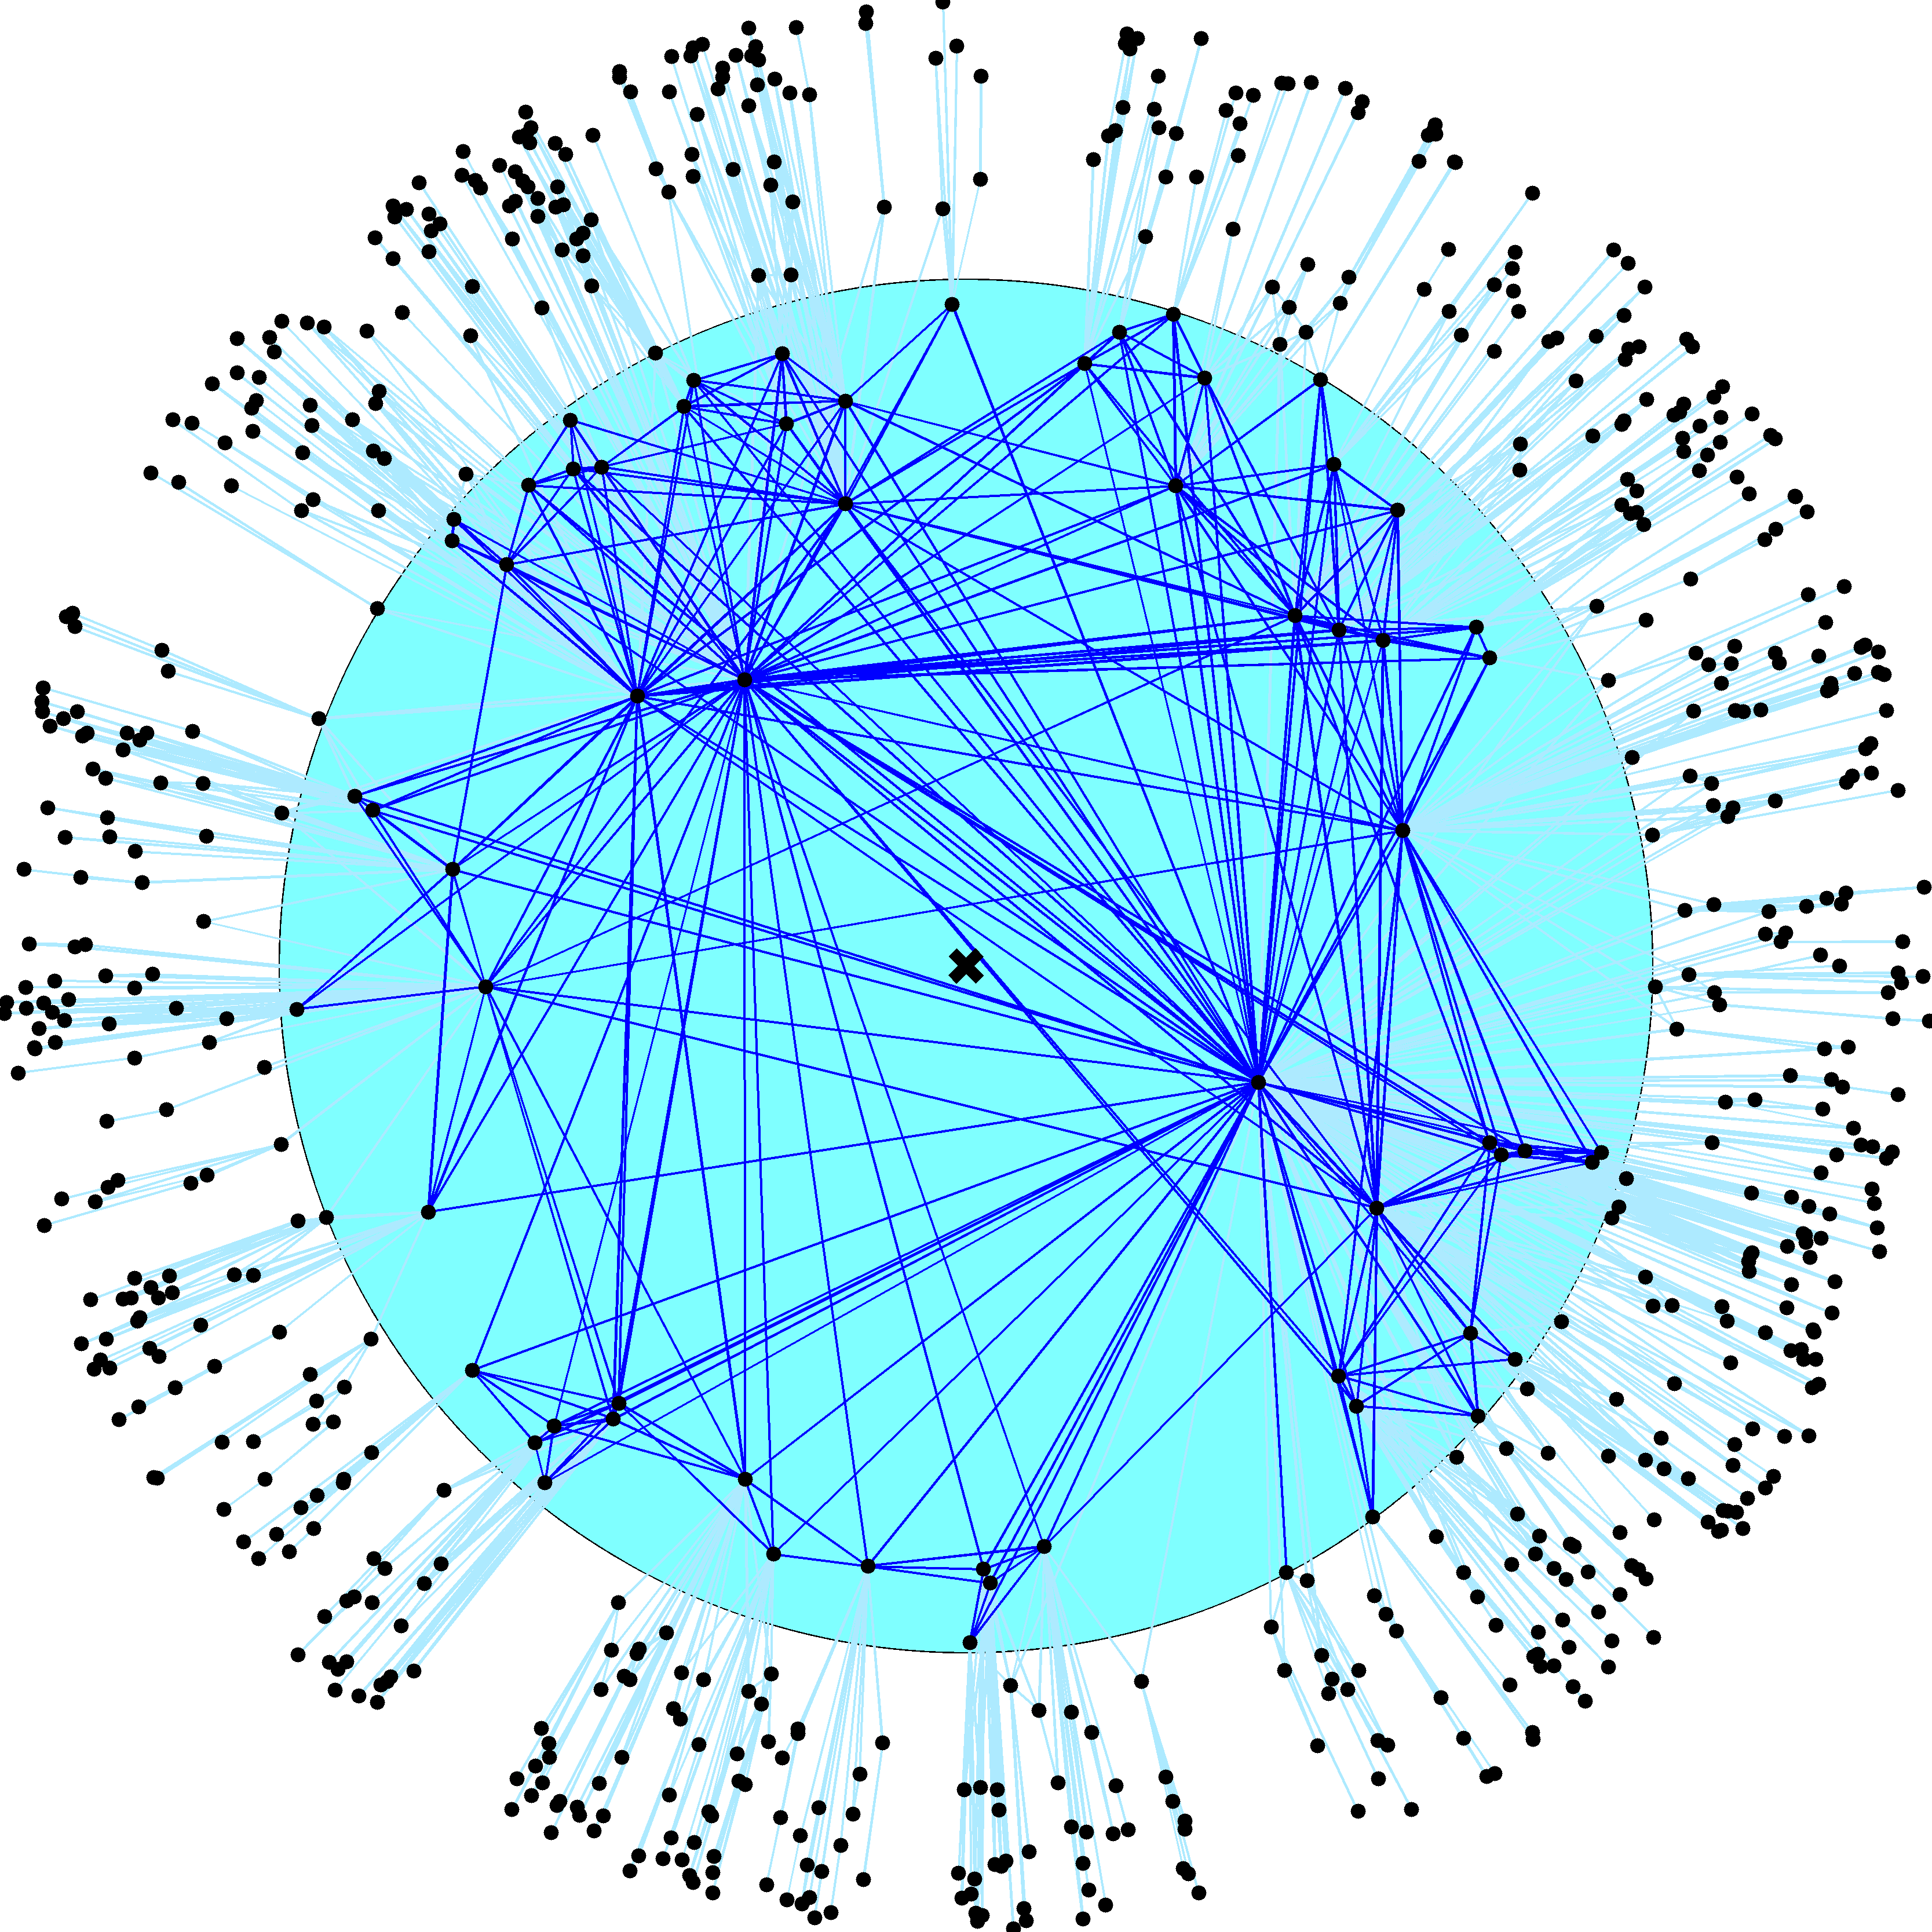

Slide 46
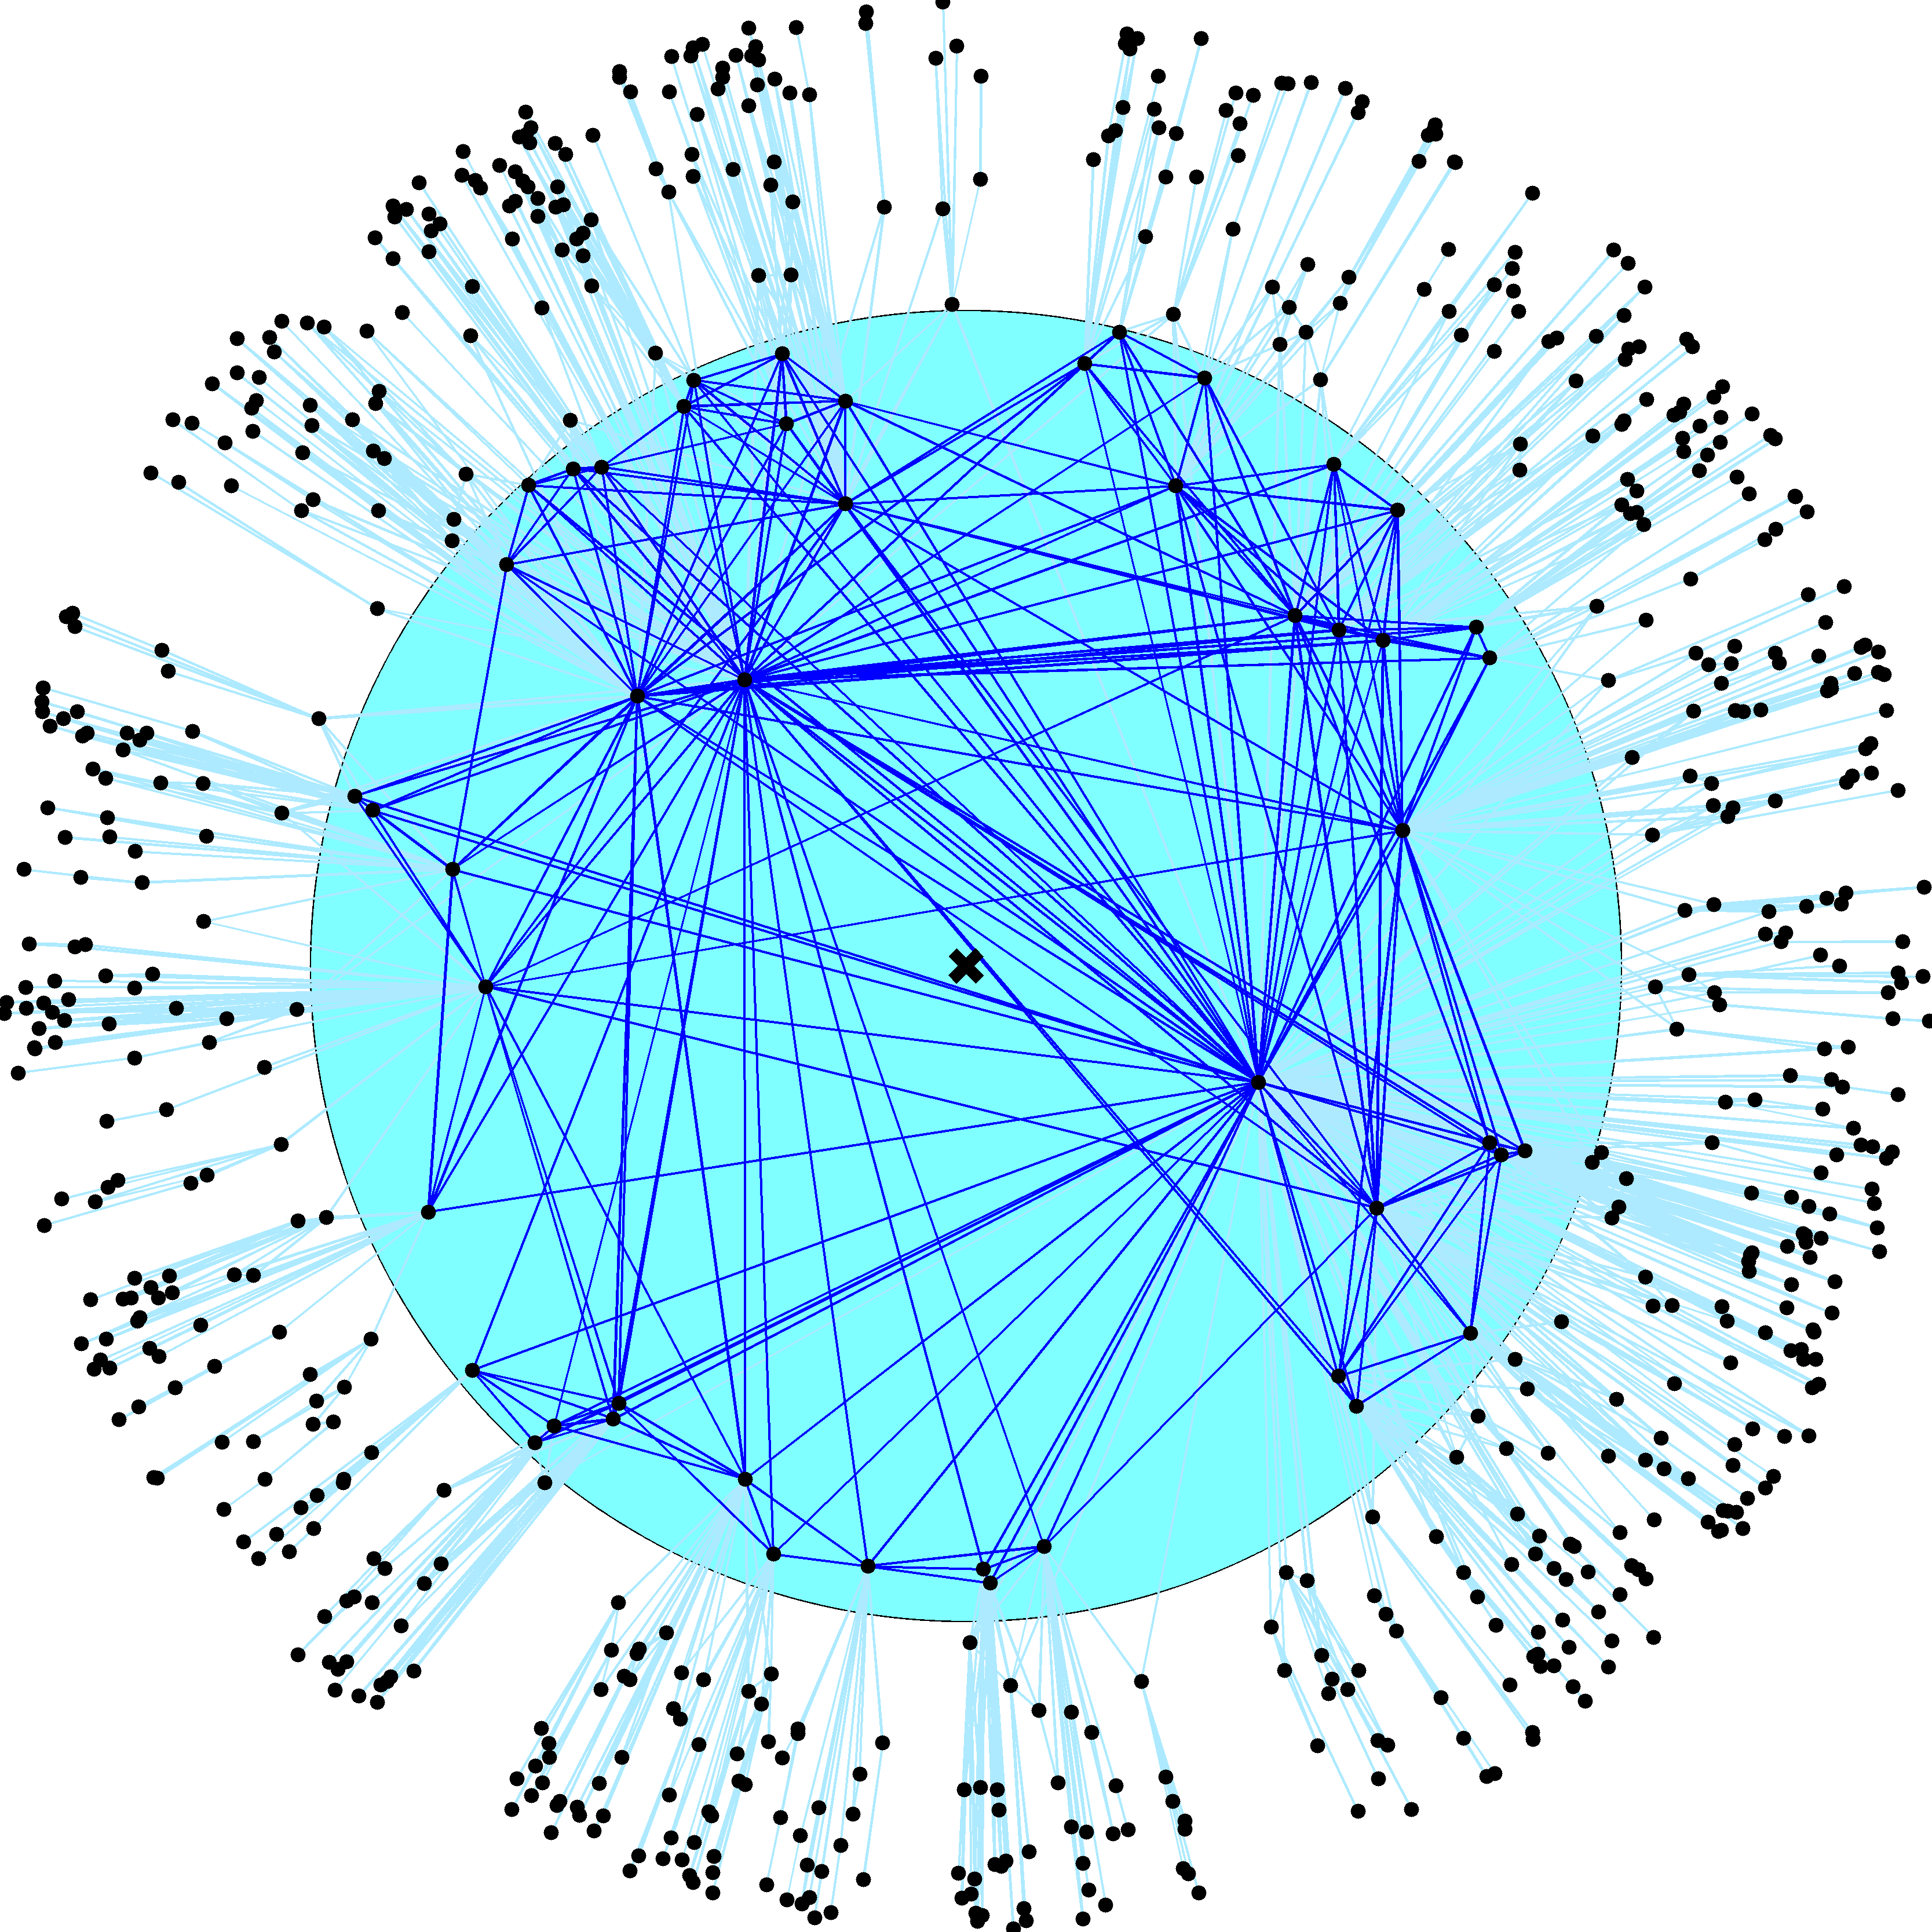

Slide 47
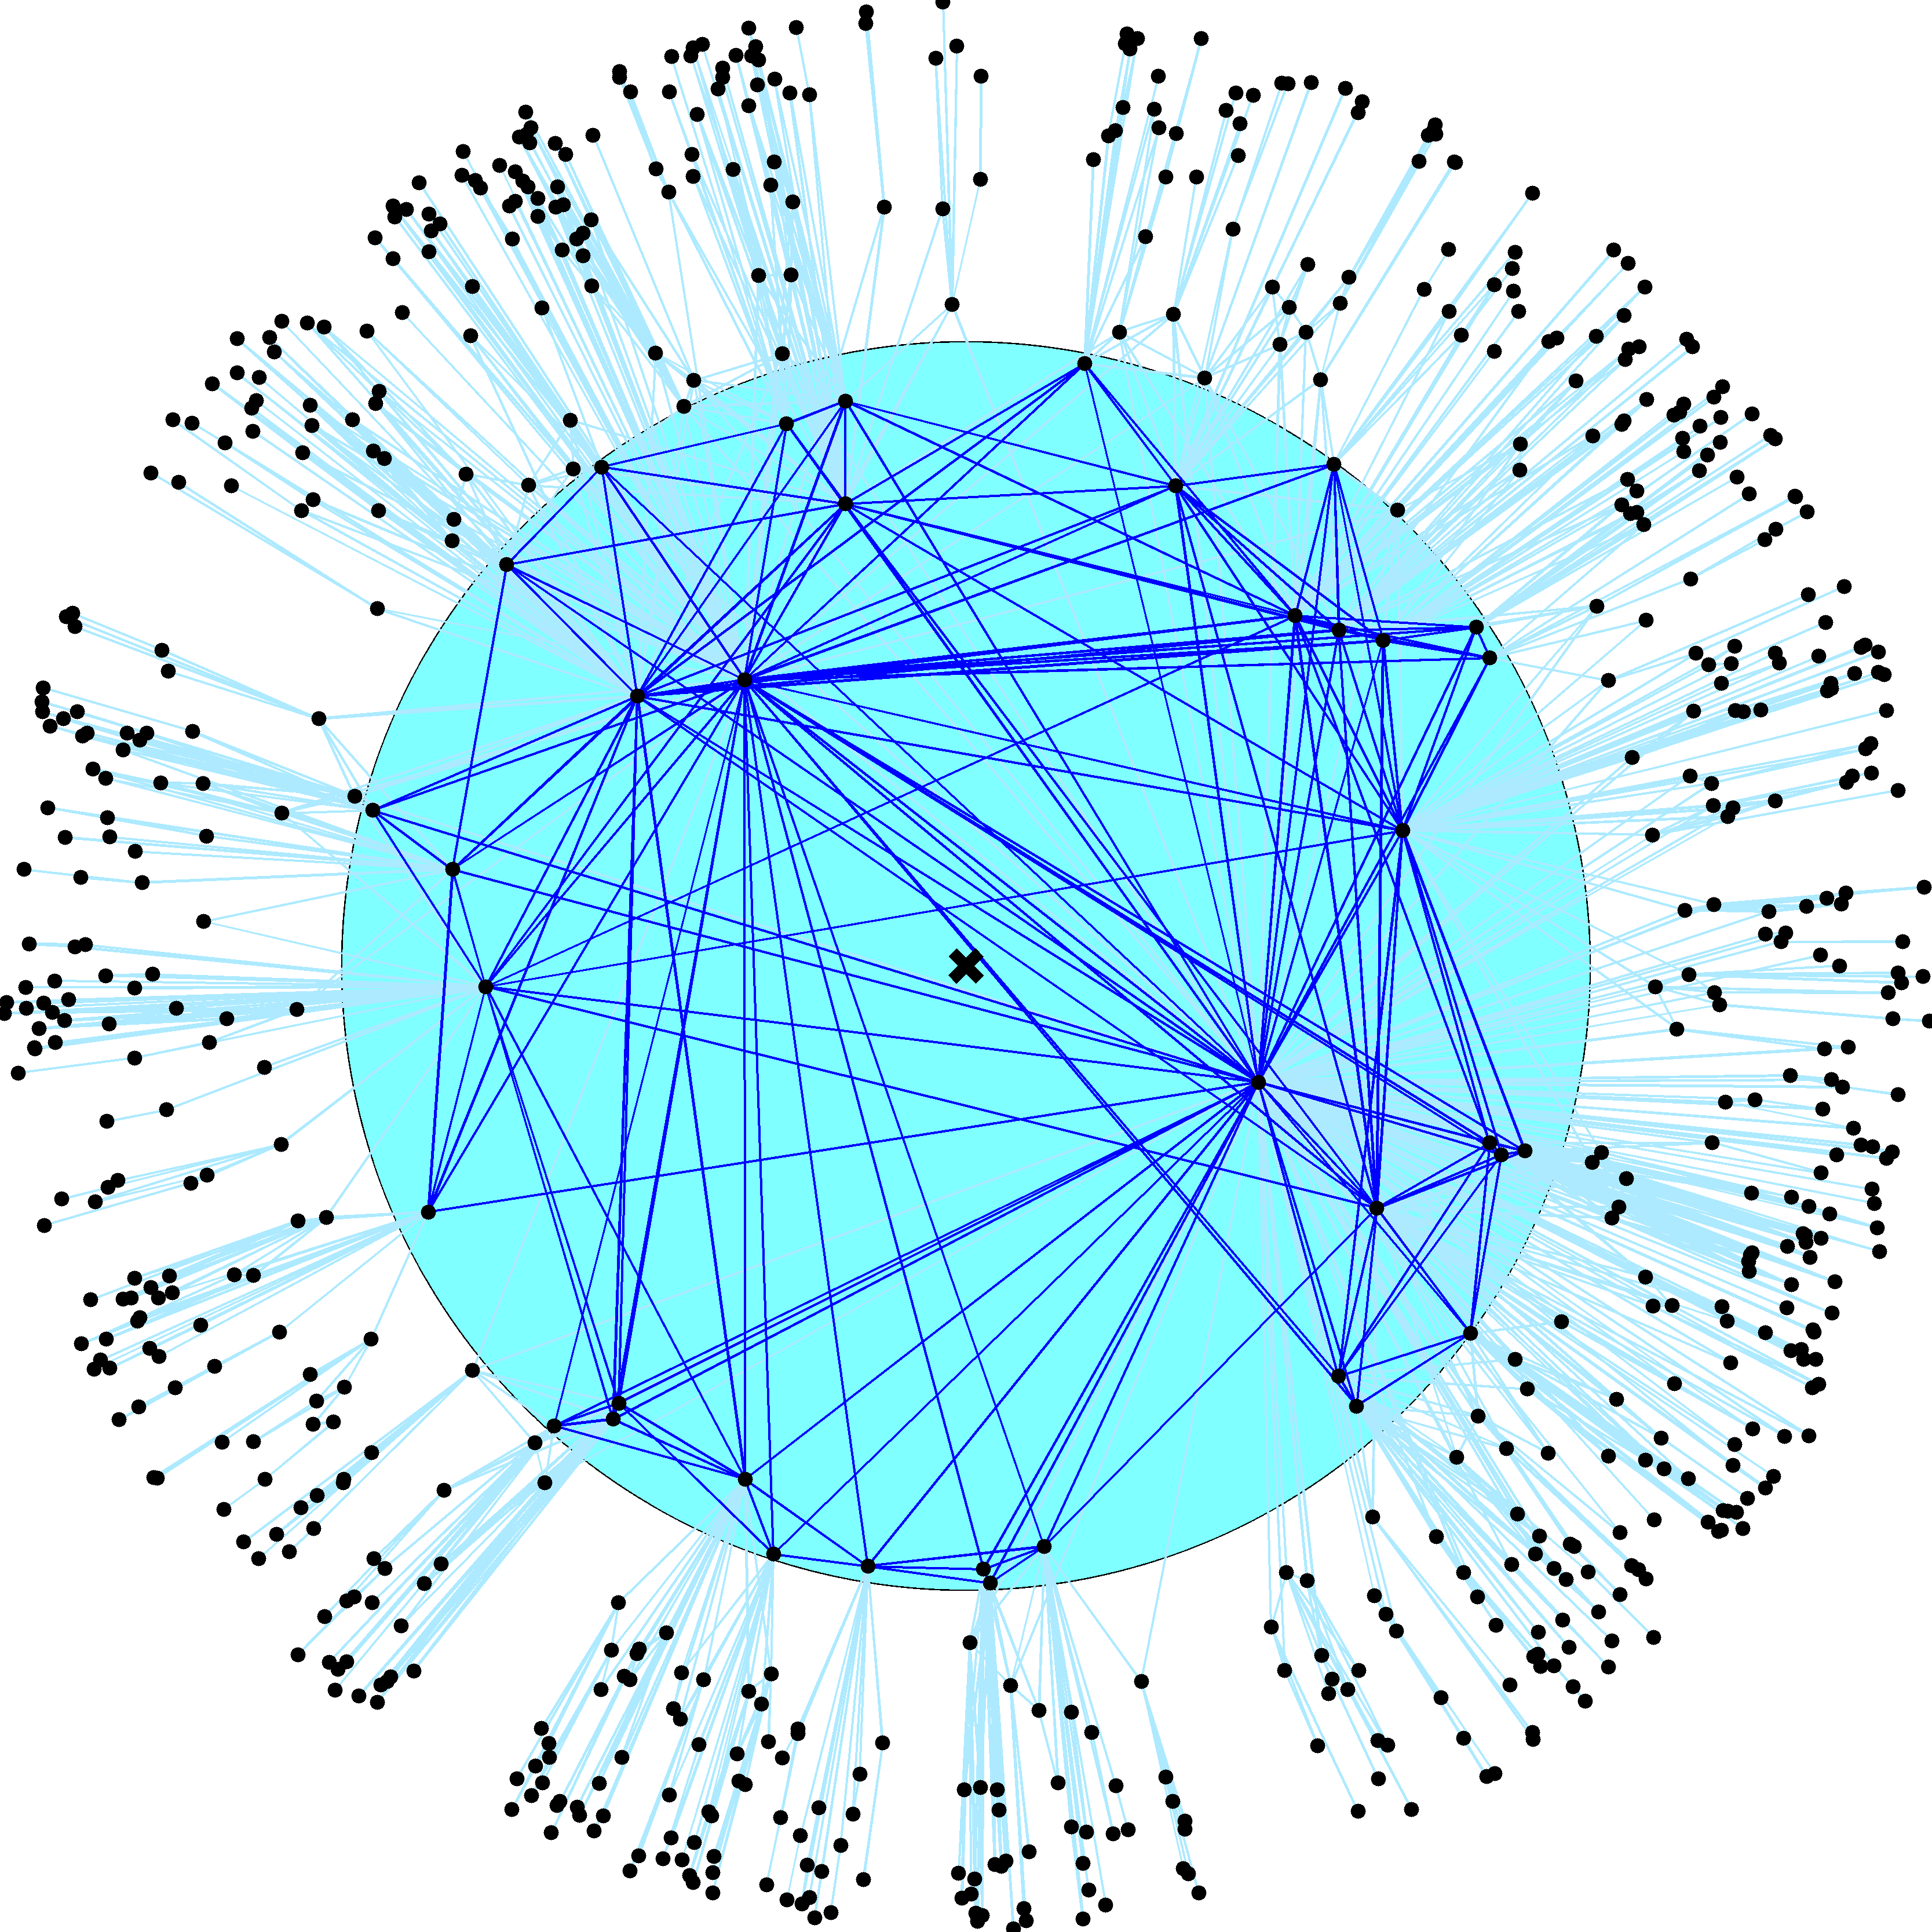

Slide 48
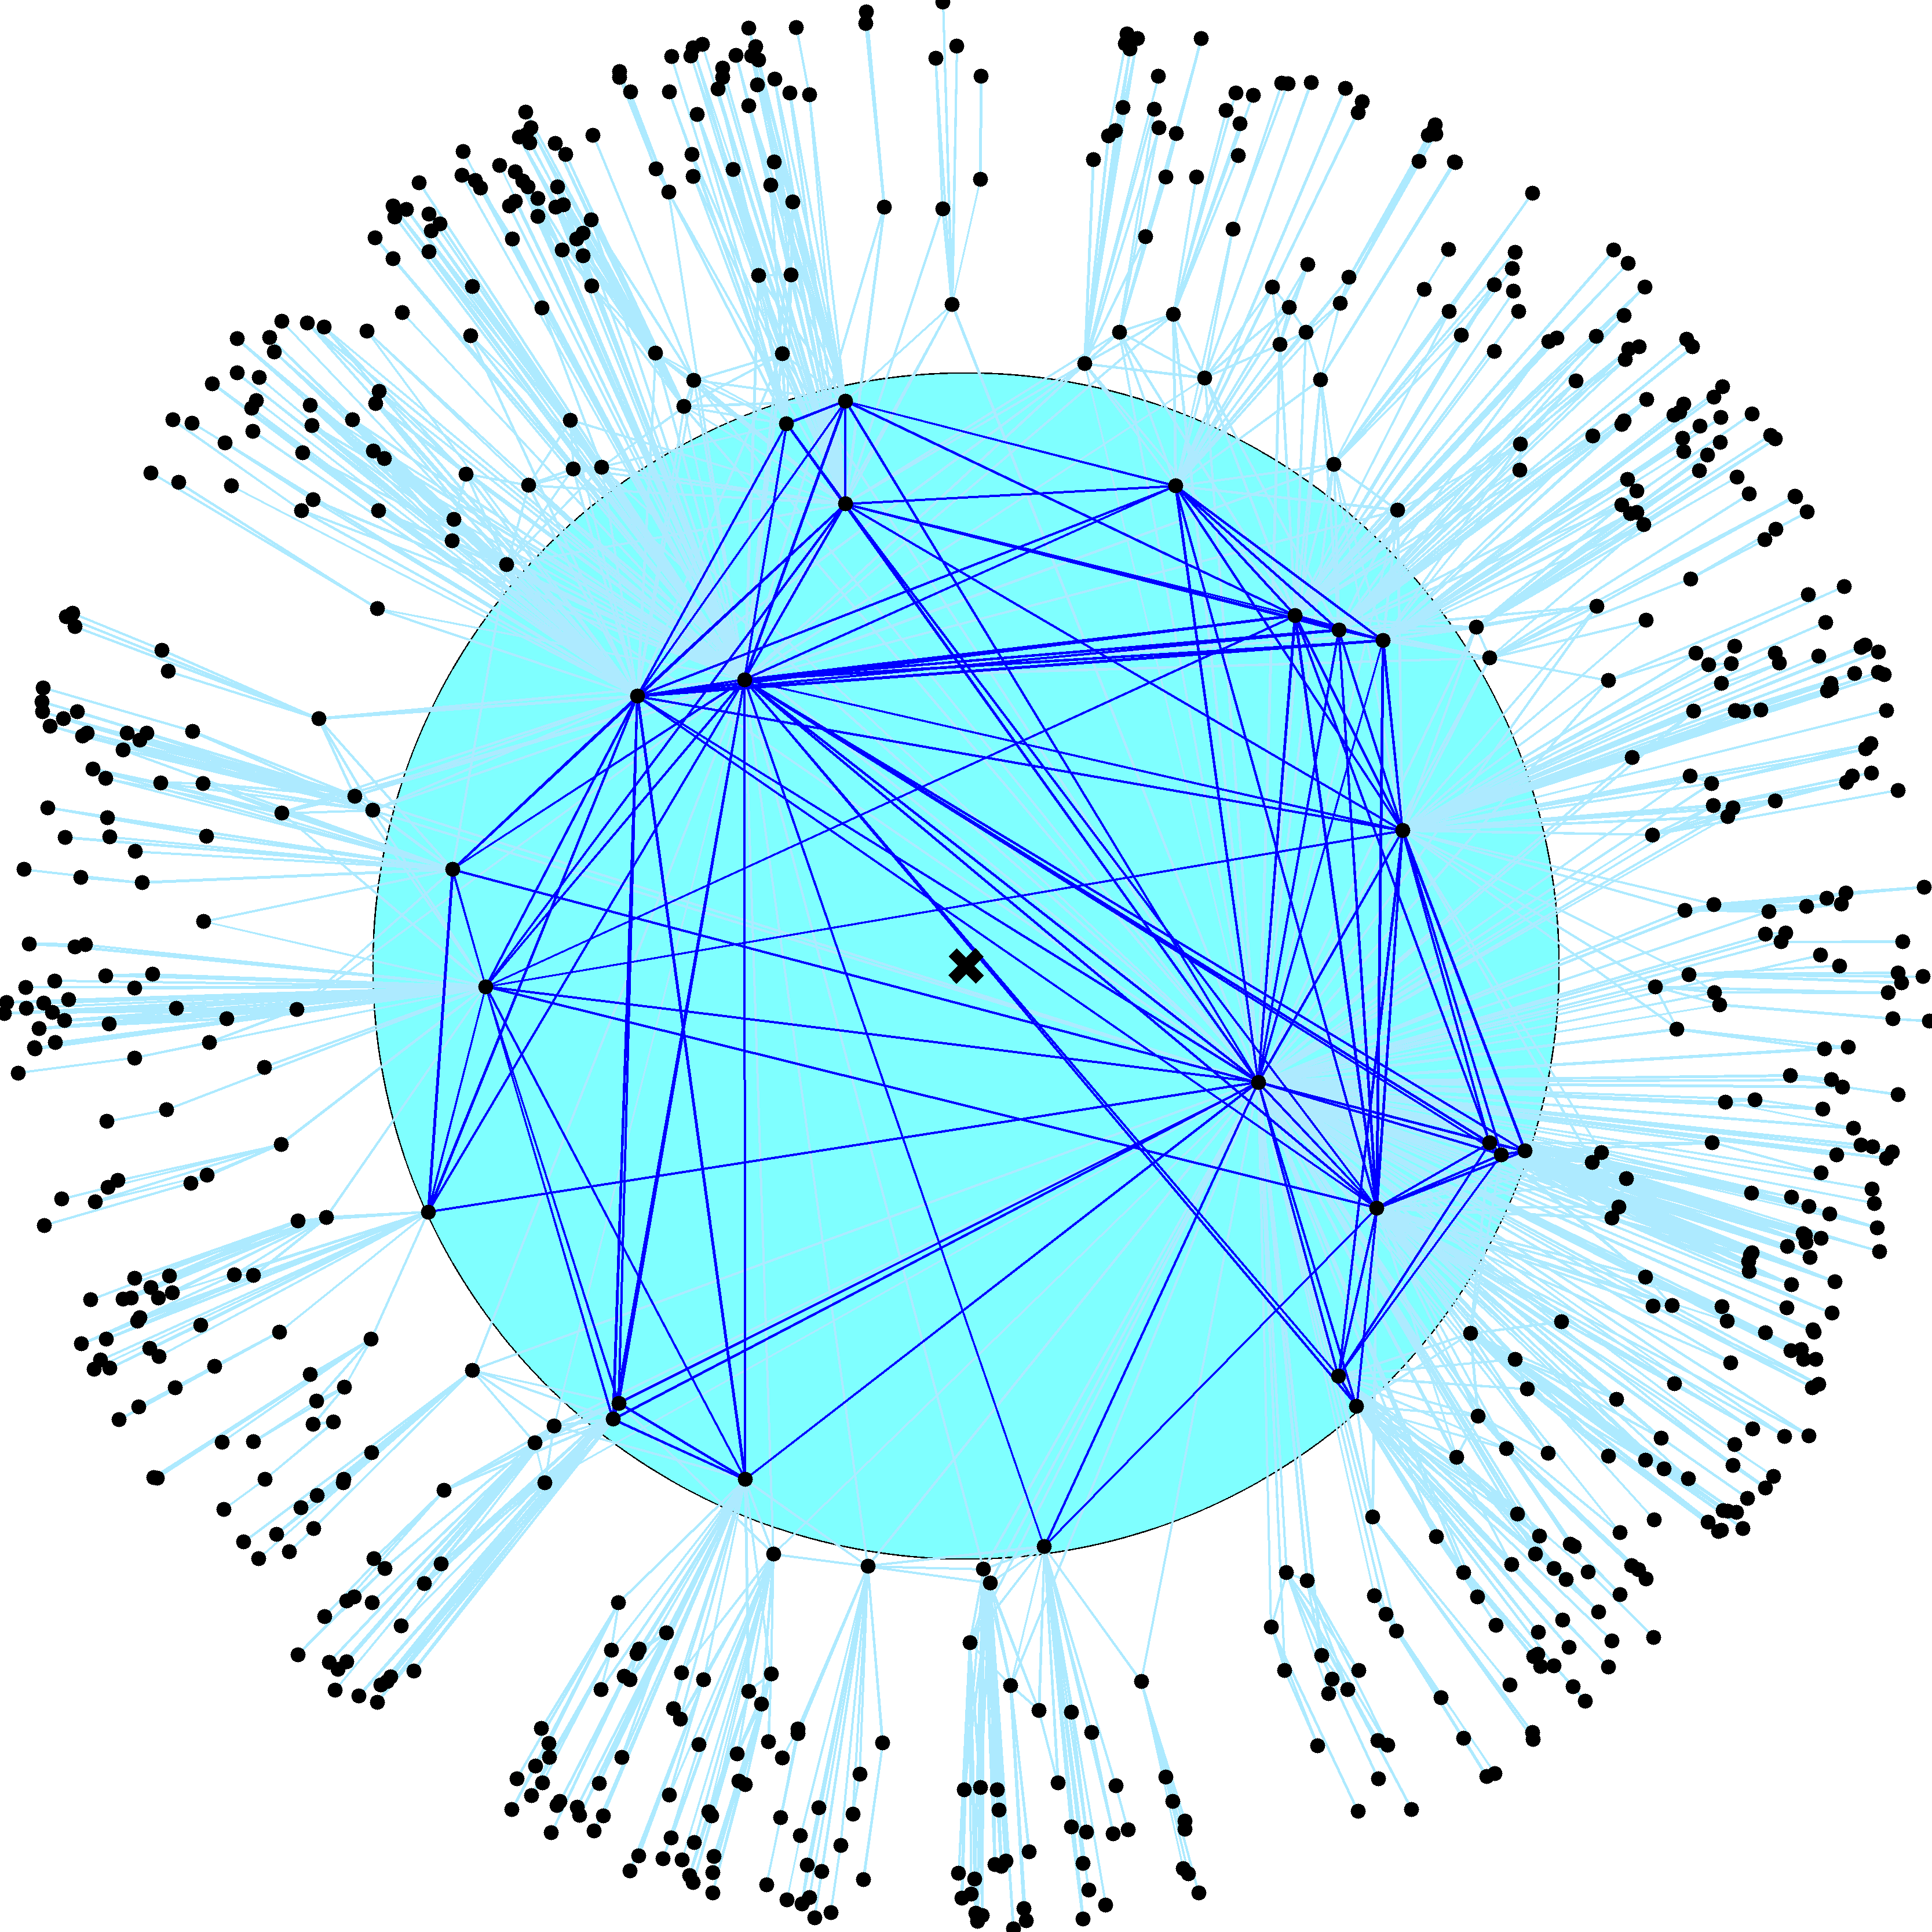

Slide 49
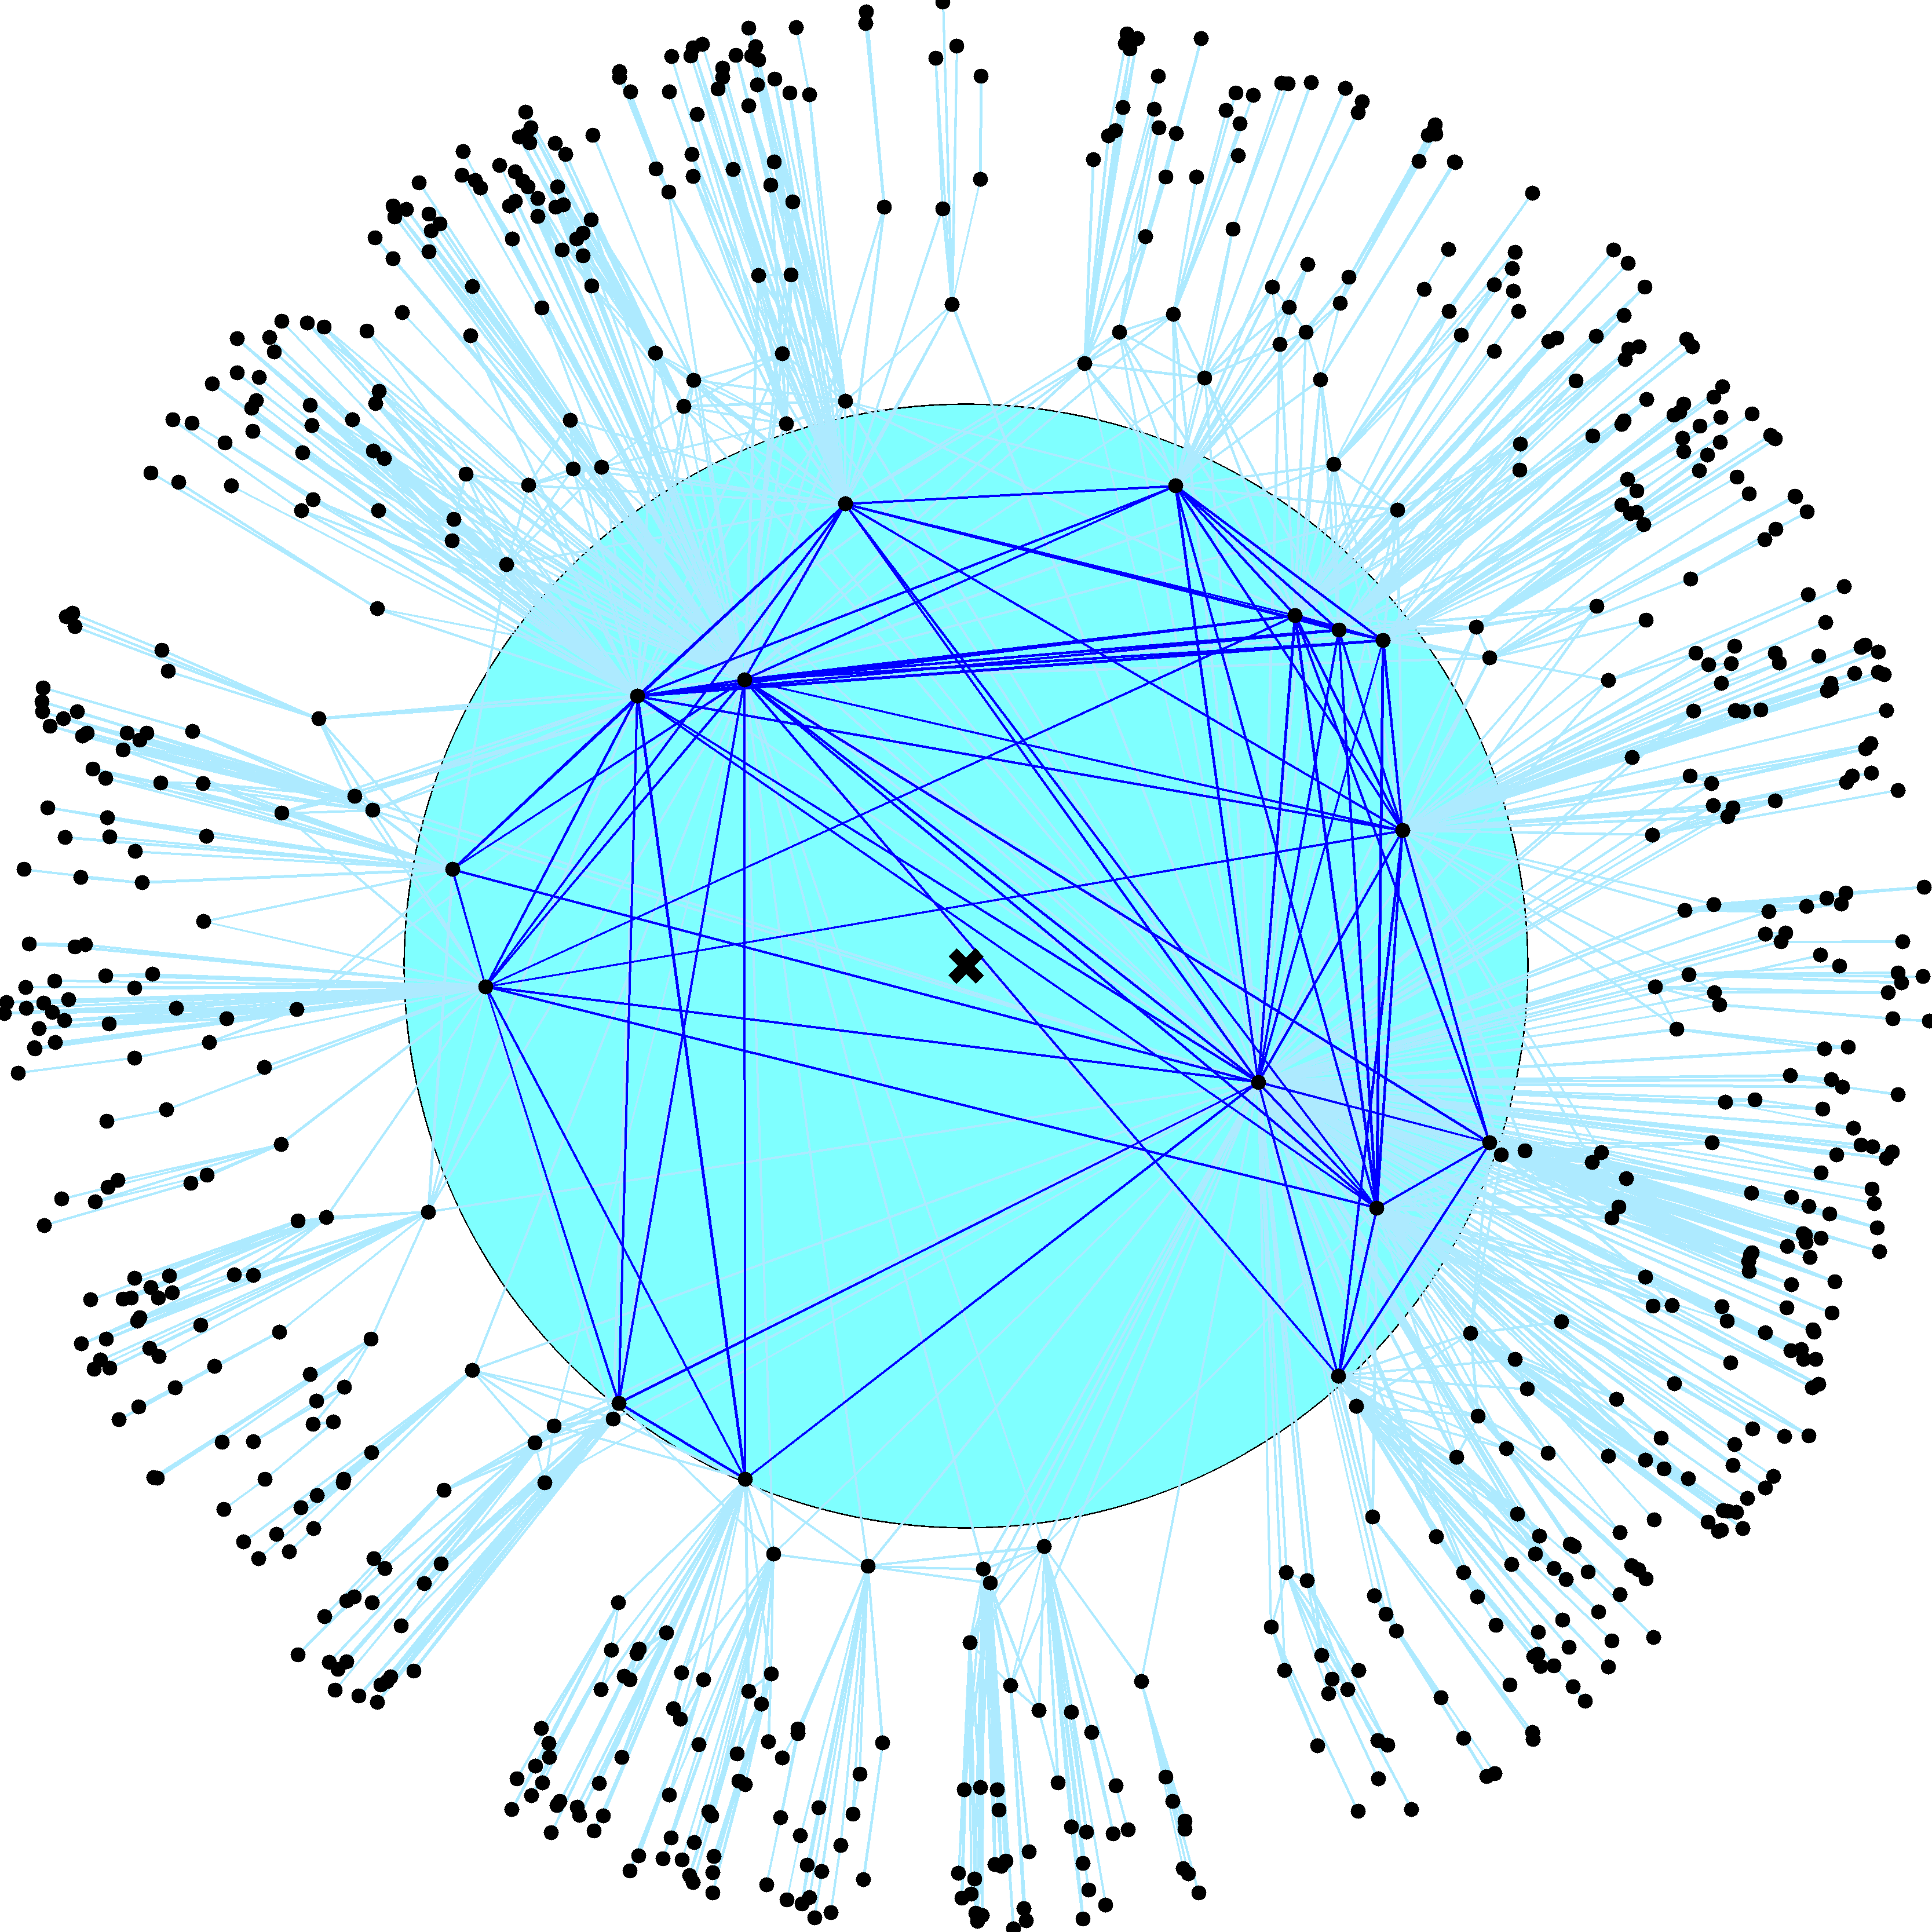

Slide 50
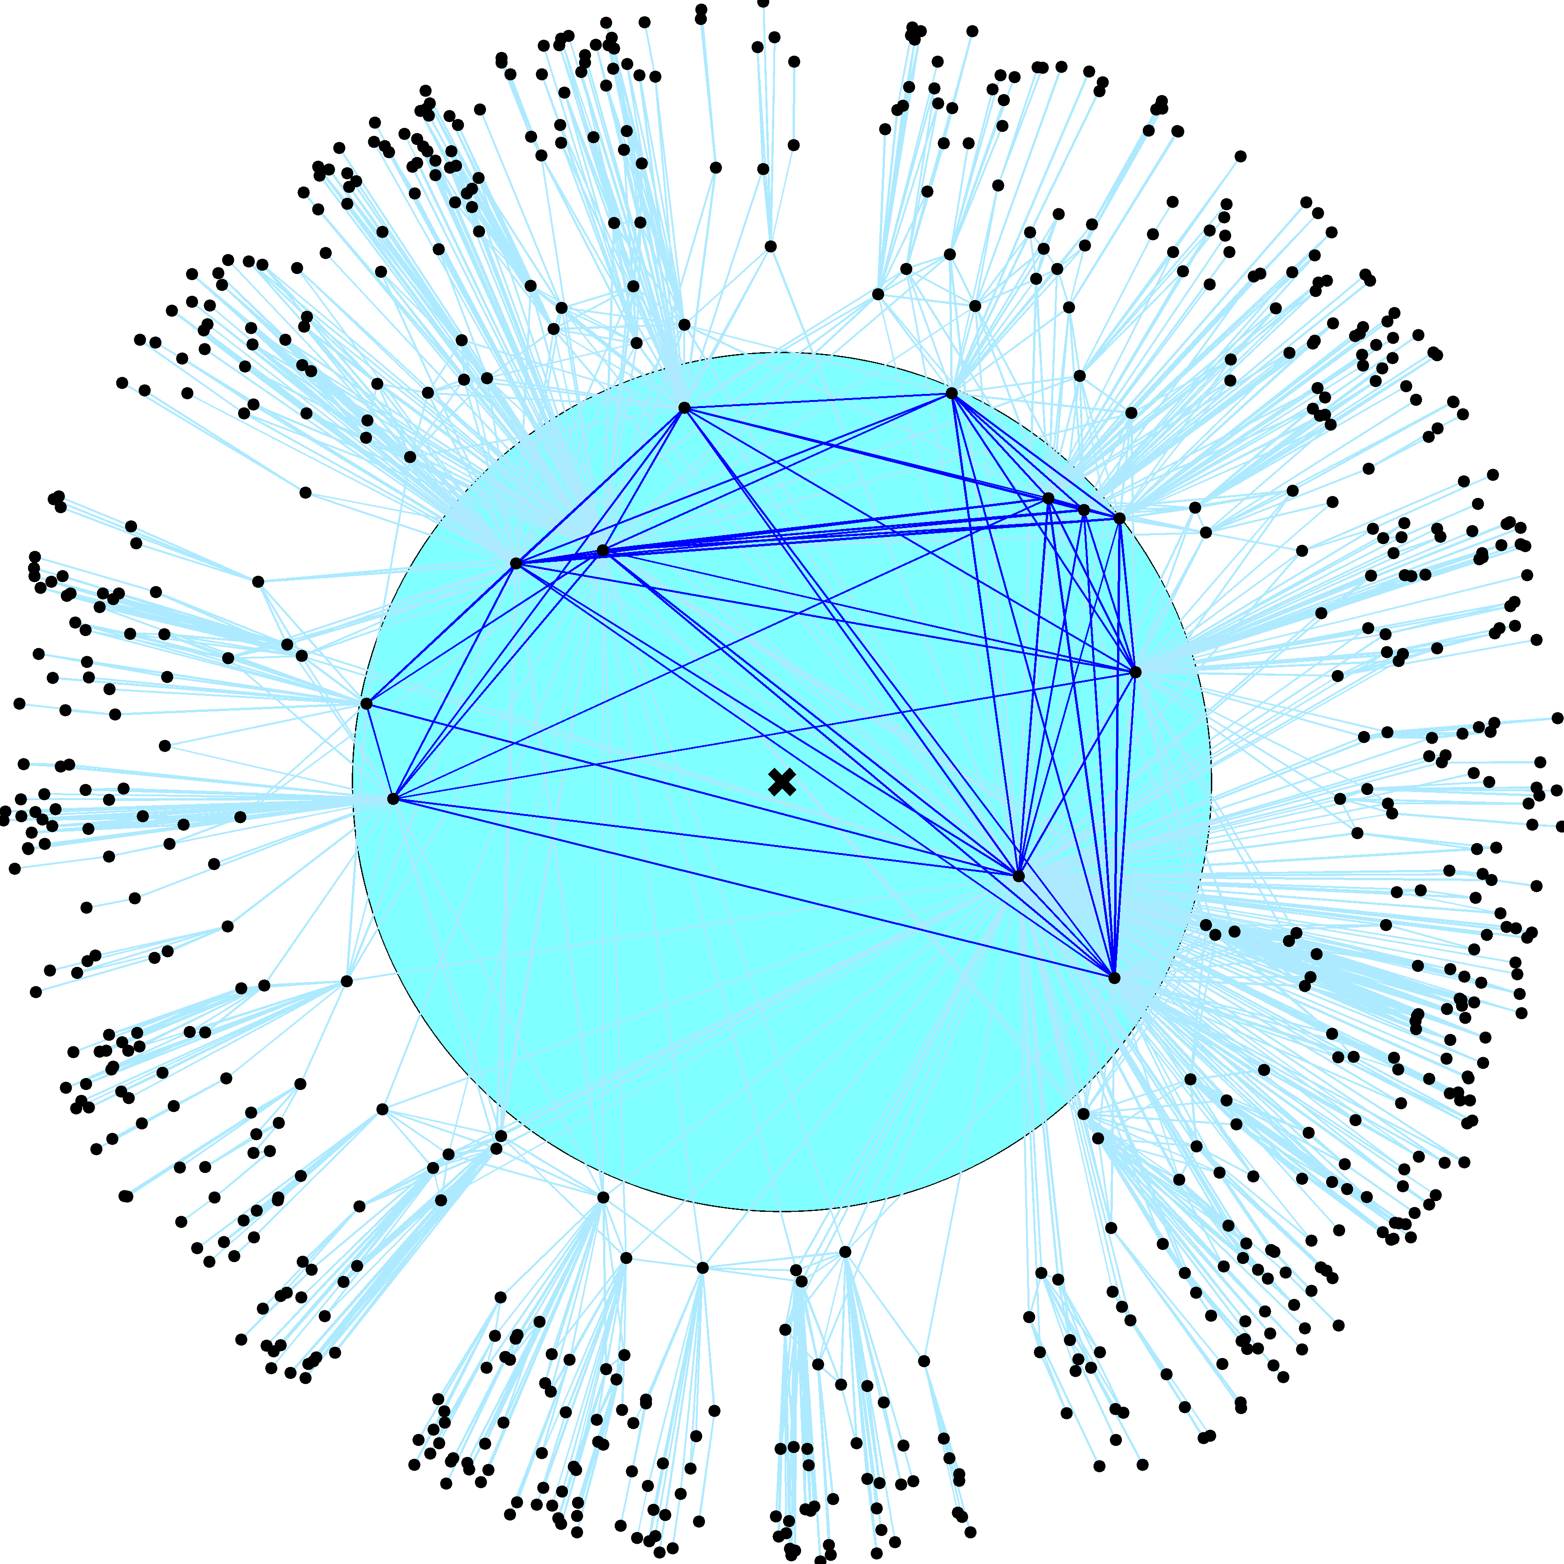

Slide 51
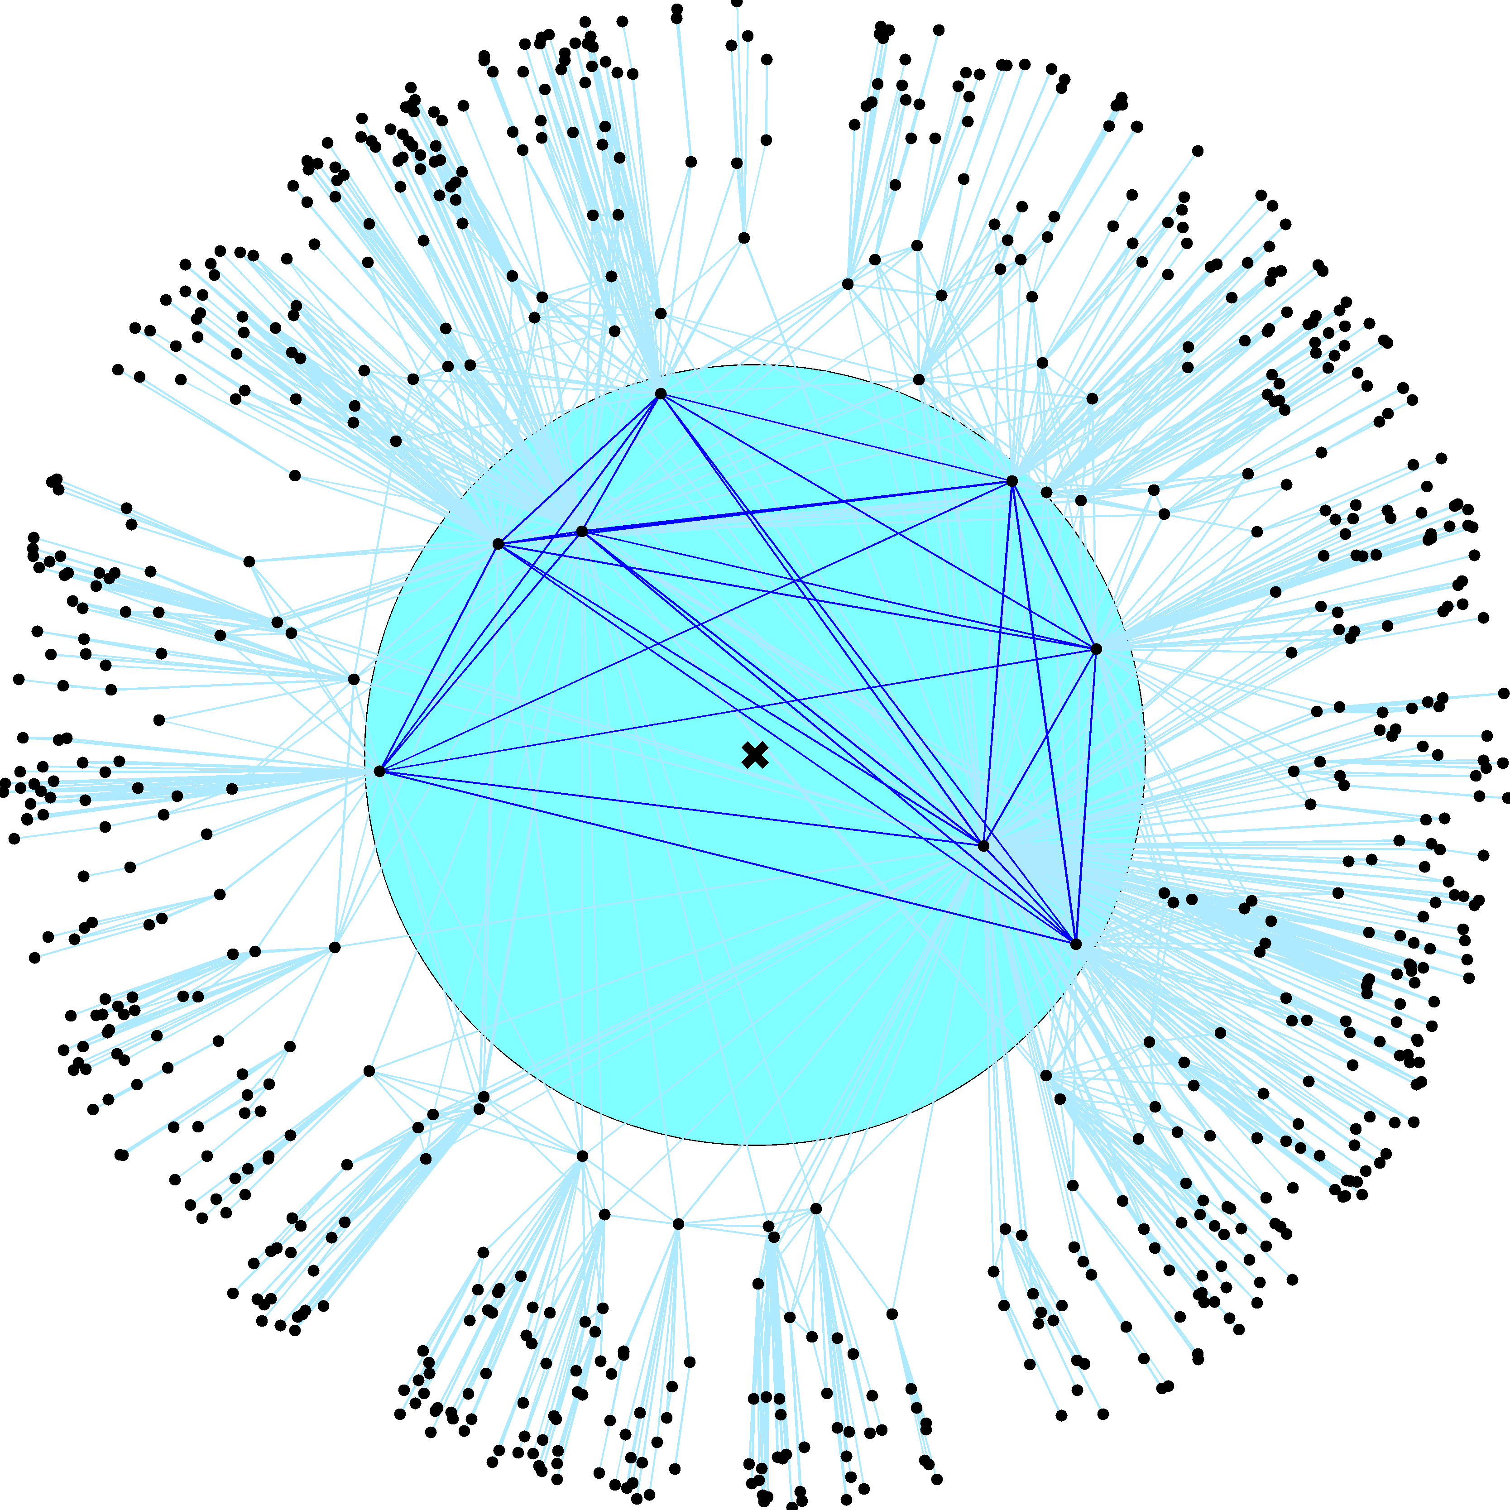

Slide 52
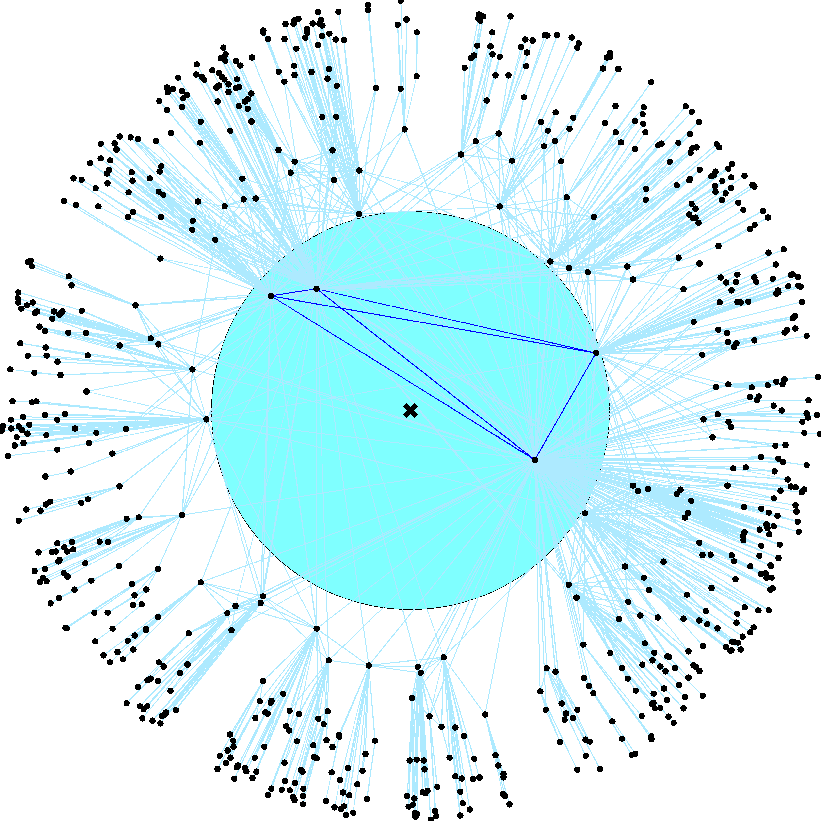

Slide 53
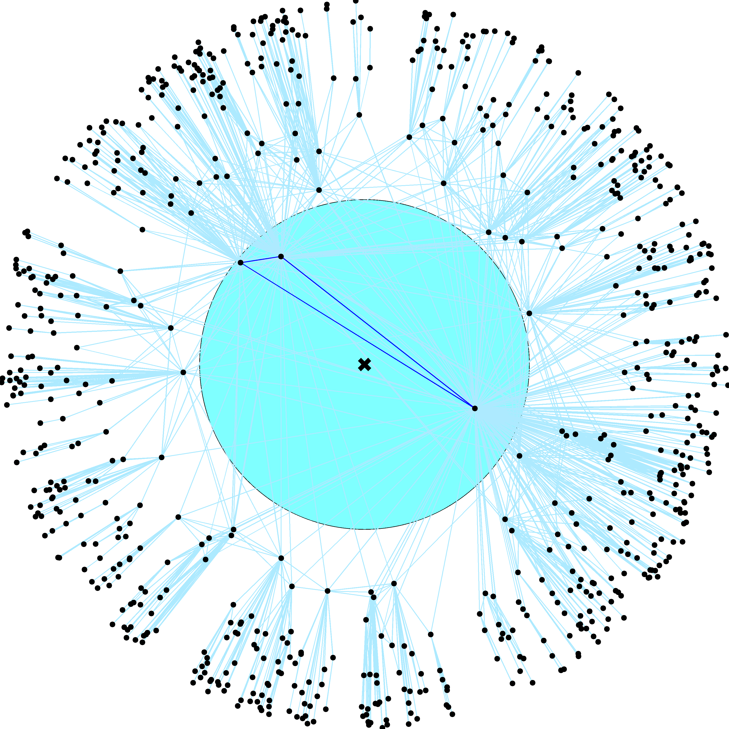

Slide 71
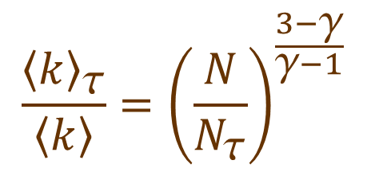
$$N_{τ}=N{\left(\frac{κ_{0}}{κ_{τ}}\right)}^{γ−1}$$
$$_{}=$$
$${\left\langle c\right\rangle }_{τ}=\left\langle c\right\rangle$$
$$\frac{{\left\langle k\right\rangle }_{τ}}{\left\langle k\right\rangle }={\left(\frac{N}{N_{τ}}\right)}^{\frac{3−γ}{γ−1}}$$
$${\left\langle k\right\rangle }_{τ} ={\left\langle k\right\rangle \left(\frac{κ_{τ}}{κ_{0}}\right)}^{3−γ}$$

Slide 72
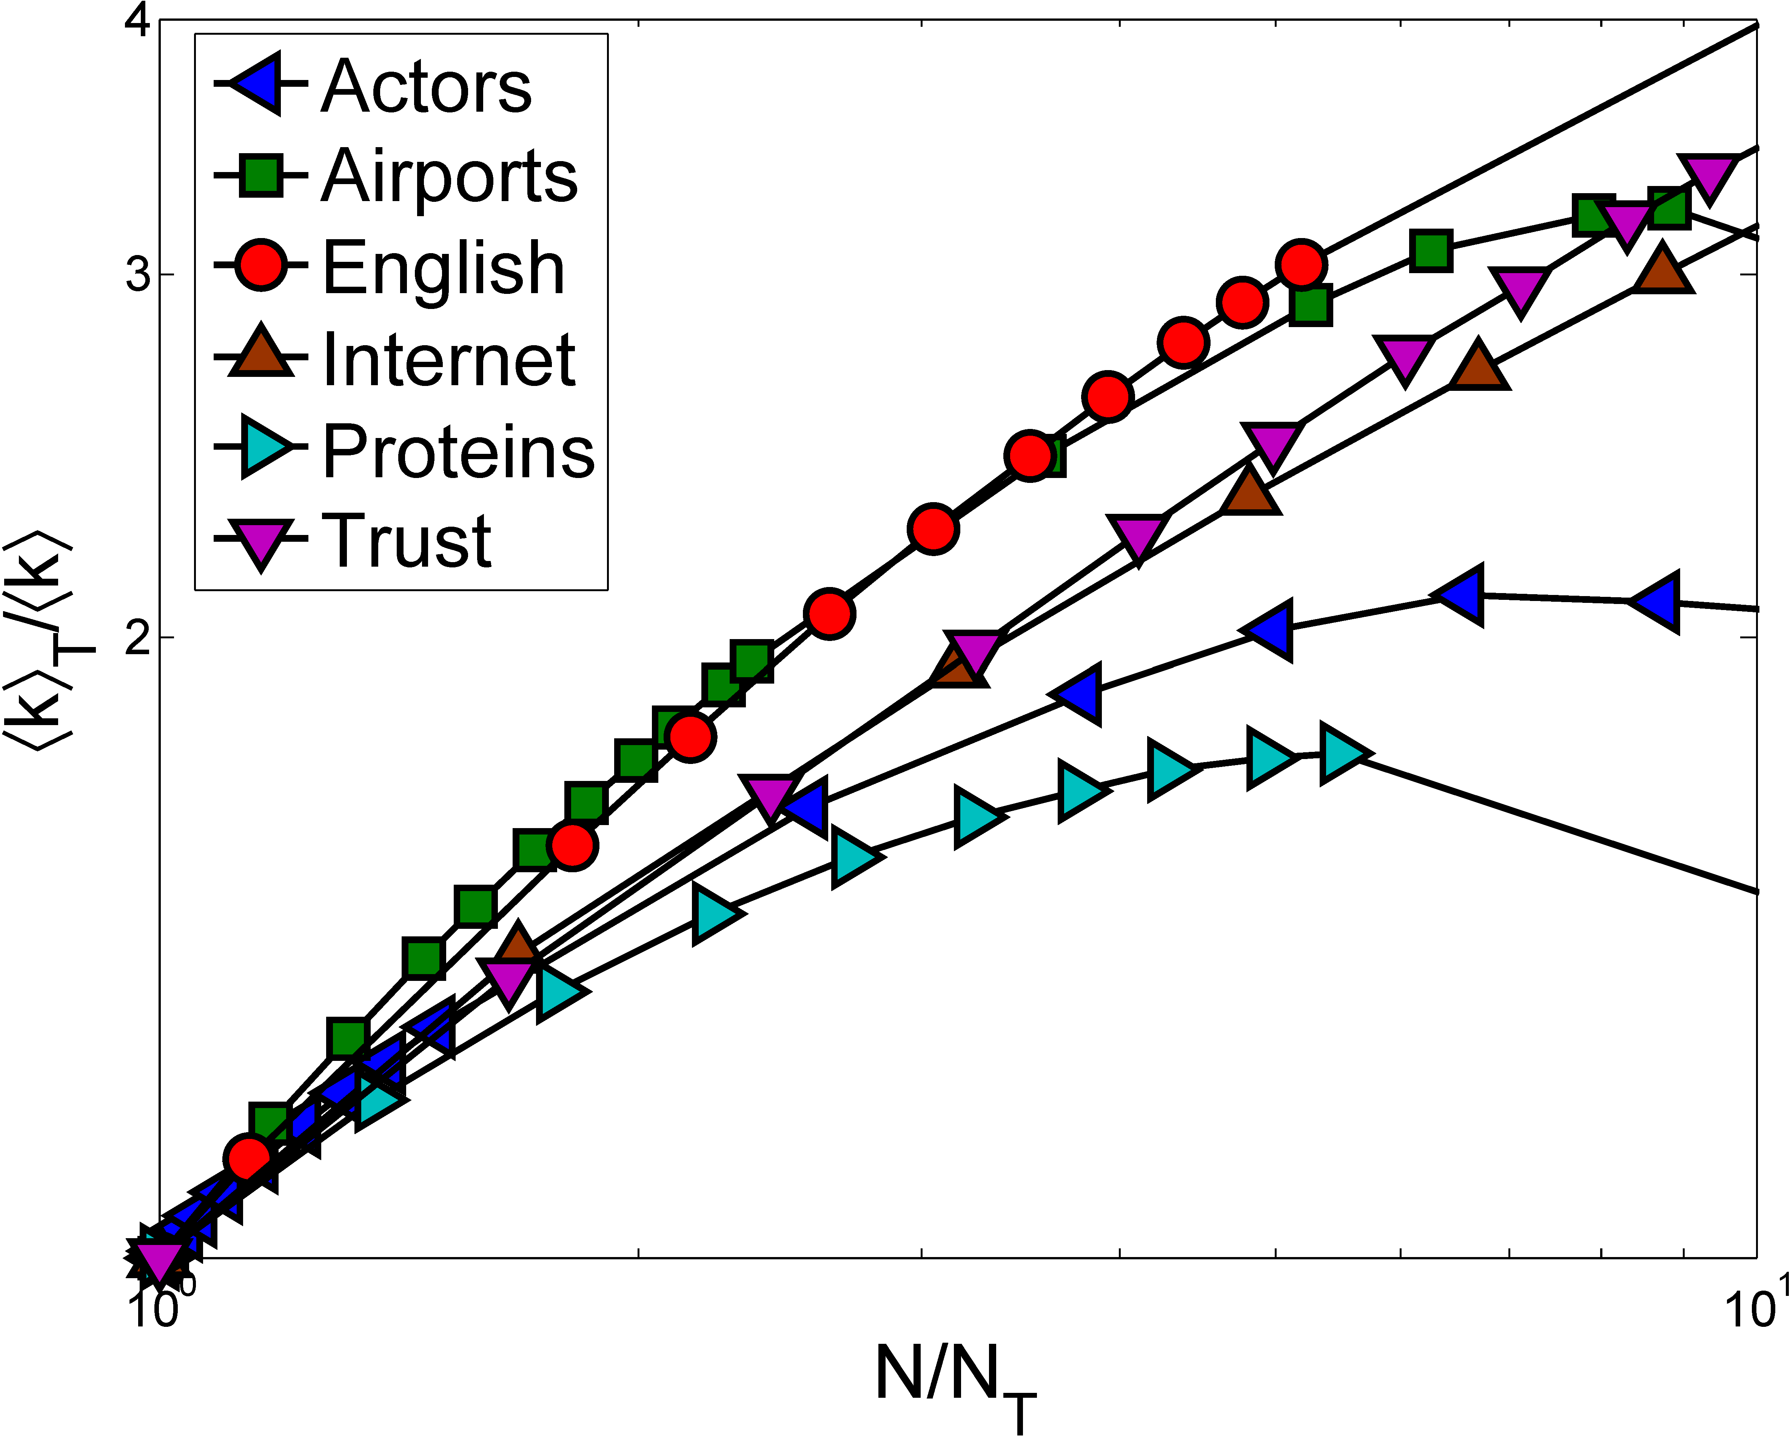

Slide 73
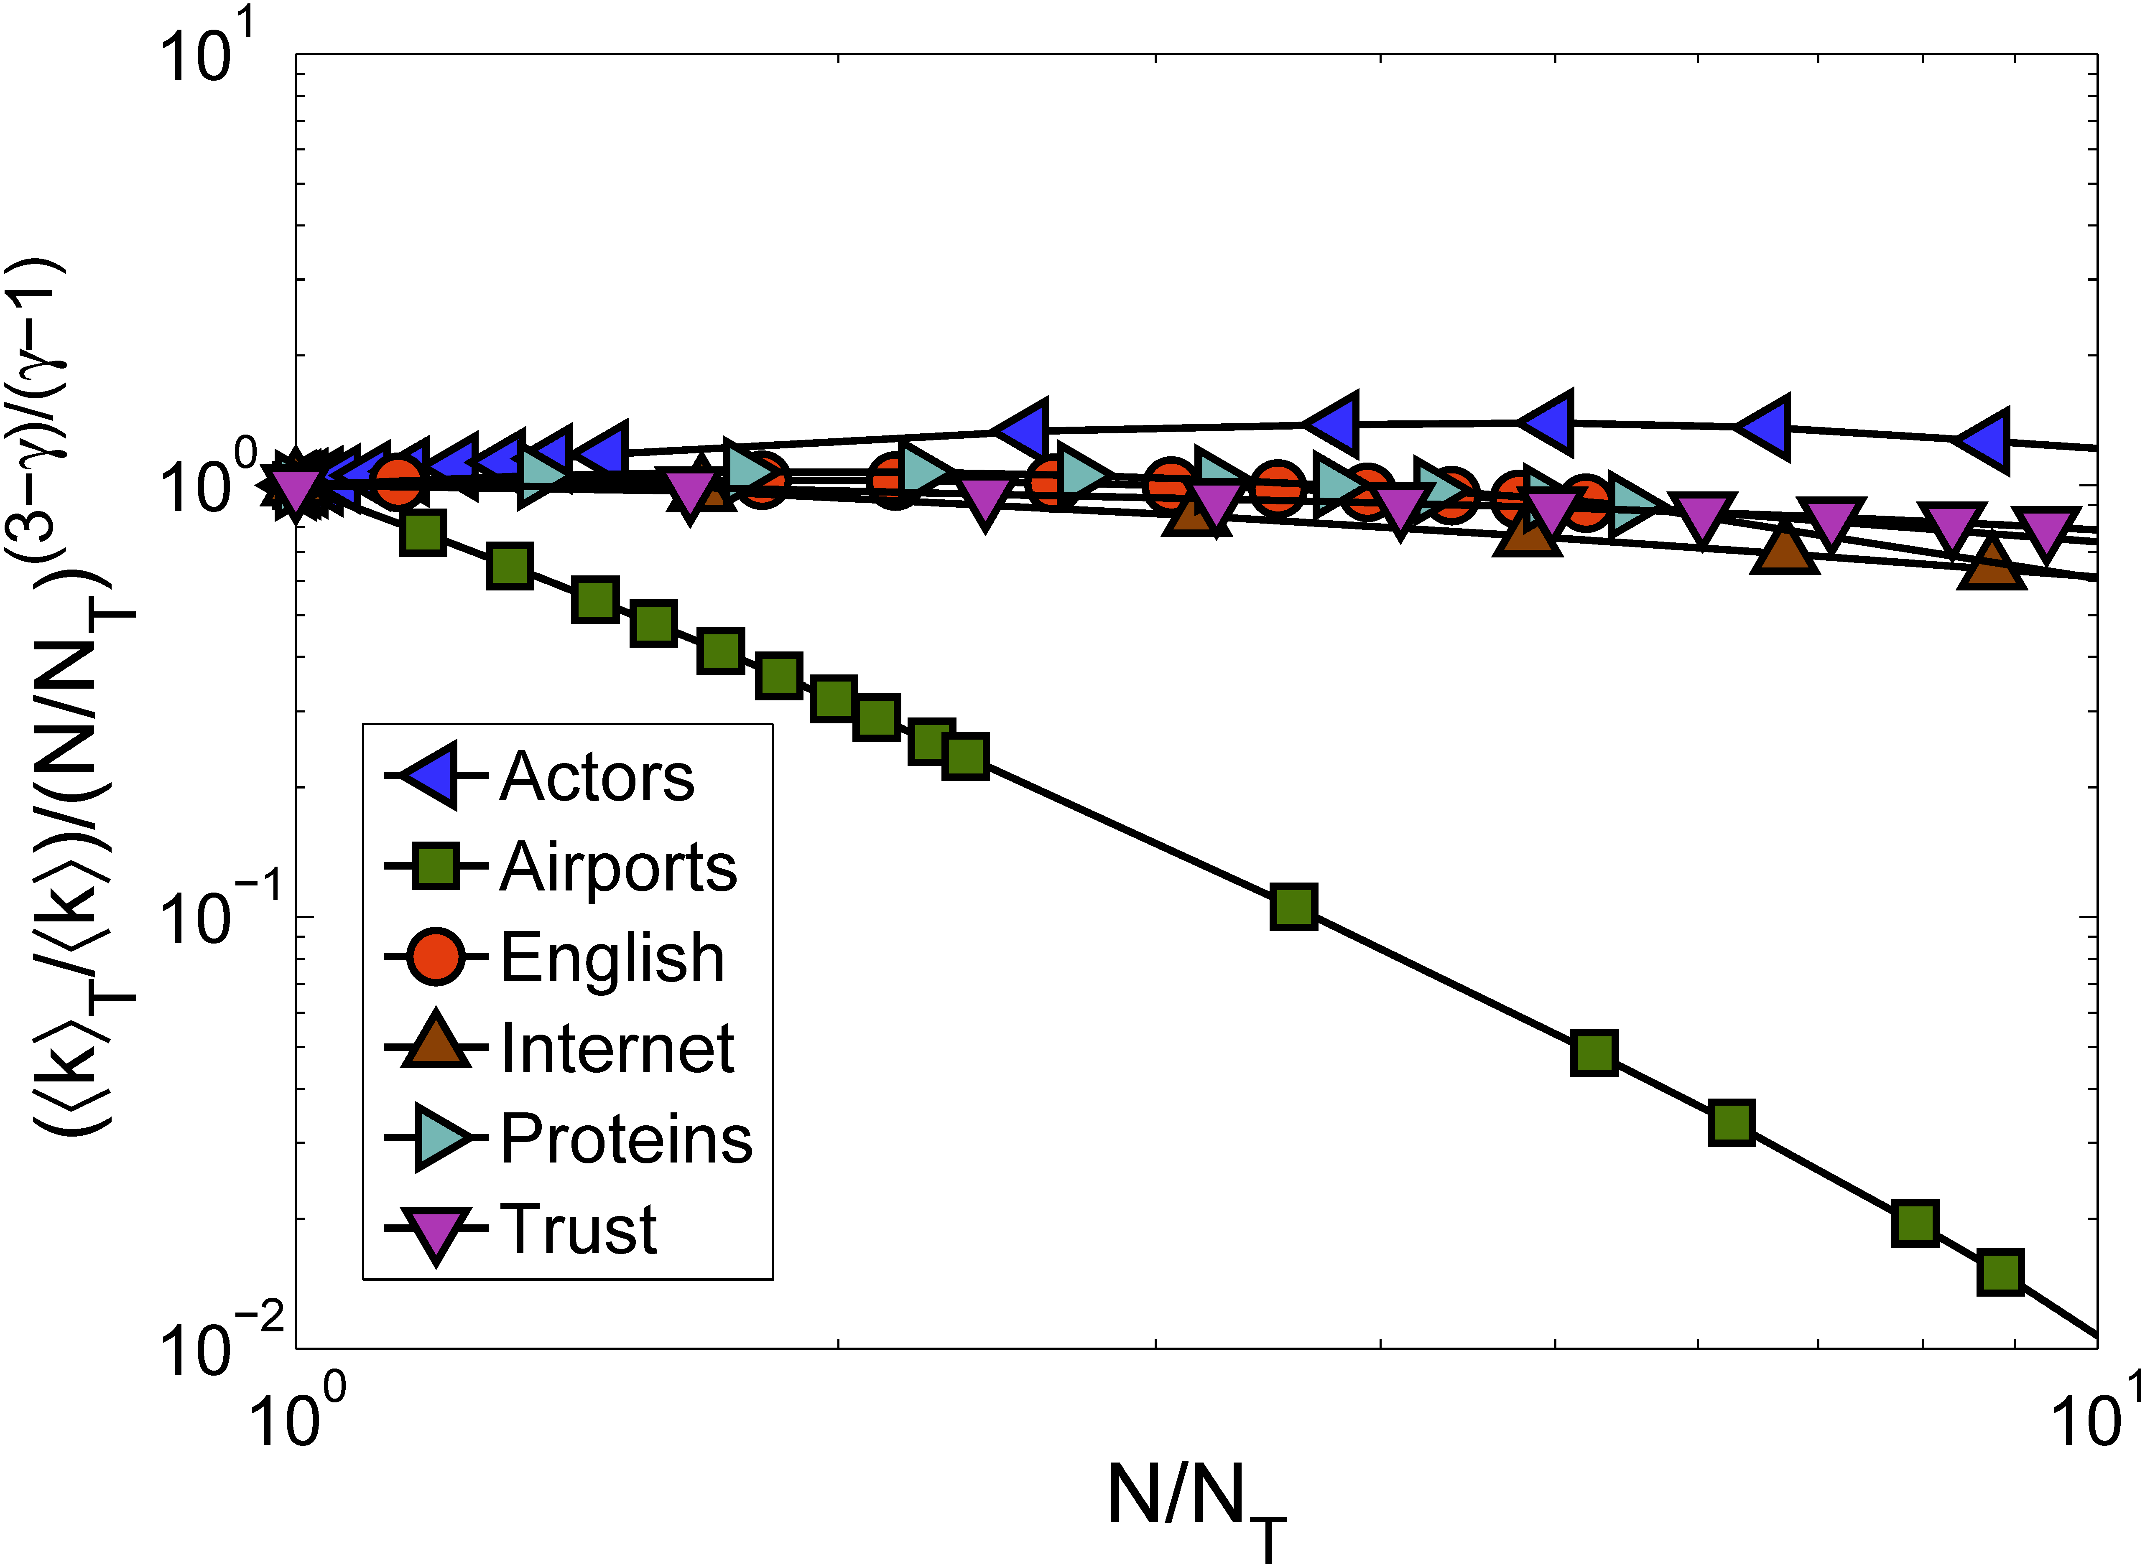

Slide 74
Theorem
Theorem:
  Self-similar networks with growing ↑k() and linear N (N) have zero percolation threshold (↑k_{c} = 0)
Proof:
  Suppose it is not true, i.e., ↑k_{c} > 0, and consider graph G below the threshold, i.e., a graph with ↑k < ↑k_{c} which has no giant component
  Since ↑k() is growing, there exist  such that G’s subgraph G is above the threshold, ↑k > ↑k_{c}, i.e., G does have a giant component
  Contradiction: a graph that does not have a giant component contains a subgraph that does

Slide 75
Conclusions
Amazingly simple proof of the strongest possible structural robustness for an amazingly general class of random networks
  Applies also to random graphs with given degree correlations, and to some growing networks
Self-similarity, or more generally, scale or conformal invariance, seem to be the pivotal properties for percolation in networks
  Other details appear unimportant
Conjecturing three obvious percolation universality classes for self-similar networks
  ↑k() increases, decreases, or constant (PA!)
The proof can be generalized to any processes whose critical parameters depend on ↑k monotonically
  Ising, SIS models, etc.

Slide 76
Take-home message
The size of your brain does not matter
What matters is how self-similar it is

