Slide 1
Optimal routing in complex networks
Dmitri Krioukov CAIDA/UCSD
dima@caida.org
F. Papadopoulos, M. Kitsak, M. Boguñá, M. Á. Serrano, A. Vahdat, and kc claffy NDN, Palo Alto, May 2011

Slide 2
Optimal routing
Routing table size
~k
Stretch
~1
Communication overhead
~0

Slide 3
Complex networks
Heterogeneity: distribution P(k) of node degrees k:
Real: P(k) ~ k
Random: P(k) ~ ^{k}e/k!
Clustering: average probability that node neighbors are connected:
Real: 0.46
C(k) ~ k^{1}
Random: 6.810^{4}
C(k) ~ const

Slide 5
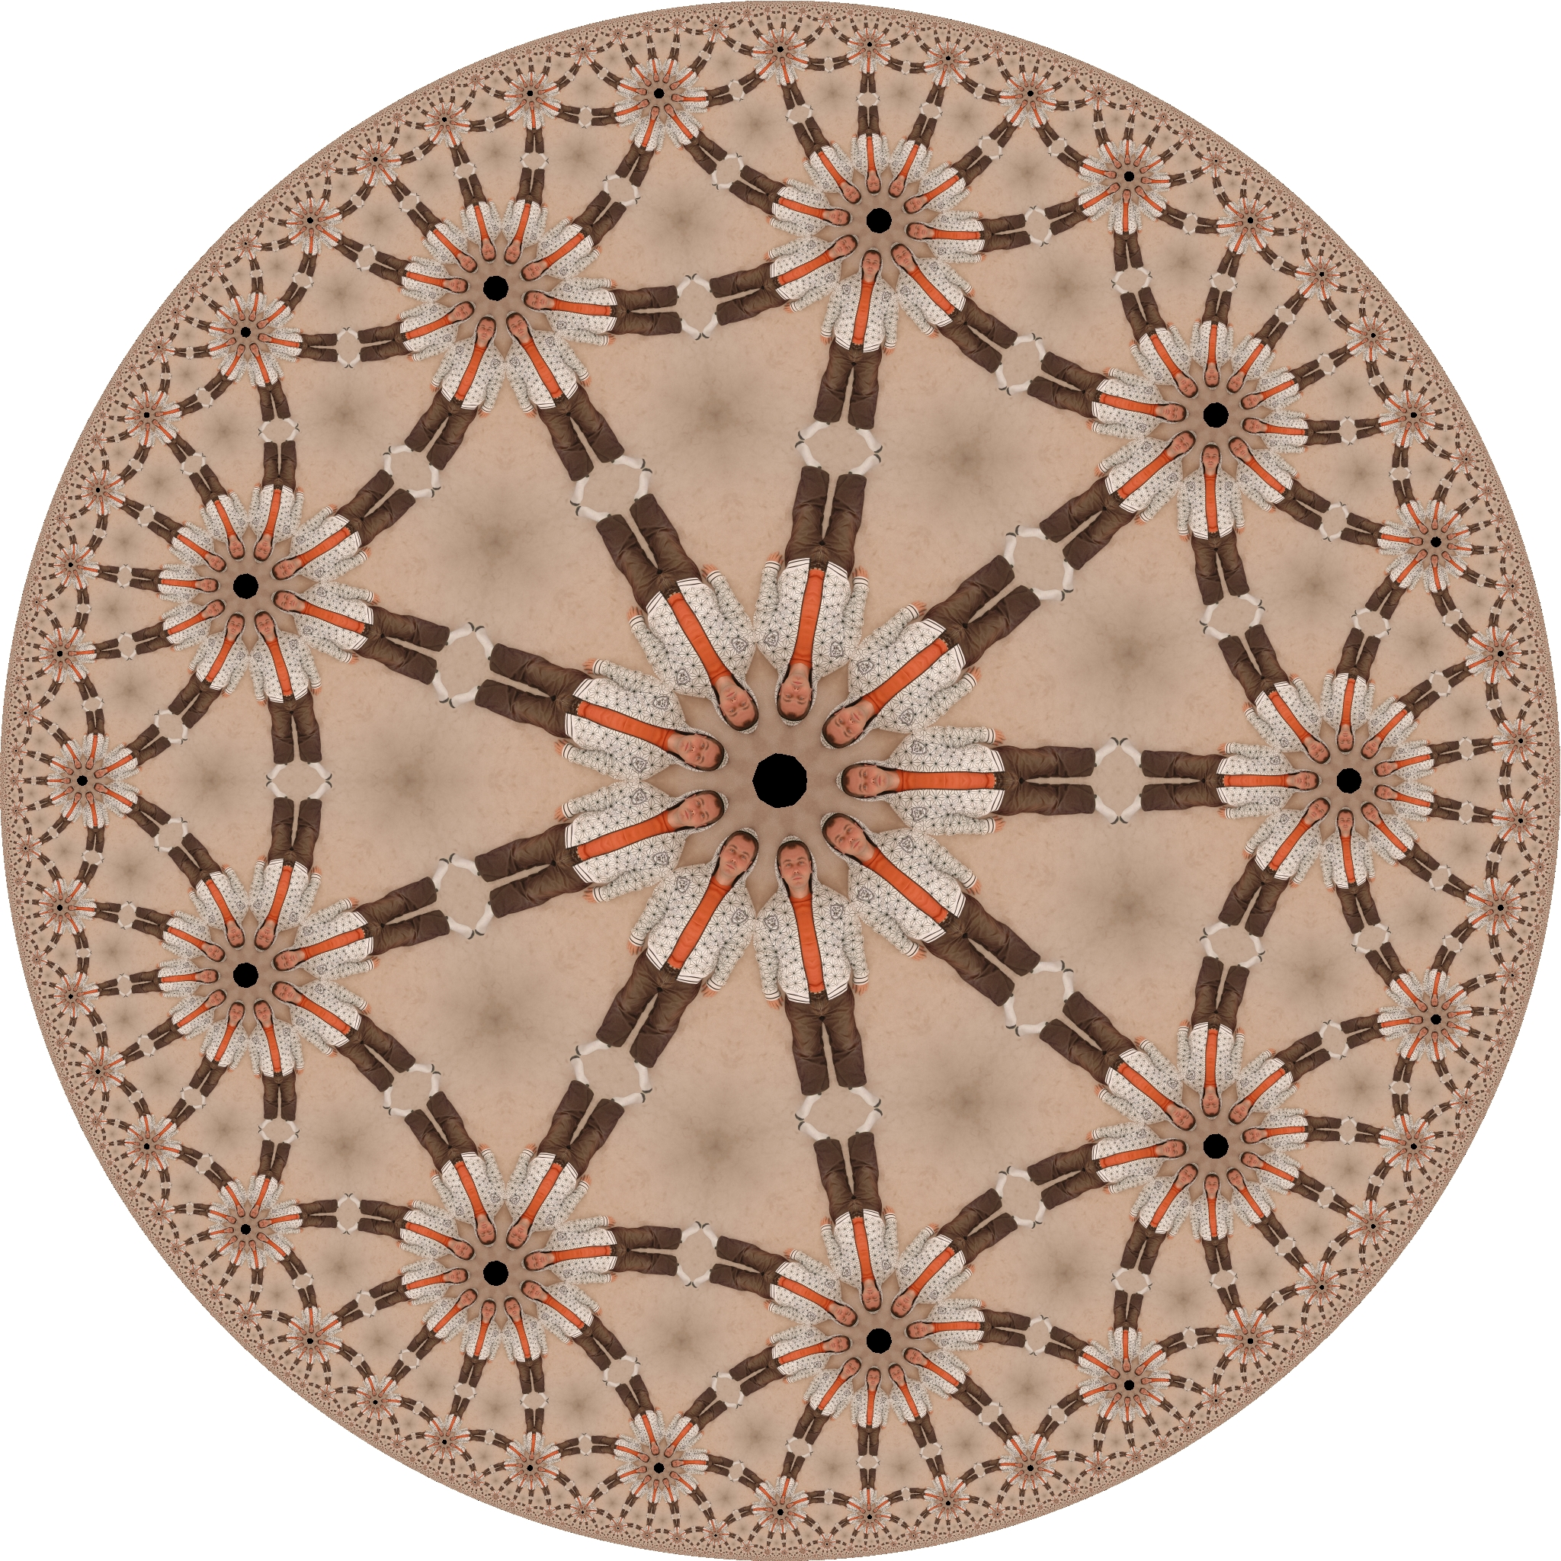

Slide 8
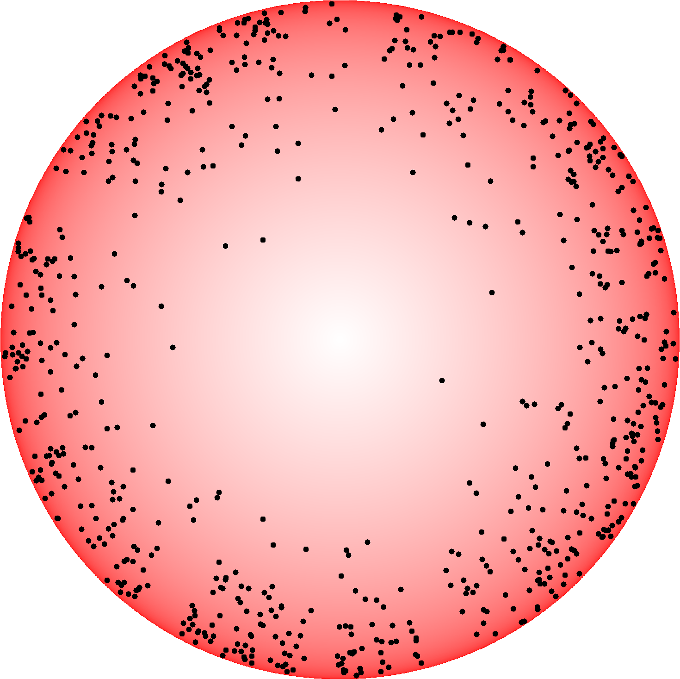

Slide 10
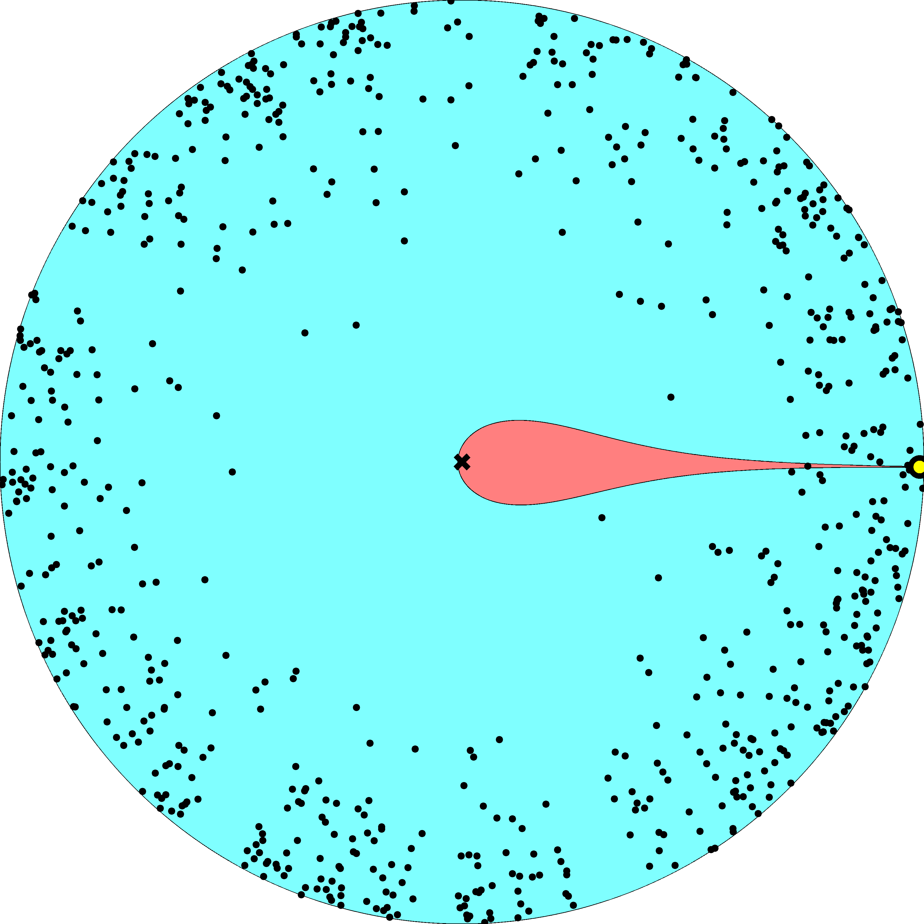

Slide 11
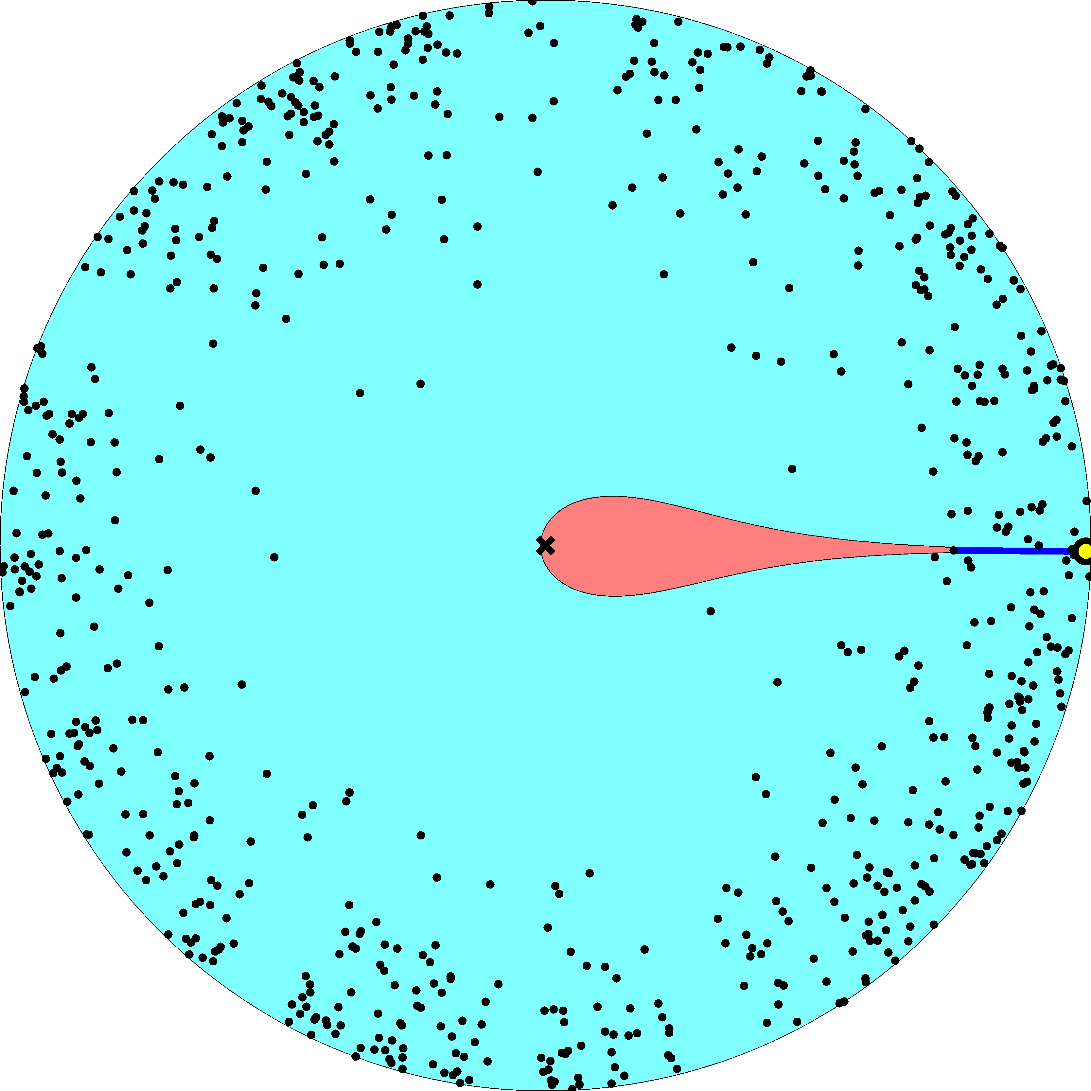

Slide 12
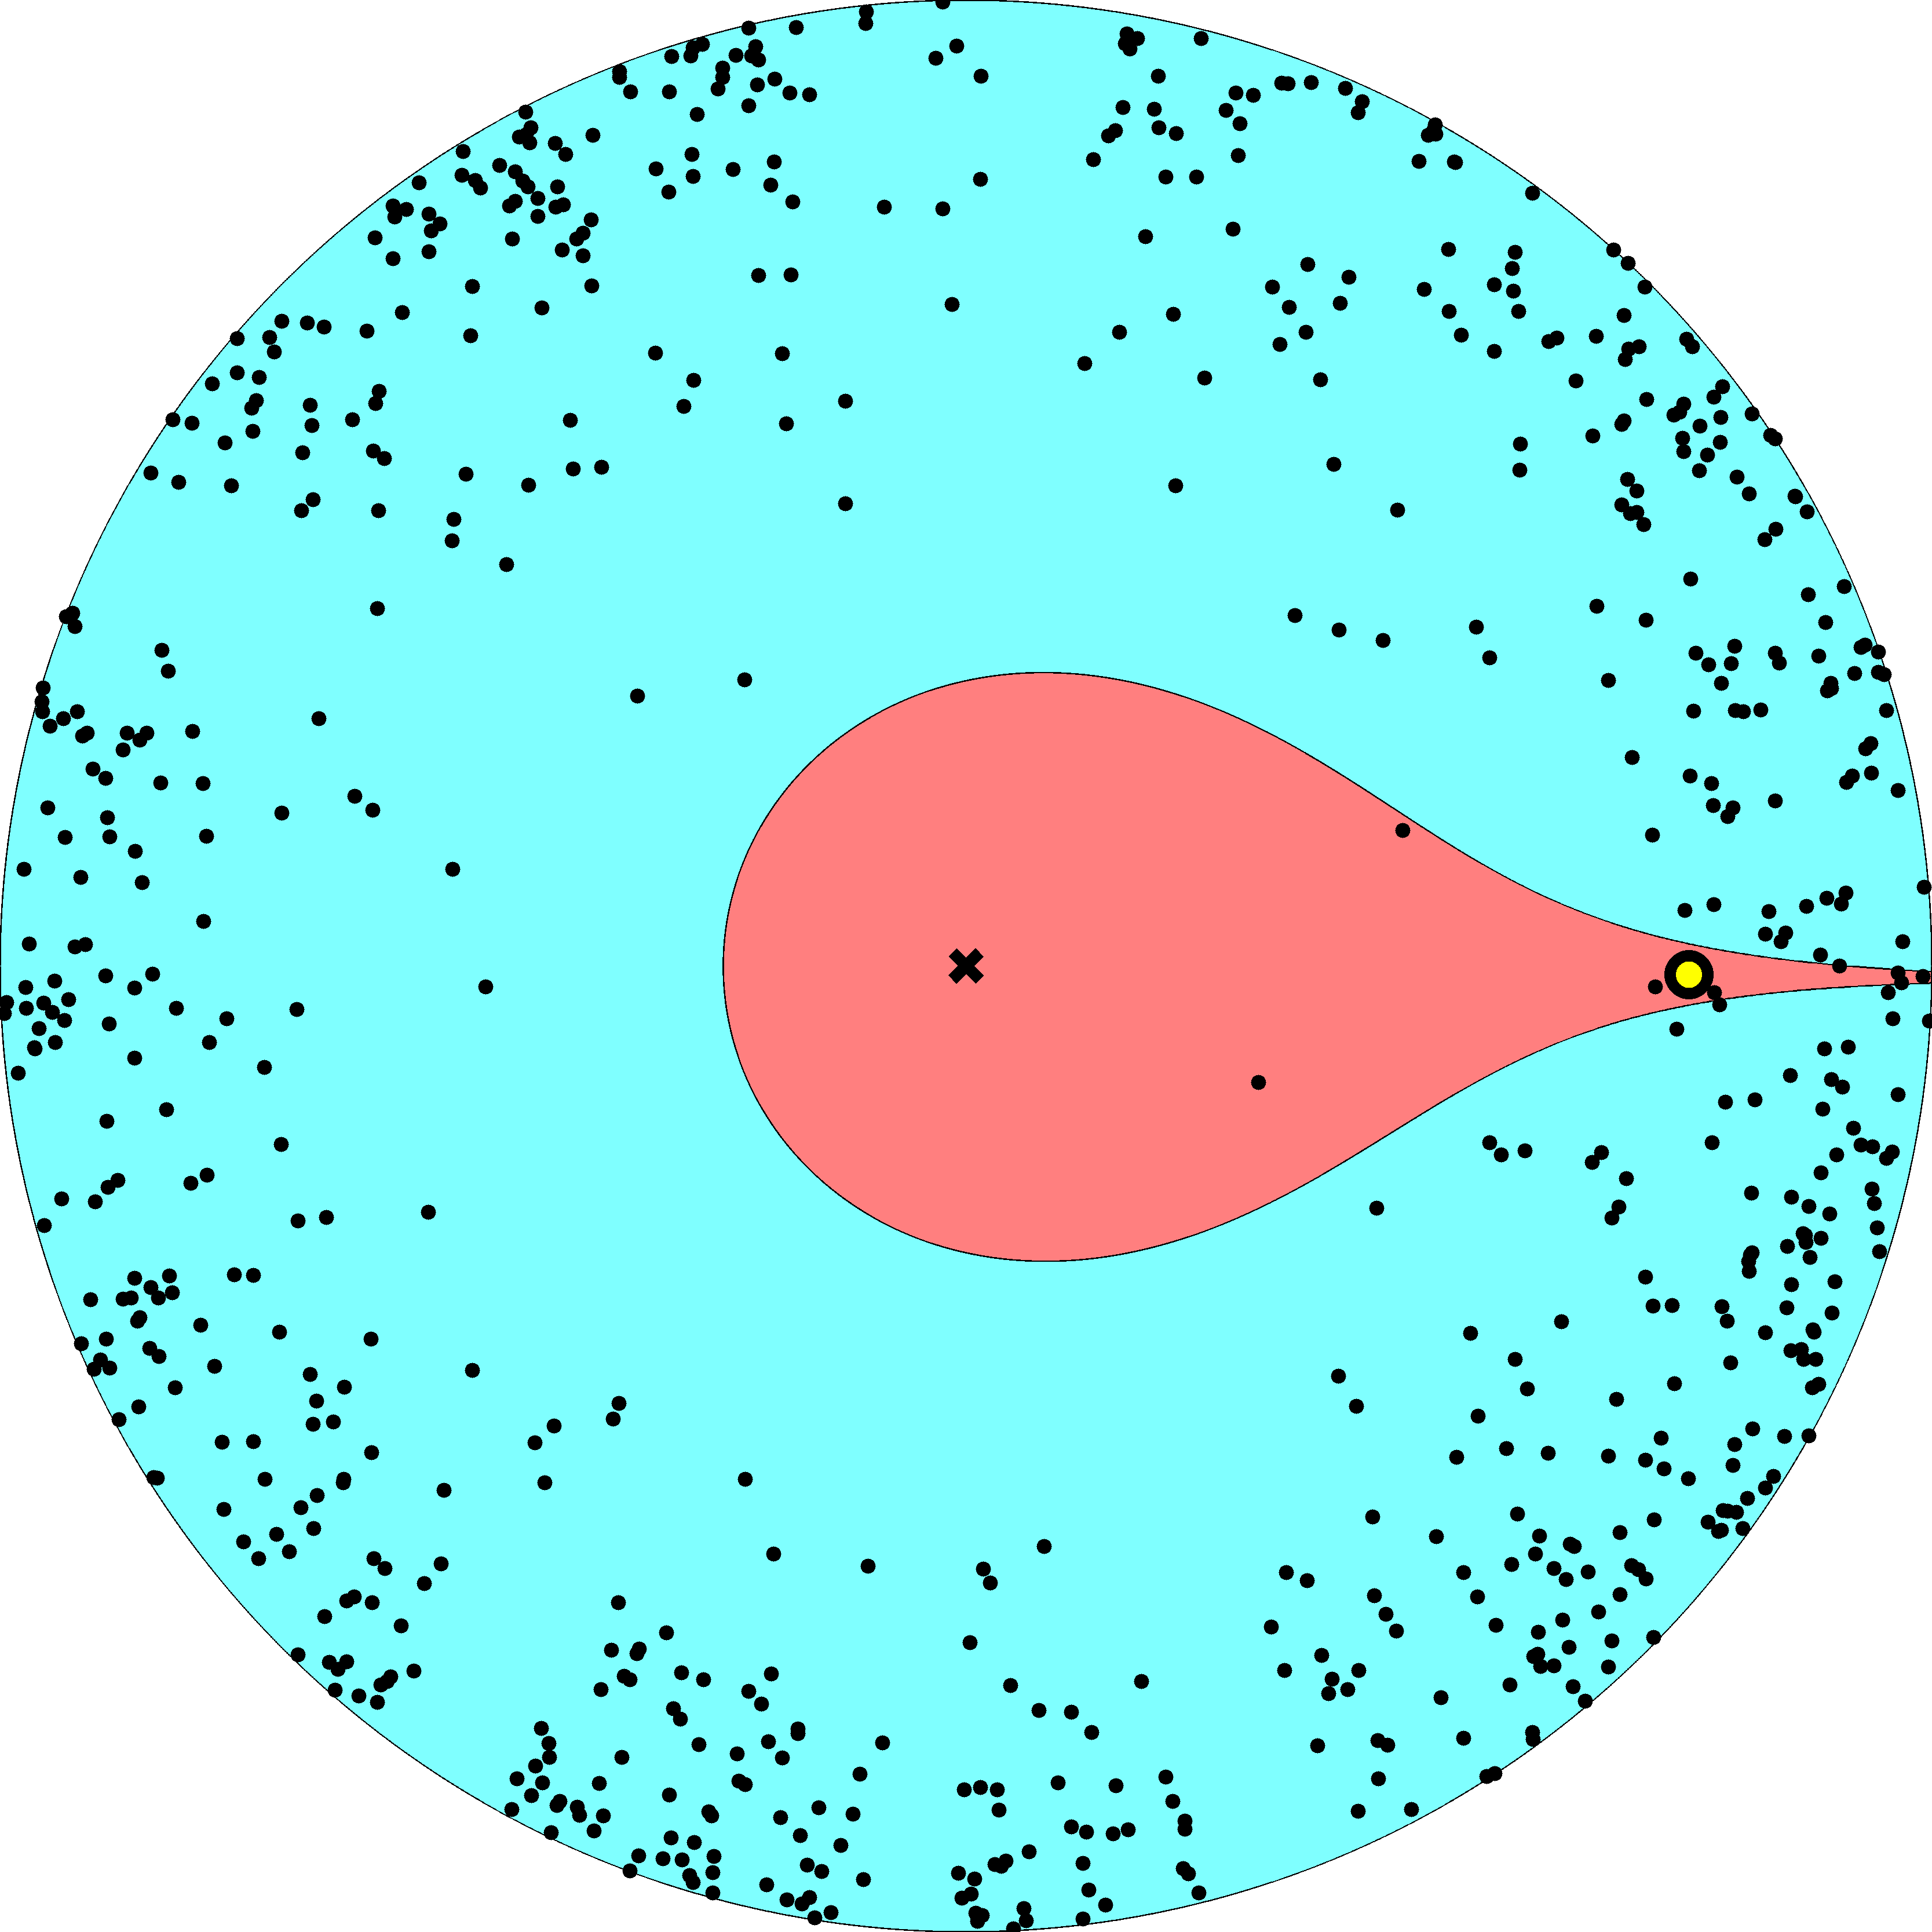

Slide 13
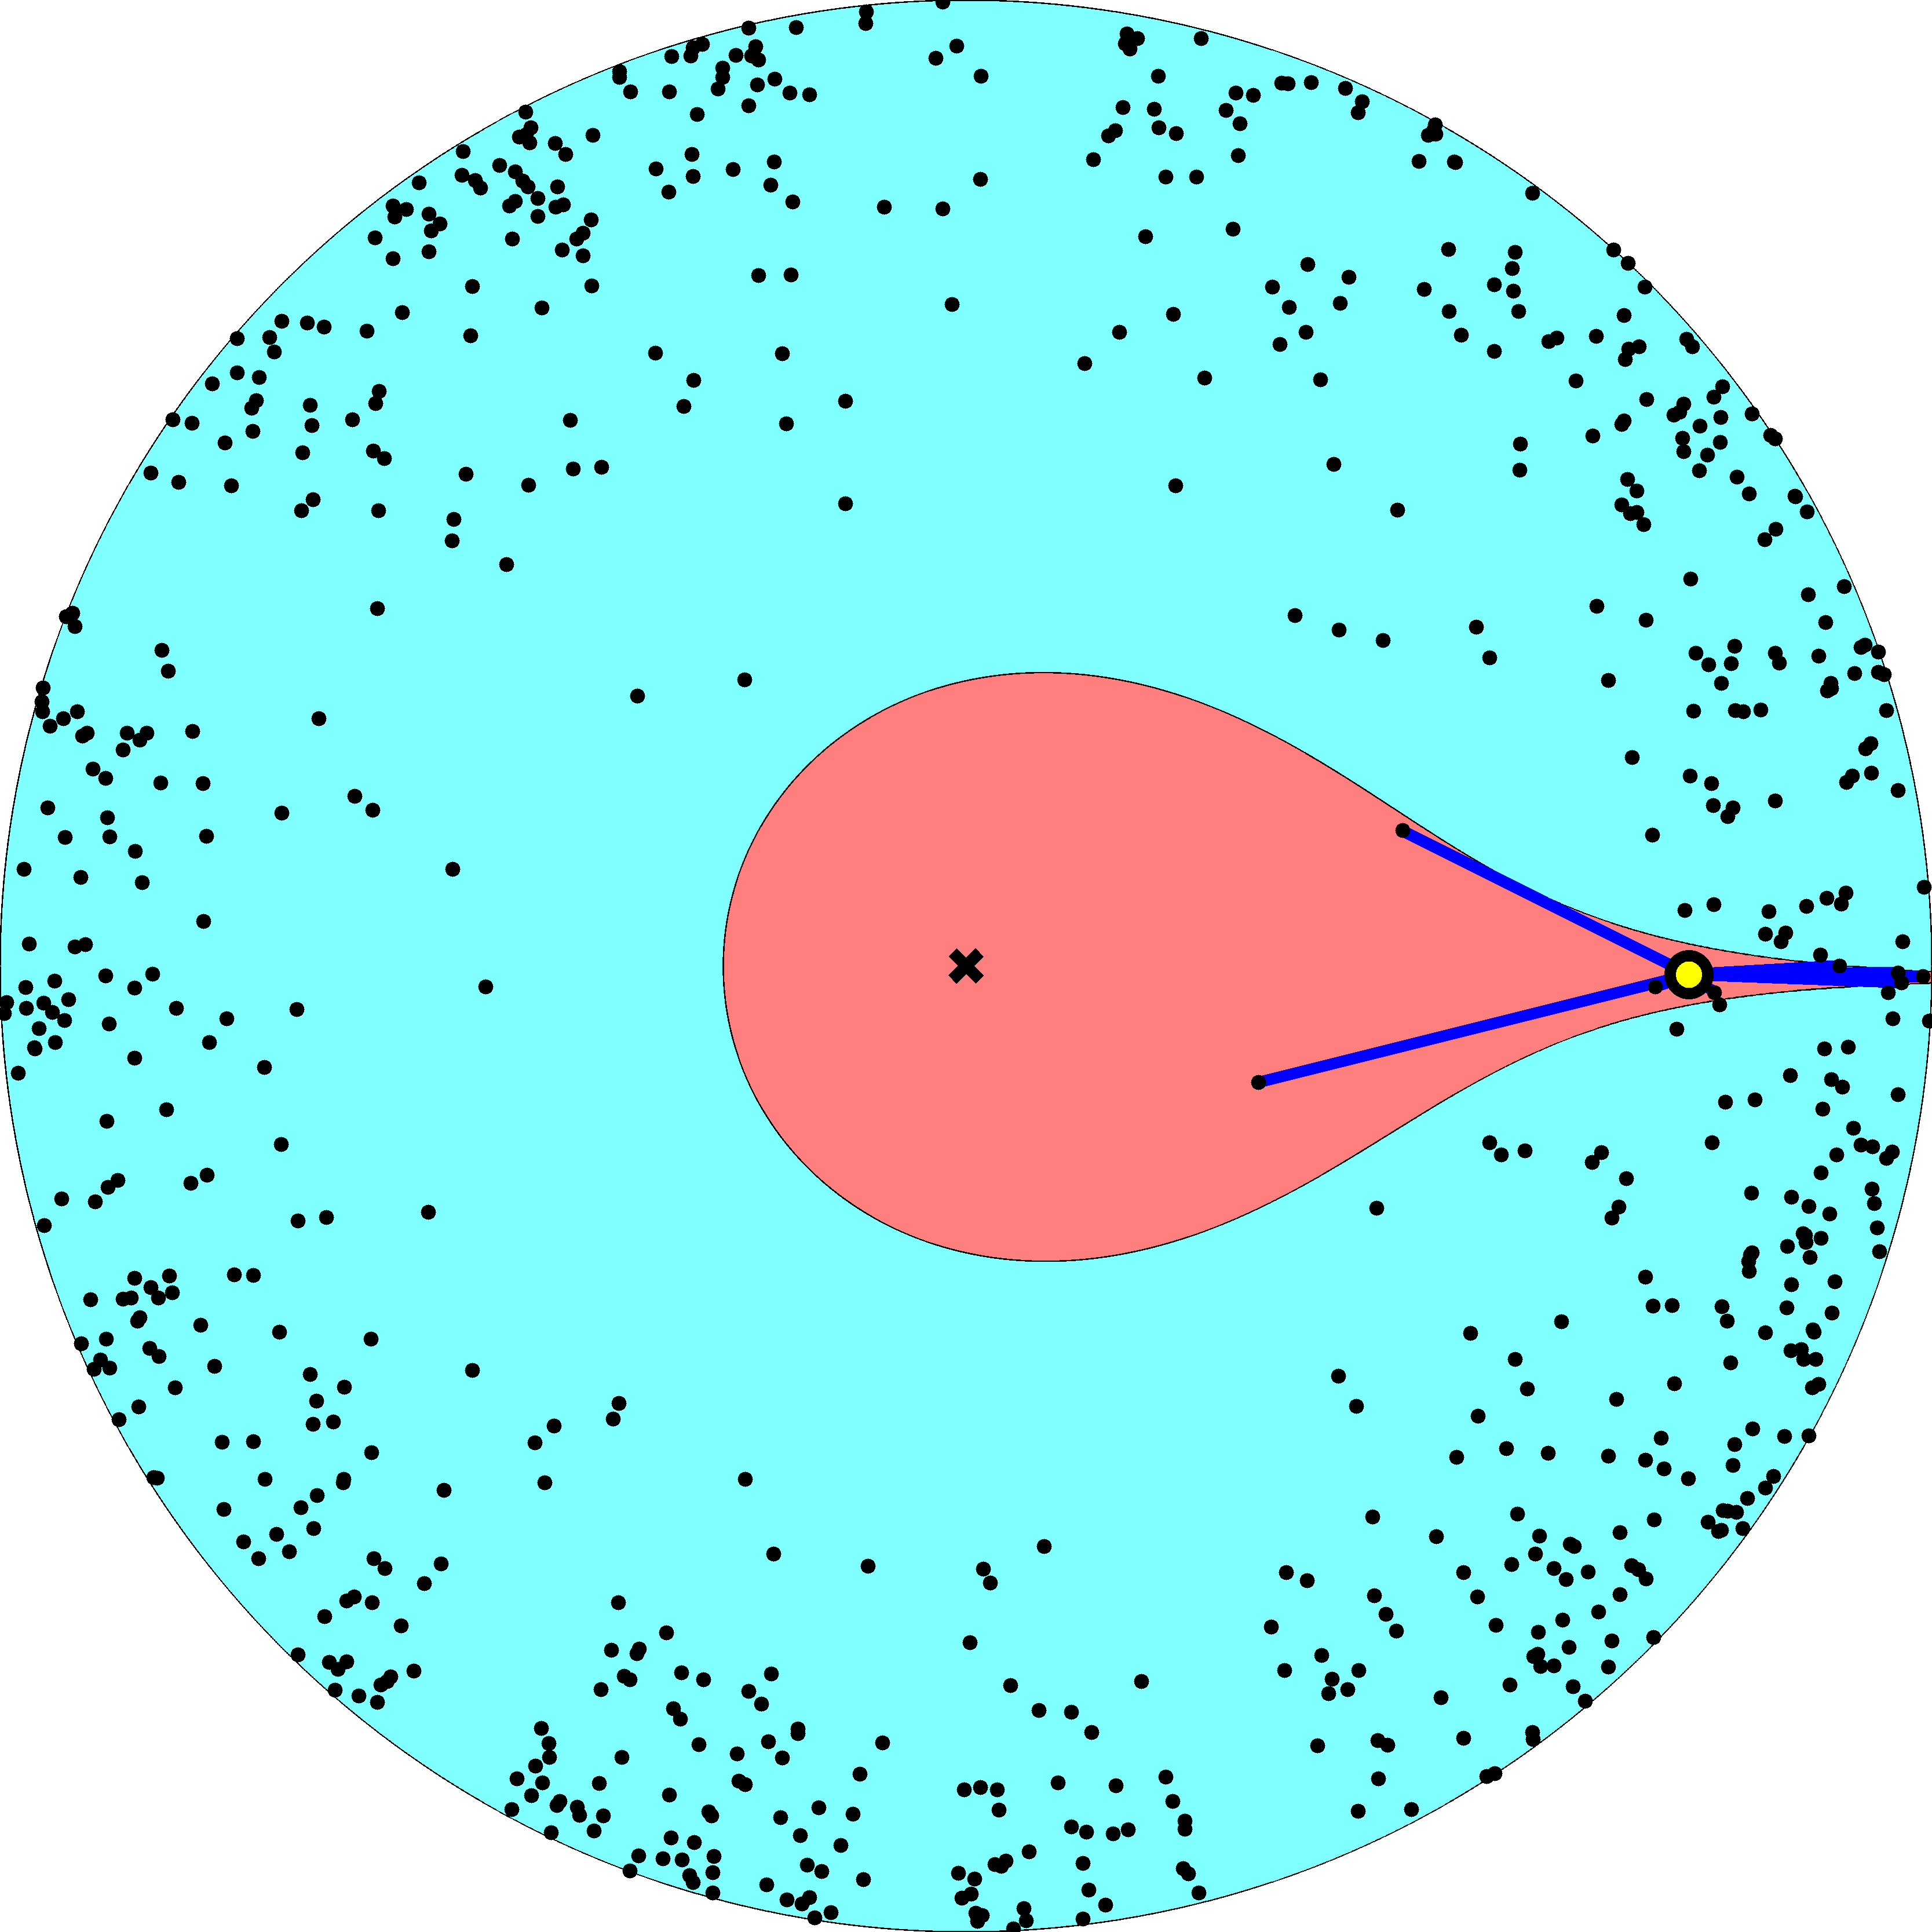

Slide 14
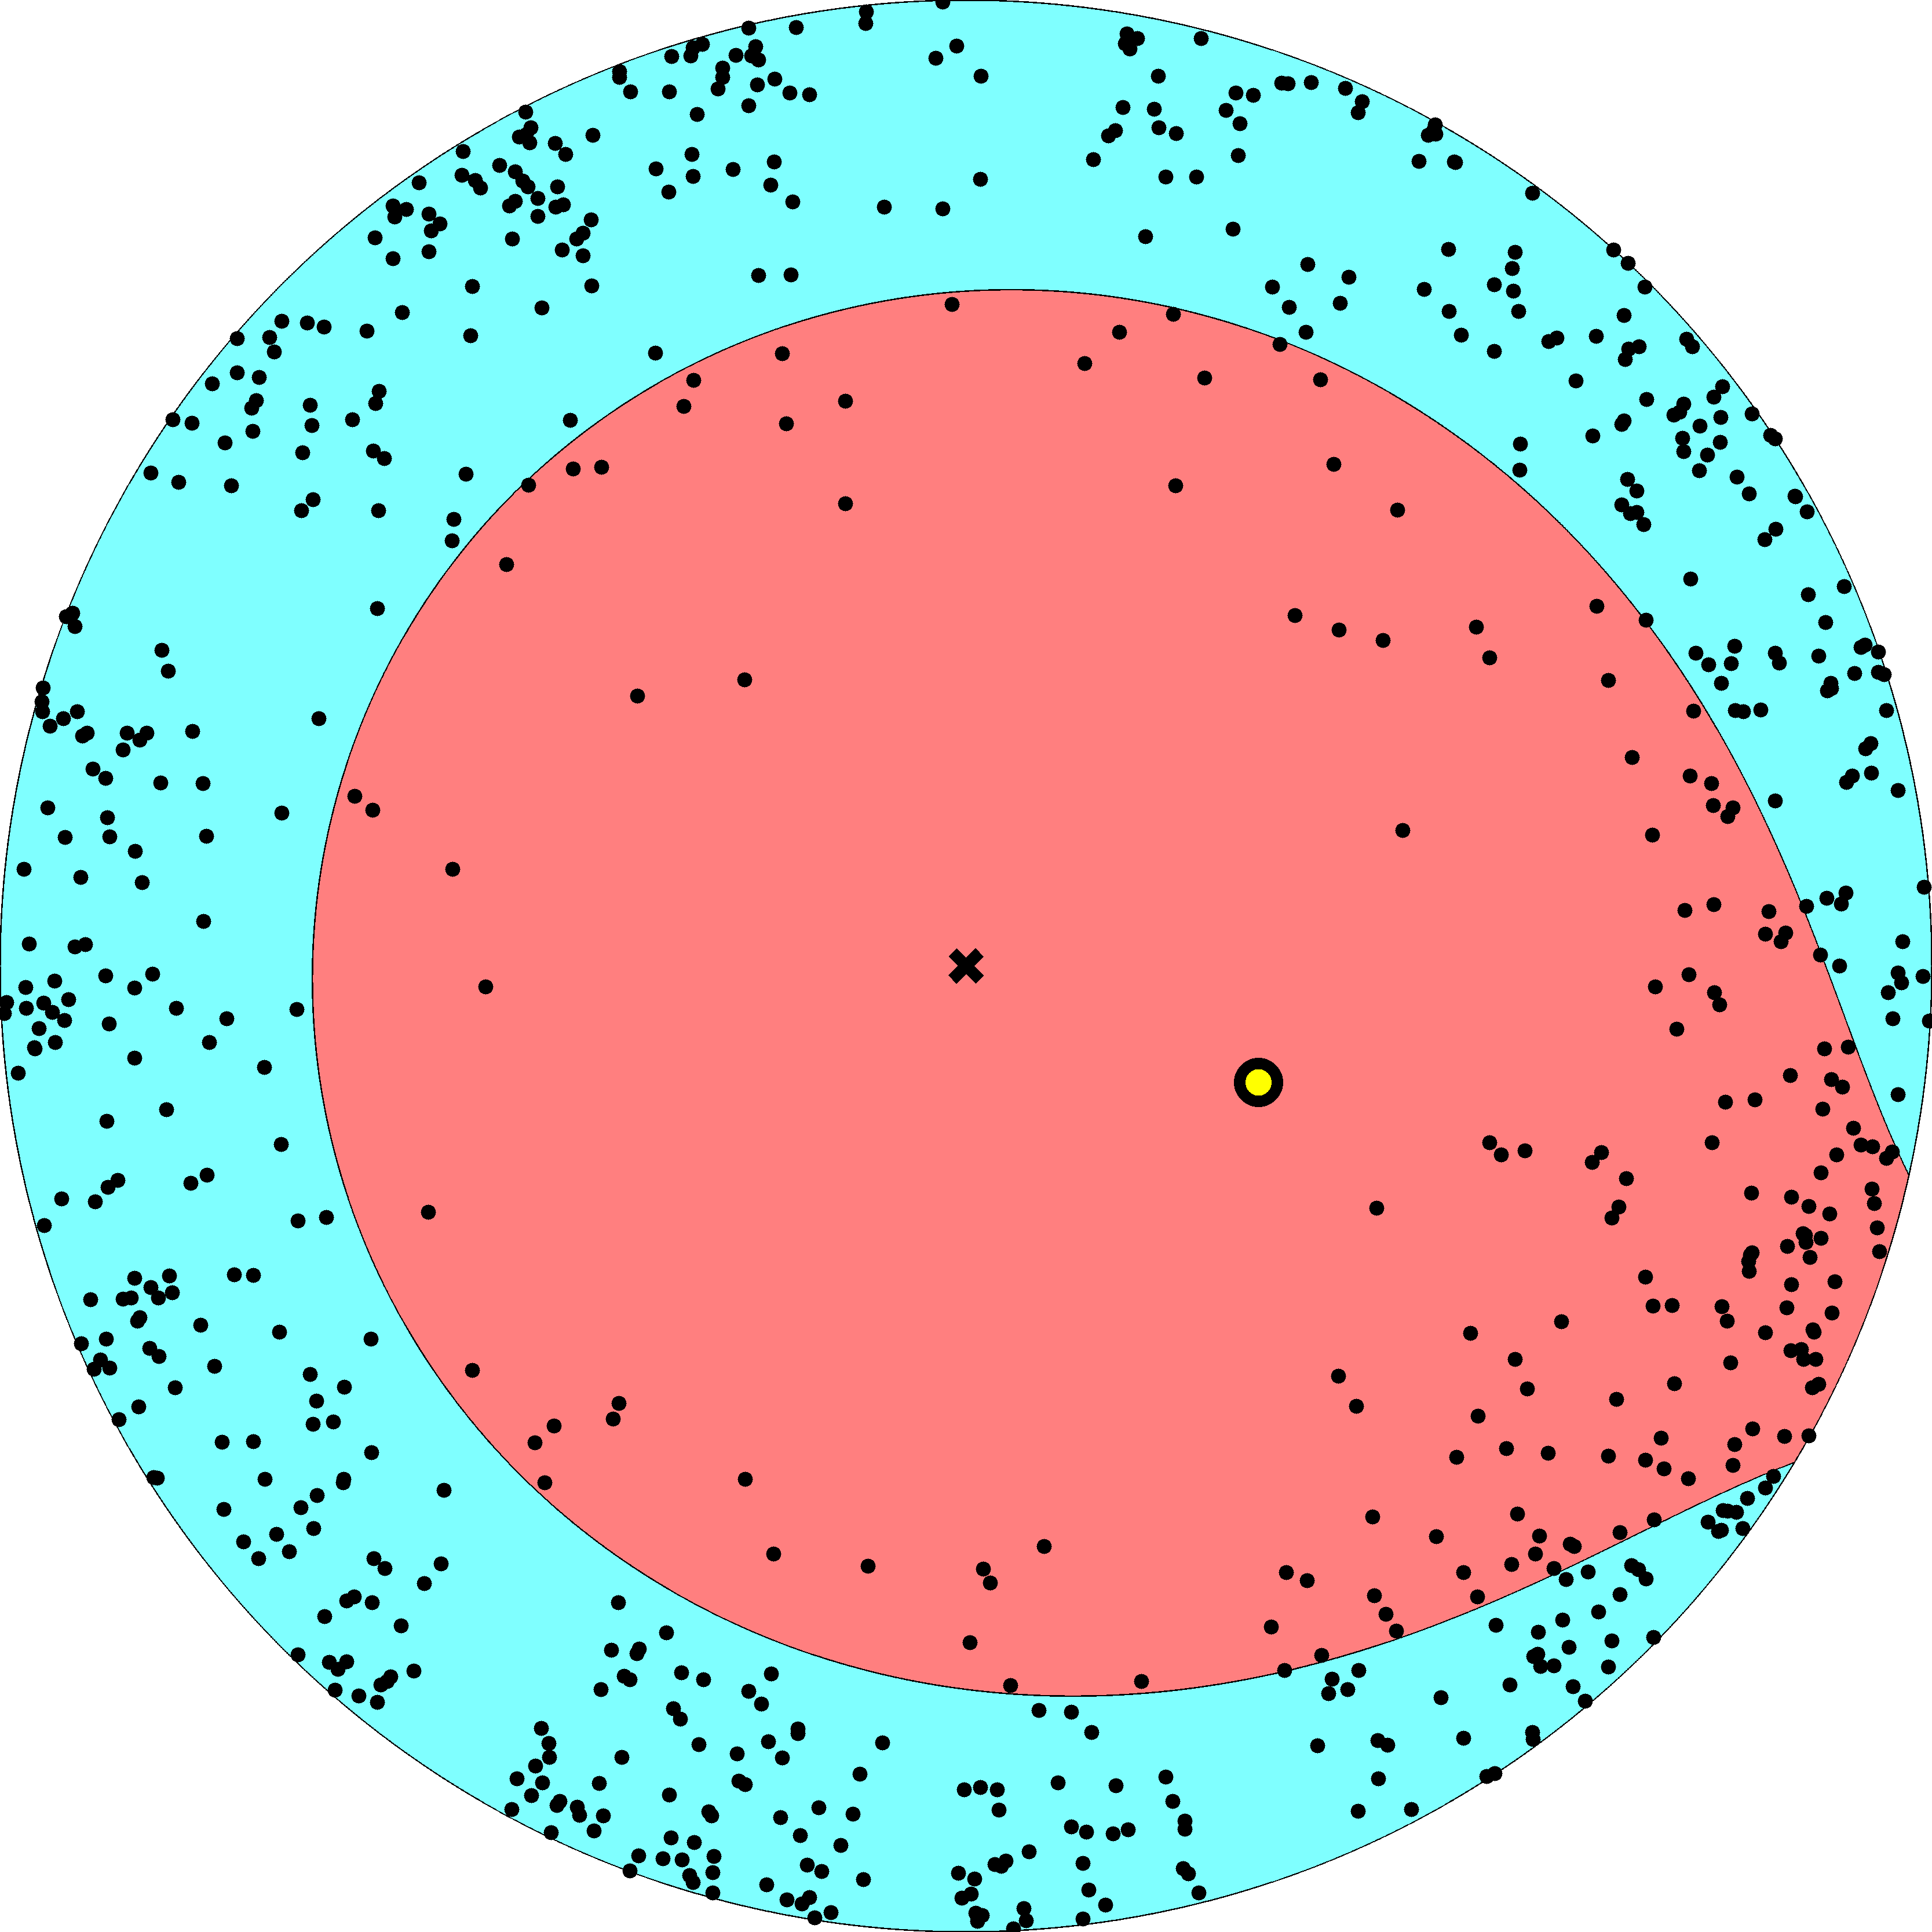

Slide 15
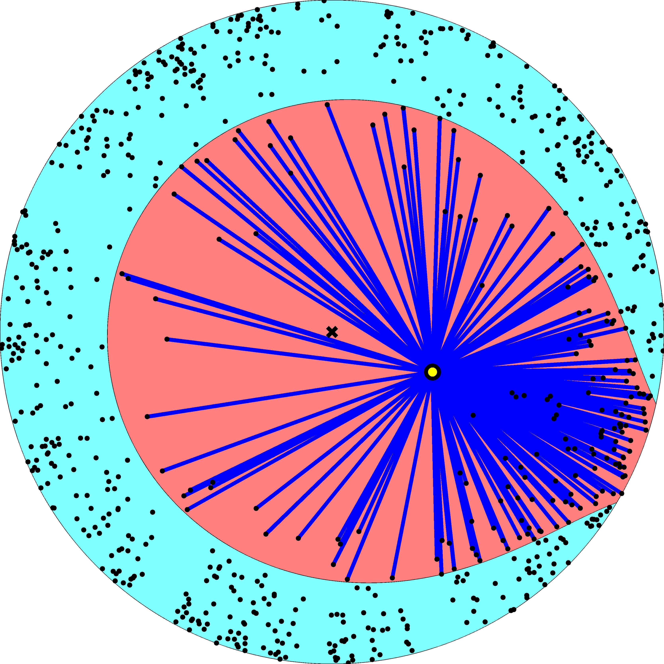

Slide 16
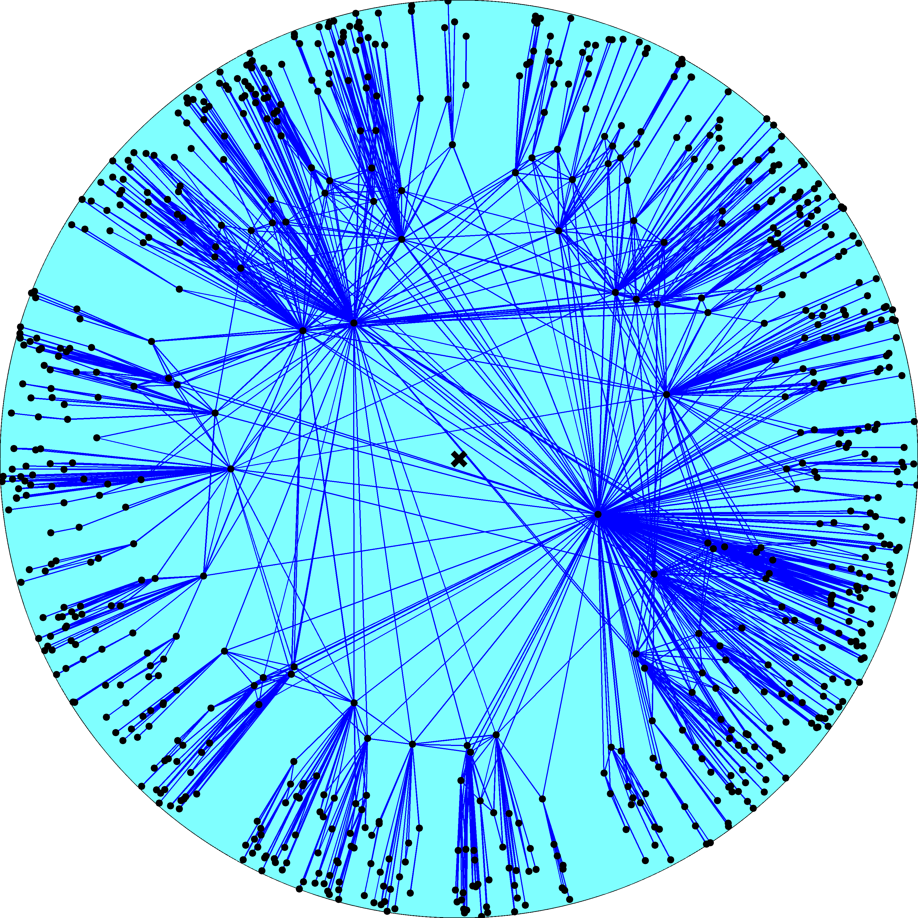
Node density
Node degree
R – disk radius
K – disk curvature
maximized
Degree distribution
Clustering

Slide 17
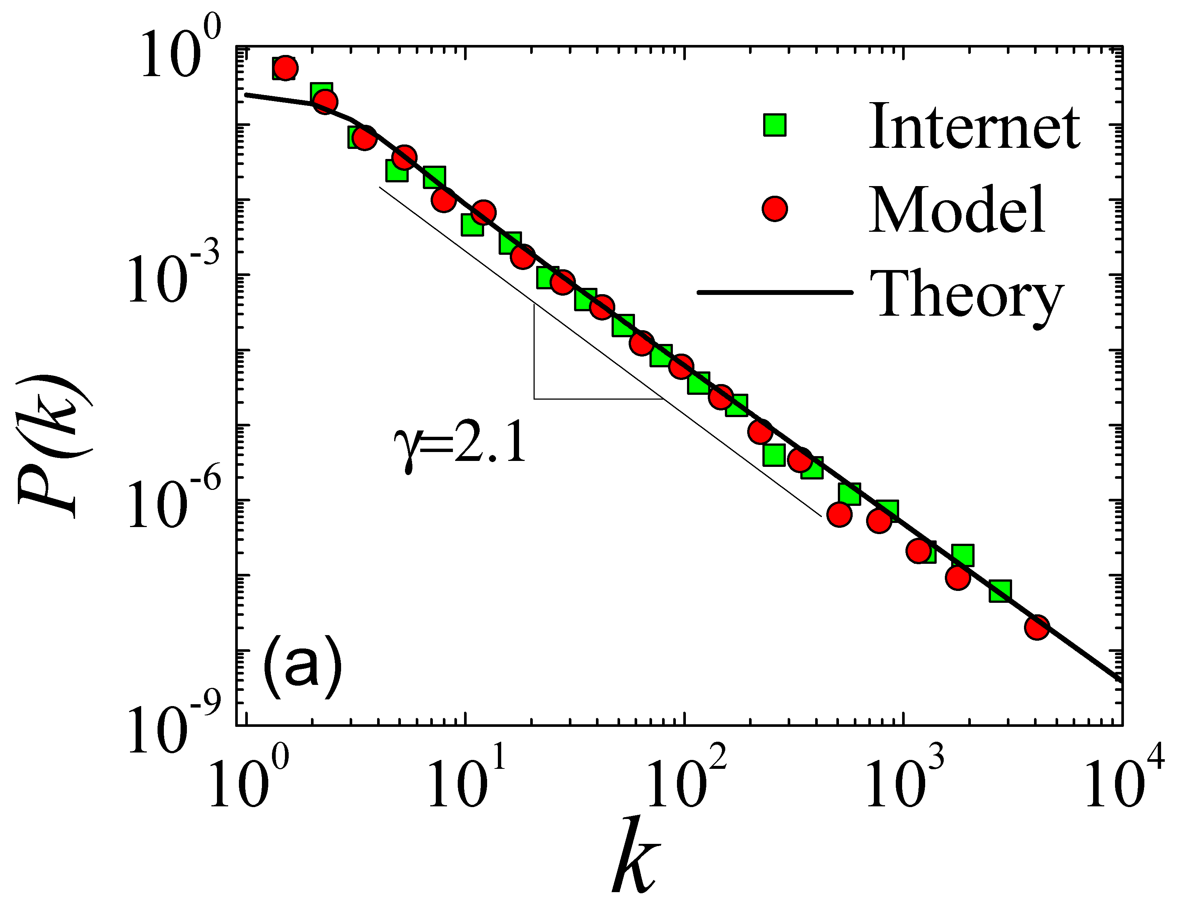

Slide 18
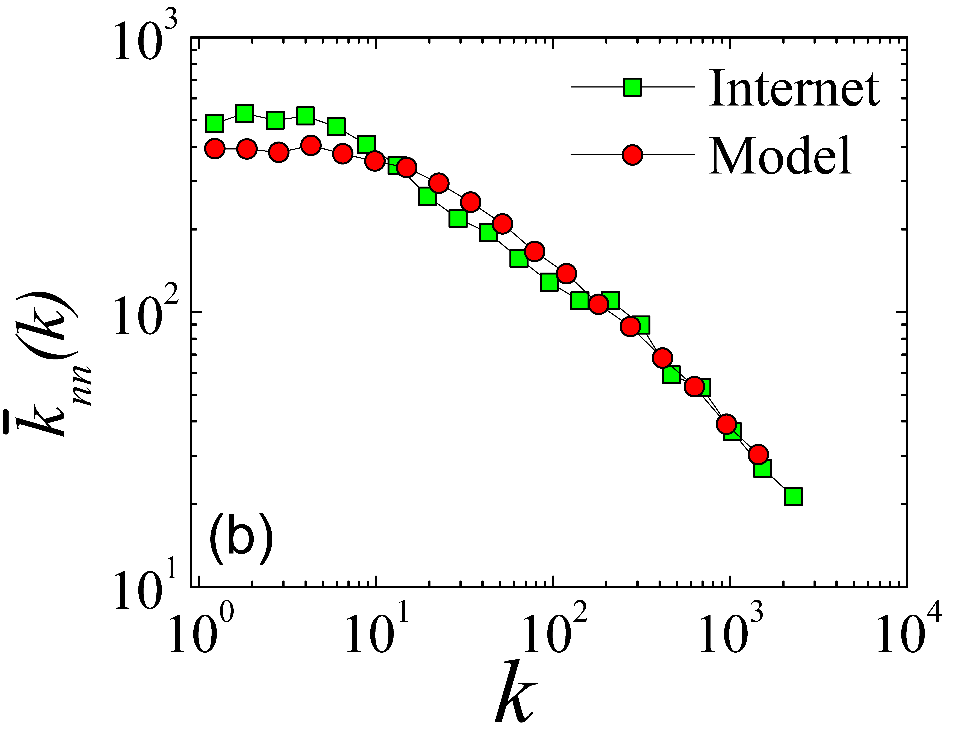

Slide 19
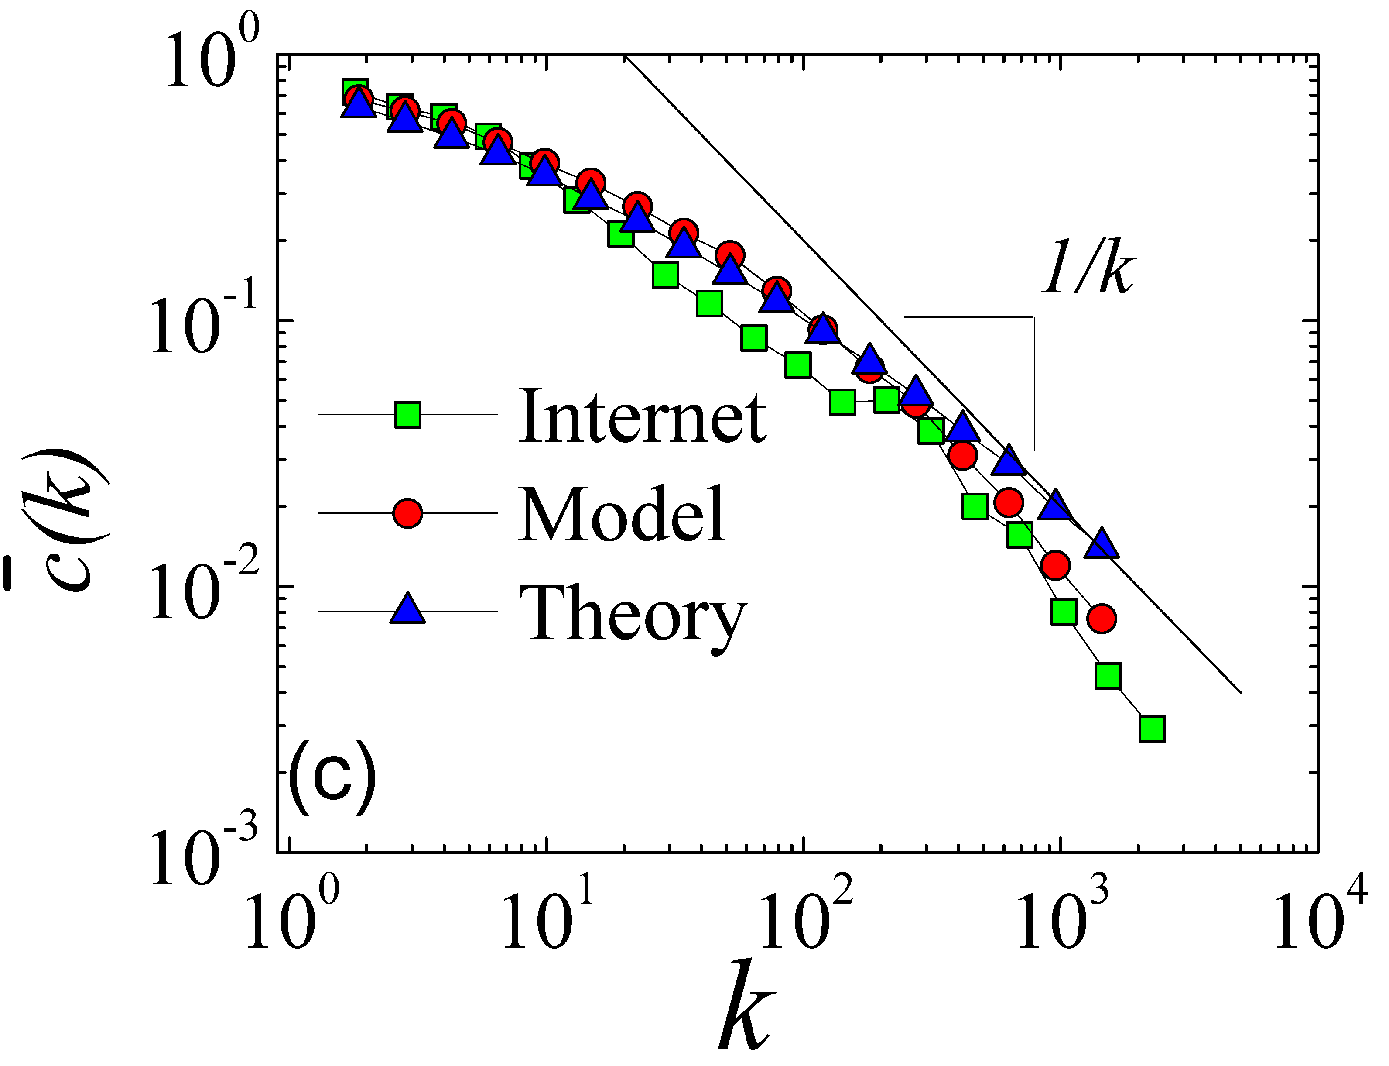

Slide 20
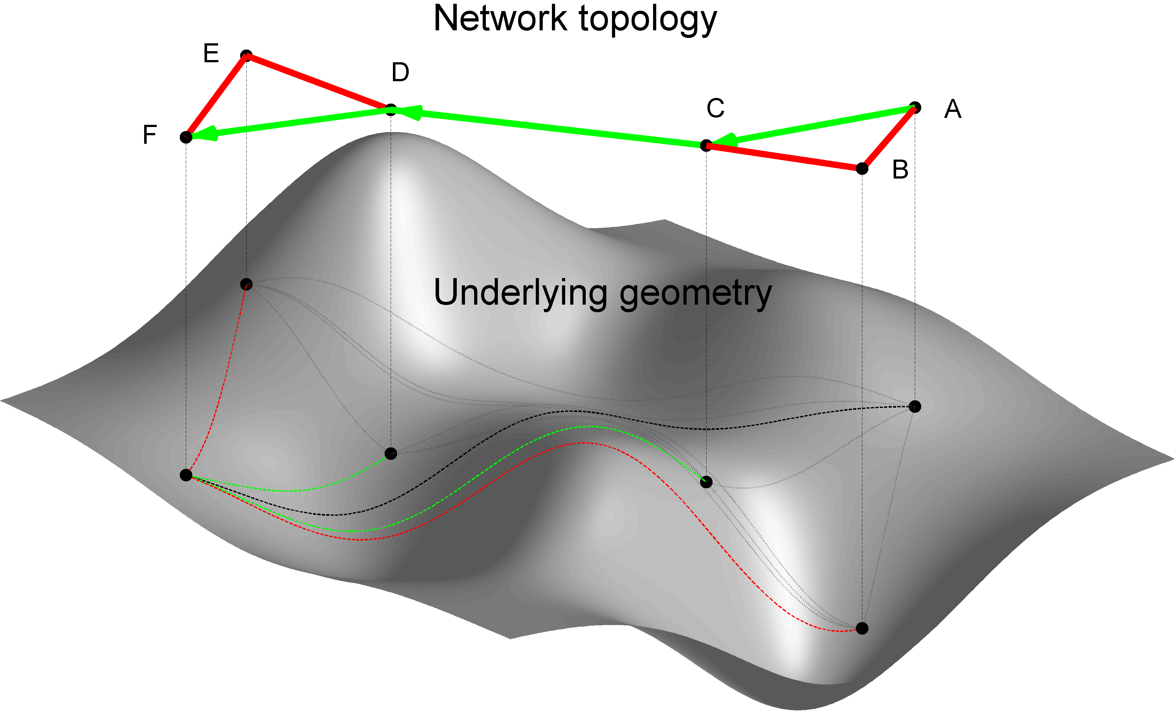
From structure
To function

Slide 23
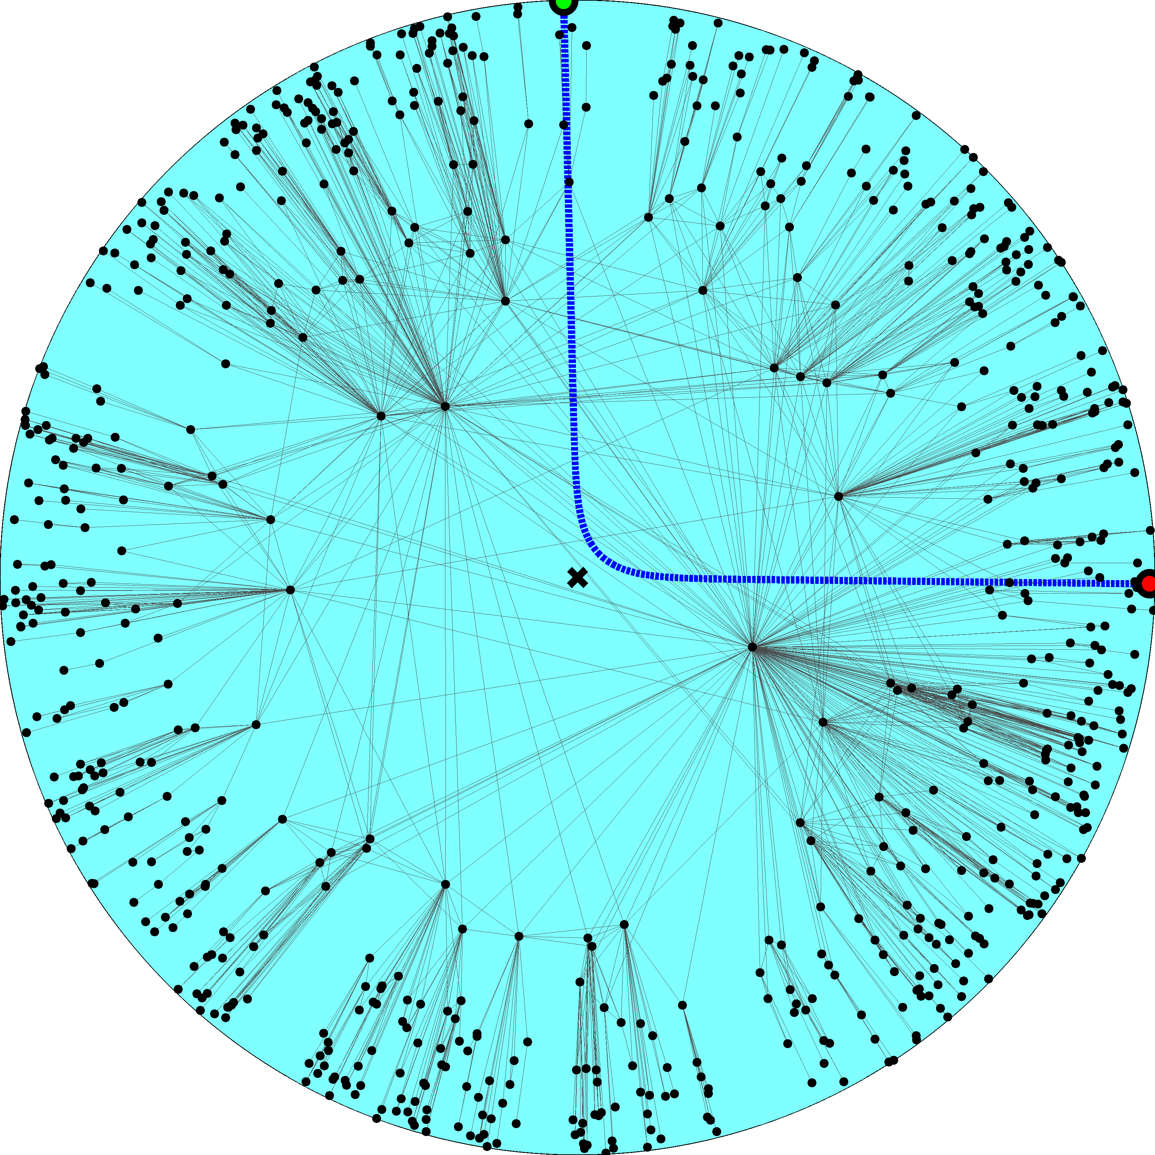

Slide 24
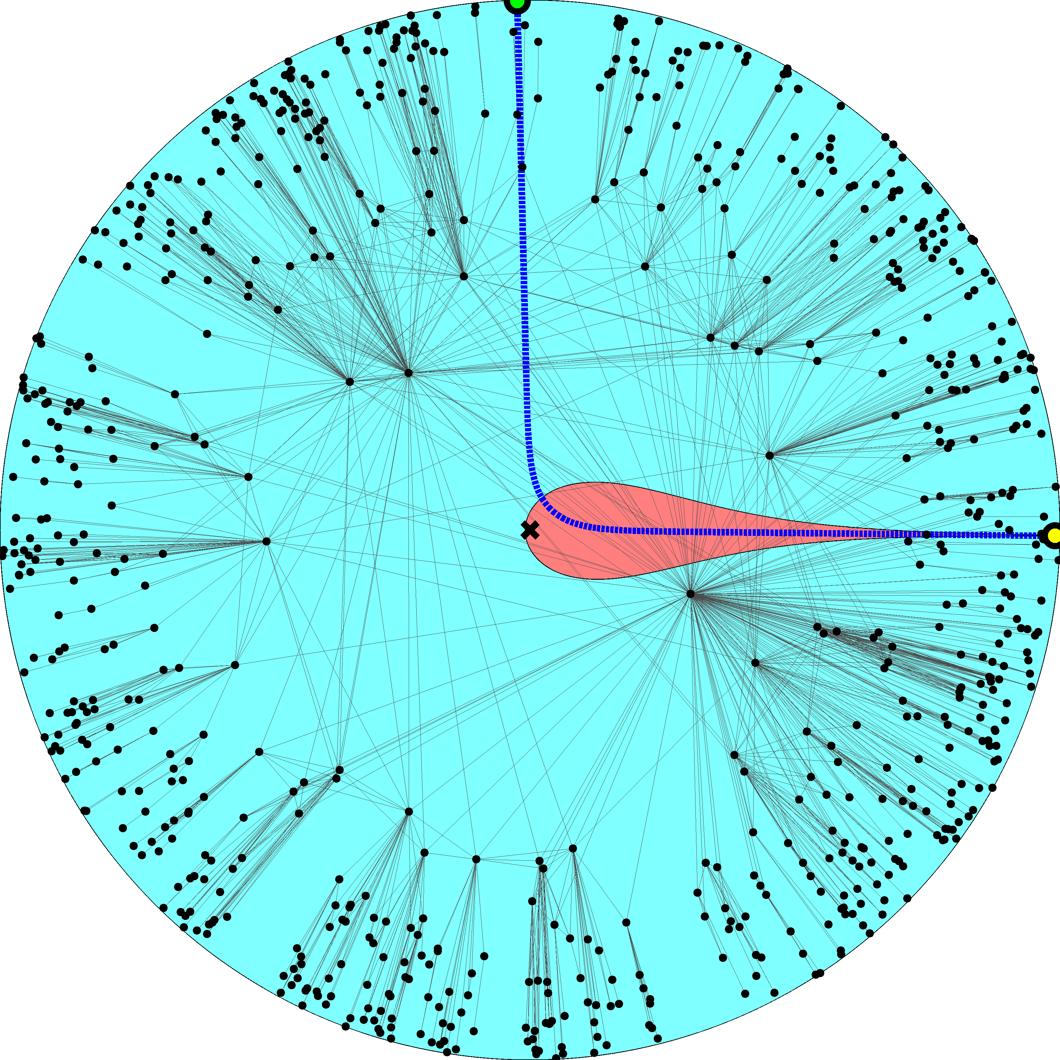

Slide 26
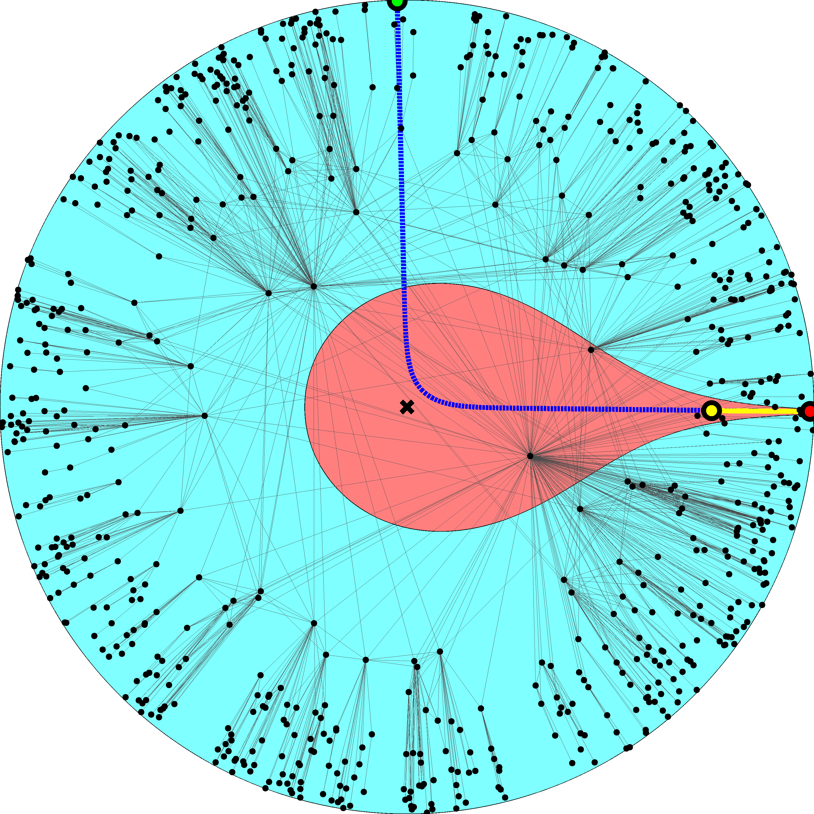

Slide 28
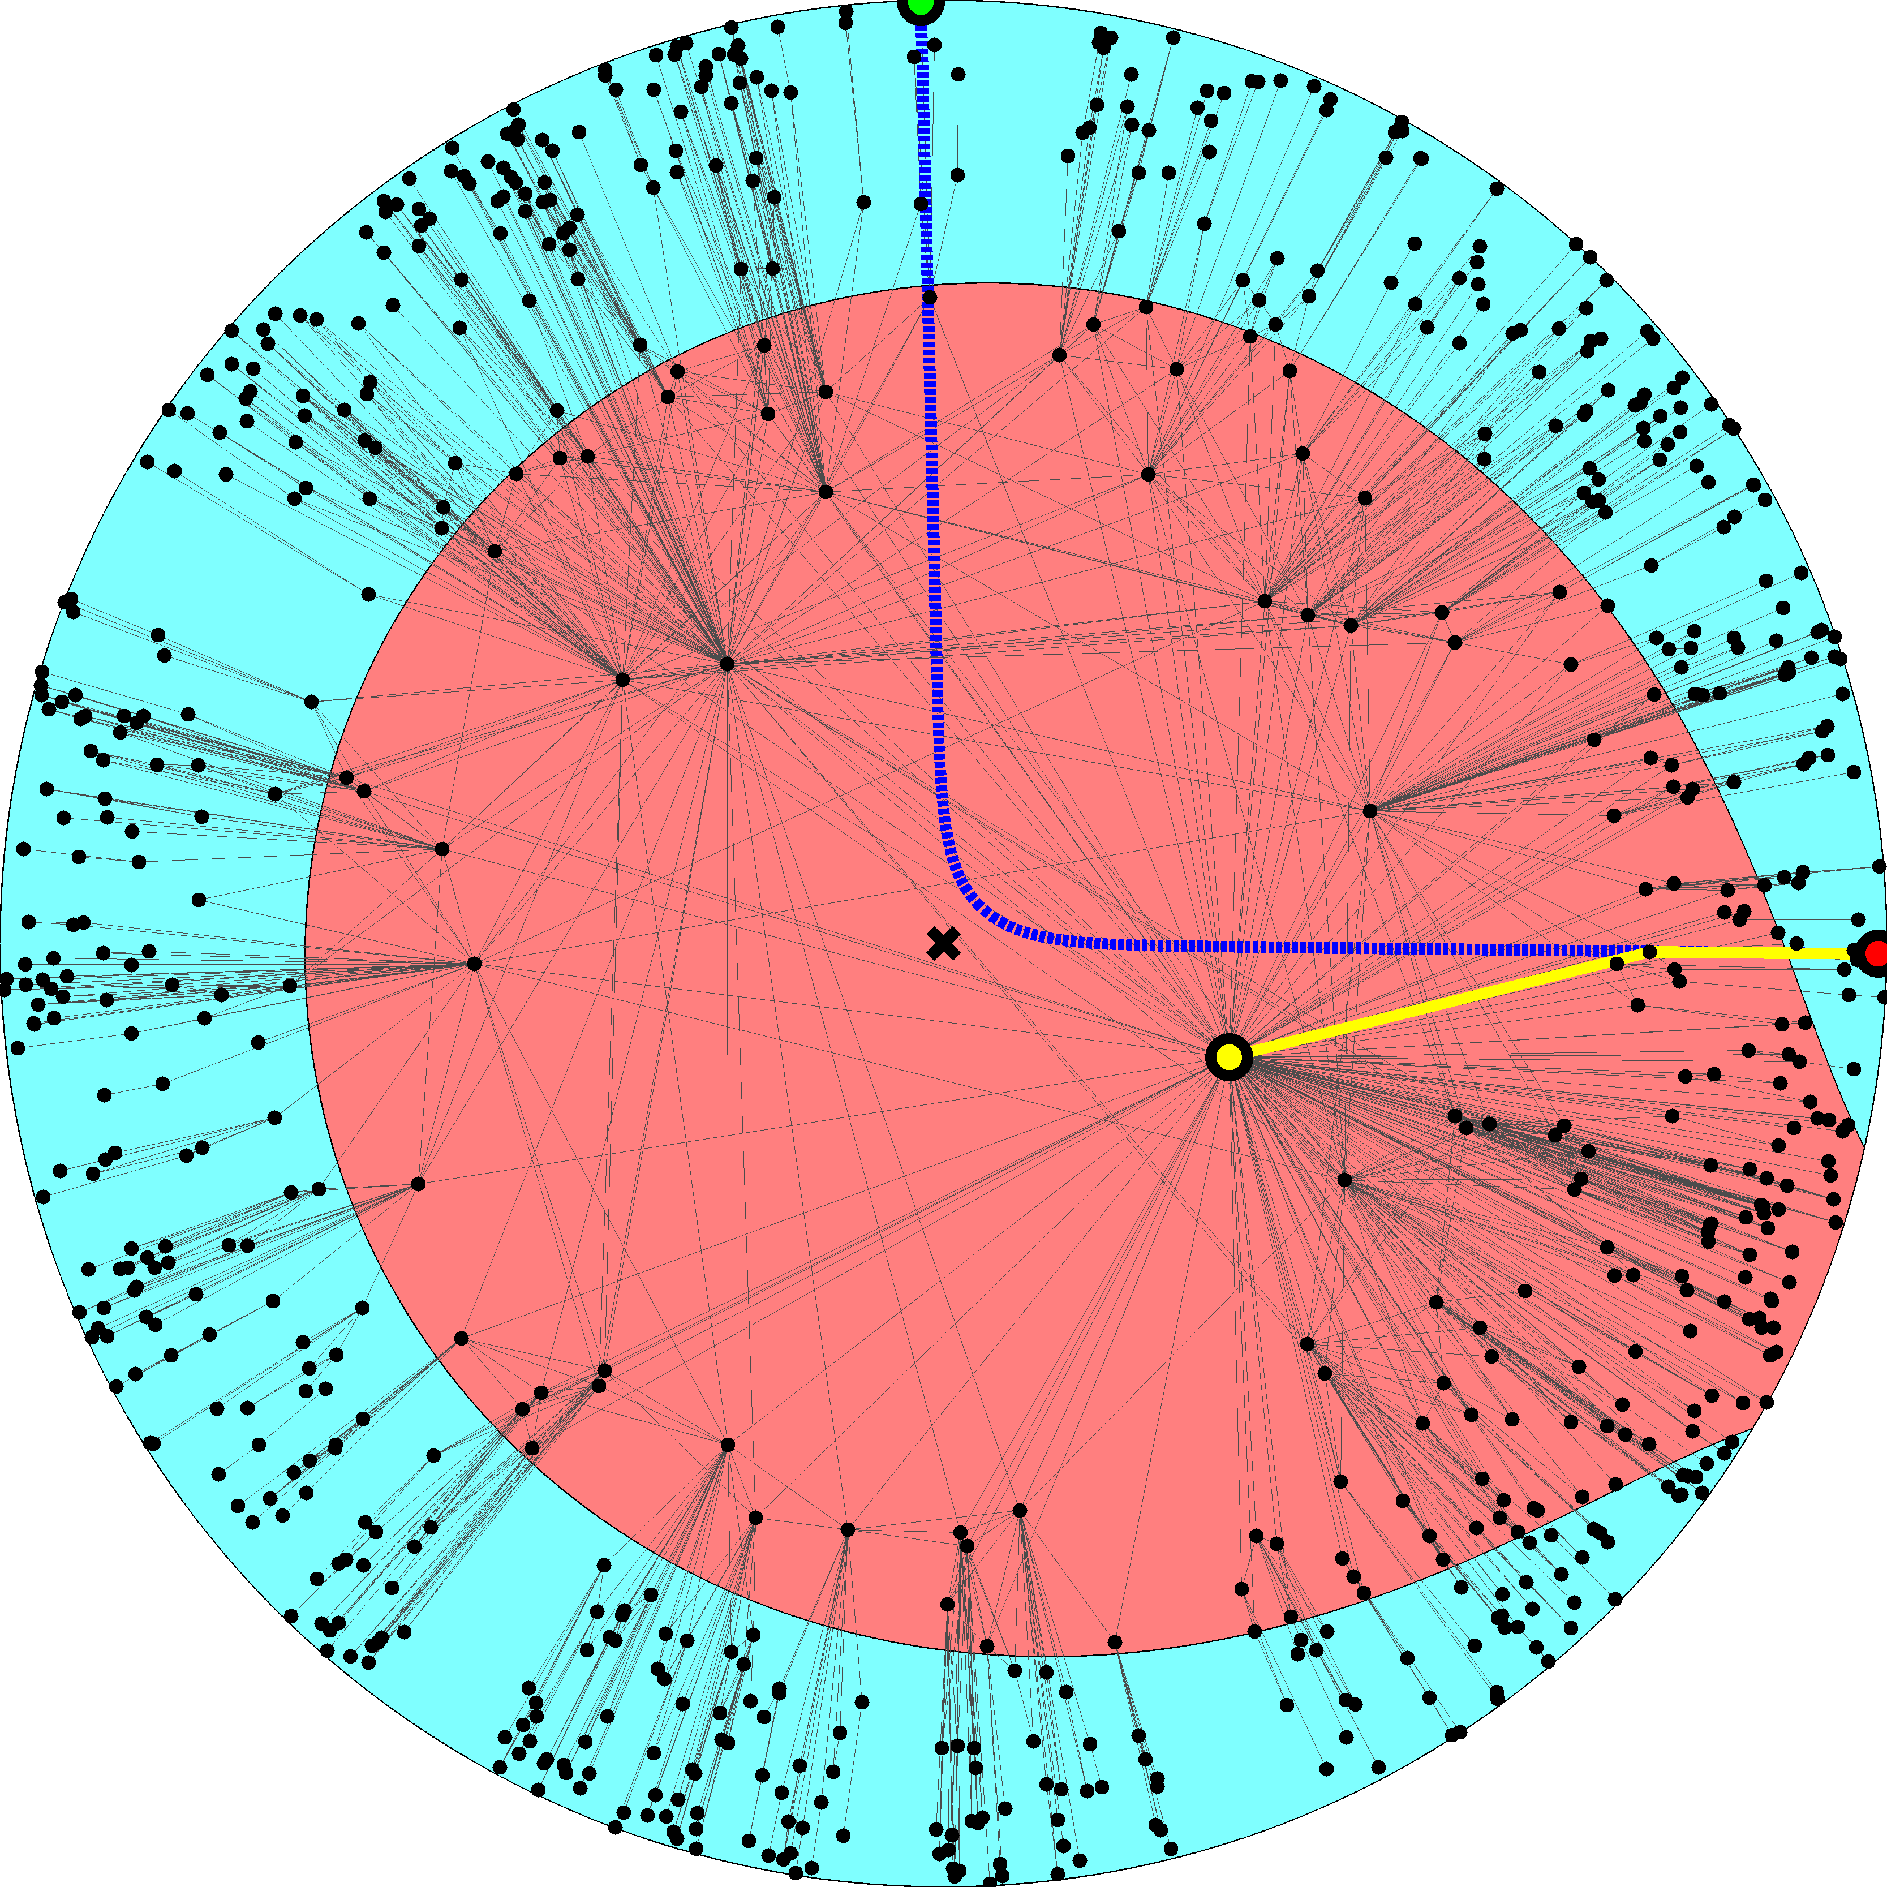

Slide 30
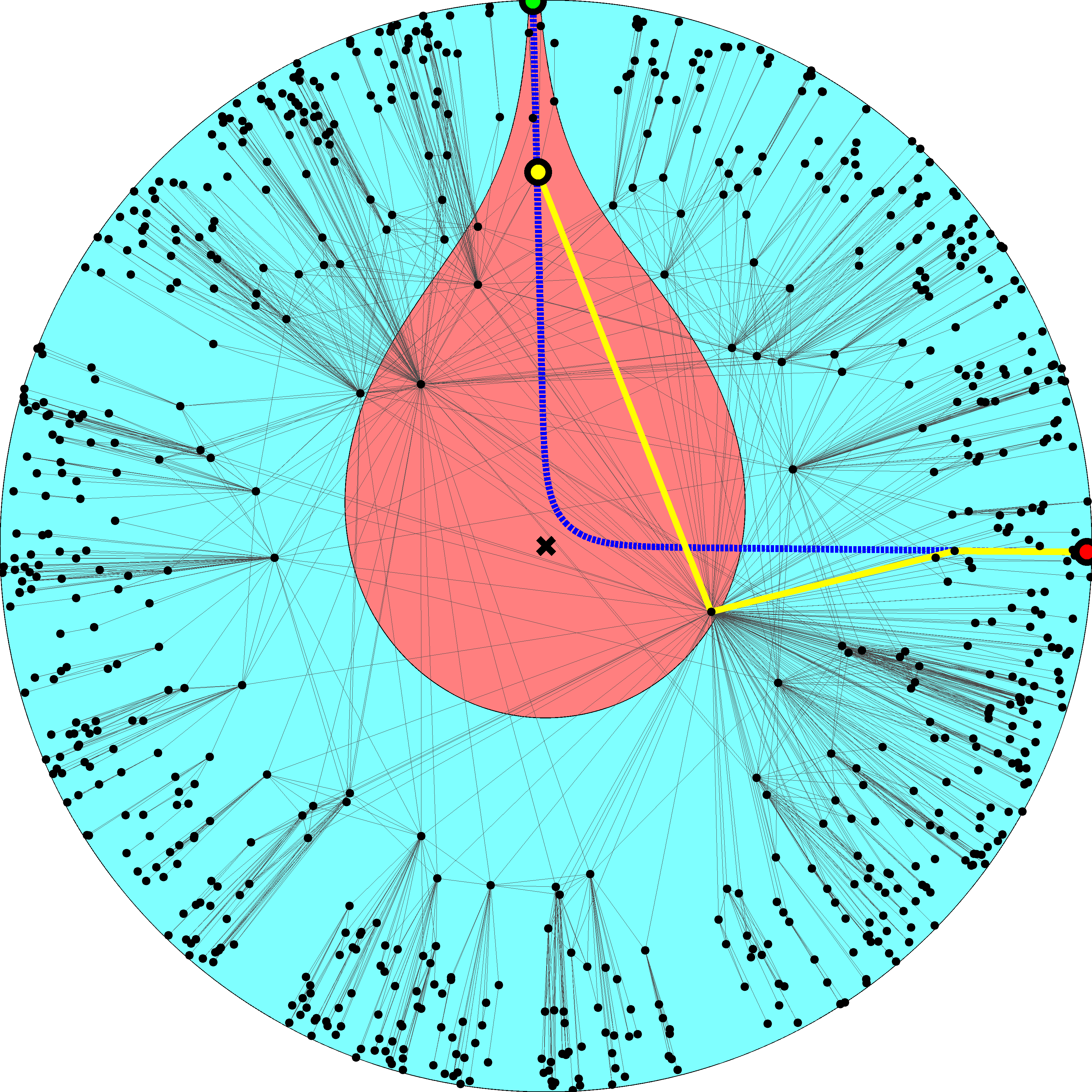

Slide 32
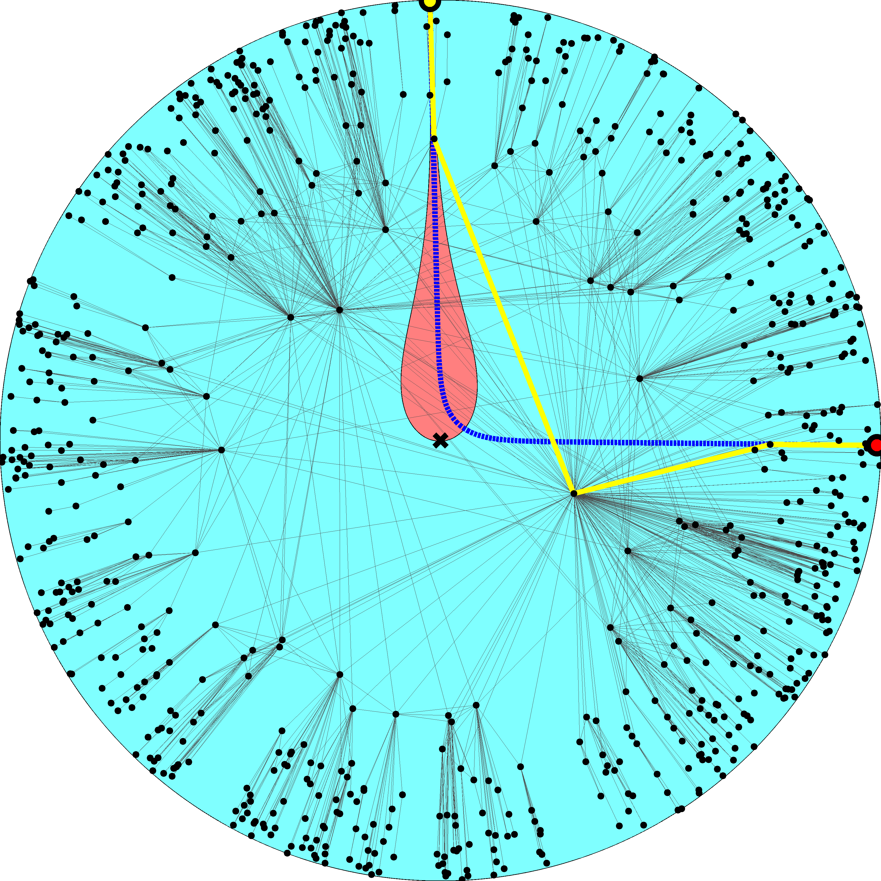

Slide 33
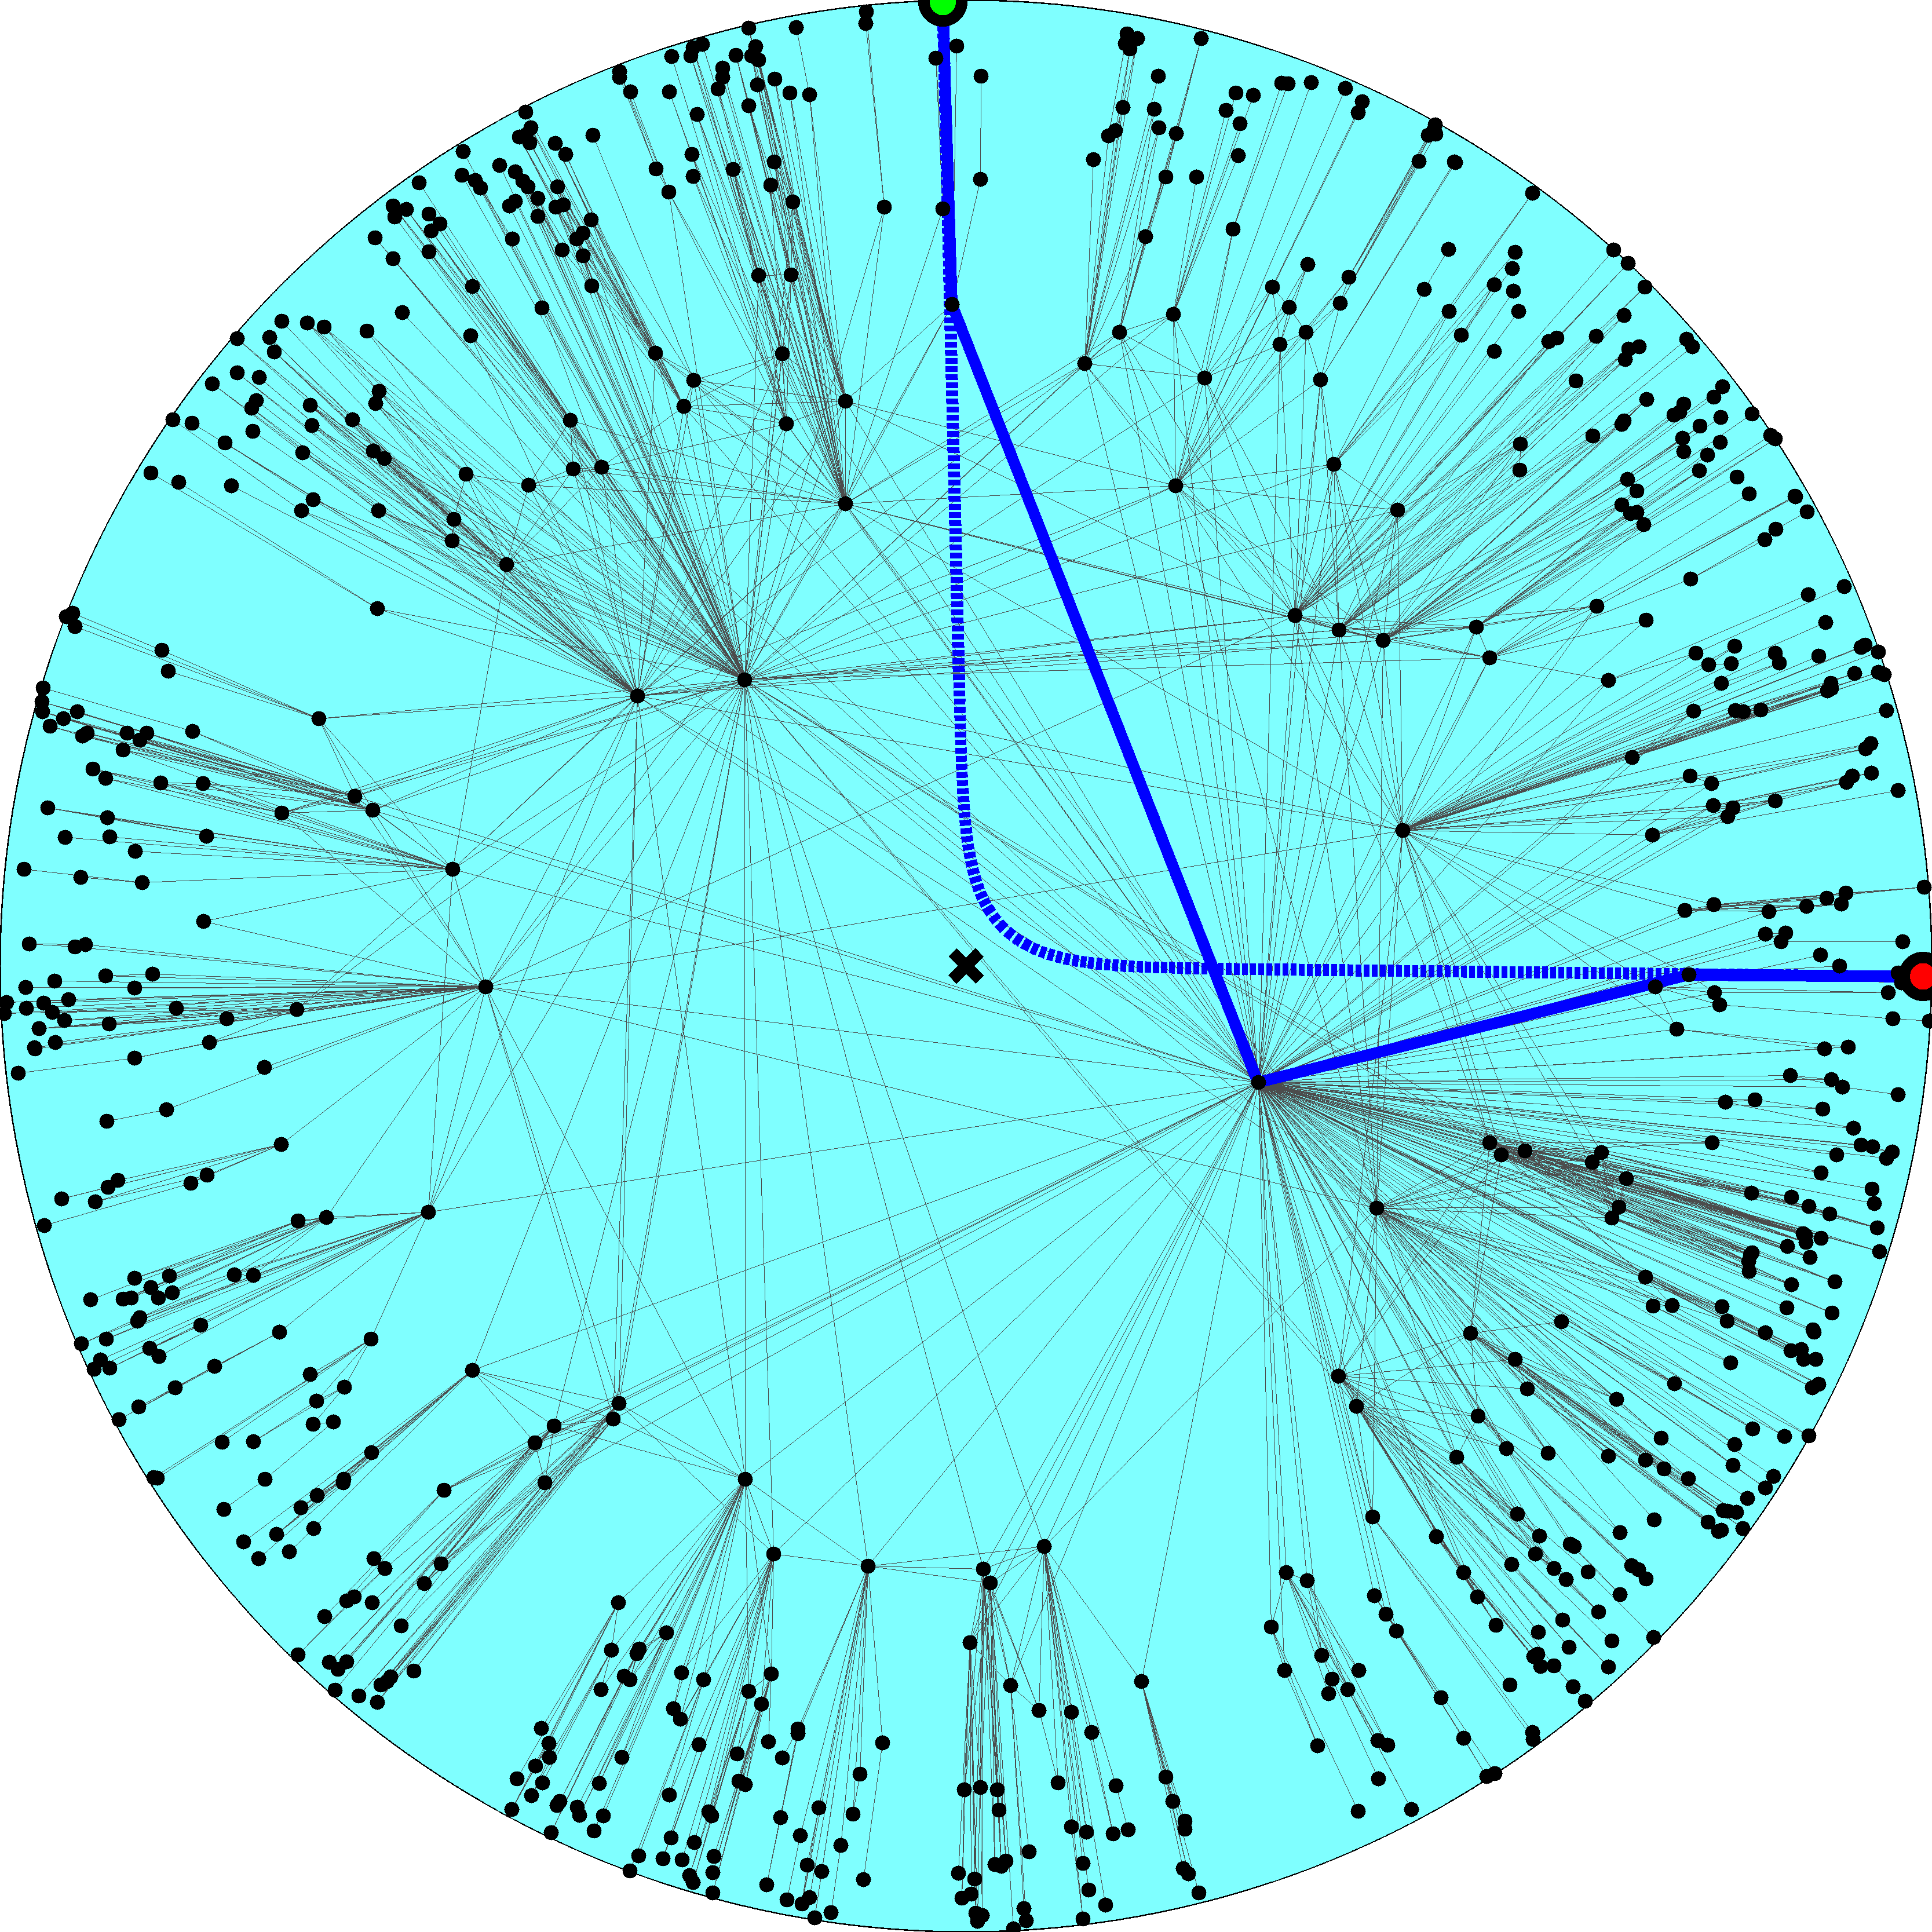

Slide 34
Navigation efficiency and robustness (2.1)
Percentage of successful greedy paths 99.99%
Percentage of shortest greedy paths 100%
Percentage of successful greedy paths after removal of x% of links or nodes
x10%  99%
x30%  95%

Slide 35
Success ratio in random graphs
Configuration model (2.1) 30%
No angular coordinates; node degree gradient only
Classical random graphs 0.17%
No radial coordinates; the connection probability does not depend on any distances at all

Slide 36
Mapping the real Internet using statistical inference methods
Measure the Internet topology properties
N, ↑k, , c
Map them to model parameters
R, , , T
Place nodes at hyperbolic coordinates (r,)
k ~ e^{(Rr)/2}
’s are uniformly distributed on [0,2]
Apply the Metropolis-Hastings algorithm to find ’s maximizing the likelihood that Internet is produced by the model

Slide 37
Metropolis-Hastings
Compute current likelihood L_{c}
Select a random node
Move it to a new random angular coordinate
Compute new likelihood L_{n}
If L_{n} > L_{c}, accept the move
If not, accept it with probability L_{n} / L_{c}
Repeat

Slide 38
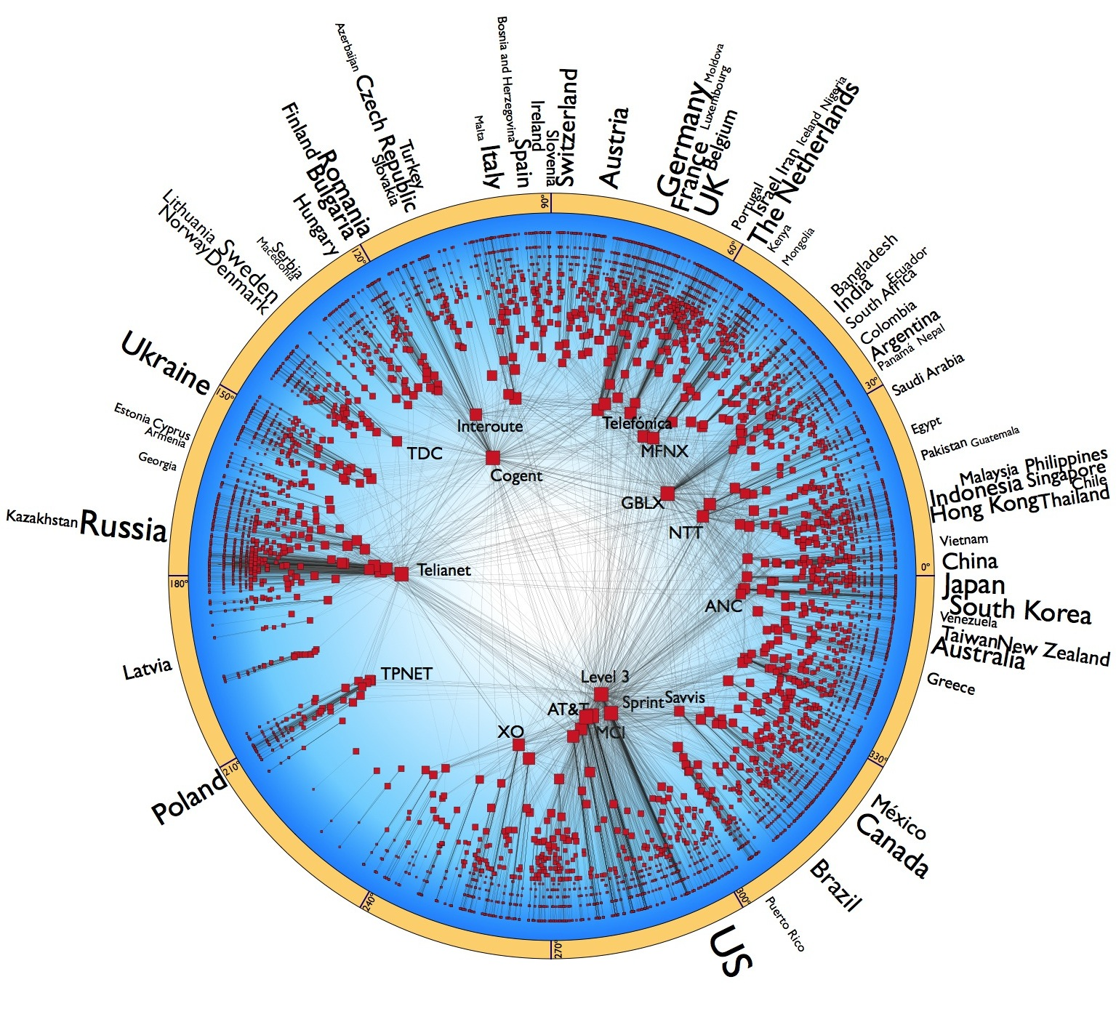

Slide 39
Navigation efficiency and robustness (Internet)
Percentage of successful greedy paths 97%
Average stretch 1.1
Percentage of successful greedy paths after removal of x% of links:
x10%  90%
x30%  75%

Slide 40
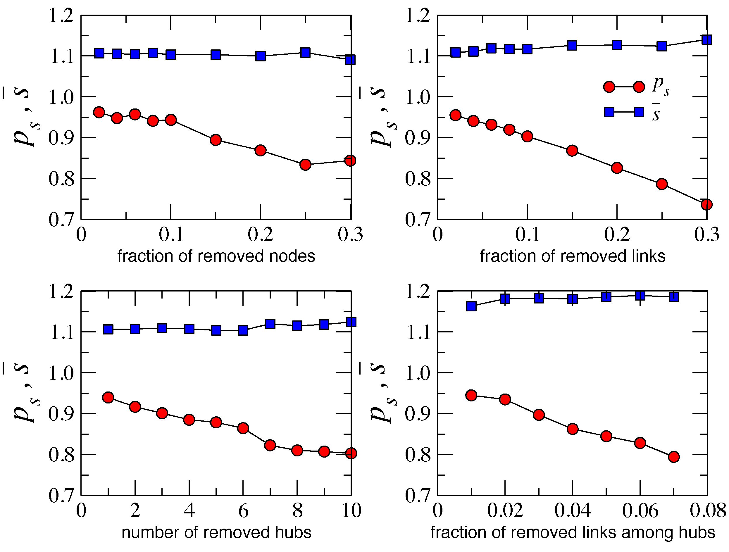
No routing information exchange upon topology changes
if the minor degradation of routing efficiency is tolerable
Slightly more intelligent variations of greedy forwarding, using small amount of non-local information, sustain 100% routing efficiency

Slide 41
Why?
Congruency between hyperbolic space geometry and scale-free network topology
Hierarchical/heterogeneous organization of the two (zooming-out/zooming-in pattern)
Strong clustering/metric structure
How?
Strong clustering yields high path diversity
All paths are congruent to their corresponding hyperbolic geodesics
If some paths are damaged, many others remain, and can still be found since they all congruent

Slide 42
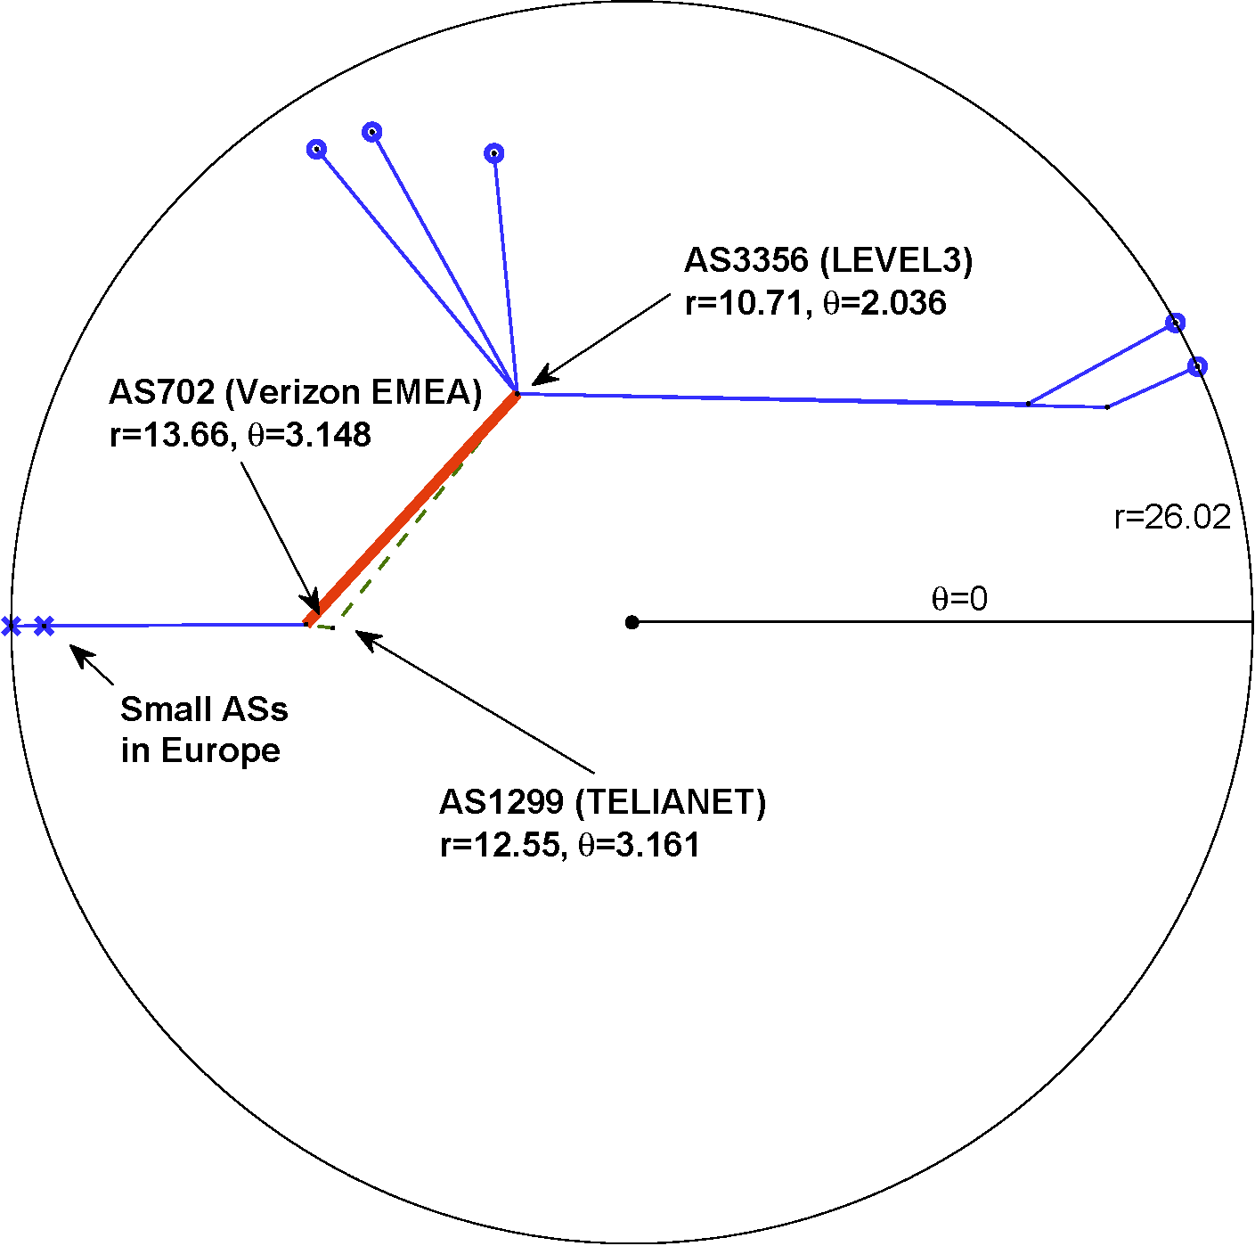

Slide 43
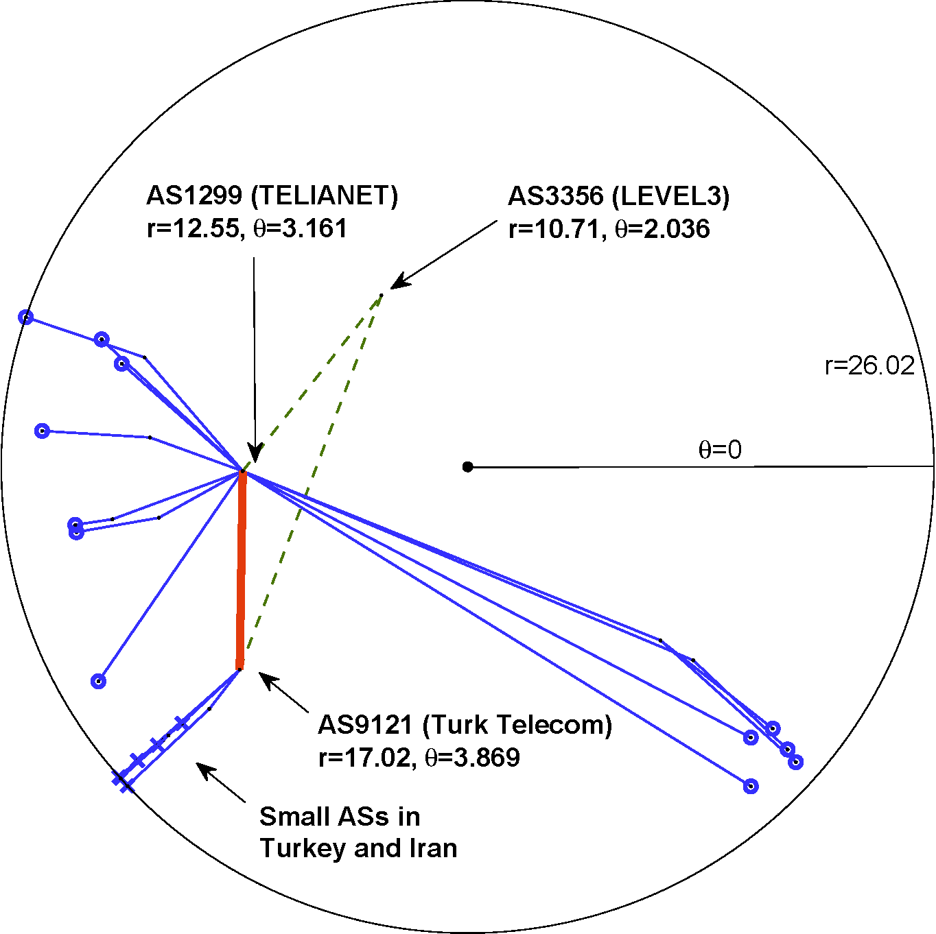

Slide 44
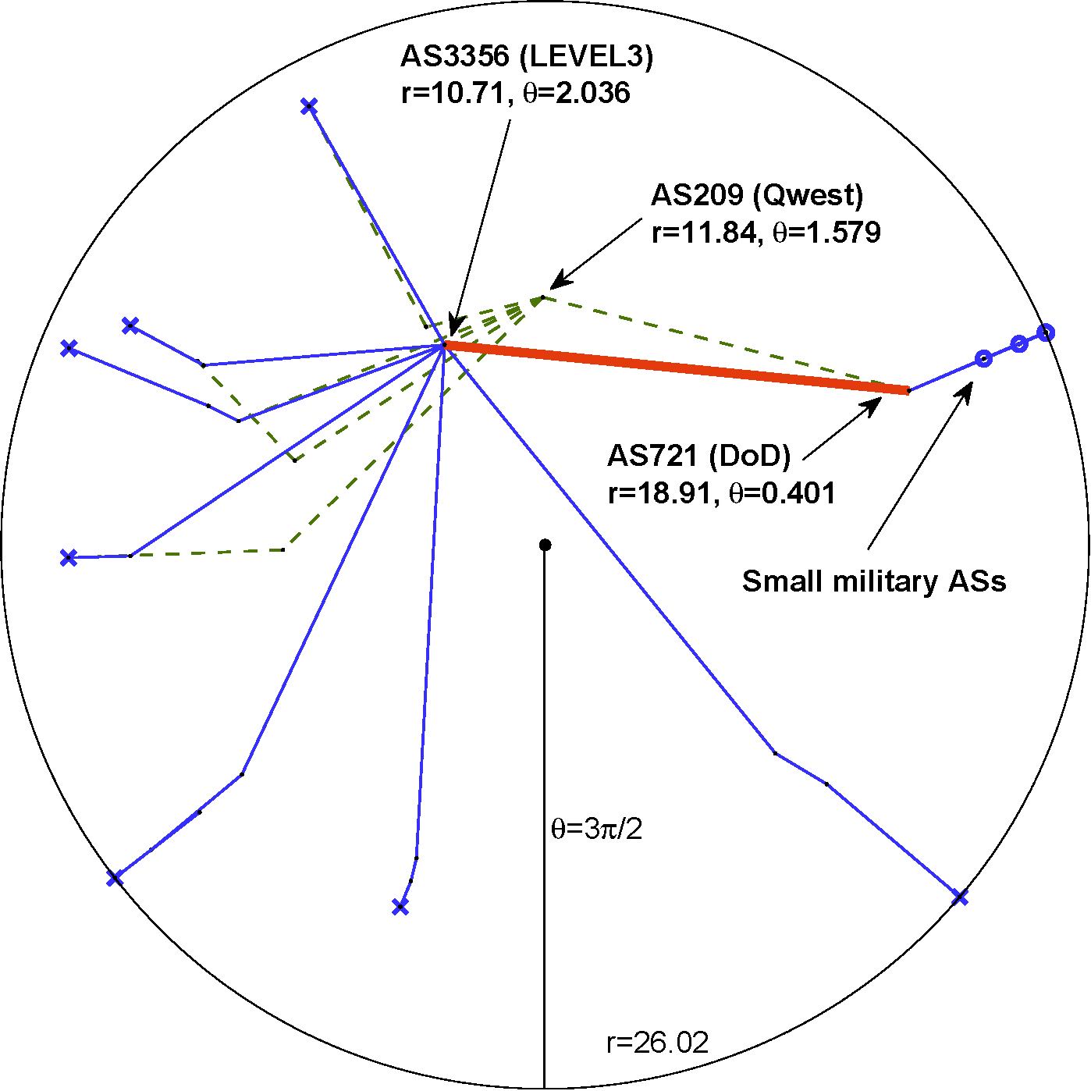

Slide 45
Take-home message

?
←

Slide 46
Open question
Does any optimization of efficiency and robustness of targeted transport drive network evolution explicitly?
Or is it just a natural but implicit by-product of other (standard) network evolution mechanisms?

Slide 47
Conclusions
Routing
optimal (maximally efficient/most scalable) routing for Internet-like networks
routing table sizes, stretch, and communication overhead approach their theoretical lower bounds
NDN
Prepend NDN names with AS names
Not well in-line with NDN philosophy, but simple, scalable, and will likely work
Hierarchical name space is the underlying hyperbolic space
???

Slide 48
M. Boguñá, F. Papadopoulos, and D. Krioukov, Sustaining the Internet with Hyperbolic Mapping, Nature Communications, v.1, 62, 2010
D. Krioukov, F. Papadopoulos, A. Vahdat, and M. Boguñá, Hyperbolic Geometry of Complex Networks, Physical Review E, v.82, 036106, 2010, Physical Review E, v.80, 035101(R), 2009
F. Papadopoulos, D. Krioukov, M. Boguñá, and A. Vahdat, Greedy Forwarding in (Dynamic) Scale-Free Networks Embedded in Hyperbolic Metric Spaces, INFOCOM 2010, SIGMETRICS MAMA 2009
M. Boguñá, D. Krioukov, and kc claffy, Navigability of Complex Networks, Nature Physics, v.5, p.74-80, 2009

