Slide 1
Percolation in self-similar networks PRL 106:048701, 2011
Dmitri Krioukov CAIDA/UCSD M. Á. Serrano, M. Boguñá NetSci, Budapest, June 2011

Slide 2
Percolation
Percolation is one of the most fundamental and best-studied critical phenomena in nature
In networks: the critical parameter is often average degree ↑k, and there is ↑k_{c} such that:
If ↑k < ↑k_{c}: many small connected components
If ↑k > ↑k_{c}: a giant connected component emerges
↑k_{c} can be zero
The smaller the ↑k_{c}, the more robust is the network with respect to random damage

Slide 3
Analytic approaches
Usually based on tree-like approximations
Employing generating functions for branching processes
Ok, for zero-clustering networks
Configuration model
Preferential attachment
Not ok for strongly clustered networks
Real networks
Newman-Gleeson:
Any target concentration of subgraphs, but
The network is tree-like at the subgraph level
Real networks:
The distribution of the number of triangles overlapping over an edge is scale-free

Slide 4
Identification of percolation universality classes of networks
Problem is seemingly difficult
Details seem to prevail
Few results are available for some networks

Slide 5
Conformal invariance and percolation

Slide 6
Conformal invariance and percolation
z₁
z₂
z₄
z₃
J. Cardy’s crossing formula: , where
Proved by S. Smirnov (Fields Medal)

Slide 7
Scale invariance and self-similarity

Slide 8
Self-similarity of network ensembles
Let ({}) be a network ensemble in the thermodynamic (continuum) limit, where {} is a set of its parameters (in ER, {} = ↑k)
Let  be a rescaling transformation
For each graph G  ({}),  selects G’s subgraph G according to some rule
Definition: ensemble ({}) is self-similar if ({}) = ({}) where {} is some parameter transformation

Slide 9
2
100
2
1
1000

Slide 10
Model properties
Very general geometric network model
Can model networks with any
Average degree
Power-law degree distribution exponent
Clustering
Subsumes many popular random graph models as limiting regimes with degenerate geometries
Has a well-defined thermodynamic limit
Nodes cover all the hyperbolic plane
What about rescaling?

Slide 11
Rescaling transformation 
Very simple: just throw out nodes of degrees  > 

Slide 12
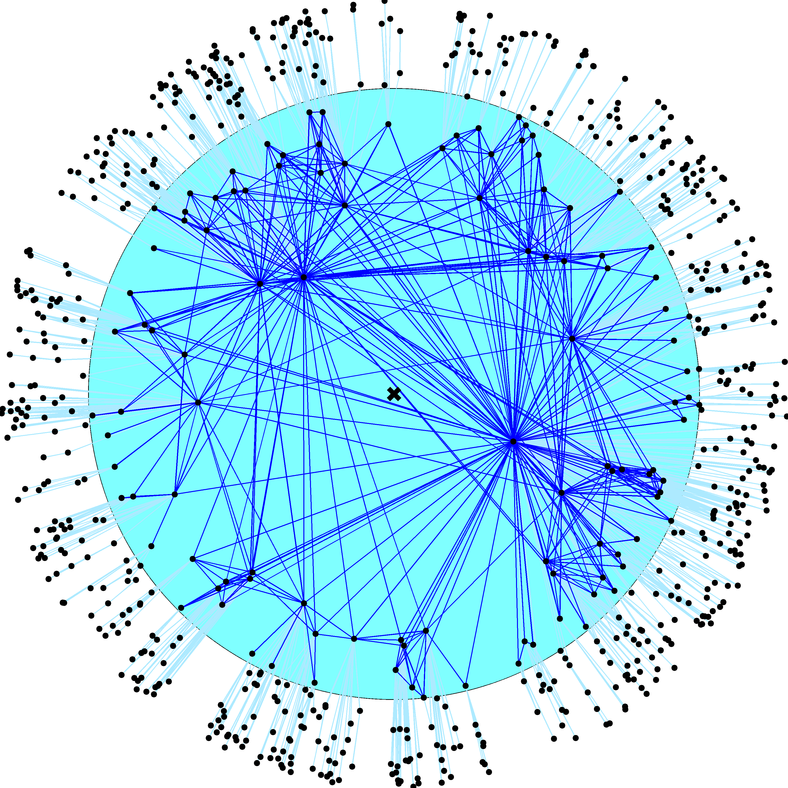
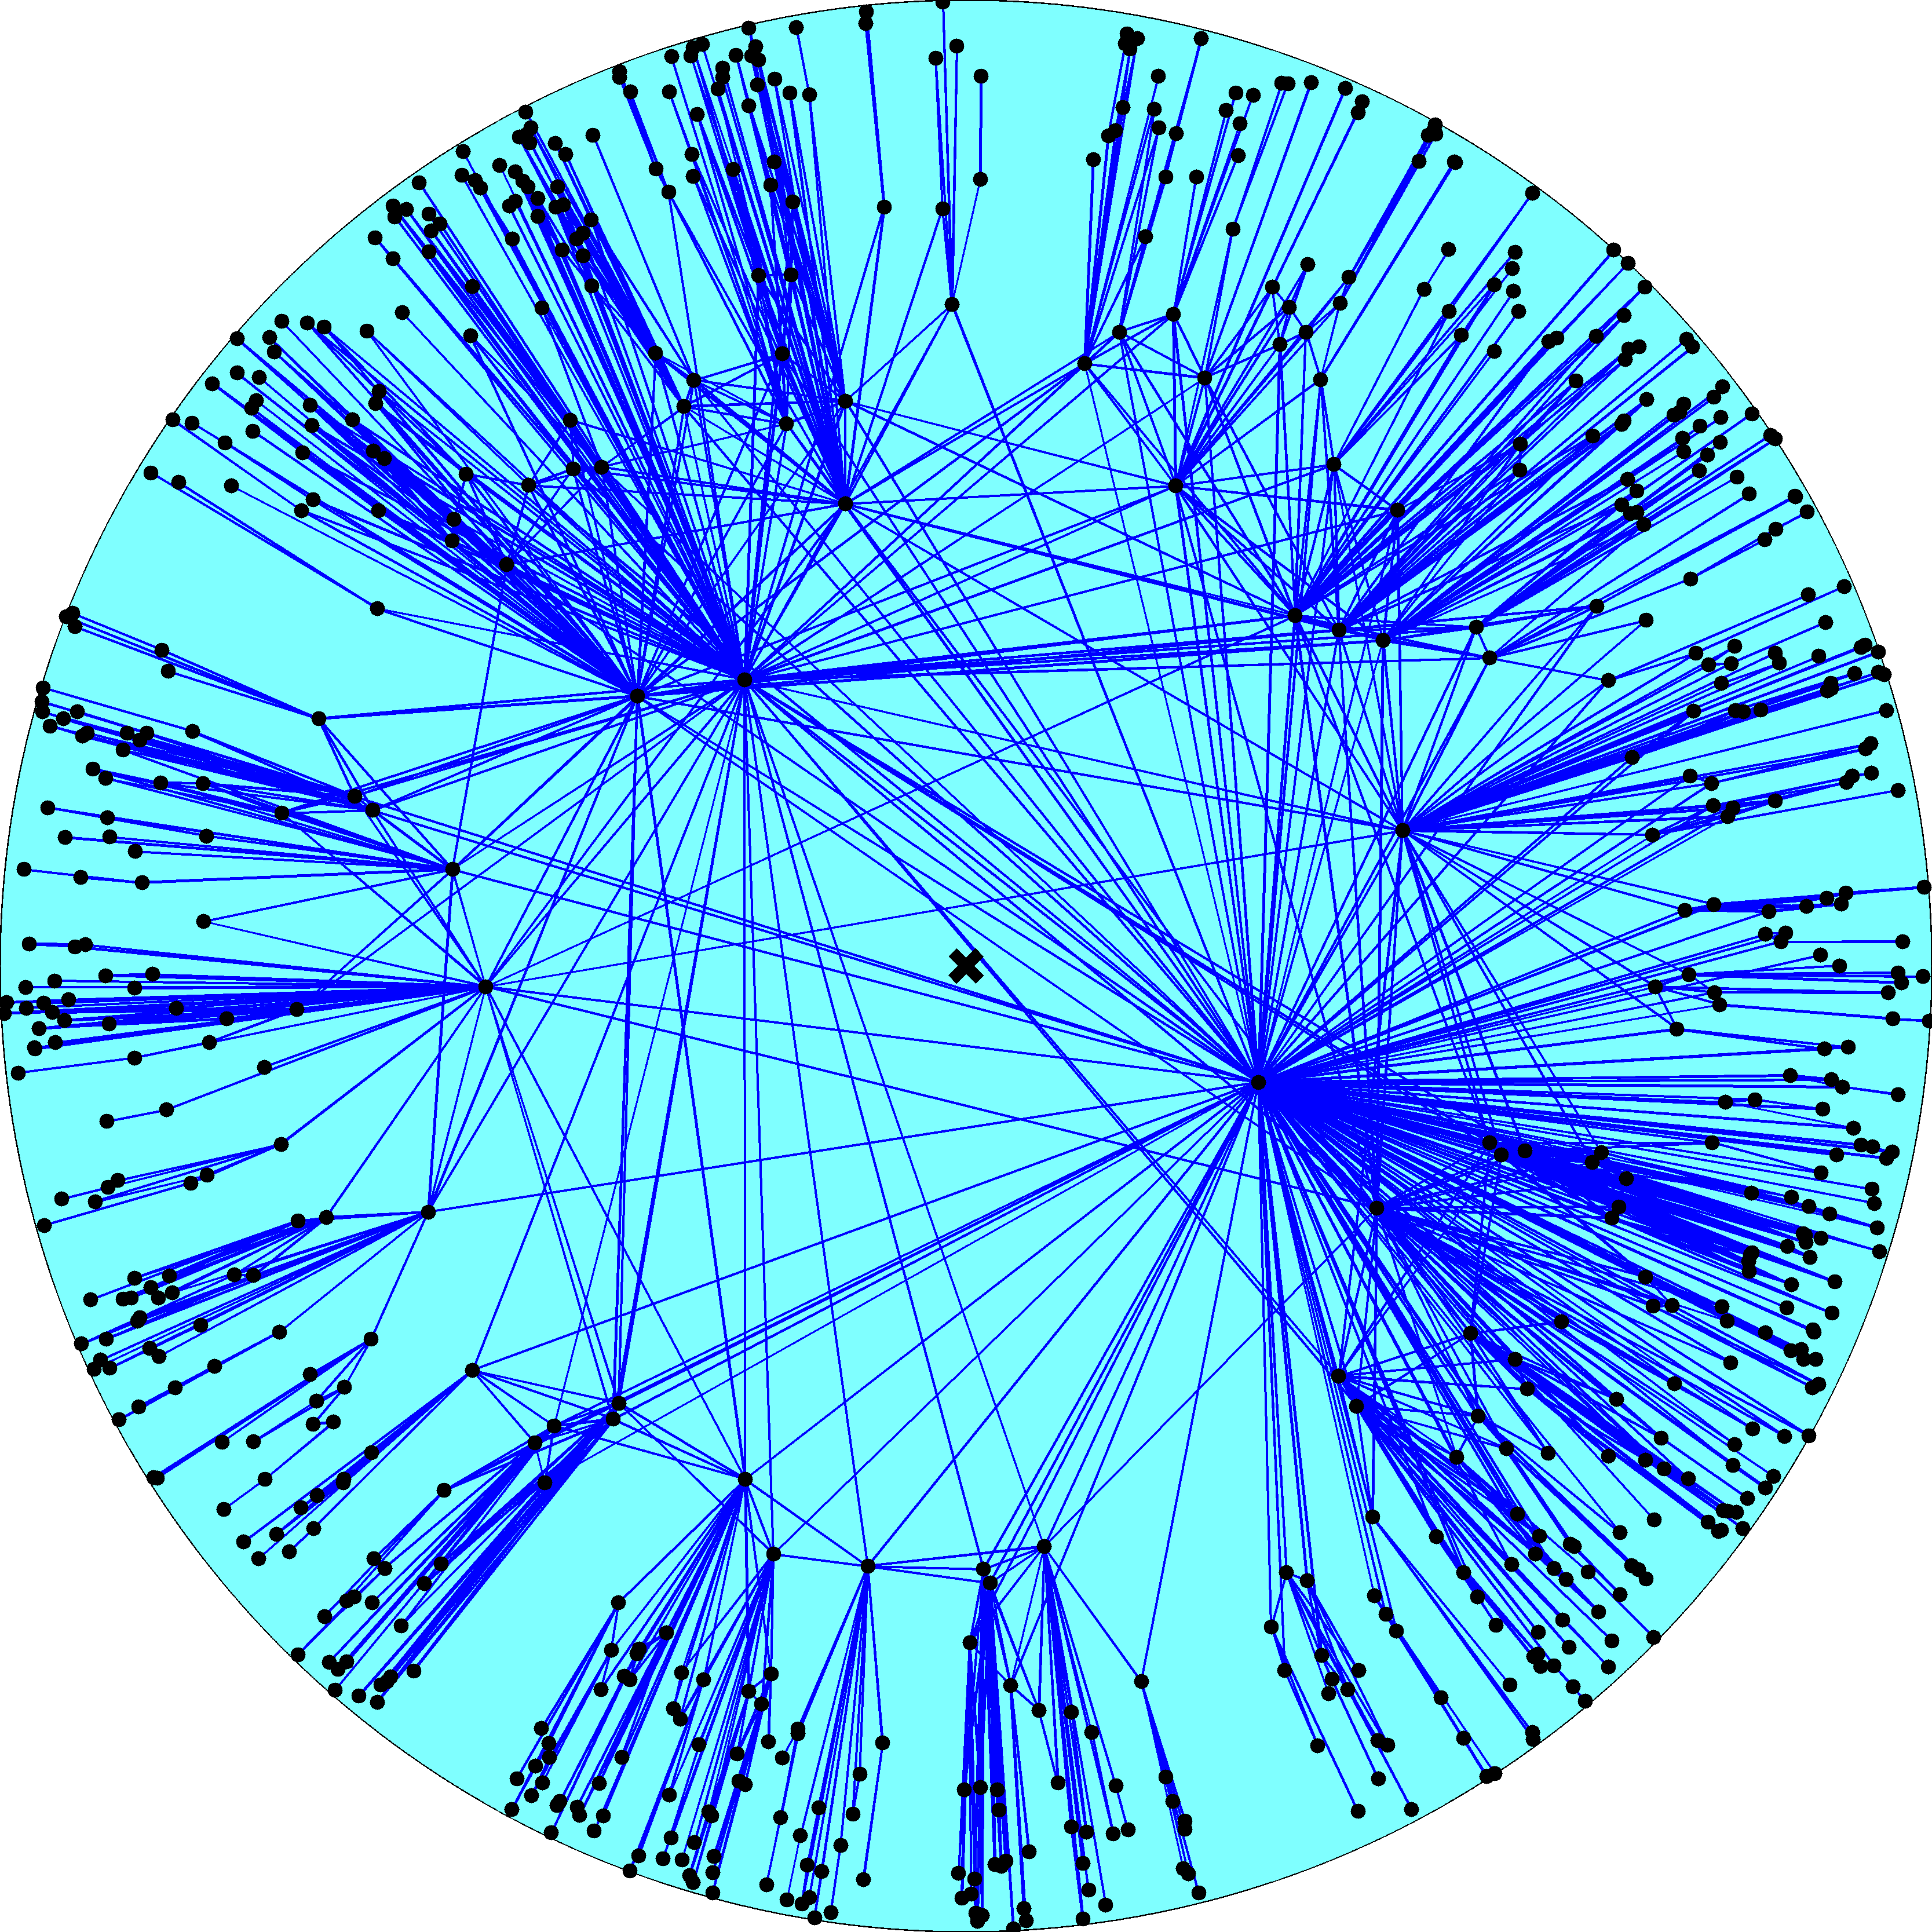
$$N_{τ}=N{\left(\frac{κ_{0}}{κ_{τ}}\right)}^{γ−1}$$
$$_{}=$$
$${\left\langle c\right\rangle }_{τ}=\left\langle c\right\rangle$$
$${\left\langle k\right\rangle }_{τ} ={\left\langle k\right\rangle \left(\frac{κ_{τ}}{κ_{0}}\right)}^{3−γ}$$

Slide 15
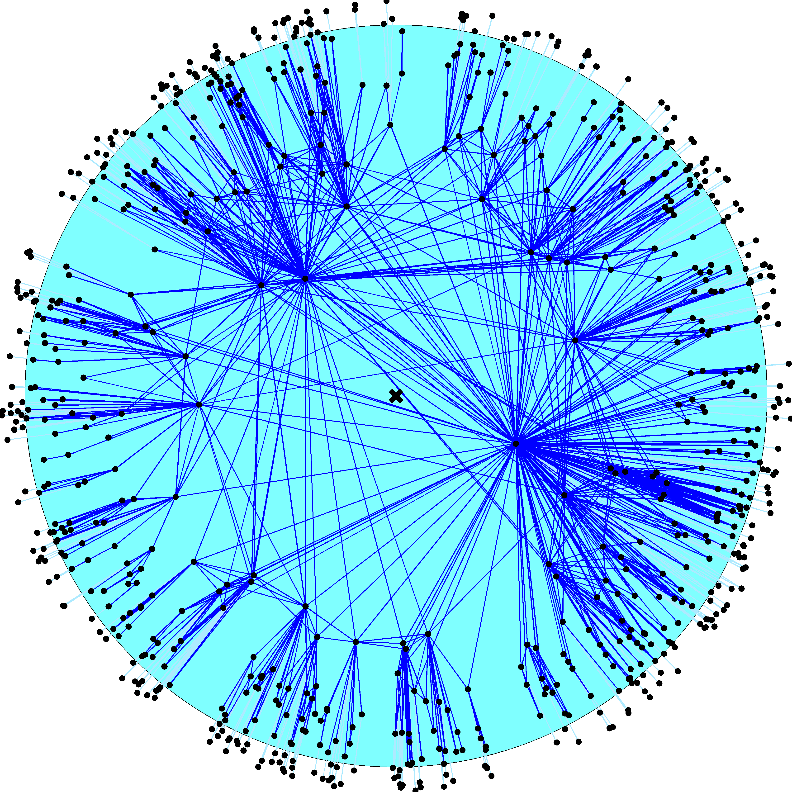

Slide 16
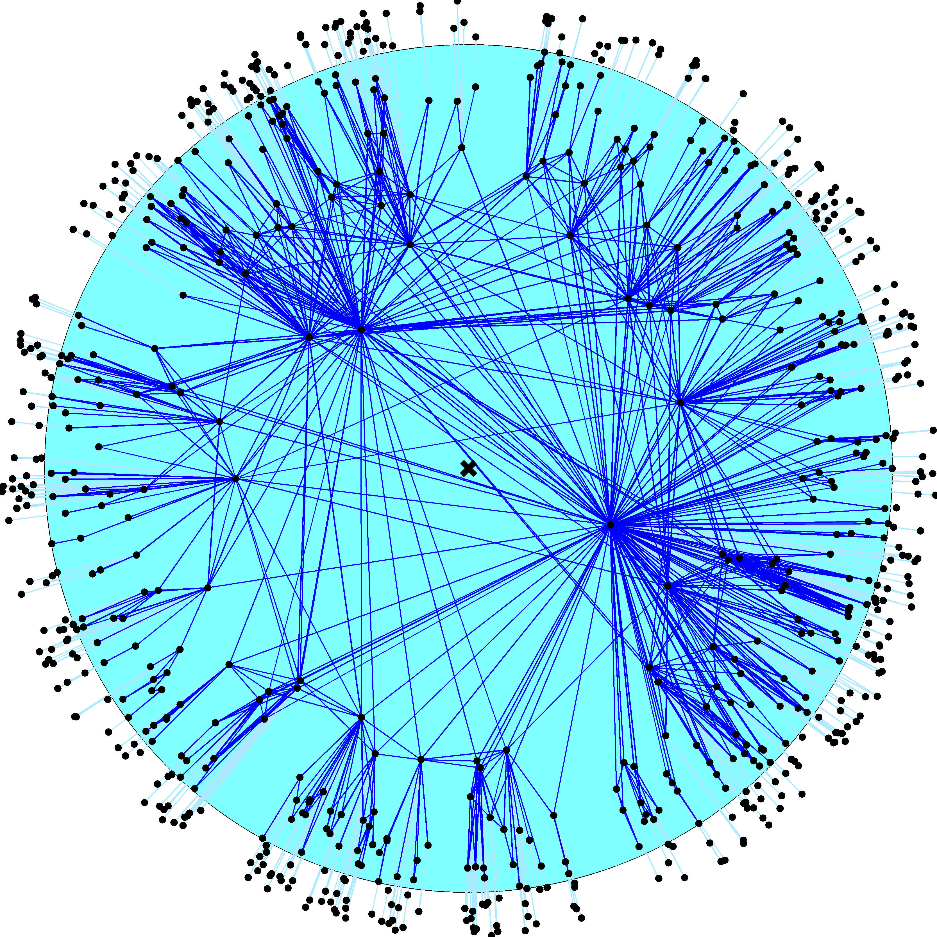

Slide 17
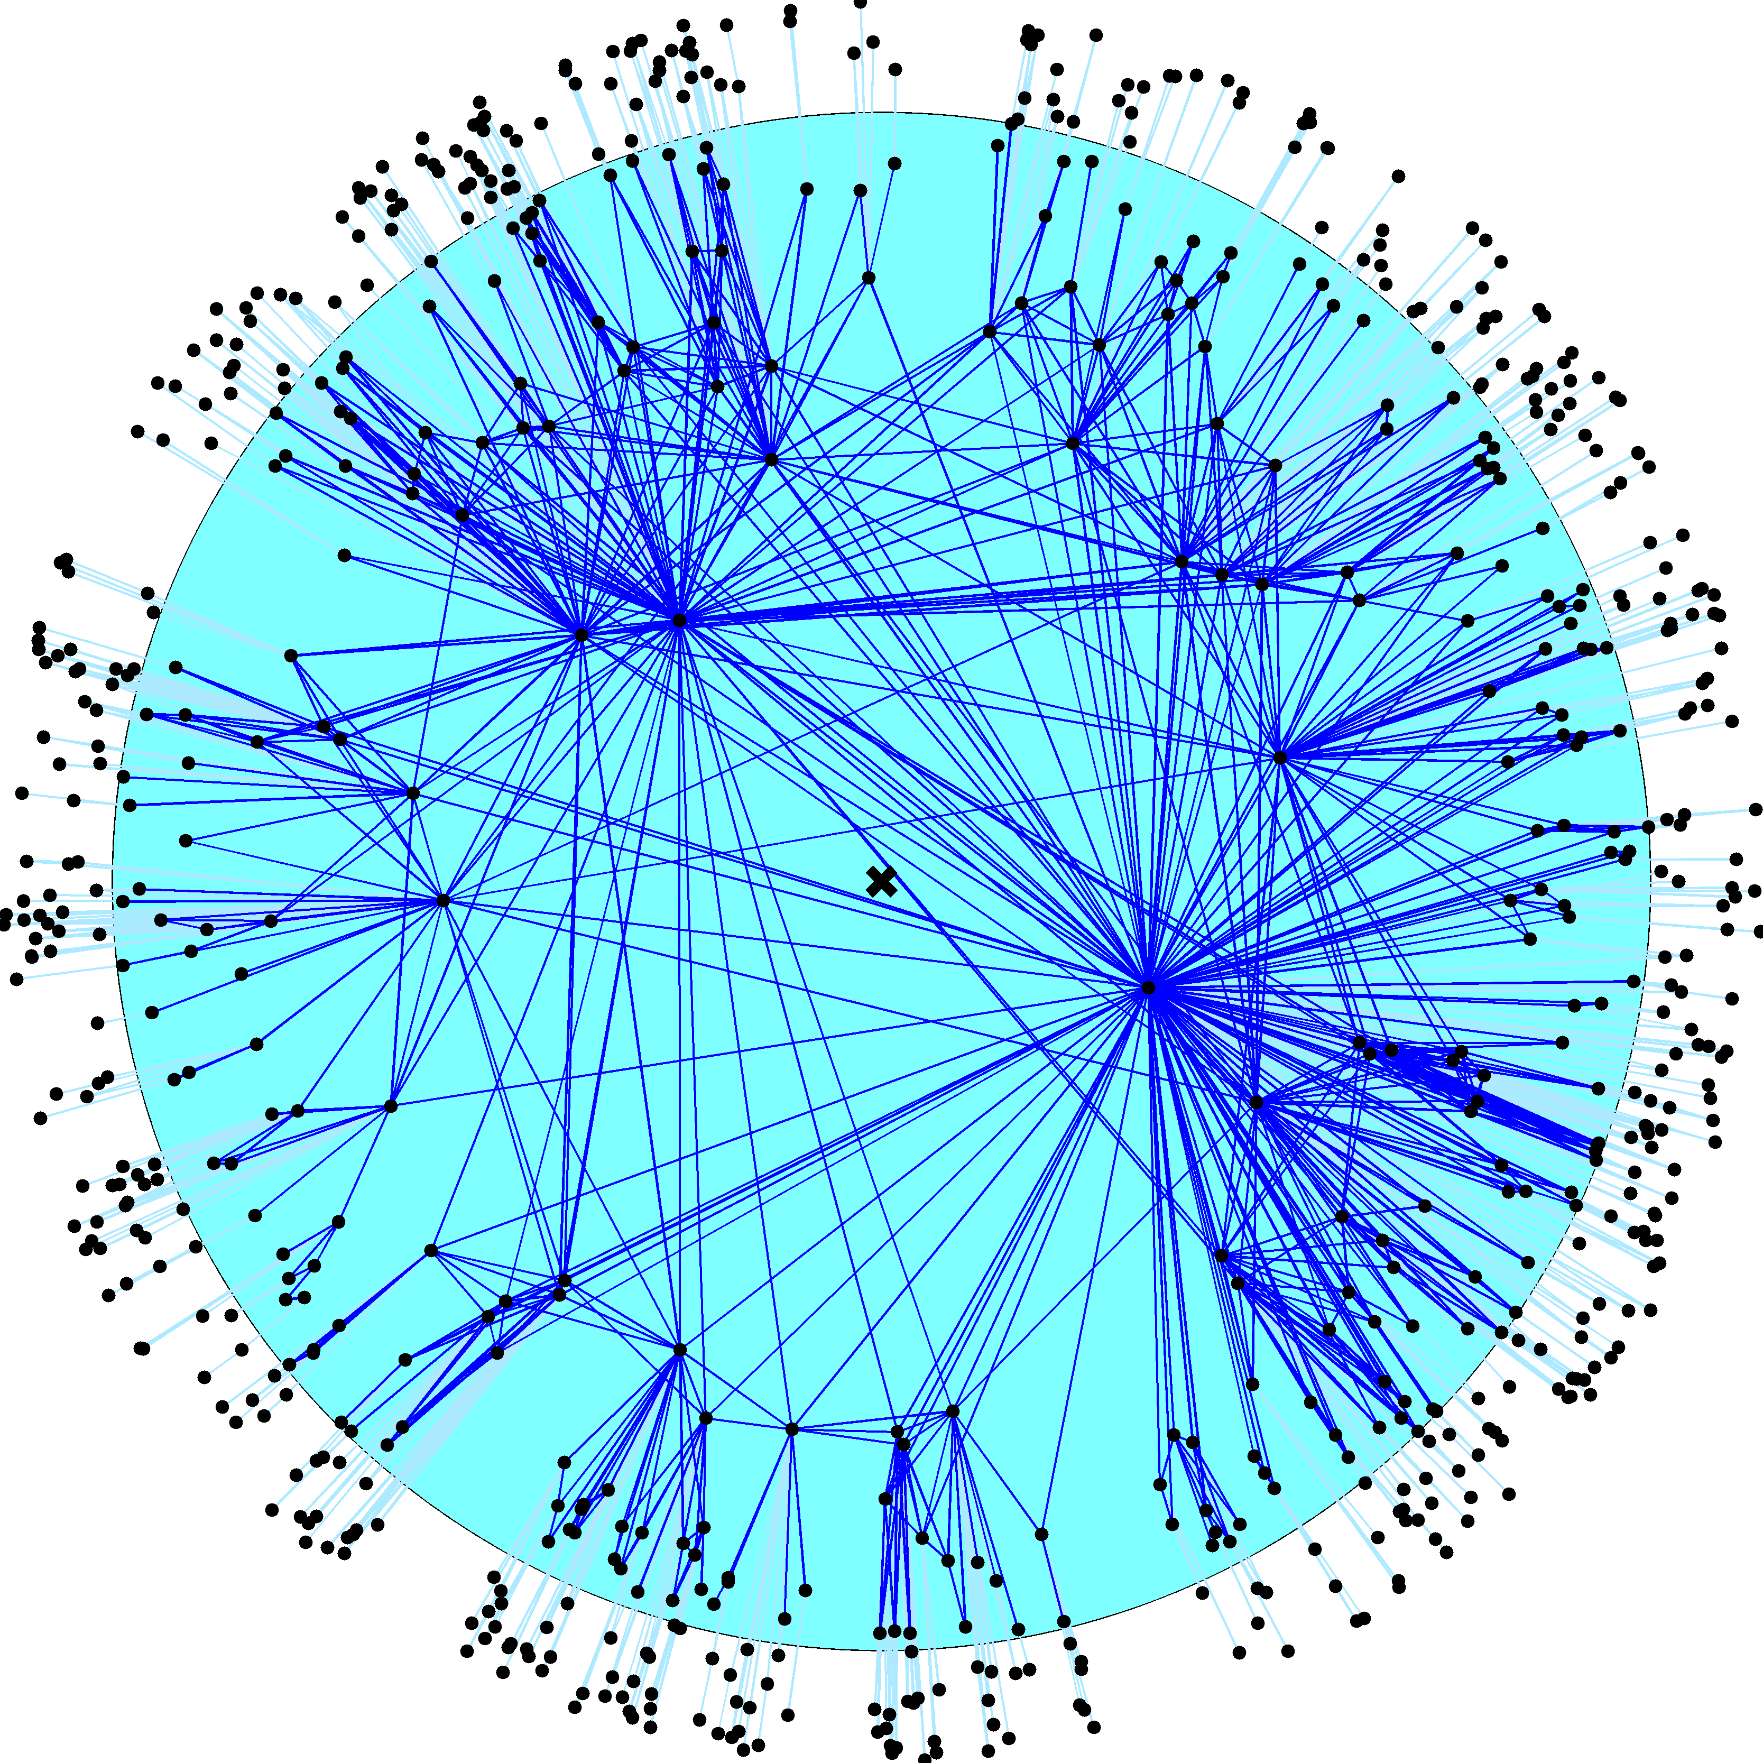

Slide 18
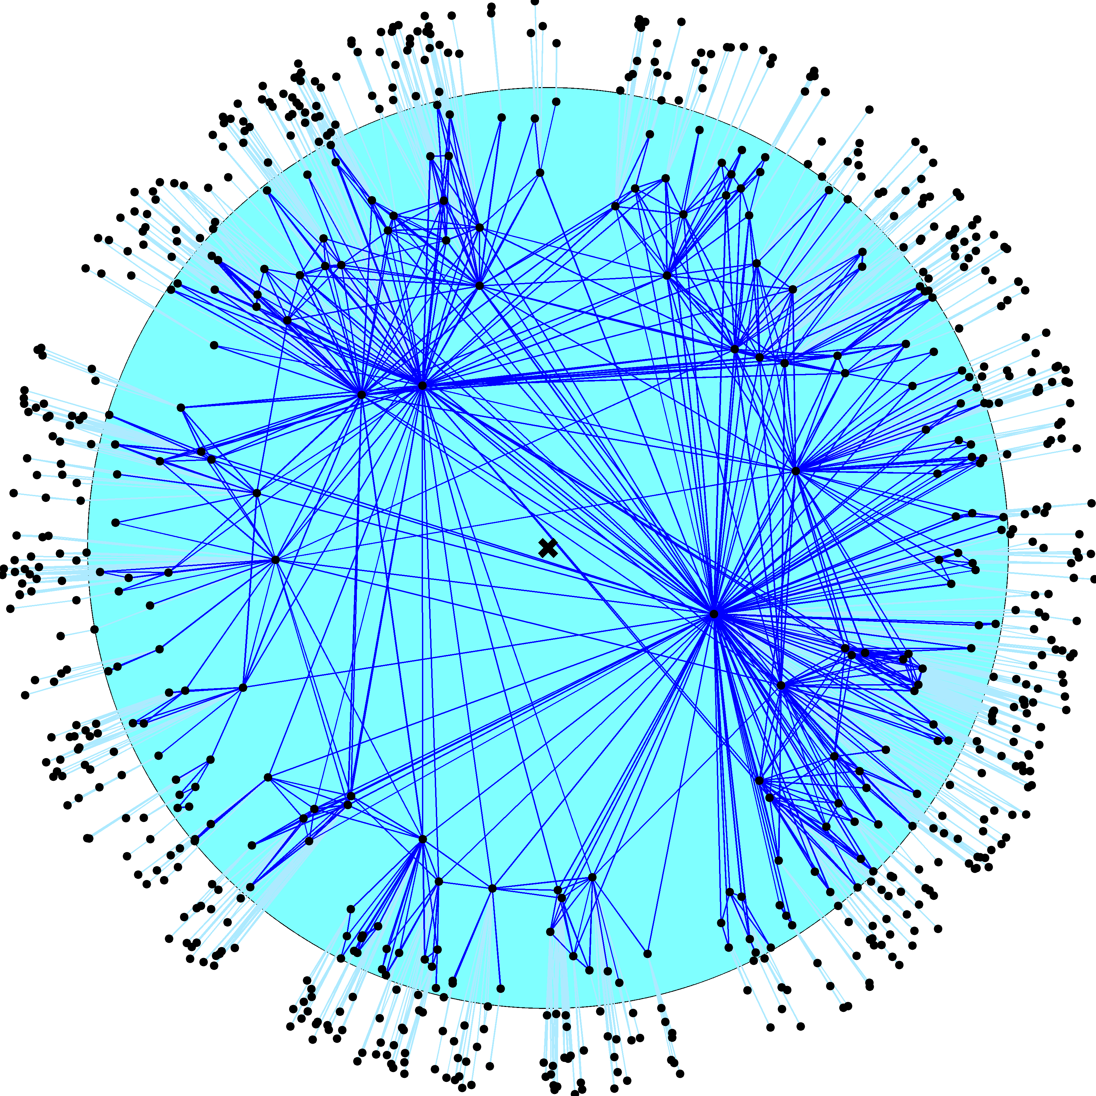

Slide 19
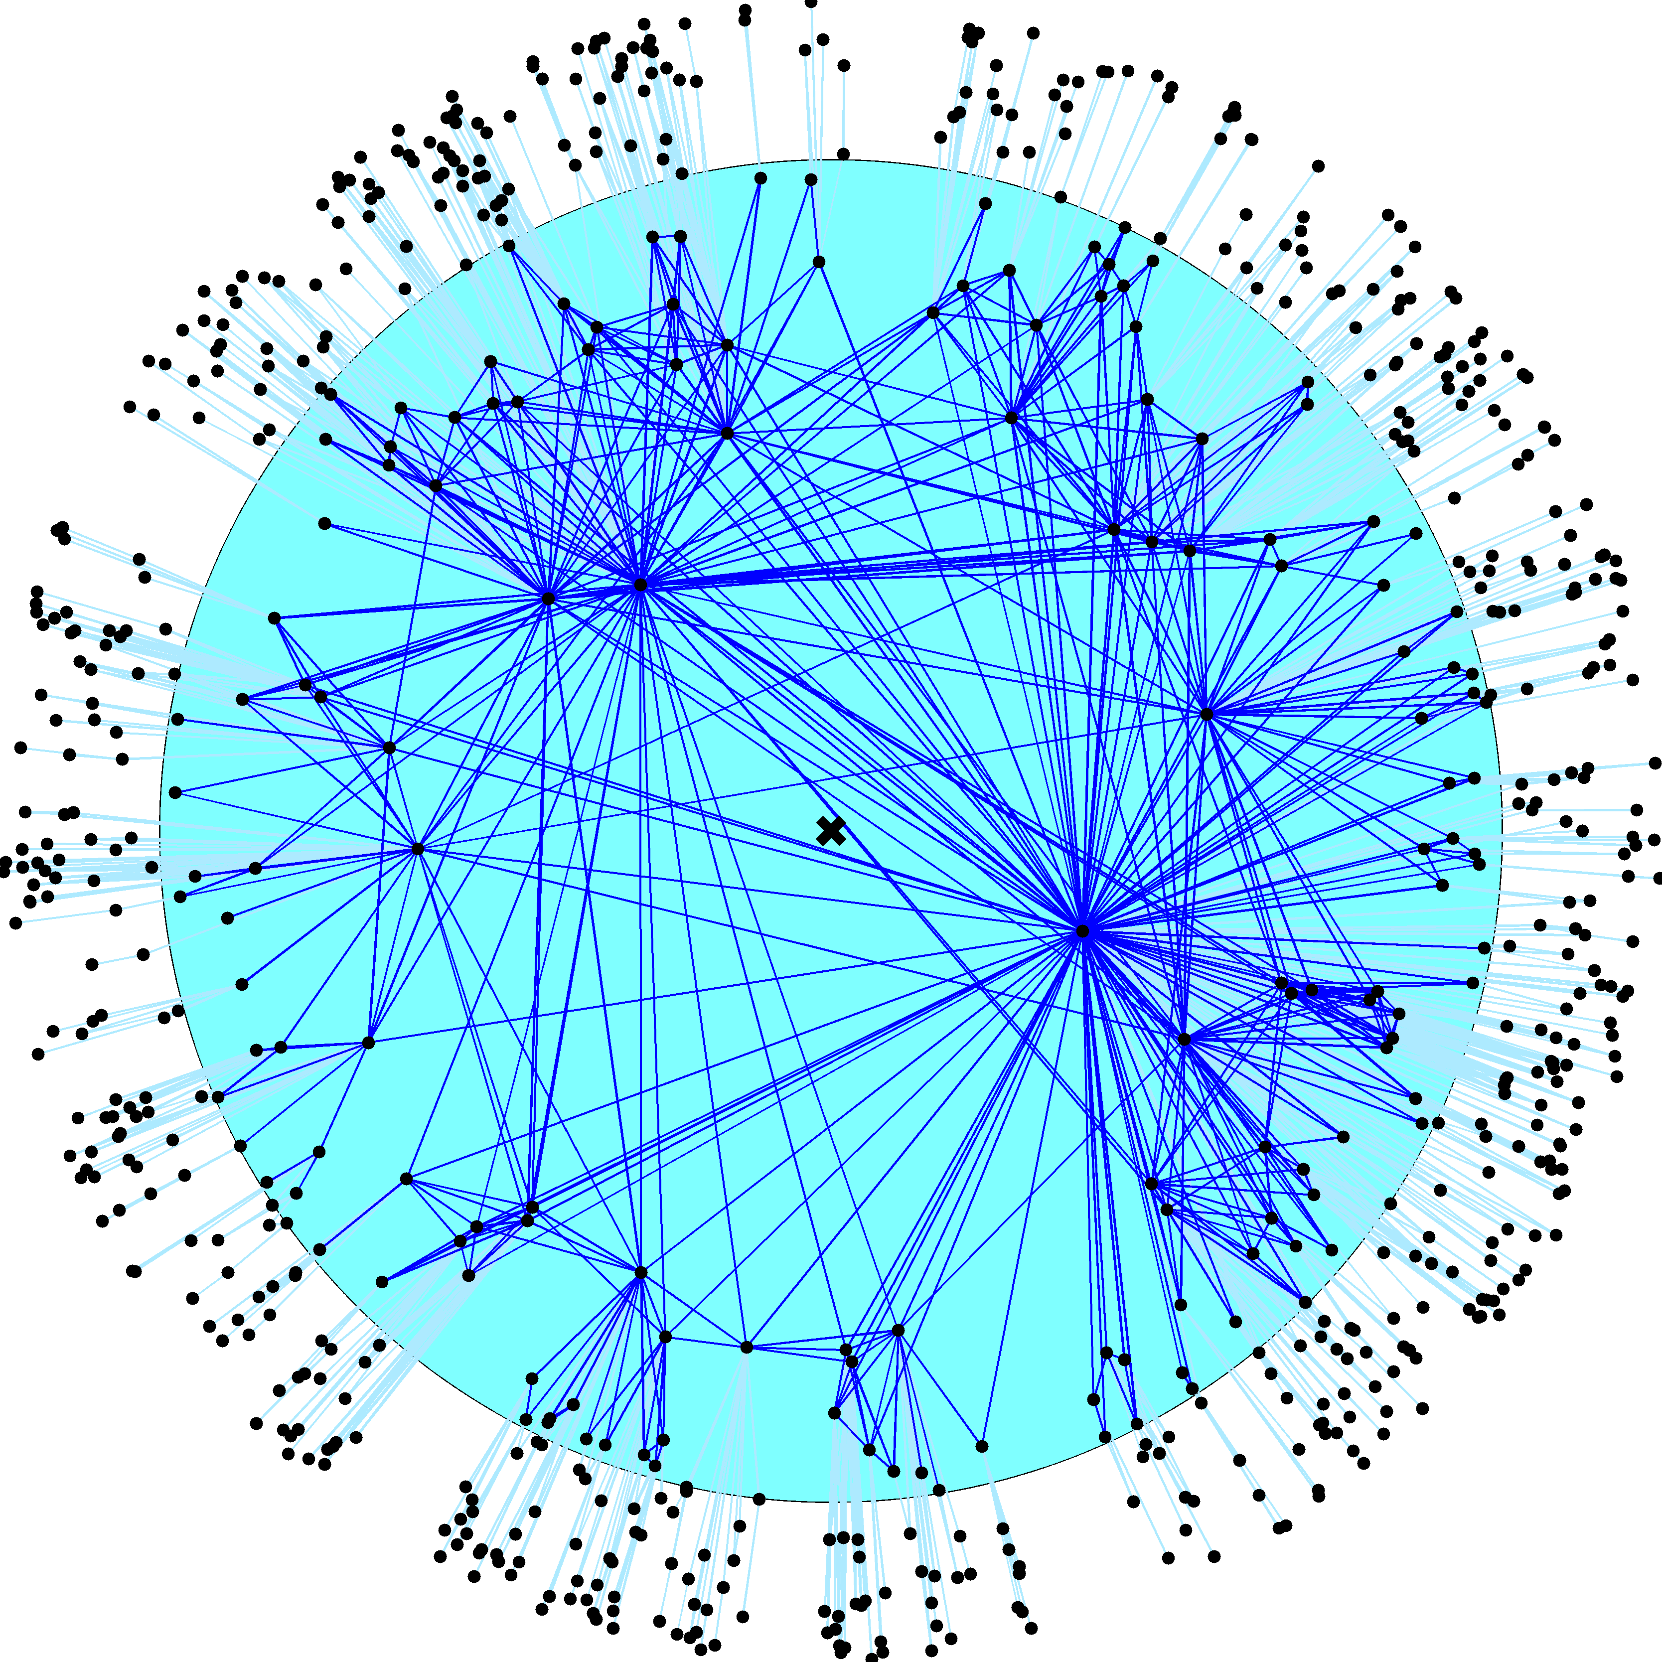

Slide 21
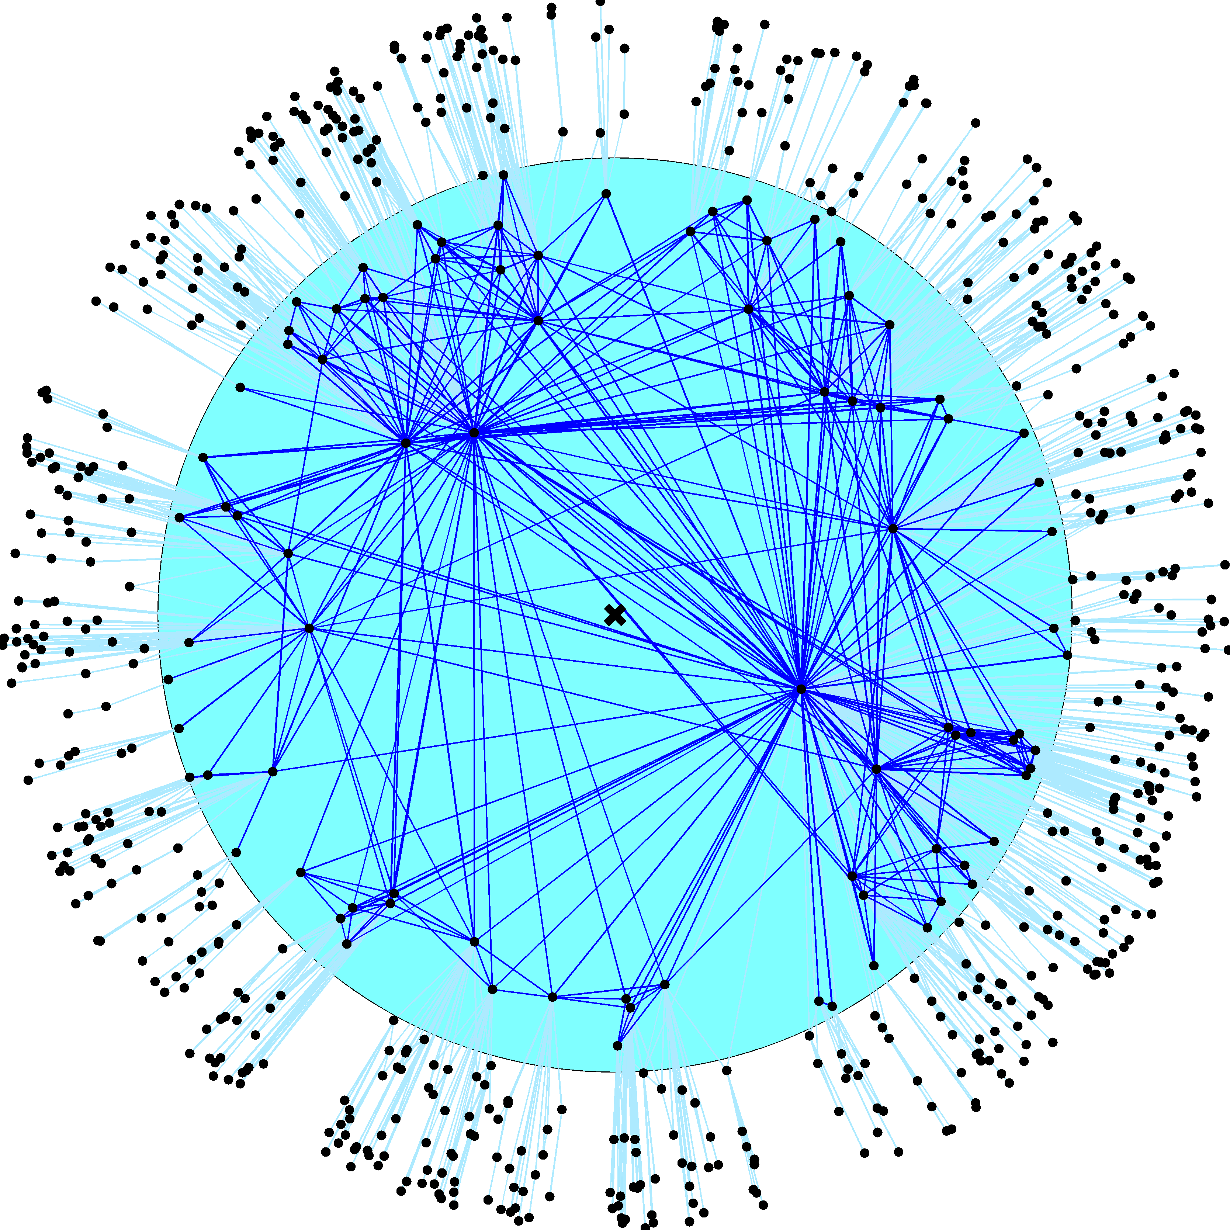

Slide 22
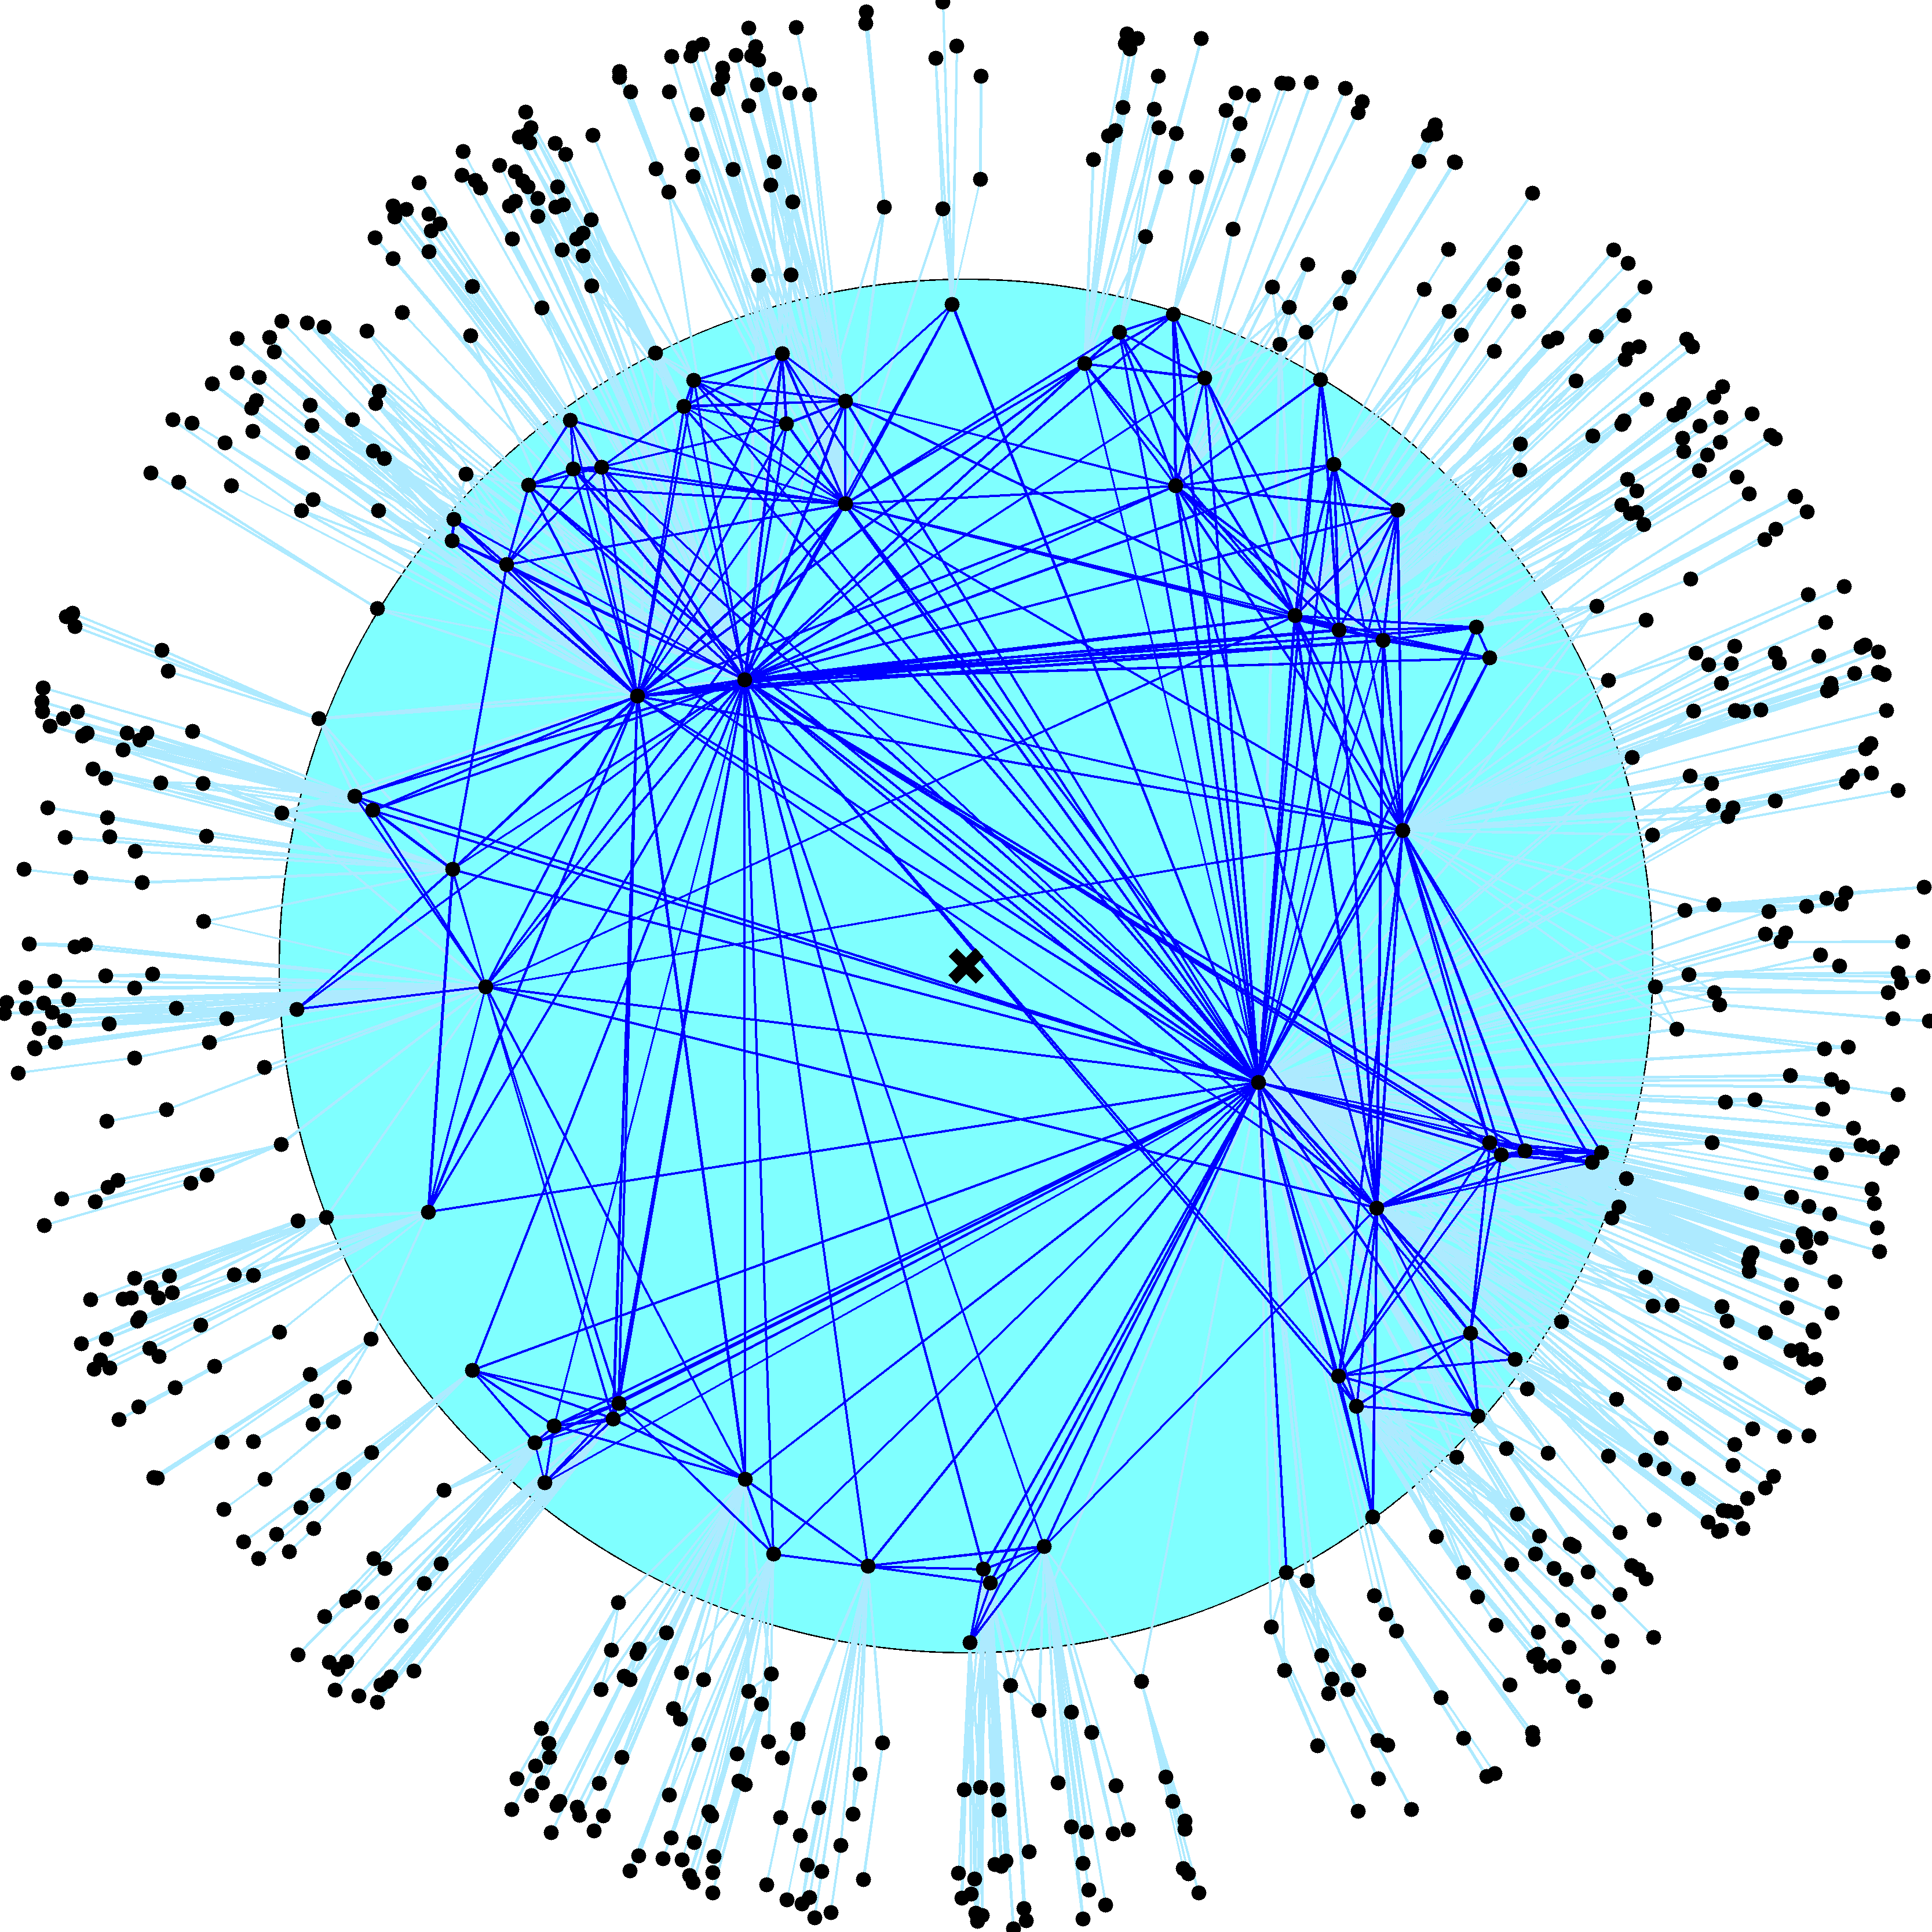

Slide 23
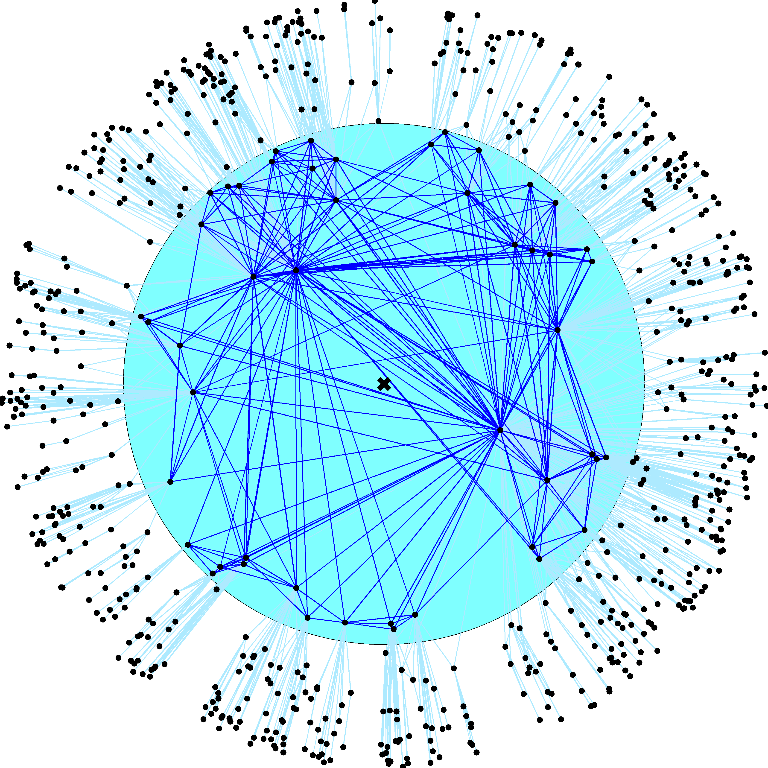

Slide 24
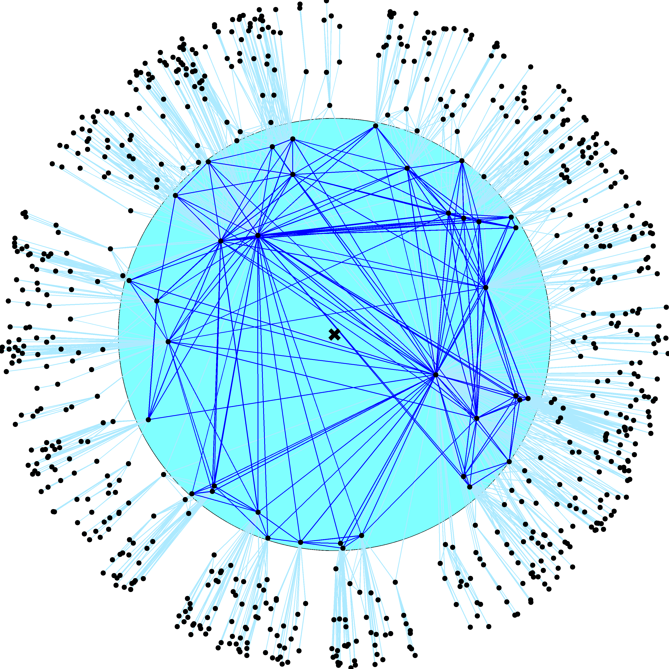

Slide 25
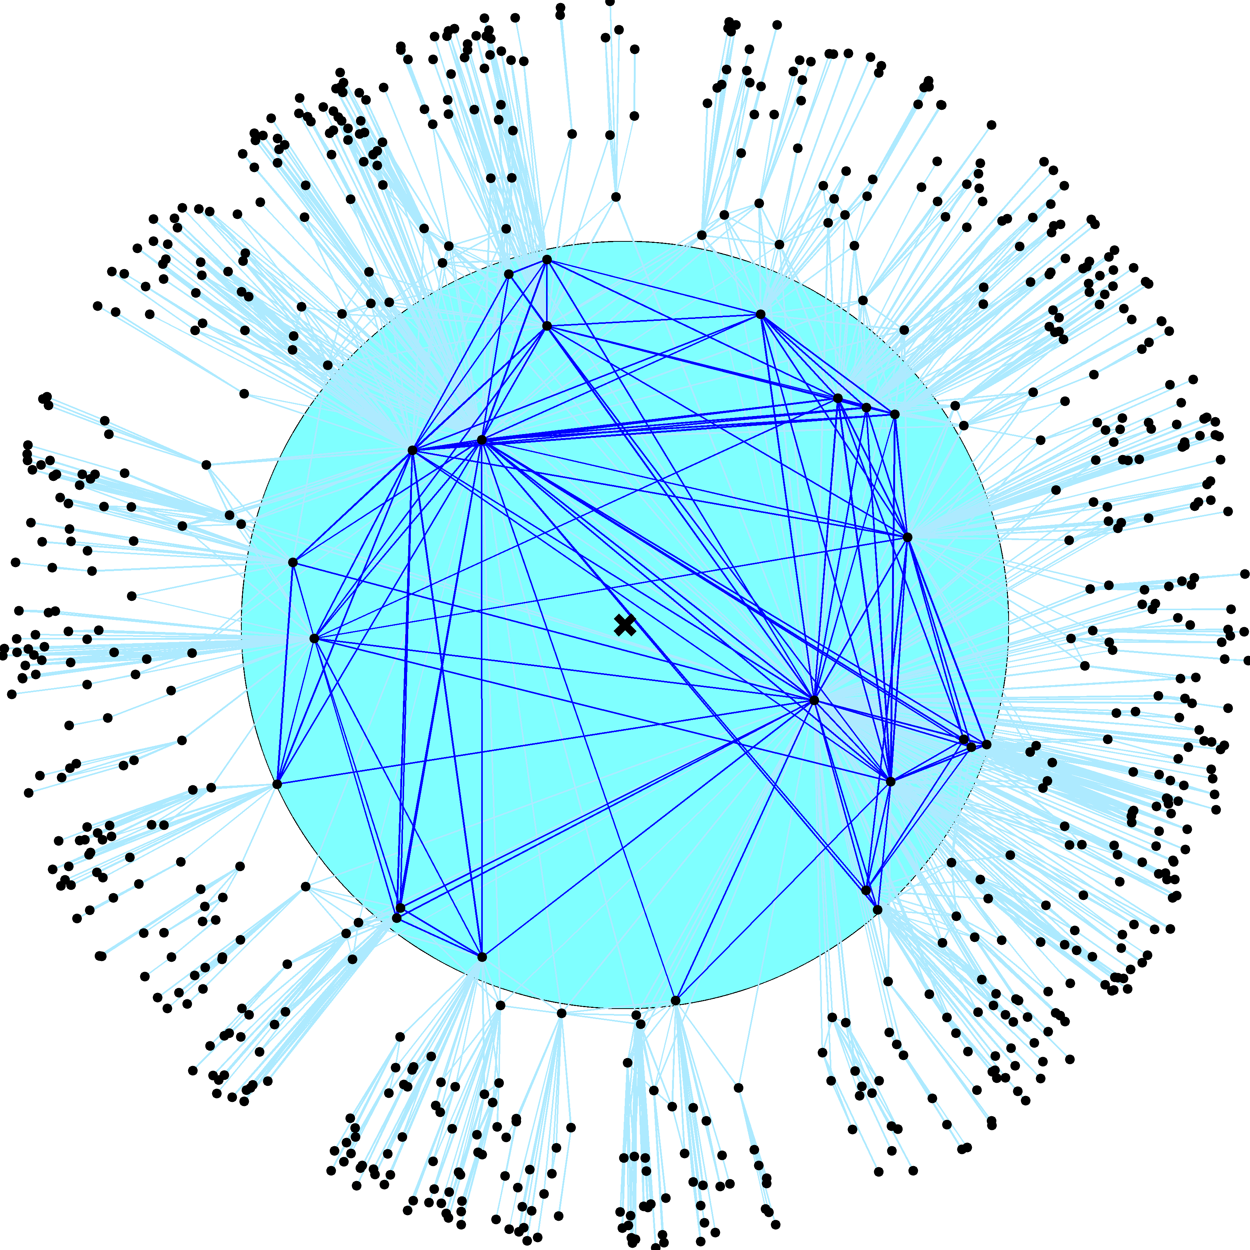

Slide 26
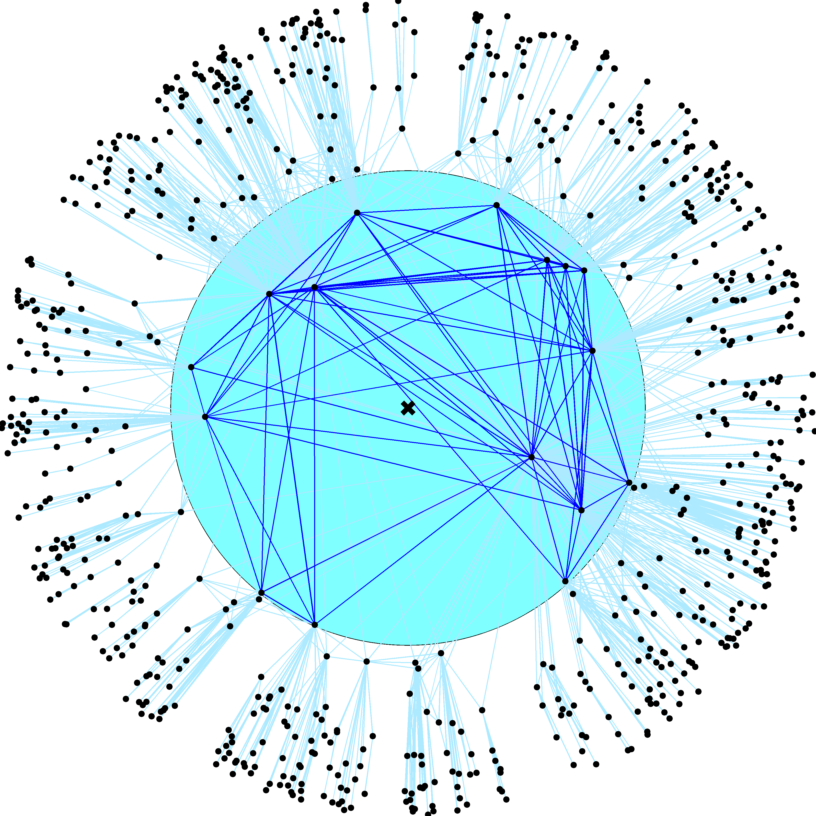

Slide 27
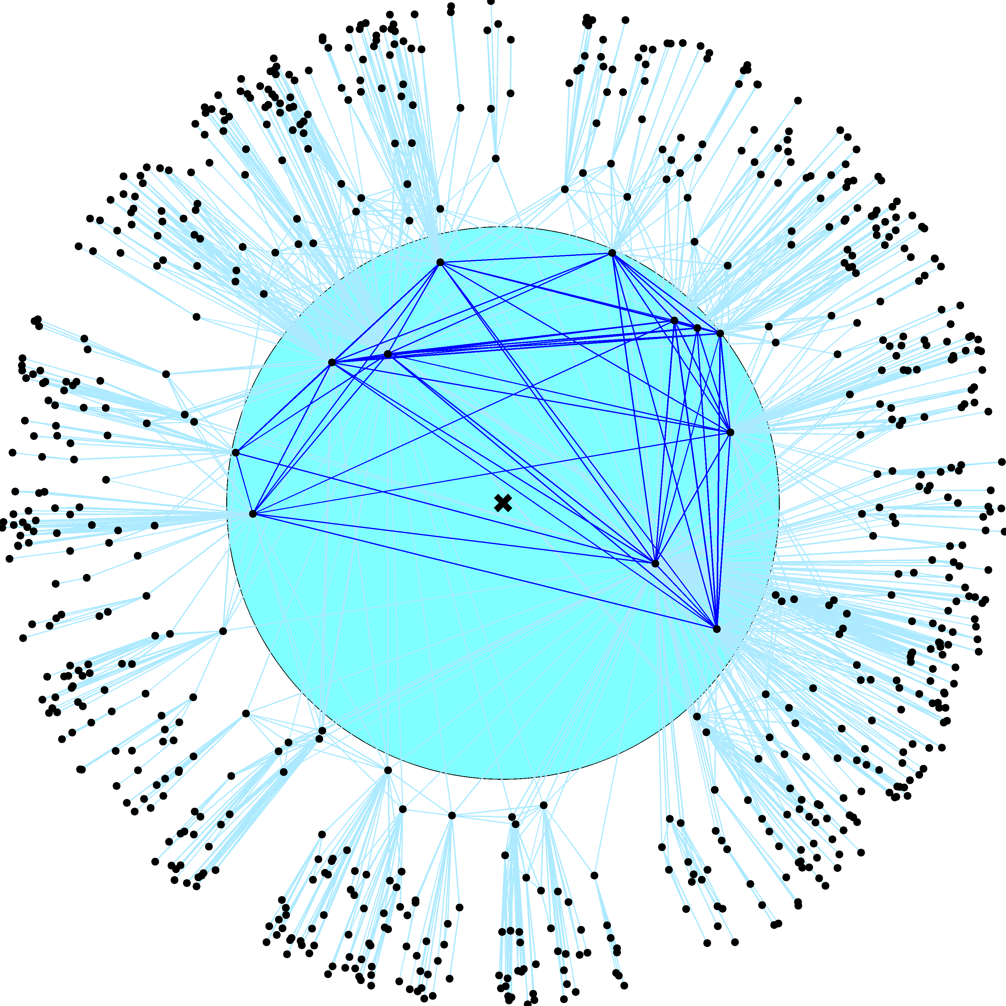

Slide 28
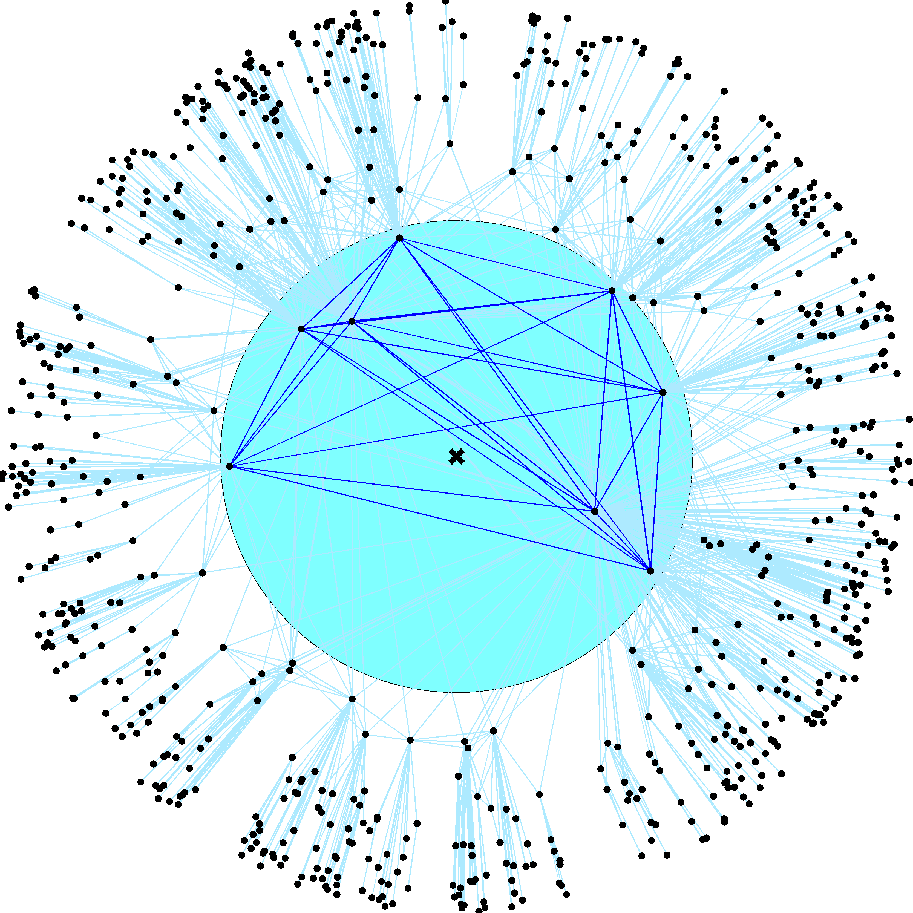

Slide 29
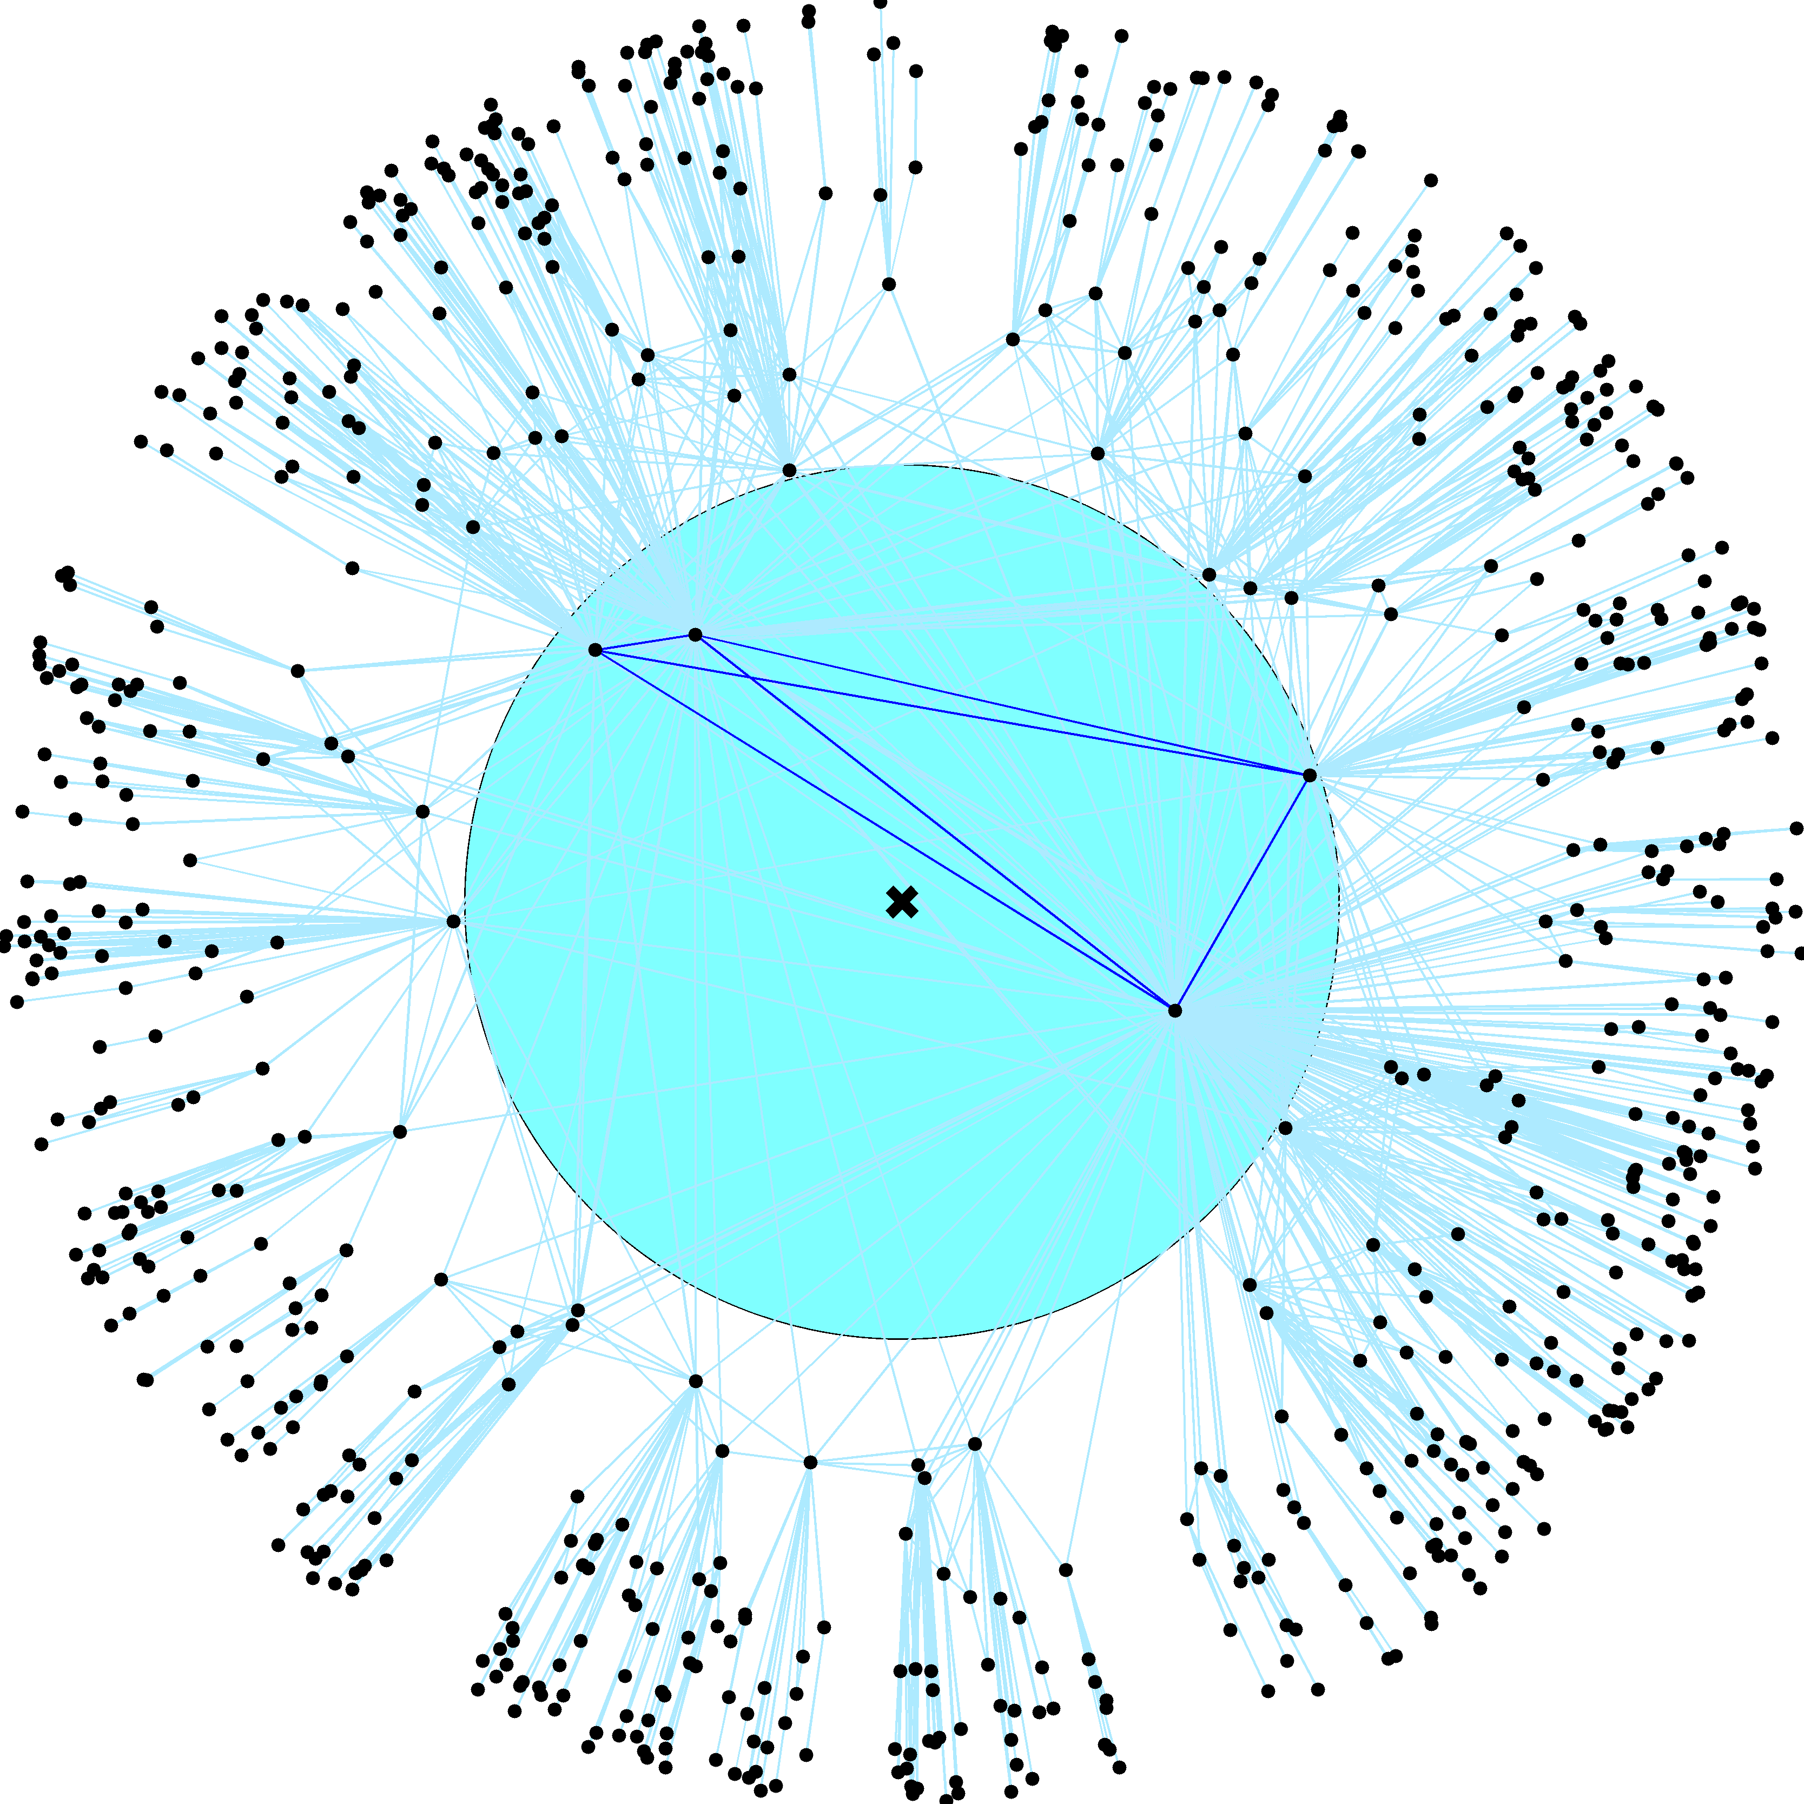

Slide 30
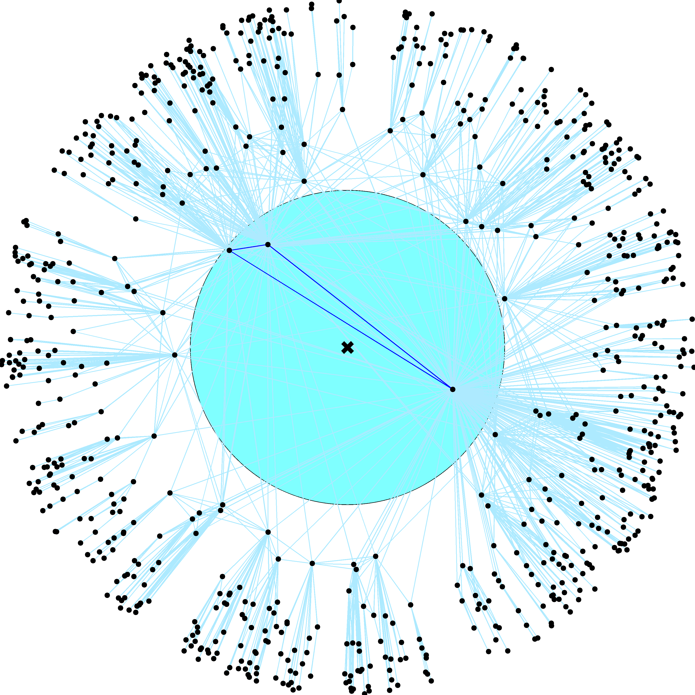

Slide 48
$$N_{τ}=N{\left(\frac{κ_{0}}{κ_{τ}}\right)}^{γ−1}$$
$$_{}=$$
$${\left\langle c\right\rangle }_{τ}=\left\langle c\right\rangle$$
$$\frac{{\left\langle k\right\rangle }_{τ}}{\left\langle k\right\rangle }={\left(\frac{N}{N_{τ}}\right)}^{\frac{3−γ}{γ−1}}$$
$${\left\langle k\right\rangle }_{τ} ={\left\langle k\right\rangle \left(\frac{κ_{τ}}{κ_{0}}\right)}^{3−γ}$$

Slide 49
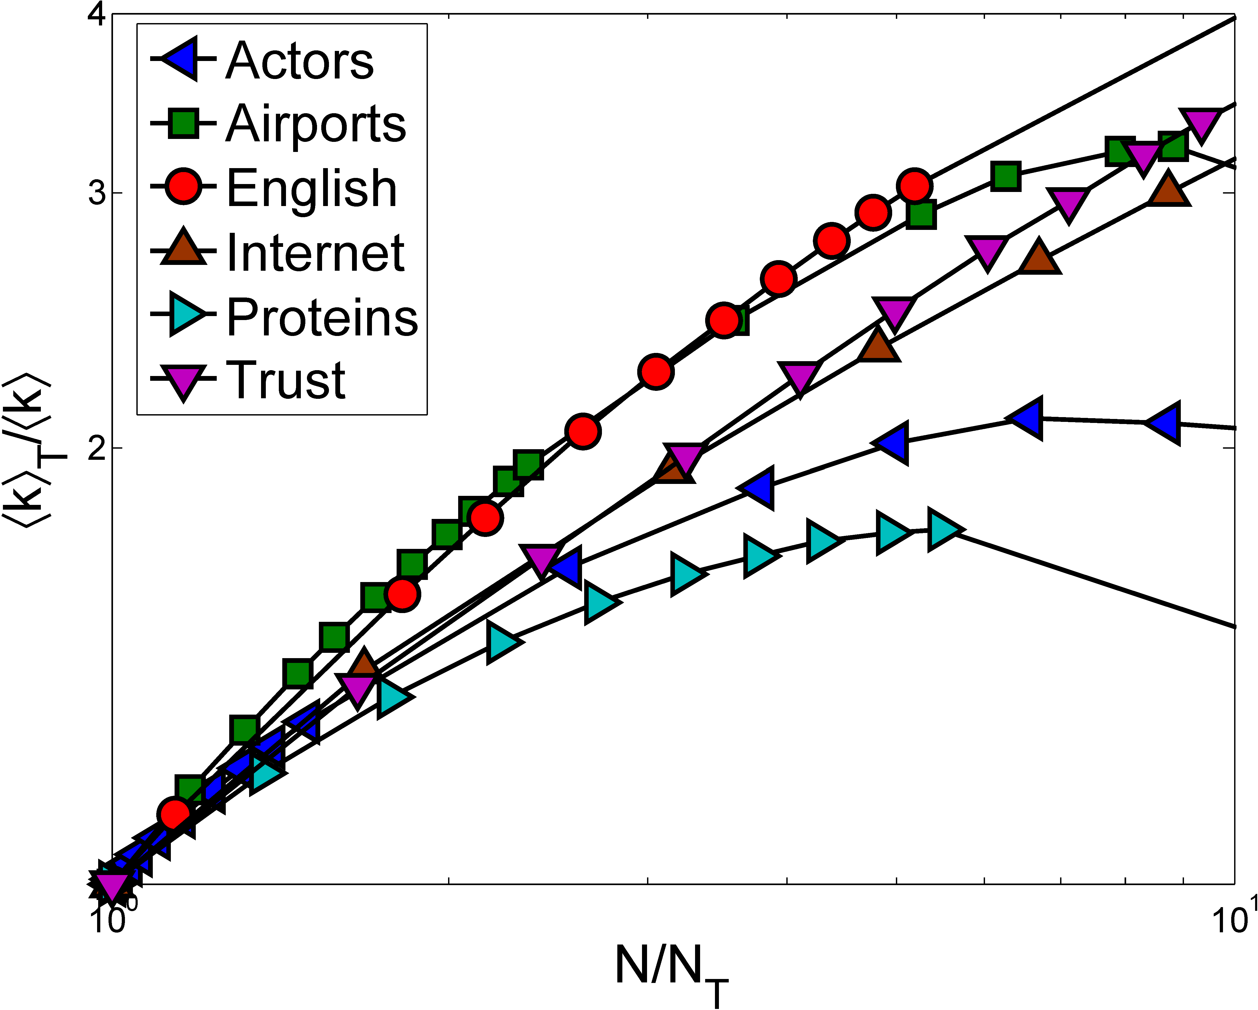

Slide 50
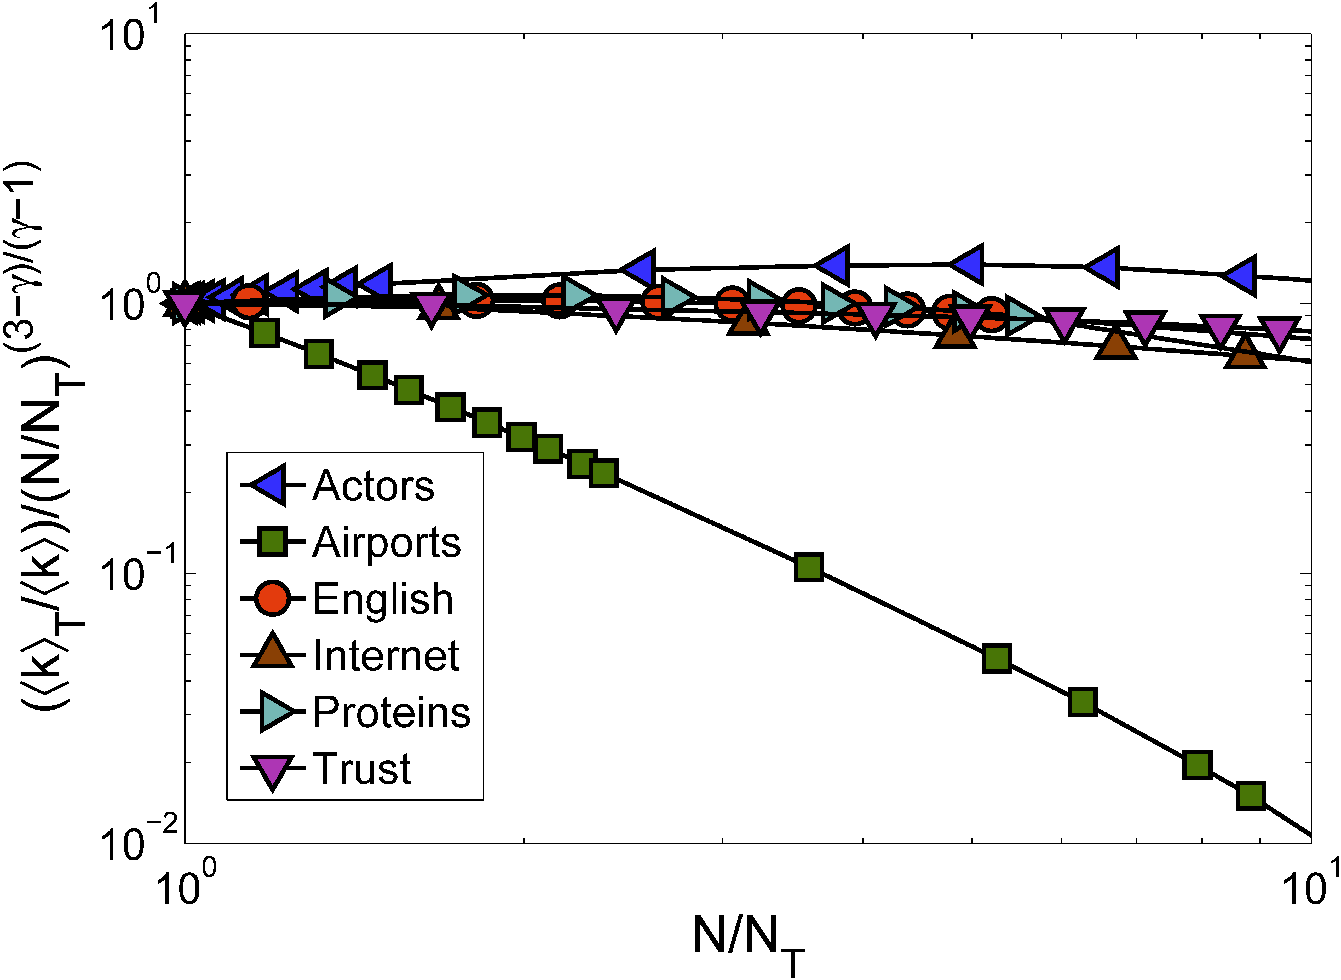

Slide 51
Theorem
Theorem:
Self-similar networks with growing ↑k() and linear N (N) have zero percolation threshold (↑k_{c} = 0)
Proof:
Suppose it is not true, i.e., ↑k_{c} > 0, and consider graph G below the threshold, i.e., a graph with ↑k < ↑k_{c} which has no giant component
Since ↑k() is growing, there exist  such that G’s subgraph G is above the threshold, ↑k > ↑k_{c}, i.e., G does have a giant component
Contradiction: a graph that does not have a giant component contains a subgraph that does

Slide 52
Conclusions
Amazingly simple proof of the strongest possible structural robustness for an amazingly general class of random networks
Applies also to random graphs with given degree correlations, and to some growing networks
Self-similarity, or more generally, scale or conformal invariance, seem to be the pivotal properties for percolation in networks
Other details appear unimportant
Conjecturing three obvious percolation universality classes for self-similar networks
↑k() increases, decreases, or constant (PA!)
The proof can be generalized to any processes whose critical parameters depend on ↑k monotonically
Ising, SIS models, etc.

