Slide 1
Analysis of peering strategy adoption by transit providers in the Internet
Aemen Lodhi (Georgia Tech)
Amogh Dhamdhere (CAIDA)
Constantine Dovrolis (Georgia Tech)
Simula Research, May 30, 2012

Slide 2
Outline
Background
Motivation & Objective
Approach: the GENESIS model
Results
  Adoption of peering strategies
  Impact on economic fitness
  Who loses? Who gains?
Alternative peering strategies
Conclusion

Slide 3
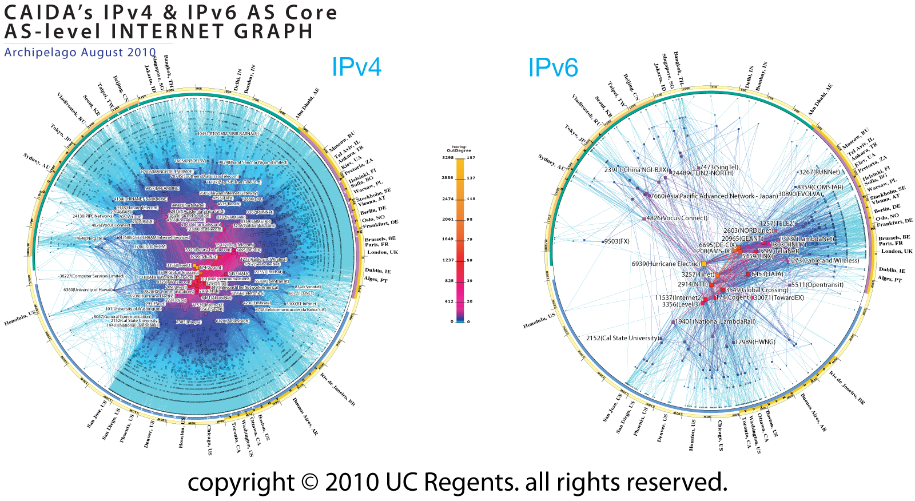
Pretty picture of the Internet

Slide 4
Background
The Internet consists of ~40,000 networks
Each independently operated and managed
  Called “Autonomous Systems” (ASes)
  Various types: transit, content, access, enterprise
Distributed, decentralized interactions between ASes
Transit link: Customer pays provider
Settlement-free peering link: Exchange traffic for free

Slide 5
Background
The Internet again..less pretty
Tier-1 network
Tier-1 network
$$
Tier-1 network
$$
Transit Provider
Transit Provider
$$
$$
$$
Enterprise customer
Content Provider
Content Provider
Enterprise customer

Slide 6
Motivation: Existing peering environment
Increasing fraction of interdomain traffic flows over peering links*
How are transit providers responding?
Transit Provider
☺
☹
☺
☹
Content Provider/CDN
Access ISP/Eyeballs

Slide 7
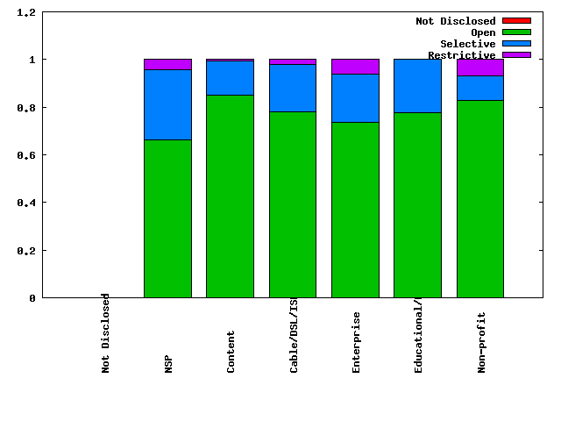
Motivation: Existing peering environment
Peering strategies of ASes in the Internet
(source: PeeringDB www.peeringdb.com)
Transit Providers peering openly ?

Slide 8
Objective
Why are so many transit providers peering openly?
What gives them the incentive to do so?
What is the impact on their economic fitness?
Which transit providers lose/gain?
Are their any alternative peering strategies?

Slide 9
The model: GENESIS*
Agent based interdomain network formation model
Incorporates
  Geographic constraints in provider/peer selection
  Interdomain traffic matrix
  Public & Private peering
  Realistic peering costs, transit costs, transit revenue

Slide 10
The model: GENESIS*
  Fitness = Transit Revenue – Transit Cost – Peering cost
Objective: Maximize economic fitness
Optimize connectivity through peer and transit provider selection
Choose the peering strategy that maximizes fitness

Slide 11
Peering strategies
Networks must be co-located in order to establish a peering link
Restrictive: Peer only if the internetwork would otherwise be partitioned
Selective: Peer only with networks of “similar size”
  Use total traffic volume of potential peers as proxy for size
Open: Agree to peer with any co-located network

Slide 12
Peering strategy adoption
Strategy update in each round
Enumerate all available strategies
Estimate fitness with the connectivity that results from each strategy
Choose the one which gives maximum fitness

Slide 13
Execution of a sample path
No exogenous changes
Networks have no foresight
Networks do not co-ordinate
Continues until every network has played, but none has changed its peering strategy
Depeering
Peering
Transit provider selection
Peering strategy update
Depeering
Peering
Transit provider selection
Peering strategy update
Depeering
Peering
Transit provider selection
Peering strategy update
Iteration
Iteration
1
2
N
1
2
N
Time

Slide 14
Scenarios
*Stubs always use Open
Without-open
Selective
Restrictive
With-open
Selective
Restrictive
Open
vs.

Slide 15
results

Slide 16
Strategy adoption by transit providers

Slide 17
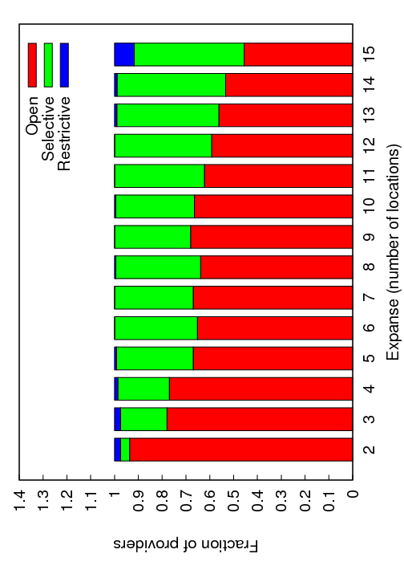
Strategy adoption by transit providers
Attraction towards Open peering not uniform
Less attractive for large transit providers

Slide 18
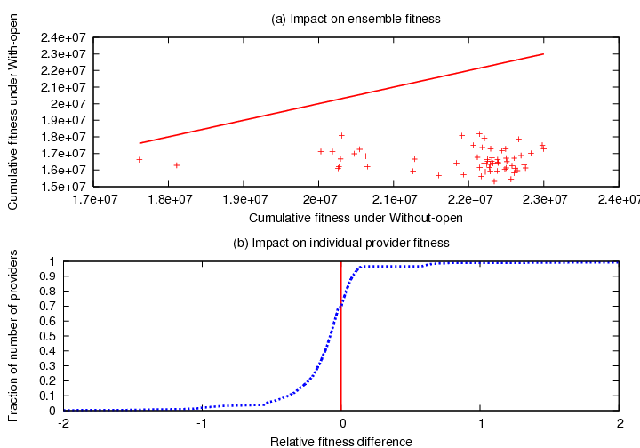
Impact of Open peering on cumulative fitness
Cumulative fitness reduced in all simulations
70% providers have lower fitness

Slide 19
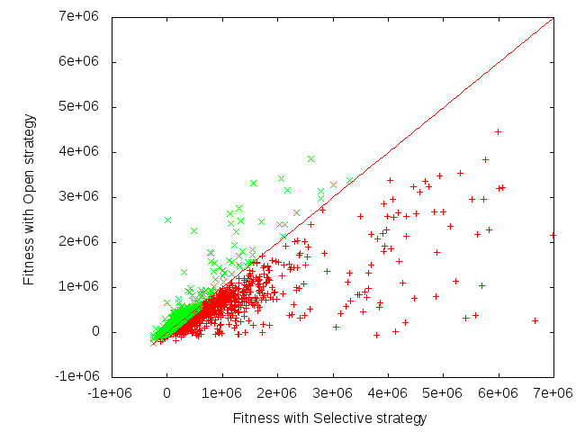
Impact of Open peering on individual fitness
Some providers lose significantly due to open peering

Slide 20
An Open peering environment
Affects:
Transit Cost
Transit Revenue
Peering Cost
v
Save transit costs
x
y
But your customers are doing the same!
z
w

Slide 21

Why gravitate towards Open peering?
Options for x?
Y reduced transit traffic and revenue for X!!
x adopts Open peering
x
y
Not isolated decisions!!
X recovers some of its transit traffic
Y peering openly
z w,
traffic passes through x
z
w
z w,
z y,
traffic bypasses x

Slide 22
Some Game Theory (finally..)
Analyzed a simplified model game-theoretically
  Only two providers, co-located, no economies of scale, each has single customer
With complete information about each other’s payoffs, providers choose Selective peering
In the absence of complete information, Open peering is the “risk-dominant” strategy

Slide 23

Quantifying traffic stealing
Contention metric: Quantify traffic stealing effect
No contention
Maximum Contention
x
y
z
w

Slide 24
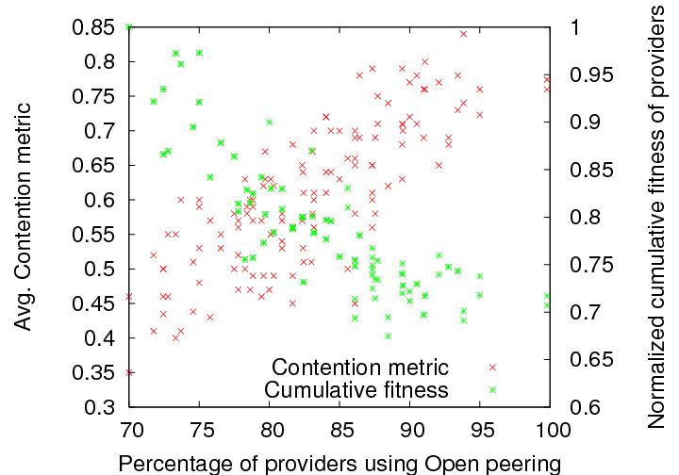
Contention and fitness
Cumulative fitness of transit providers decreases as traffic stealing becomes more prevalent

Slide 25
Avoid fitness loss?
Lack of coordination
No incentive to unilaterally withdraw from peering with peer’s customer
Sub-optimal equilibrium
x
y
vs.
x
y
z
w
z
w

Slide 26
Traffic volume and customer cone size
Traffic stealing seems to be the root cause of fitness loss
Let’s classify providers based on how likely they are to steal traffic and have their traffic stolen by peers
See what happens to different classes

Slide 27
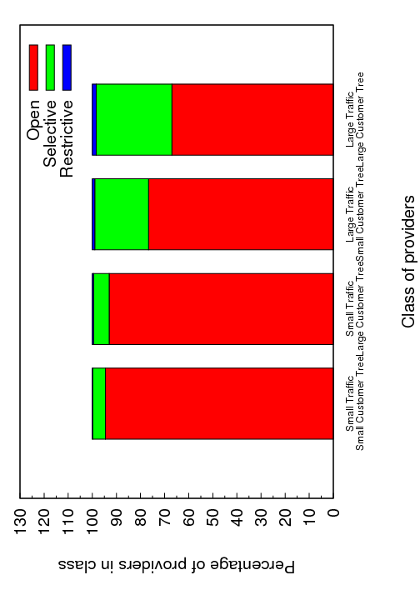
Classification of transit providers
Classification of transit providers
  Traffic volume, Customer cone size

Slide 28
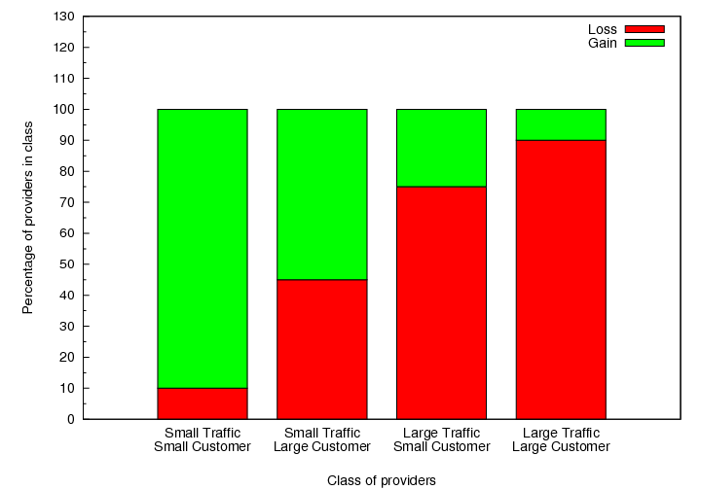
Who loses? Who gains?

Slide 29
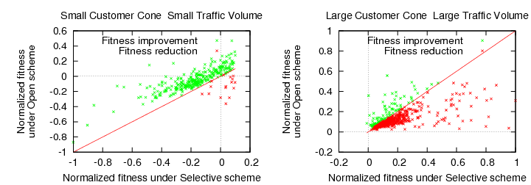
Who loses? Who gains?
Who gains: Small customer cone small traffic volume
  Cannot peer with large providers using Selective
  Little transit revenue loss
Who loses: Large customer cone large traffic volume
  Can peer with large transit providers with Selective
  Customers peer extensively

Slide 30
Alternatives: Open peering variants
Do not peer with immediate customers of peer (Direct Customer Forbiddance DCF)
Do not peer with any AS in the customer tree of peer (All Customer Forbiddance ACF)
x
y
x
y
w
z
w
z
v
DCF
ACF

Slide 31
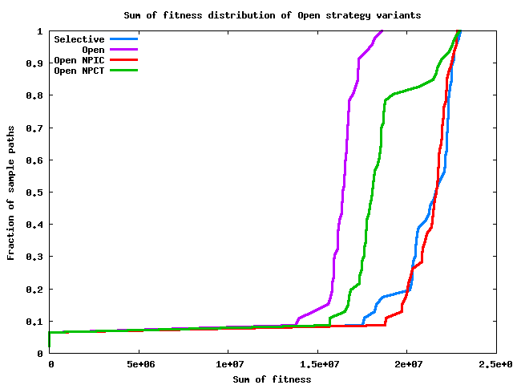
Open peering variants: Fitness
Selective
Open
DCF
ACF
Collective fitness with DCF approaches Selective

Slide 32
Open peering variants: Fitness
Why the improvement with DCF?
  No traffic “stealing” by peers
  Aggregation of peering traffic over fewer links (economies of scale !!)
  Less pressure to adopt Open peering

Slide 33
Open peering variants: Open questions
These rules cannot be enforced!
What happens if some networks decide to cheat at the eqilibrium? i.e., is the DCF equilibrium stable?
  Tit-for-tat equibrium
  Genetic algorithm
What if some networks never agree to DCF? Can these networks cause the system to gravitate towards Open peering?
  Coaalition games
  Shapley value

Slide 34
Conclusion
Gravitation towards Open peering is a network effect for transit providers (79% adopt Open peering)
  Economically motivated strategy selection
  Myopic decisions
  Lack of coordination
Extensive Open peering by transit providers in the network results in collective loss

Slide 35
Conclusion
Effect on the fitness of transit providers is not uniform
  Small transit providers gain
  Large transit providers lose
Coordination is required to mitigate losses
Not peering with customers of peers can avoid fitness loss

Slide 36
Thank you

Slide 37
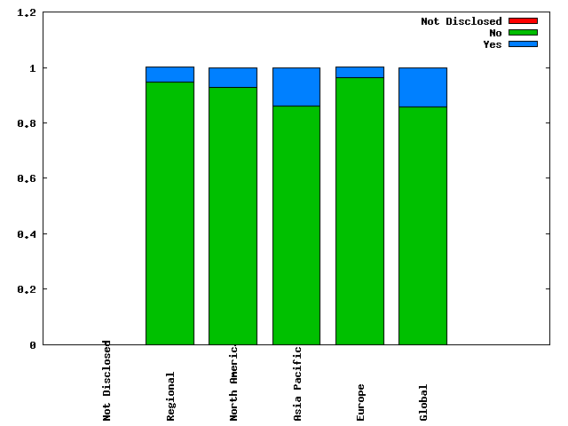
Motivation
Traffic ratio requirement for peering?
(source: PeeringDB www.peeringdb.com)

Slide 38
Traffic components
Inbound traffic
Traffic consumed in the AS
Traffic generated within the AS
Traffic transiting through the AS
Autonomous system
Outbound traffic
Transit traffic = Inbound traffic – Consumed traffic
same as
Transit traffic = Outbound traffic – Generated traffic

Slide 39
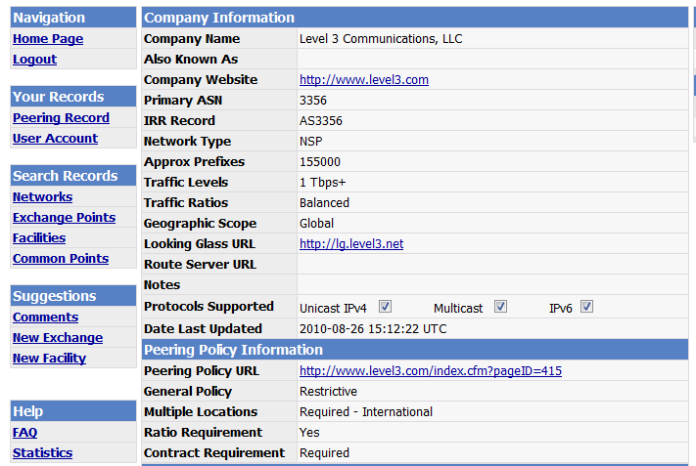
Customer-Provider traffic comparison – PeeringDB.com
Traffic carried by the AS

Slide 40
Customer-Provider traffic comparison
2500 customer-provider pairs
90% pairs: Customer traffic significantly less than provider traffic
9.5% pairs: Customer traffic larger than provider traffic (difference less than 20%)
0.05% pairs: Customer traffic significantly larger than provider traffic

Slide 41
Geographic presence & constraints
Peering link at top tier possible across regions
Geographic overlap
Link formation across geography not possible
Regions corresponding to unique IXPs

Slide 42
Logical Connectivity

Slide 43
Traffic Matrix
Traffic for ‘N’’ size network represented through an N * N matrix
Illustration of traffic matrix for a 4 AS network
Intra-domain traffic not captured in the model
Traffic sent by AS 0 to other ASes in the network
Generated traffic
Traffic received by AS 0 from other ASes in the network
Consumed traffic

