Slide 1
Hyperbolic Geometry of Large Networks
Dmitri Krioukov CAIDA/UCSD DARPA, February 2012

Slide 2
Large networks
Technological
Internet
Transportation
Power grid
Social
Collaboration
Trust
Friendship
Biological
Gene regulation
Protein interaction
Metabolic
Brain
Can there be anything common to all these networks???
Naïve answer:
No
Well, yes: they all are messy, complex, “very random”
And that’s it

Slide 3
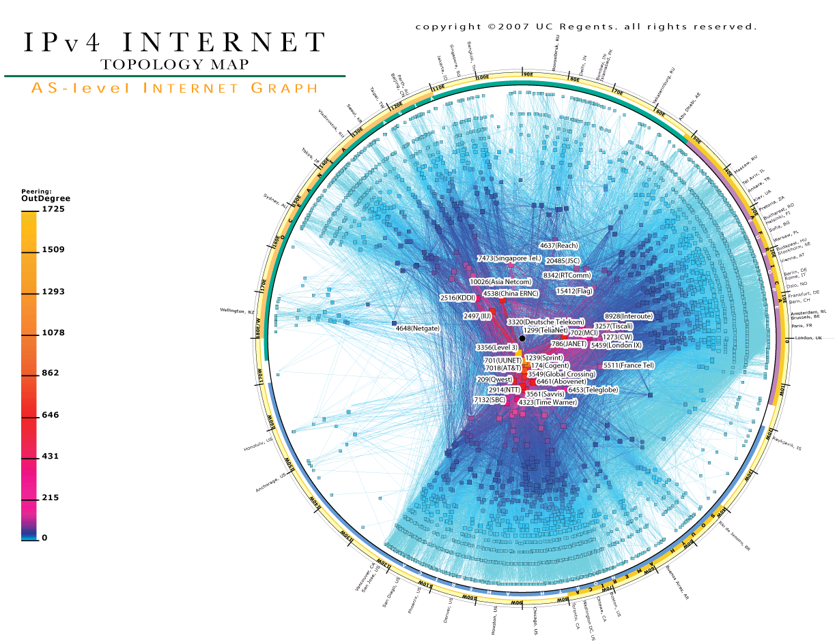

Slide 4
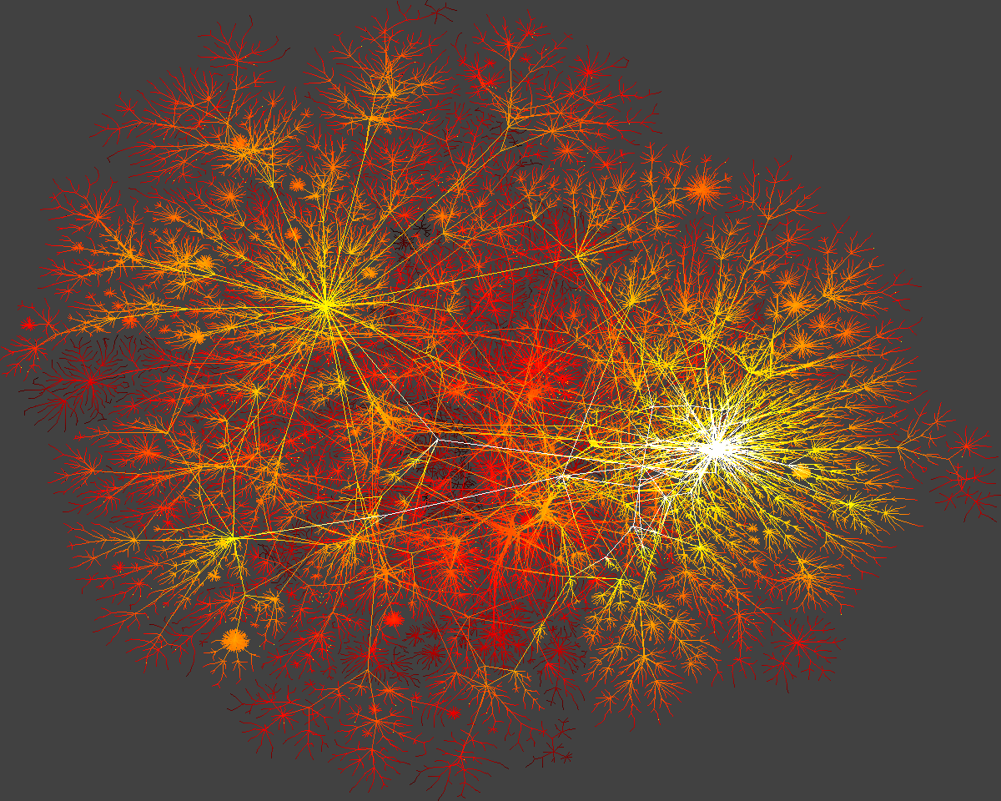

Slide 5
“Very random” graphs
Classical random graphs (Erdős-Rényi)
Take N nodes
Connect each node pair with probability p
Soft version of -regular graphs (  Np)
Maximum-entropy graphs of size N and expected average degree 

Slide 6
Heterogeneity
Distribution P(k) of node degrees k
Real: P(k) ~ k
Random: P(k) ~ ^{k} e / k!

Slide 7
“Less random” graphs
Random graphs with expected node degree distributions
Take N nodes
Assign to each node a random variable  drawn from a desired distribution, e.g., () ~ 
Connect each node pair with probability p(,) ~ 
Soft version of the configuration model
Maximum-entropy graphs of size N and expected degree distribution ()

Slide 8
Clustering
Distribution P(k) of node degrees k
Real: P(k) ~ k
Random: P(k) ~ k
Average probability that node neighbors are connected
Real: 0.5
Random: 710^{4}

Slide 9
Random geometric graphs
Take a compact region in a Euclidean space, e.g., a circle of radius R
Sprinkle N nodes into it via the Poisson point process
Connect each pair of nodes if the distance between them is d  r  R

Slide 10
Heterogeneity lost
Distribution P(k) of node degrees k
Real: P(k) ~ k
Random: P(k) ~ ^{k} e / k!
Average probability that node neighbors are connected
Real: 0.5
Random: 0.5

Slide 11
Strong heterogeneity and clustering as common properties of large networks
Network | Exponent of the degree distribution | Average clustering
Internet | 2.1 | 0.46
Air transportation | 2.0 | 0.62
Actor collaboration | 2.3 | 0.78
Protein interaction S. cerevisiae | 2.4 | 0.09
Metabolic E. coli and S. cerevisiae | 2.0 | 0.67
Gene regulation E. coli and S. cerevisiae | 2.1 | 0.09

Slide 12
Any other common properties?
No
Well, some randomness, of course
Real large networks appear to be quite different and unique in all other respects
Any simple random graph model that can reproduce these two universal properties?

Slide 13
Hyperbolic geometric graphs
Take a compact region in a hyperbolic space, e.g., a circle of radius R
Sprinkle N nodes into it via the Poisson point process (R  ln N)
Connect each pair of nodes if the distance between them is x  R

Slide 14
Succeeded finally
Distribution P(k) of node degrees k
Real: P(k) ~ k
Random: P(k) ~ k
Average probability that node neighbors are connected
Real: 0.5
Random: 0.5

Slide 15
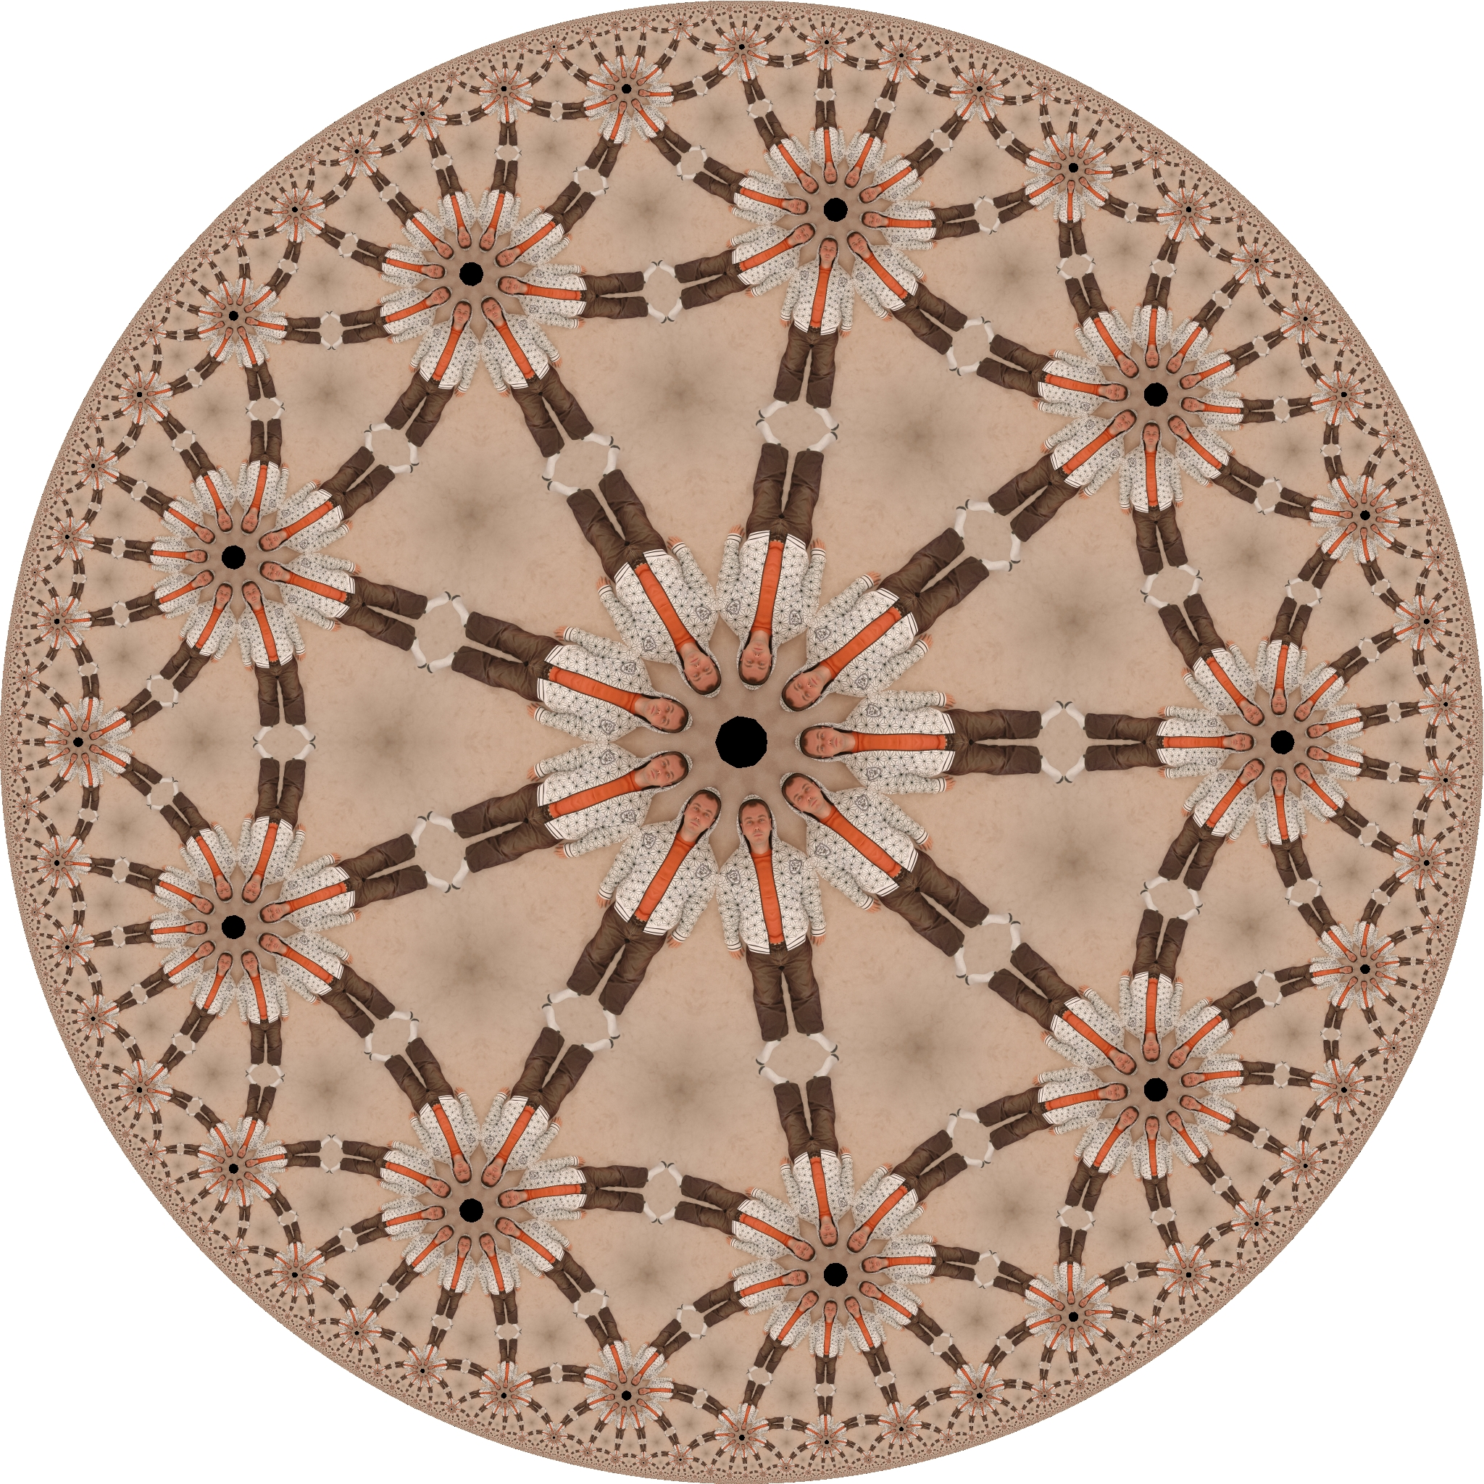

Slide 18
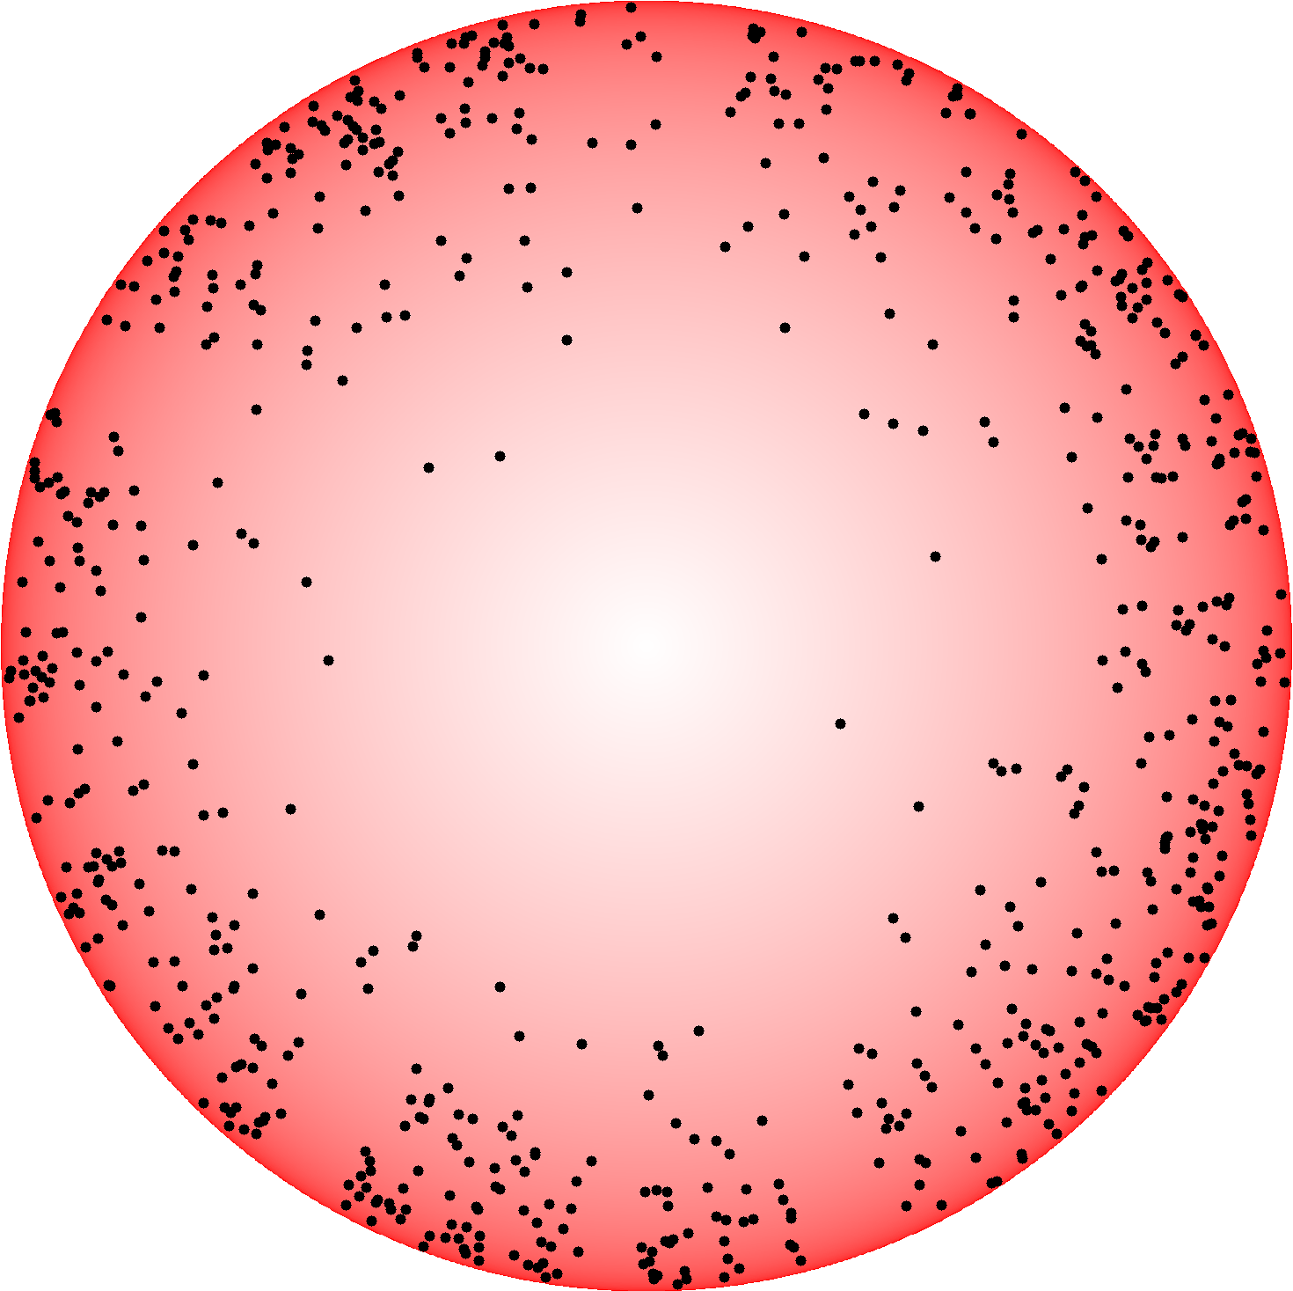

Slide 20
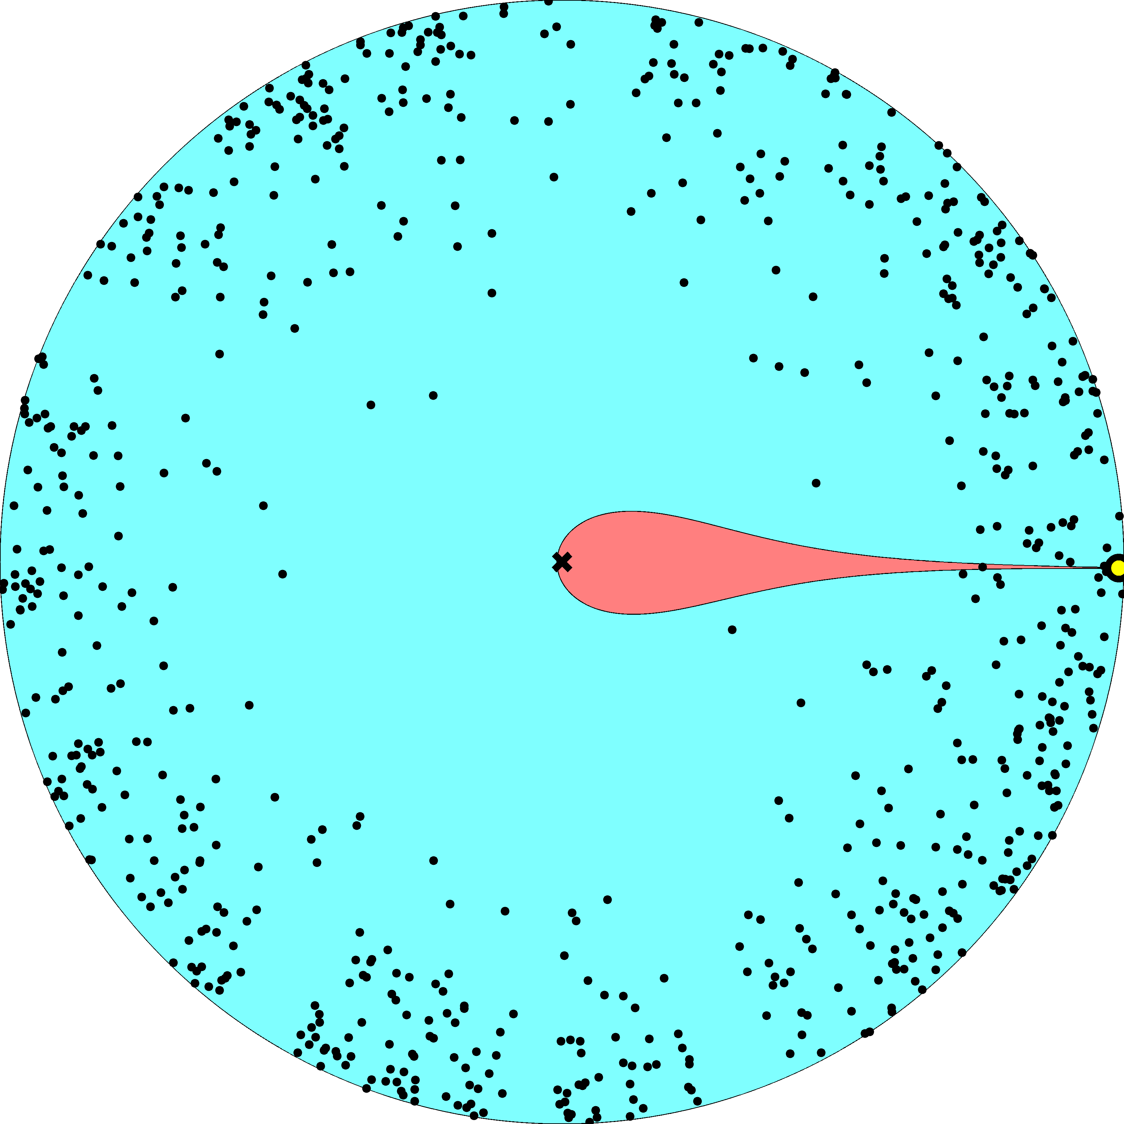

Slide 21
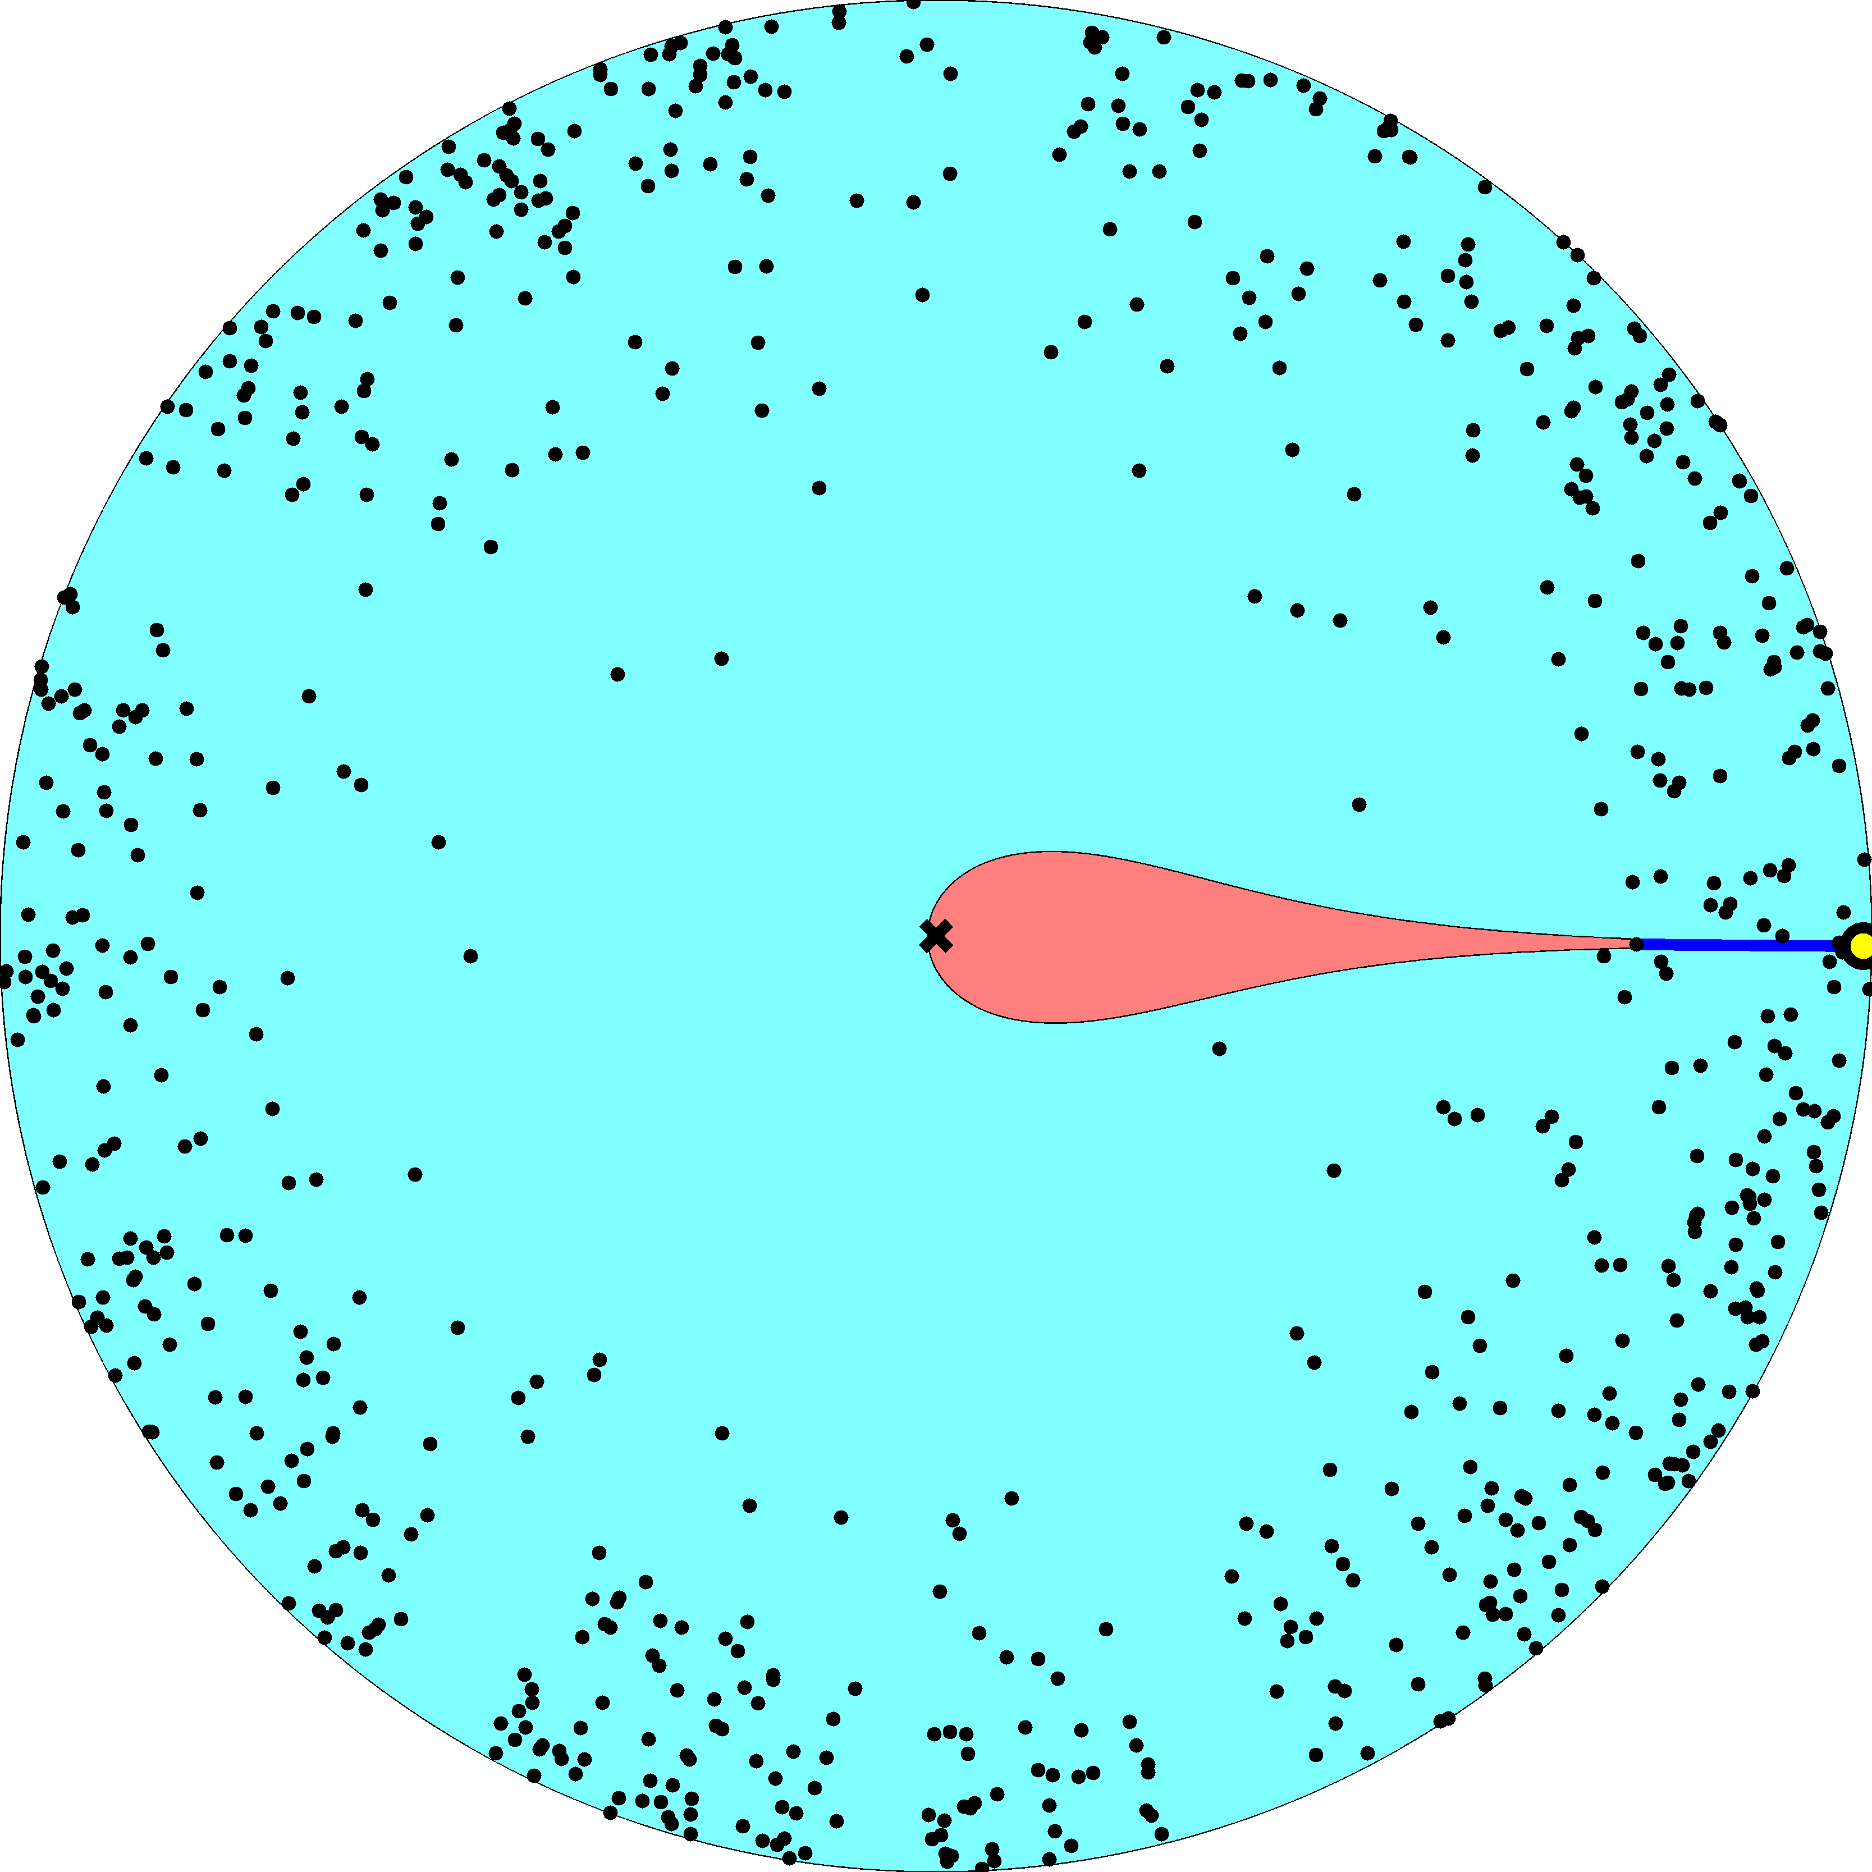

Slide 22
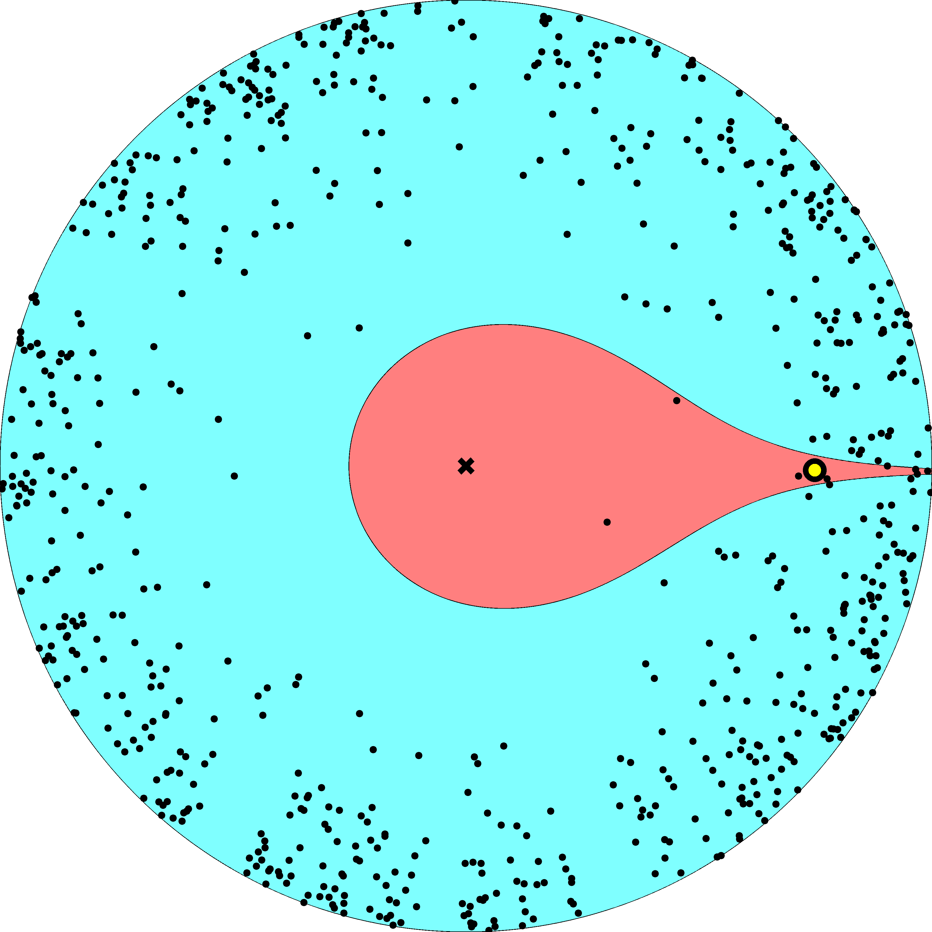

Slide 23
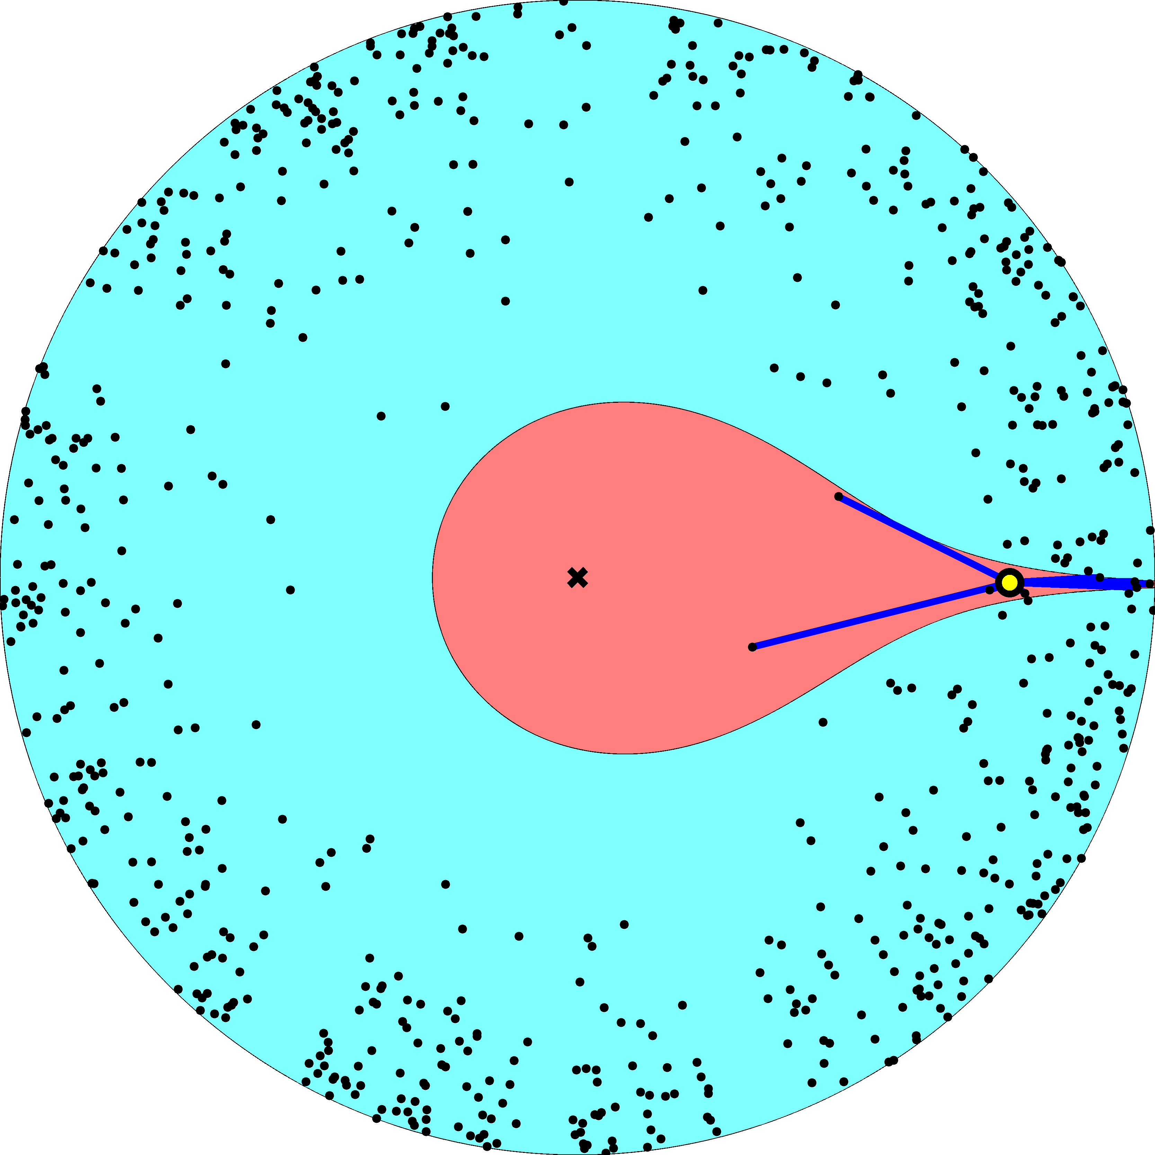

Slide 24
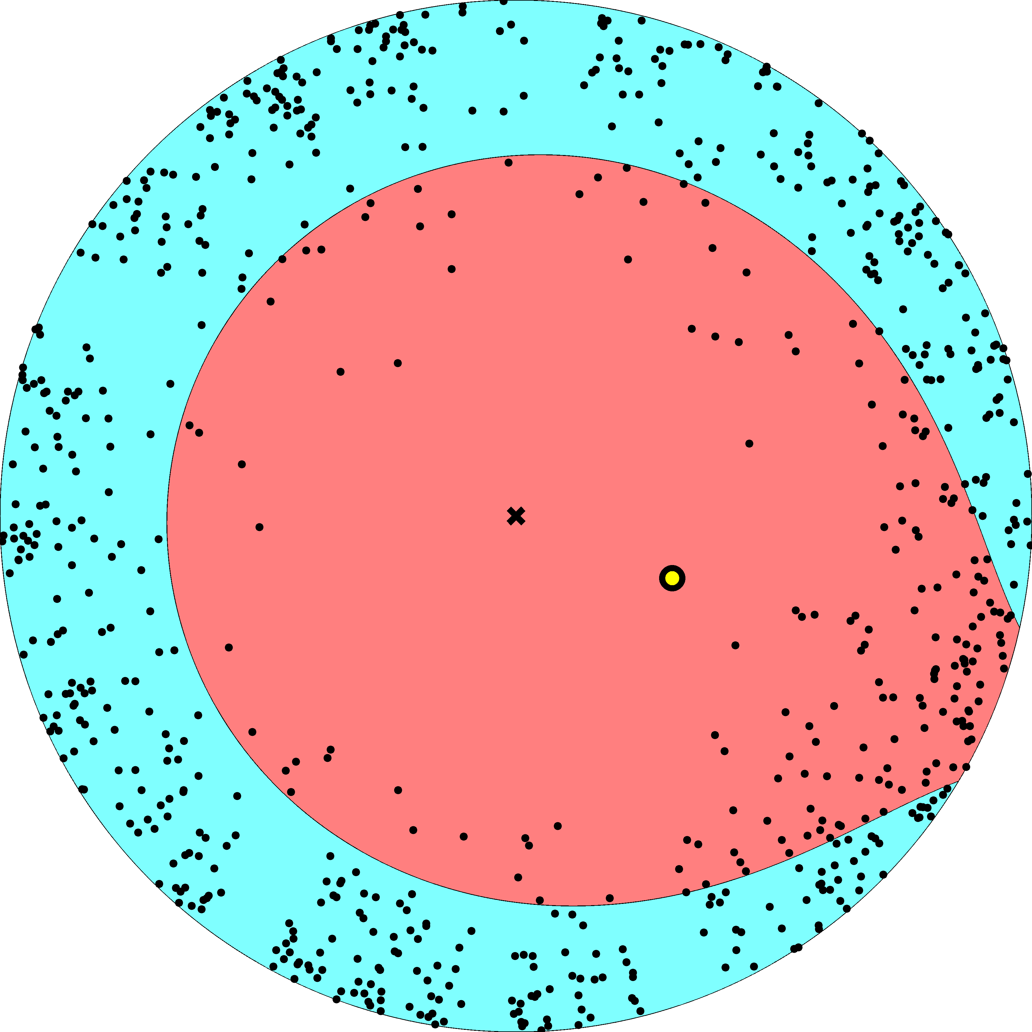

Slide 25
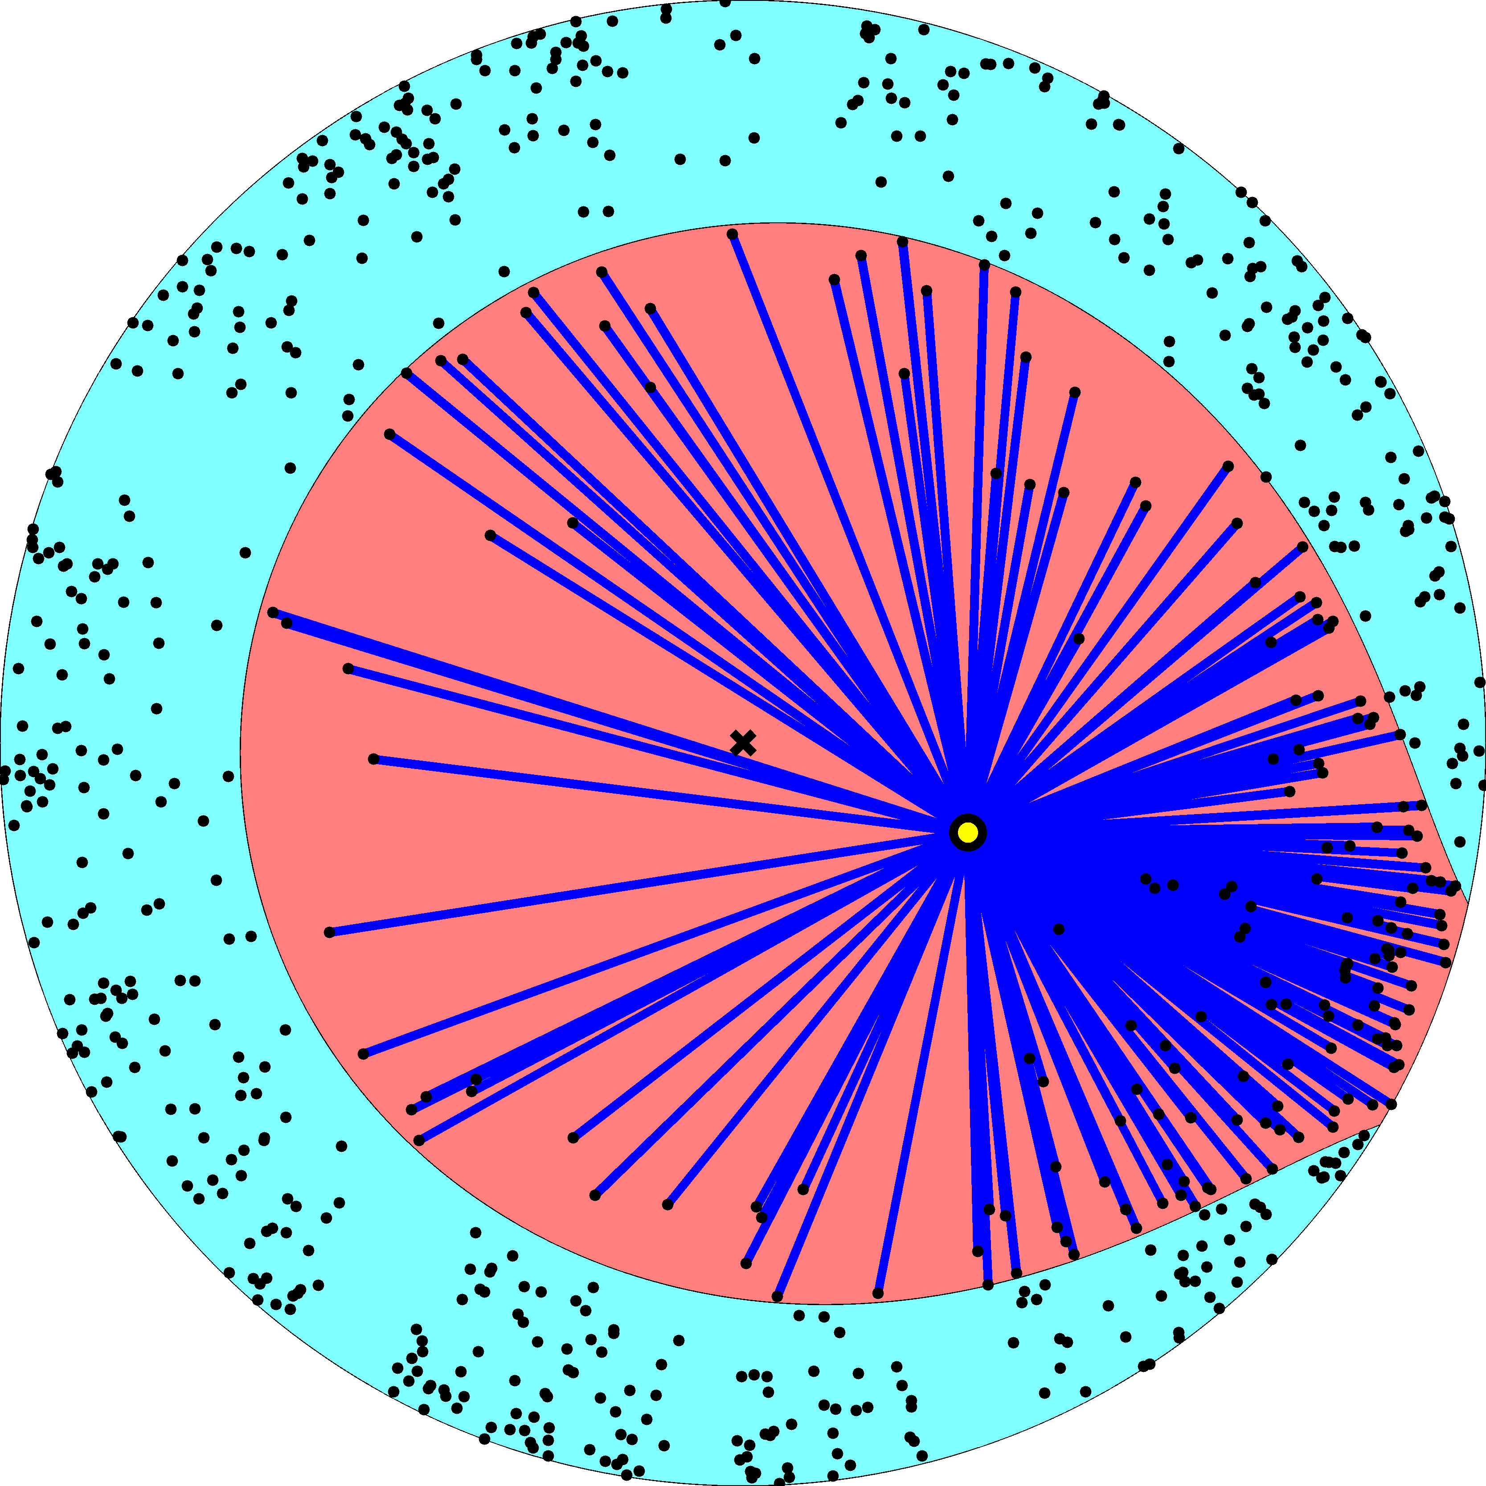

Slide 26
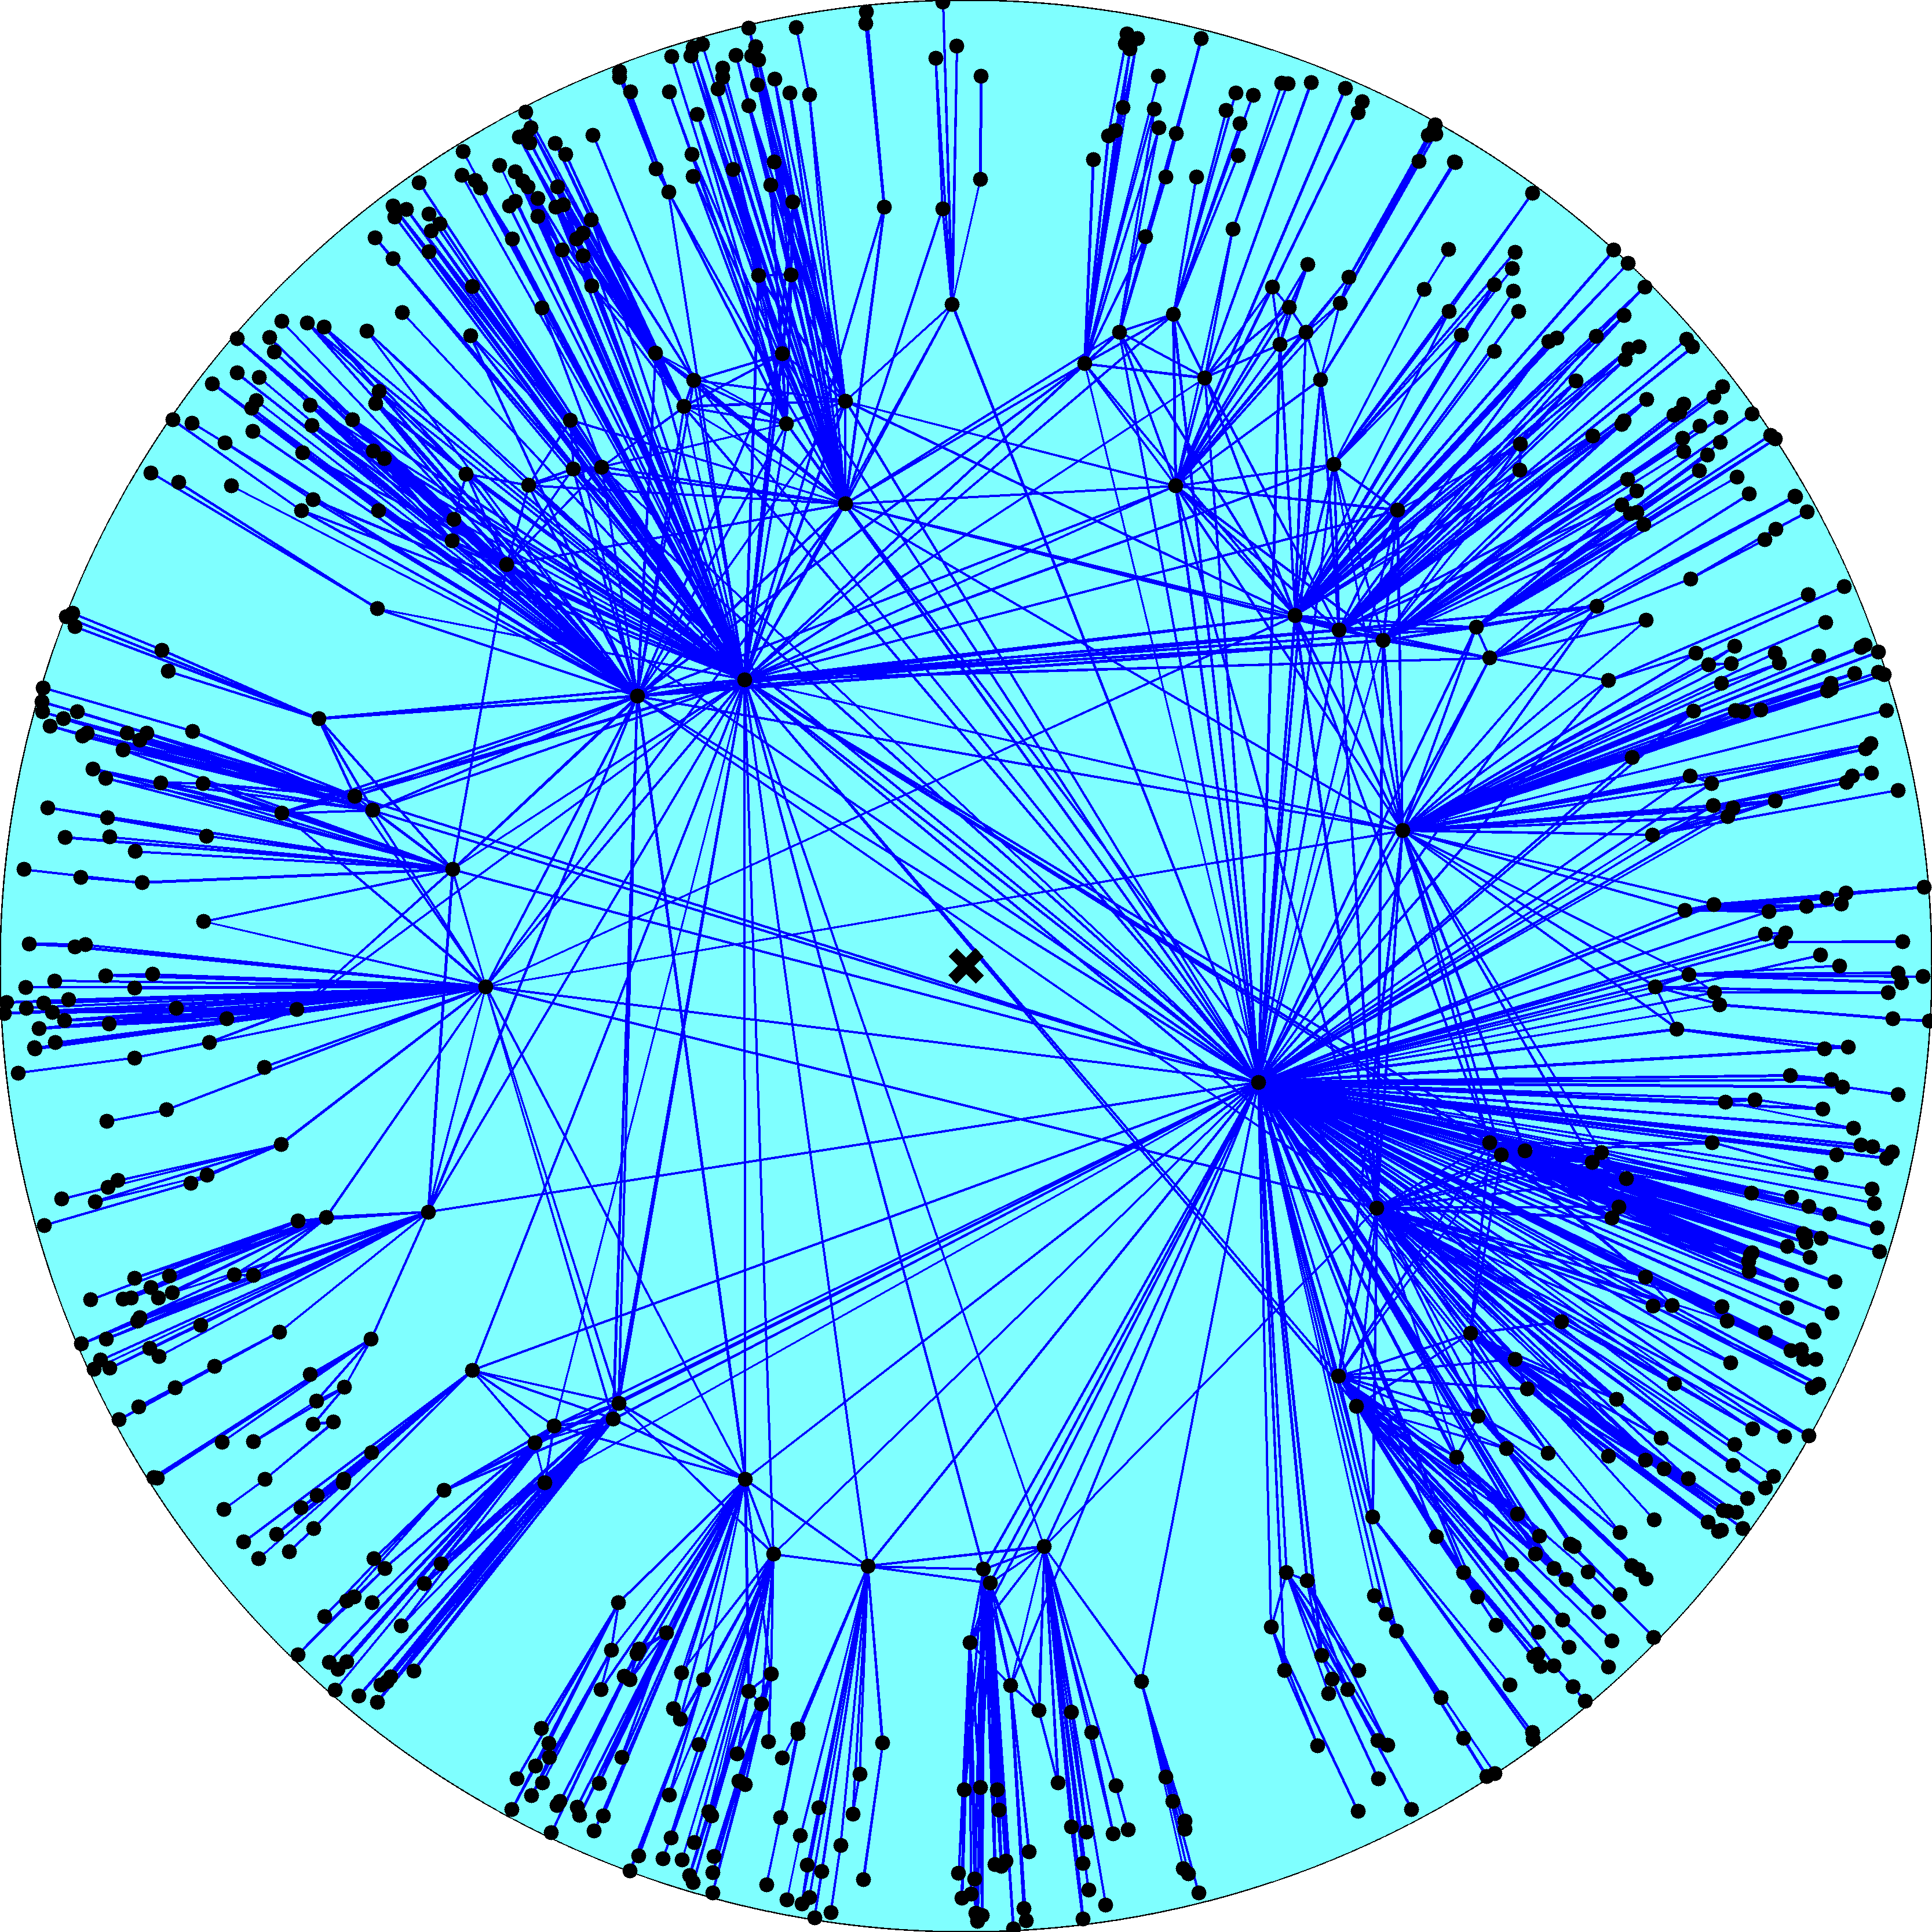
Node density
Node degree
R – disk radius
K – disk curvature
maximized
Degree distribution
Clustering

Slide 27
Fermi-Dirac connection probability
connection probability p(x) – Fermi-Dirac distribution
hyperbolic distance x – energy of links/fermions
disk radius R – chemical potential
two times inverse sqrt of curvature 2/ – Boltzmann constant
parameter T – temperature

Slide 28
Curvature and temperature
Curvature   0 controls power-law exponent   [2,]
Temperature T  0 controls clustering ↑c  [0,↑c_{max}]

Slide 29
Limiting cases
Curvature  \ Temperature T | Finite T | Infinite T
Finite  | Random hyperbolic graphs and real networks | Classical random graphs
Infinite  | Random geometric graphs | Random graphs with expected degree distributions

Slide 30
Network growth dynamics
Nodes join the network one by one t  1, 2, 3, …
New node t appears at a random location on the edge of an expanding hyperbolic disc of radius R  ln t
New node t connects to all existing nodes at hyperbolic distance x  R

Slide 32
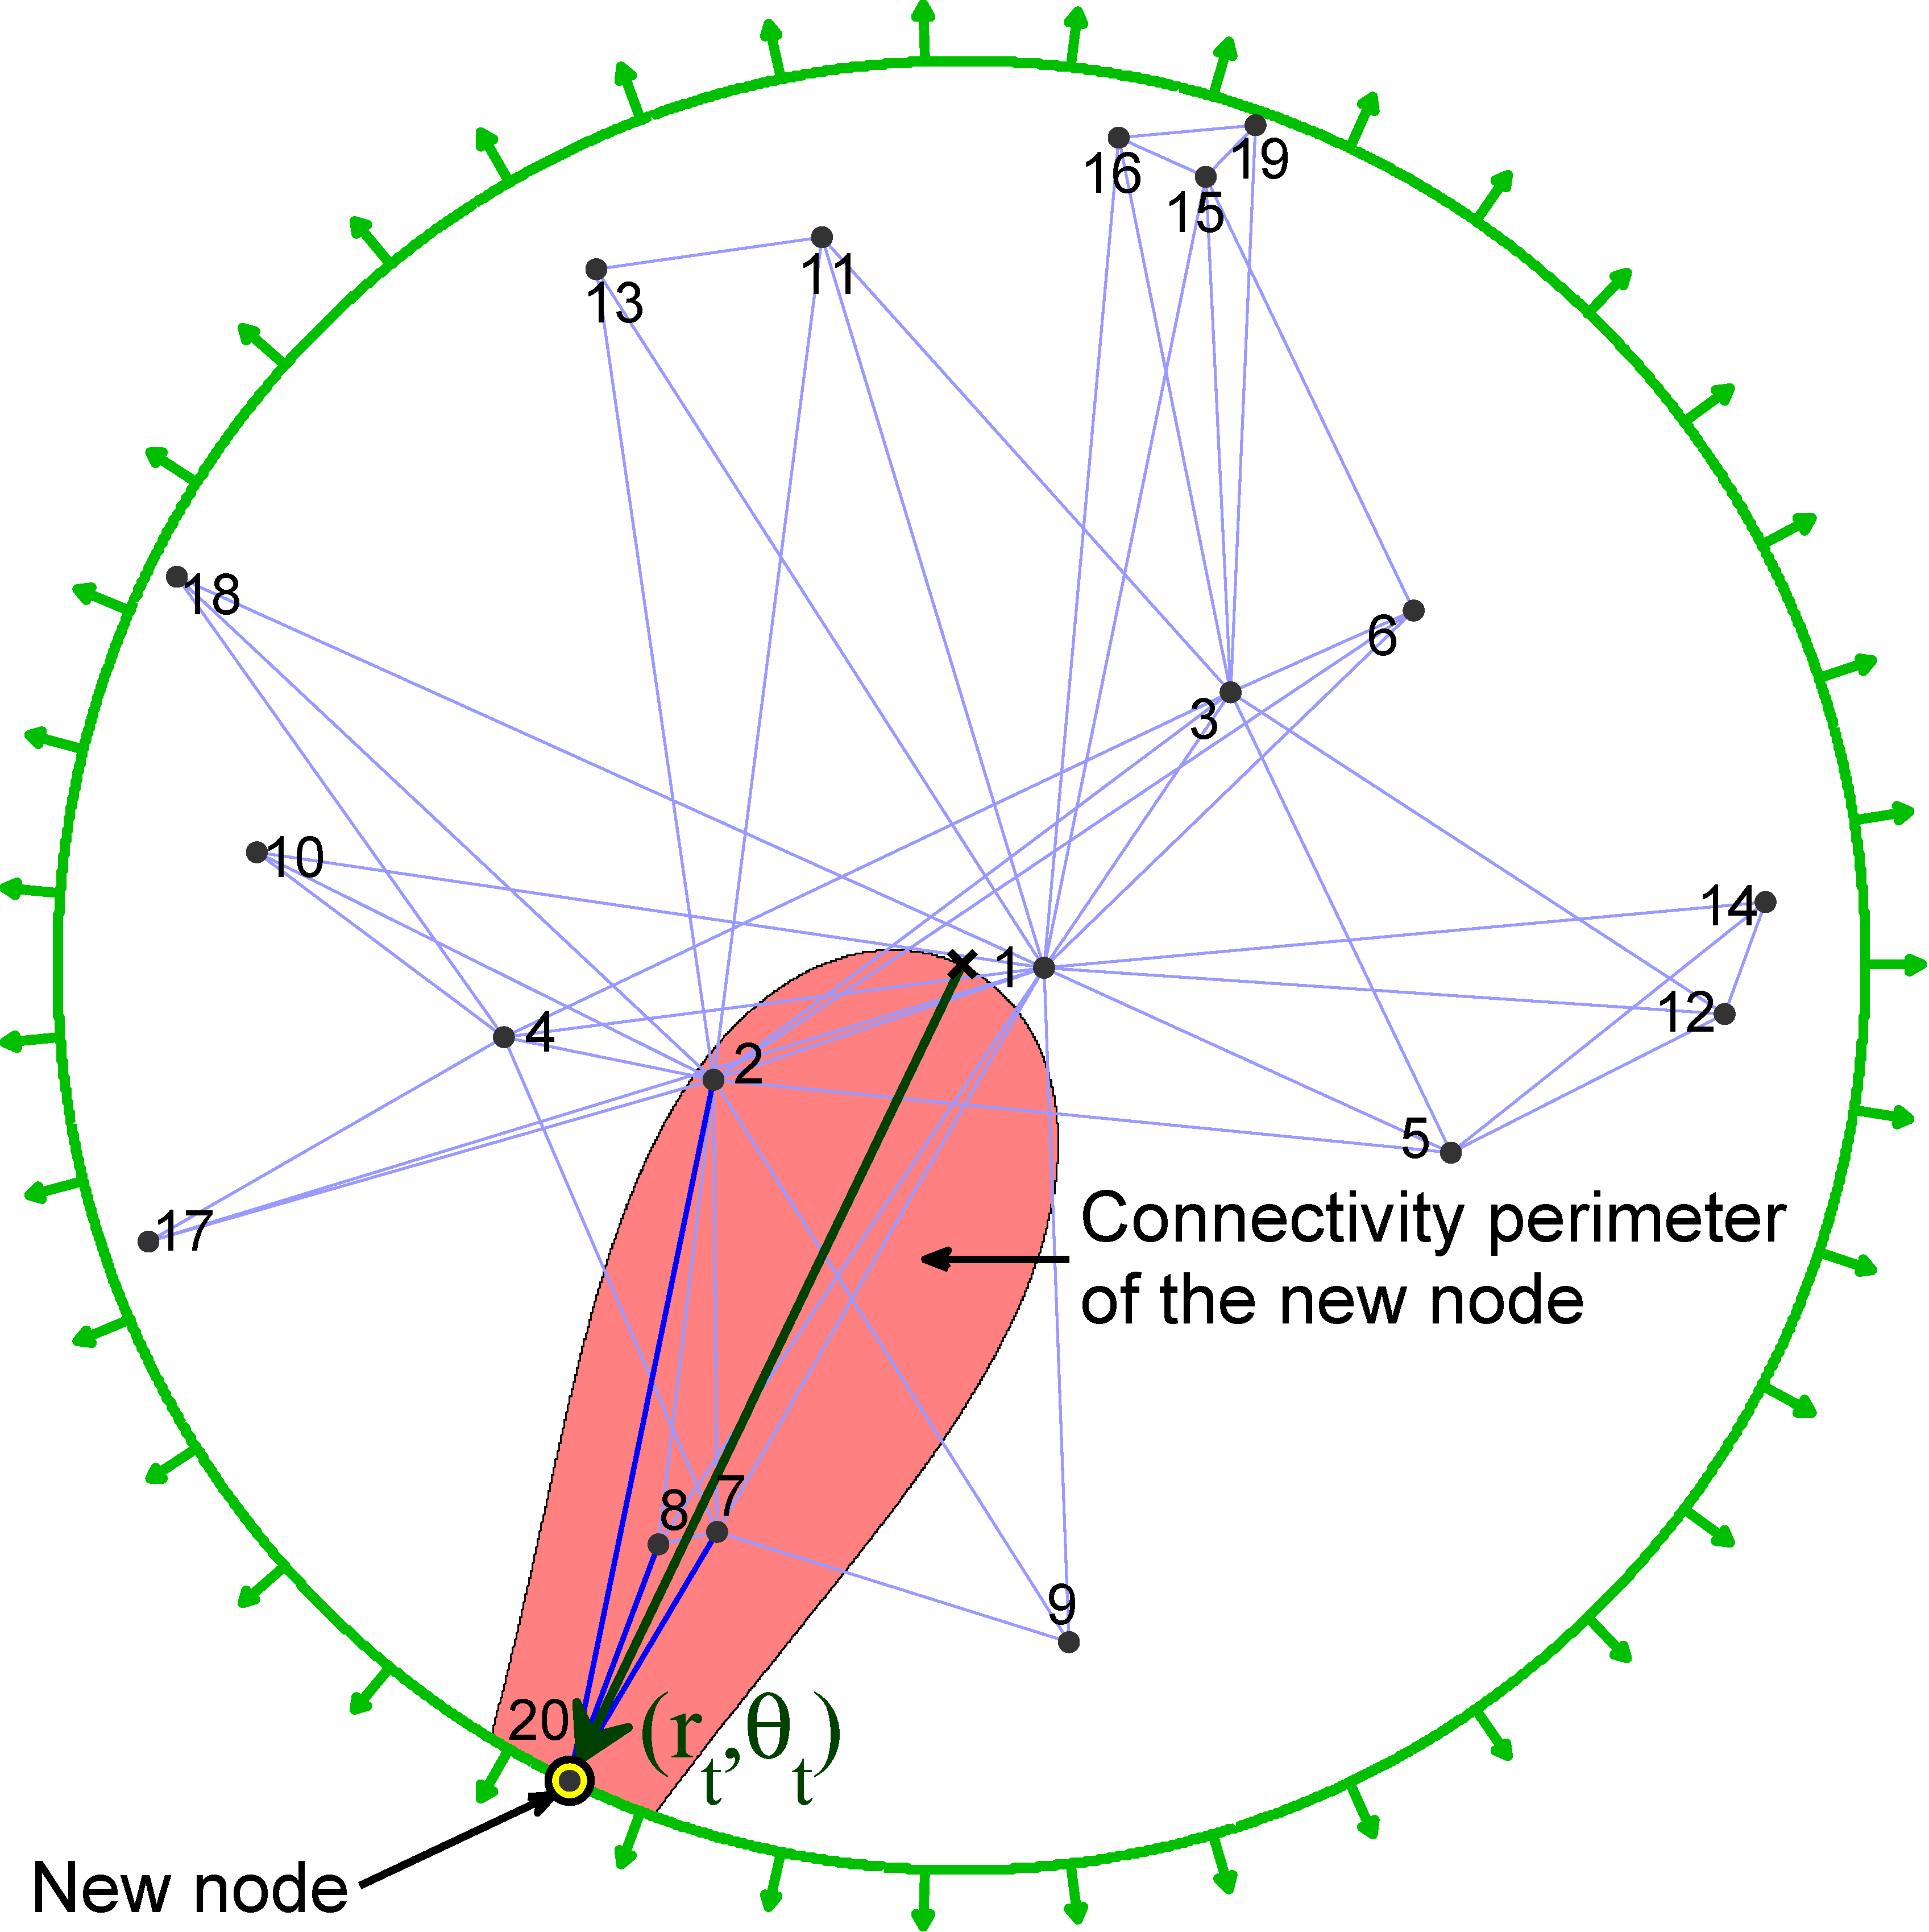

Slide 33
Limiting cases
Curvature  \ Temperature T | Finite T | Infinite T
Finite  | Growing random hyperbolic graphs and real networks | Growing classical random graphs
Infinite  | Growing random geometric graphs | Preferential attachment

Slide 34
Validation
Infer/learn node coordinates using maximum-likelihood methods (e.g., MCMC)
Compare the empirical probability of connections in the real network with the inferred coordinates against the theoretical prediction
If the model is correct, the two should match

Slide 35
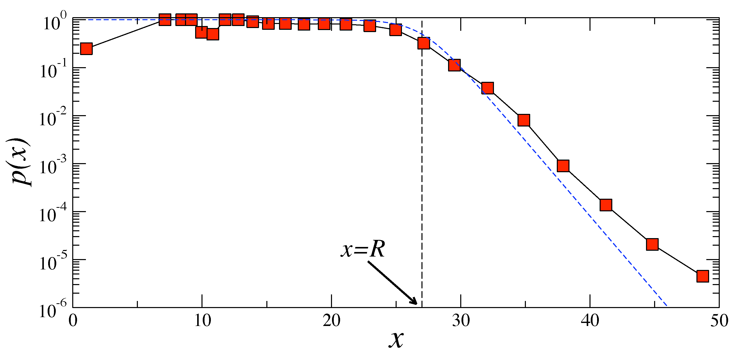
Internet

Slide 36
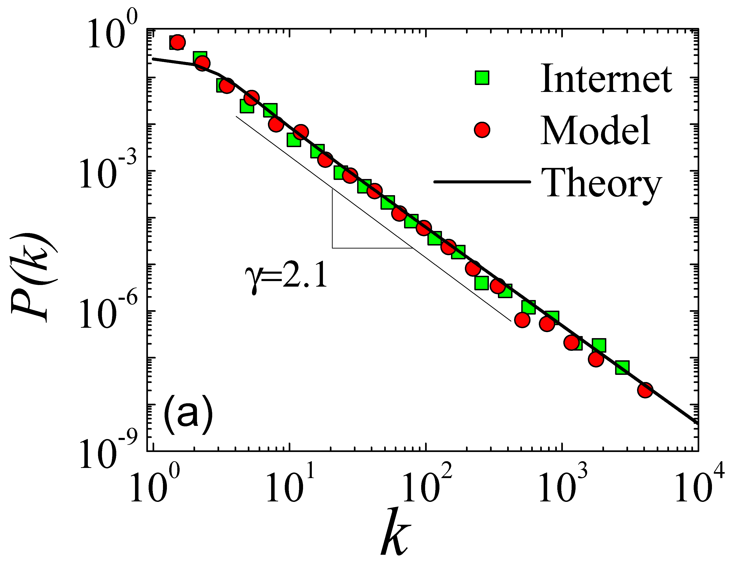

Slide 37
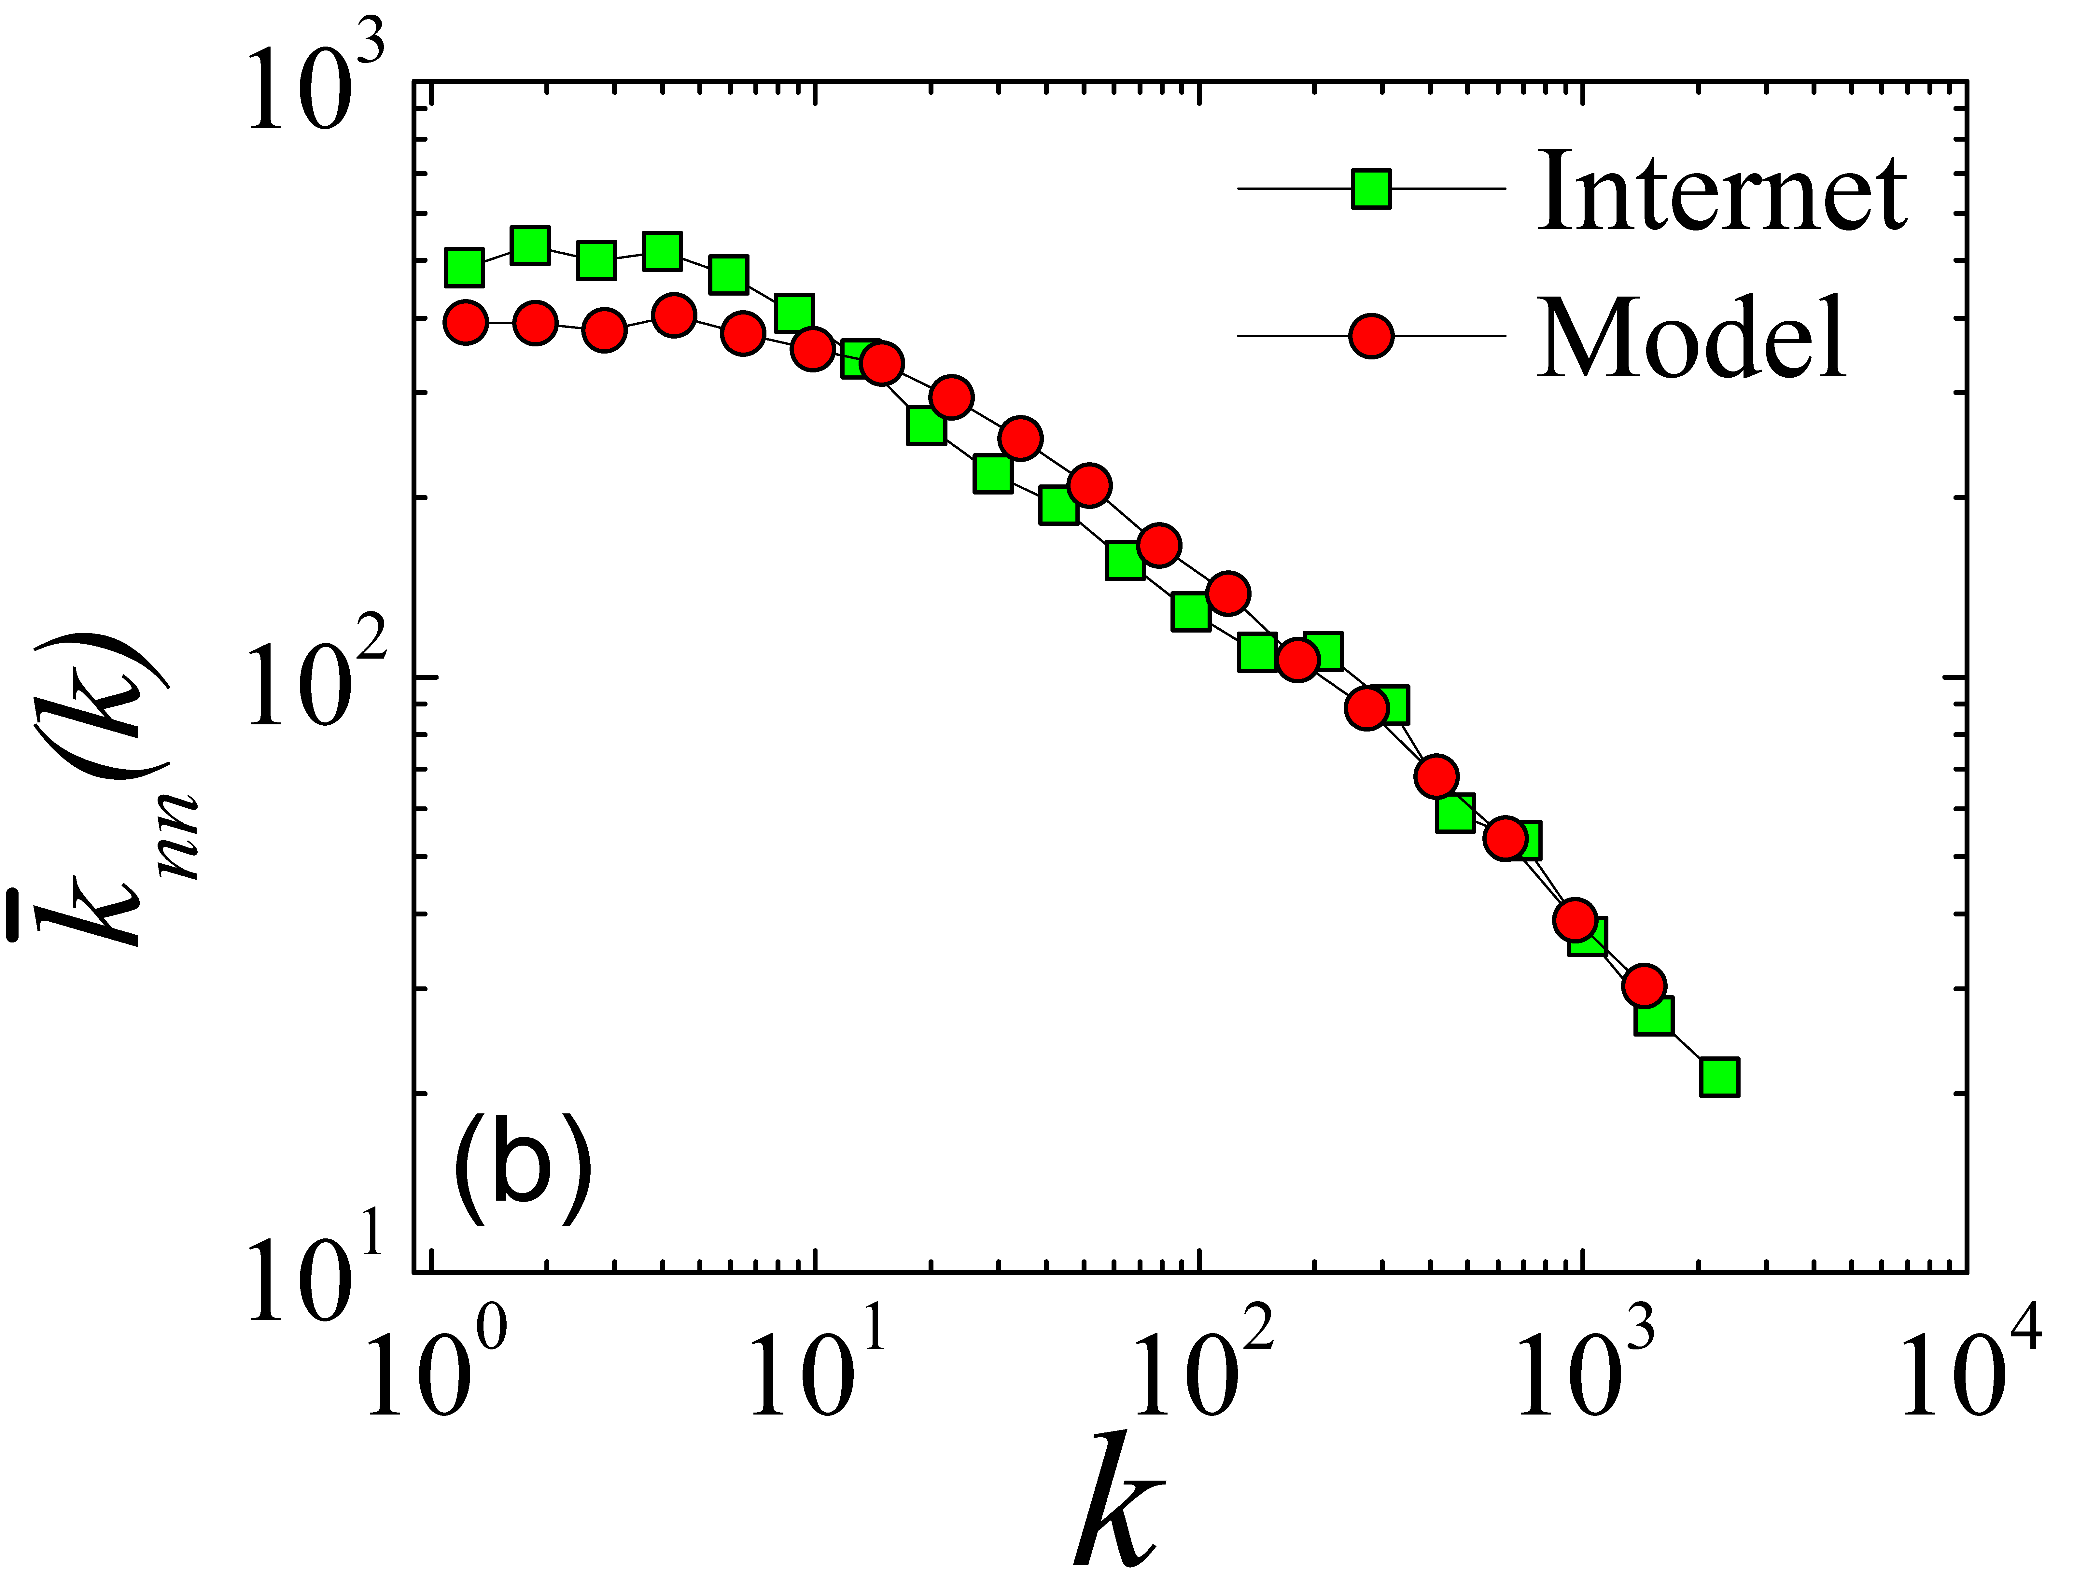

Slide 38
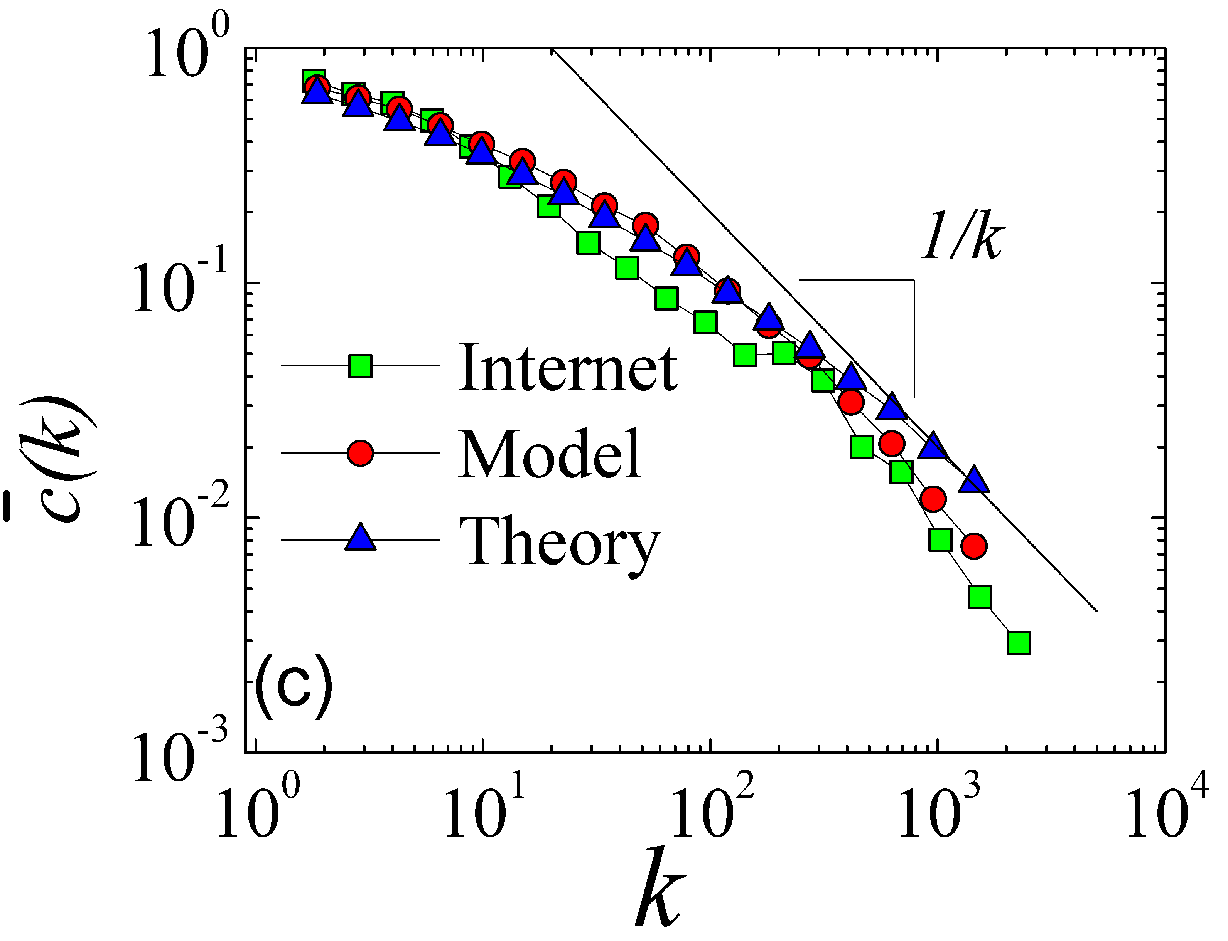

Slide 39
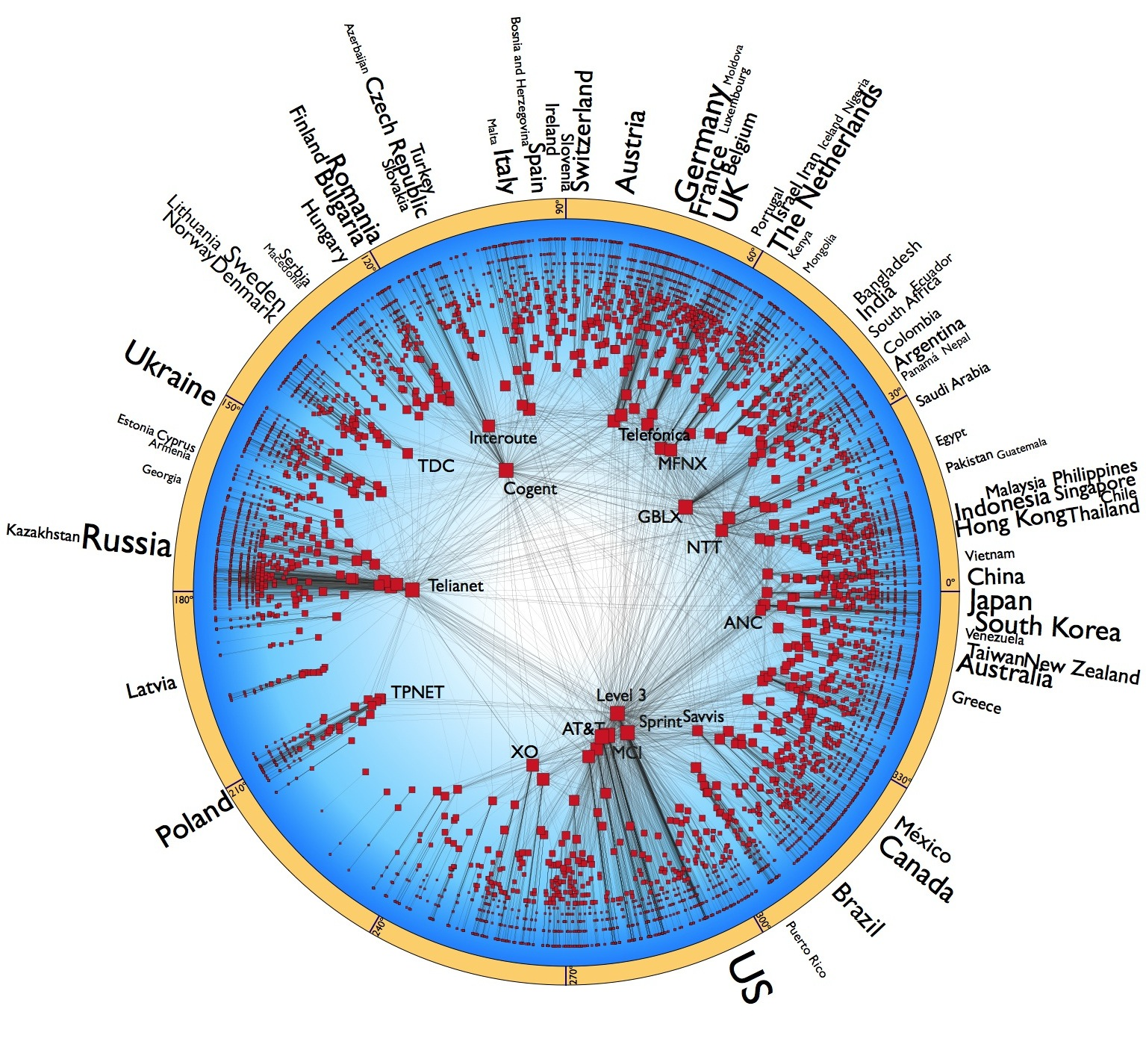

Slide 40
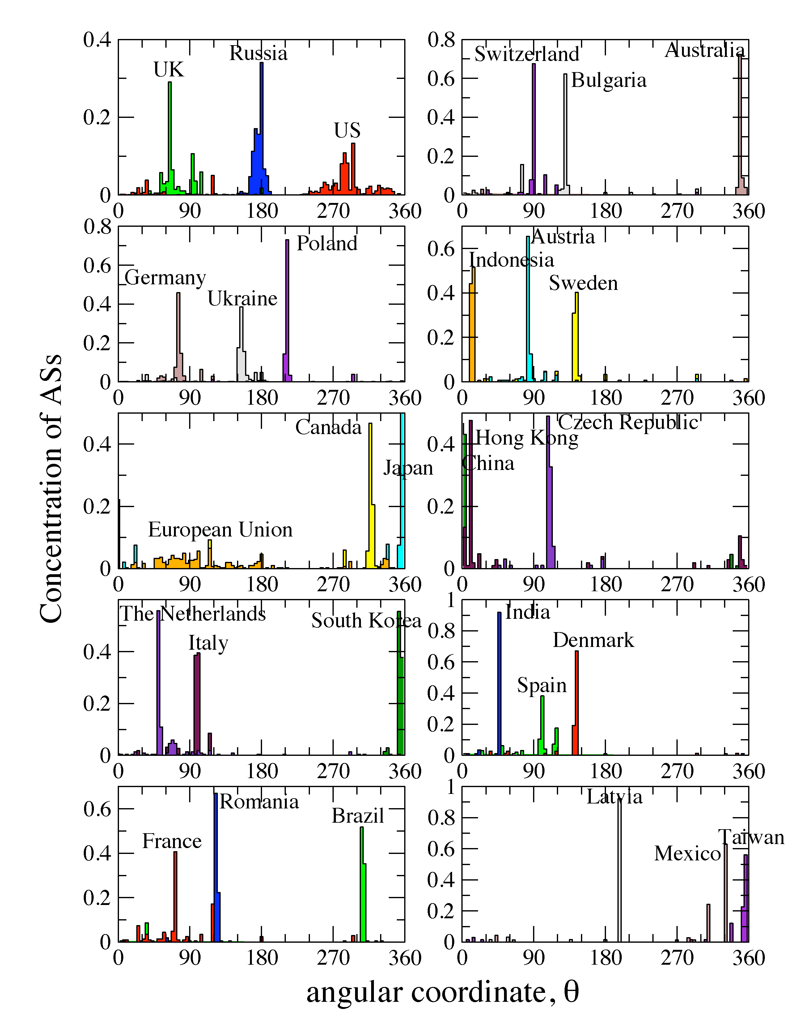

Slide 41
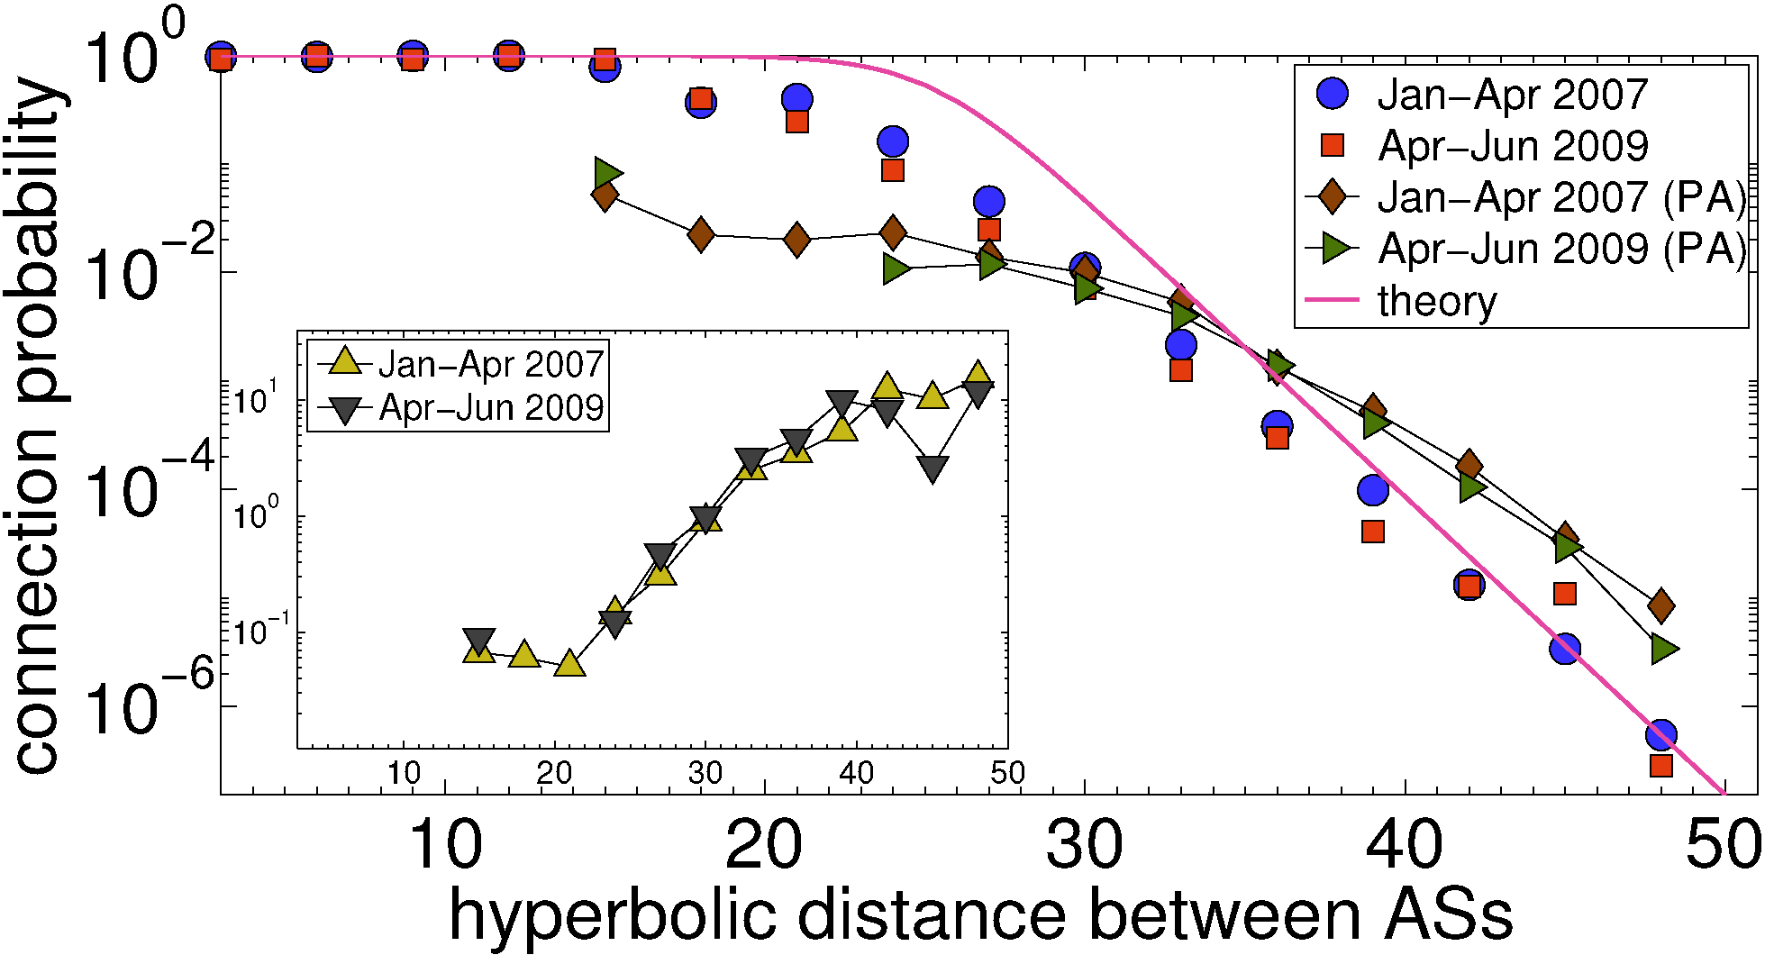

Slide 42
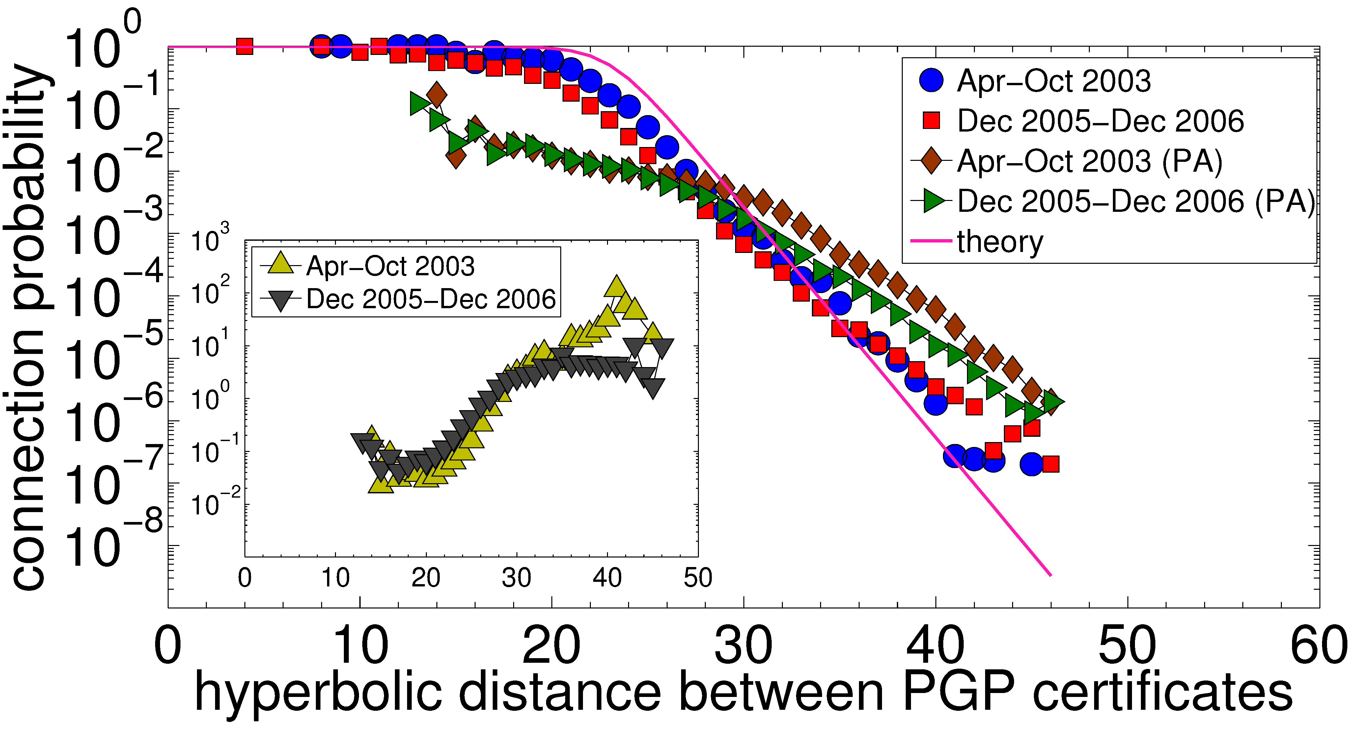

Slide 43
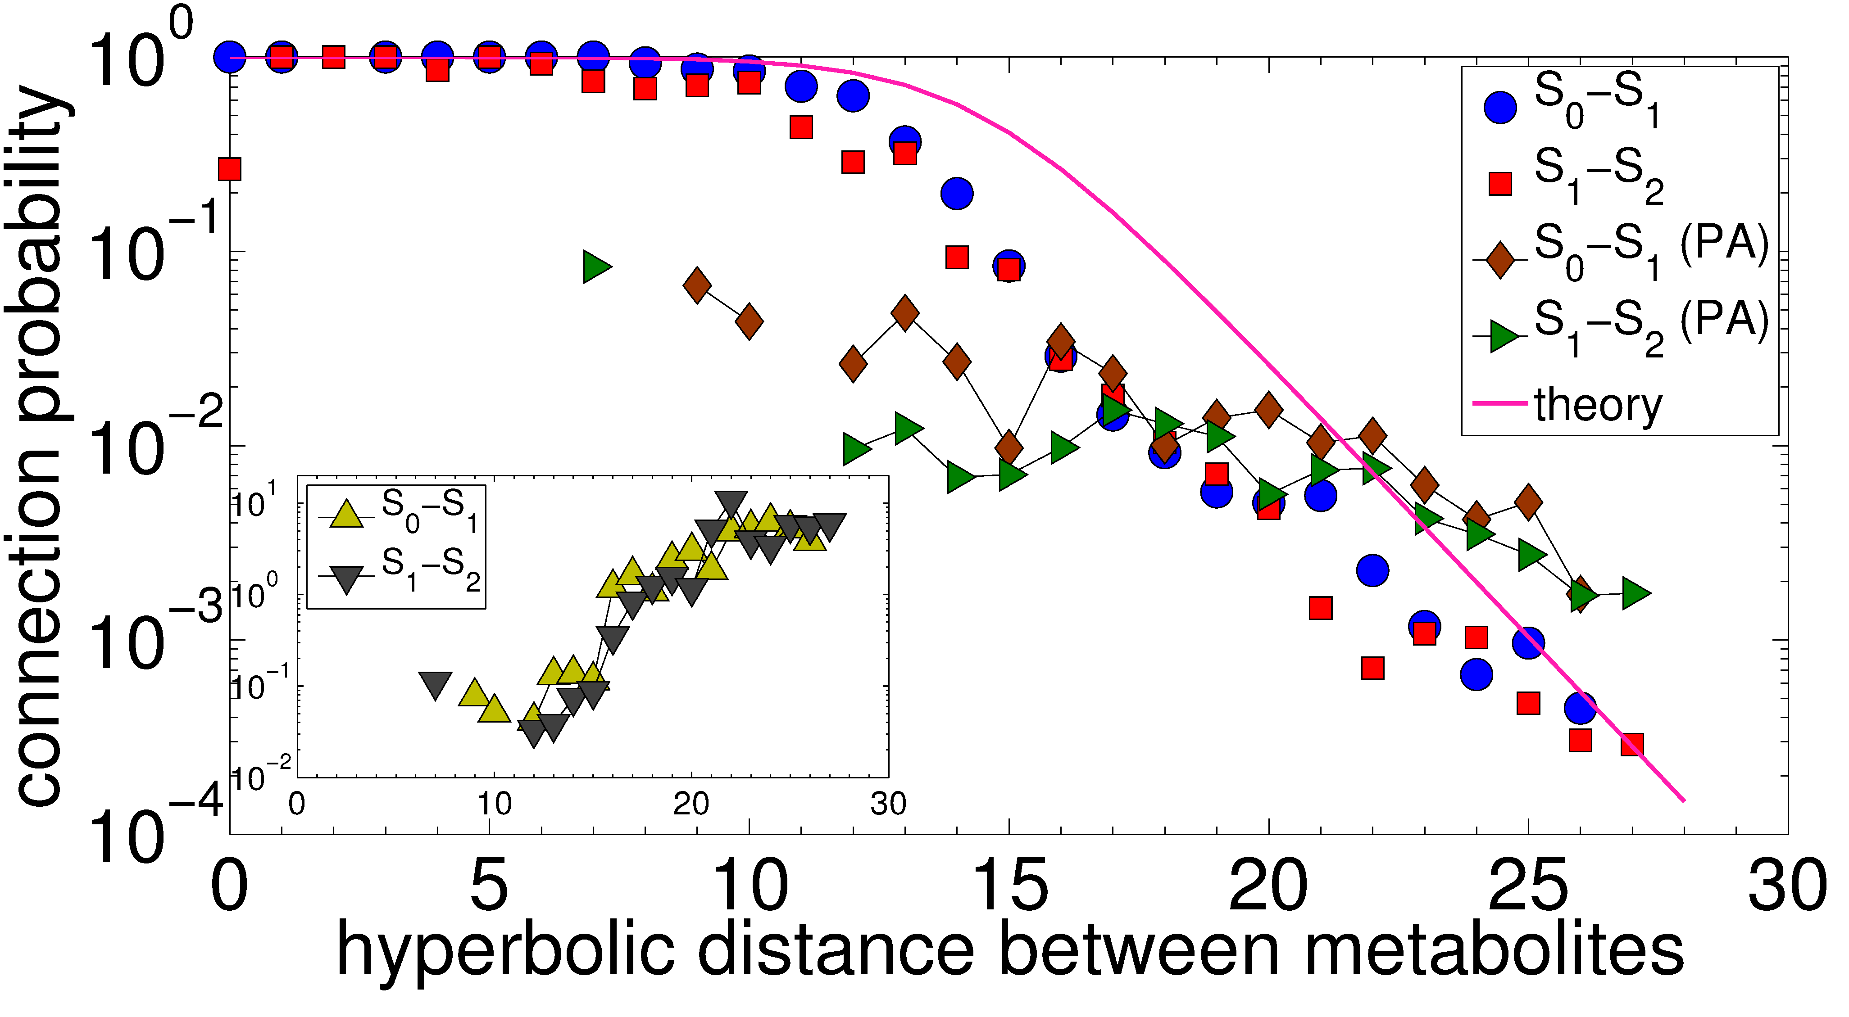

Slide 44
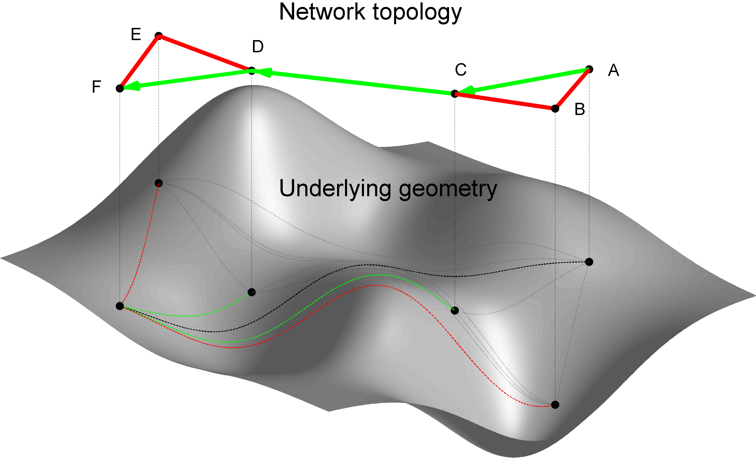
From structure
To function

Slide 45
Notes:
In maze without the MAP
Learning its MAP
Dynamic
More complex

Slide 46
Notes:
Direction would be good
Efficiency
Optimality
Robustness
Geometry!!! (no geometry on the previous slide!)
BEST POSSIBLE if all these conditions satisfied

Slide 48
Navigation efficiency and robustness (2.1)
Percentage of successful greedy paths 99.99%
Percentage of shortest greedy paths 100%
Percentage of successful greedy paths after removal of x% of links or nodes
x10%  99%
x30%  95%

Slide 49
Navigation efficiency and robustness (Internet)
Percentage of successful greedy paths 97%
Average stretch 1.1
Percentage of successful greedy paths after removal of x% of links:
x10%  90%
x30%  75%

Slide 50
Success ratio in random graphs
Random graphs with expected P(k) (2.1) 30%
No angular coordinates; node degree gradient only
Classical random graphs 0.17%
No radial coordinates; the connection probability does not depend on any distances at all

Slide 51
Take-home picture

?
←

Slide 52
Summary
New geometric framework to study the structure and function of large real networks
The framework provides a natural (no “enforcement” on our side) explanation of two universal structural properties of these networks (scale-free degree distribution and strong clustering) as consequences of a latent hyperbolic geometry
The framework admits a standard statistical physics approach (exponential random graphs), interpreting auxiliary fields as linear function of hyperbolic distances/energies
The framework subsumes
classical random graphs
random geometric graphs
random graph with expected degree distributions
preferential attachment
as limiting cases with degenerate geometric structures
The framework explains how the structure of complex networks ensures the maximum efficiency of their function – optimal information propagation without global knowledge of the network

Slide 53
Conclusions
Theory
A step forward to write down the equations governing the dynamics of large networks
Applications
A step forward to be able to predict and, consequently, control the dynamics of large networks
Soft community detection
Navigability analysis provides clues to what drives signaling/information-flow paths in networks, and what network perturbations may drive such signaling to failures (such as cancer or autism)
Optimal (as efficient as theoretically possible) routing algorithms
In the Internet, scalable routing has been a long-standing vital practical problem that could not be solved by any other methods for decades

Slide 54
M. Boguñá, F. Papadopoulos, and D. Krioukov, Sustaining the Internet with Hyperbolic Mapping, Nature Communications, v.1, 62, 2010
D. Krioukov, F. Papadopoulos, A. Vahdat, and M. Boguñá, Hyperbolic Geometry of Complex Networks, Physical Review E, v.82, 036106, 2010, Physical Review E, v.80, 035101(R), 2009
F. Papadopoulos, D. Krioukov, M. Boguñá, and A. Vahdat, Greedy Forwarding in (Dynamic) Scale-Free Networks Embedded in Hyperbolic Metric Spaces, INFOCOM 2010, SIGMETRICS MAMA 2009
M. Boguñá, D. Krioukov, and kc claffy, Navigability of Complex Networks, Nature Physics, v.5, p.74-80, 2009

