Slide 1
Large graphs in physics:
From statistical mechanics of networks to quantum cosmology
Dmitri Krioukov
UCSD/CAIDA
University of Houston, November 2012

Slide 2
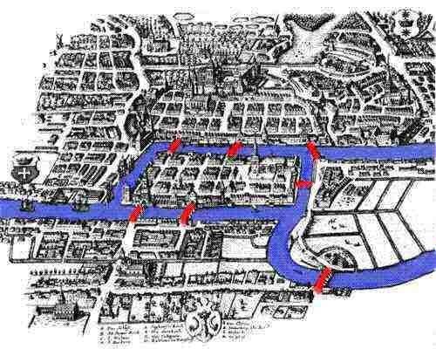

Slide 3
Adjacency list:
Node1 Node2 Links
1 2 2
1 3 0
1 4 1
2 3 2
2 4 1
3 4 1
1
2
4
Adjacency matrix:
N | 1 | 2 | 3 | 4
1 | 0 | 2 | 0 | 1
2 | 2 | 0 | 2 | 1
3 | 0 | 2 | 0 | 1
4 | 1 | 1 | 1 | 0
3
A_{ij} is the number of links between nodes i and j

Slide 4
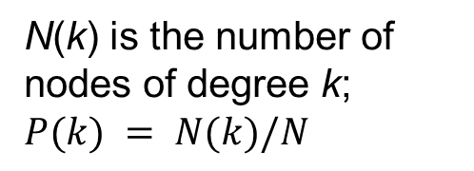
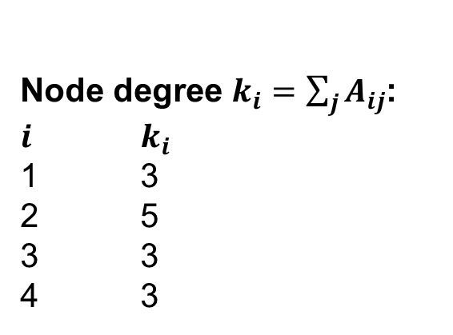
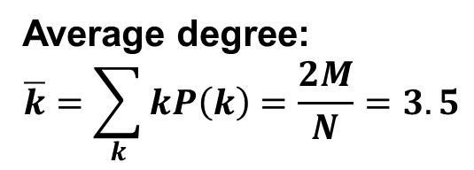
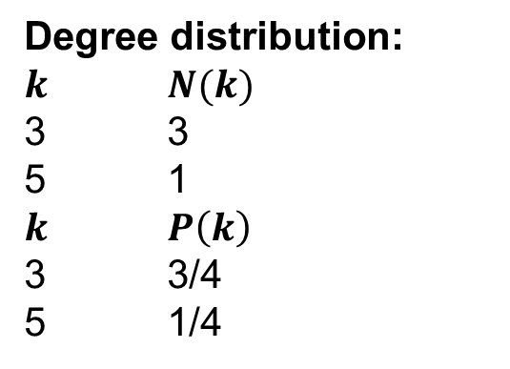
Node degree $k_{i}=\sum_{j}{A_{ij}}$:
$i$ $k_{i}$
1 3
2 5
3 3
4 3
1
Degree distribution:
$k$ $N(k)$
3 3
5 1
$k$ $P\left(k\right)$
3 3/4
5 1/4
2
4
N(k) is the number of nodes of degree k;
$$P(k) = N(k)/N$$
3
Average degree:
$$\overline{k}=\sum_{k}{kP\left(k\right)=\frac{2M}{N}=3.5}$$

Slide 5
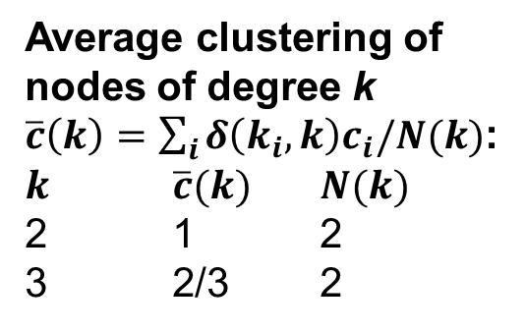
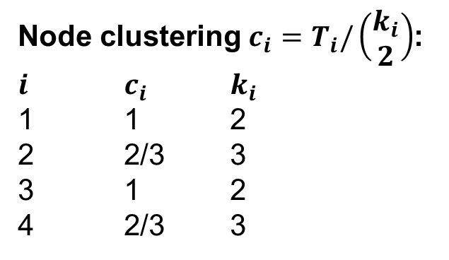
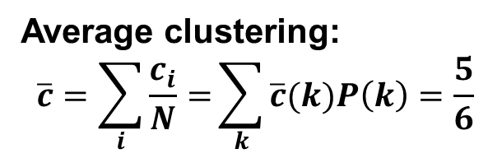
Node clustering $c_{i}=T_{i}/\left(\begin{matrix}k_{i} \\ 2\end{matrix}\right)$:
$i$ $c_{i}$ $k_{i}$
1 1 2
2 2/3 3
3 1 2
4 2/3 3
1
T_{i} is the number of links between i’s neighbors
2
4
Average clustering of nodes of degree k
$\overline{c}\left(k\right)=\sum_{i}{δ\left(k_{i},k\right)c_{i}/N(k)}$:
$k$ $\overline{c}(k)$ $N(k)$
2 1 2
3 2/3 2
3
Average clustering:
$$\overline{c}=\sum_{i}{\frac{c_{i}}{N}=}\sum_{k}{\overline{c}(k)P\left(k\right)=\frac{5}{6}}$$

Slide 6
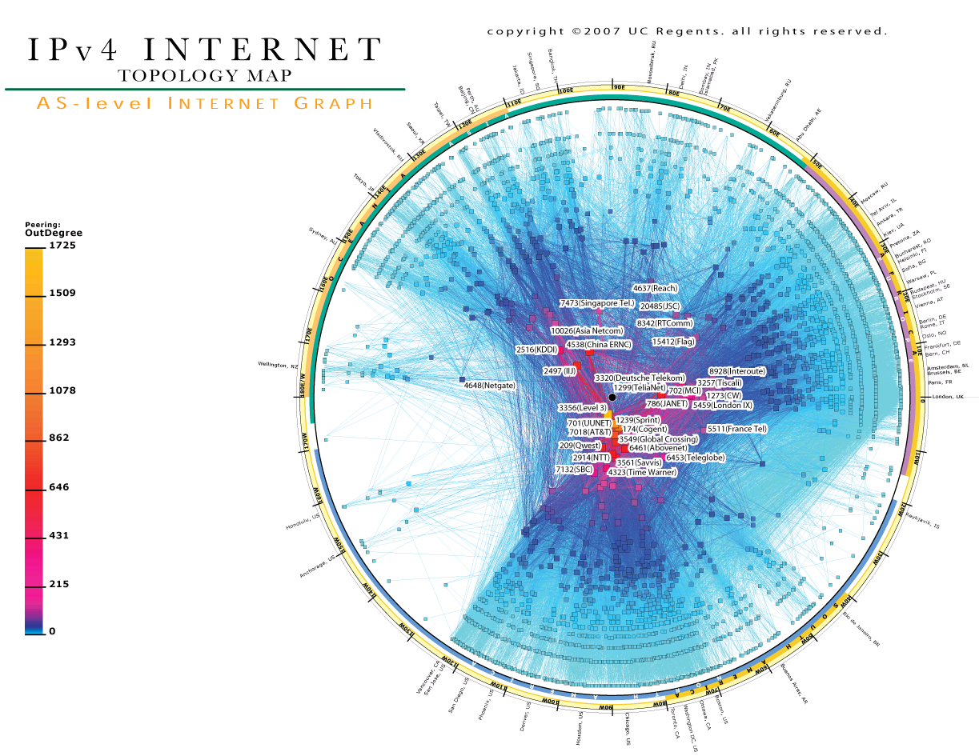

Slide 7
Routers
R₂
R₃
R₁
R₄
H₁
H₂

Slide 8
Autonomous Systems
A
X
Y
Z

Slide 9
AS graph
A
X
Y
Z

Slide 11
Web of trust (PGP graph)
User A
User B
Trust
User A signs data B
Data A
Email address,
PGP certificate
Data B
Email address,
PGP certificate

Slide 12
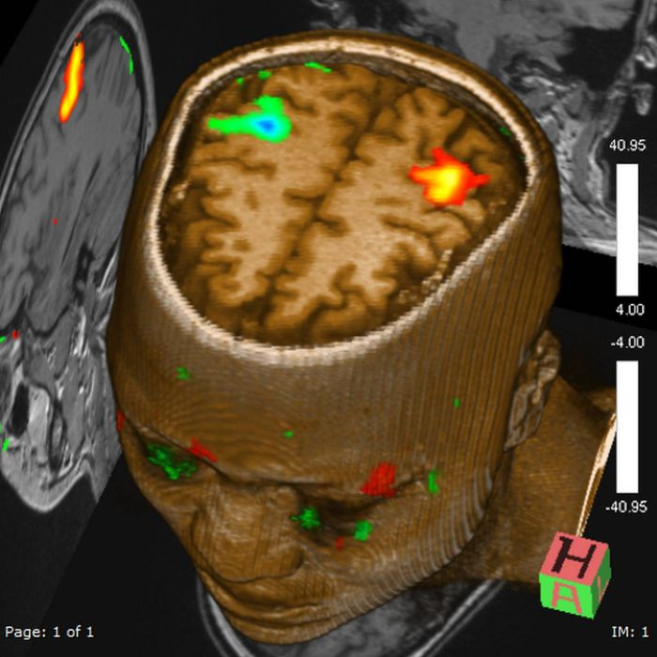
Brain (fMRI graph)

Slide 13
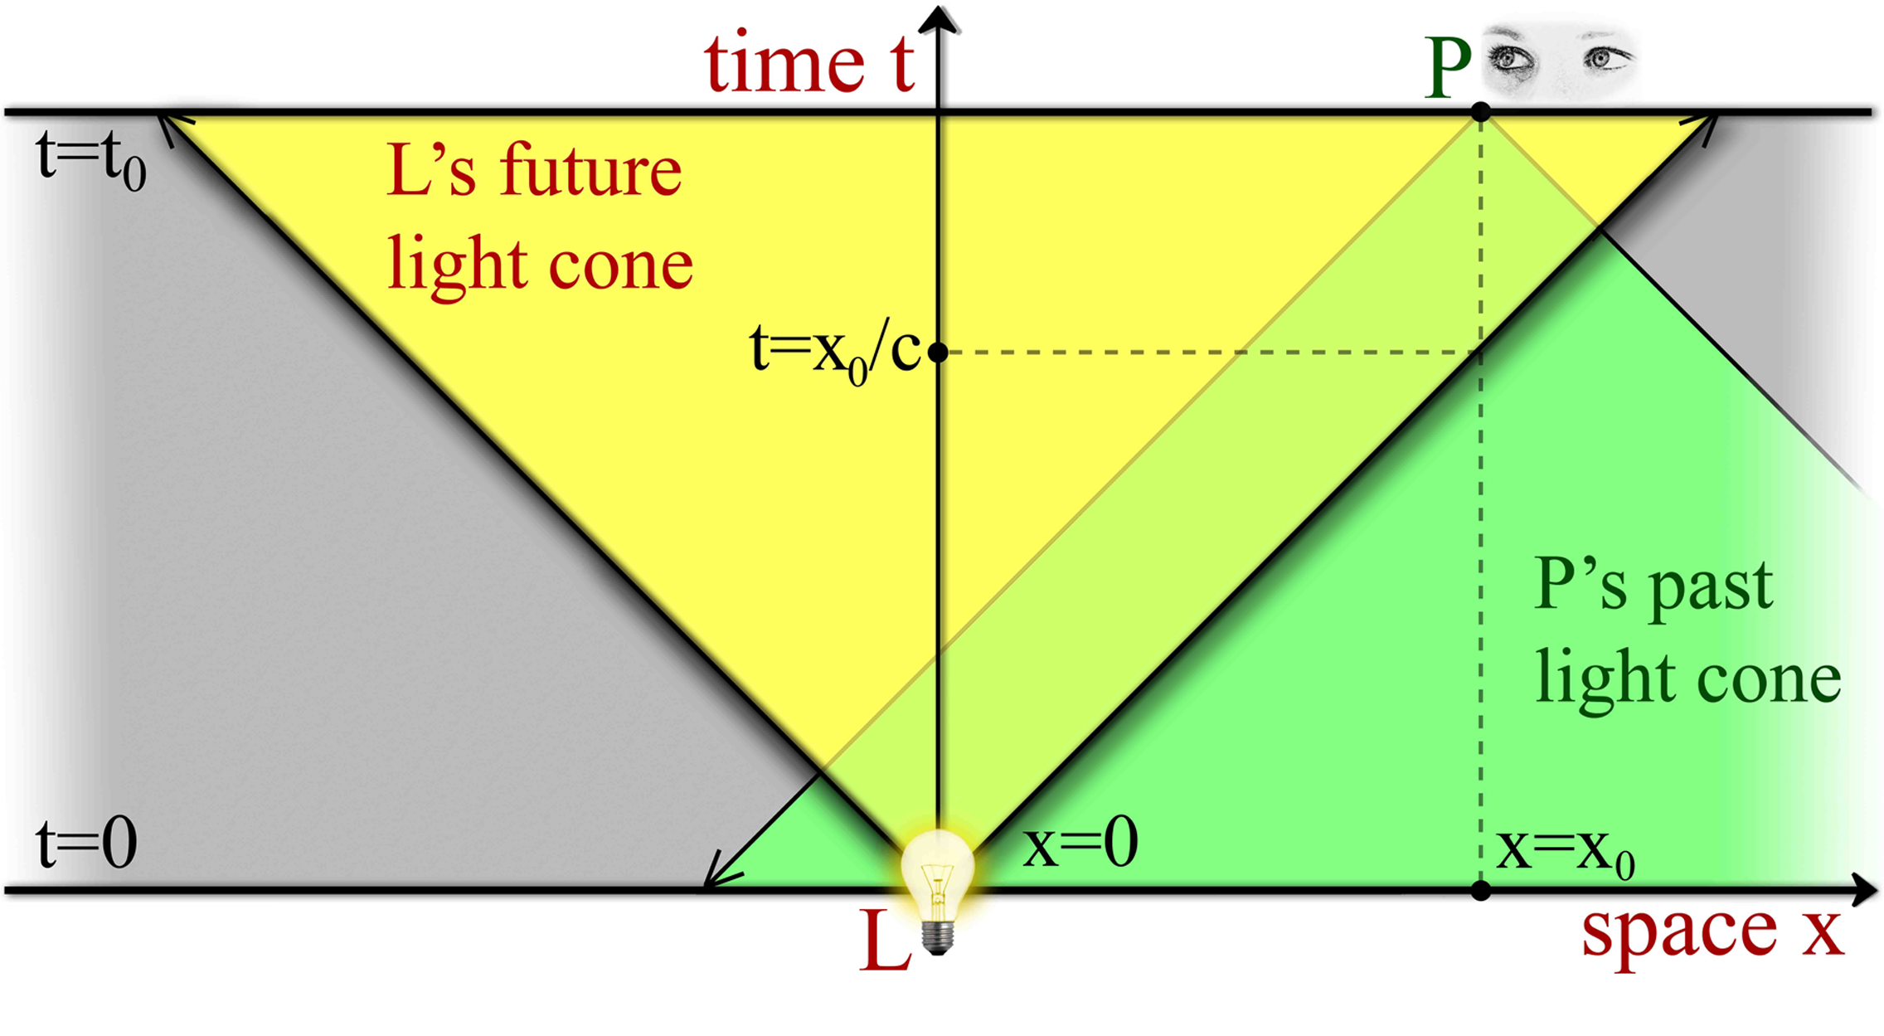
Universe (causal set)

Slide 14
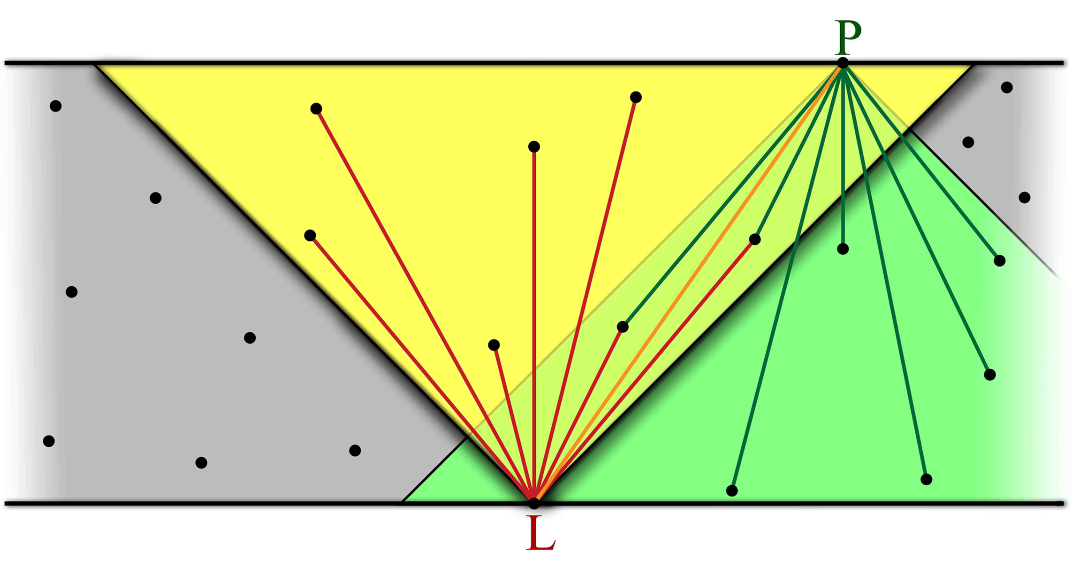
Universe (causal set)

Slide 15
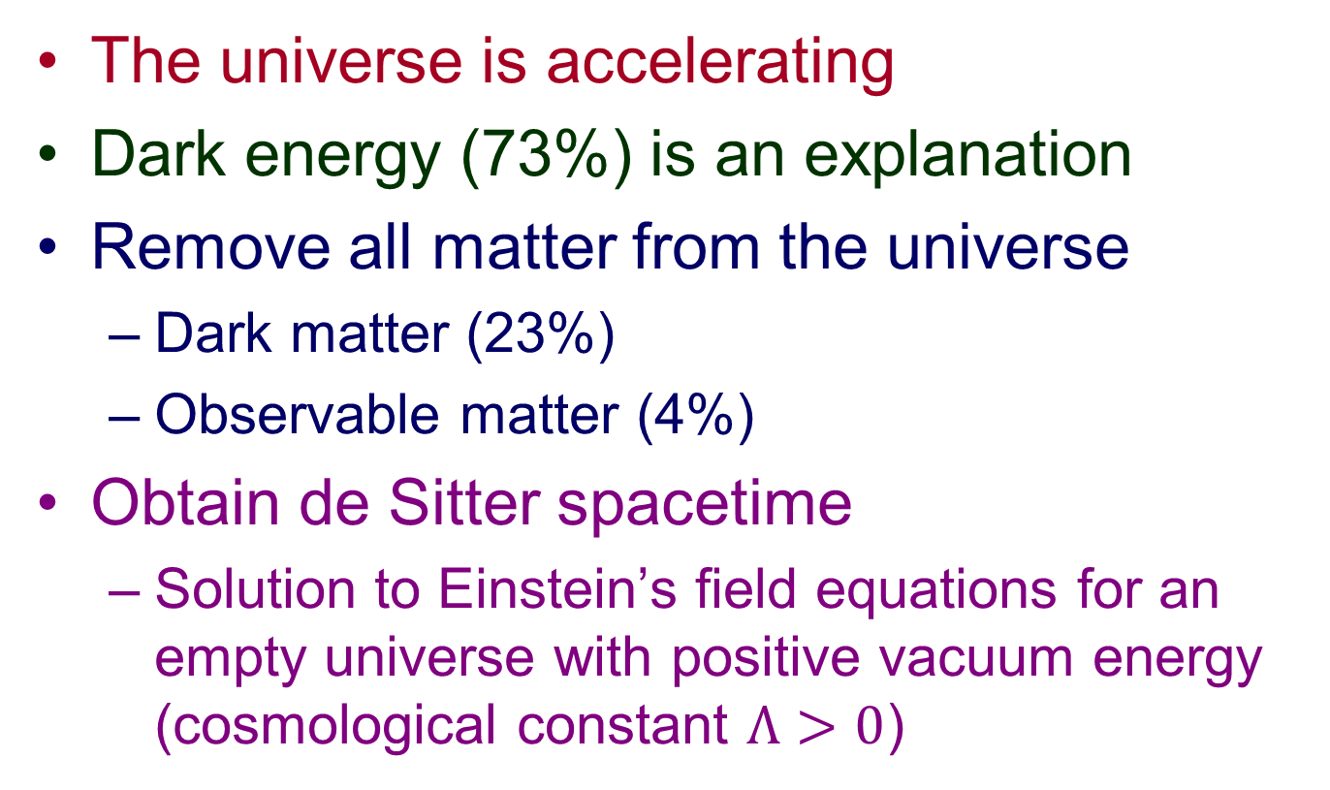
De Sitter spacetime
The universe is accelerating
Dark energy (73%) is an explanation
Remove all matter from the universe
  Dark matter (23%)
  Observable matter (4%)
Obtain de Sitter spacetime
  Solution to Einstein’s field equations for an empty universe with positive vacuum energy (cosmological constant $Λ>0$)

Slide 16
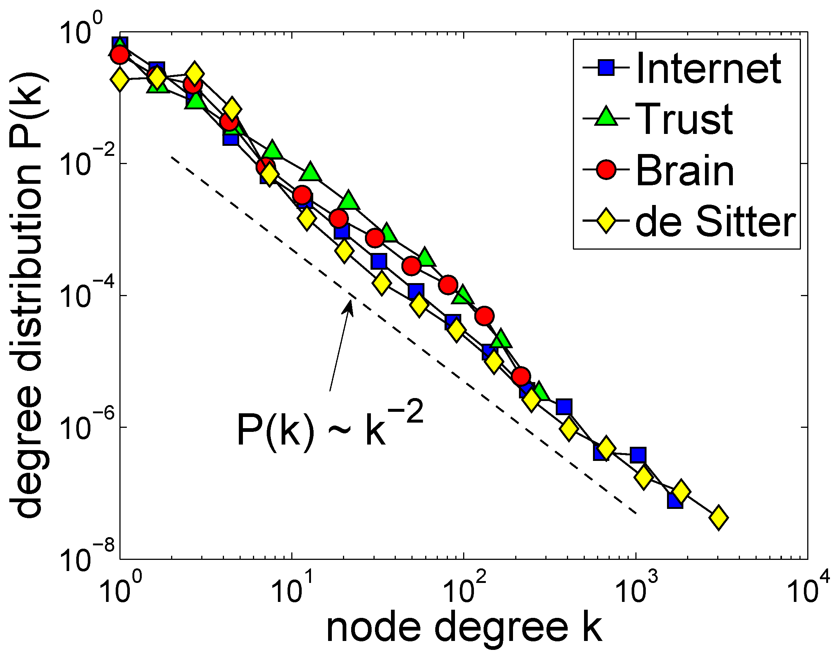

Slide 17
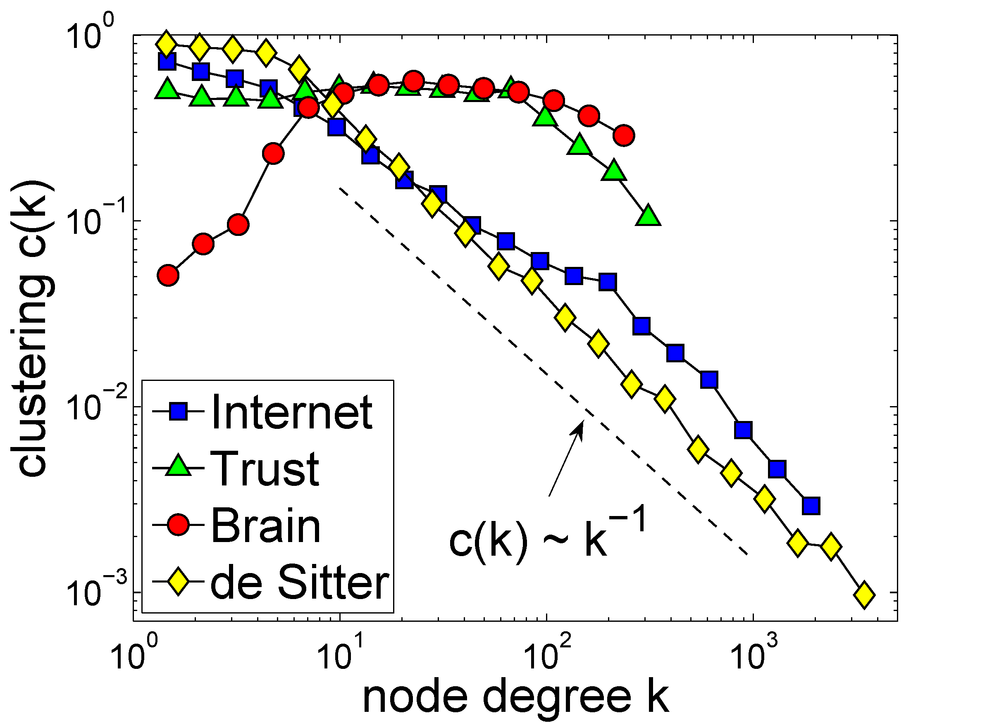

Slide 18
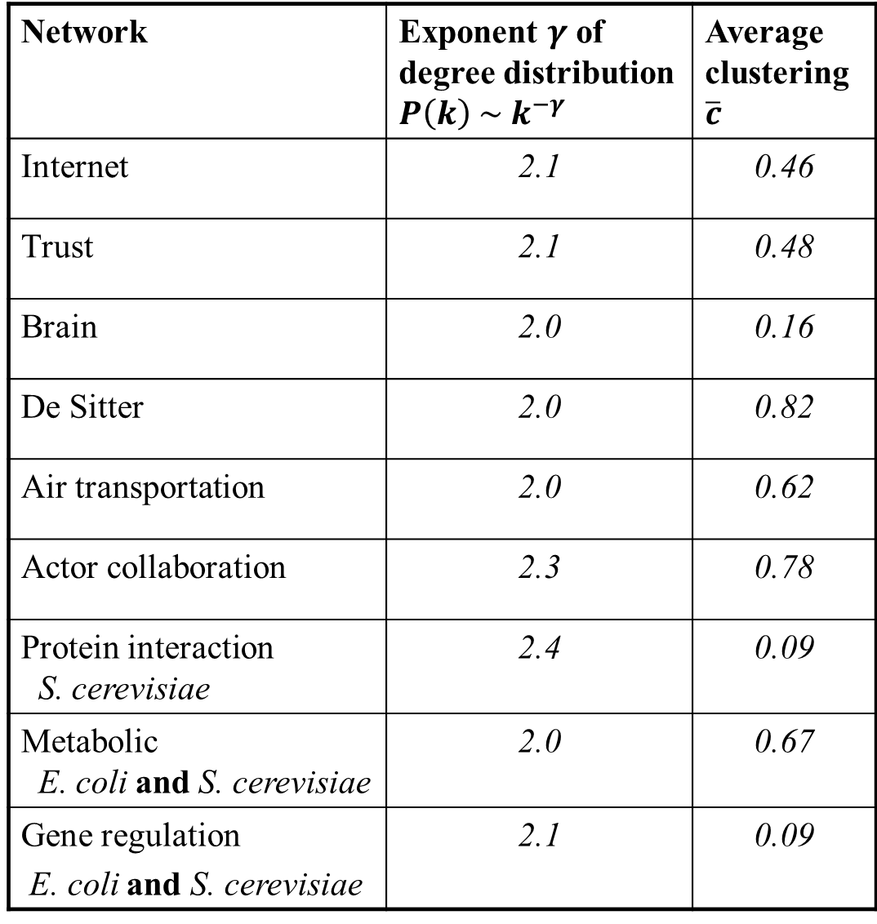
Network | Exponent $γ$ of degree distribution $P\left(k\right) \sim k^{−γ}$ | Average clustering $\overline{c}$
Internet | 2.1 | 0.46
Trust | 2.1 | 0.48
Brain | 2.0 | 0.16
De Sitter | 2.0 | 0.82
Air transportation | 2.0 | 0.62
Actor collaboration | 2.3 | 0.78
Protein interaction S. cerevisiae | 2.4 | 0.09
Metabolic E. coli and S. cerevisiae | 2.0 | 0.67
Gene regulation E. coli and S. cerevisiae | 2.1 | 0.09

Slide 19



Random graphs with hidden variables
Given N nodes
Assign to each node a random variable  drawn from distribution ()
Connect each node pair with probability p(,)
$$κ$$
$$κ′$$
$$p(κ,κ^{′})$$

Slide 20
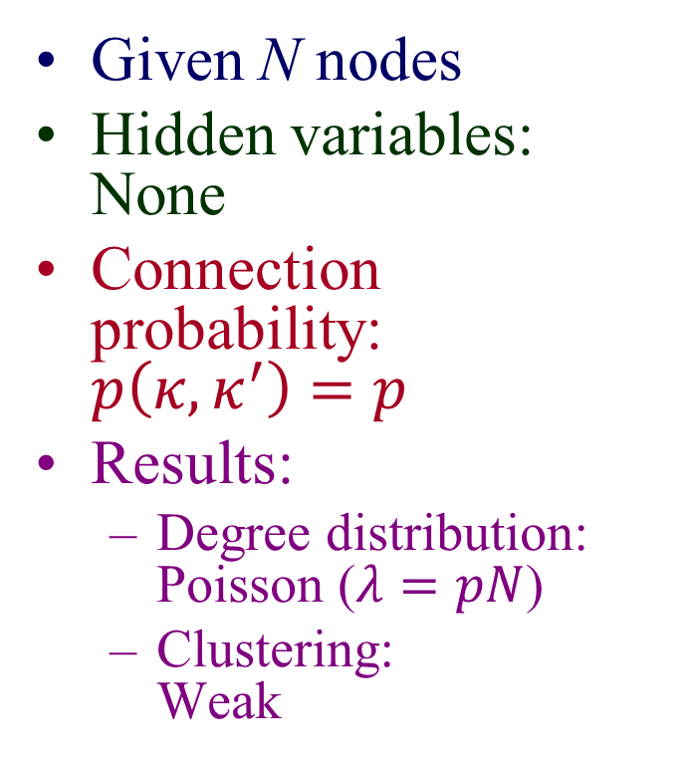

Example:
Classical random graphs
Given N nodes
Hidden variables: None
Connection probability:
$p\left(κ,κ^{′}\right)=p$
Results:
  Degree distribution:
  Poisson ($λ=pN$)
  Clustering:
  Weak
$$κ$$
$$κ′$$
$$p$$

Slide 21
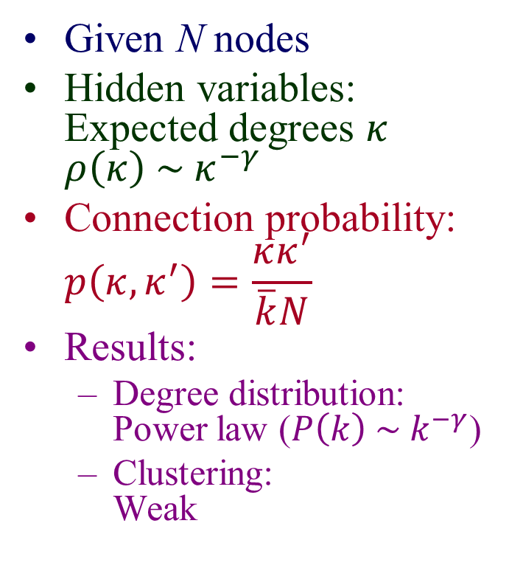

Example:
Soft configuration model
Given N nodes
Hidden variables: Expected degrees $κ$
$ρ\left(κ\right) \sim κ^{−γ}$
Connection probability:
$p\left(κ,κ^{′}\right)=\frac{κκ^{′}}{\overline{k}N}$
Results:
  Degree distribution:
  Power law ($P\left(k\right) \sim k^{−γ}$)
  Clustering:
  Weak
$$κ$$
$$κ′$$
$$p\left(κ,κ^{′}\right) \sim κκ′$$

Slide 22

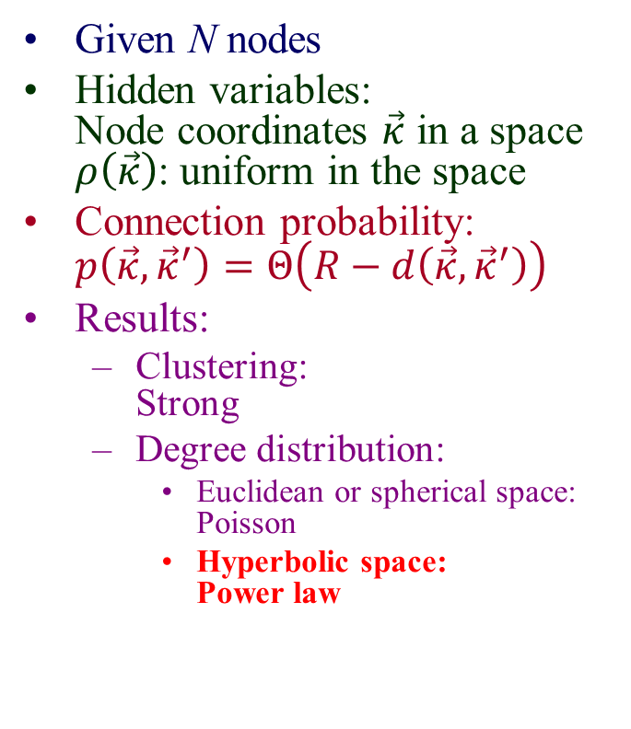


Example:
Random geometric graphs
Given N nodes
Hidden variables:
Node coordinates $\vec{κ}$ in a space
$ρ\left(\vec{κ}\right)$: uniform in the space
Connection probability:
$p\left(\vec{κ},{\vec{κ}}^{′}\right)=Θ\left(R−d\left(\vec{κ},{\vec{κ}}^{′}\right)\right)$
Results:
  Clustering:
  Strong
  Degree distribution:
    Euclidean or spherical space:
    Poisson
    Hyperbolic space:
    Power law
$$\vec{κ}$$
$$\vec{κ}′$$
$$d\left(\vec{κ},{\vec{κ}}^{′}\right)<R$$

Slide 23
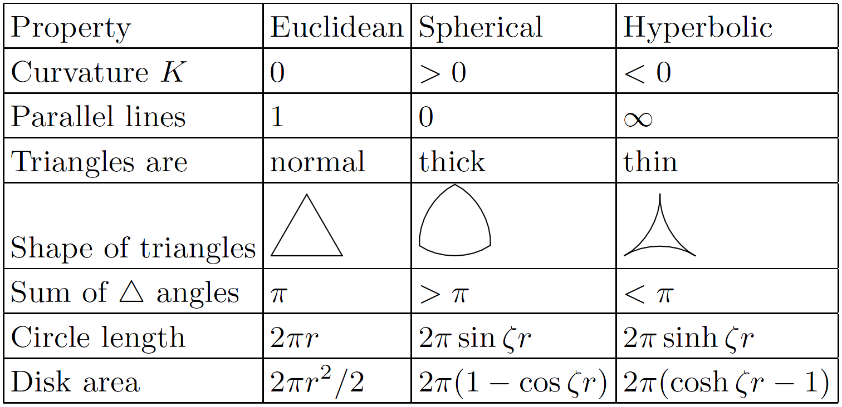
Taxonomy of spaces

Slide 24
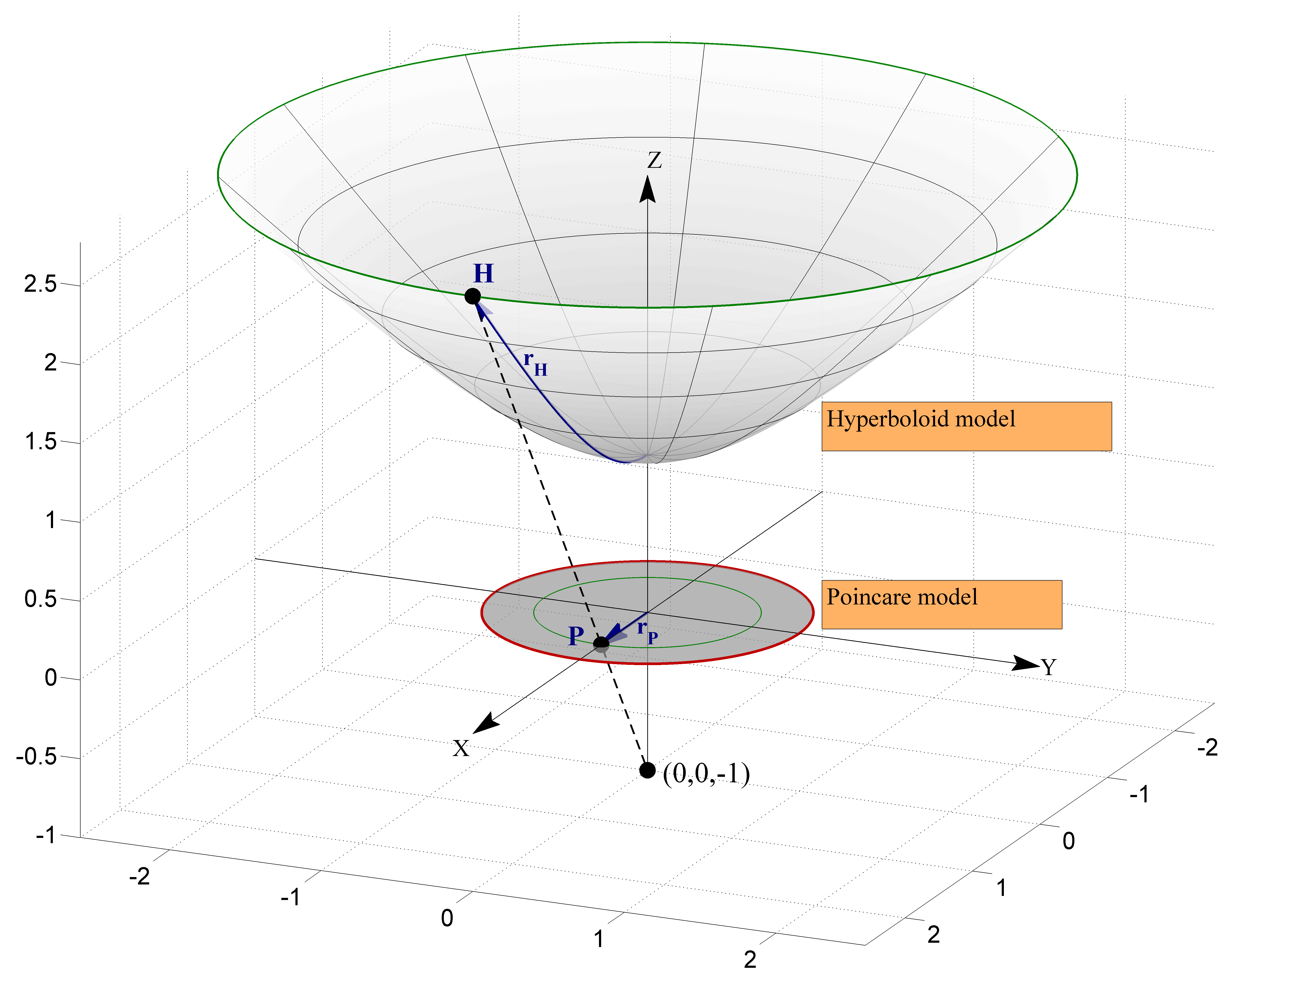




$${ds}^{2}={dx}^{2}+{dy}^{2}−{dz}^{2}$$
$$r_{P}=\tanh{\frac{r_{H}}{2}}$$
$${ds}^{2}={dx}^{2}+{dy}^{2}+{dz}^{2}$$
$$r_{E}=−iE\left(ir_{H},2\right)$$

Slide 25
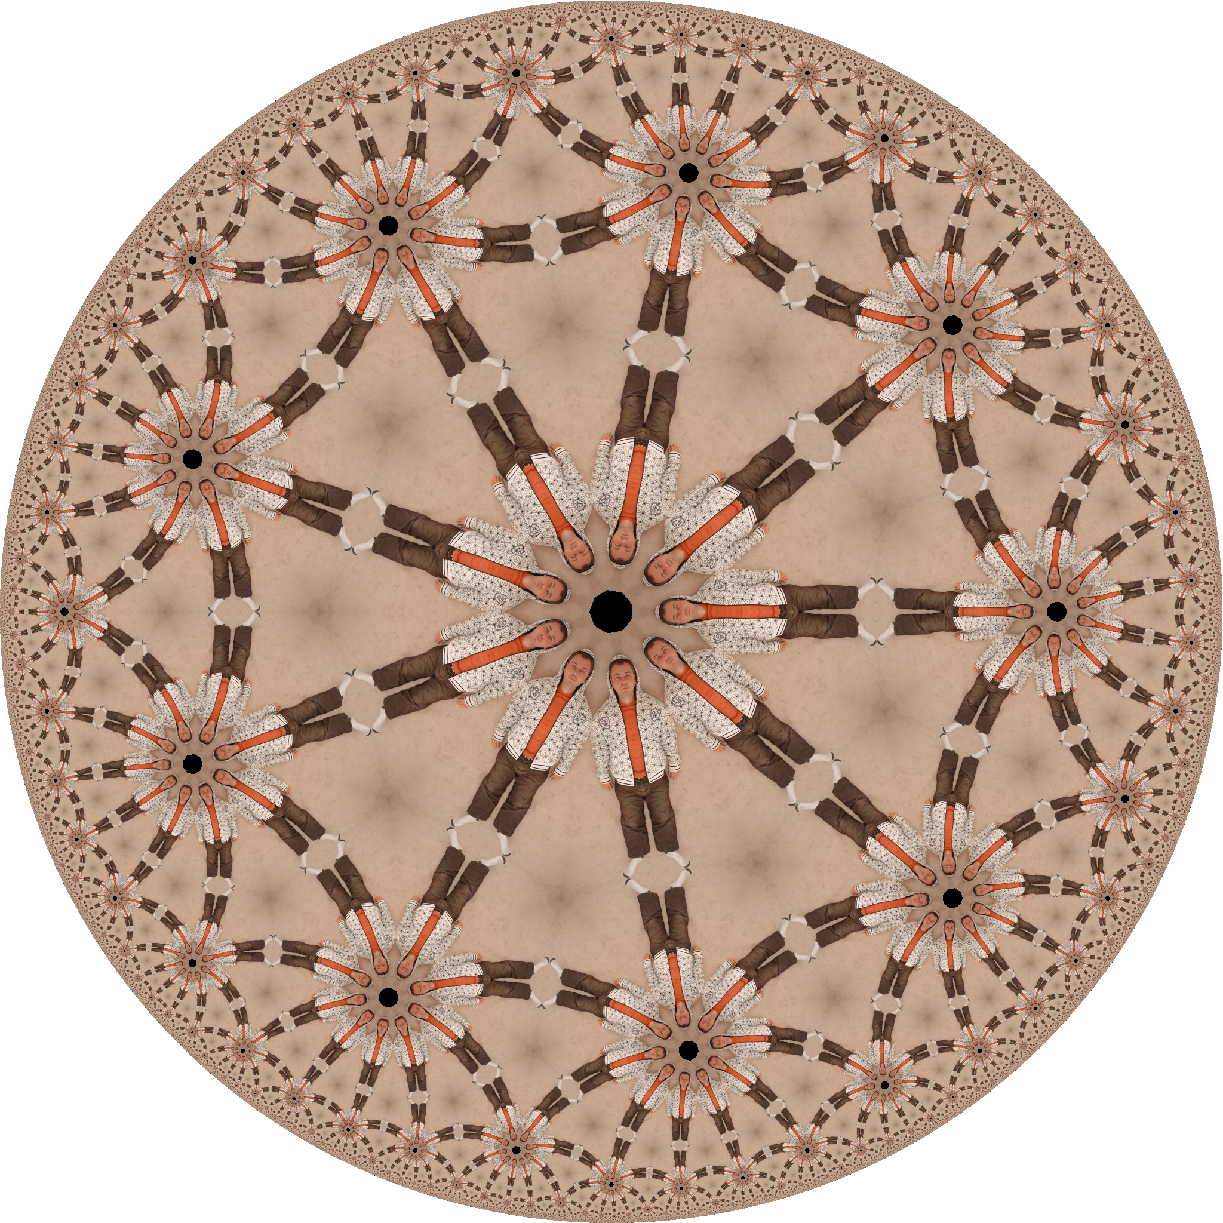

Slide 27
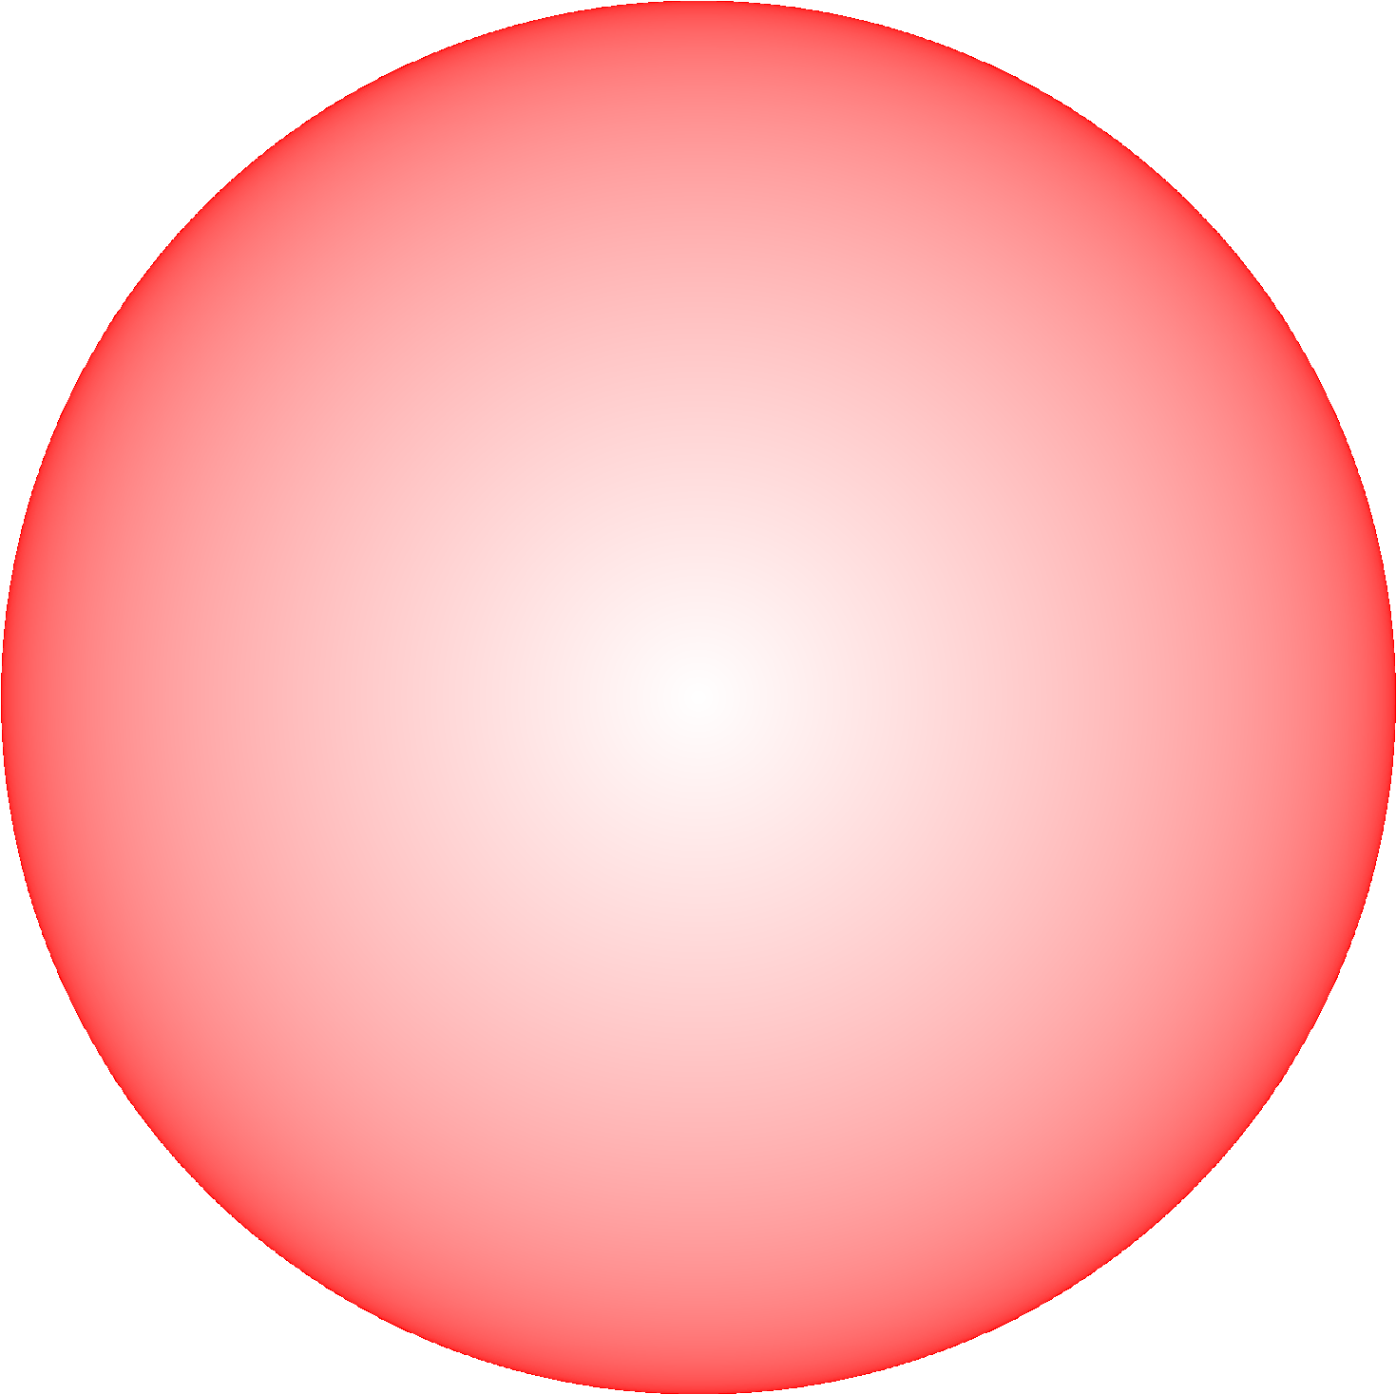

Slide 28
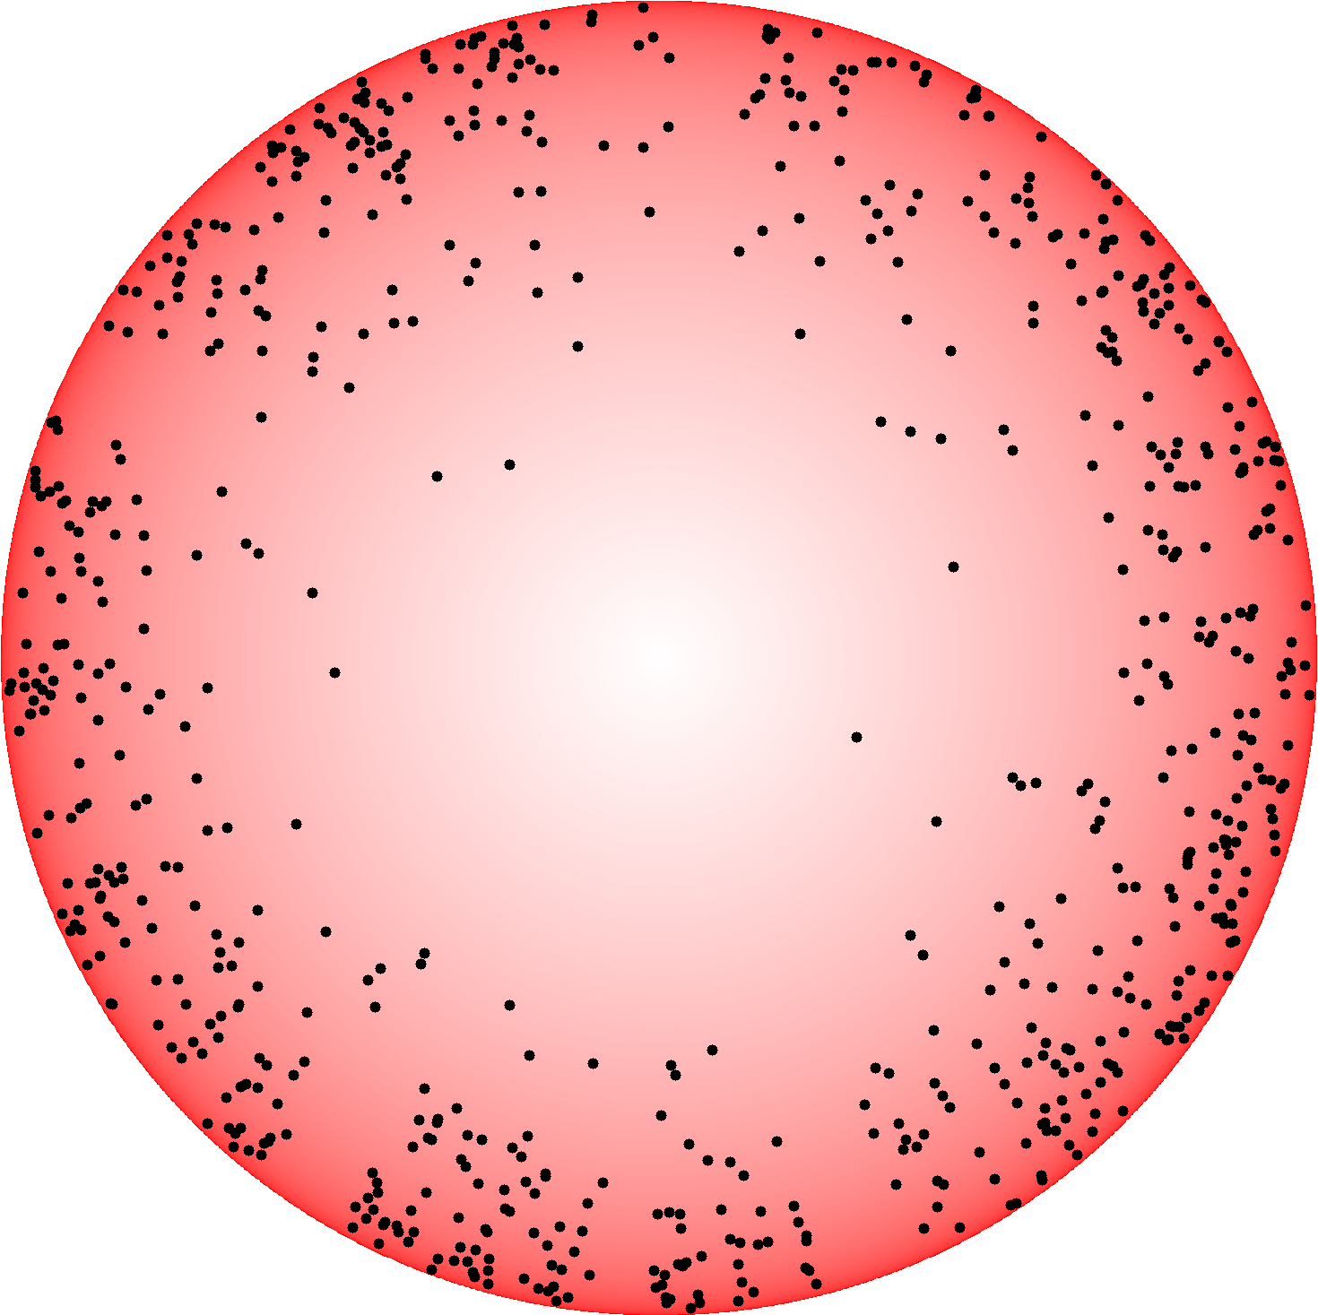

Slide 29
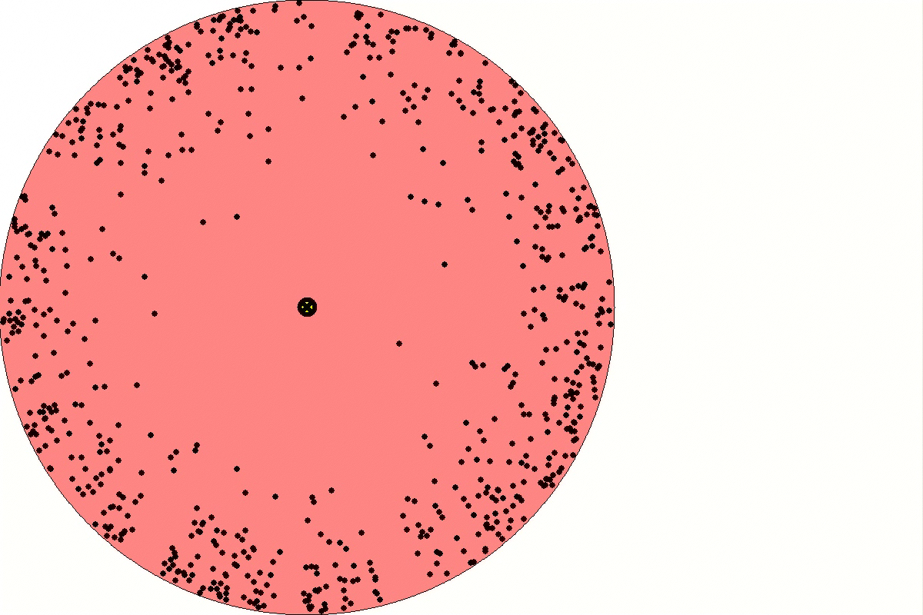

Slide 30
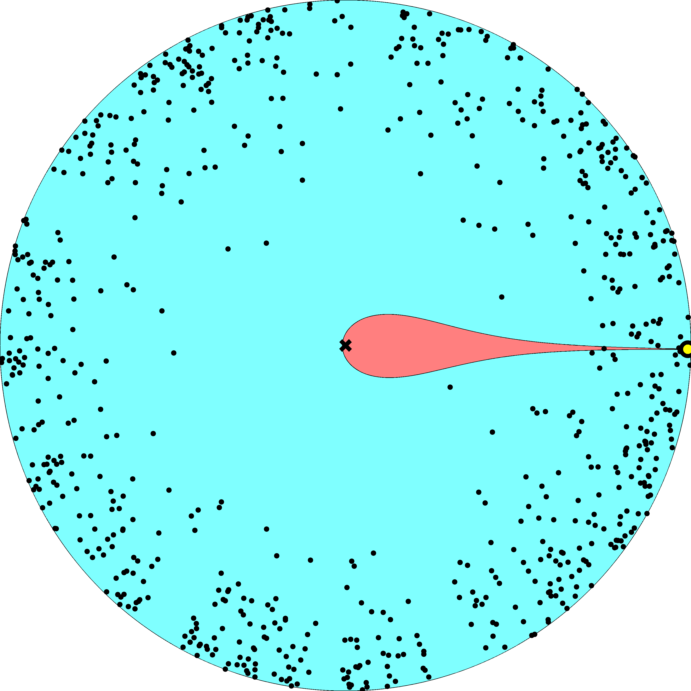

Slide 31
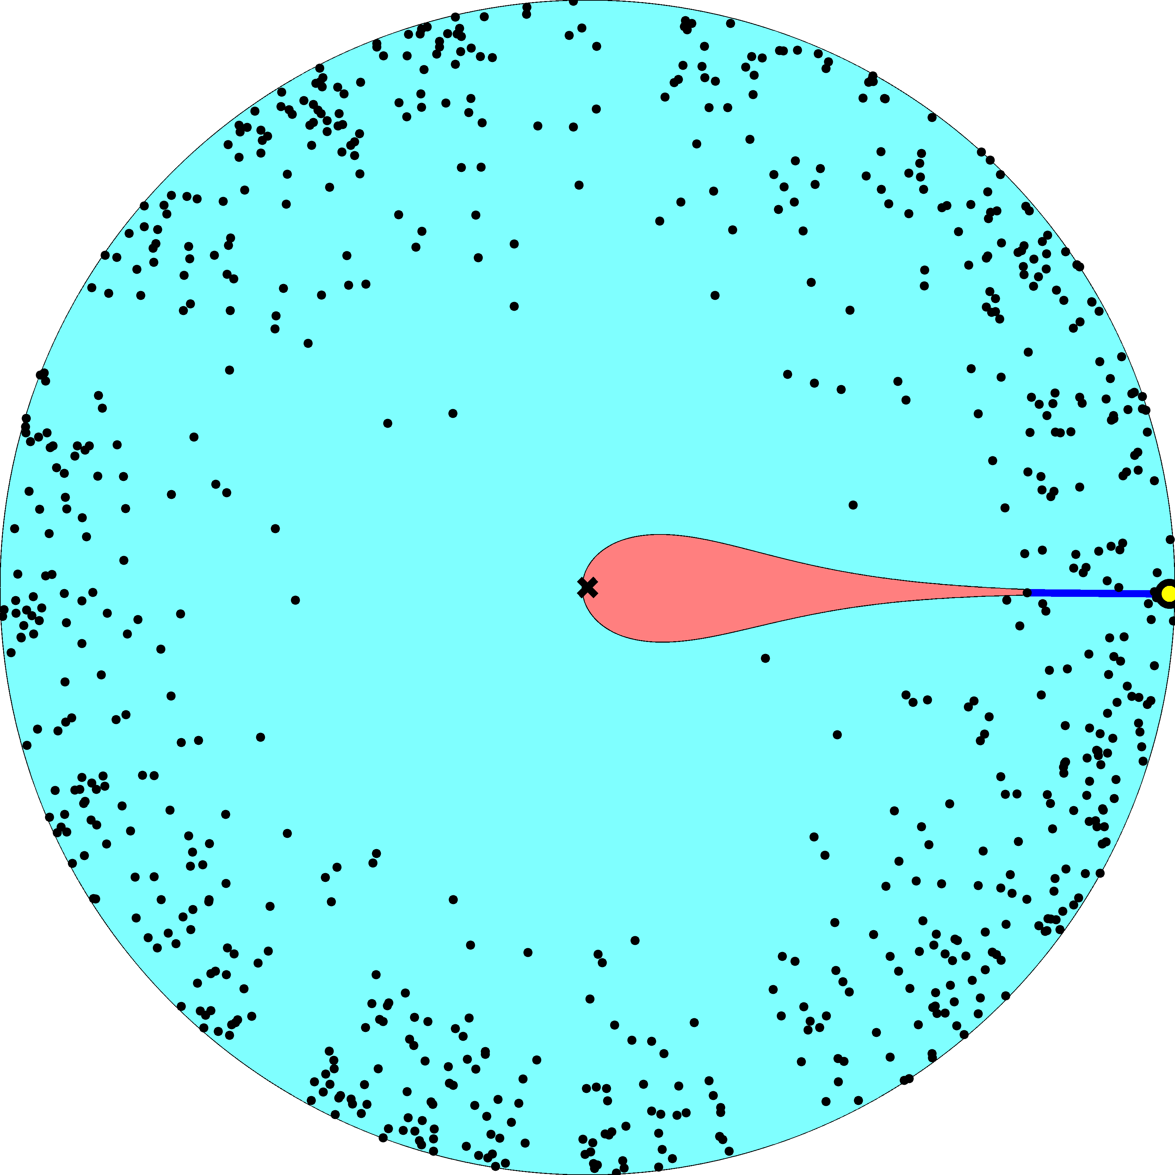

Slide 32
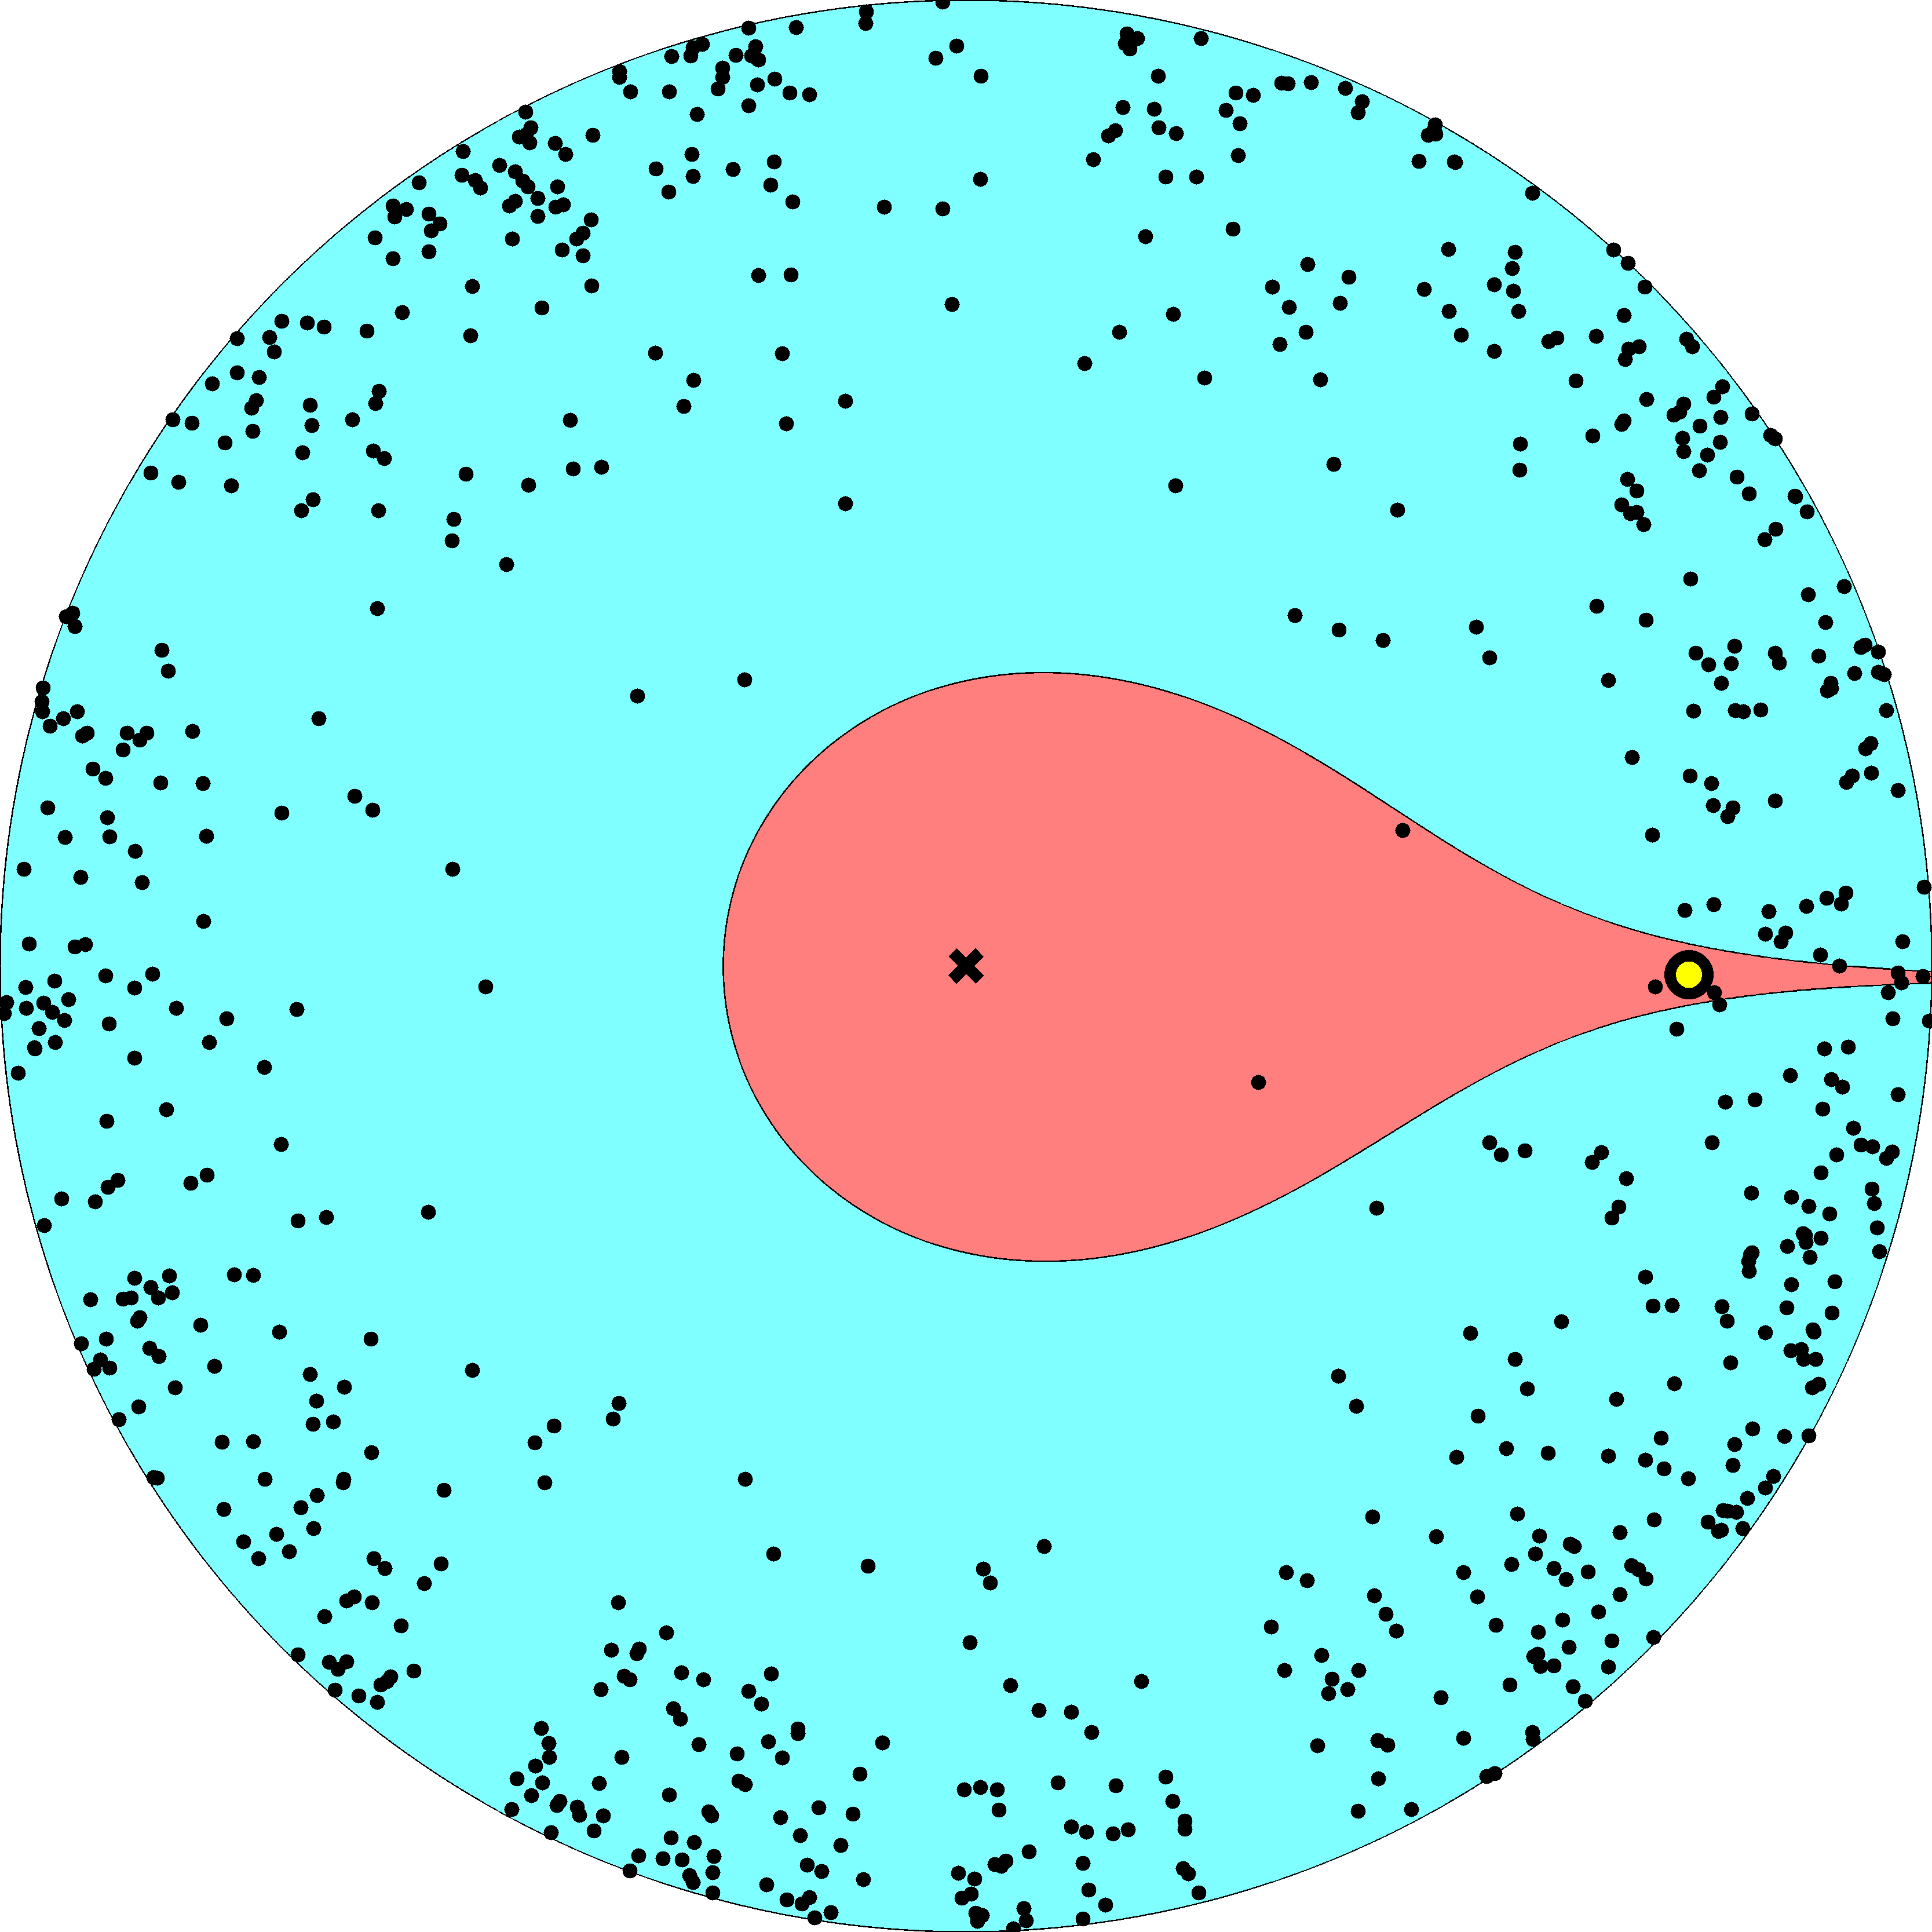

Slide 33
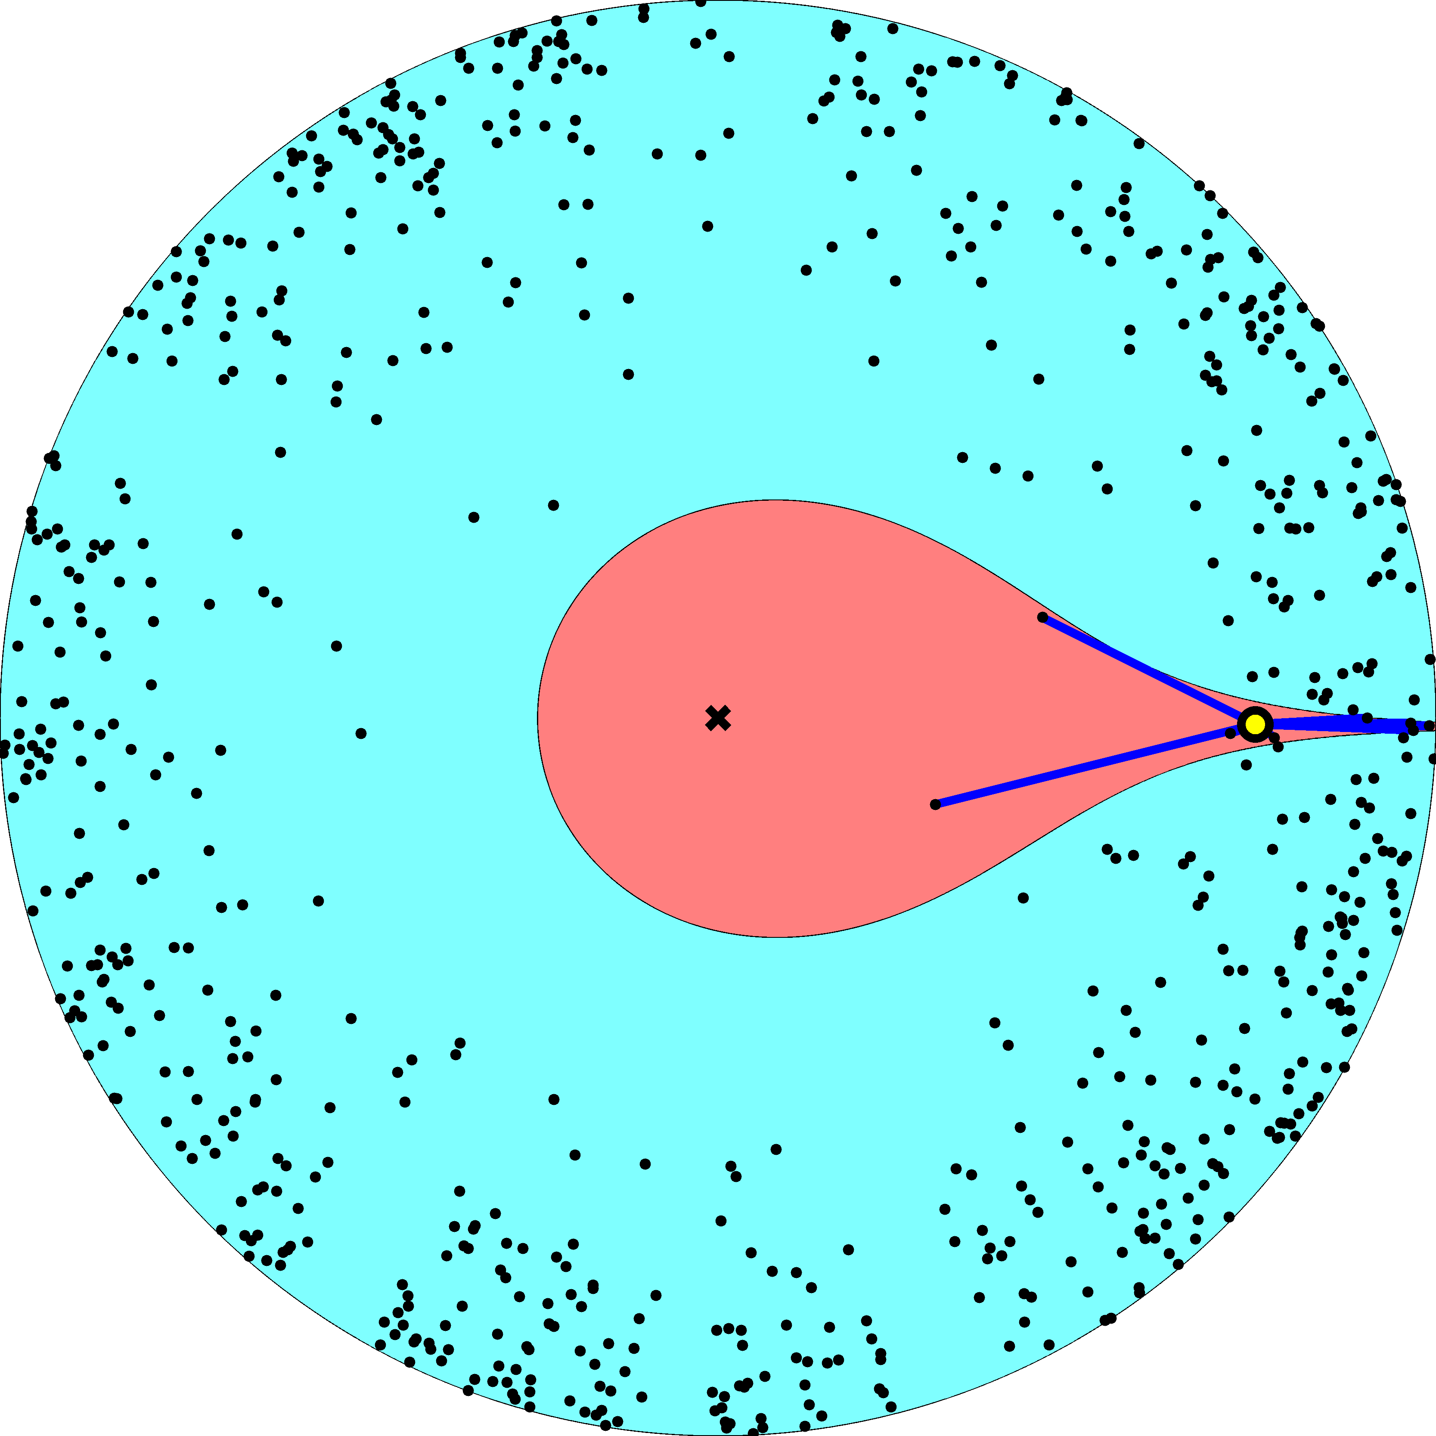

Slide 34
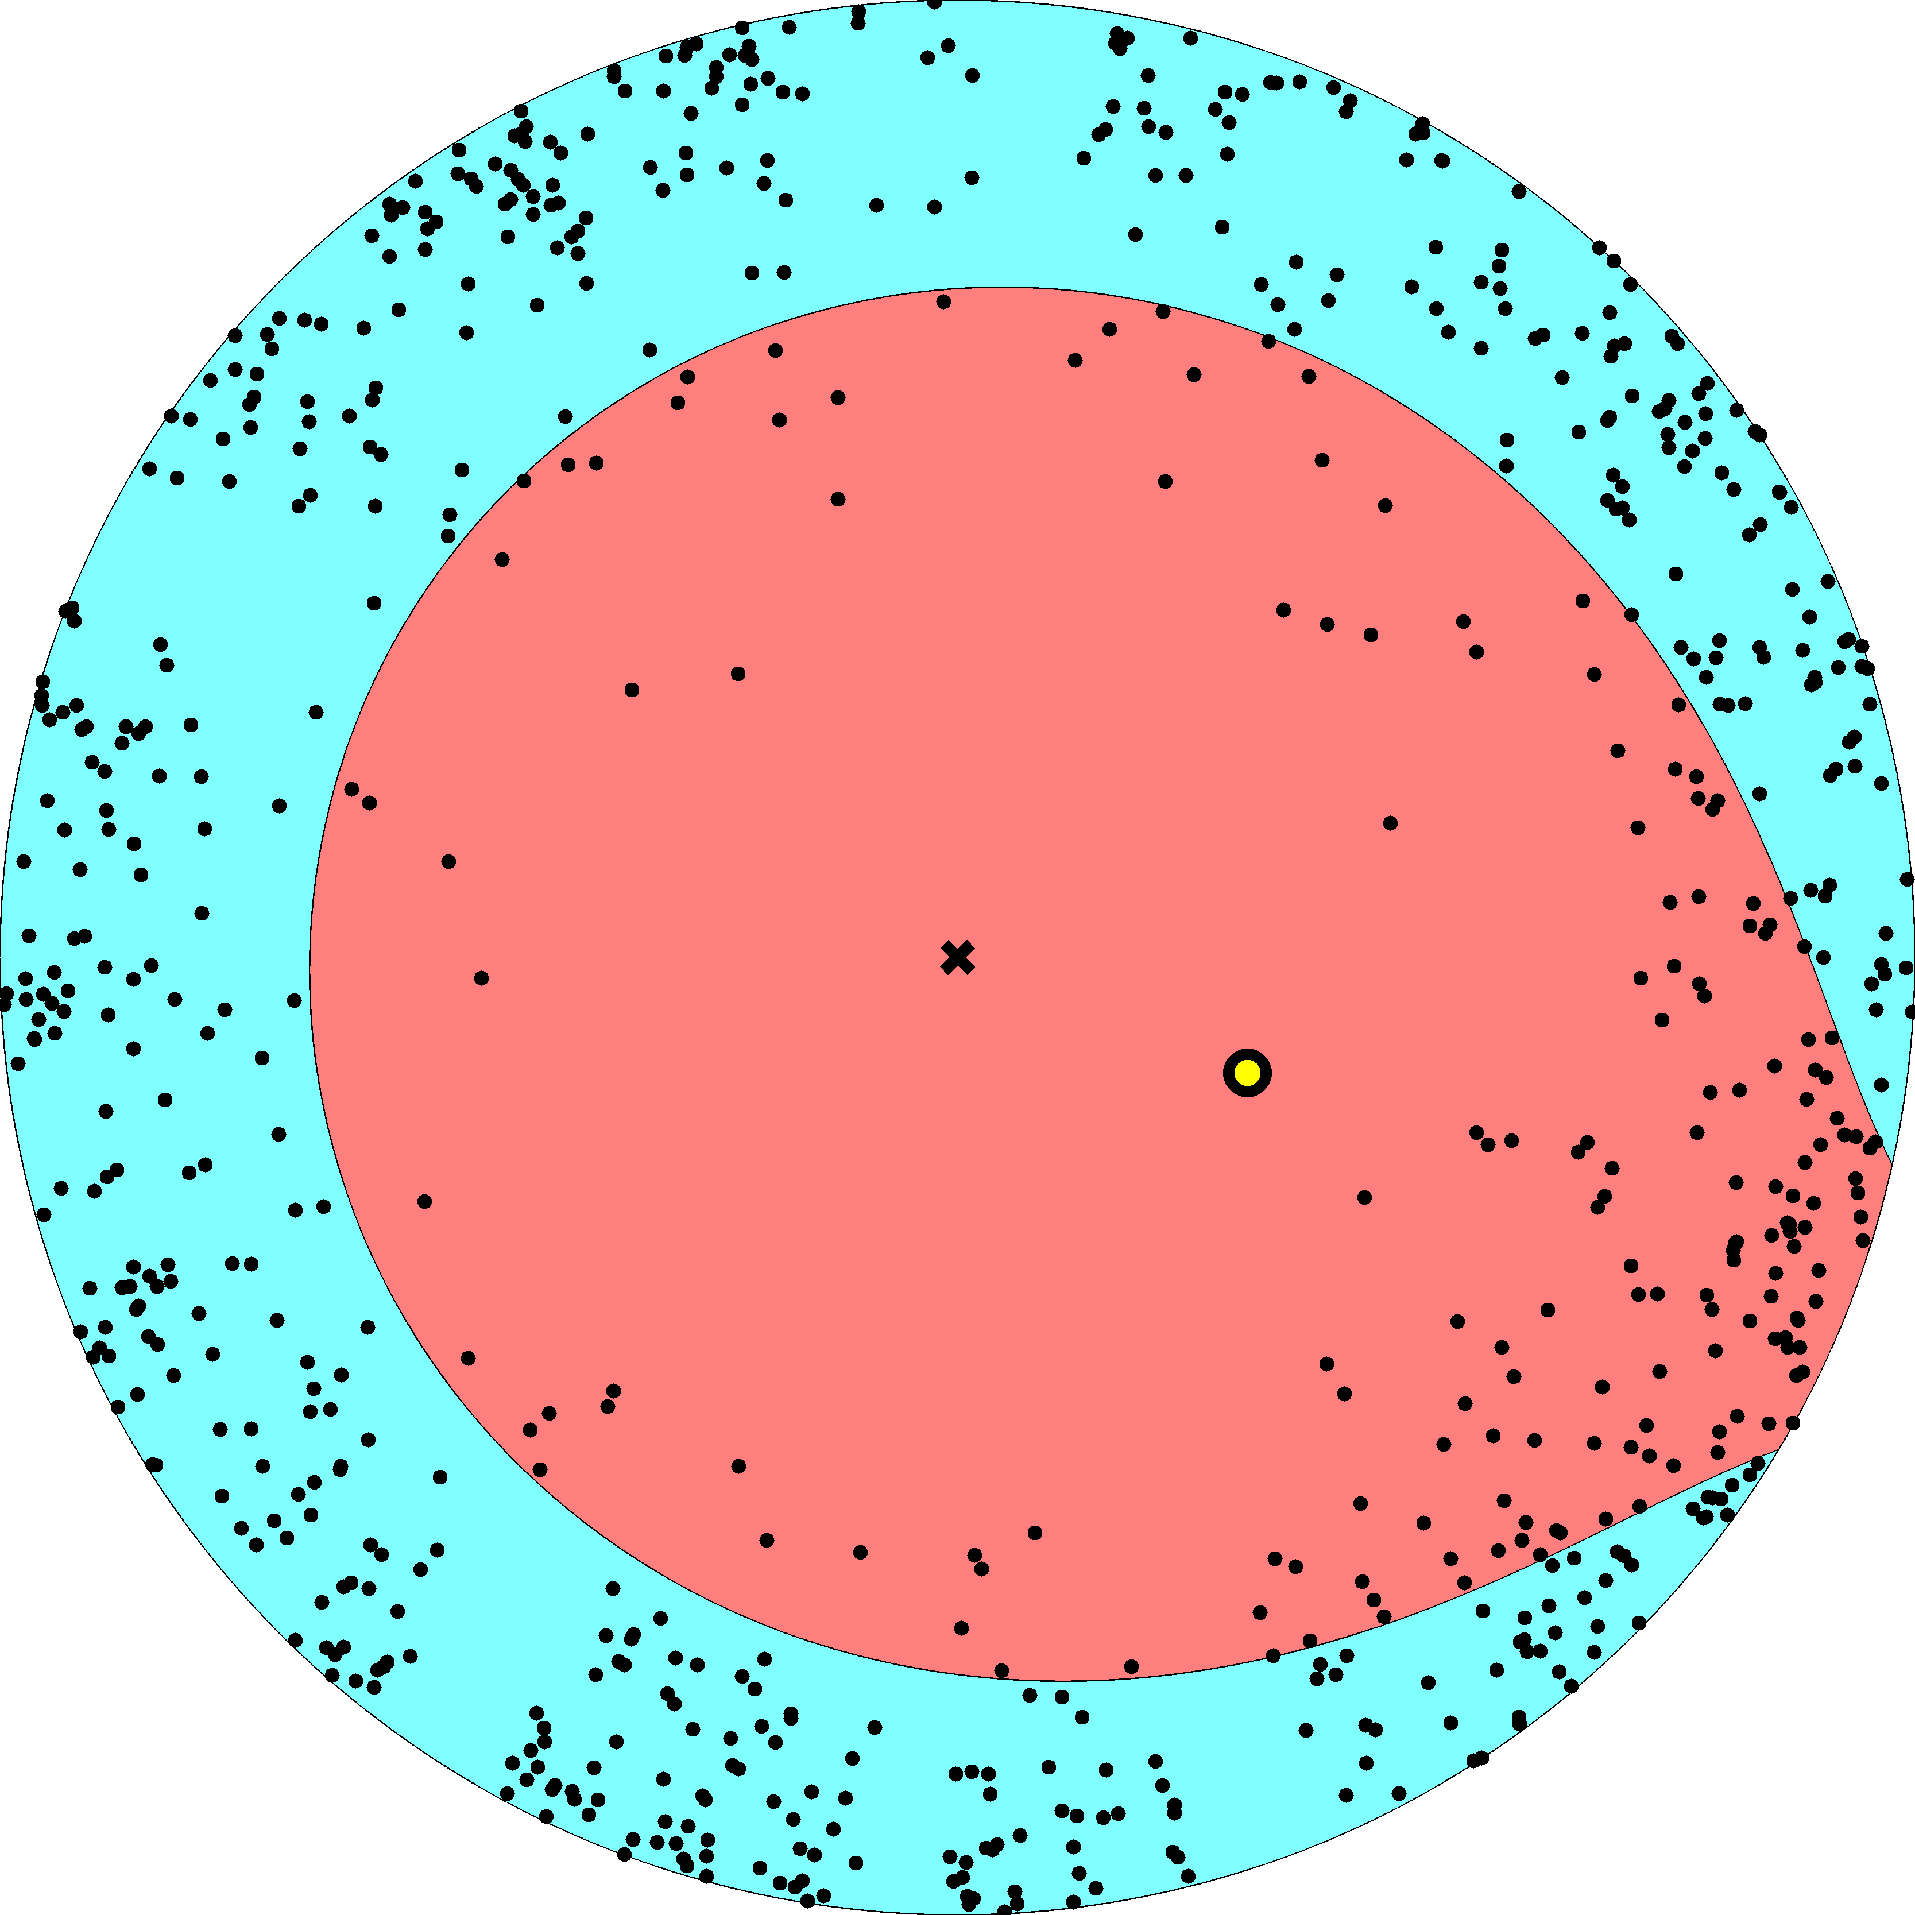

Slide 35
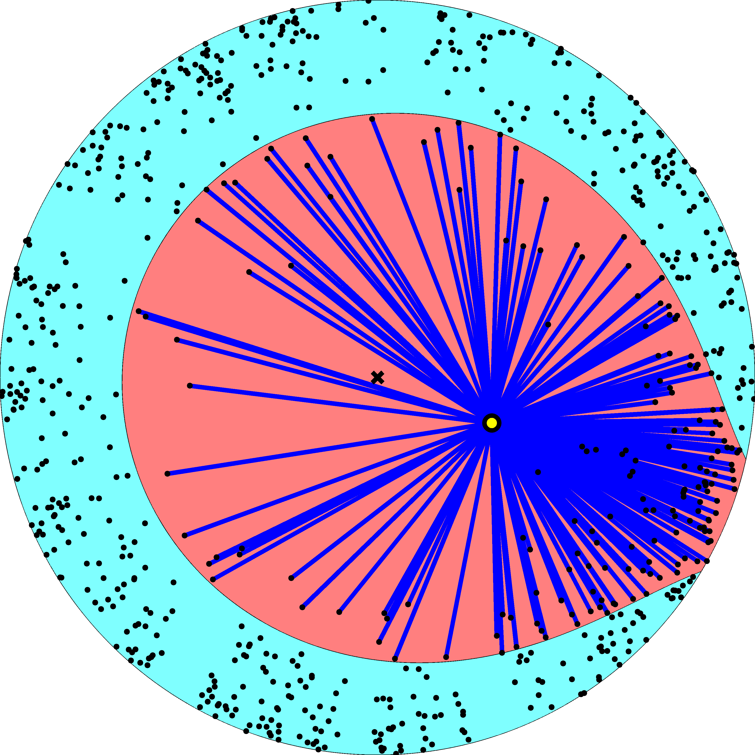

Slide 36
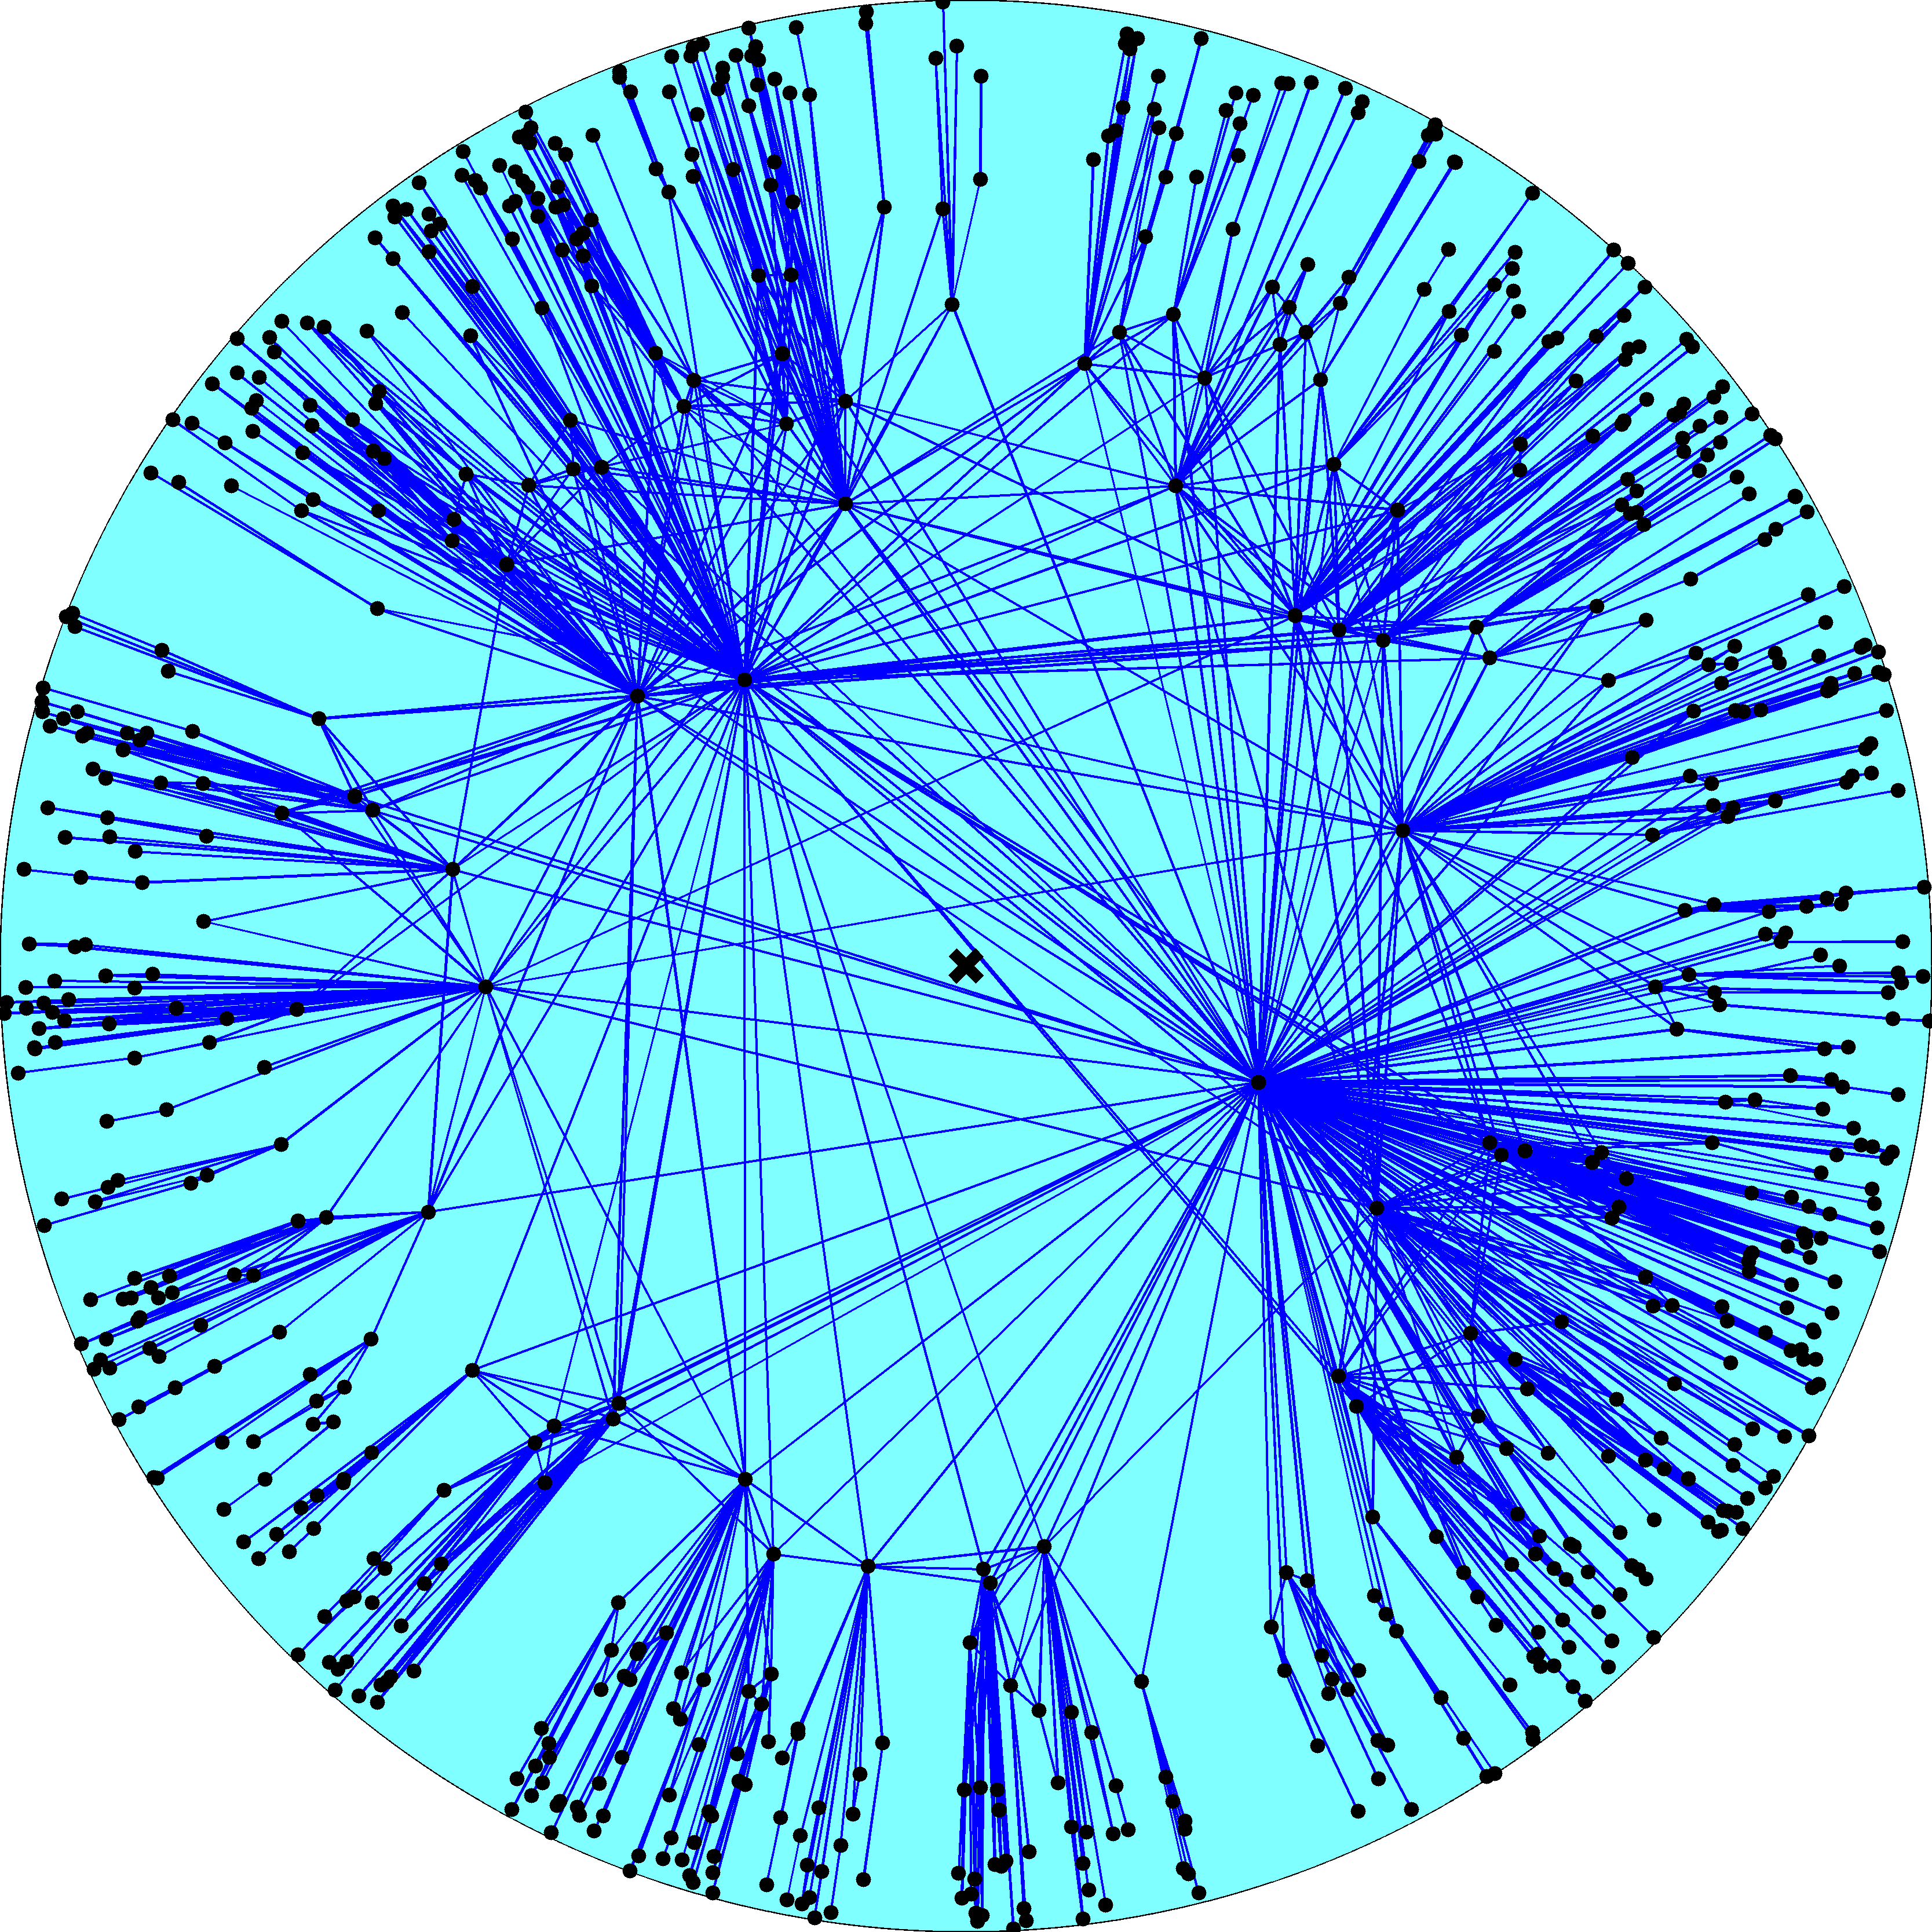

Slide 37
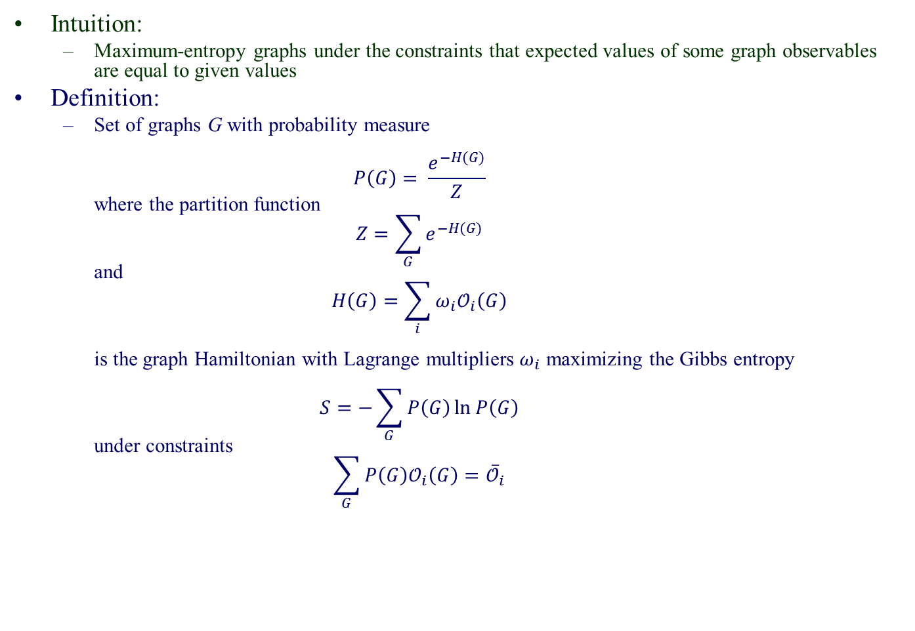
Exponential random graphs
Intuition:
  Maximum-entropy graphs under the constraints that expected values of some graph observables are equal to given values
Definition:
  Set of graphs G with probability measure
  $P\left(G\right)= \frac{e^{−H(G)}}{Z}$
  where the partition function
  $Z=\sum_{G}{e^{−H(G)}}$
  and
  $H\left(G\right)=\sum_{i}{ω_{i}𝒪_{i}\left(G\right)}$
  is the graph Hamiltonian with Lagrange multipliers $ω_{i}$ maximizing the Gibbs entropy
  $S=−\sum_{G}{P\left(G\right)\ln{P\left(G\right)}}$
  under constraints
  $\sum_{G}{P\left(G\right)𝒪_{i}\left(G\right)={\overline{𝒪}}_{i}}$

Slide 38
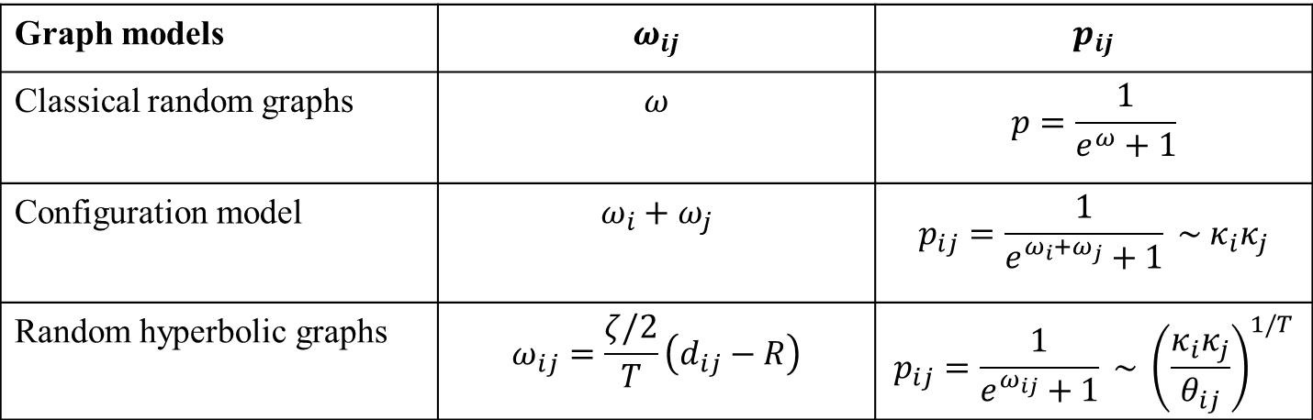
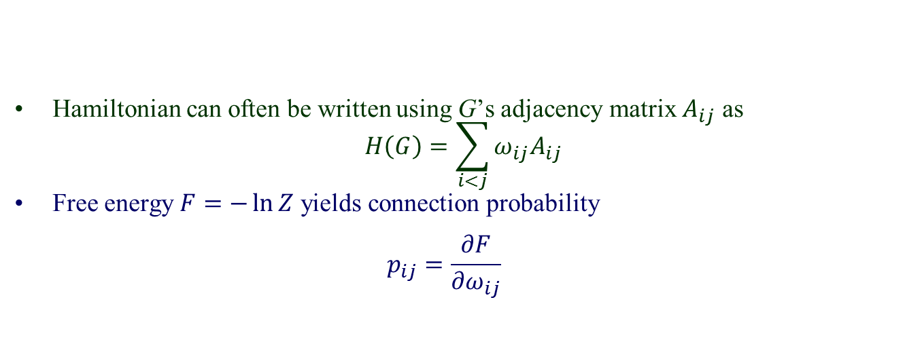
Examples
Hamiltonian can often be written using G’s adjacency matrix $A_{ij}$ as
$H\left(G\right)=\sum_{i<j}{ω_{ij}A_{ij}}$
Free energy $F=−\ln{Z}$ yields connection probability
$p_{ij}=\frac{∂F}{∂ω_{ij}}$
Graph models | $$ω_{ij}$$ | $$p_{ij}$$
Classical random graphs | $$ω$$ | $$p=\frac{1}{e^{ω}+1}$$
Configuration model | $$ω_{i}+ω_{j}$$ | $$p_{ij}=\frac{1}{e^{ω_{i}+ω_{j}}+1} \sim κ_{i}κ_{j}$$
Random hyperbolic graphs | $$ω_{ij}=\frac{ζ/2}{T}\left(d_{ij}−R\right)$$ | $$p_{ij}=\frac{1}{e^{ω_{ij}}+1} \sim {\left(\frac{κ_{i}κ_{j}}{θ_{ij}}\right)}^{1/T}$$
Analogy Boltzmann distribution Fermi-Dirac distribution

Slide 41


Slide 42
The key property of the model
The model describes the large-scale structure and growth dynamics of some real networks remarkably well
  Internet
  PGP
  Metabolic

Slide 43
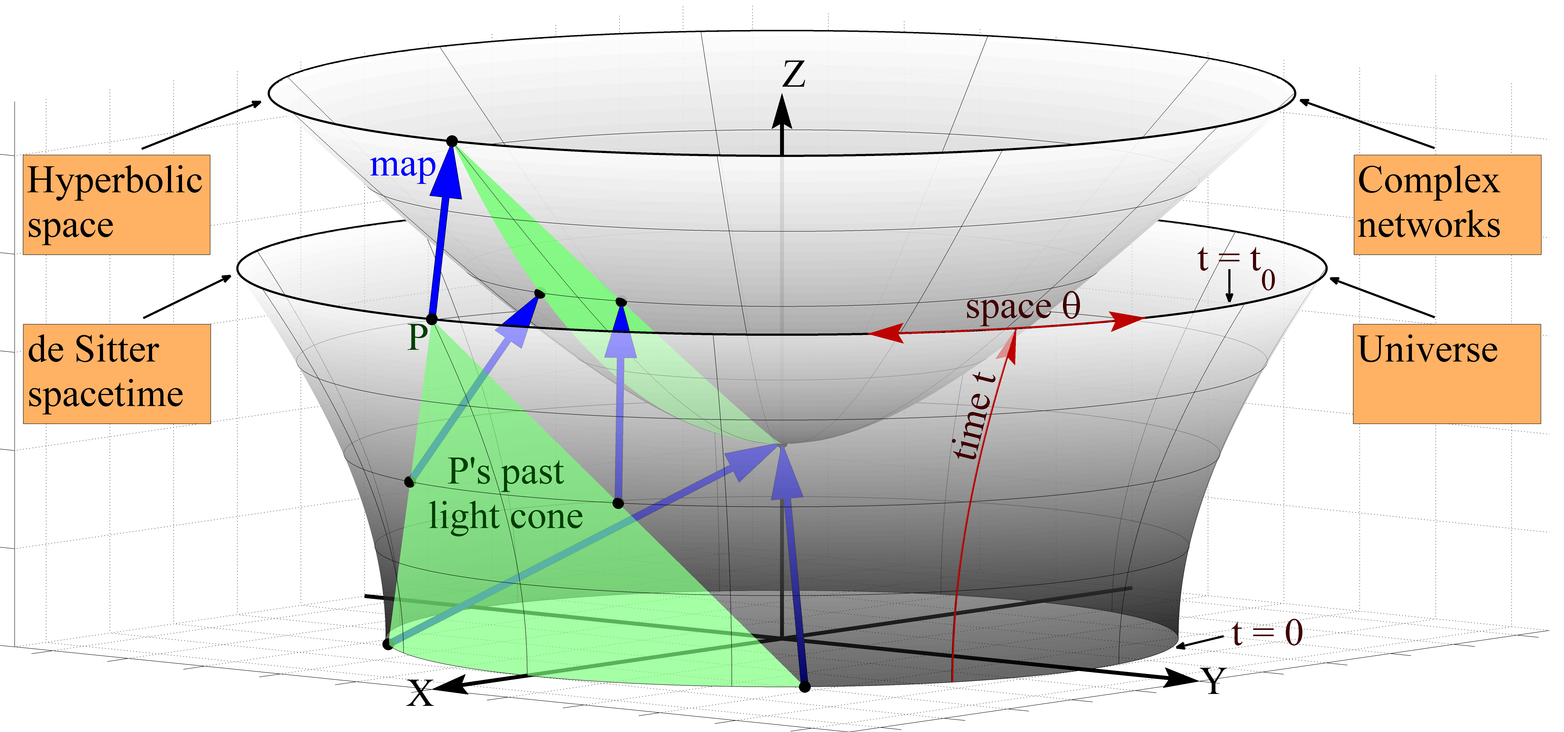

Slide 44
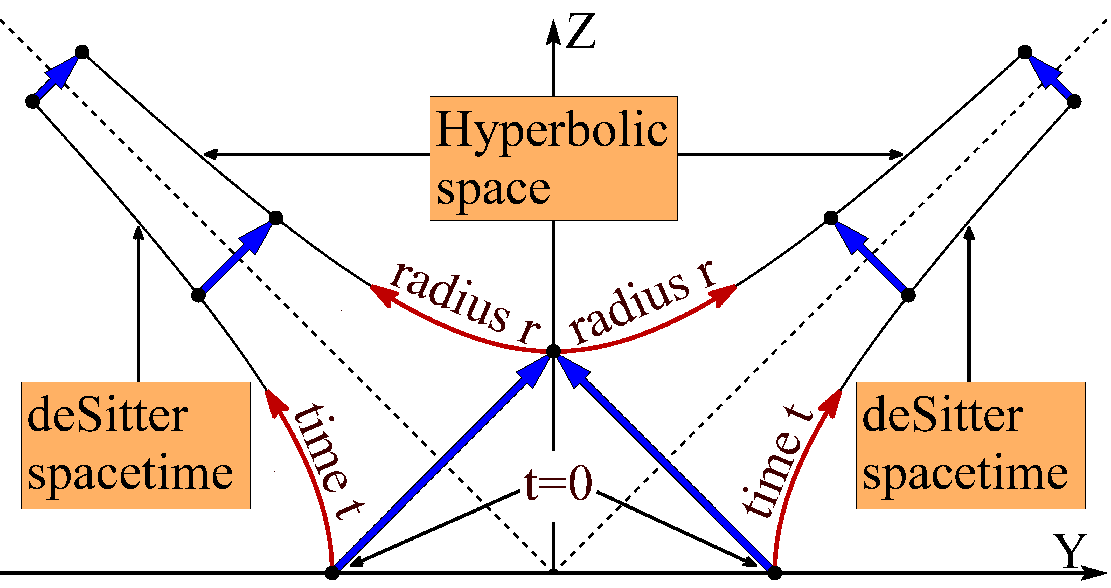

Slide 47
Take-home messages
Graphs are useful abstractions of many complex systems
The large-scale structure and dynamics of complex networks and causal networks in de Sitter universes are asymptotically identical
Two options:
  This equivalence is a coincidence
    Compute the probability of this coincidence ☺
  This equivalence is not a coincidence
    Find common fundamental laws from which Einstein’s equations (known) and equations describing complex network dynamics (unknown) follow as particular cases

Slide 48
D. Krioukov, M. Kitsak, R. Sinkovits, D. Rideout, D. Meyer, and M. Boguñá,
Network Cosmology,
Nature Scientific Reports, v.2, 793, 2012
F. Papadopoulos, M. Kitsak, M. Á. Serrano, M. Boguñá,, and D. Krioukov,
Popularity versus Similarity in Growing Networks,
Nature, v.489, p.537, 2012
M. Boguñá, F. Papadopoulos, and D. Krioukov,
Sustaining the Internet with Hyperbolic Mapping,
Nature Communications, v.1, 62, 2010
D. Krioukov, F. Papadopoulos, A. Vahdat, and M. Boguñá,
Hyperbolic Geometry of Complex Networks,
Physical Review E, v.82, 036106, 2010,
Physical Review E, v.80, 035101(R), 2009
F. Papadopoulos, D. Krioukov, M. Boguñá, and A. Vahdat,
Greedy Forwarding in Scale-Free Networks
Embedded in Hyperbolic Metric Spaces,
INFOCOM 2010,
SIGMETRICS MAMA 2009
M. Boguñá, D. Krioukov, and kc claffy,
Navigability of Complex Networks,
Physical Review Letters, v.102, 058701, 2009
Nature Physics, v.5, p.74-80, 2009
M. Á. Serrano, M. Boguñá, and D. Krioukov,
Self-Similarity of Complex Networks,
Physical Review Letters, v.106, 048701, 2011
Physical Review Letters, v.100, 078701, 2008

