Slide 1
Network Cosmology
Dmitri Krioukov CAIDA/UCSD M. Kitsak, R. Sinkovits, D. Rideout, D. Meyer, M. Boguñá PCGM, UCSB, March 2012

Slide 2
Large networks
Technological
Internet
Transportation
Power grid
Social
Collaboration
Trust
Friendship
Biological
Gene regulation
Protein interaction
Metabolic
Brain
Can there be anything common to all these networks???
Naïve answer:
No
Well, yes: they all are messy, complex, “very random”
And that’s it

Slide 3
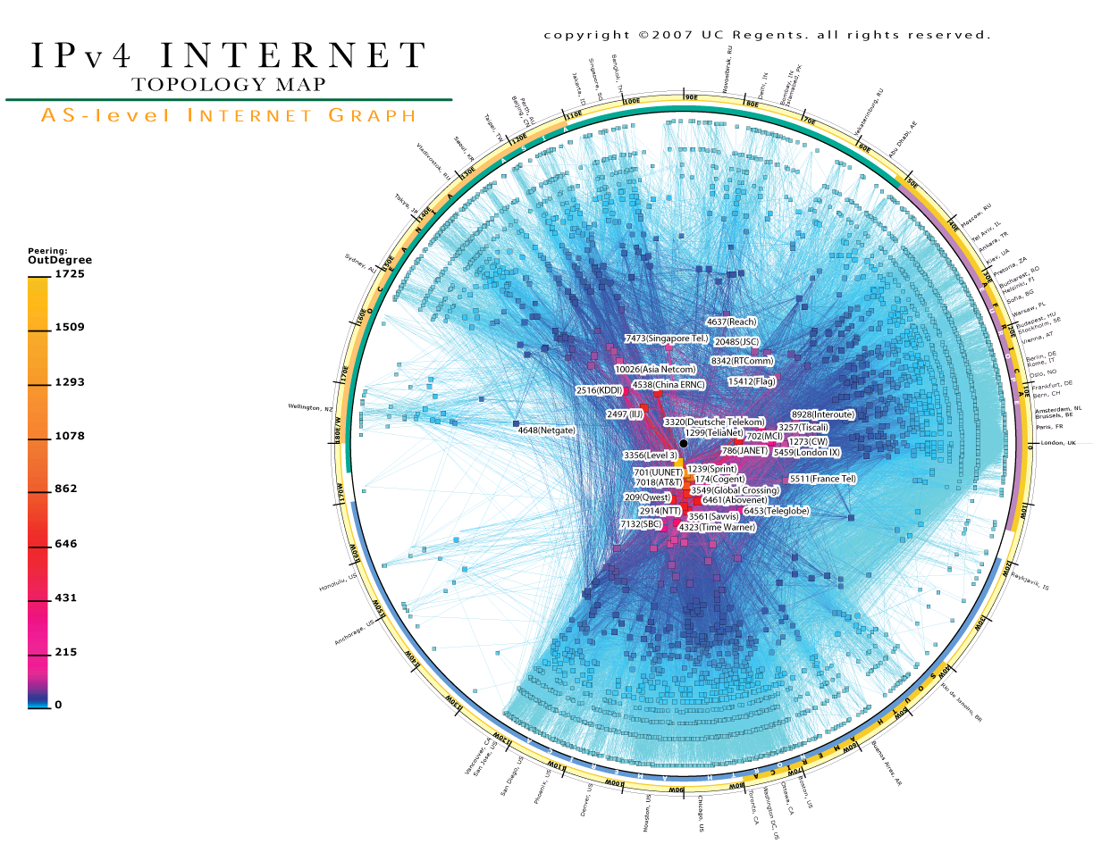

Slide 4
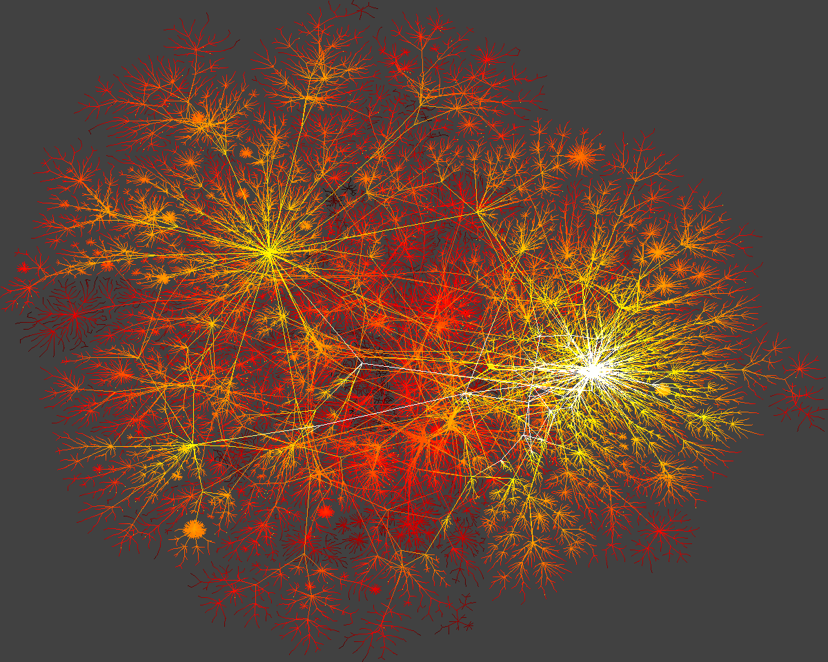

Slide 5
Heterogeneity and Clustering
Distribution P(k) of node degrees k
Real: P(k) ~ k
Random: P(k) ~ ^{k} e / k!
Average probability that node neighbors are connected
Real: 0.5
Random: 710^{4}

Slide 6
Strong heterogeneity and clustering as common properties of large networks
Network | Exponent of the degree distribution | Average clustering
Internet | 2.1 | 0.46
Air transportation | 2.0 | 0.62
Actor collaboration | 2.3 | 0.78
Protein interaction S. cerevisiae | 2.4 | 0.09
Metabolic E. coli and S. cerevisiae | 2.0 | 0.67
Gene regulation E. coli and S. cerevisiae | 2.1 | 0.09

Slide 7
Any other common properties?
No
Well, some randomness, of course
Real large networks appear to be quite different and unique in all other respects
Any simple random graph model that can reproduce these two universal properties?

Slide 8
Hyperbolic geometric graphs
Take a compact region in a hyperbolic space, e.g., a circle of radius R
Sprinkle N nodes into it via the Poisson point process (R  ln N)
Connect each pair of nodes if the distance between them is x  R

Slide 9
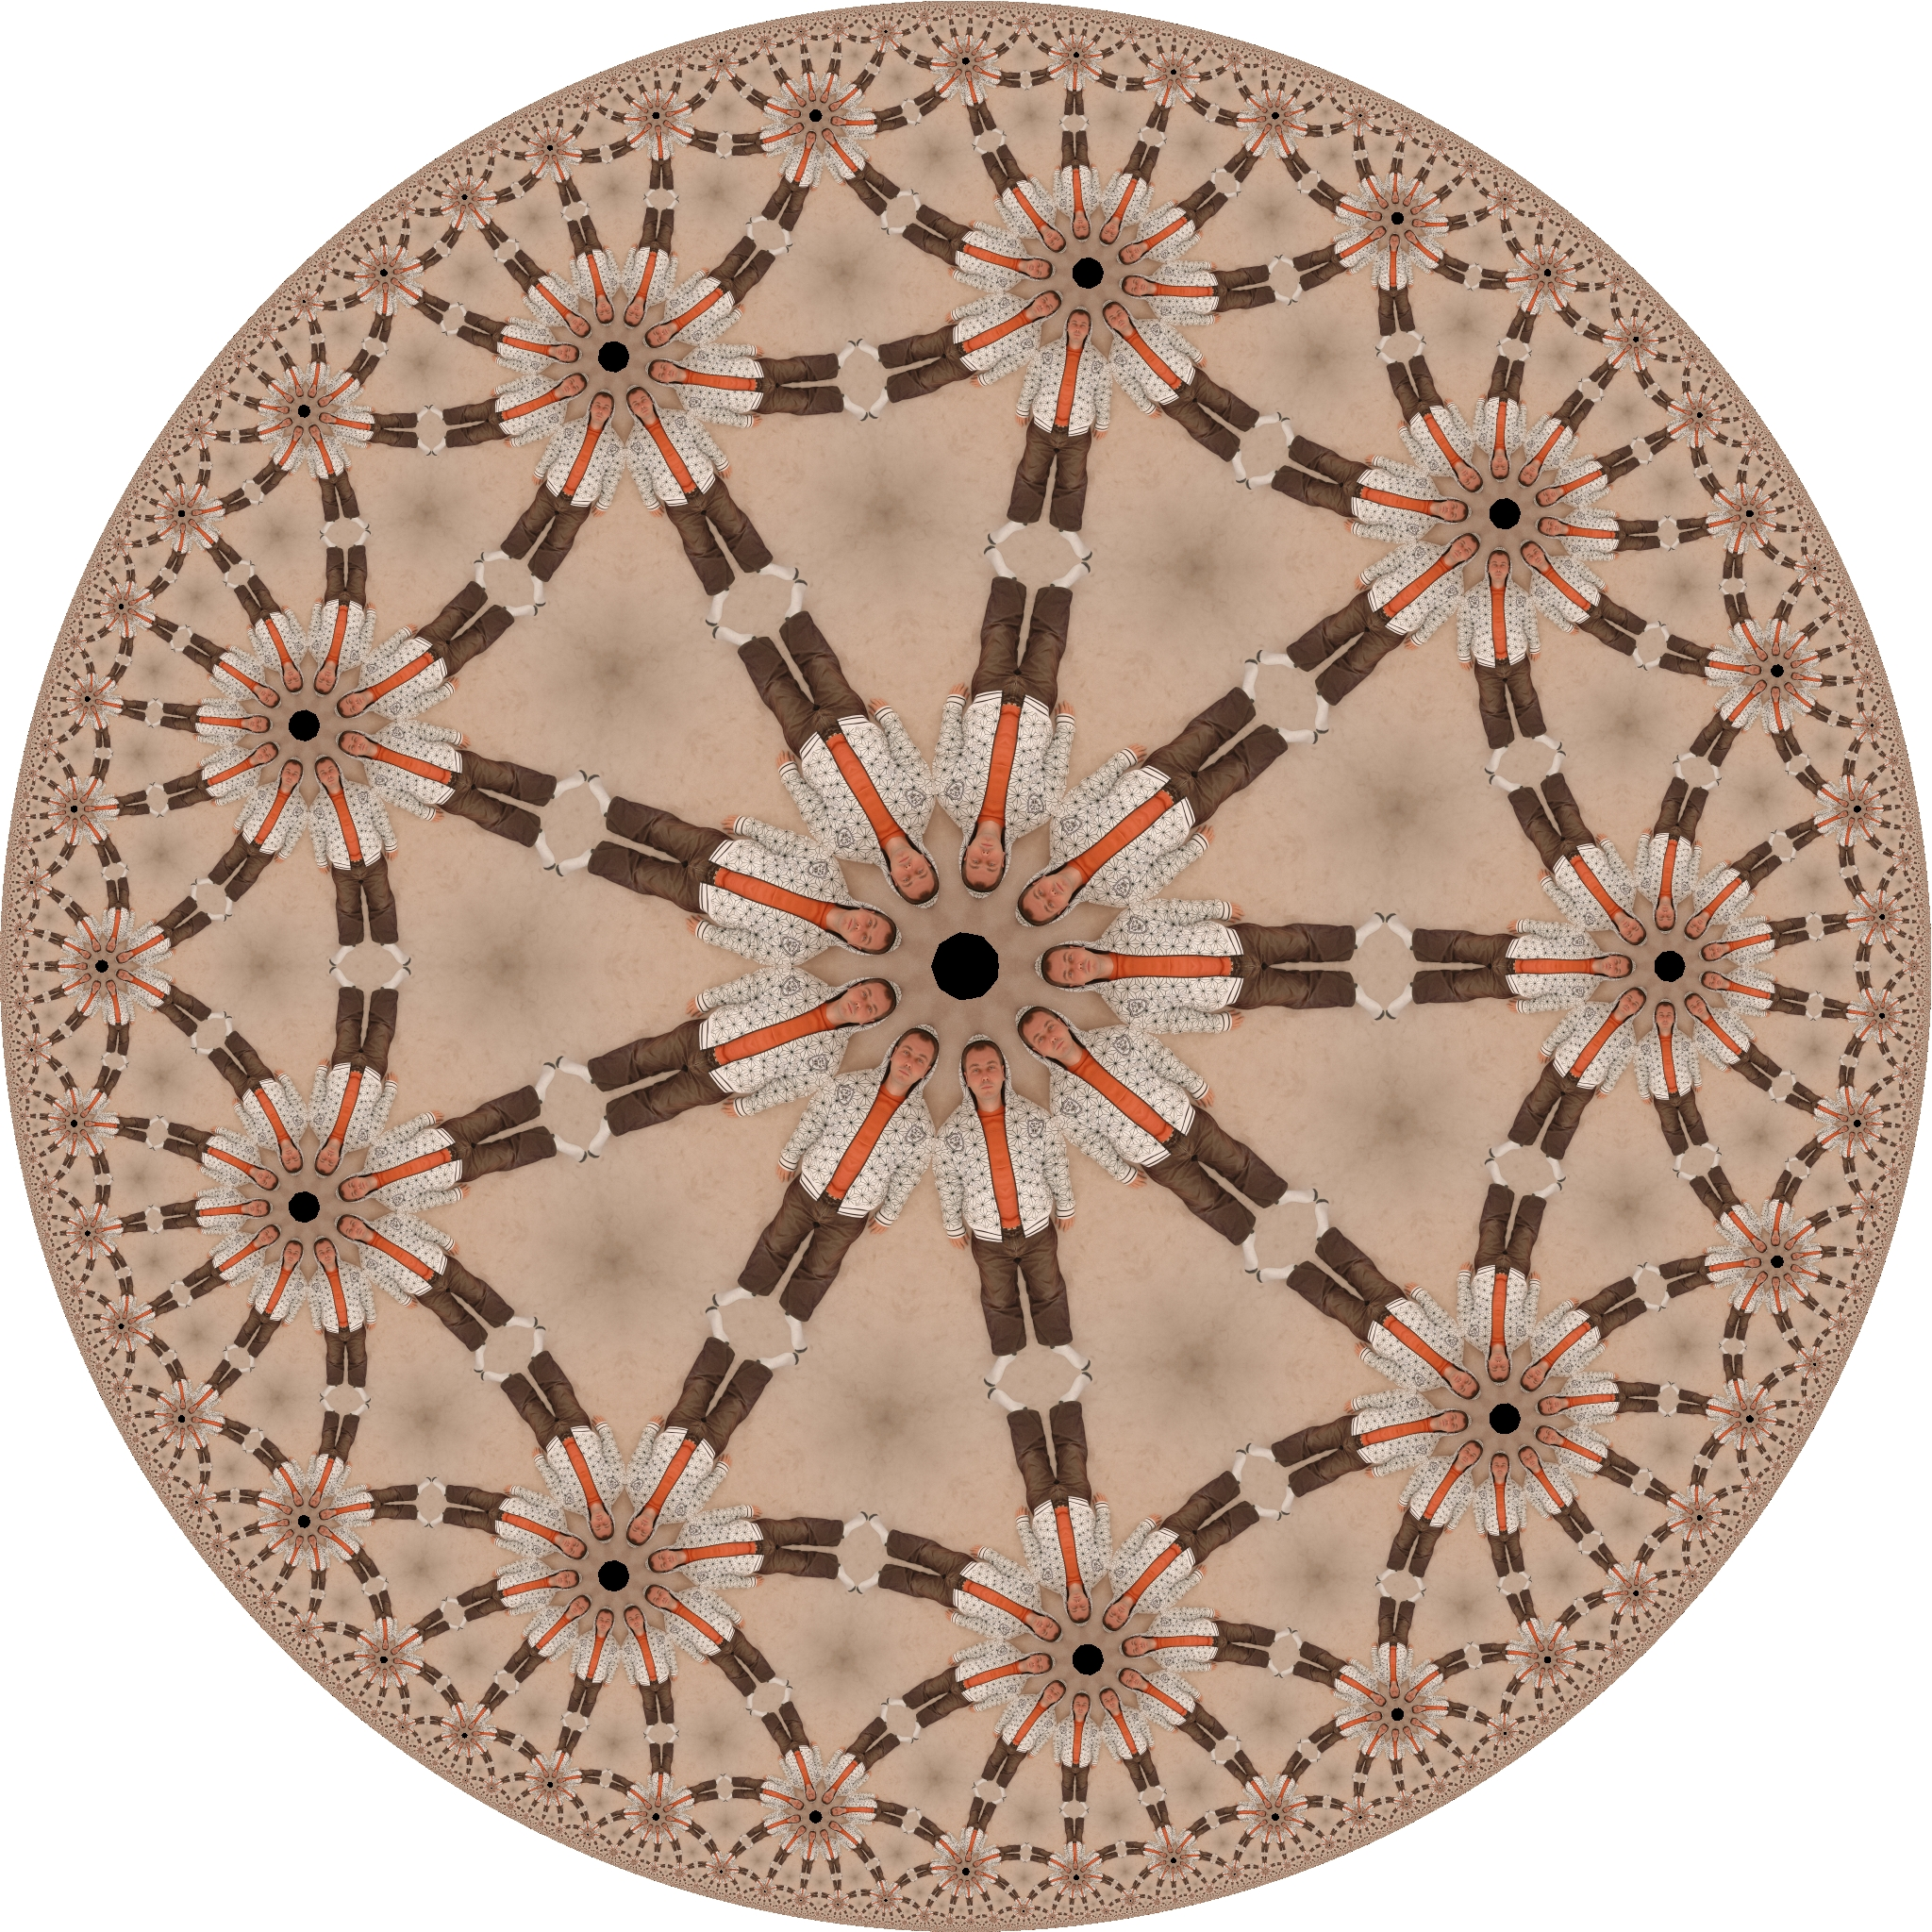

Slide 12
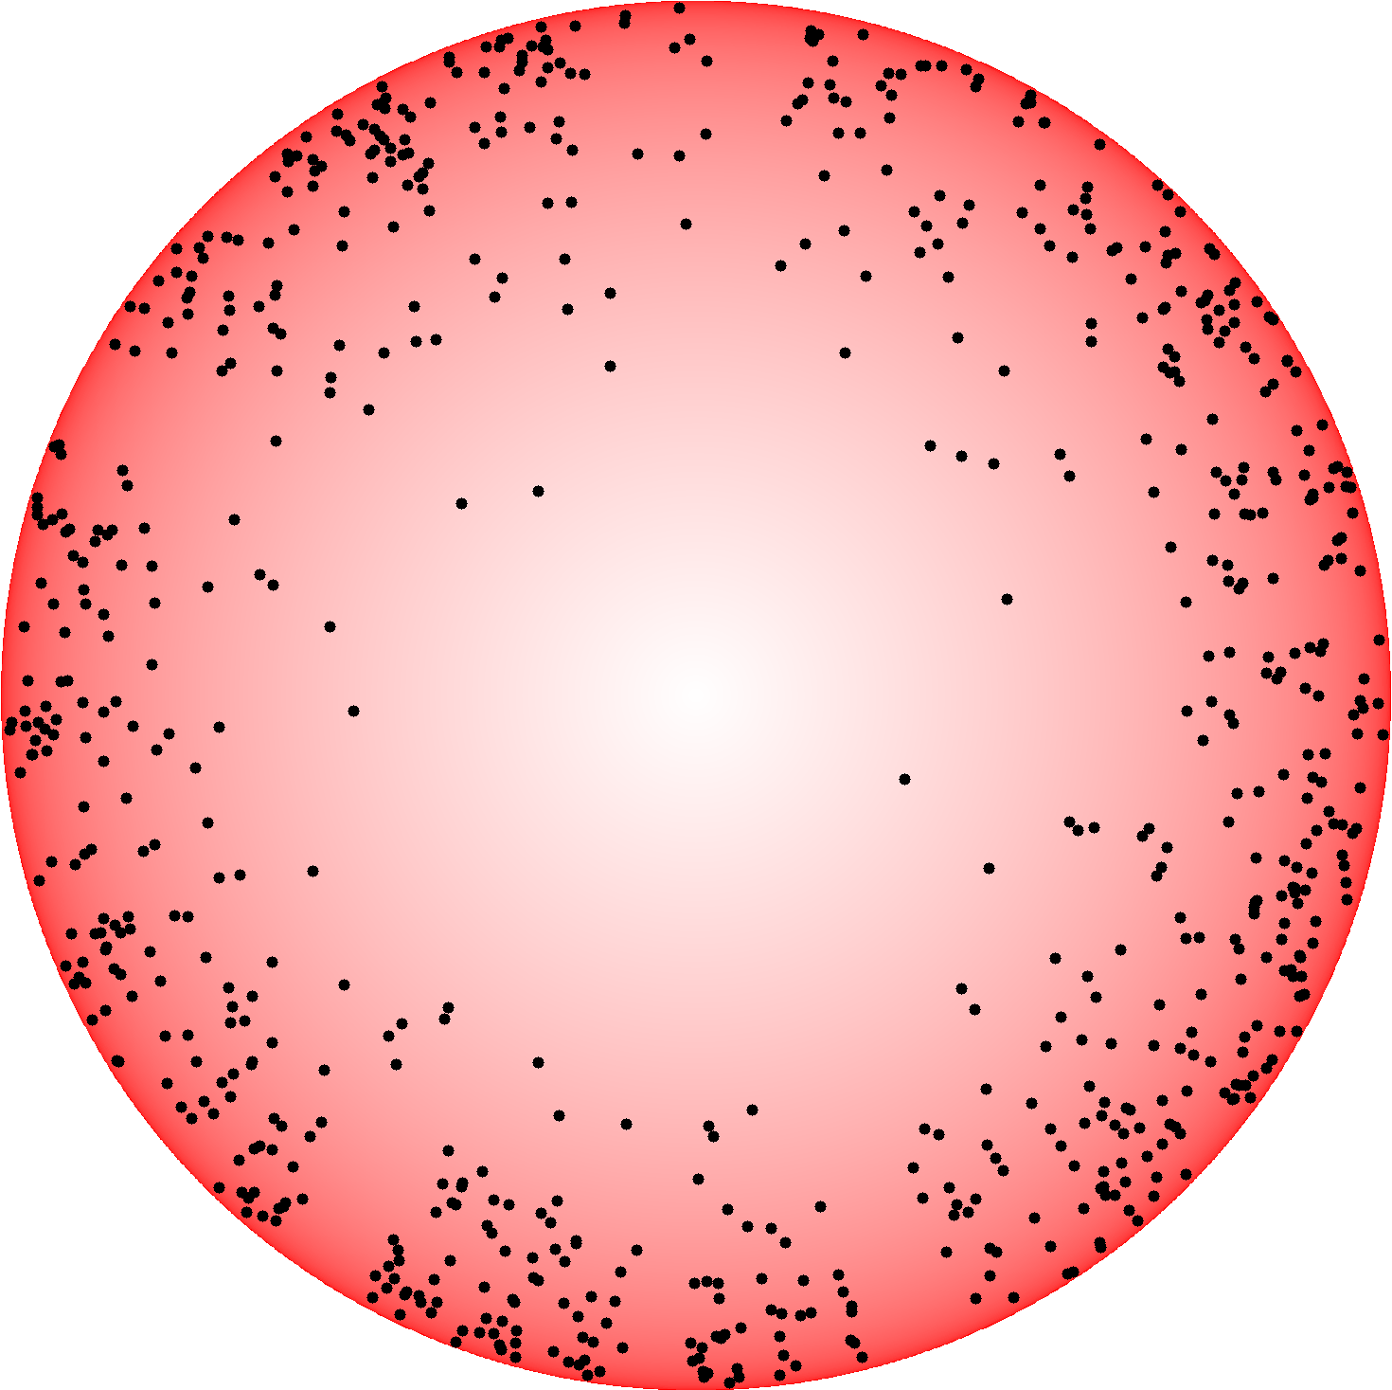

Slide 14
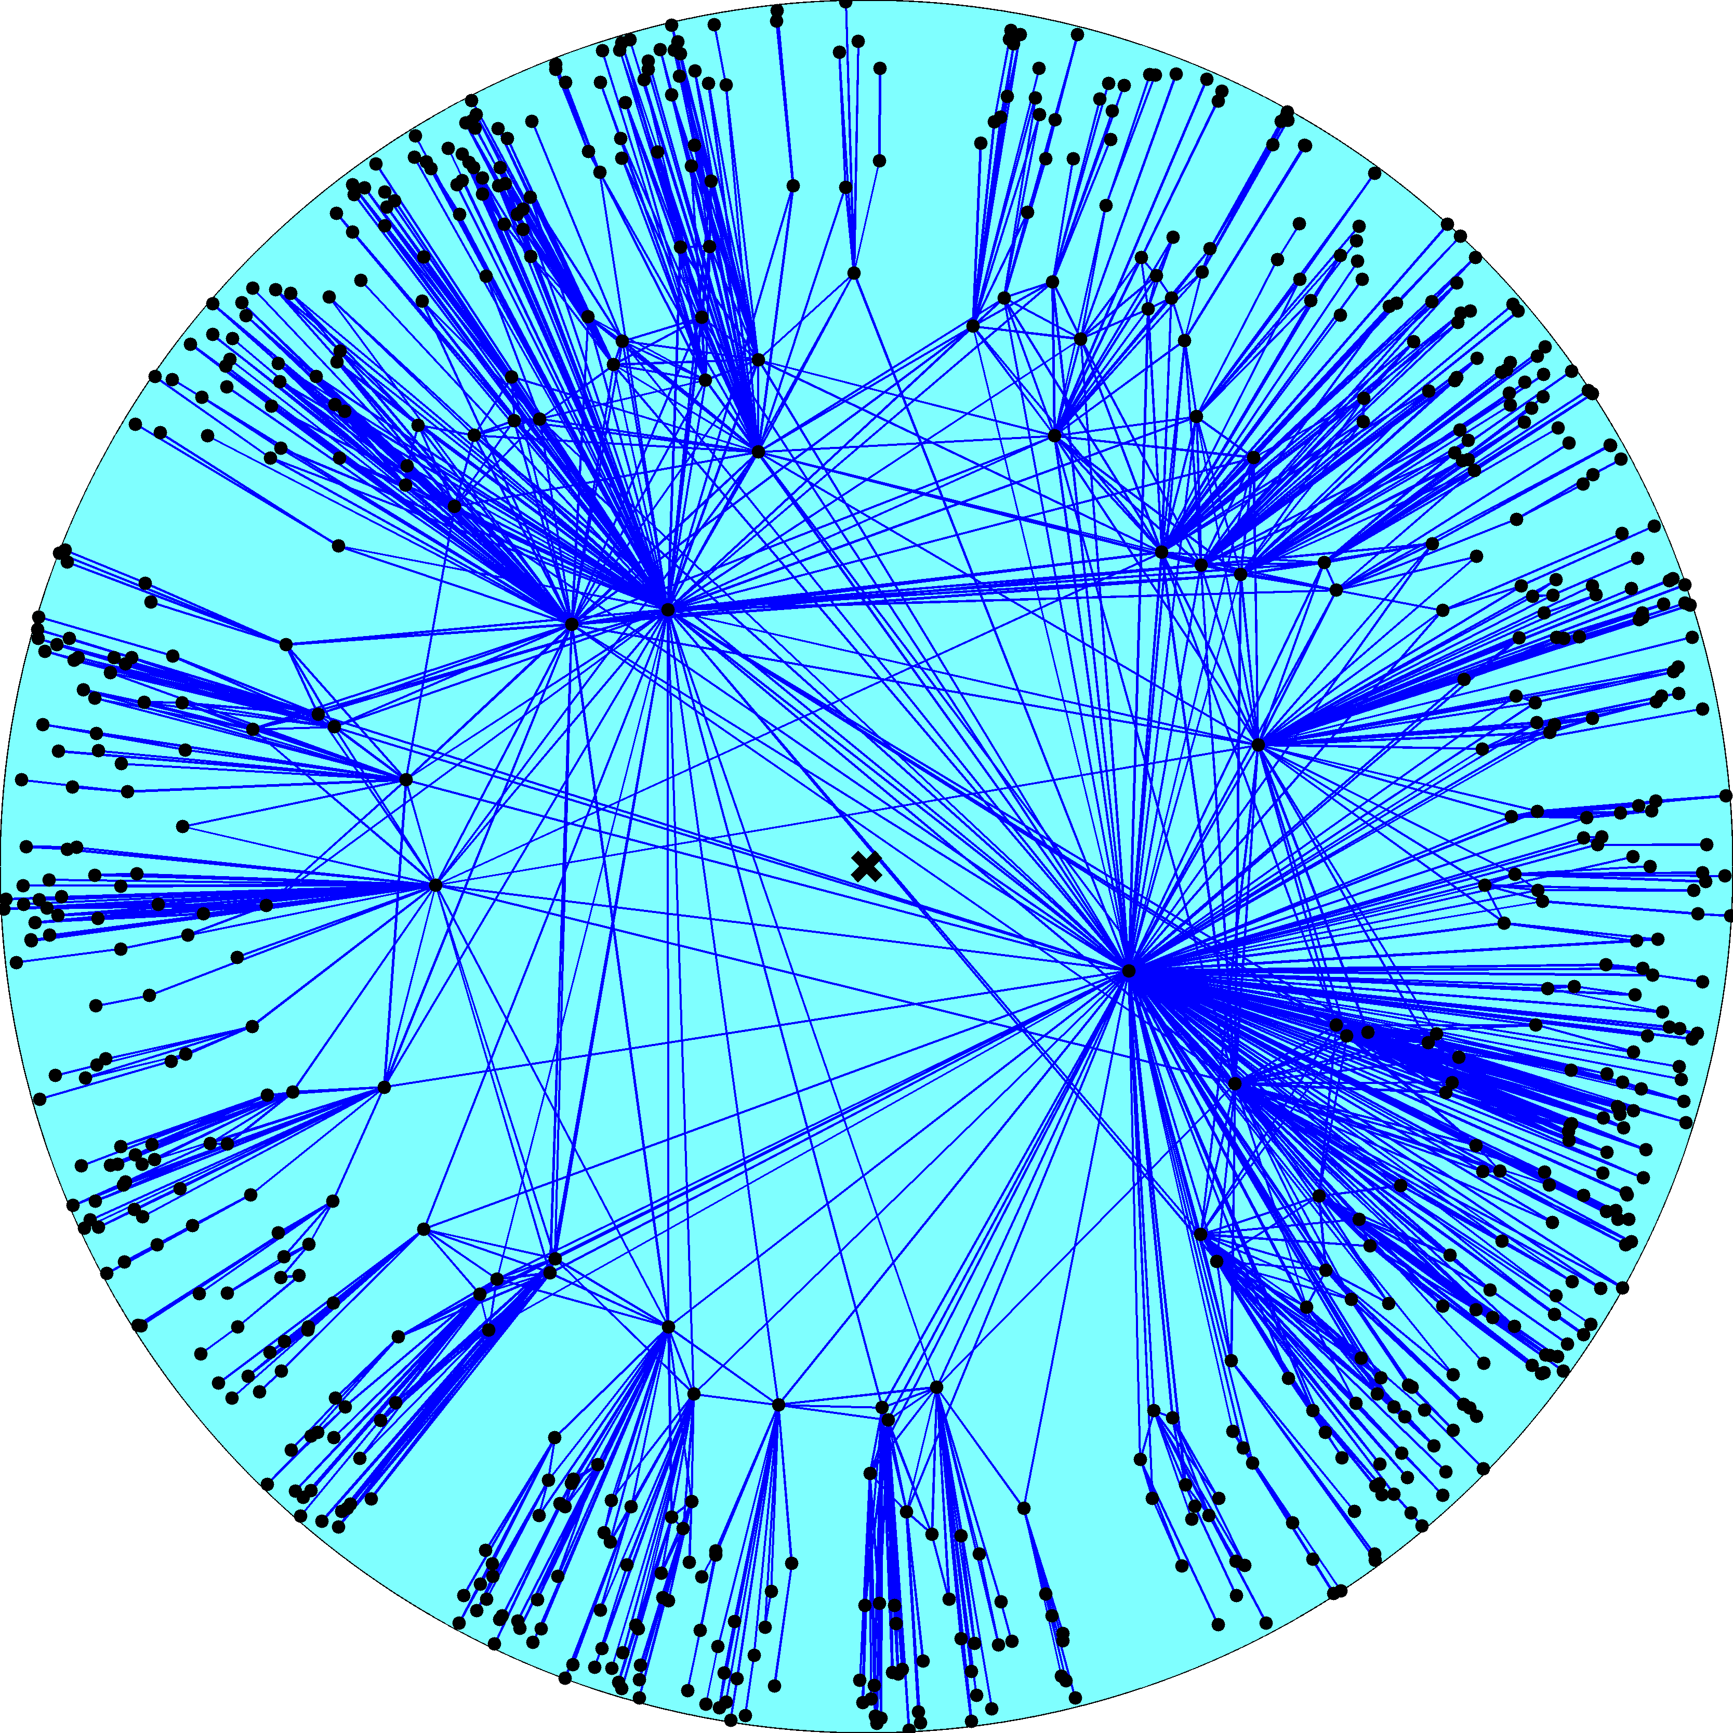
Node density
Node degree
R – disk radius
K – disk curvature
maximized
Degree distribution
Clustering

Slide 15
Network growth dynamics
Nodes join the network one by one t  1, 2, 3, …
New node t appears at a random location on the edge of an expanding hyperbolic disc of radius R  ln t
New node t connects to all existing nodes at hyperbolic distance x  R

Slide 17
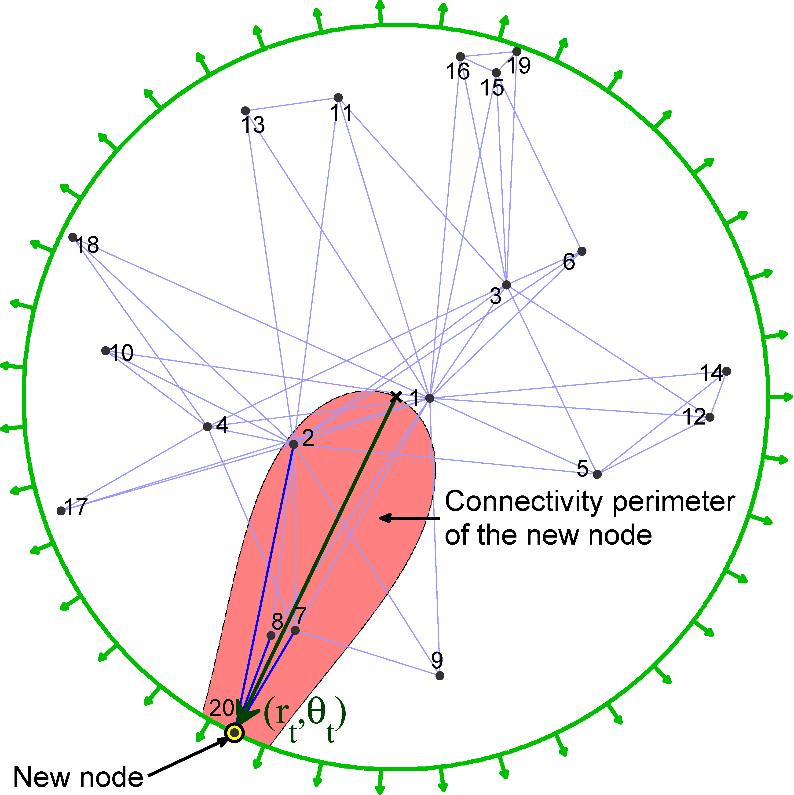

Slide 18
Validation
The model describes accurately the large-scale structure and dynamics of a variety of real networks, e.g.,
Internet
Social networks
Metabolic networks

Slide 19
Results
Causal sets approximating de Sitter spacetimes have structure nearly identical to the structure of many complex networks:
Power-law degree distributions with exponent 2
Strongest possible clustering
Their growth dynamics is asymptotically identical to the growth dynamics of complex networks in the described model
The causal set of the universe has a double power-law degree distribution (with exponents 3/4 and 2)

Slide 20
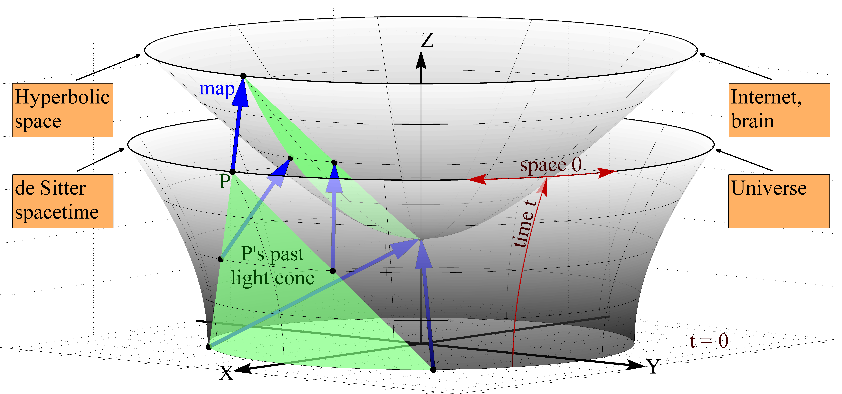

Slide 21
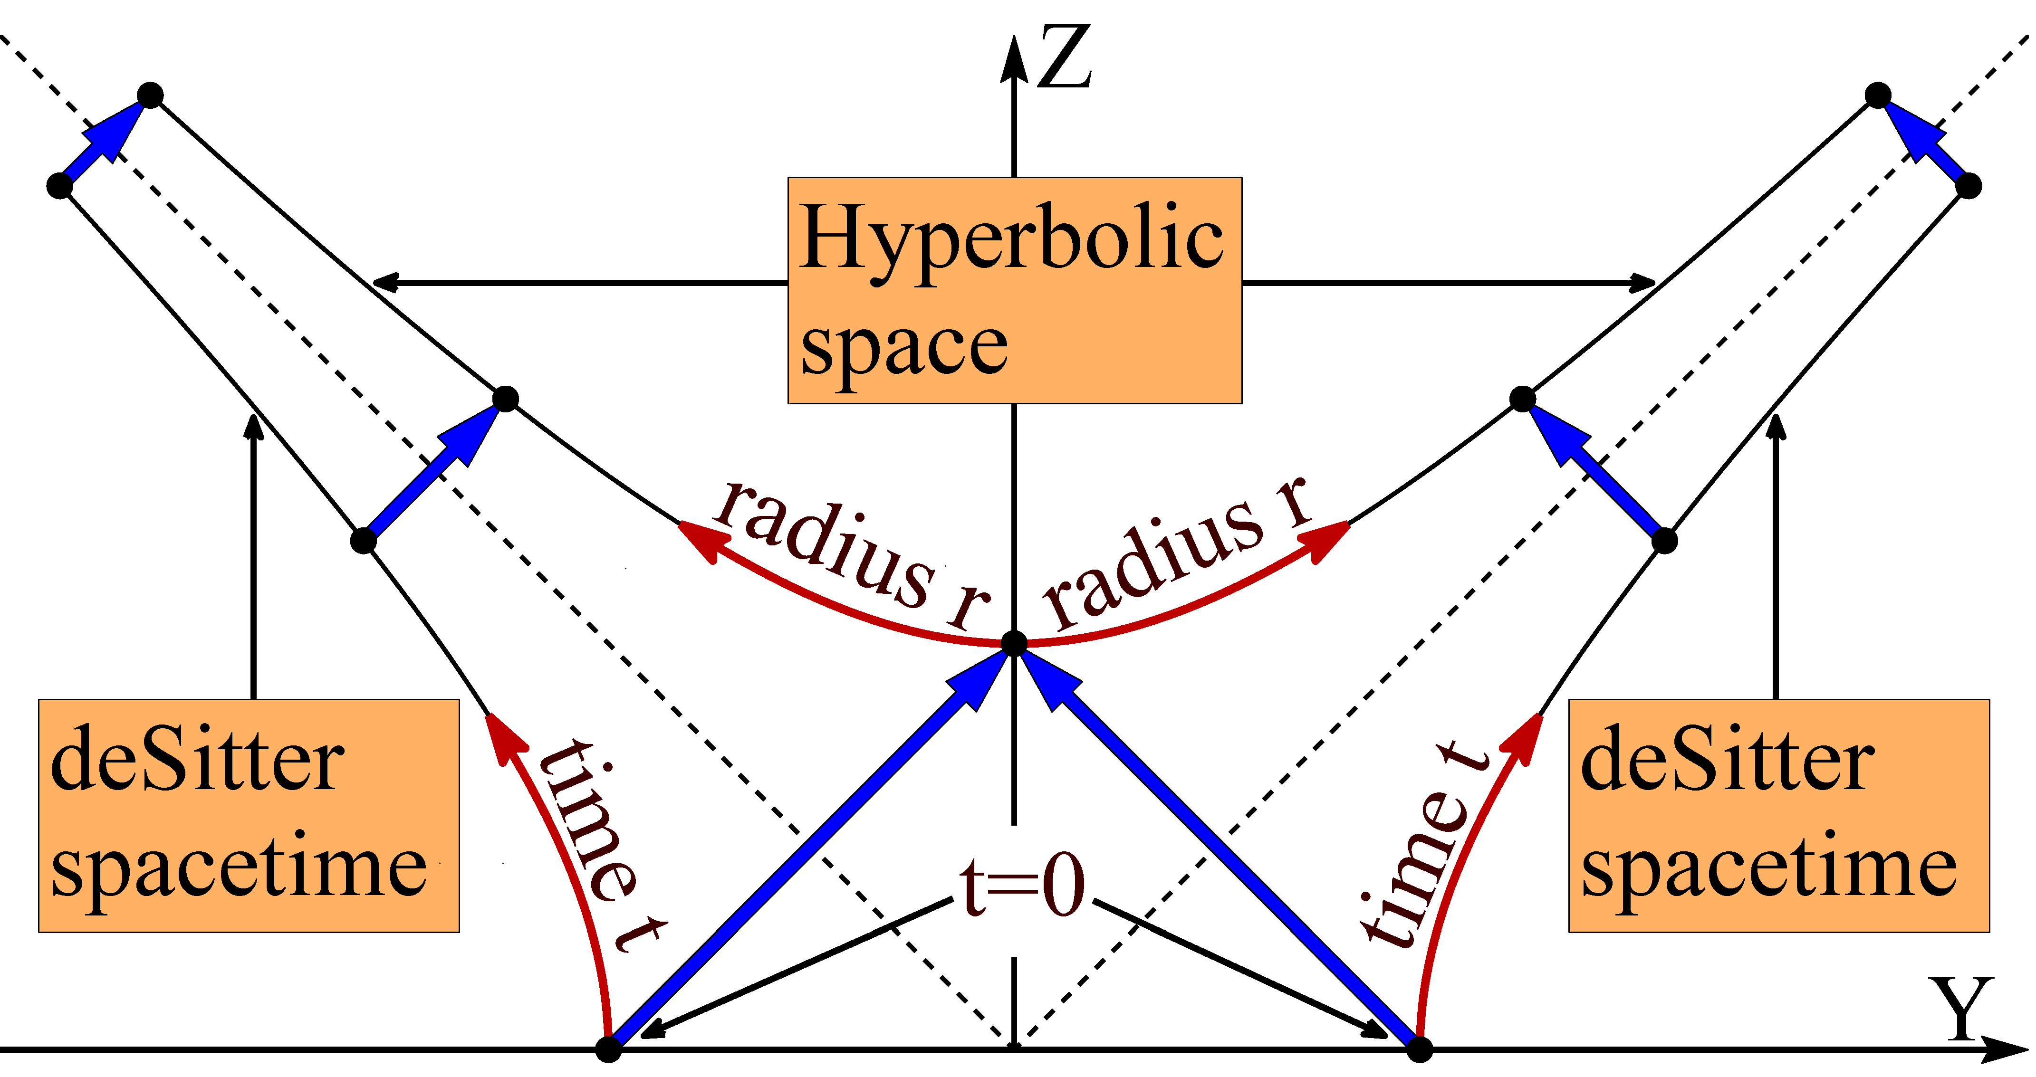

Slide 22
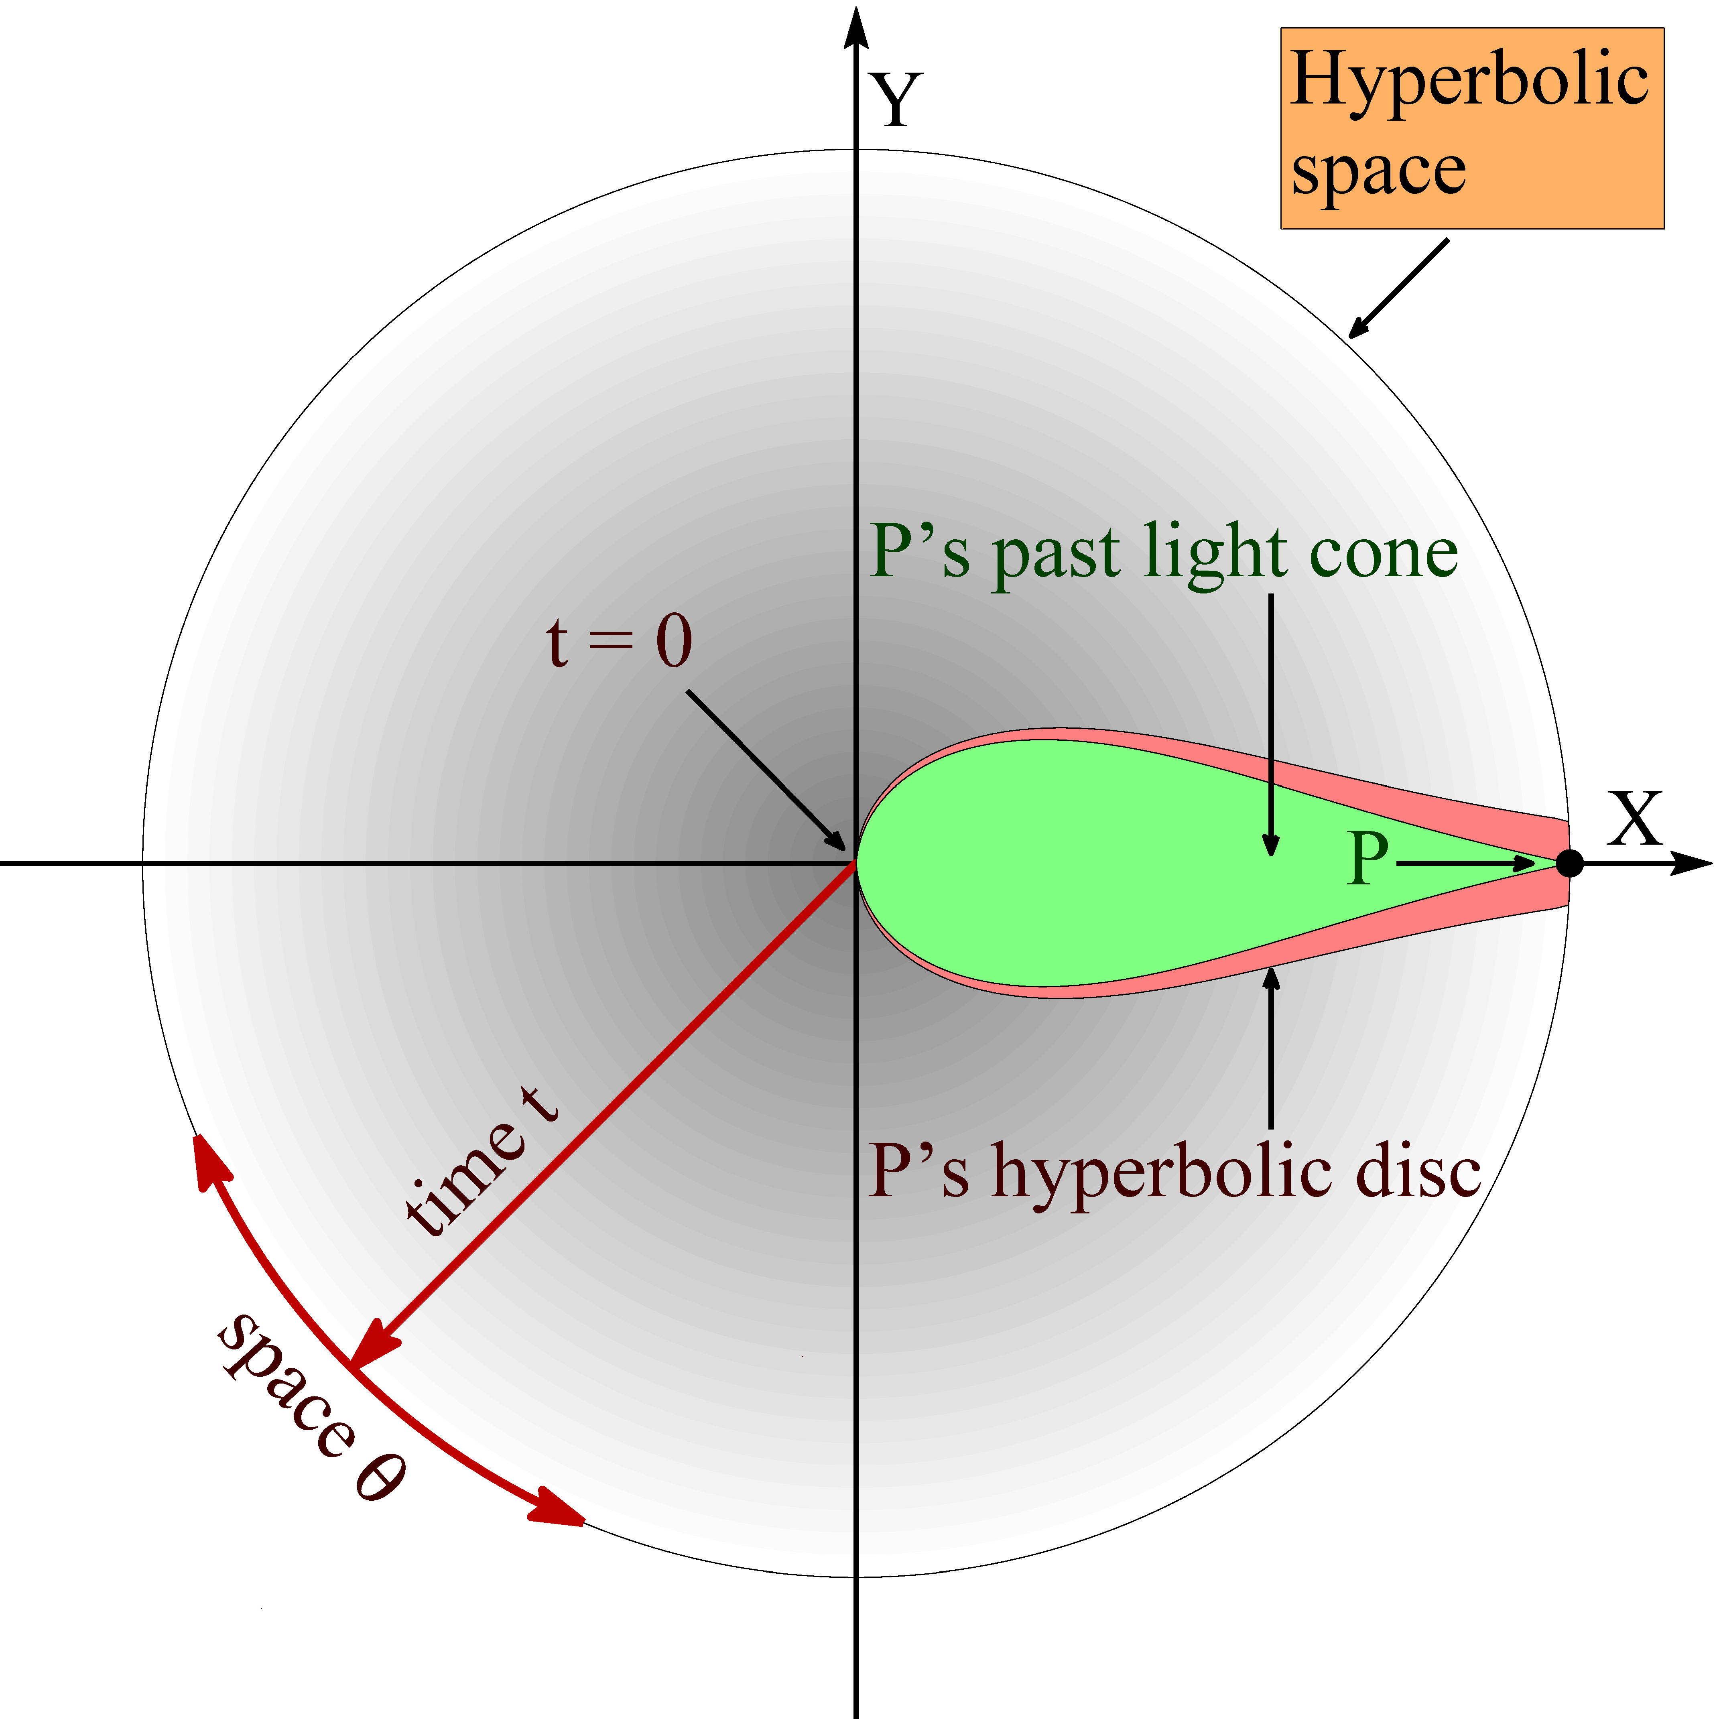

Slide 23
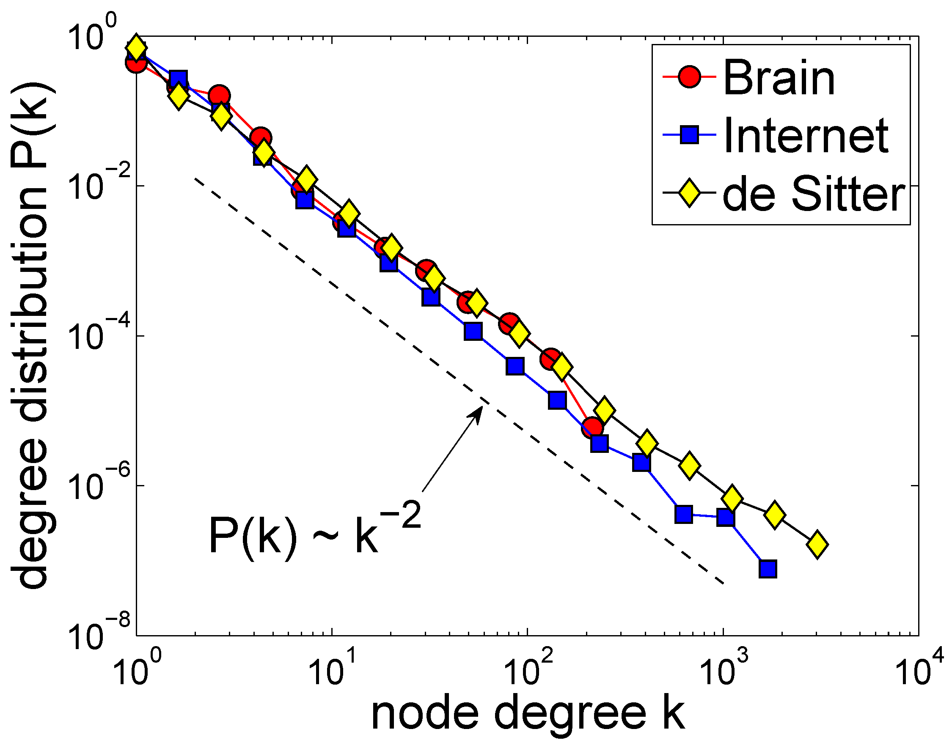

Slide 24
Conclusion
The large-scale structure and dynamics of complex networks and causal sets in de Sitter universes are asymptotically identical
Can we apply gravity theory to predict and control the dynamics of complex networks?
What are the implications of the established equivalence for cosmology and (quantum) gravity?
Is this equivalence a coincidence or an indication that some common fundamental principles lie behind the laws governing the dynamics of complex systems as different as the brain, the Internet, and the universe?

Slide 25
M. Boguñá, F. Papadopoulos, and D. Krioukov, Sustaining the Internet with Hyperbolic Mapping, Nature Communications, v.1, 62, 2010
D. Krioukov, F. Papadopoulos, A. Vahdat, and M. Boguñá, Hyperbolic Geometry of Complex Networks, Physical Review E, v.82, 036106, 2010, Physical Review E, v.80, 035101(R), 2009
F. Papadopoulos, D. Krioukov, M. Boguñá, and A. Vahdat, Greedy Forwarding in (Dynamic) Scale-Free Networks Embedded in Hyperbolic Metric Spaces, INFOCOM 2010, SIGMETRICS MAMA 2009
M. Boguñá, D. Krioukov, and kc claffy, Navigability of Complex Networks, Nature Physics, v.5, p.74-80, 2009

