Slide 1
Popularity versus Similarity in Growing Networks
Dmitri Krioukov
CAIDA/UCSD
Fragiskos Papadopoulos
Cyprus University of Technology
M. Kitsak, M. Á. Serrano, M. Boguñá, and
ISI.USC, November 2012

Slide 2
Preferential Attachment (PA)
Popularity is attractive
If new connections in a growing network prefer popular (high-degree) nodes, then the network has a power-law distribution of node degrees
  This result can be traced back to 1924 (Yule)

Slide 3
Issues with PA
Zero clustering
PA per se is impossible in real networks
  It requires global knowledge of the network structure to be implemented
The popularity preference should be exactly a linear function of the node degree
  Otherwise, no power laws

Slide 4
One solution to these problems
Mechanism:
  New node selects an existing edge uniformly at random
  And connects to its both ends
Results:
  No global intelligence
  Effective linear preference
  Power laws
  Strong clustering
Dorogovtsev et al., PRE 63:062101, 2001

Slide 5
One problem with this solution
It does not reflect reality
It could not be validated against growth of real networks

Slide 6
No model that would:
Be simple and universal (like PA)
  Potentially describing (as a base line) evolution of many different networks
Yield graphs with observable properties
  Power laws, strong clustering, to start with
  But many other properties as well
Not require any global intelligence
Be validated

Slide 7
Validation of growth mechanism
State of the art
  Here is my new model
  The graphs that it produces have power laws!
  And strong clustering!!
  And even X!!!
Almost never the growth mechanism is validated directly
PA was validated directly for many networks, because it is so simple

Slide 8
Paradox with PA validation
Dilemma
  PA was validated
  But PA is impossible
Possible resolution
  PA is an emergent phenomenon
  A consequence of some other underlying processes

Slide 9
Popularity versus Similarity
Intuition
  I (new node) connect to you (existing node) not only if you are popular (like Google or Facebook), but also if you are similar to me (like Tartini or free soloing) — homophily
Mechanism
  New connections are formed by trade-off optimization between popularity and similarity

Slide 10
Mechanism (growth algorithm)
Nodes t are introduced one by one
  t  1, 2, 3, …
Measure of popularity
  Node’s birth time t
Measure of similarity
  Upon its birth, node t gets positioned at a random coordinate θ_{t} in a “similarity” space
  The similarity space is a circle
  θ is random variable uniformly distributed on [0,2π]
  Measure of similarity between t and s is θ_{st}  |θ_{s} θ_{t}|

Slide 11
Mechanism (contd.)
New connections
  New node t connects to m existing nodes s, s  t, minimizing sθ_{st}
  That is, maximizing the product between popularity and similarity

Slide 12
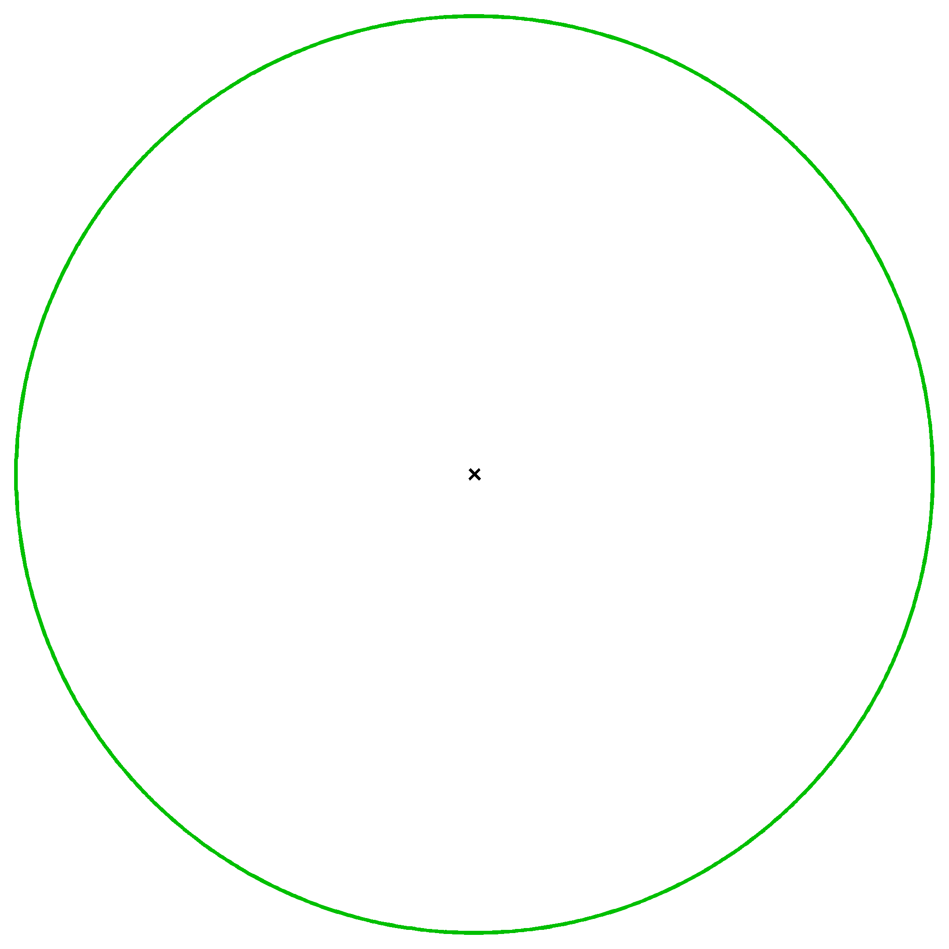

Slide 13
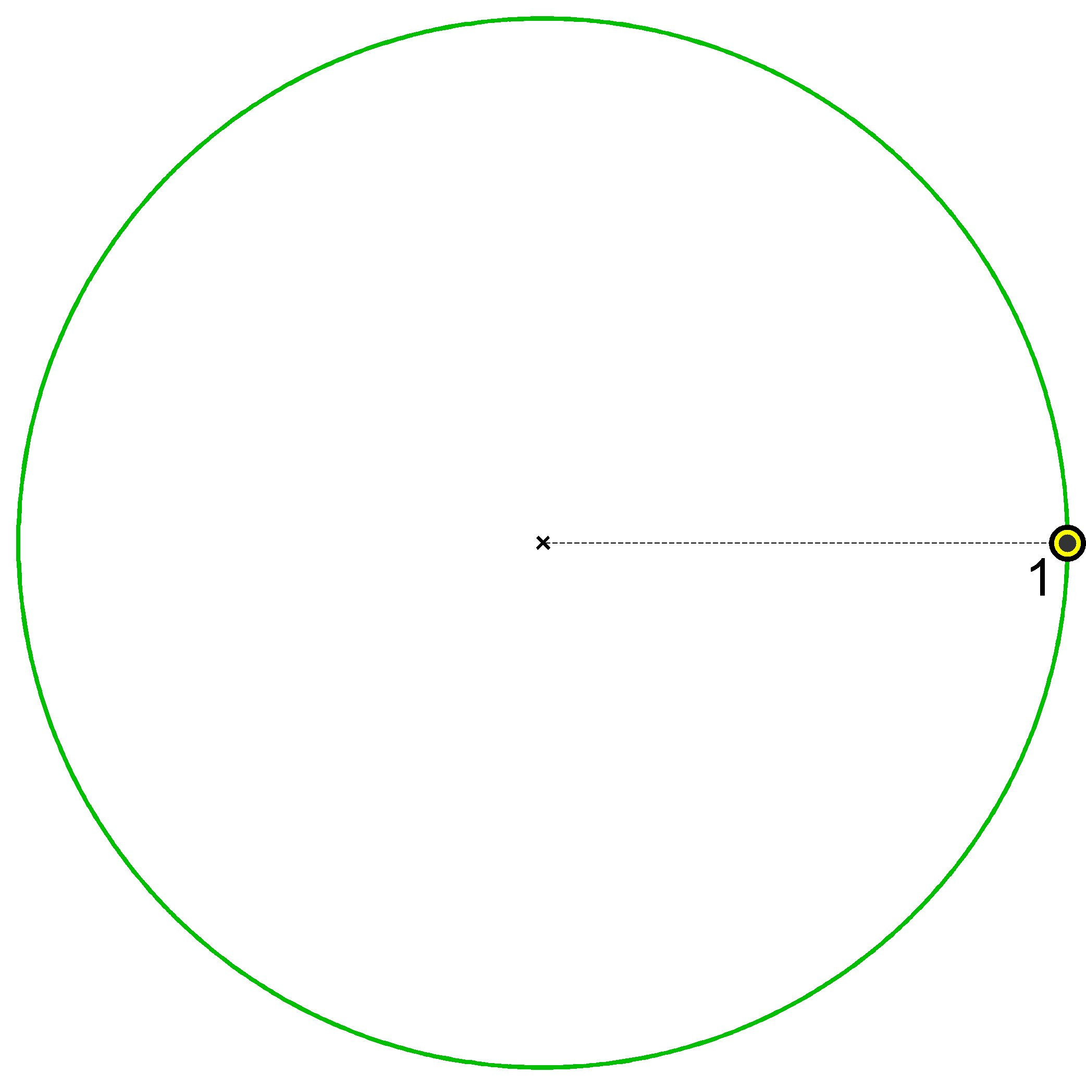

Slide 14
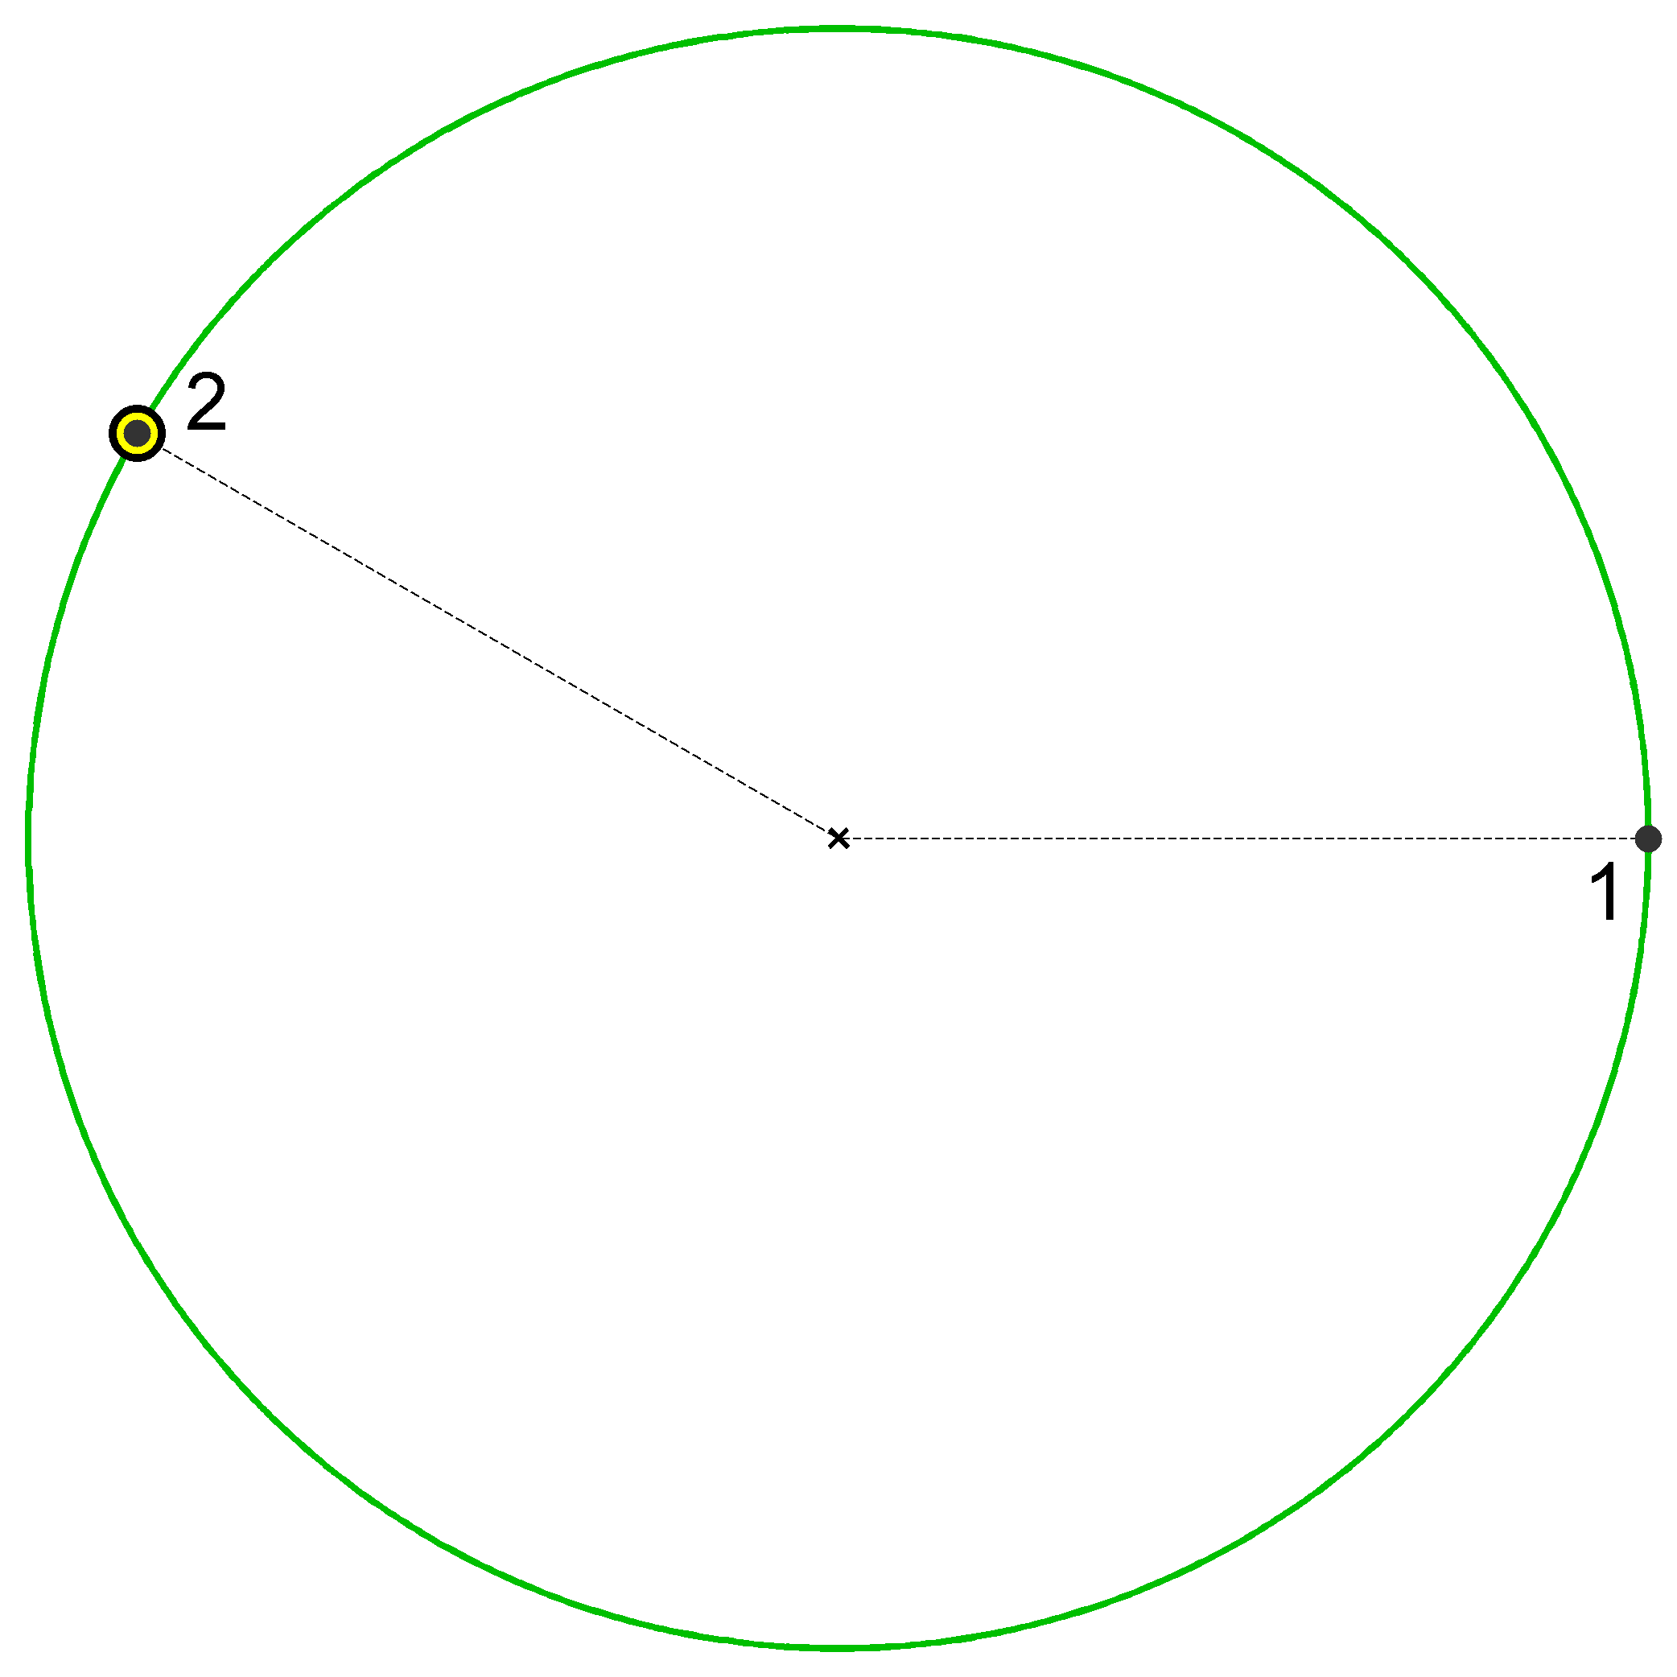

Slide 15
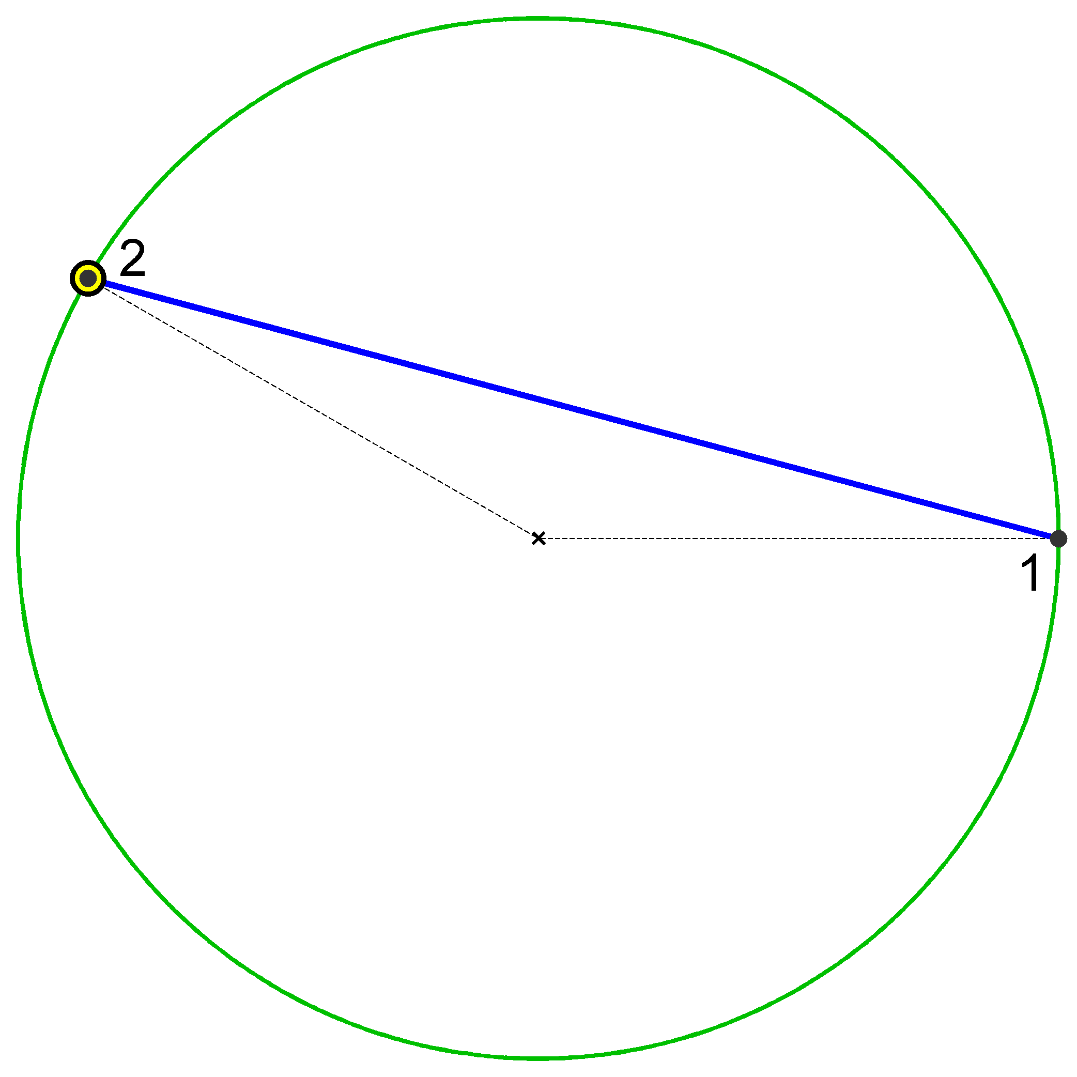

Slide 16
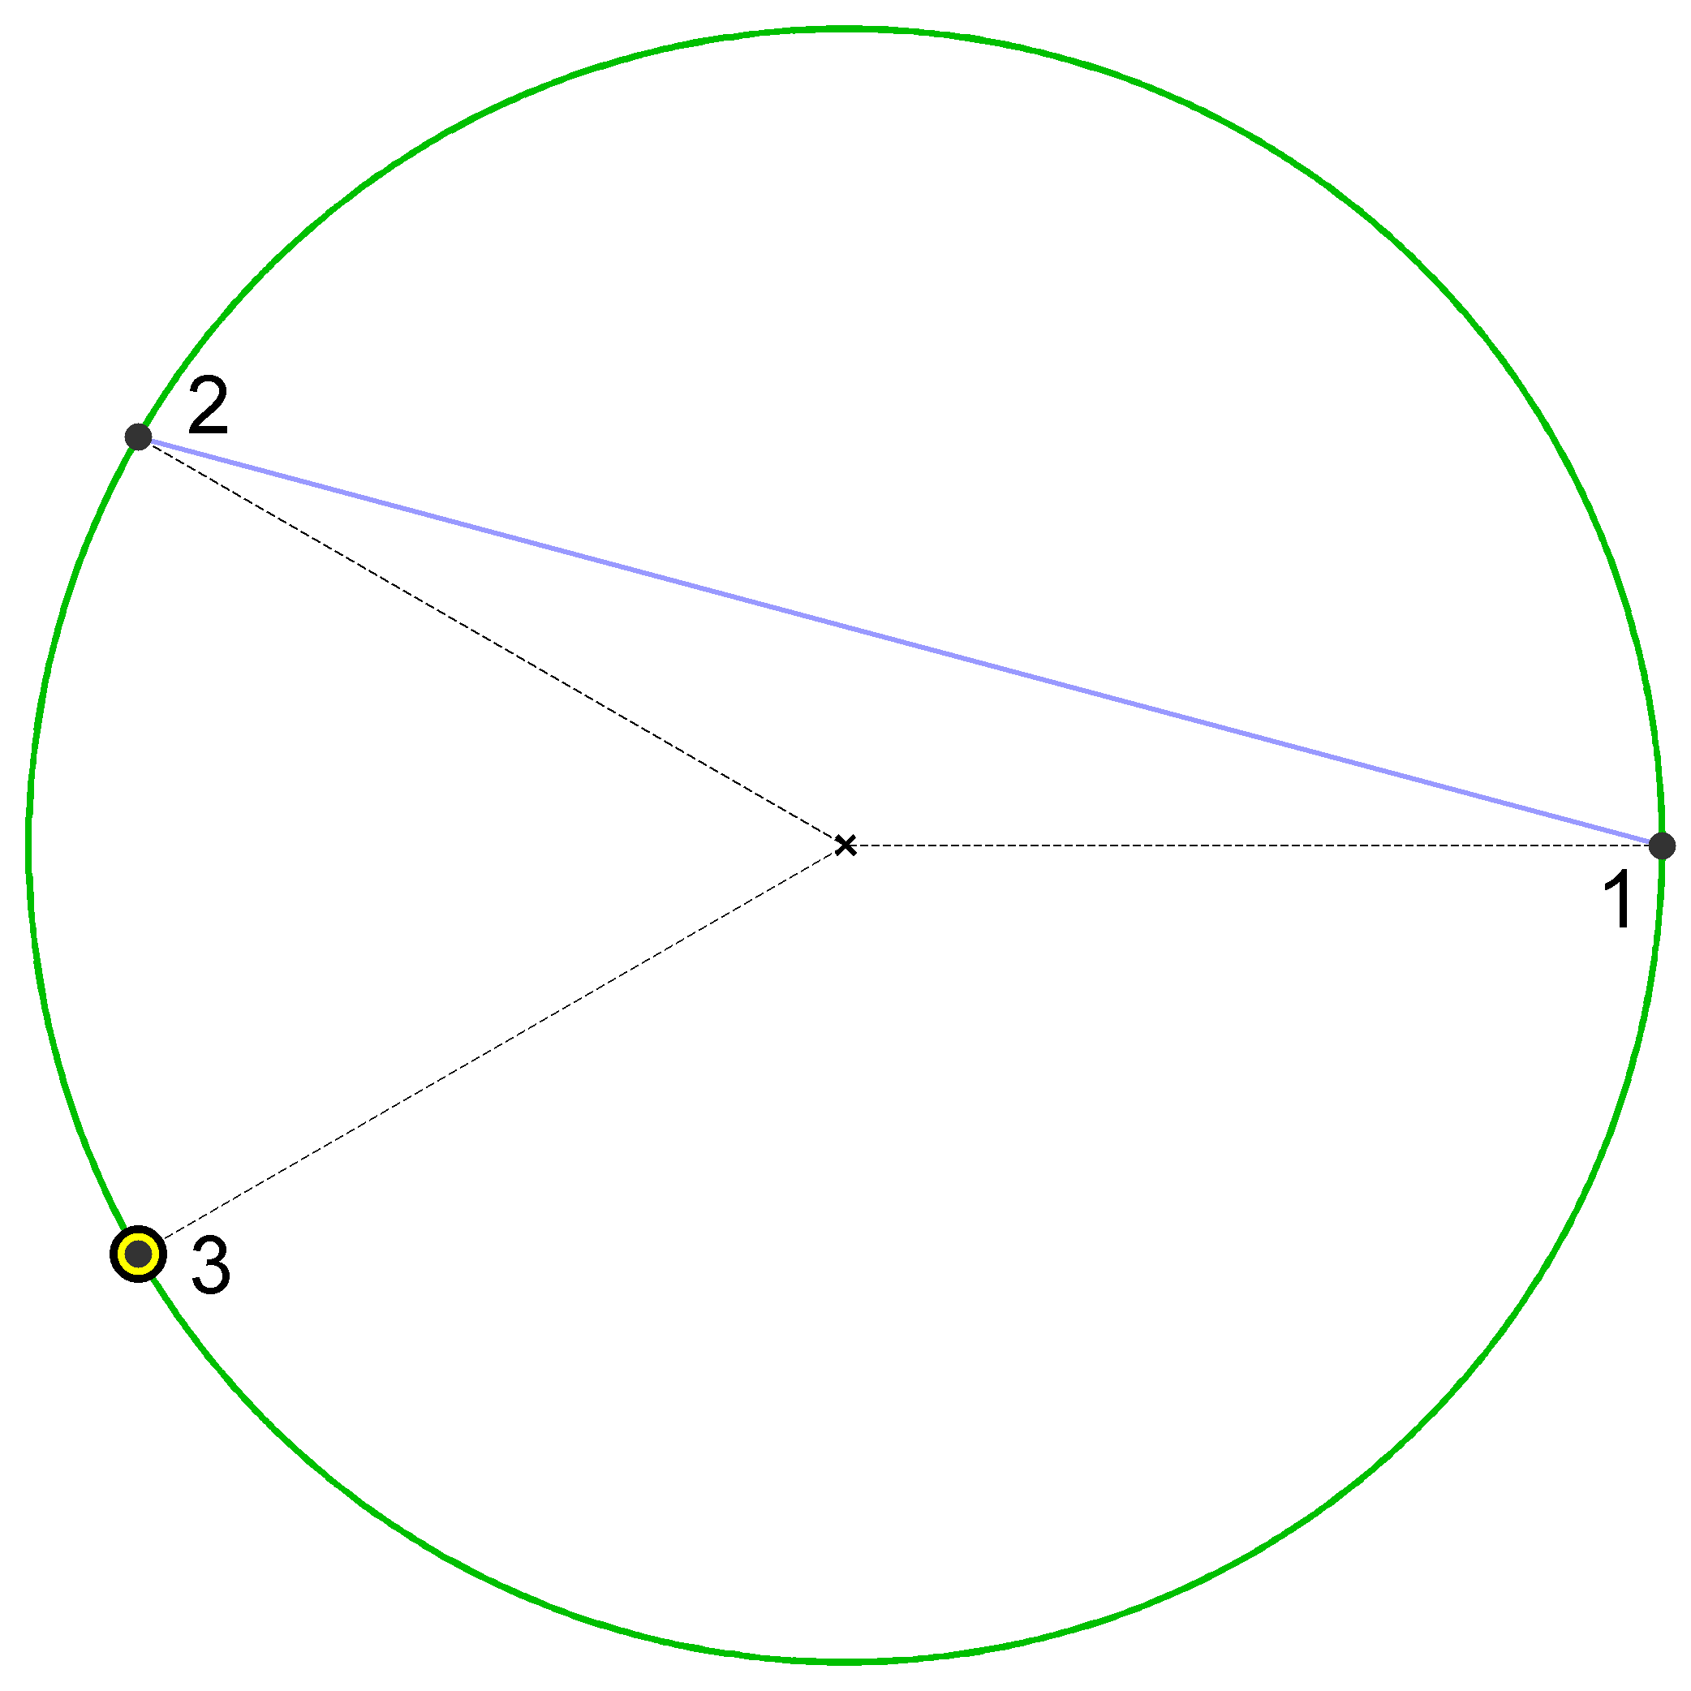

Slide 17
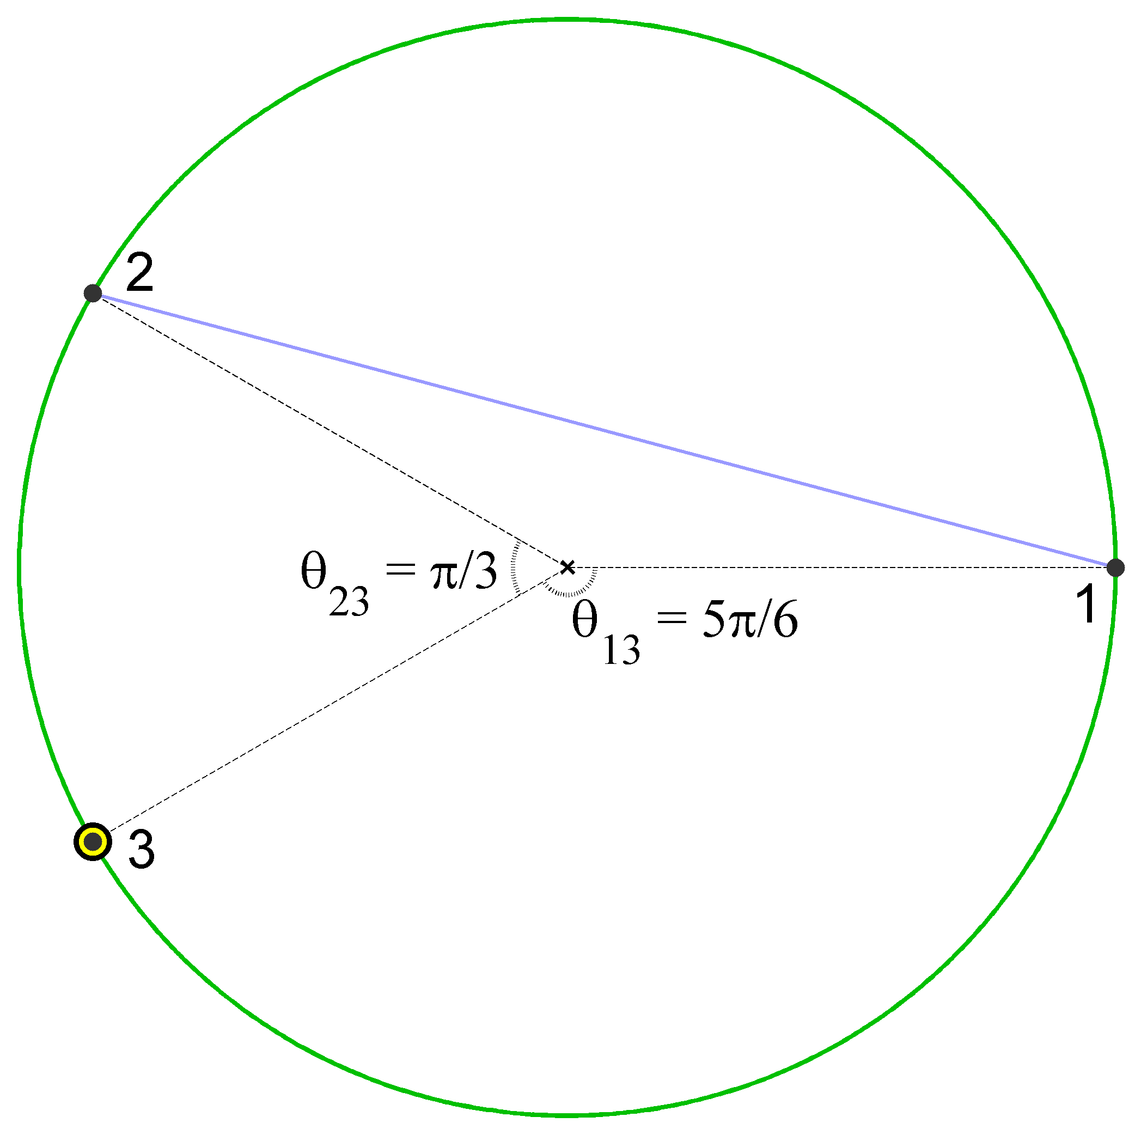

Slide 18
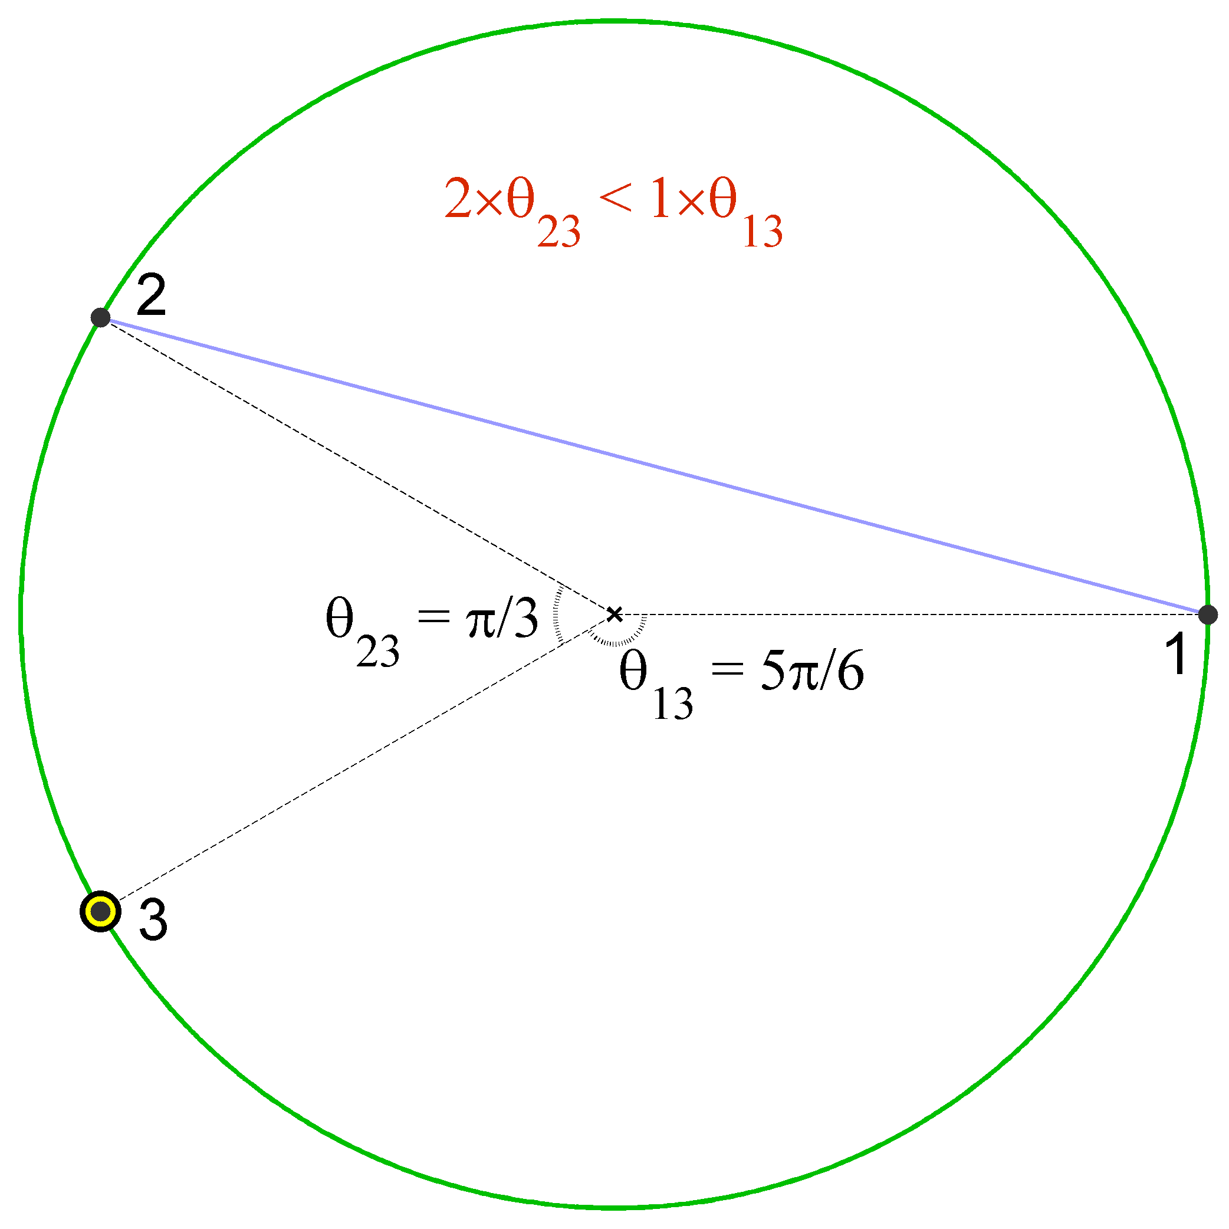

Slide 19
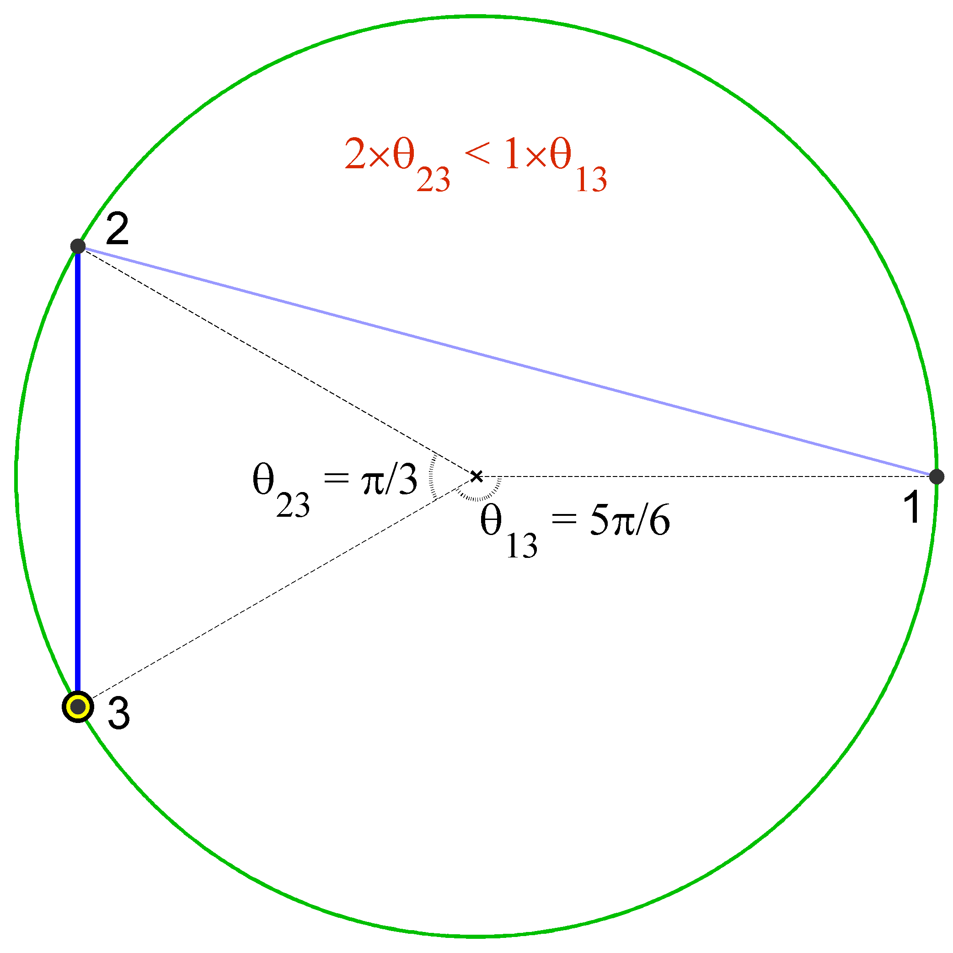

Slide 20
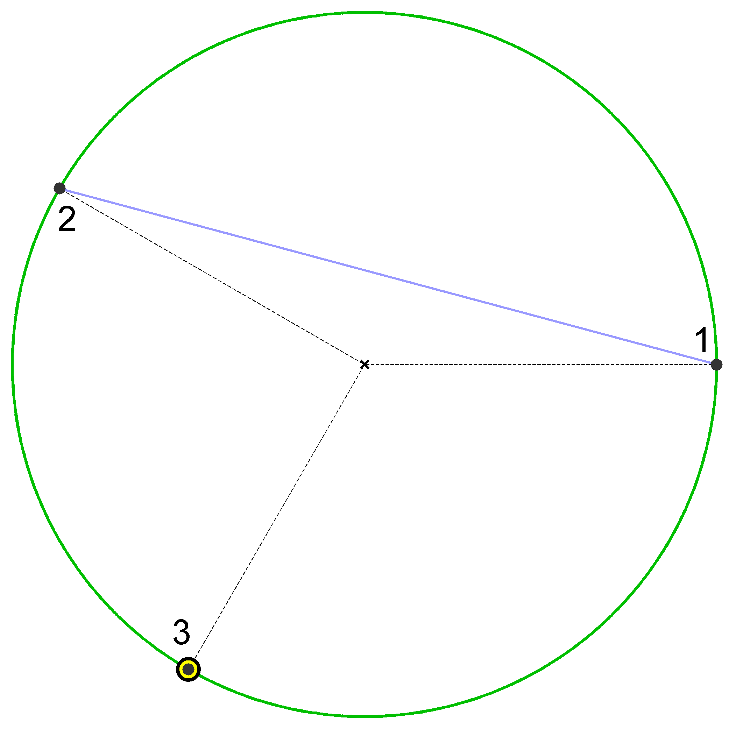

Slide 21
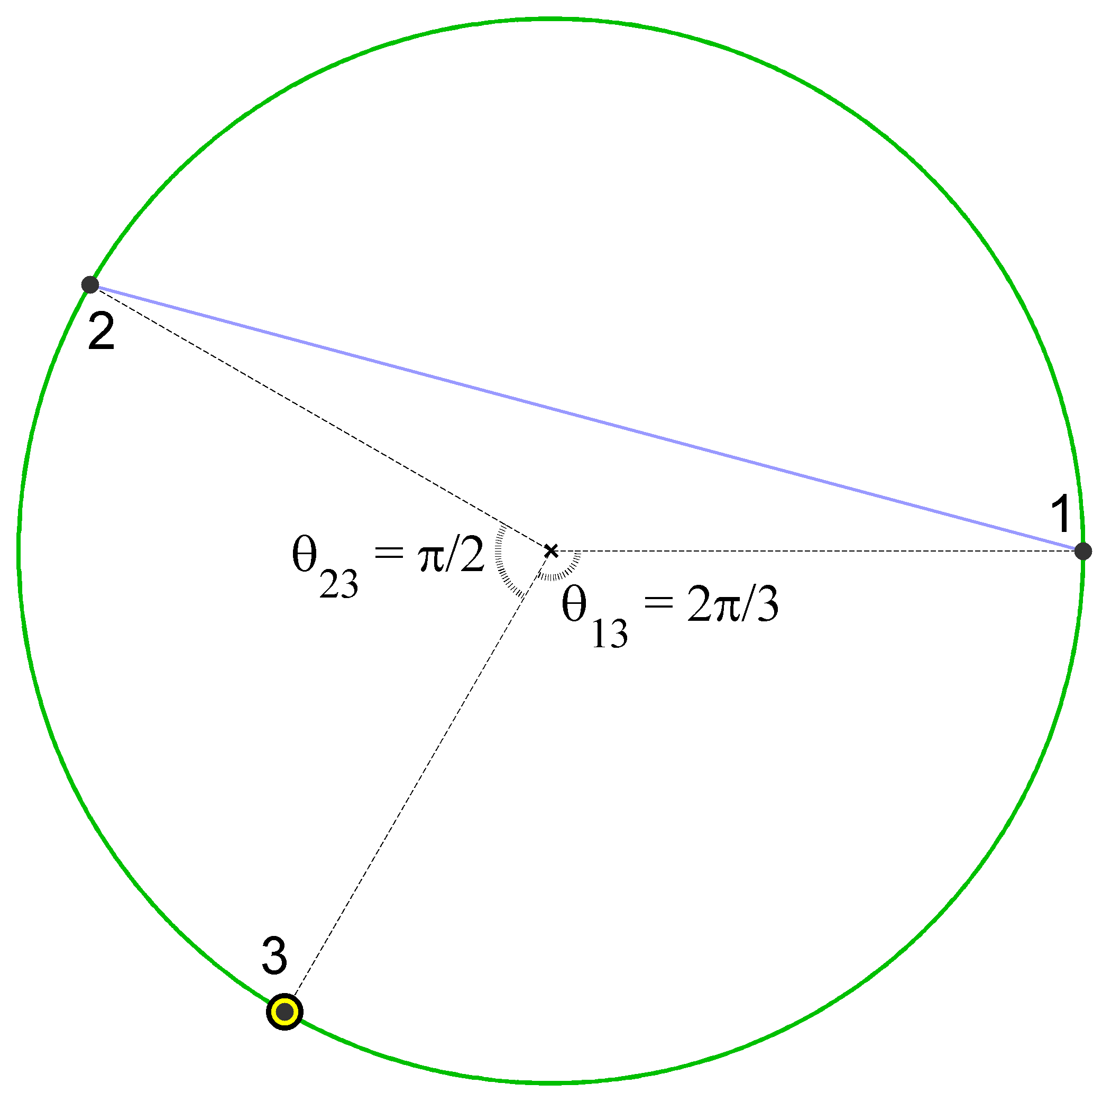

Slide 22
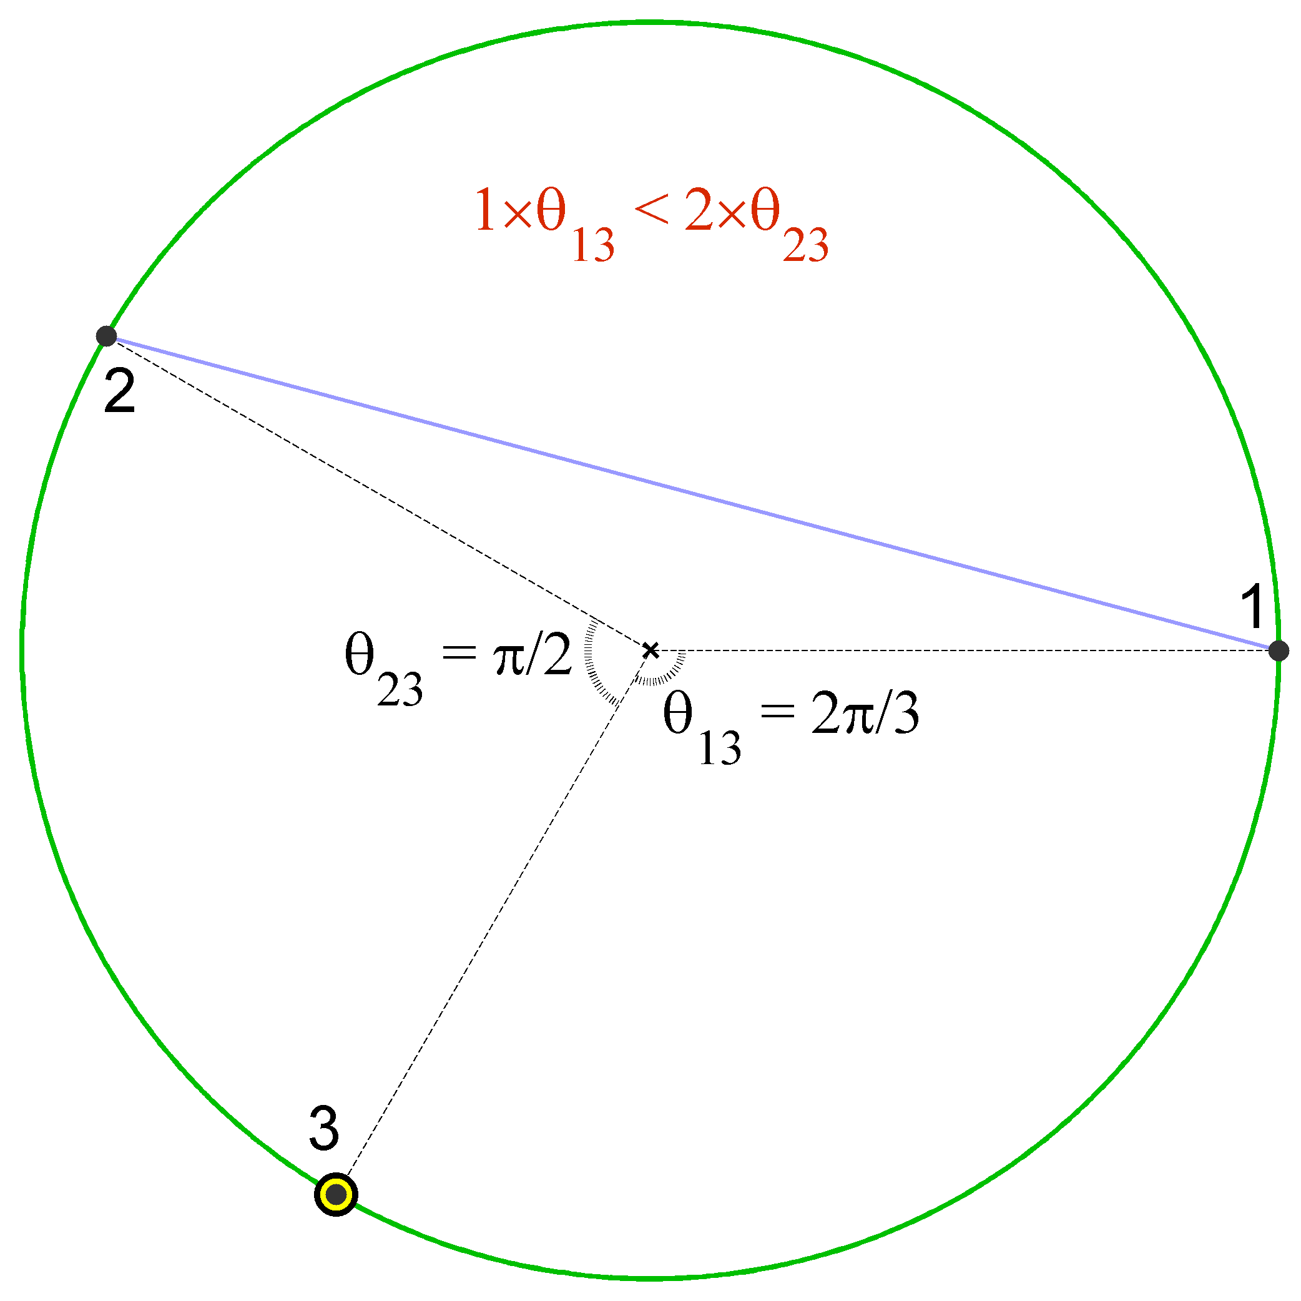

Slide 23
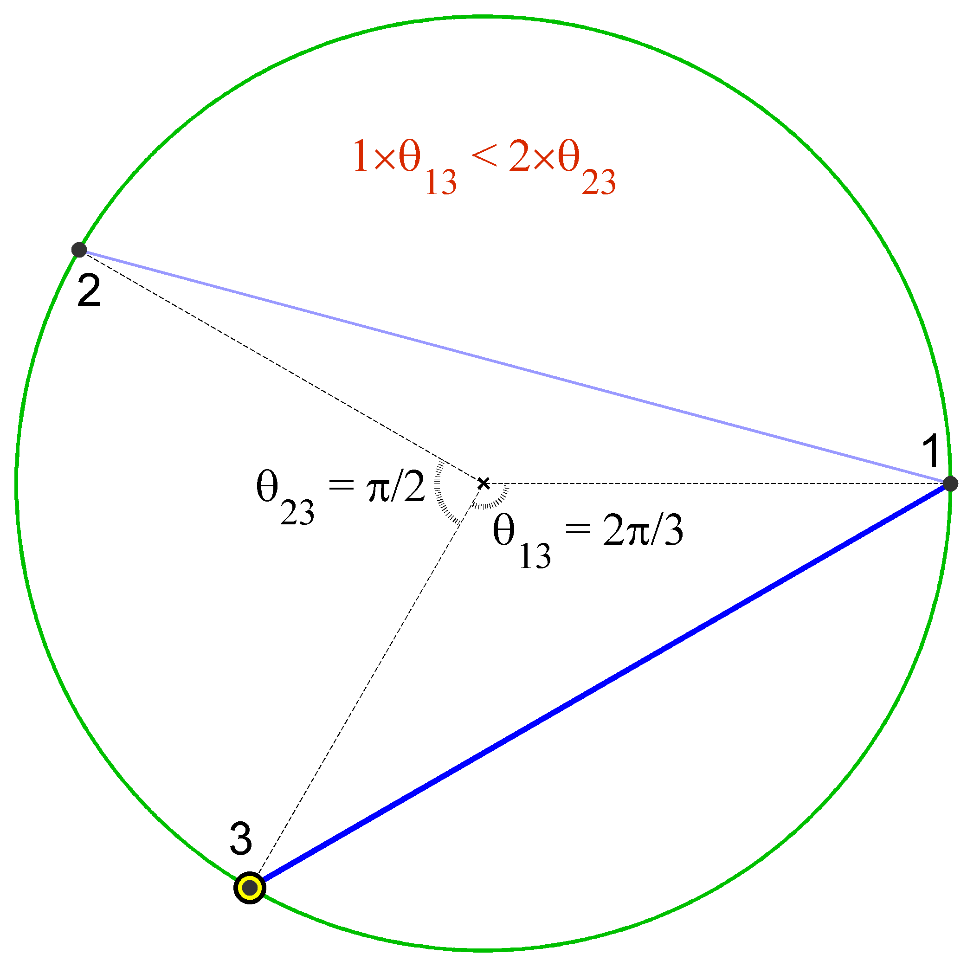

Slide 24
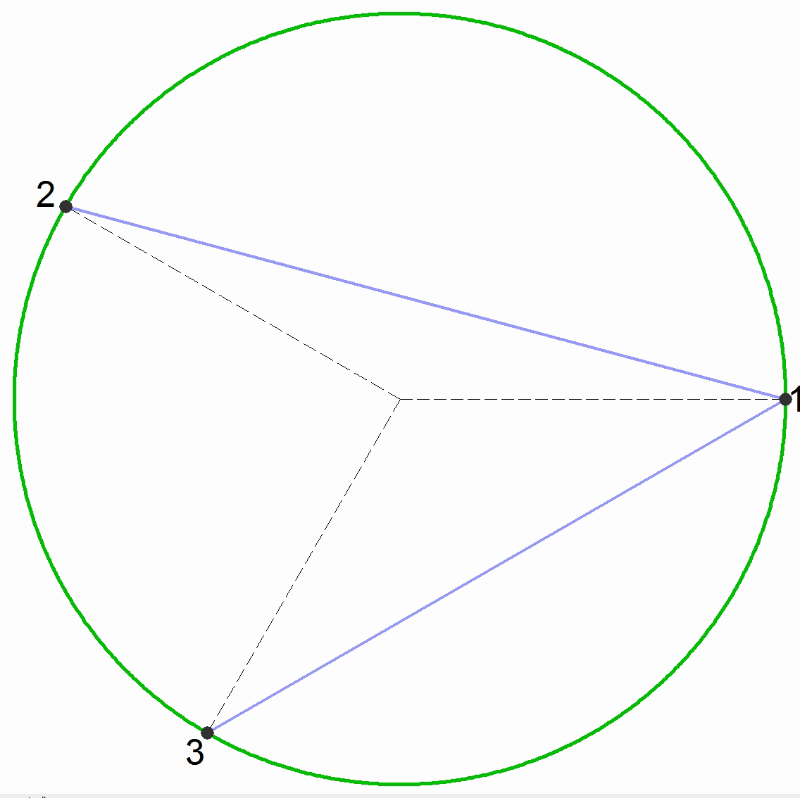

Slide 25
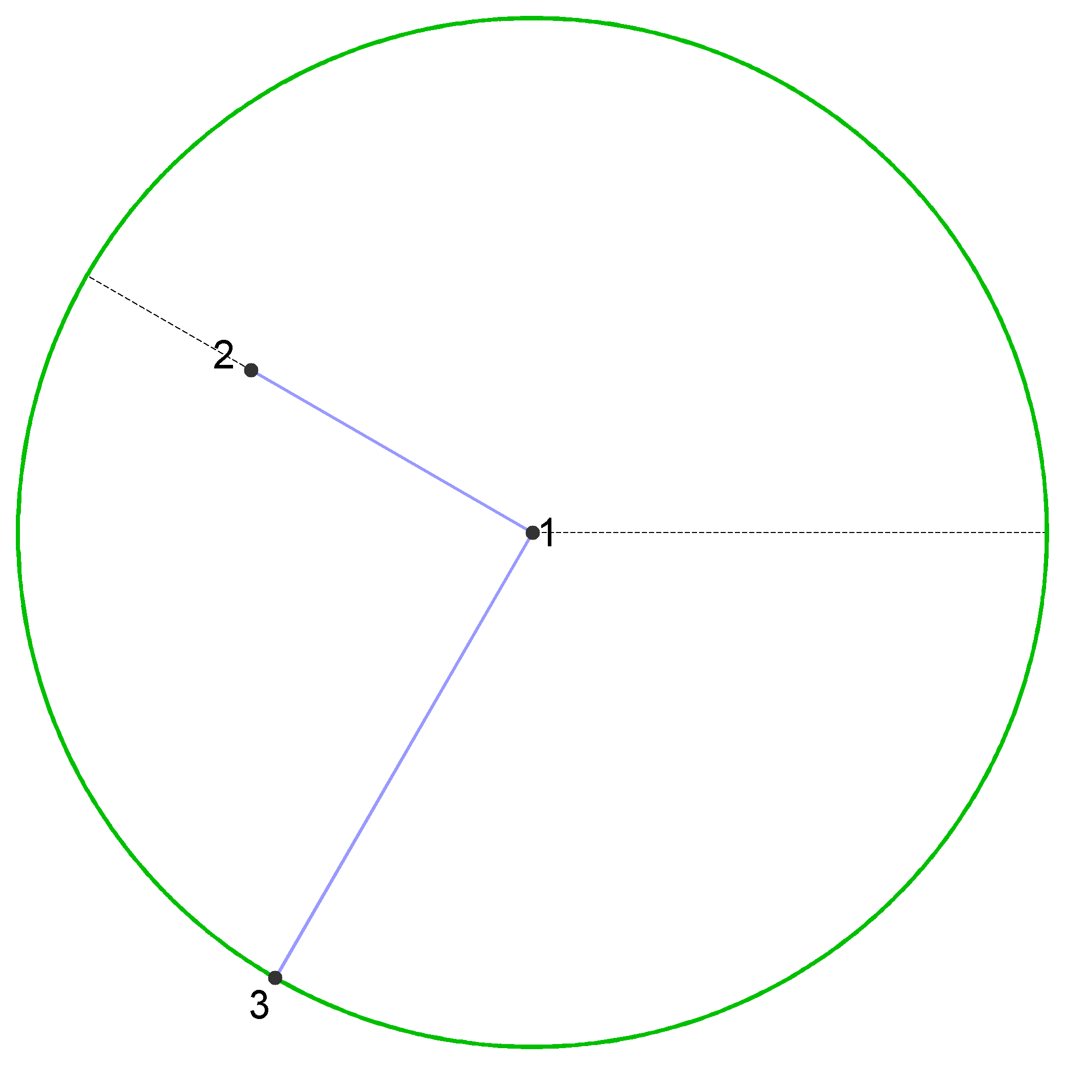



$$r_{t}=\ln{t}$$
$$\ln{2}$$
$$\ln{3}$$

Slide 26




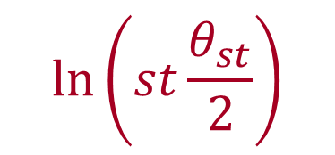
New node t connects to m existing nodes s that minimize
$$sθ_{st}$$
$$st\frac{θ_{st}}{2}$$
$$\ln\left(st\frac{θ_{st}}{2}\right)$$
$$=r_{s}+r_{t}+\ln{\frac{θ_{st}}{2}}$$
$${≈x}_{st}$$
— the hyperbolic distance
between s and t
New nodes connects to m hyperbolically closest nodes

Slide 27
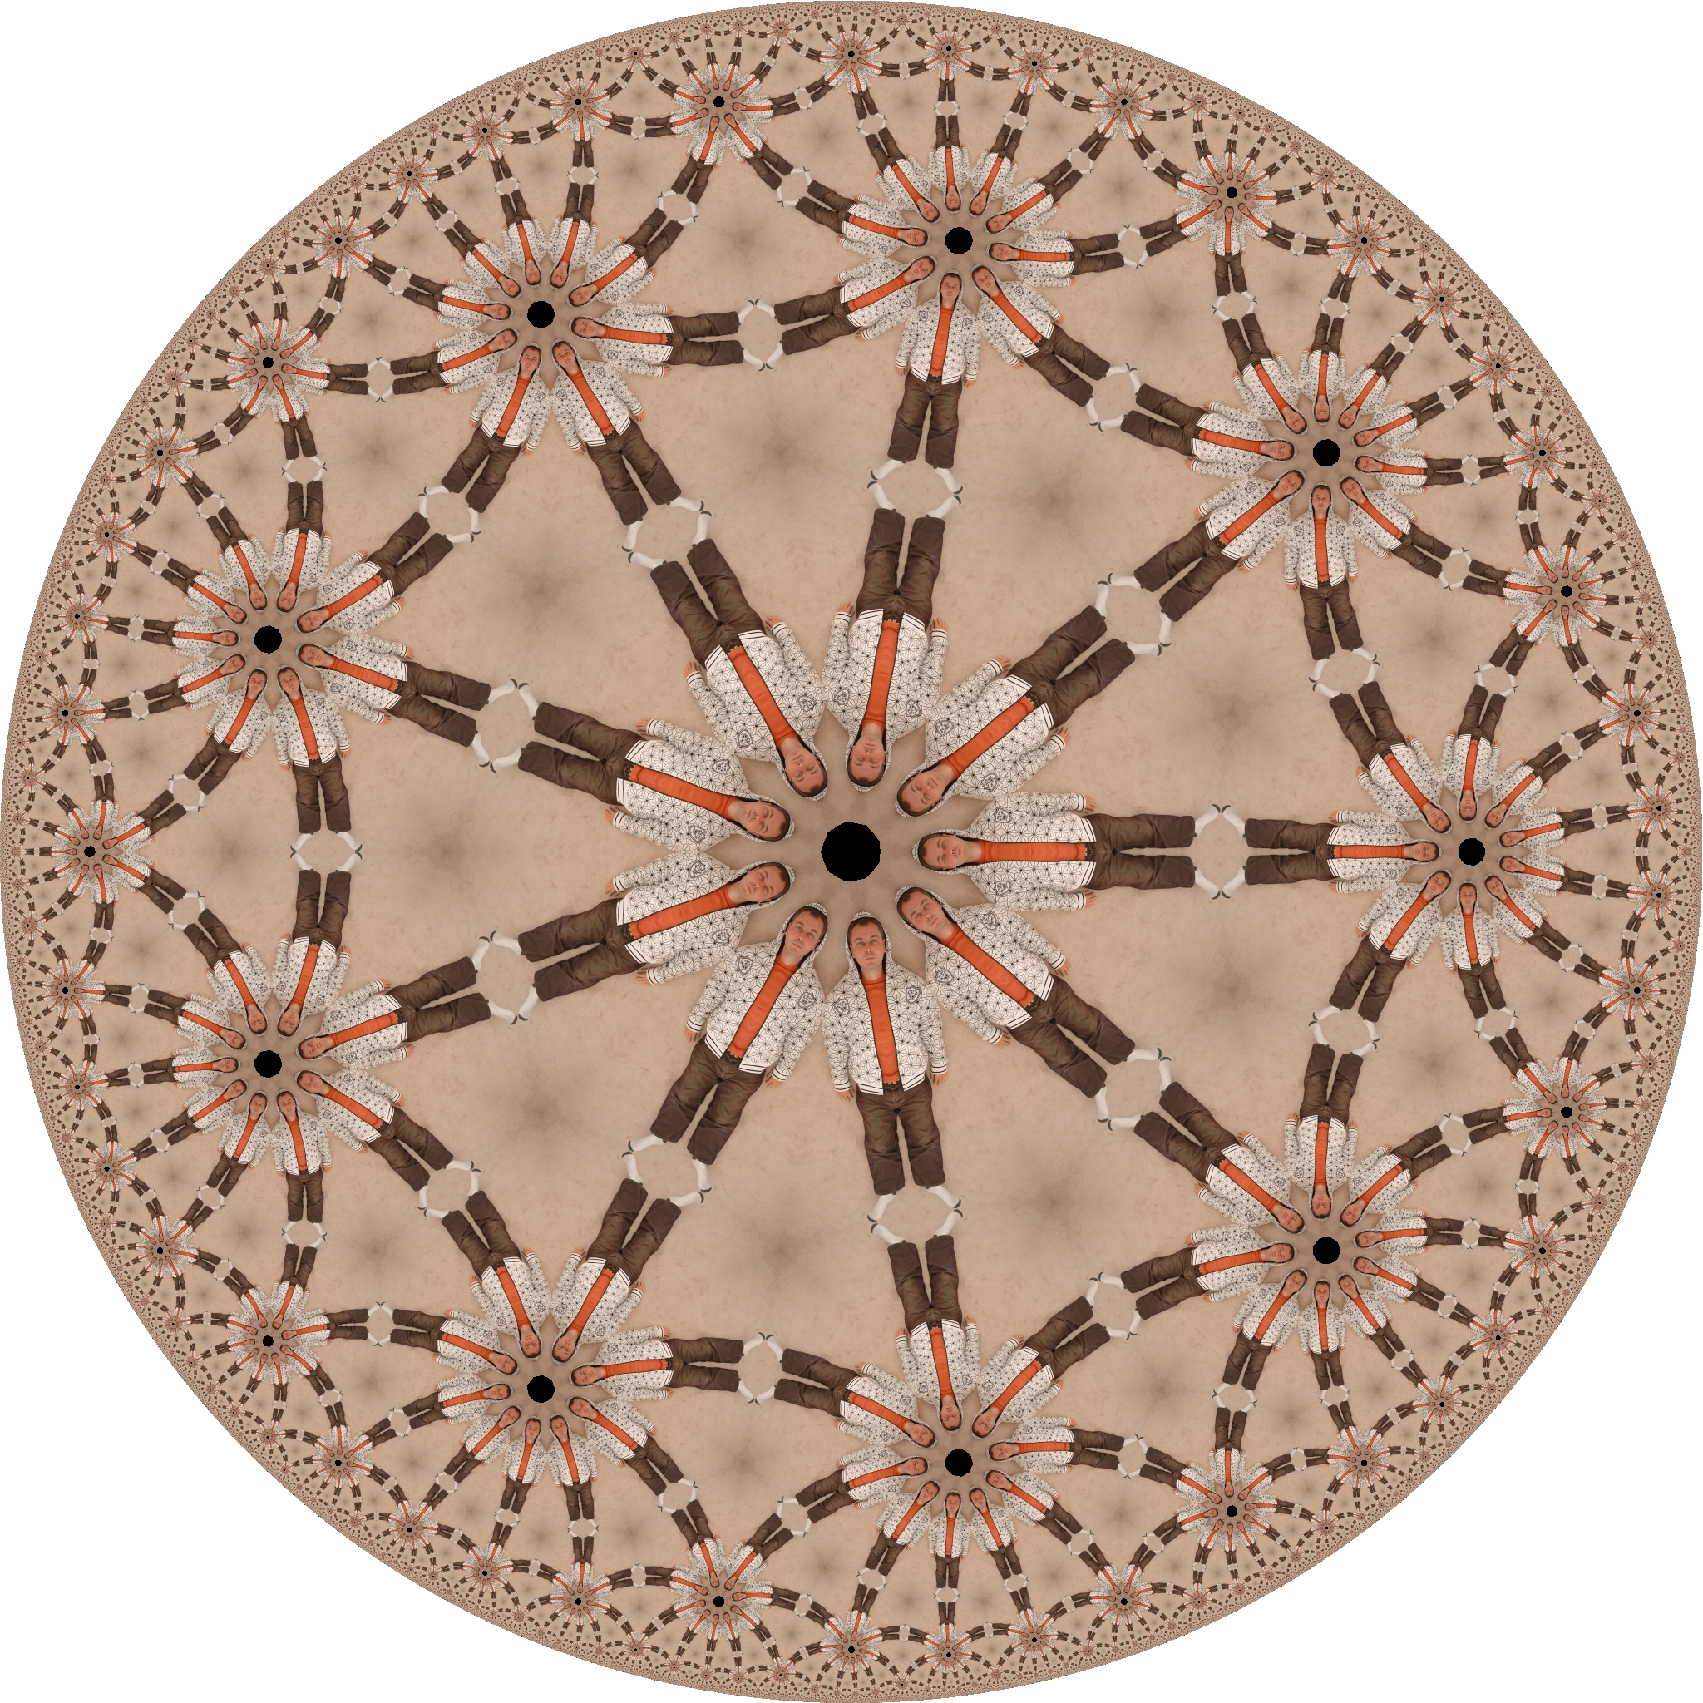
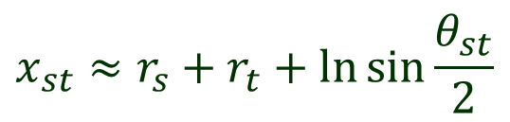
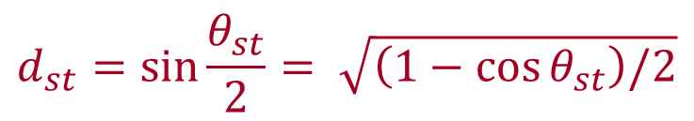


$$H^{2}$$
$${∂H}^{2}$$
Popularitysimilarity
Similarity only
$$x_{st}≈r_{s}+r_{t}+\ln{\sin{\frac{θ_{st}}{2}}}$$
$$d_{st}=\sin{\frac{θ_{st}}{2}}= \sqrt{\left(1−\cos{θ_{st}}\right)/2}$$

Slide 28
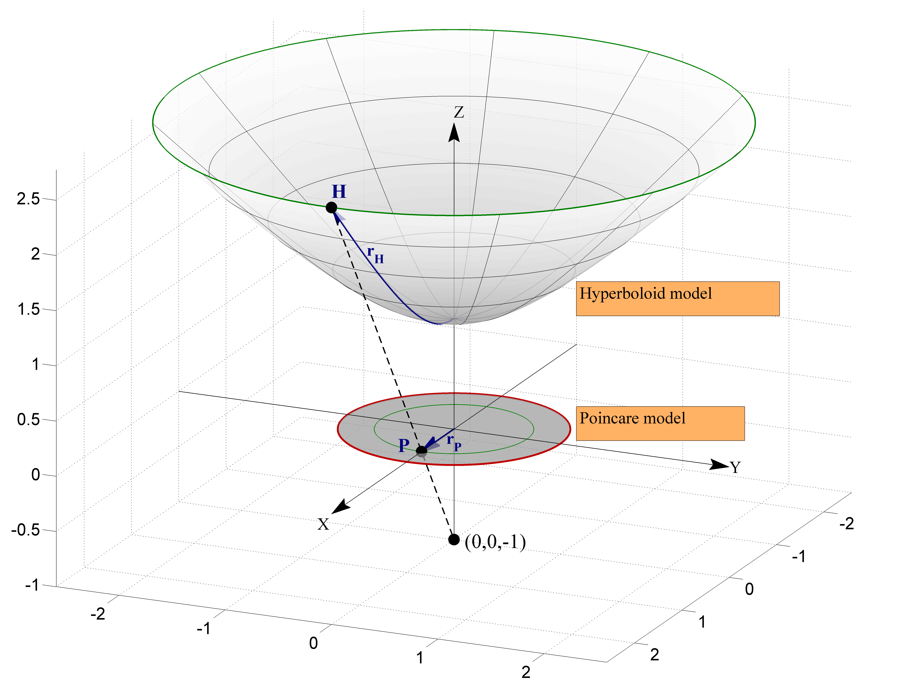





$${ds}^{2}={dx}^{2}+{dy}^{2}−{dz}^{2}$$
$$r_{P}=\tanh{\frac{r_{H}}{2}}$$
$$x^{2}+y^{2}−z^{2}=−1$$
$${ds}^{2}={dx}^{2}+{dy}^{2}+{dz}^{2}$$
$$r_{E}=−iE\left(ir_{H},2\right)$$

Slide 29
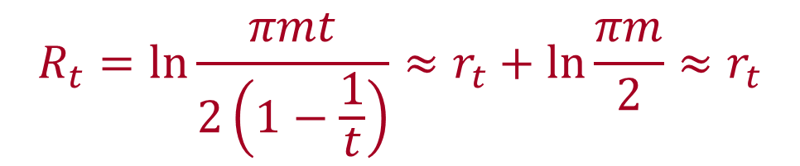
New nodes connects to m hyperbolically closest nodes
The expected distance to the m’th closest node from t is
$$R_{t}=\ln{\frac{πmt}{2\left(1−\frac{1}{t}\right)}}≈r_{t}+\ln{\frac{πm}{2}}≈r_{t}$$
New node t is located at radial coordinate r_{t} ~ ln t,
and connects to all nodes within distance R_{t} ~ r_{t}

Slide 30
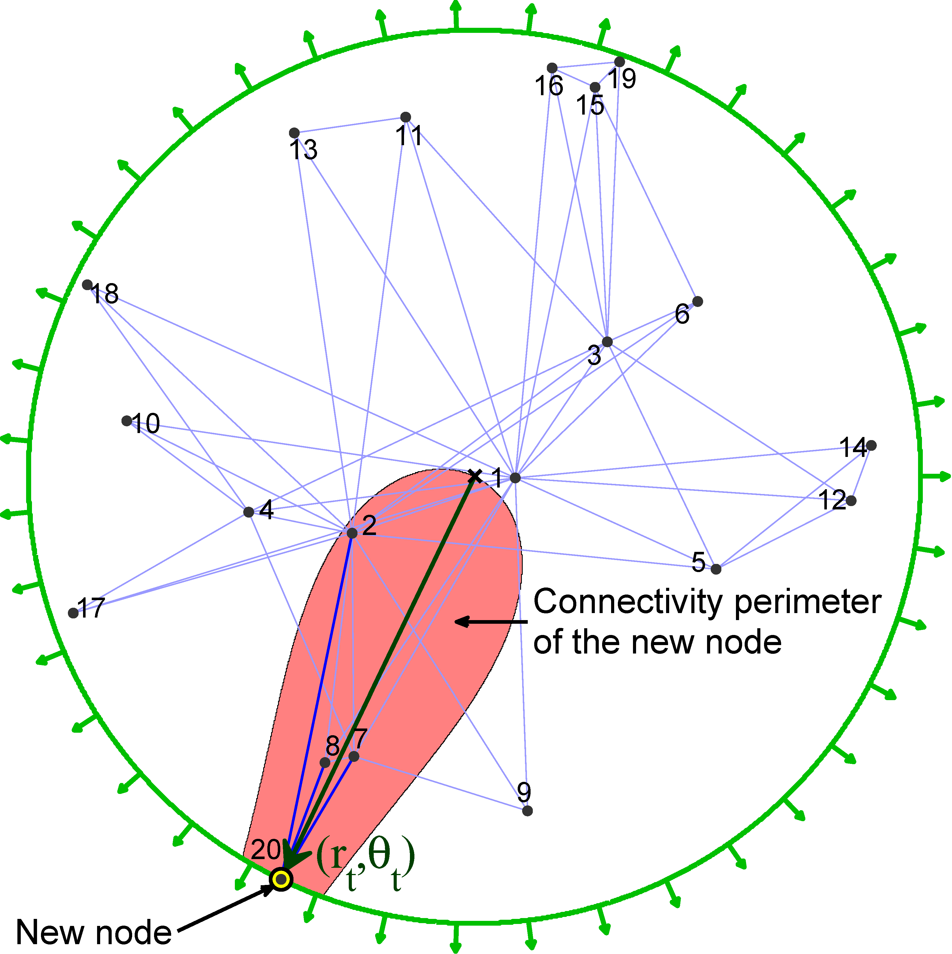

Slide 31


Slide 32
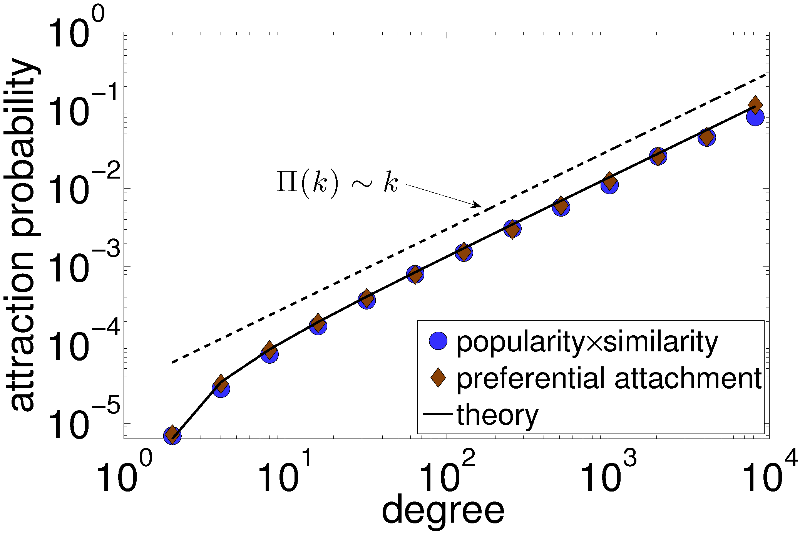

Slide 33
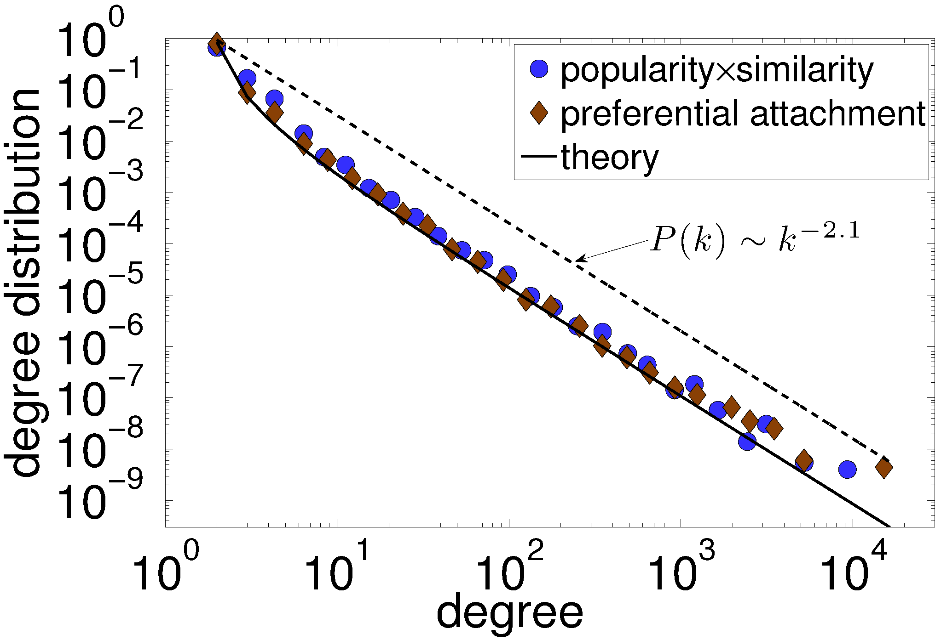

Slide 34





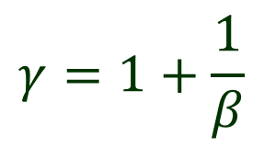
$$γ=1+\frac{1}{β}$$
$$r_{s}\left(t\right)=βr_{s}+(1−β)r_{t}$$
$$s<t$$
$$P\left(k\right) \sim k^{−γ}$$
$$0<β≤1$$

Slide 35
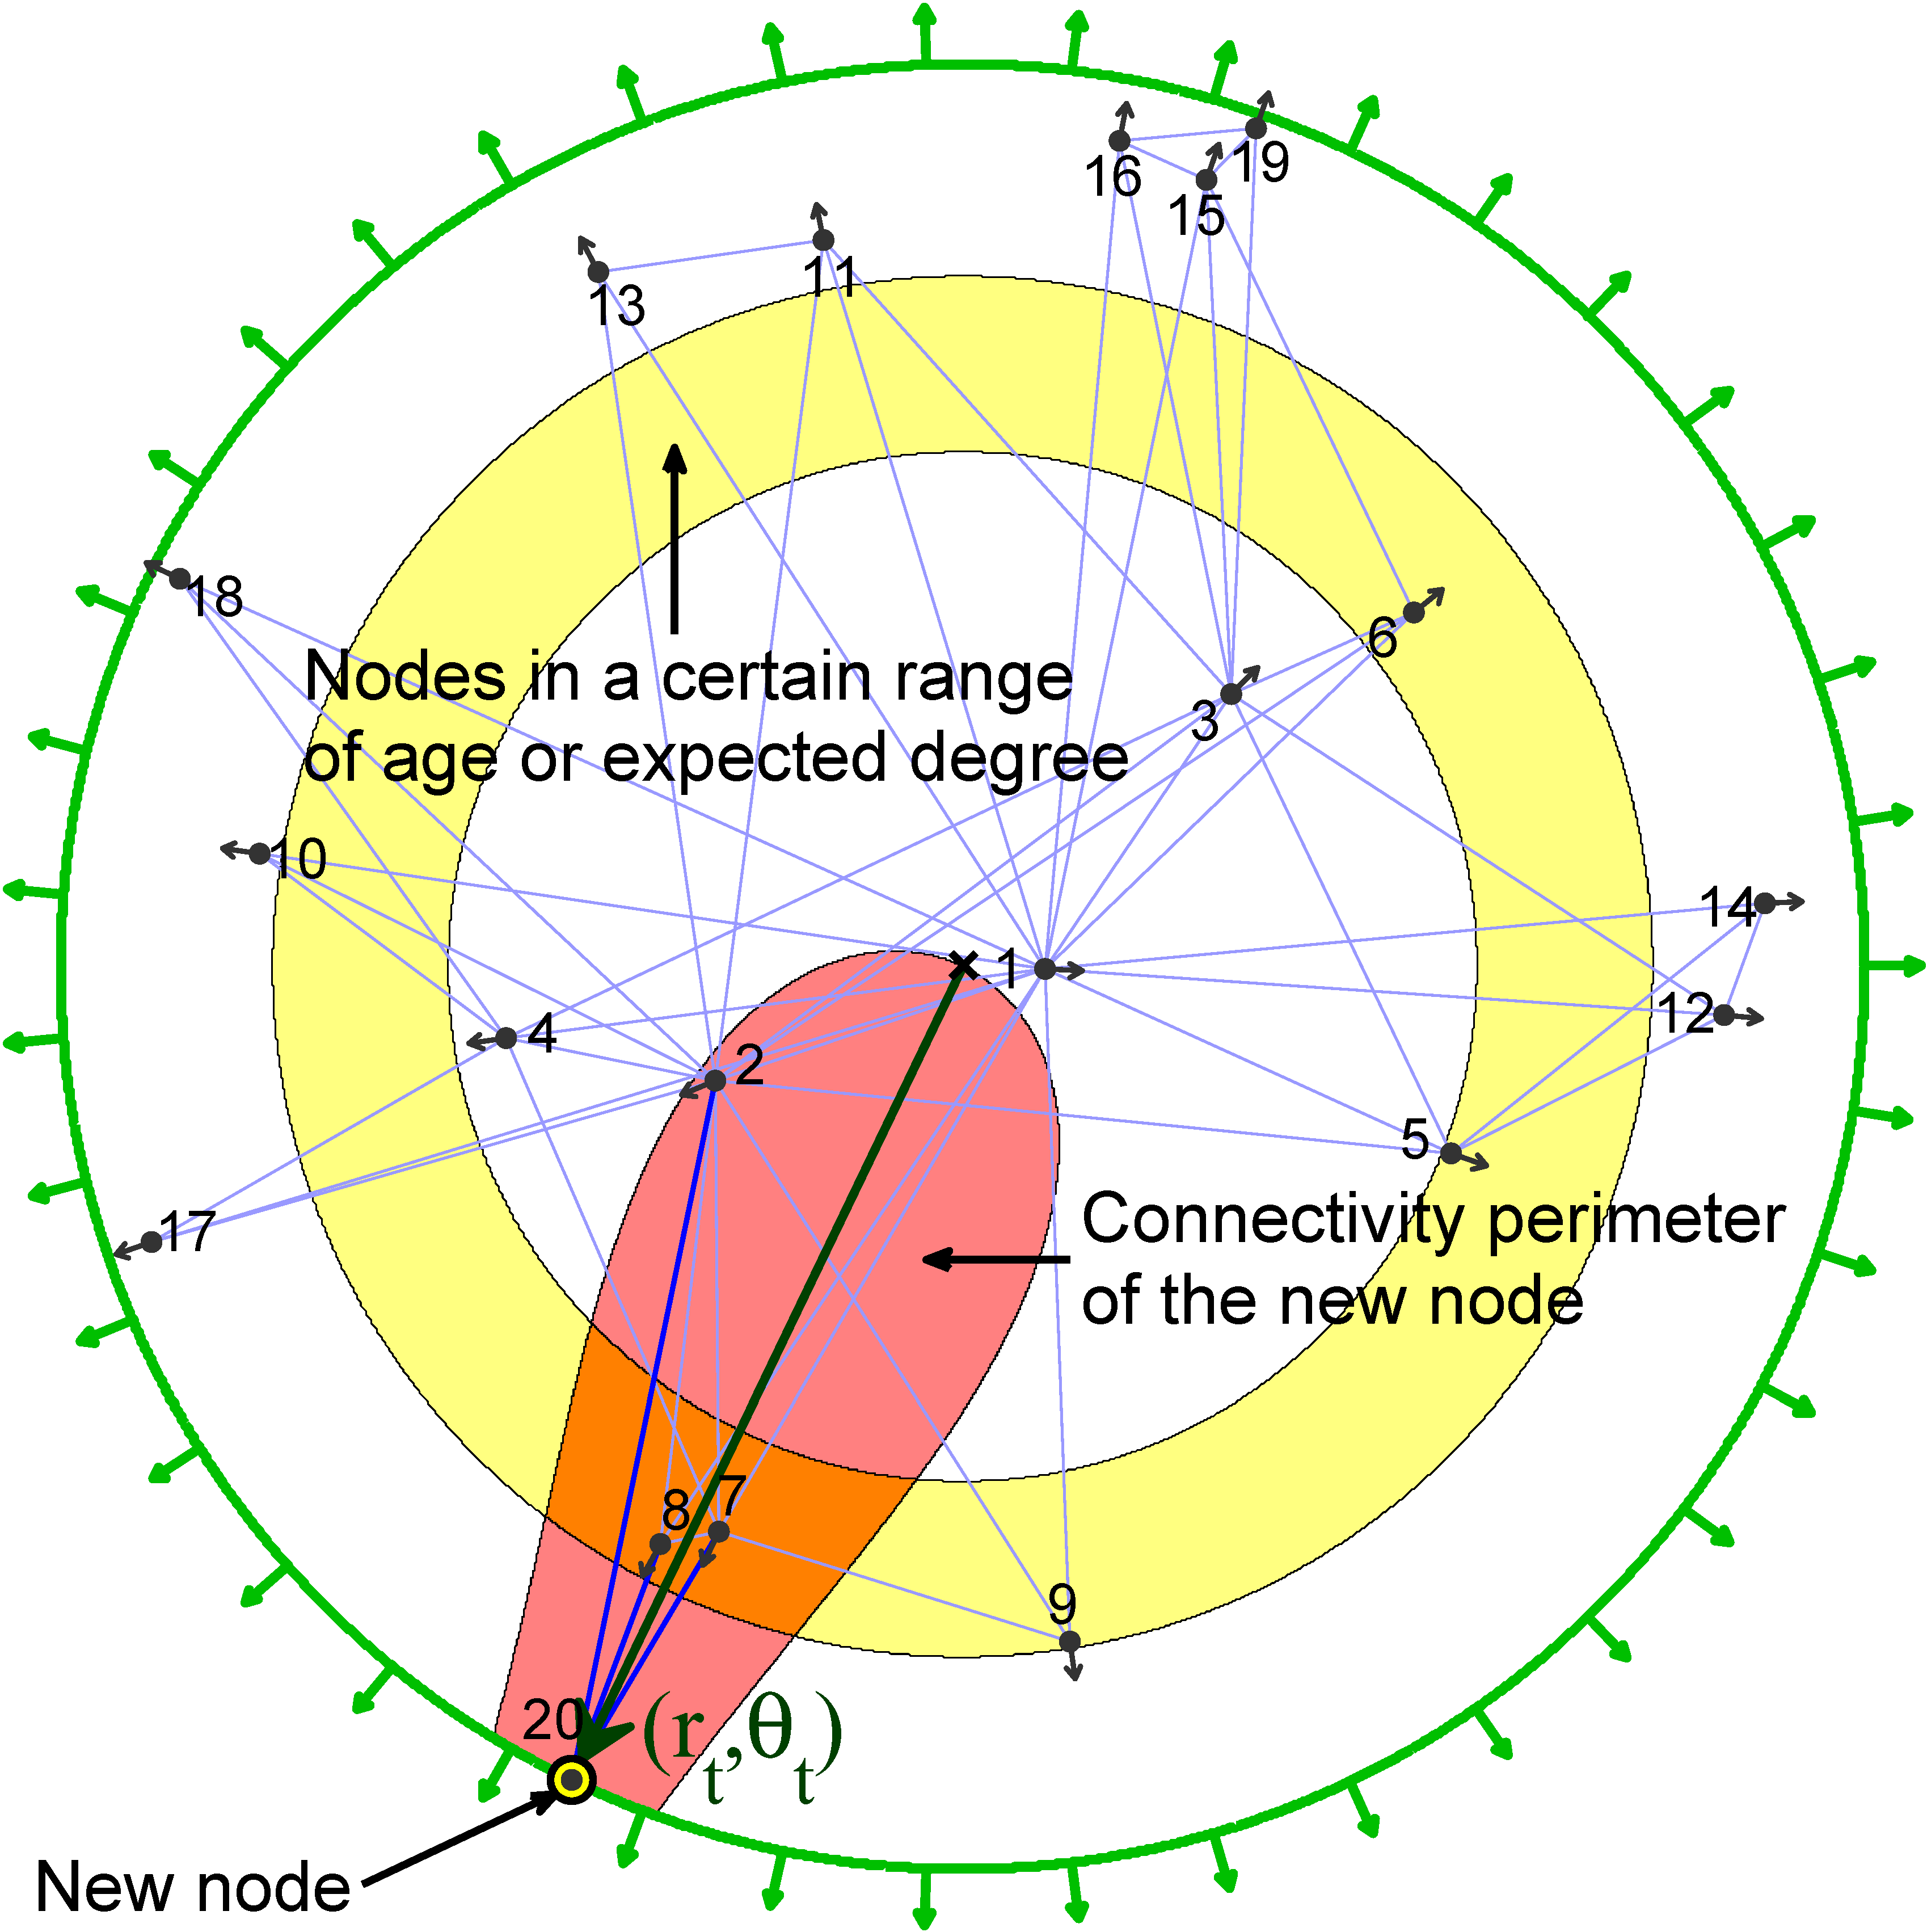

Slide 36
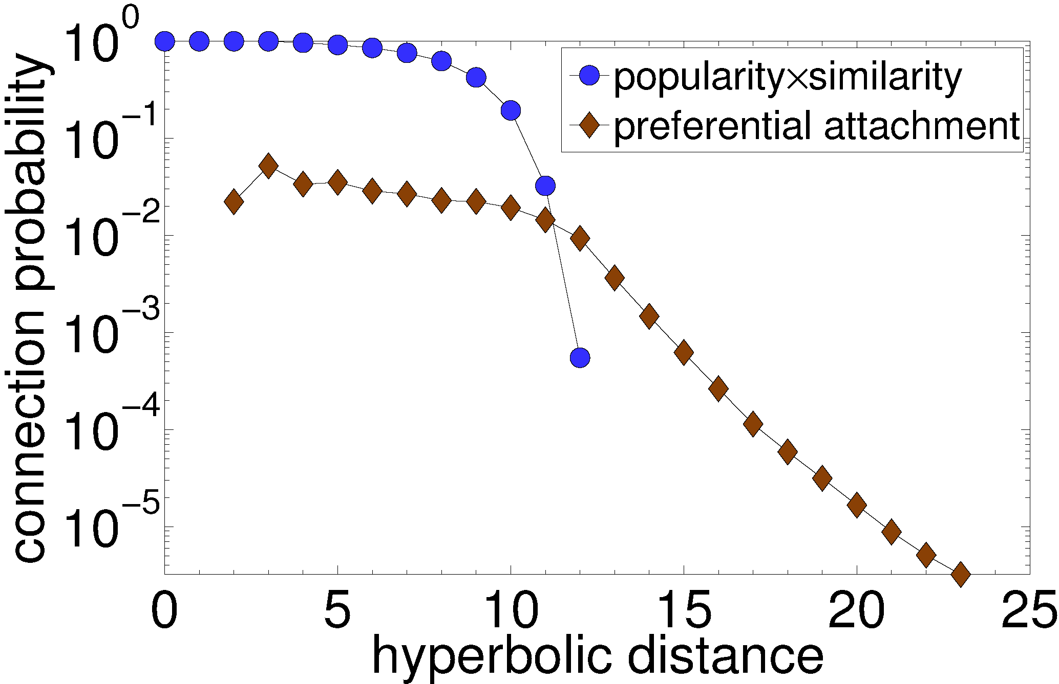

Slide 37
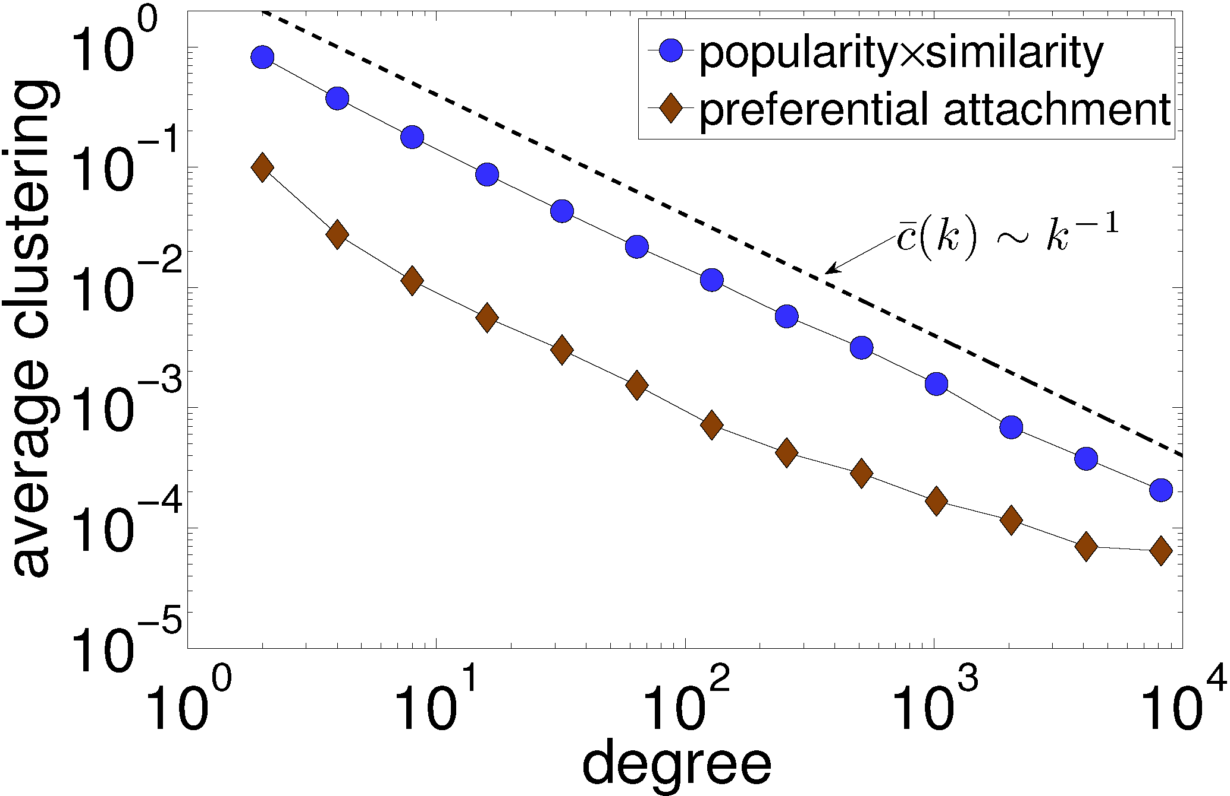

Slide 38
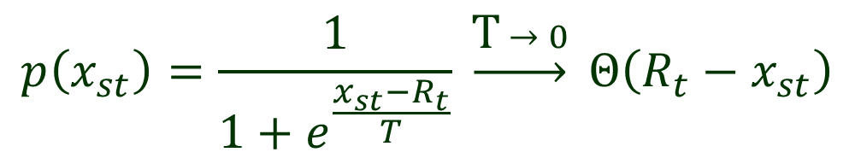

Clustering
Probability of new connections from t to s so far
If we smoothen the threshold
Then average clustering linearly decreases
with T from maximum at T = 0 to zero at T = 1
Clustering is always zero at T > 1
The model becomes identical to PA at T  
$$p\left(x_{st}\right)=Θ\left(R_{t}−x_{st}\right)$$
$$p\left(x_{st}\right)=\frac{1}{1+e^{\frac{x_{st}−R_{t}}{T}}} \underset{→}{\text{T} → 0} Θ\left(R_{t}−x_{st}\right)$$

Slide 39
Validation
Take a series of historical snapshots of a real network
Infer angular/similarity coordinates for each node
Test if the probability of new connections follows the model theoretical prediction

Slide 40
Learning similarity coordinates
Take a historical snapshot of a real network
Apply a maximum-likelihood estimation method (e.g., MCMC) using the static hyperbolic model
Metropolis-Hastings example
  Assign random coordinates to all nodes
  Compute current likelihood
  Select a random node
  Move it to a new random angular coordinate
  Compute new likelihood L_{n}
  If L_{n} > L_{c}, accept the move
  If not, accept it with probability L_{n} / L_{c}
  Repeat

Slide 41
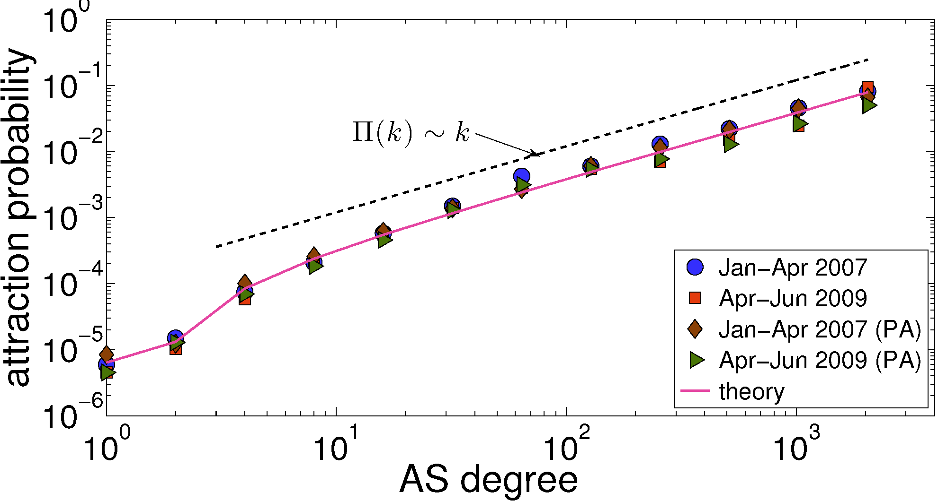

Slide 42
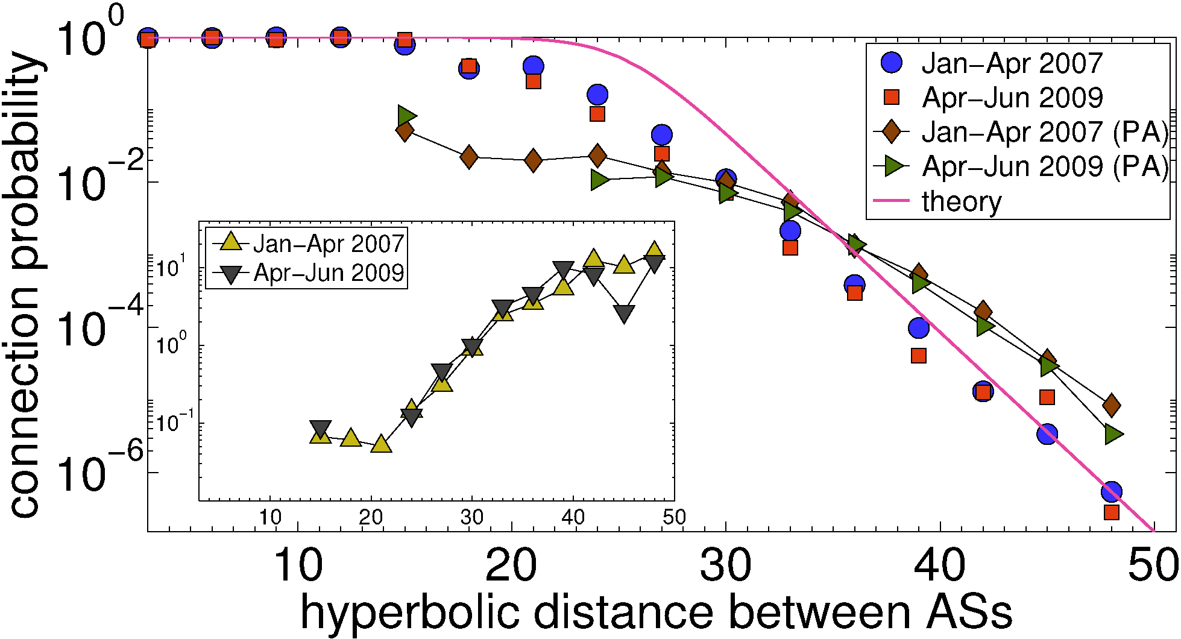

Slide 43
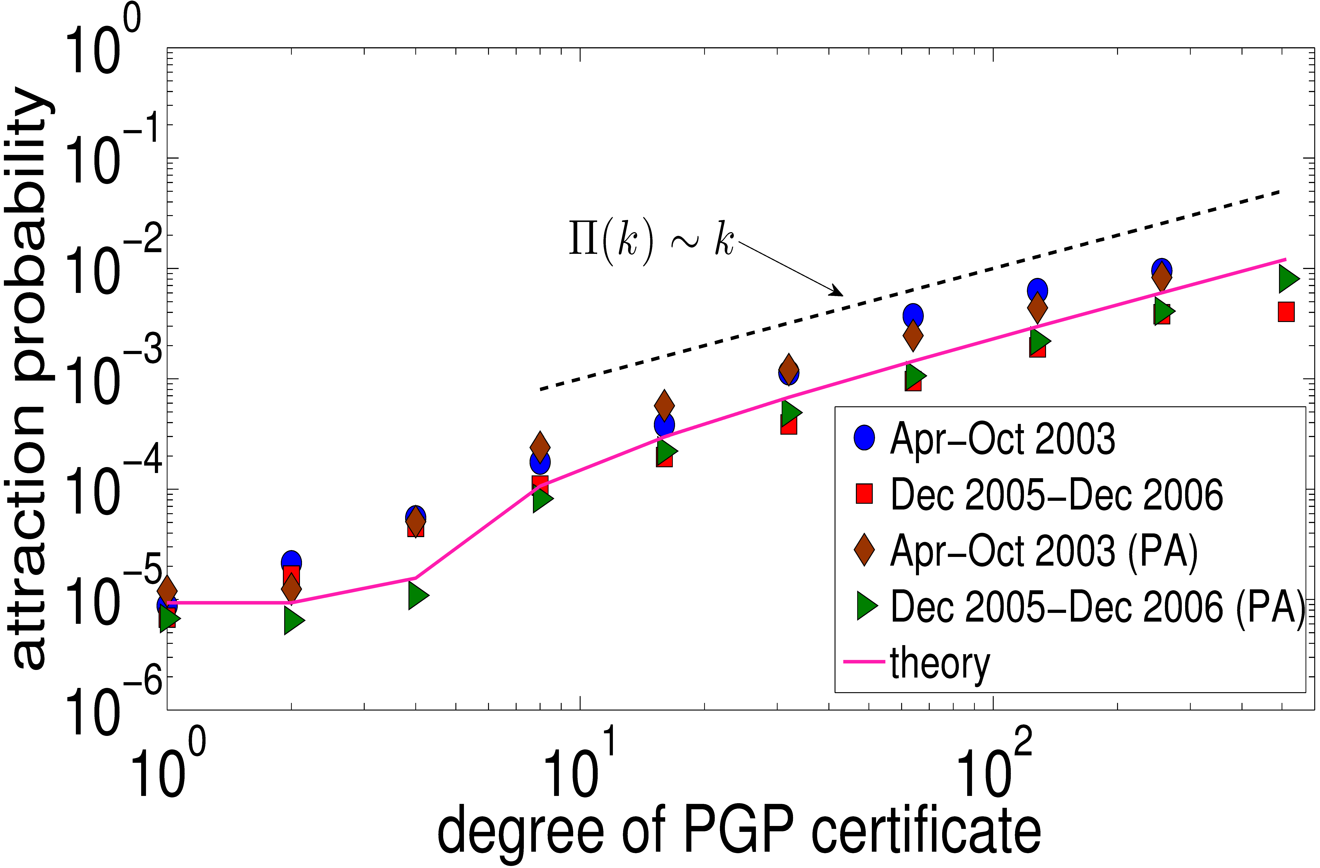

Slide 44
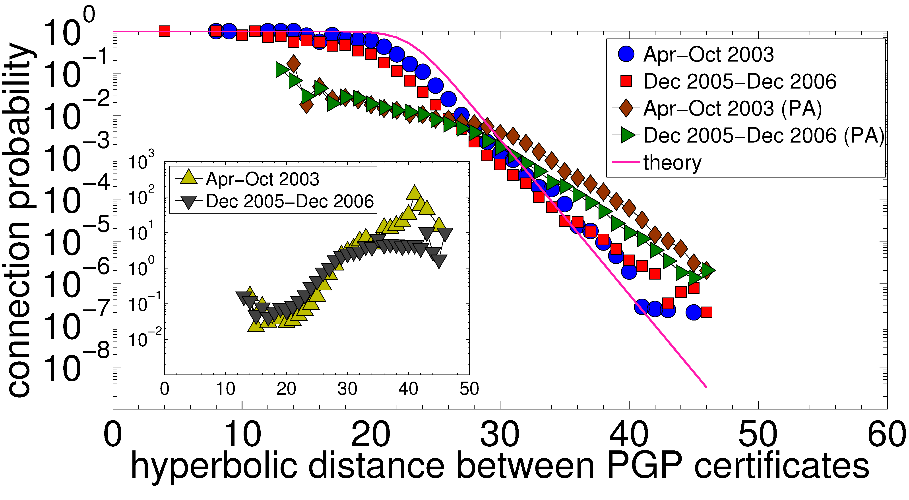

Slide 45
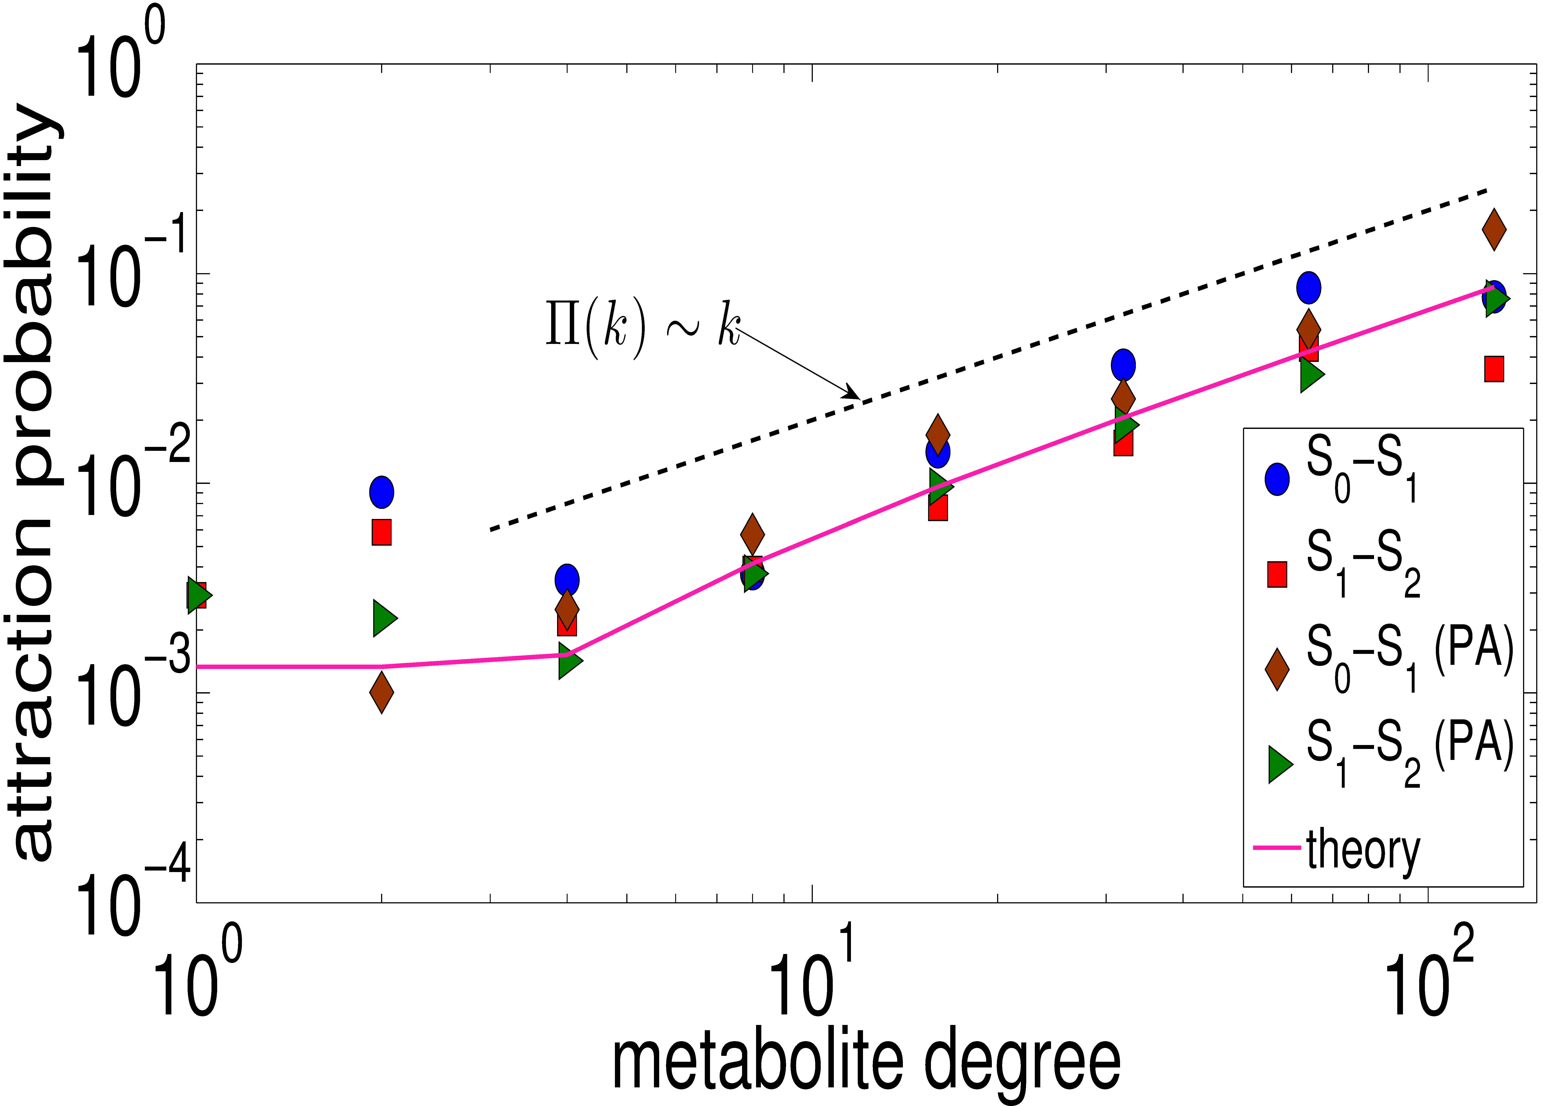

Slide 46
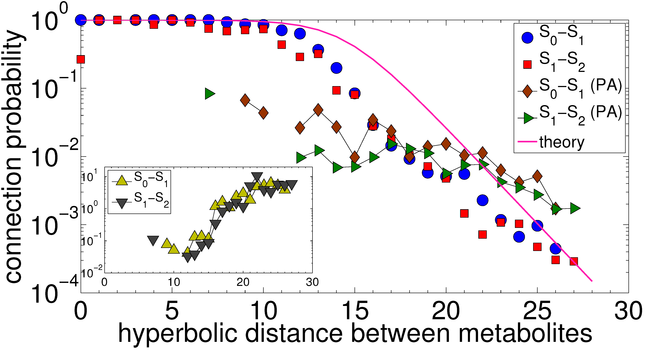

Slide 47
Popularitysimilarity optimization
Explains PA as an emergent phenomenon
Resolves all major issues with PA
Generates graphs similar to real networks across many vital metrics
Directly validates against some real networks
  Technological (Internet)
  Social (web of trust)
  Biological (metabolic)
  Universe

Slide 48
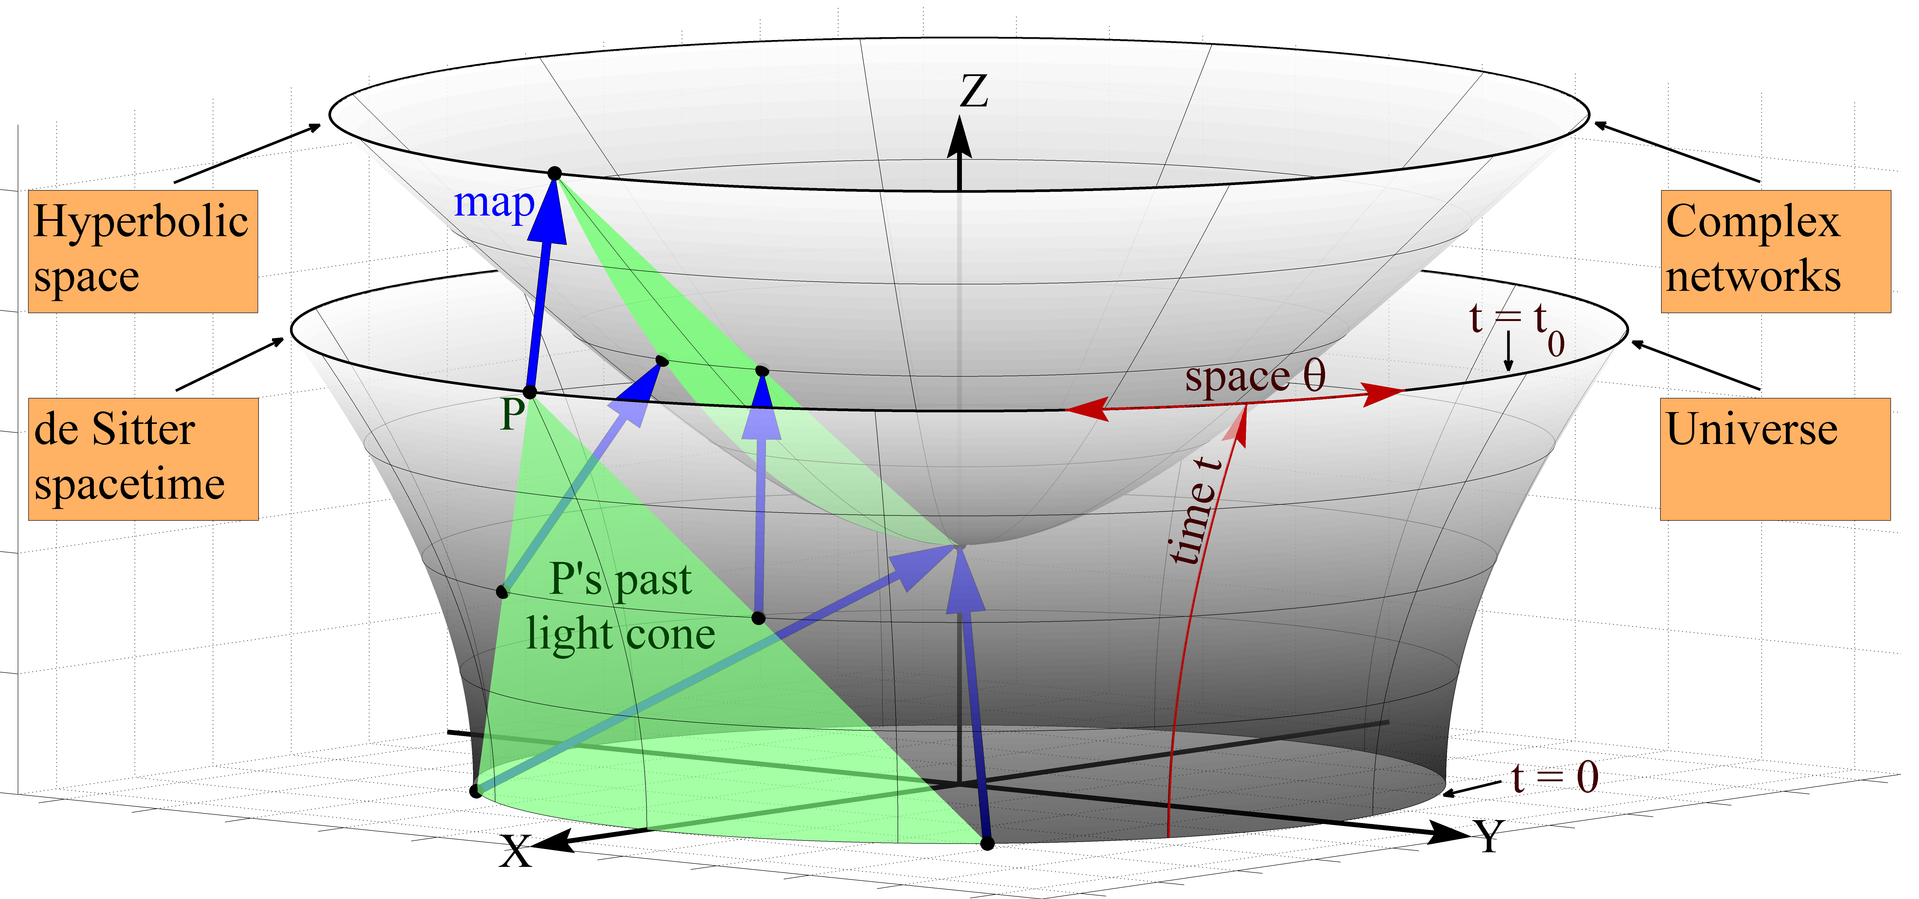


$$x^{2}+y^{2}−z^{2}=−1$$
$$x^{2}+y^{2}−z^{2}=+1$$

Slide 49
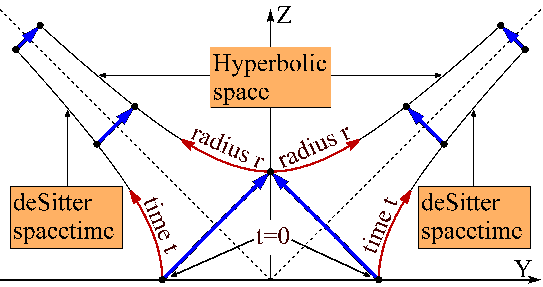

Slide 52
PSO compared to PA
PA just ignores similarity (or space), which leads to severe aberrations
  Probability of similar (spatially close) connections is badly underestimated
  Probability of dissimilar (spatially distant) connections is badly overestimated
If the connection probability is correctly estimated, then one immediate application is link prediction

Slide 53
Link prediction
Suppose that some network has zero temperature
Then one can predict links with 100% accuracy!
  Because the connection probability is
  either 0 or 1
Example: the universe
  Dynamics: Einstein’s equations

Slide 54
Non-zero temperature
Link prediction is worse than 100%, but it must be still accurate since the connection probability is close to the step function
No global intelligence is required
  At zero temperature, new nodes connect to exactly the closest nodes
  Non-zero temperature models reality where this hyperbolic proximity knowledge cannot be exact, and where it is mixed with errors and noise
PA is an infinite-temperature regime with similarity forces reduced to nothing but noise (no space, only time)

Slide 55
F. Papadopoulos, M. Kitsak, M. Á. Serrano, M. Boguñá, and D. Krioukov,
Popularity versus Similarity in Growing Networks,
Nature, v.489, p.537, 2012
D. Krioukov, M. Kitsak, R. Sinkovits, D. Rideout, D. Meyer, and M. Boguñá,
Network Cosmology,
Nature Scientific Reports, v.2, 793, 2012

