Slide 1

NDN-Android: NDN Networking Stack for Android Platform
Haitao Zhang, Alex Afanasyev, Lixia Zhang (UCLA)
NDNComm 2017
March 23-26, 2017

Slide 2
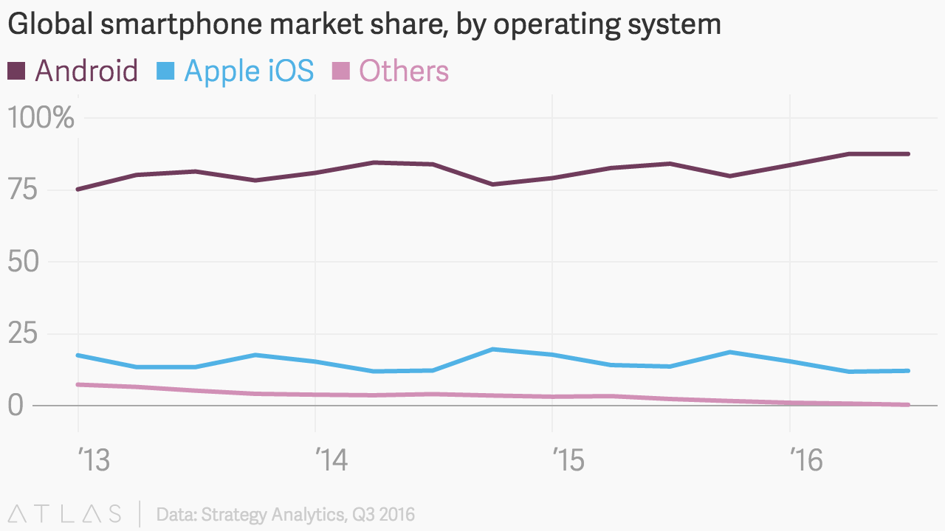
Motivation
Android devices are
widely used
  Android accounts for 88% market
  share of all smartphones
Android is an ideal platform to
experiment with NDN’s mobility support
Android is open for service extensions
  Ideal platform to experiment with new networking stack
Notes:
NDN control center is a convenient tool to run and configure NDN on Mac OS.
Android is an open platform

Slide 3
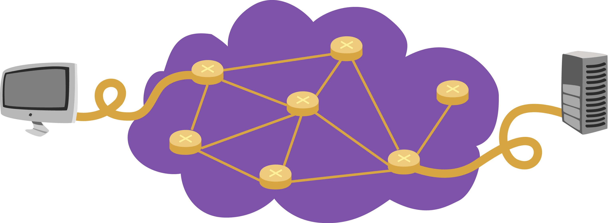

What is the difference with IP?
Internet Protocol (RFC791): Focused on delivering packets to destination node
NDN: Focusing on retrieving data
1.2.3.4
5.6.7.8
Destination address
Source address
Meaningful static identifier
Interest contains desired name
Data has unique name
Data has to be secured
  Sign Data with certificate

Slide 4
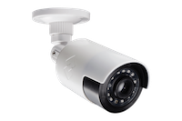


  Example: enable a camera to publish data
    NDN protocol stack
      NFD: for network connectivity
    Routing configuration
      Discovery of local hub & prefixes
      Local data prefixes propagation
    Identity/Certificate
      Sign Data with the certificate corresponded to identity
Packet
Packet
Global NDN
network
/
/camera

Slide 5

NDN apk : NDN Stack for Android
NDN Forwarding Daemon
NDN Tools
Security Tools
NDN Certificate Management
NDN.apk
Management GUI
WiFi Direct
Communication

Slide 6
What’s Inside NDN.apk (integrate NFD into apk)
Platform-specific native-compiled NFD
  (-) No “nfd” binary
    No main() function as a starting point
  (+) A bundled shared library
    No starting point
libnfd-wrapper.so adds starting point to create NFD thread from Android Java code via JNI interface
  Runs as Android Service
NFD management tools, other tools and UIs are implemented in Java
No need to root Android and can be deployed through GooglePlay store
Cannot have direct access to hardware
TCP, UDP, WebSocket faces
5

Slide 7
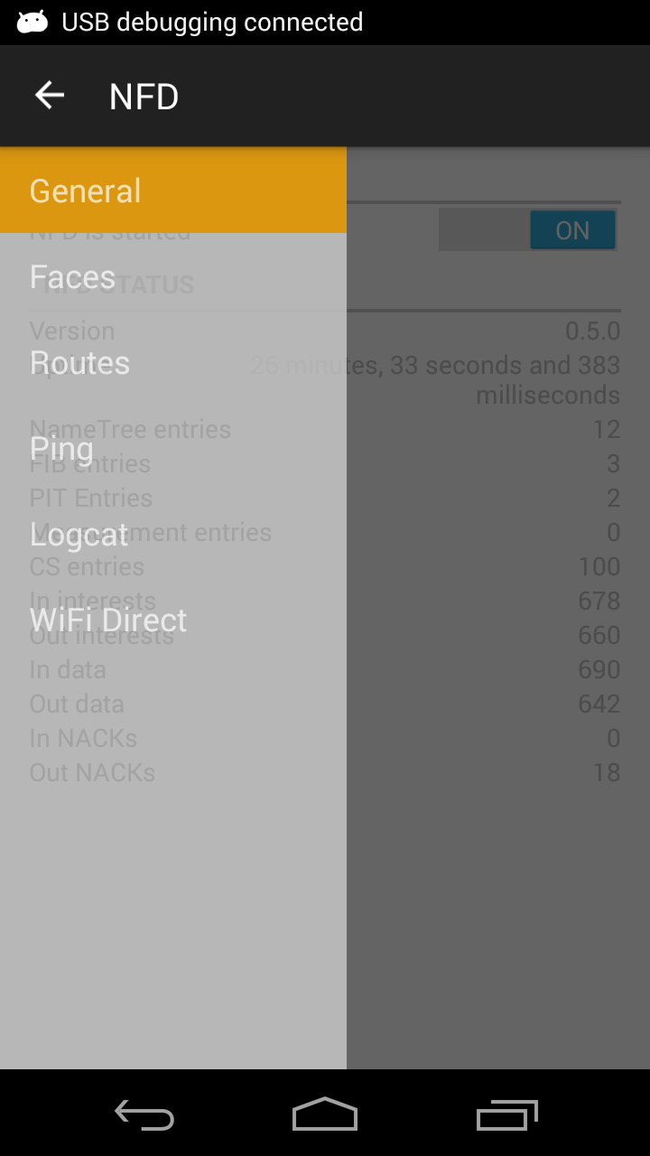
Enabling NDN on Android
Download and install NDN.apk from Google Play
  https://play.google.com/store/apps/details?id=net.named_data.nfd
  Or compile from source
    https://github.com/named-data-mobile/NFD-android
Start the app
Start NFD
+ (Auto) Configure name reachability
+ Enable local or global NDN connectivity
+ (Auto) Configure security identities

Slide 8
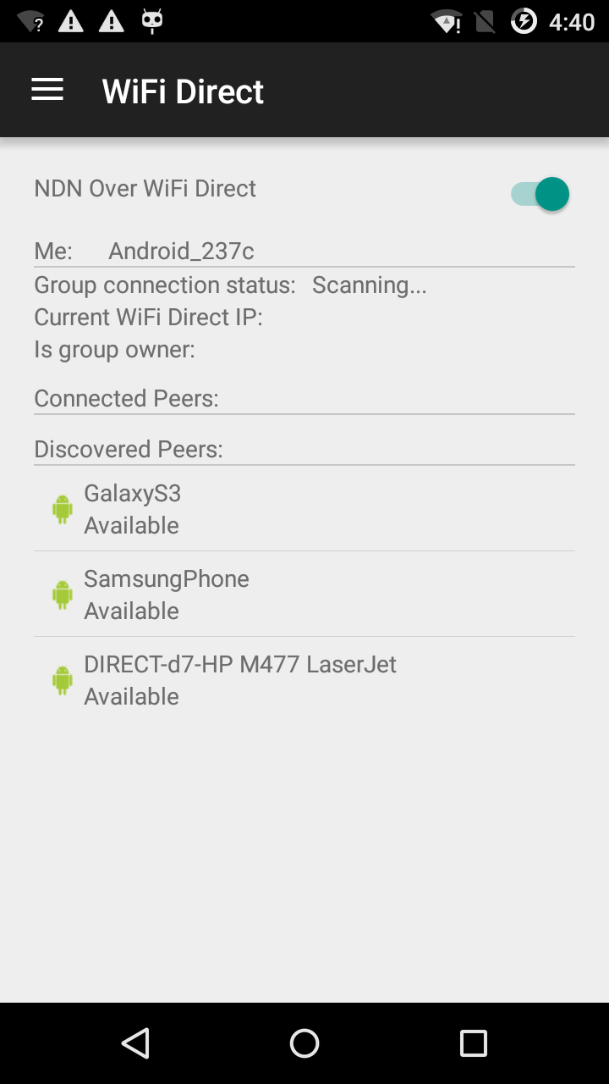
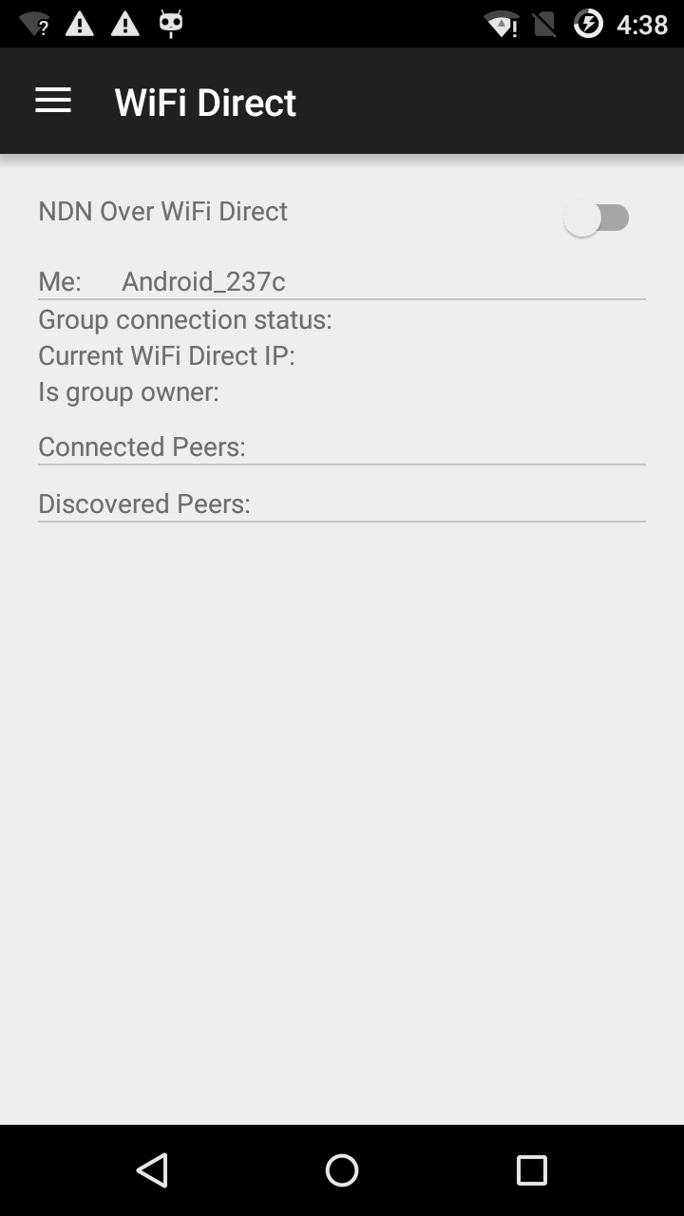
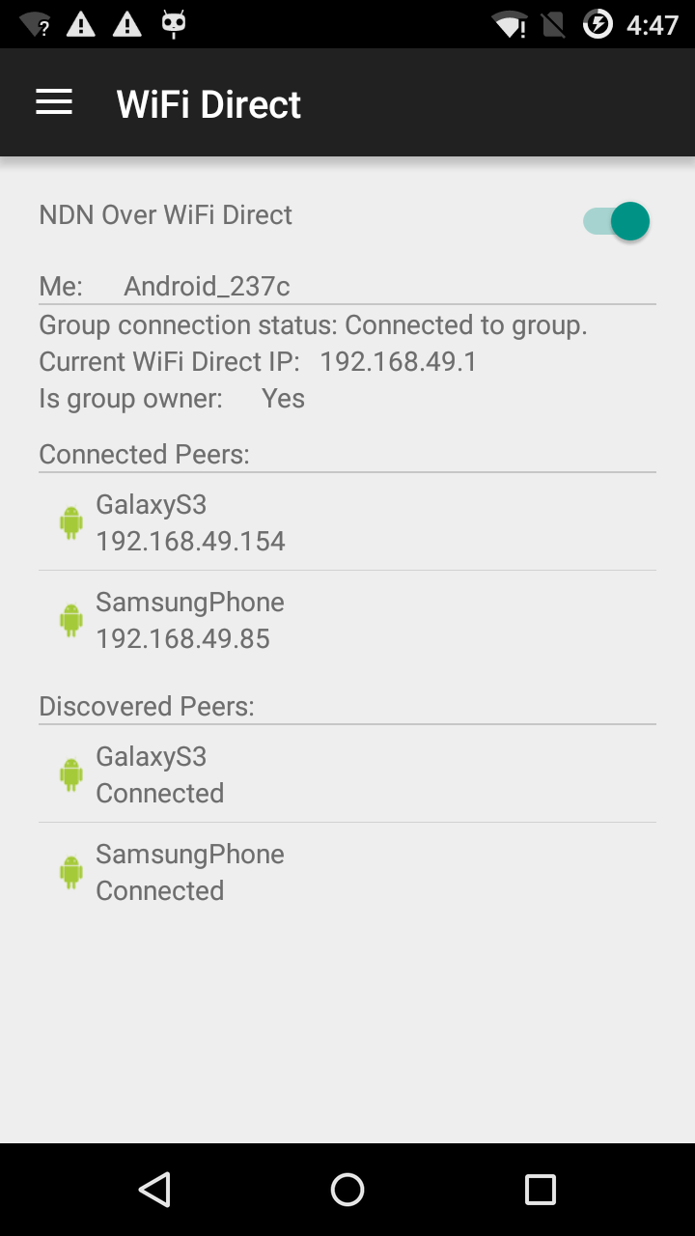
Local NDN Communication
Enables NDN communication over WiFi Direct
  Faces and routes are configured and maintained automatically

Slide 9

Global NDN Communication
Create Faces and configure routes automatically (in progress) or manually
  Face and route configuration recover automatically when network is disconnected and reconnected
Discover nearby NDN hub & maintain the connectivity automatically (working in progress)
NFD
/Qi
NFD
/Qi
NFD
NFD
/Haitao
NDN Testbed
Notes:
Step
Connect to hub
Configure routes
connectivity lost
connectivity recovers automatically

Slide 10
Identity Management
Every application should have corresponding identity (namespace) and the corresponding certificate for this namespace
Applications could to manage sub-identities and their certificates (working in progress)
Other device
Remote CA
Other device
Local CA
Other device
Local CA
Local CA
Local APP
Notes:
Three steps:
Get cert from remote CA
Issue certs for local apps, other devices
Mutual trust with other devices

Slide 11
Future Work
Create GUI versions of other NDN tools
Implement NDN over Bluetooth
Notes:
in progress
See the demo
work to be done

Slide 12
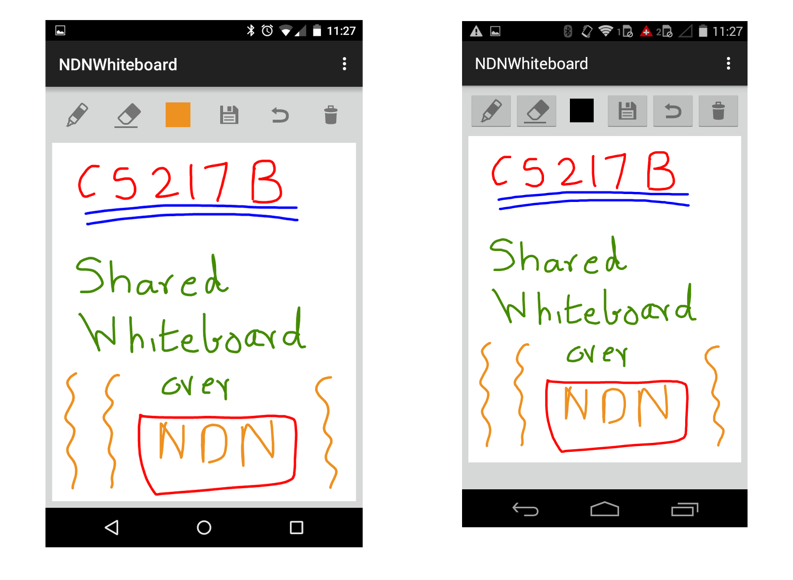
Demo of NFD-Android’s Wifi-Direct module
NDN Whiteboard
  Share a whiteboard among a distributed group of Android devices in real time
  Without going through an AP or the network
  Built upon ChronoSync
Notes:
cs217B

